Slide 1
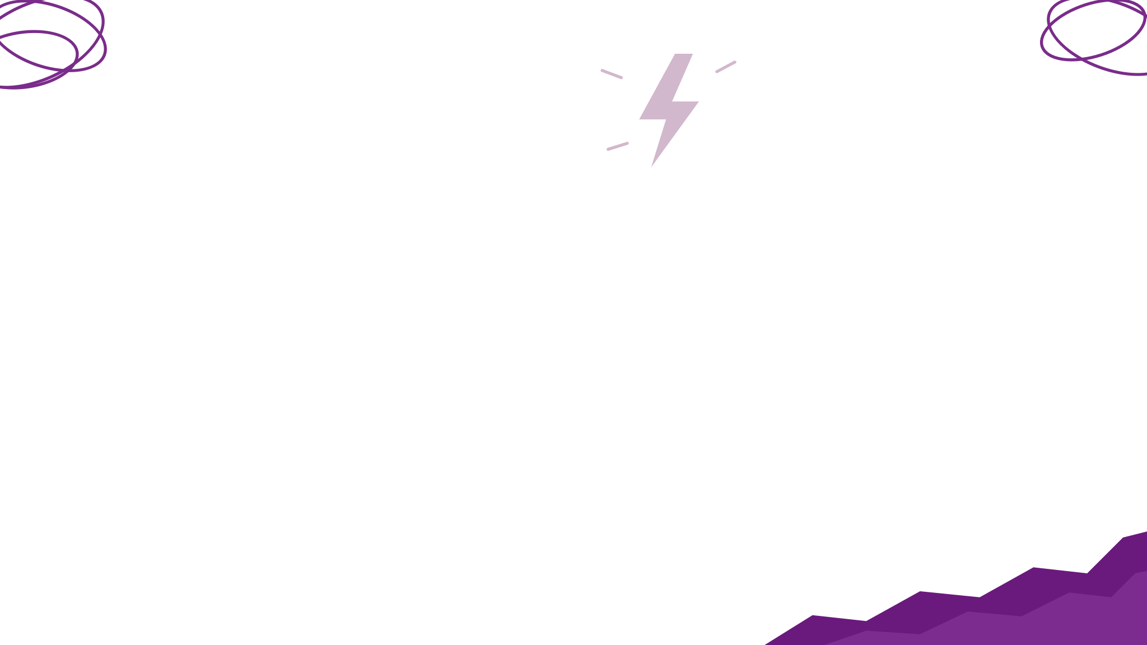



Ick-a-thon 2026
Problem Statement Title - Doomscrolling steals youth's free time, with no easy way out
Team Name - Flame Kaiser
Team Member Details -
Dhesh Sarvajith R (IT, 2nd year)
Anirudh Badri Narayanan (IT, 2nd year)
Krrish P (CSE, 2nd year)
Jeeva K (IT, 2nd year)
Our solution: Terrarium: Focus Debt, a Chrome extension that swaps the scroll for a task

Slide 2


The Assigned Ick (Problem Statement)
Proposed Solution (Describe your Idea/Solution/Prototype)
What is the everyday inconvenience? What exactly happens? Who experiences it?
“Just 5 minutes”: you open Reels or Shorts and look up an hour later.
No stopping point: infinite feeds, autoplay and swipe-to-next never end.
The cost: tired, anxious, behind on work, sleeping late.
Who: students and young adults, mostly late at night and between classes.
Blockers don't stick: one tap on “ignore limit” and you're back in.
5 min
60+ min
planned
actually lost
46%
of US teens say they are online “almost constantly”
Pew Research Center, Dec 2024
IEEE WIE, SSN
2

Slide 3
Our Take on the Ick
How we understood the problem and what we decided to focus on
Our approach to solving it and the key idea involved in it.
Catch the moment: the urge wins in the first few seconds, so we act right then.
Replace, don't remove: blockers leave a gap, so people bypass them.
Not all of YouTube is bad: lectures and DMs stay untouched; only feeds count.
Focus: Shorts, Reels and home feeds, weighted more late at night.
“We don't block the scroll. We swap it.”
1
Pause 5-sec breath: why are you here, and for how long?
2
Measure Focus Debt grows with time, scroll speed, late nights
3
Nudge page fades to grey; 20-20-20 eye-break reminders
4
Swap pay the debt with one 15-min task picked by mood
5
Stop Hard Stop locks feeds till tomorrow; your plant grows
IEEE WIE, SSN
3

Slide 4
Technical Implementation
What we built, tech stack used and how it works. Simple workflow / architecture (if any)
Feed tab
content.js: scroll speed, Shorts/Reels count, pause gate, grey fade, alerts
Service worker
Focus Debt engine
Feed-aware rules (path level)
Per-site budgets, daily item limit
Hard Stop until midnight
Night x1.5 multiplier
Terrarium + popup
Life Mixer task, honest timer, camera rep counter (Pose), Insights
Tech stack
Chrome Extension, Manifest V3
JavaScript (ES modules), HTML, CSS
MediaPipe Tasks Vision (WASM), on-device
Chrome storage, alarms, offscreen APIs
Optional Gemini 2.5 Flash / OpenAI
Focus Mirror
Offscreen camera, MediaPipe Face: blinks, drowsiness, distance (opt-in)
Storage + AI
chrome.storage (no server); optional Gemini/OpenAI, offline task fallback
Focus Debt += seconds × (1 + scroll speed + tiredness) × night factor
No account, no server. Camera frames never leave the laptop.
IEEE WIE, SSN
4

Slide 5
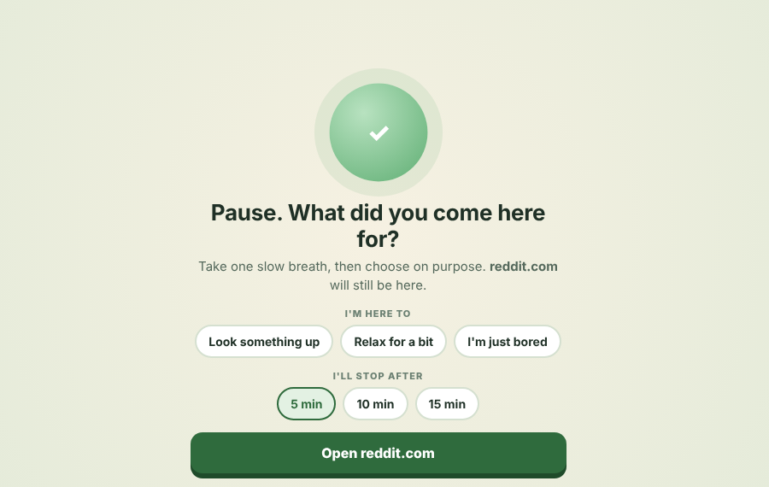
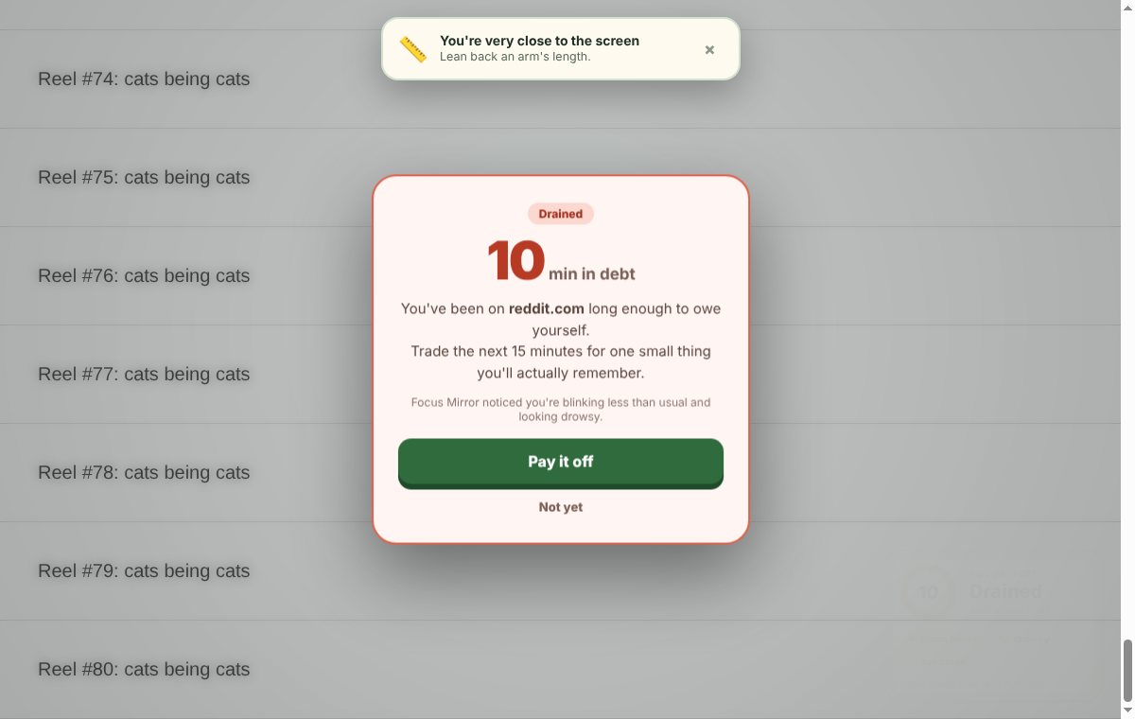
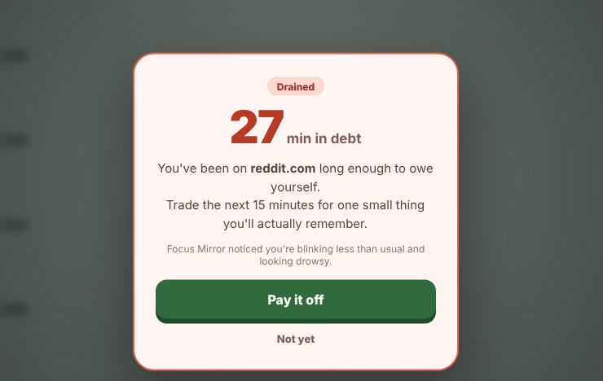
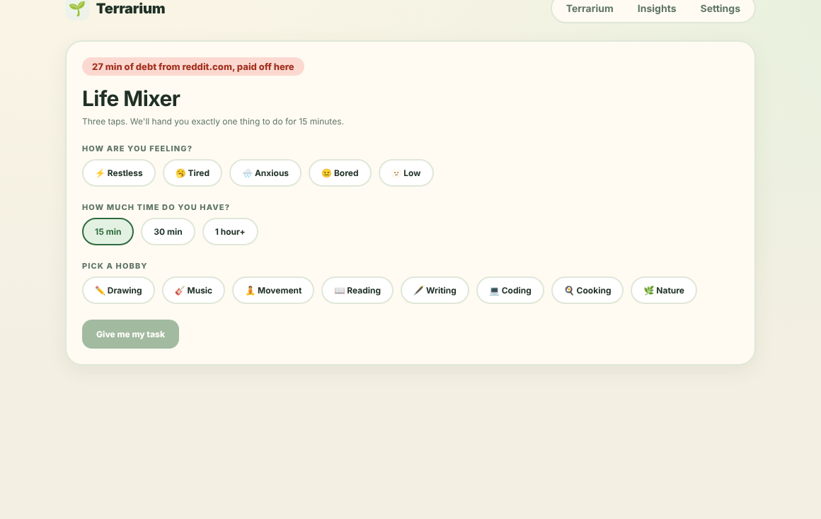
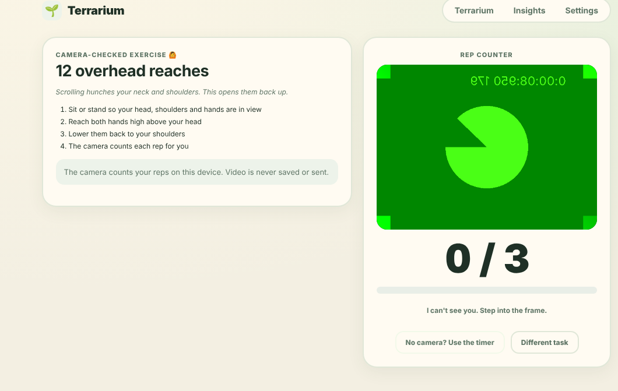
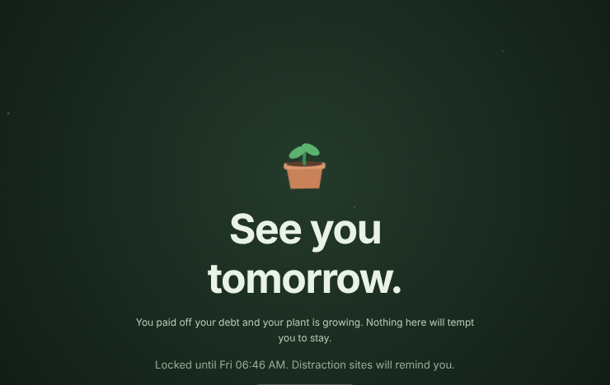
Project Screenshots
Working prototype / demo screenshots, main features and key user flow
1
2
3
Pause
A 5-second breath, then “what did you come for?”
Track
Debt gauge, grey fade and eye-break tips
Alert
At 10 min of debt: pay it off with one task
4
5
6
Swap
Life Mixer: mood + time + hobby = one task
Verify
Camera counts your exercise reps on the laptop
Stop
Hard Stop: feeds locked until tomorrow
IEEE WIE, SSN
5

Slide 6
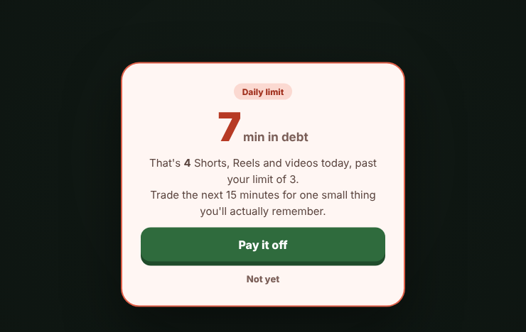
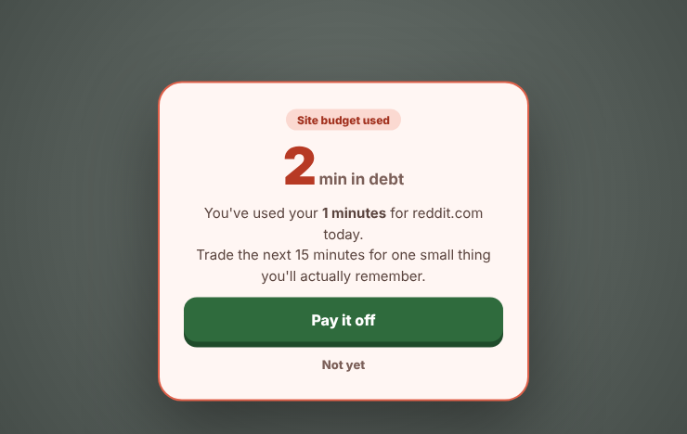
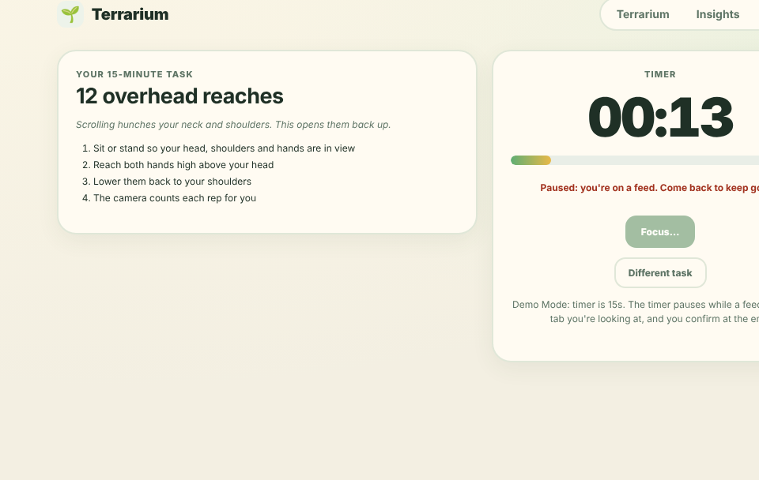
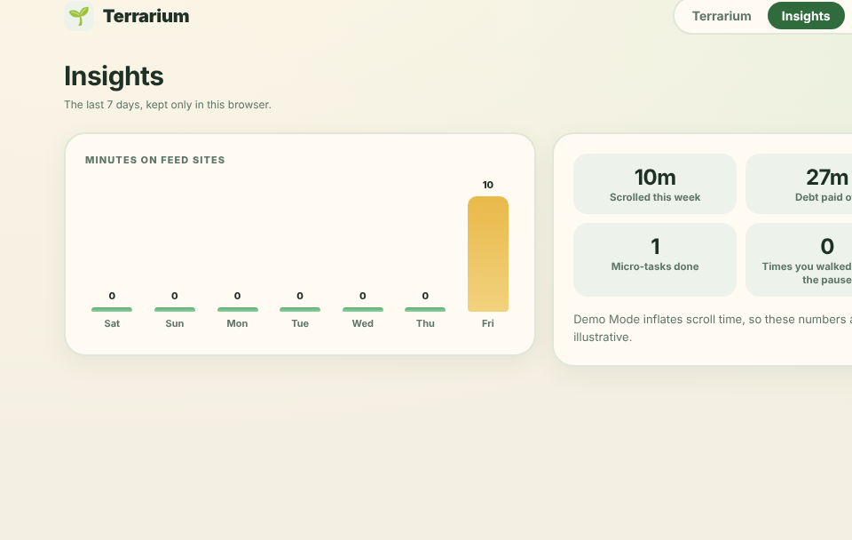
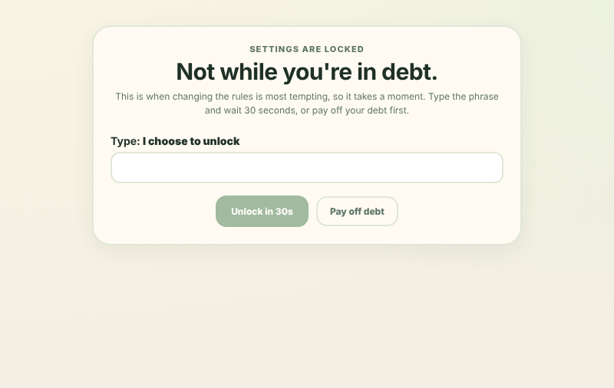
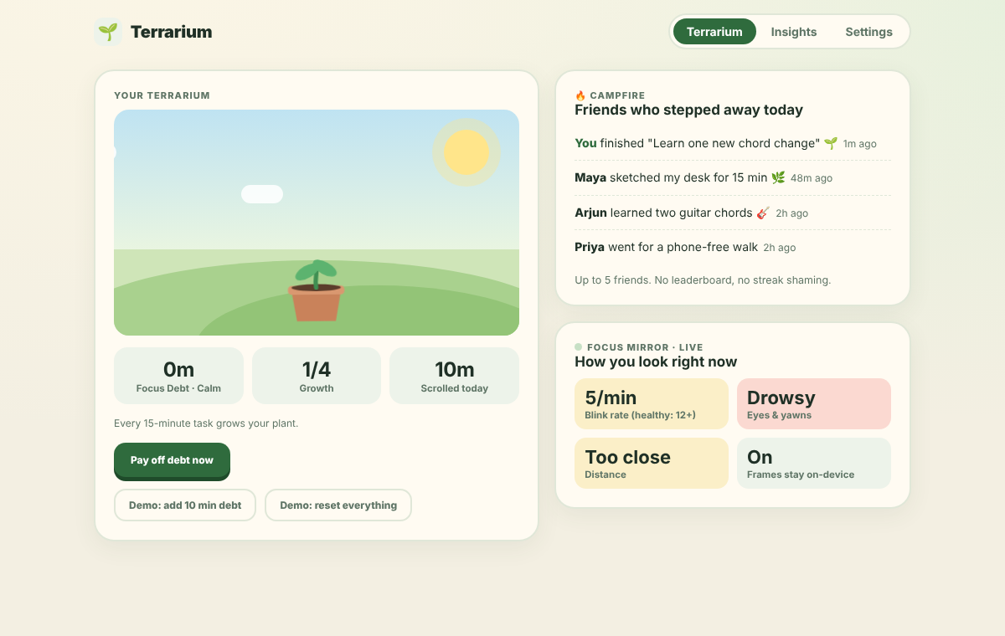
Project Screenshots (contd.)
Working prototype / demo screenshots, main features and key user flow
1
2
3
Feed-aware
Lectures untouched; Shorts counted, daily limit
Budgets
Daily minute budget for each site
Honest timer
Pauses while a feed tab is open
4
5
6
Insights
7 days of scroll time, debt paid, tasks
Settings lock
In debt? Type a phrase, then wait half a minute
Grow
Plant grows; Campfire friends; Focus Mirror
IEEE WIE, SSN
6

Slide 7
Us vs Existing Extensions
How we differ from the anti-doomscroll extensions already on the Chrome Web Store, and the trade-offs
 | Doomscroll Blocker | Doomscroll Fog | Doomscroll protection | Terrarium (ours)
How it works | Fade + reminder after set scrolling | Blur builds after set time | Only the first Short plays | Pause, Focus Debt, task, Hard Stop
Lectures safe? | Whole-site blocklist | Per-site on / off | YouTube Shorts only | ✔ Feed pages only + budgets
Something to do instead | ✘ | ✘ | ✘ | ✔ 15-min task or exercise
Hard to bypass | — | Snooze button | — | ✔ Hard Stop + settings lock
Stats | — | Daily scroll totals | ✘ | ✔ Popup + 7-day Insights
Trade-offs
we chose
Bigger download (~23 MB): the AI runs on your laptop, not a server
Only exercise is camera-checked; other tasks trust your honesty
Chrome desktop only for now; phone apps are future scope
Stricter than a blocker on purpose; Settings tune every rule
Competitor details are from their Chrome Web Store listings (Oct 2026), not hands-on testing.
IEEE WIE, SSN
7

