Slide 1
skiode
AI led Lowcode Platform
an AI led platform built to simplify the enterprise business
harnessing the power low code

Slide 2
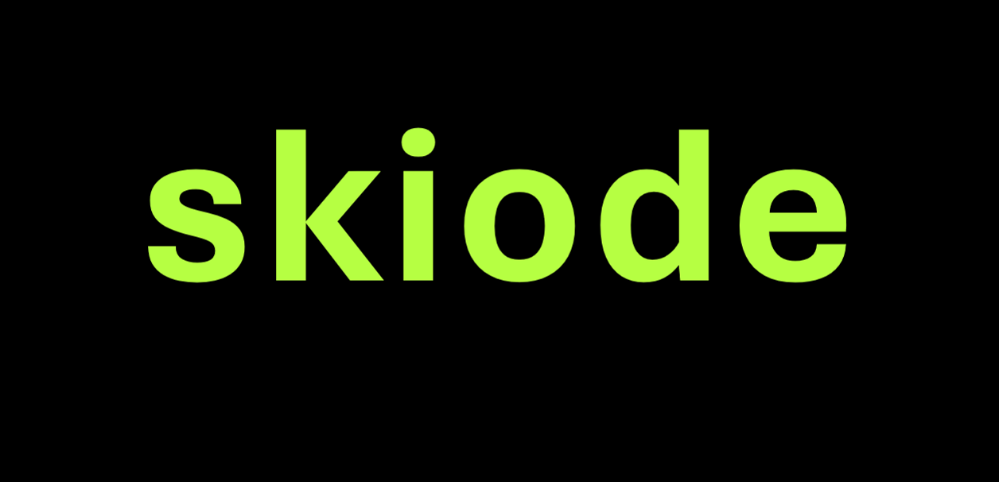
Value Creation
Will
Simplify Processes
Boost Productivity
Amplify ROI
Multiply Cost Savings
Drive innovation
AI led Lowcode Platform
for
Digital Solutions
|
Enterprise Automation
|
Automated Workflows
|
Process Automation

Slide 3

Dashborads
Web and Mobile Ready
Case Management
SLA
Screen Flow
Integration
Rule Engine
Reports
User Groups
BPM
Visual Designing
LOWCODE
Process Orchestration
Inbuilt CI/CD
Form Builder
Process Builder
Configurable BOTS
Generate Documents
User Management
Screen Scrapping
Decision Management
RPA
WORKFLOW
API connections
Can be Headless
Notification
OCR / Document Reading
Visual Workflow Studio
Approvals
Track and Report flow
Rulesets
AI / ML pattern match
Flow Management
Map Data

Slide 4
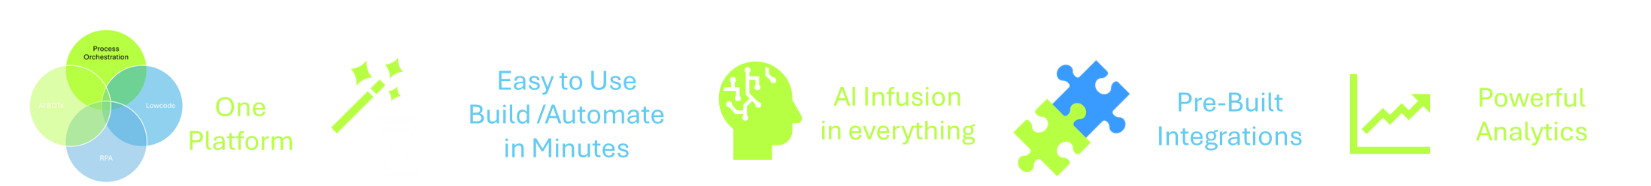
The Platform Difference
Low code
RPA
Process orchestration
AI/ML
BOTS
Takes
Minutes
For
MVP
(Minimal Viable Product)
Builds Apps 5x
Faster
50+
Leading
platform
integrations
charts
productivity, efficiency &
savings
70% reduction in cycle times with utmost efficiency
Improves the operational excellence by 50% on Technology, Engineering, Process and business teams
Assured productivity increase to 10X times by individuals and teams
Deliver POINTED SOLUTIONS and automation solutions through a collaborative model
Instant conversion of ideation to solutions
Value Proposition

Slide 5
Competitive Benefits
Seamless and simplified management of digtal eco-system involving products , complex processes and workflows
For enterprises at scale
Digtal Transformation done right with enhanced productivity and efficiency
Cost savings by 10X times for all digital & automation efforts resulting in execution excellence
Execution of critical journeys with a simplified approach yet impactful solutions
Competitive licensing with 5X times less than industry leading products resulting in Reduced Capex

Slide 6
Solutions Delivered
By Industry Verticals
Manufacturing
Sale Order Automation
Vendor flow Automation
Supply Chain Management
Production line Flow Automation
Manufacturing Project Management
Safety and Risk Management
Healthcare
Clinical Trials Flow Automation
Medical Transcription Automation
Legal & Government
Bank statement Reconciliations
Federal/ Government Grant flow
Invoice entry Automation
Bulk Mortgage document information extraction
Energy & Utilities
Customer Onboarding
Field Operations
Document Processing

Slide 7
Solutions Delivered
By functions
Finance & Accounting
Sale Order Automation
Invoice Processing
Human Resources
Employee Onboarding
Customer Service
Customer Care Centre
Service Operations
Document Processing
Technology
Purchase Order Automation
Bank Statement Reconciliation
Robotic Process Automation
Alert Configuration
Claim Processing
Service Desk
Order Management
Feedback or Complaint processing
Field Operations
Integrations
AI Bots

Slide 8
Hooklines
Skiode helps organizations simplify operations, automate processes, and gain complete visibility into their business—enabling faster execution, better control, and sustainable growth.
For example, whether it's employee onboarding, procurement approvals, customer service requests, contract management, project tracking, or manufacturing operations, Skiode brings every step, approval, document, and status update into a single digital platform—making work faster, more transparent, and easier to manage.

Slide 9
Hooklines
Recommended for Middle East Positioning
"Skiode helps organizations gain complete visibility, automate operations, and accelerate digital transformation—without the complexity of traditional software development."
1. Growth & Efficiency
Skiode helps growing businesses scale operations without scaling complexity.
2. Digital Transformation
Skiode turns manual processes into digital business advantages.
3. Control & Visibility
Skiode gives leaders real-time visibility into how work moves across their organization.
4. Speed
From idea to working business application—in weeks, not months.
5. Operations
Skiode helps businesses run faster, smarter, and with greater control.
6. Executive Level
We help organizations eliminate bottlenecks before they impact growth.
7. Transformation
Your processes are your business. Skiode helps you modernize both.
8. ROI Focus
Every delayed approval has a cost. Skiode helps eliminate that cost.
9. Governance
Automation with visibility, accountability, and compliance built in.
10. AI + Automation
AI where it matters. Automation where it counts. Results where it shows.

Slide 10
Hooklines
Universal CEO/CXO Hooks
These tend to work across all industries:
If you could automate one process tomorrow, which one would it be?
Where do most approvals get stuck today?
How much of your business still runs on Excel, emails, and WhatsApp?
What is the cost of process delays to your organization?
Do you have complete visibility into process bottlenecks?
How long does it take to launch a new business process or application?
If I could reduce process turnaround time by 30–50%, would that be worth a discussion?
Are your teams spending more time managing processes than executing them?
How confident are you that every process is audit-ready?
What would happen if you could digitize a process in weeks instead of months?
1.How much of your business still runs on Excel, Email, and WhatsApp?
2.Where does work get stuck in your organization today?
3.Can you see every pending approval across the company right now?
4.How many hours does your team spend chasing updates instead of doing actual work?
5.If your best employee goes on leave tomorrow, will the process still run smoothly?
6.How long does it take your organization to turn an idea into a working application?
7.Which business process frustrates your employees the most?
8.Do your managers spend more time managing work or improving work?
9.How much revenue is delayed because of slow internal processes?
10.Can your customers track the status of their requests without calling your team?
11.How many business decisions are waiting for approvals right now?
12.If an auditor walked in today, how quickly could you produce a complete process trail?
13.What would happen if you could reduce process turnaround times by 50%?
14.Are process bottlenecks visible before they become business problems?
15.If you could automate only one process this quarter, which one would deliver the biggest impact?

Slide 11
Hooklines
CEO / Managing Director
How much of your business still runs on emails and Excel?
Where are the biggest process bottlenecks today?
Do you have real-time visibility into operations?
How quickly can your organization adapt to change?
What would a 20-30% productivity improvement mean for your business?
Operations
How much time is spent following up on approvals?
Where do operational delays occur most often?
Can you measure turnaround times accurately?
How many manual handoffs exist in your processes?
What processes would you automate first if given the chance?
HR
How long does employee onboarding take today?
Are employee requests still managed through emails?
How much HR time is spent on repetitive administration?
Can employees track request status themselves?
How quickly can you implement new HR policies and workflows?
Quality & Compliance
Are audits creating operational stress?
Can you trace every action and approval digitally?
How quickly can non-conformities be resolved?
How do you ensure process compliance across teams?
Can you identify compliance risks before audits?
Finance
How long does it take to approve payments and expenses?
Can you track every approval trail instantly?
How much effort goes into compliance reporting?
Where are invoice processing delays occurring?
How much manual data entry still exists?
Procurement
How long does it take to convert an RFQ into a PO?
How many approvals delay purchasing decisions?
Can you see pending procurement requests in real time?
How much procurement activity happens outside the system?
How do you ensure procurement compliance?
Sales
How quickly are leads converted into opportunities?
How much time is spent on manual follow-ups?
Can you track every customer touchpoint?
Are approval delays impacting deal closures?
How quickly can you respond to customer requests?
IT
How many business applications are waiting in the development backlog?
How much time is spent maintaining custom software?
Can business users create applications without coding?
How quickly can you automate a manual process?
How many systems need integration today?

Slide 12
Hooklines
Manufacturing
Can you track an order from enquiry to dispatch without opening Excel?
Where do production approvals get stuck today?
How much production time is lost due to manual coordination?
Can management see shop-floor bottlenecks in real time?
What would a 30% reduction in process delays mean to your business?
Healthcare
How much time is spent on patient and insurance paperwork?
Can you track every approval and document digitally?
Where do patient service delays typically occur?
Are your hospital processes audit-ready at all times?
How quickly can you adapt to changing compliance requirements?
Banking & Financial Services
How many days does customer onboarding currently take?
What percentage of approvals are still manual?
Can you identify bottlenecks before customers complain?
How much effort goes into audit preparation?
How fast can you launch a new business process?
Insurance
How long does it take to settle a claim?
Can you track claims in real time from submission to closure?
Where are claims getting delayed today?
How do you ensure SLA compliance?
How much manual effort exists in your claims process?
Logistics & Supply Chain
Can you track every shipment exception instantly?
How much time is spent chasing updates from multiple teams?
Where are dispatch approvals causing delays?
Can customers get real-time status updates?
How much visibility do you have across the supply chain?

Slide 13

Pharma Sale Order Process Automation
Challenge
A Pharmaceutical company faced inefficiencies in sale order processing due to reliance on emails, Excel sheets, WhatsApp, and manual workflows across six teams that includes Marketing, Accounts, Production, Quality, Management and Dispatch leading to multiple issues.
Solution
Delivered an automated solution to streamline the workflows leveraging skyaicode platform which resulted in structured processing with speed and accuracy.
AI-driven email parsing extracted sale order details (product, quantity, client info) from a dedicated mailbox.
Marketing reviewed requests, followed by Management approval through a real-time portal.
BOT automated sale order creation eliminating manual entry.
Production and Quality teams handled manufacturing and inspections, ensuring compliance
Digital records provided complete traceability and regulatory compliance.
Skyaicode features/components leveraged
Email Spooling
Intelligent Data Extraction
Decision Management
Document Generation BOT
Process Orchestration
Mobile App Development module
Benefits Delivered
70% faster order processing.
95% Accuracy in sale orders.
60% Reduction in team effort.
Real-time tracking compliance with audit trails.
Scalable solution for growing order volumes.

Slide 14

Vendor Operations Automation for Airport Solutions
Challenge
A leading Airport Solution Manufacturing company, relied on manual processes for vendor operations. Vendors managed Advance Shipping Notices (ASNs) through emails, lacking a centralized system. This resulted in inefficiencies, limited visibility, and errors in shipment processing.
Solution
Delivered a distinctive solution leveraging skyaicode to streamline the existing challenges that resulted in increased operational efficiency
A digital platform integrated with Microsoft Dynamics Business Central.
Vendors access POs directly from the portal Integrating to Business Central
Vendors select POs, to generate ASNs QR to print
ASNs are sent to Business Central, enabling receipts team to verify shipments efficiently.
Digital records provided full traceability and regulatory compliance.
Skyaicode features/components leveraged
Pre-Built Integration
Workflow Automation
Decision Management
Document Generation BOT
Dashboard
User Groups & Users
Benefits Delivered
90% Reduction in Manual Errors
75% Improvement in Vendor Transparency
Increased Operational stability by reducing dependency on emails.
100% Scalability for future business needs and additional functionalities

Slide 15

Ticketing Tool for Manufacturing company
Challenge
A Manufacturing Company faced recurring delays and miscommunication in handling internal service requests and incidents. Employees raised tickets via emails or phone calls, which lacked tracking, accountability, and timely resolution.
Solution
Implemented an automated ticketing and incident management system using Skyaicode. The system enabled employees to raise service tickets via a unified portal, which routed requests to the right department, ensured approvals, tracked status, and maintained a complete audit trail.
Live chat option enabled at each stage to support communication.
Employees raise tickets by selecting the service department and filling the request form.
Department heads receive email notifications when a ticket is raised.
Support team accepts, rejects, or requests revisions with remarks
Tickets are closed only after requestor confirmation of issue resolution.
Skyaicode features/components leveraged
Live reports
Workflow Automation
Decision Management
Live chat facility
Dashboard
User Groups & Role based access
Benefits Delivered
85% Reduction in Resolution Time
100% Ticket Traceability Across Departments
Streamlined Inter Department Communications.
Improved
Employee Satisfactions

Slide 16
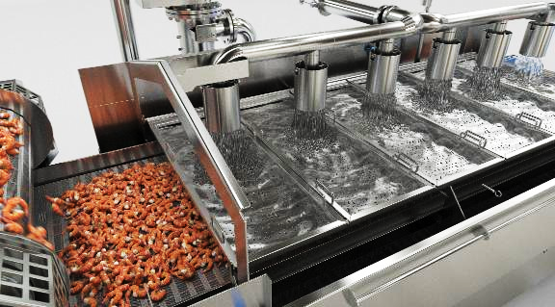
Procurement Process Automating for a Large Aquaculture enterprise
Challenge
An aquaculture enterprise, faced inefficiencies and manual overheads in their procurement operations across multiple divisions such as Hatchery, Farm, Feed Mill, and Processing Plant. The lack of a unified system led to delayed approvals, poor vendor tracking, and lack of process transparency.
Solution
Skyaicode enabled end-to-end procurement automation by digitizing purchase requisitions, approvals, order generation, and vendor management through streamlined the process by eliminated delays.
Indent go through multi-level approval flows based on pre-set conditions.
Procurement platform integrated with internal master data and finance systems.
Employees raise Indent Request digitally using role-based forms.
All procurement documents stored and retrievable digitally for audits.
Approved Indents auto-generate POs and notify vendors.
Skyaicode features/components leveraged
Pre-Built Integration
Workflow Automation
Decision Management
Document Generation BOT
Dashboard
User Groups & Role based access
Benefits Delivered
90% Reduction in approval delays
90% Increase in Procurement Transparency
Improved operational controls Through centralized Dashboards.
100% Audit-ready
Digital Documents

Slide 17



Reimbursement/Claim processing Automation for a African & ME FMCG Group of Companies
Challenge
A prominent FMCG and supply chain management company serving the African and Middle East markets faced challenges in managing employee reimbursements. Manual submission of expense claims via emails resulted in inconsistencies, delayed approvals, and poor visibility into reimbursement statuses. This created pressure on the finance team and affected employee satisfaction
Solution
Skyaicode enabled a structured and fully automated reimbursement system where employees could raise claims through a digital interface. Approved claims are automatically converted into Purchase Orders (POs) for seamless integration with finance workflows and audit readiness.
Track every stage of the reimbursement lifecycle submitted, approved, rejected, paid.
Employees submit claims through a standardized form capturing all necessary details and documents.
Automated, Multi-level approval process based on claim amount and department.
Once approved, the claim is auto-converted into a PO for traceability and processing
All claims, approvals, and POs are stored digitally with complete traceability.
Skyaicode features/components leveraged
Dynamic Forms
Workflow Automation
Decision Management
Role-Based Access Control
Dashboard
Notification Bots
Benefits Delivered
85% Reduction in Resolution Time
Centralized, Searchable
Record keeping
Faster Turnaround on reimbursements and payments.
Seamless Finance Control via PO linkage

Slide 18




Tubes Manufacturing Company Quality Test- Lab Automation
Challenge
A large Tubes manufacturing organization operating multiple labs across its divisions faced challenges in managing lab test requests, approvals, and report tracking. The manual process—often paper-based—caused delays, lack of traceability, and inefficiencies in coordination between production, engineering, and lab teams.
Solution
SkyaiCode enabled complete digitization of the lab test management process. From request initiation to report submission, every step was automated and streamlined, ensuring faster turnaround, better visibility, and improved collaboration, customized report generation.
Departments initiate lab test requests using dynamic digital forms with predefined fields.
Requests are automatically routed to the appropriate lab team based on sample type, department, and priority
Requests go through a multi-level approval system and are assigned to lab schedules
Labs acknowledge sample receipt and log test initiation and progress.
Lab engineers upload test reports directly to the system, notifying the requestor for review.
Skyaicode features/components leveraged
Forms & Structured Data
Workflow Automation
Decision Management
Role-Based Access Control
Dashboard & Reports
Notification Bots
Benefits Delivered
80% Faster lab test Processing
100% Digital traceability
Of requests and reports
Improved Efficiency
Requestors and Lab Team
Scalable
Across Divisions and Test Types

Slide 19


Sale Order Automation for Fuel Injection Manufacturing Company
Challenge
A global auto parts distribution company with deep roots in manufacturing relied heavily on Excel spreadsheets to manage goods tracking, stock updates, and inventory movements. This manual method led to frequent data mismatches, version conflicts, and delays in updating the central Oracle system. As operations scaled, the inefficiency and risk of human error grew significantly.
Solution
Using SkyaiCode’s Robotic Process Automation (RPA), the company digitized the goods management workflow. A bot was developed to read structured Excel data, validate it, and directly push entries into Oracle in real-time, removing the need for manual intervention.
Validated data is mapped and entered into Oracle Fusion inventory, stock ledgers, and movement entries are updated instantly
Goods inward and outward details are entered in a predefined Excel format by field teams
The RPA BOT is scheduled or triggered to fetch the latest Excel file from a secure folder or email.
The bot performs automatic checks for missing fields, mismatched codes, or duplication
Success and failure logs are generated, with alerts to the operations team in case of data issues.
Skyaicode features/components leveraged
RPA Bot Integration
Data Mapping Automation
Validation Rules Engine
Secure Access & Audit Logs
Status Dashboard & Reporting
Notification Bots
Benefits Delivered
95% Reduction in Manual data Entry efforts
Real-Time Synchronization
between Excel and Oracle
Improved Inventory Accuracy
across systems
Scalable Automation
for future ERP modules

Slide 20



Outstanding Payment Tracking Workflow Automating for Stem Cell Banking Company
Challenge
A leading healthcare and stem cell banking service provider offering subscription-based packages faced recurring issues in recovering outstanding dues from customers. Manual follow-ups and inconsistent tracking of defaulters led to delays, missed payments, and poor recovery visibility. The lack of a structured escalation—from demand notice to legal action—hindered effective resolution
Solution
SkyaiCode was used to build a structured payment recovery workflow. The system automatically identifies customers with pending payments, triggers demand notices, escalates unresolved cases to legal teams, and maintains a complete audit trail of communications and actions.
Real-time insights on pending, resolved, escalated, and closed cases.
System scans customer subscription records in datastore for overdue payments.
First-level payment reminders (demand notices) are sent via email or RPAD
If payment is still pending, legal notices are generated and assigned to legal officers for further action.
All notices, responses, and activities are tracked and logged against the customer profile.
Skyaicode features/components leveraged
Decision & Condition Logic
Document Generation Bots
Workflow Automation
Dashboard & Reports
Case Management & Audit Trail
Notification Bots
Benefits Delivered
Improved Recovery Rate
with timely reminders
Complete Visibility
of defaulter status and case progress
Audit-Ready
documentation for legal and finance compliance
Structured Legal Escalation
reducing manual coordination

Slide 21
Features
Tailored low-code features for GenX citizen developers.
Simplified, process-oriented data architecture.
RPA and integrations optimized for strategic solutions.
Specialized LLM and image models for common use cases.
Multi-tenant DMS supporting S3, OneDrive, Google Drive, local, or FTP storage.
State management for deploying BOTs within workflows.
Supports both stateful and stateless process flows.
Customizable dashboards.
Designed for Citizen Developers
Keep it Simple
Architecture
Bolt onto any System
Dashboards and Reports
AI/ML Led Platform
In Built DMS
Deploy BOTS
Supports Stateful and Stateless

Slide 22










Built-in integrations with
50+ industry products
and leading tools

Slide 23
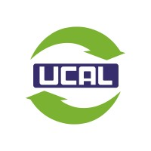
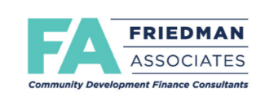


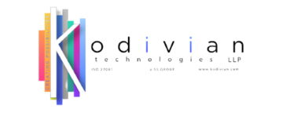










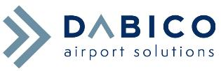


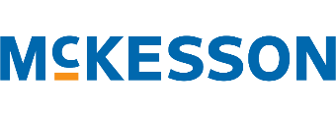




Recent Clients & Partners

Slide 24
Commercial Model
Platform led Services
Offerings
Delivery Approach
Pricing
Process Orchestration
(Robotic) Process Automation
Workflow Automation
Up to 2 weeks of assessment as an investment for solution strategy
Output based approach delivered in units
Fixed cost/unit delivered
Discounts for large volume of units delivery
Platform as a Service
Phase 1 Rollout
Phase 2 Rollout
Skyaicode platform will be provided as a value-add to customers with potential interest at no additional cost for a period of 6 months with the below privileges.
Skyaicode platform will be released officially with the below projected licensing model
Module
Quantity
Pricing Options
Module
Access
Development Suite
Per User
Monthly/Yearly
Development Suite
Up to 5 users unlimited access
Automation Suite
Per User
Monthly/Yearly
Automation Suite
Up to 10 users unlimited access
Bots Suite
Per User
Monthly/Yearly
Bots Suite
Up to 10 users unlimited access
All Inclusive bundle
Per User
Monthly/Yearly

Slide 25
Thank You

