Slide 1
Boosting
Saravana

Slide 2
What is Boosting?
Boosting is a method of converting a set of weak learners into strong learners. To convert a weak learner into strong learner, we take a family of weak learners, combine them and vote. This turns this family of weak learners into strong learners.
The idea here is that the family of weak learners should have a minimum correlation between them.

Slide 3
Types of boosting algorithms:
AdaBoost
Gradient Boosting
XGBoost

Slide 4
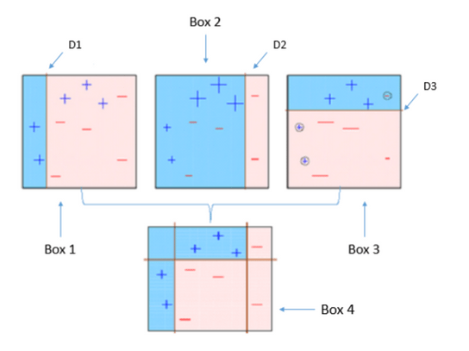
AdaBoost(Adaptive Boosting)
We take the training data and randomly sample points from this data and apply decision stump algorithm to classify the points.
After classifying the sampled points we fit the decision tree stump to the complete training data.
This process iteratively happens until the complete training data fits without any error or until a specified maximum number of estimators.

Slide 5
Drawbacks
It is easily defeated by noisy data, the efficiency of the algorithm is highly affected by outliers as the algorithm tries to fit every point perfectly.
You might be wondering since the algorithm tries to fit every point, doesn’t it overfit? No, it does not. It manages them efficiently

Slide 6
Gradient Boosting
Gradient Boosting trains many models in a gradual, additive and sequential manner. The major difference between AdaBoost and Gradient Boosting Algorithm is how the two algorithms identify the shortcomings of weak learners (eg. decision trees). While the AdaBoost model identifies the shortcomings by using high weight data points, gradient boosting performs the same by using gradients in the loss function.
A logical understanding of loss function would depend on what we are trying to optimise. For example, if we are trying to predict the sales prices by using a regression, then the loss function would be based off the error between true and predicted house prices.

Slide 7
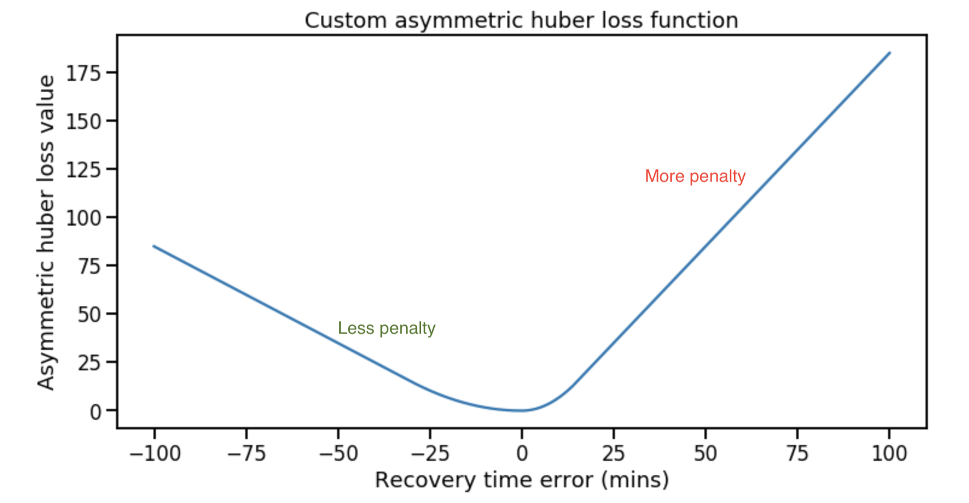
Loss Functions in Gradient Descent

Slide 8
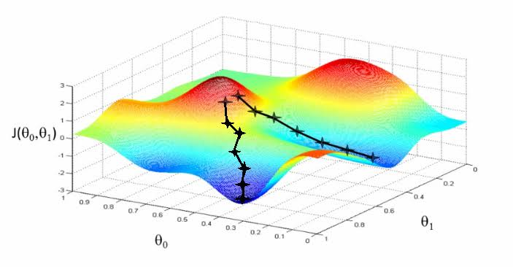
Gradient Descent in Linear Regression
In linear regression, the model targets to get the best-fit regression line to predict the value of y based on the given input value (x)
This involves knowing the form of the cost as well as the derivative so that from a given point you know the gradient and can move in that direction, e.g. downhill towards the minimum value

Slide 9
XGBoost
XGBoost stands for eXtreme Gradient Boosting.
XGBoost is an implementation of gradient boosted decision trees designed for speed and performance, it’s a Regularized Gradient Boosting with both L1 and L2 regularization.
The two reasons to use XGBoost are also the two goals of the project:
Execution Speed.
Model Performance.

Slide 10
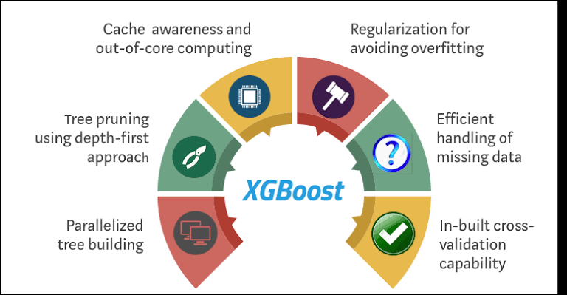
Power of XGboost

Slide 11
Thanks

