Slide 1
SQLite
Saravana

Slide 2
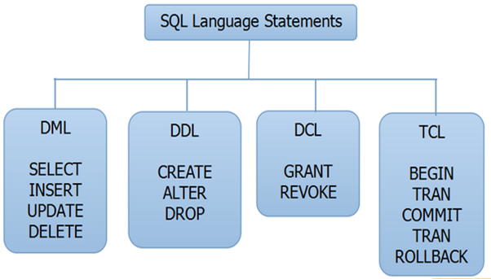
Structured Query Language
Structured Query Language is a Standard Database Language for storing, manipulating and retrieving data in databases.
DML (DATA MANIPULATION LANGUAGE)
DDL (DATA DEFINITION LANGUAGE)
DCL (DATA CONTROL LANGUAGE)
TCL (TRANSACTION CONTROL LANGUAGE)

Slide 3
SQL Statements
CREATE TABLE table_name ( column1 datatype, column2 datatype, column3 datatype, .... );
INSERT Into Table Values()
DROP TABLE table_name;

Slide 4
SQL Statements
SELECT column1, column2, ... FROM table_name;
SELECT DISTINCT column1, column2, ... FROM table_name;
DELETE FROM table_name WHERE condition;

Slide 5

SQLite
SQLite in general, is a server-less database that can be used within almost all programming languages including Python
SQLite is a lightweight database that can provide a relational database management system with zero-configuration because there is no need to configure or setup anything to use it

Slide 6
SQLite Limitations
Only Left Outer Join is implemented, No Right Outer Join or Full Outer Join
In Alter table - RENAME TABLE and ADD COLUMN variants of the ALTER TABLE command are supported, The DROP COLUMN, ALTER COLUMN, ADD CONSTRAINT are not supported
VIEWs in SQLite are read-only. You may not execute a DELETE, INSERT, or UPDATE statement on a view
To Learn More on SQL - https://www.w3schools.com/sql/

