Slide 1
Normalization & Standardization
Saravana

Slide 2
Standardize, or Normalize
Standardization - rescales data to have a mean of 0 and a standard deviation of 1 (unit variance).
Normalization - rescales the values into a range of [0,1].
https://www.kaggle.com/adx891/sonar-data-set

Slide 3
Scaling the Data
It is a step of Data Pre Processing which is applied to independent variables or features
It basically helps to normalise the data within a particular range.
Sometimes, it also helps in speeding up the calculations in an algorithm.

Slide 4
Examples of Algorithms where Feature Scaling matters
1. K-Means uses the Euclidean distance measure here feature scaling matters. 2. K-Nearest-Neighbours also require feature scaling. 3. Principal Component Analysis (PCA): Tries to get the feature with maximum variance, here too feature scaling is required. 4. Gradient Descent: Calculation speed increase as Theta calculation becomes faster after feature scaling.

Slide 5
Methods
MinMaxScaler - subtracts the minimum value in the feature and then divides by the range
RobustScaler - transforms the feature vector by subtracting the median and then dividing by the interquartile range (75% value — 25% value)
StandardScaler - subtracts the values from the mean and then divides all the values by the standard deviation
Normalizer - To each observation, if each element were squared and summed, the total would equal 1

Slide 6
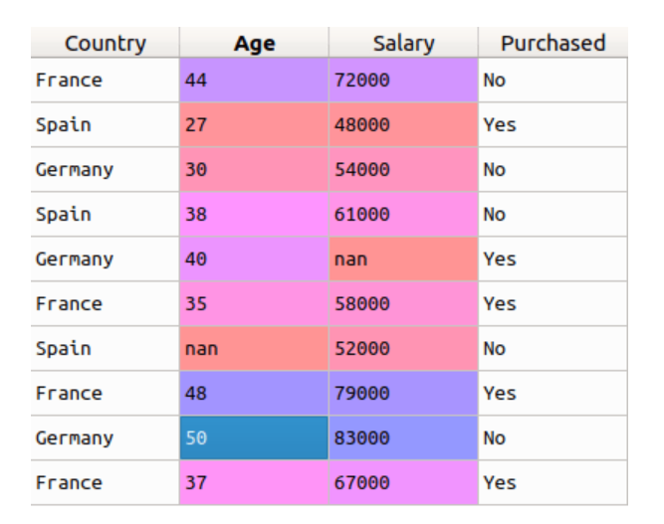
Difference between Label Encoder and One Hot Encoding

Slide 7
Wrap
Use MinMaxScaler as the default if you are transforming a feature.
You could use RobustScaler if you have outliers and want to reduce their influence. However, you might be better off removing the outliers, instead.
Use StandardScaler if you need a relatively normal distribution.
Use Normalizer sparingly — it normalizes sample rows, not feature columns. It can use l2 or l1 normalization.

