Slide 1
Bookshop Registration

Slide 2
Aim
Make registration easy
It not complicate to use
Help to learn easy
Simple way to check

Slide 3
The topic of my project is a method for bookshop registration system. A list of the books will be available on the dashboard.
Just the count needs to be added, and the book needs to be enabled.
The registration is provided in the text area for book name, edition and the price.
Also, the search bar is providing book details.
Finally, there are five buttons: save, update, delete, clear and exit.

Slide 4
Tools used
Apache netbeans
Core language
java

Slide 5
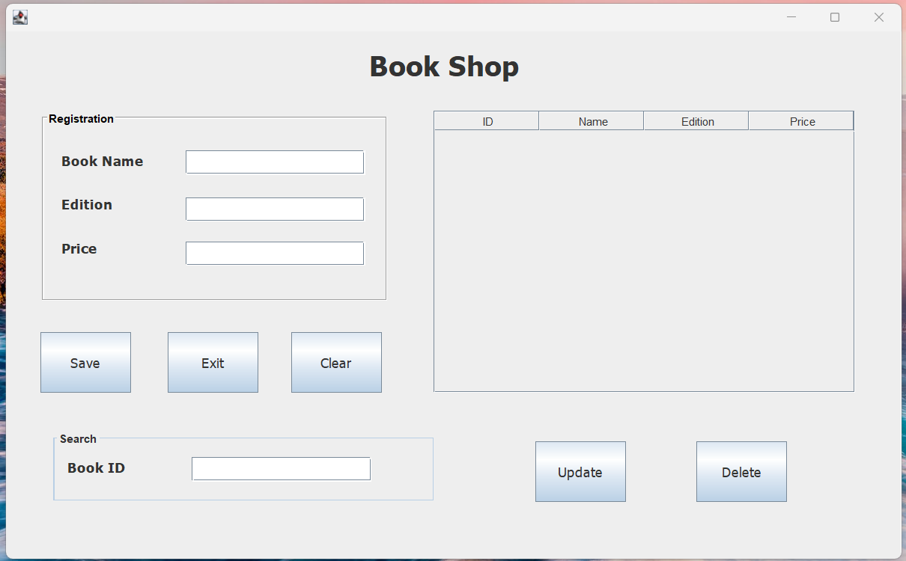
Preview image

Slide 6
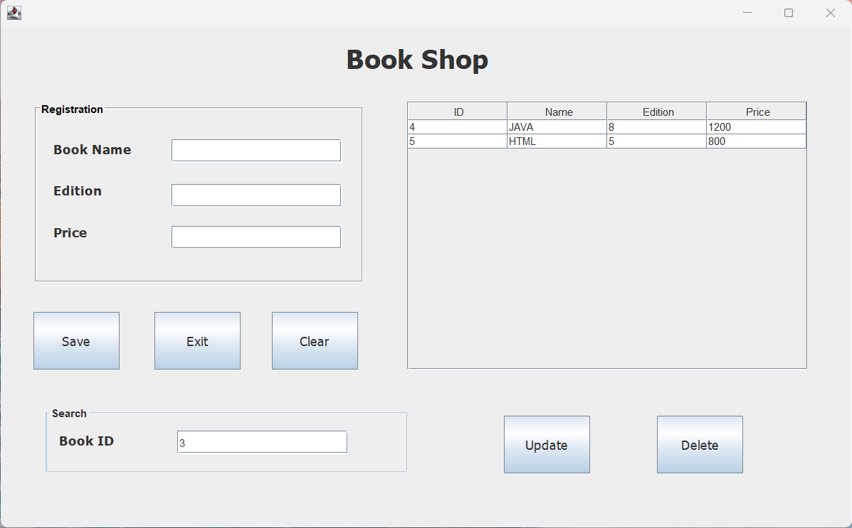
Preview with data loaded

Slide 7
Thank you

