Slide 1
Saravanakkumar D
Interactive Fiction Writer:
AI-powered Story Generation Tool
Final Project
Reg.No:813821205045
NM Mail id:d.saravana2003@gmail.com
College Name: Saranathan College of Engineering
3/21/2024 Annual Review

Slide 2
PROJECT TITLE Interactive Fiction Writer: AI-powered Story Generation Tool
3/21/2024 Annual Review

Slide 3


AGENDA
Introduction
Problem Statement
Project Overview
End Users
Solution and Value Proposition
Key Features
Modelling: Understanding Convolutional Neural Networks (CNN)
Results
Conclusion
3/21/2024 Annual Review

Slide 4

PROBLEM STATEMENT
Our project makes it a priority to address the challenge of delivering a seamless and intuitive solution for crafting captivating narratives using artificial intelligence. We recognize that existing text generation tools tend to be overly complex and inaccessible to non-technical users, limiting their widespread adoption. Moreover, these tools often fall short in effectively integrating user input, leading to disjointed or irrelevant story outcomes. Our aim is to fill this gap by empowering users to actively engage in the storytelling process while harnessing AI technology to amplify creativity and coherence.
3/21/2024 Annual Review

Slide 5

PROJECT OVERVIEW
The Interactive Fiction Writer project introduces an AI-powered Story Generation Tool enhanced by Generative AI capabilities, poised to revolutionize the storytelling process. This innovative platform harnesses the potential of advanced Generative Adversarial Networks (GANs) and natural language processing models to facilitate interactive fiction creation. By leveraging cutting-edge Generative AI techniques, including sophisticated text generation algorithms, the tool empowers users to craft immersive narratives effortlessly. Through an intuitive and user-friendly interface, writers can input prompts and story elements, guiding the AI in generating dynamic and engaging storylines. The project aims to democratize storytelling by providing a versatile tool accessible to writers, educators, and enthusiasts alike. With its ability to seamlessly integrate user input and Generative AI assistance, the Interactive Fiction Writer promises to inspire creativity and redefine the landscape of narrative creation.
3/21/2024 Annual Review

Slide 6

WHO ARE THE END USERS?
Writers seeking inspiration and assistance in generating story ideas.
Educators looking to enhance storytelling activities in classrooms and educational settings.
Students interested in exploring interactive fiction and narrative creation.
Story enthusiasts eager to participate in collaborative storytelling experiences.
Content creators aiming to incorporate dynamically generated narratives into their projects.
3/21/2024 Annual Review

Slide 7

YOUR SOLUTION AND ITS VALUE PROPOSITION
Our AI-powered Story Generation Tool leverages advanced Generative AI technology to simplify narrative creation. Key points include:
Seamless integration of Generative AI allows users to input prompts and receive dynamically generated narratives.
Intuitive user interface ensures accessibility for writers of all skill levels.
Personalization options enable users to customize tone, genre, and character development.
Versatility caters to writers, educators, and enthusiasts across various domains, fostering creativity and collaboration.
Interactive feedback mechanisms facilitate refinement and iteration of generated stories.
Real-time generation capabilities provide instant access to diverse storytelling possibilities.
Enhanced storytelling experiences inspire innovation and captivate audiences across multiple platforms.
3/21/2024 Annual Review

Slide 8

THE WOW IN YOUR SOLUTION
Cutting-Edge AI Narrative Crafting: Our solution transforms storytelling using advanced AI algorithms, enabling users to create immersive narratives effortlessly.
Personalized Storytelling: Unlike traditional tools, our platform offers tailored experiences, allowing users to shape tone, genre, and character development to fit their vision.
Collaborative AI Partner: Serving as a collaborative ally, our solution empowers writers to co-create compelling narratives, pushing creative boundaries.
Seamless Multi-Platform Integration: With seamless integration across devices, users can unleash creativity anytime, anywhere, ensuring an uninterrupted storytelling experience.
3/21/2024 Annual Review
8

Slide 9
MODELLING
Graph LR
A[Load Story Prompts & Endings] --> B{Define Model Architectures}
B --> C{Text Generator (build_generator)}
B --> D{Discriminator (build_discriminator)}
C --> E{GAN Model (build_gan)}
A & E --> F{Training Loop}
F --> G{Select Prompt-Ending Pair}
F --> H{Generate Story (prompt -> generator)}
G & H --> I{Train Discriminator (real, fake labels)}
I --> F
H --> J{Train Generator (via GAN)}
J --> F
F --> K{Log & Visualize (epoch intervals)}
K --> F
3/21/2024 Annual Review
9

Slide 10
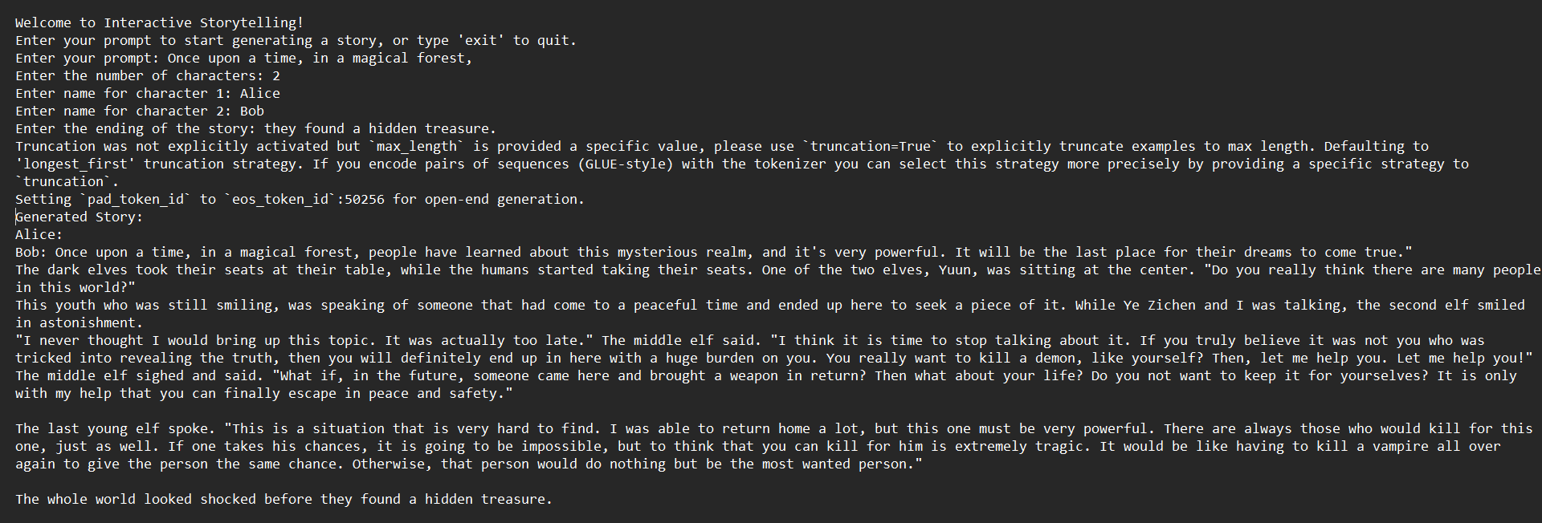
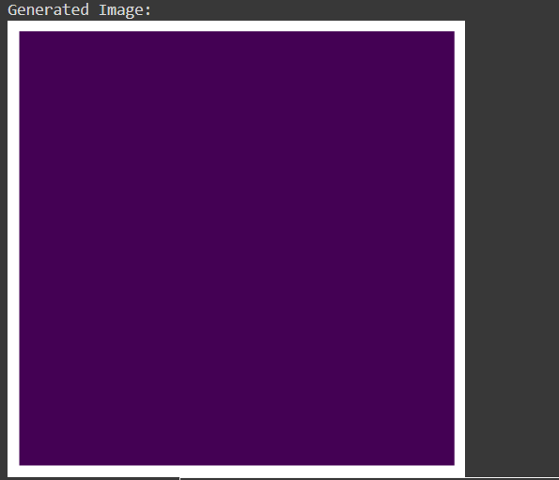
RESULTS
https://github.com/Saravanakkumar2003/TNSDC--Generative--AI.git
Video Link For Result: https://drive.google.com/file/d/1M_wwyFo48KTjTwlKGS7t8uEfd4llfoBF/view?usp=sharing
10

