Slide 1
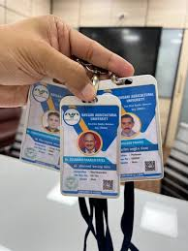



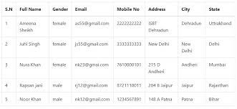


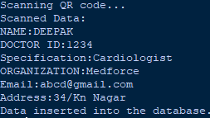
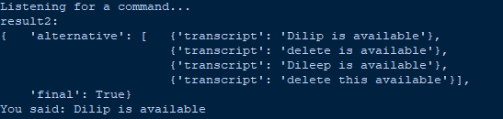



Idea/Approach Details
Technology stack
QR Code Scanning | Patient identification and data input | OpenCV (cv2) for webcam access
Data Encoding and Decoding | QR code data extraction | QRCode library
Database Connection | Storing and retrieving doctor and appointment information | pyodbc for SQL Server database connection
Voice Recognition | Patient queries and interaction | speech_recognition library (e.g., Google Web Speech API)
Text-to-Speech | Providing voice responses to patients | pyttsx3 for text-to-speech synthesis
Doctor Availability Check | Determining doctor availability and recommendations | SQL Server database queries
Data Security | Protecting patient and doctor information | Username and Password Authentication
User Interface | Displaying QR code scanner and receiving voice queries | OpenCV for webcam display
QR Code
Face Recognition
Database
Voice Recognition
Check data availability
Show available doctors according to their Specification and time slots
Process flow
If not available
2

Slide 2
Idea/Approach Details
Use cases:
AI-Powered Hospital Appointment Optimization
Dependencies:
User Case
Actors
Doctors, Patients, Administrators
➢Hardware Availability
QR Code should be valid data
➢Database Setup
Preconditions
➢Network Connection
Voice should be clear .
➢Third-Party Libraries
By Running the program it starts to open
Webcam start to scan the Qrcode.
The Scanned Qrcode generate the data and
These are stored in the Microsoft SQL server.
Step 1
➢Doctor Information
Description
.
Show stoppers:
Normal Flow
Step 2
Capture a patient’s query-speechRecognition
➢Hardware Failure: Webcam or microphone issues can disrupt system functionality.
➢Database Connection Issues: Misconfigurations or downtime can halt the system.
➢Voice Recognition Accuracy: Inaccurate speech recognition affects query interpretation.
➢Security Vulnerabilities: Weak data security risks exposing sensitive information.
➢Data Integrity: Errors in database data can lead to incorrect operations and trust issues.
Step 3
Search and provide available slot detail
Post
We include set of data to the Qrcode and face
details -incase we use of face_detection
Conditions
.
Instead of using Qrcode [biometric] .Alternately
we use face detection it easily find out and fetch
data even though they not access [biomertic]
(Not scan Qrcode)
Alternative Flows
Non-functional
All non-functional requirements are: Performance,
requirements
Reliability, data backup and Recovery, Maintainability
3

