Slide 1

The 7 Layers of Cyber Security & Vulnerabilities
Module 8

Slide 2
Module 8 Agenda
Finish Module 7 Activity 2
The 7 Layers of Cyber Security
Malware
Vulnerabilities
Copyright 2021 Iowa State University

Slide 3
ID | name | salary | Dept_name | Building | Budget
1 | Aravindh | 78885 | IT | Watson | 9
2 | Nandha | 755222 | CSE | Painter | 8
3 | Kabilan | 96369 | IT | Watson | 2
4 | Winstar | 255265 | ECE | Painter | 1
5 | Leo | 878754 | EEE | Watson | 5

Slide 4

Module 7 Activity 2
Each team, take about 10 to 20 minutes to finish up Module 7 Activity 2

Slide 5
The 7 Layers of Cyber Security

Slide 6
The 7 Layers of Cyber Security
Mission Critical Assets
This is the data that is being protected. Any asset an organization cannot function without (computers, software and data).
Data Security
Protecting your systems at this level would entail establishing reliable backups to save data, encryption of your data, and other policies such as Two-Factor Authentication (usernames & passwords).
Application Security
The testing and adding of application features to prevent and patch vulnerabilities.
Routine updating of applications and software to not leave any system open to an old exploit.
Endpoint Security
Protects the connection between the network and its devices
We can implement endpoint security through the use of antivirus software, web content filtering, and application controls.

Slide 7
The 7 Layers of Cyber Security
5. Network Security
At this layer, we are concerned with the breadth of access a user has within a network. It would be dangerous to grant every employee root access.
We need to provide people with the minimum amount of “user privilege” possible for them to do their job and nothing more.
6. Perimeter Security
Prevents suspicious activity from entering the network by protecting the gateway with firewalls, data encryption, anti-virus software.
Monitors and secures devices that transmit data outside of the walls of your network.
7. The Human Layer
Being aware of human threats like spamming, phishing, and any other clever form of social engineering.

Slide 8
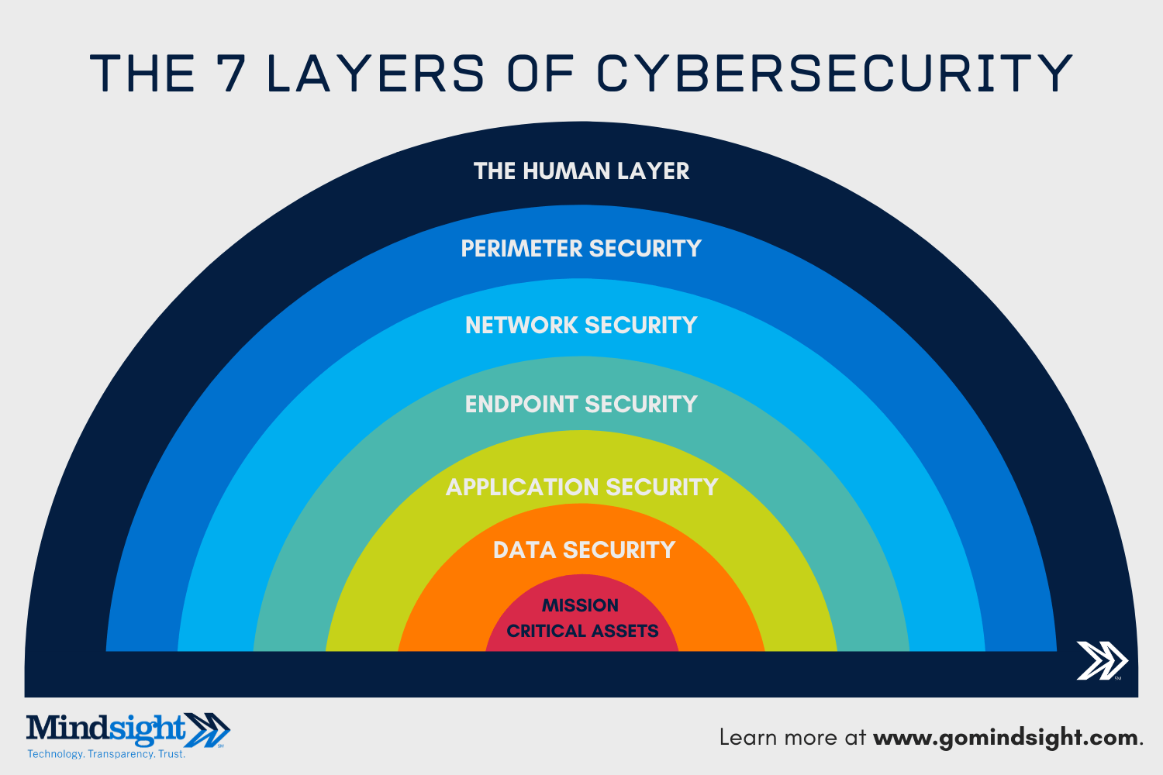
The 7 Layers of Cyber Security

Slide 9

Malware

Slide 10
Malware
Malware: Malicious Software. Malicious code scripts, files, or programs that aim to deceive, manipulate or spy on the target user without their knowledge.
Malware comes in different forms, and not limited to
Worms, Trojan Horses, Viruses, Keyloggers, Scareware
Another way to define malware is to know that malware is any software that compromises confidentiality, integrity, and availability of your computers.
Confidentiality: No unauthorized reading
Integrity: No unauthorized writing
Availability: System are accessible, ready to use

Slide 11
Malware
Malware Propagation Methods:
Worms
Worms are able to self-replicate, without the need for human interaction.
Computer Viruses
Requires a human to spread. Usually hidden and embedded within an application or other software.
Social Engineering
Also referred to as “human hacking”, involves taking advantage of the human element to gain access to unauthorized systems.
Malicious Websites
Sometimes trustworthy websites can contain dangerous content.
Trojan Horses
A malicious function contained within a seemingly benign product.

Slide 12
Malware
Malware Vessels:
Removable Media (USB flash-drives)
Internet Downloads
E-mail Attachments
Corrupt Files
An unsuspecting user
Modern cyber attacks will implement a variety of these methods and those mentioned on the previous slide to successfully infiltrate the target.

Slide 13
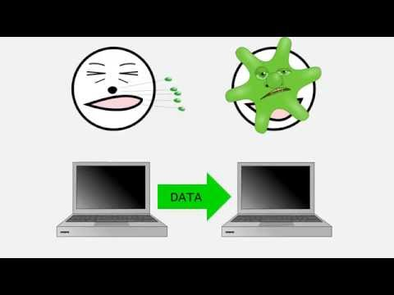
Malware
Video: Varieties of Malware by IowaCyber
https://www.youtube.com/watch?v=pFETP9CAJj4

Slide 14
Malware
Malware Triggers:
Triggers are the mechanism that activates the “core” or payload of malware. Examples of triggers include but are not limited to:
Time
System configuration settings
Existence of certain files or folders
Current software version
A specific human user action
Failure to comply with ransomware demands

Slide 15
Malware
Malware Payloads:
A payload could be considered malware’s purpose. What is it setting out to accomplish? Examples include:
Destruction of data
Data encryption
Spy on the target
Bring down a website by keeping people from accessing it, through a denial of service attack
Cause real-world harm, in the case of attacking hospitals
Install a backdoor
Zombify your computer

Slide 16
Vulnerabilities
Speed(mph) | Driver | Car | Engine
407.447 | Arun | BMW | GE173
413.33 | Dharshan | Suzuki | WEJ789
456.909 | Keerthi | Thrust | GE89
767.443 | Sangeeth | Wingfoot | Rocket
45.667 | Dhanapal | Ferrari | RR Spey

Slide 17
Vulnerabilities
By using some of the propagation methods previously described, hackers can intrude and embed malware through vulnerabilities.
Vulnerabilities are weaknesses within a computer system that compromise systems under attack. They can occur throughout the system’s. . .
Design
Implementation
Configuration

Slide 18
Vulnerabilities
Design Vulnerability: flaws in the design of the computer or software that bypass security.
Implementation Vulnerability: errors within implemented software. (installed improperly)
Configuration Vulnerability: user configures the system incorrectly or uses defaults. (not changing default password/using weak passwords)

Slide 19
Vulnerabilities
How to check for vulnerabilities?
Penetration testing (Pen test):
Simulated cyber attack against a computer system to check for vulnerabilities (test run)
Provides insight on weak parts of a system that need to be patched up
Used to ensure that a system is secure and reliable
Allows for vulnerabilities to be detected and fixed before the system is compromised by attackers

Slide 20
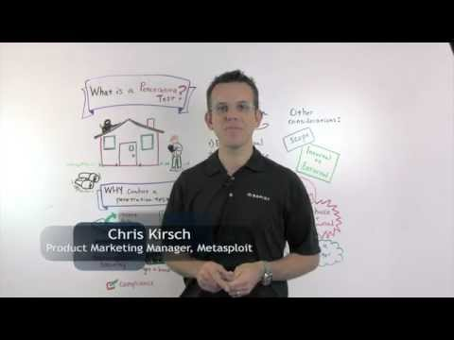
Vulnerabilities
Steps of a pen test (Optional video)
https://youtu.be/b7jW9X9UqiY

Slide 21
Vulnerabilities
As we learned in the video, passive reconnaissance is the first active step of a pen test.
Passive reconnaissance is the action of acquiring and analyzing as much publicly available information as possible without interacting in any way with the target.
This gives the attacker the opportunity to identify potentially vulnerable and misconfigured systems for physical attacks. Additionally, it could potentially provide sensitive information that might allow for impersonation, exploitation, or blackmail.
You will be practicing passive reconnaissance in Activity 1

Slide 22
To Do
Have Module 7 Activity 1 Completed
Complete Module 8 Activity 1
Complete Module 8 Activity 2
Copyright 2021 Iowa State University

Slide 23
End of Module 8!
What questions do you have?
Next Module Topic:
Web Vulnerabilities
Copyright 2021 Iowa State University

Slide 24
Questions?
Contact Innovate-IT support staff!
email:
innovate_it@iastate.edu
Your school’s IP-Range can be found at:
http://www.it-adventures.org/ip-ranges/

Slide 25
ID | name | salary
1 | Aravindh | 78885
2 | Nandha | 755222
3 | Kabilan | 96369
4 | Winstar | 255265
5 | Leo | 878754
A)Instructor Table
Dept_name | Building | Budget
IT | Watson | 9
CSE | Painter | 8
IT | Watson | 2
ECE | Painter | 1
EEE | Watson | 5
B)Department Table

Slide 26
ID | name | salary | Dept_name | Building | Budget
1 | Aravindh | 78885 | IT | Watson | 9
2 | Nandha | 755222 | CSE | Painter | 8
3 | Kabilan | 96369 | IT | Watson | 2
4 | Winstar | 255265 | ECE | Painter | 1
5 | Leo | 878754 | EEE | Watson | 5

Slide 27
Outline
The Need for Databases
Data Models
Relational Databases
Database Design
Storage Manager
Query Processing
Transaction Manager

Slide 28



