Slide 1

Cloud Computing
Prepared By
Prof. Mukesh More
HOPE FOUNDATION’S
INTERNATIONAL INSTITUTE OF INFORMATION TECHNOLOGY, (I²IT)
www.isquareit.edu.in
+91 20 22933441 / 2

Slide 2
Contents
What is the cloud computing?
Cloud Computing Components
Service Models
Deployment Models
Architecture
Cloud Engineering
Security and Privacy
Cloud Clients
Advanatges
References

Slide 3
What is Cloud Computing?
Cloud computing :
Internet-based computing
large groups of remote servers are networked
sharing of data-processing tasks, centralized data storage, computer services and resources
Any computer related task that is done entirely on Internet

Slide 4
What is Cloud Computing?
Allows users to deal with the software without having the hardware.
Everything is done by remote, nothing is saved locally.

Slide 5
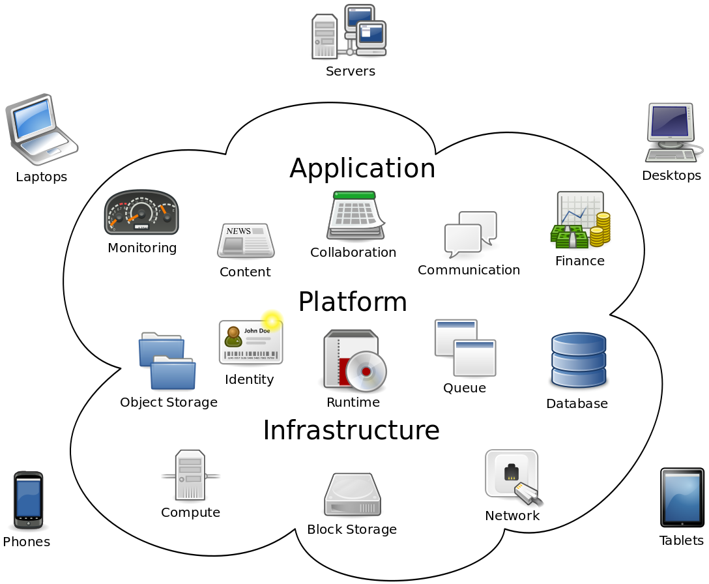
Cloud Computing Components
Fig. 1 Cloud Computing Components [5]

Slide 6
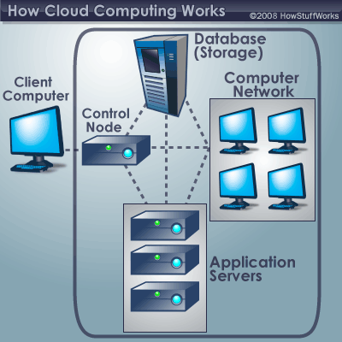
Characteristics
Empowerment
Agility and API
Cost and Security
Device and location independence
Visualization
Multi-tenancy
Reliability and Maintenance
Scalability and Elasticity
Fig. 2 How Cloud Computing Works [6]

Slide 7
Service Models
Infrastructure as a Service (IaaS)
Basic, service users maintain software
Platform as a Service (PaaS)
Users are given software and hardware automatically
Software as a Service (SaaS)
All software and hardware is transparent
User only knows their own access point

Slide 8
Deployment Models
Public cloud
Done by service providers
Community cloud
organizations from a specific community with common concerns
Private cloud
operated solely for a single organization
Hybrid cloud
composition of two or more clouds (private, community or public)
Private Cloud Rentals
option to consider when security is a concern

Slide 9
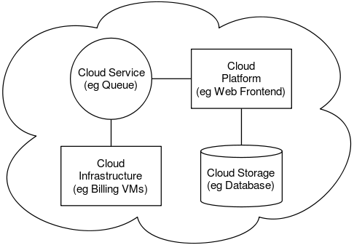
Architecture
The software systems involved in the delivery, communicating over a loose coupling mechanism
The Inter-cloud
The Inter-cloud is an interconnected global "cloud of clouds" and an extension of the Internet
Fig. 4 Cloud Architecture [8]

Slide 10
Cloud Engineering
The application of engineering disciplines to cloud computing
High level concerns
Commercialization
Standardization
Governance in
Conceiving
Developing
Operating
maintaining

Slide 11
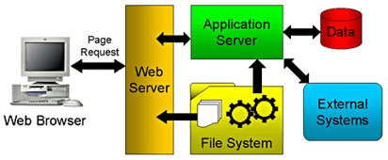
Heterogeneous system​
Front end​
Browser: IE, Firefox, Chrome, Safari…​
Server side​
Application Server​
Database Server​
File System

Slide 12
Should test all involved parts​
Everything can go wrong…​
However, only front end is accessible for tests​
Can not directly test the Server code and SQL​
Have to drive the execution and test​
Frontend​
HTML: Malformed HTML page? (demo) ​
JavaScript: Runtime Errors? (demo)​
Server script​
PHP, Java…: Runtime Errors? (demo)​
SQL: Malformed SQL query string? (demo)​

Slide 13
Uniqueness 4: Security
SQL Injection
The untrusted input is used to construct dynamic SQL queries.
E.g, update my own password
$str = "UPDATE users SET password = \” “ . $_POST['newPass’] . “\” WHERE username =\”“ . $_POST['username'] . “\””;
mysql_query( $str );
PHP Script
$_POST['newPass’] = pass, $_POST['username'] = me
Query String: UPDATE users SET password = “pass” WHERE username =“me”
Normal Case
$_POST['newPass’] = pass, $_POST['username'] = “ OR 1=1 --
Query String: UPDATE users SET password = “pass” WHERE username =“” OR 1=1 --”
Attack

Slide 14
Course Project 4
Part 1: overview
Design test cases against the requirement
The tests should consider
all possible cases
equivalence class partitioning
Implement Selenium WebDriver Script for “Add new class”
Your test cases
input
Your WebDriver test template
output
Test
results

Slide 15
Course Project 4
Part 2: Pair wise testing
Use an existing pair wise testing tool fire-eye
Largely you may reuse the WebDriver template in Part 1
Test cases generated
Convert
Your test cases
input
Your WebDriver test template
output
Test
result

Slide 16
Part 2: Generate test cases
Consider the combination of all textboxs/options
Use the existing tool, fire-eye, to generate test cases
Export the test case in “Nist form”
Parse and convert the exported test cases to the form that your WebDriver can accept
Run all pair-wise test cases
Report the result

Slide 17
Outline
Uniqueness of web app testing
Heterogonous system
Dynamic pages
Load
Security
Selenium WebDriver
Course project 4

Slide 18
ID | name | salary | Dept_name | Building | Budget
1 | Aravindh | 78885 | IT | Watson | 9
2 | Nandha | 755222 | CSE | Painter | 8
3 | Kabilan | 96369 | IT | Watson | 2
4 | Winstar | 255265 | ECE | Painter | 1
5 | Leo | 878754 | EEE | Watson | 5

Slide 19
Cause real-world harm, in the case of attacking hospitals​
Install a backdoor​
Zombify your computer
Speed(mph) | Driver | Car | Engine
407.447 | Arun | BMW | GE173
413.33 | Dharshan | Suzuki | WEJ789
456.909 | Keerthi | Thrust | GE89
767.443 | Sangeeth | Wingfoot | Rocket
45.667 | Dhanapal | Ferrari | RR Spey
Destruction of data​
Data encryption

Slide 20
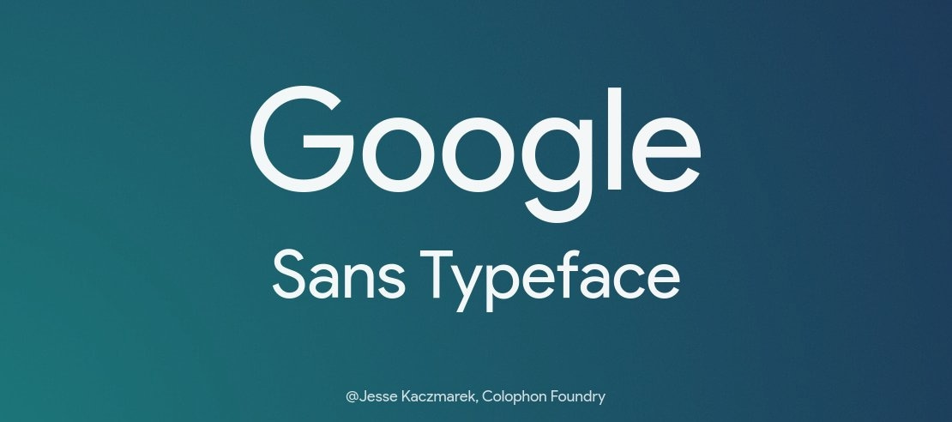

Bring down a website by keeping people from accessing it, through a denial of service attack

Slide 21

Speed(mph) | Driver | Car | Engine
407.447 | Arun | BMW | GE173
413.33 | Dharshan | Suzuki | WEJ789
456.909 | Keerthi | Thrust | GE89
767.443 | Sangeeth | Wingfoot | Rocket
45.667 | Dhanapal | Ferrari | RR Spey

Slide 22

Have Module 7 Activity 1 Completed​
Complete Module 8 Activity 1​
Complete Module 8 Activity 2

Slide 23

Existence of certain files or folders​
Current software version​
A specific human user action​
Failure to comply with ransomware demands
By using some of the propagation methods previously described, hackers can intrude and embed malware through vulnerabilities.

Slide 24
Security and privacy
Data protection
Physical Control
Identity management
Physical and personnel security
Availability
Application security
Privacy
Legal issues

Slide 25
Cloud Clients
Google Chrome book
Web browsers
Company specific applications

Slide 26
Advantages
Cloud everyday use
To save huge amounts of data
Easier to maintain information
Makes security easy
Maintainability and sustainability are better

Slide 27
References
[1] "cloud computing." Dictionary.com Unabridged. Random House, Inc. 27 Feb. 2012. <Dictionary.com http://dictionary.reference.com/browse/cloud computing>.
[2] “Cloud computing security.” Wikipedia, The Free Encyclopedia. Wikimedia Foundation, Inc.. 20 Feb 2012. Web. 27 Feb 2012. <http://en.wikipedia.org/wiki/Cloud_computing_security>.
[3] “ Cloud computing.” Wikipedia, The Free Encyclopedia. Wikimedia Foundation, Inc.. 28 February 2012. Web. 27 Feb 2012. <http://en.wikipedia.org/wiki/Cloud_computing>.
[4] nanospeak, . "Top Cloud Computing Companies List To Watch and Invest in 2012." Hub Pages. 10 Feb 2010: n. page. Web. 29 Feb. 2012. <http://nanospeck.hubpages.com/hub/Best-Cloud-Service-Providers>.
[5] https://www.fastmetrics.com/blog/tech/what-is-cloud-computing/
[6] https://computer.howstuffworks.com/cloud-computing/cloud-computing.htm
[7] https://www.ques10.com/p/30825/enlist-and-explain-various-service-model-and-deplo/
[8] https://en.wikipedia.org/wiki/Cloud_computing_architecture

Slide 28
Thank You
For further information please contact
Prof. Mukesh More
Department of Computer Engineering
Hope Foundation’s International Institute of Information Technology, I²IT
Hinjawadi, Pune – 411 057
Phone - +91 20 22933441/9284960835
www.isquareit.edu.in | mukeshm@isquareit.edu.in

