Slide 1


Understanding Computers
15th Edition
Today and Tomorrow
Comprehensive
Chapter 7
Computer Networks
Deborah Morley Charles S. Parker
Copyright 2015 Cengage Learning

Slide 2
Learning Objectives
Define a computer network and its purpose.
Describe several uses for networks.
Understand the various characteristics of a network, such as
topology, architecture, and size.
Understand characteristics about data and how it travels
over a network.

Slide 3
Learning Objectives
Name specific types of wired and wireless networking media and explain how they transmit data.
Identify the most common communications protocols and
networking standards used with networks today.
List several types of networking hardware and explain the
purpose of each.

Slide 4
Overview
This chapter covers:
Computer network is defined
Common networking and communications applications
Networking concepts and terminology
Technical issues related to networks, including general characteristics of data transmission, and types of transmission media in use today
Explanation of the various communications protocols and
networking standards
Various types of hardware used with a computer network

Slide 5
What Is a Network?
Network
A connected system of objects or people
Computer network
A collection of computers and other hardware devices connected together so users can share hardware, software, and data, and electronically communicate
Computer networks are converging with telephone and other communications networks
Networks range from small private networks to the Internet
In most businesses, computer networks are essential

Slide 6
Inside the Industry Box
Wireless Power
Powers/recharges devices via wireless signals and
magnetic induction
Wireless Power Consortium supports the Qi standard
Can use built-in or
external charging receiver
May be built into walls, homes, cars, garage floors, etc. in the future

Slide 7
Networking Applications
The Internet
Largest computer network in the world
Telephone Service
POTS Network
One of the first networks
Still used today to provide telephone service to landline
phones
Mobile Phones (wireless phones)
Use a wireless network for communications

Slide 8
Networking Applications
Cellular (cell) Phones
Must be within range of cell tower to function
Dual-mode Phones
Allow users to make telephone calls using more than one communications network
Cellular/Wi-Fi dual-mode phones can switch seamlessly between the Wi-Fi network and a cellular network
Satellite Phones
Communicate via satellite technology
Most often used by individuals such as soldiers, journalists, wilderness guides, and researchers

Slide 9
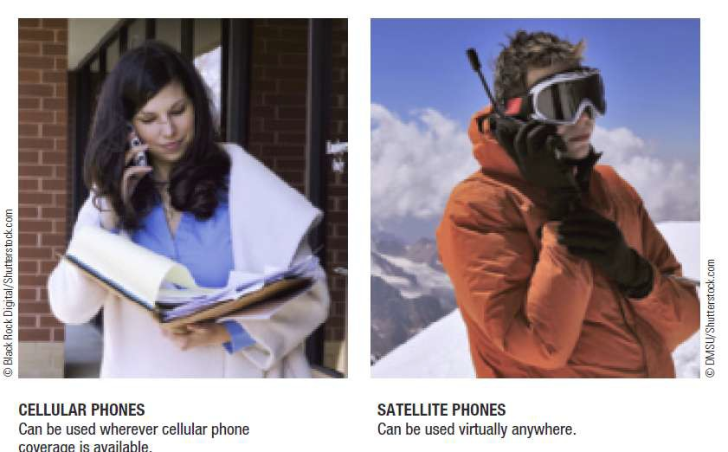

Networking Applications

Slide 10
Networking Applications
Television and Radio Broadcasting
Still used to deliver TV and radio content to the public
Other networks involved with television content delivery are cable TV networks, satellite TV networks, and private closed-circuit television systems
Global Positioning System (GPS) Applications
Uses satellites and a receiver to determine the exact geographic location of the receiver
GPS receivers
Commonly used by individuals to determine their geographic location
10

Slide 11
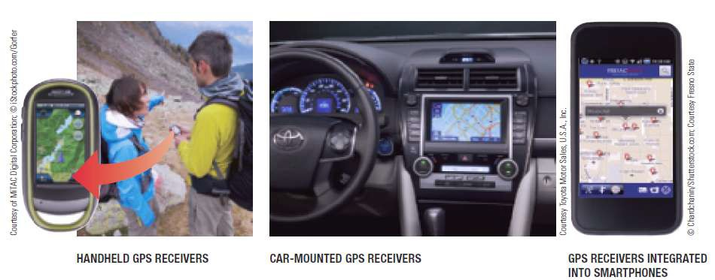
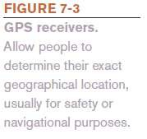
Networking Applications
GPS receivers
Used on the job by surveyors, farmers, and fishermen
Used to guide vehicles and equipment
Used by the military to guide munitions and trucks, and to track military aircraft, ships, and submarines

Slide 12
Networking Applications
Monitoring Systems
Use networking technology to determine the current
location or status of an object
RFID-based Systems
Monitor the status of objects
GPS-based Monitoring Systems
Monitor the physical location of objects
Vehicle and child monitoring systems
Electronic Medical Monitors
Home healthcare

Slide 13
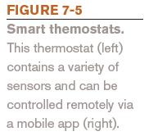
Networking Applications
Sensors are used in some monitoring systems
Sensor networks
Home automation (smart thermostats, etc.)

Slide 14
Networking Applications
Multimedia Networking
Distributing digital multimedia content, typically via a
home network
Necessary networking capabilities are often built into devices being used
Might need to use multimedia networking device such as a
digital media receiver or digital media streamer
Placeshifting Content
Allows individuals to view multimedia content at a
more convenient location, i.e., Slingbox

Slide 15
Networking Applications
Videoconferencing, Collaborative Computing, and Telecommuting
Videoconferencing
Use of computers, video cameras, microphones, and networking technologies to conduct face-to-face meetings over a network
Telepresence Videoconferencing
A setup that more closely mimics a real-time meeting
environment

Slide 16
Networking Applications
Collaborative Computing (workgroup computing)
Enables individuals to work together on documents and
projects
Telecommuting
Individuals work from a remote location (usually home) and communicate with their places of business and clients using networking technologies
Allows for employee flexibility

Slide 17
Networking Applications
Telemedicine
Use of networking technology to provide medical
information and services
Remote monitoring and consultations
Remote diagnosis
Telesurgery
Robot assisted surgery where doctor’s physical location is different from the patient’s and robot’s
Will be needed for long-term space exploration

Slide 18
Bitcoin versus Blockchain
Bitcoin
Blockchain
Currency
Physical and virtual objects
Transactions
Business logic - Smart contracts
Ownership
Conditional relationships
Diadic transfer
Multi-party and social
Single instance / closure
Transaction chain

Slide 19
Network Characteristics
Wired vs. Wireless Networks
Wired
A network in which computers and other devices are
physically connected to the network with cables
Found in schools, businesses, and government facilities
Wireless
A network in which computers and other devices are connected to the network without physical cables
Data is typically sent via radio waves
Found in homes, schools, and businesses

Slide 20
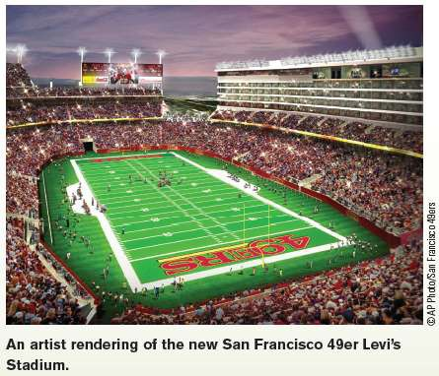
Trend Box
Stadium Wireless Networks
Professional sports venues are increasingly including
wireless access and other technology
Free Wi-Fi
Seat tablet holders
In-game apps
HD video boards
20

Slide 21
Network Characteristics
Network Topologies: Indicate how the devices in the network are arranged
Star Networks
All networked devices connect to a central device/server
If the central device fails, the network cannot work
Bus Network
Uses a central cable to which all network devices connect
Mesh network
Multiple connections among the devices on the network so that messages can take any of several possible paths

Slide 22
Network Characteristics
Time (drops of water) | Distance(cm)
1 | 10,11,12
2 | 14,78,900
3 | 43,78,22
4 | 12,45,67
5 | 56,90,765

Slide 23
Network Characteristics
Network Architectures
Client-Server Networks
Client
Computer or other device on the network that requests and utilizes network resources
Server
Computer dedicated to processing client requests

Slide 24
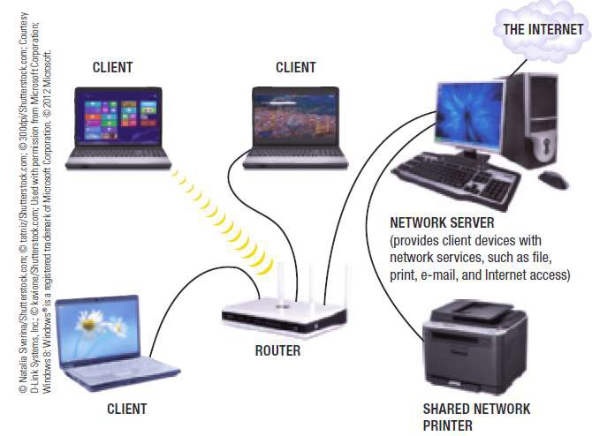
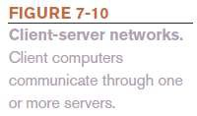
Network Characteristics

Slide 25
Networking Media
Number of Coils | Number of PaperClips
5 | 8,5,6
10 | 23,55,678,3
15 | 1,2,3,4
20 | 45,66,78

