Slide 1

CYCLIST BIKE SHARE ANALYSIS
Dive into the insights and trends of Cyclisti's bike-share program, uncovering valuable data-driven recommendations to drive growth and customer engagement.
BY
SARAVANAKUMAR R
BADM MBE4

Slide 2

OBJECTIVE OF THE ANALYSIS
The business task is to analyze the provided bike-sharing dataset to gain insights into user behavior, popular routes, usage patterns, and other factors that can inform decision-making related to resource allocation, service optimization, marketing strategies, and potential expansion opportunities for the bike-sharing system

Slide 3
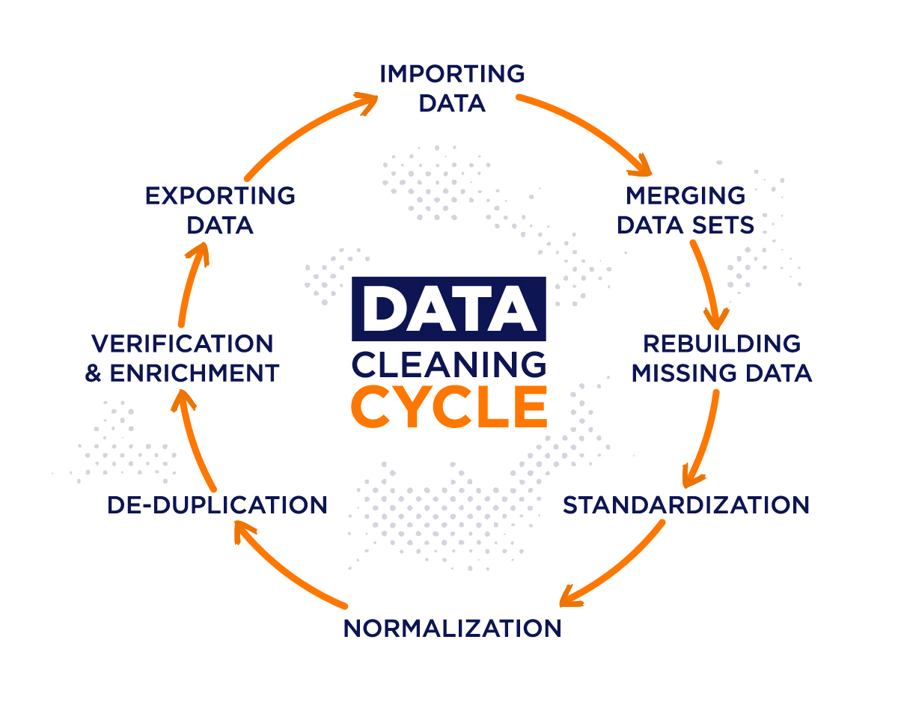
EXPLORATORY DATA ANALYSIS
Before performing any analysis, it's essential to clean and manipulate the data to ensure its accuracy and suitability for analysis. Here are some common data cleaning and manipulation tasks that may be performed on the provided dataset: Handling Missing Values: Check for missing values in any columns and decide on appropriate strategies for handling them, such as imputation or removal.
Parsing Dates: Convert date and time columns into the appropriate datetime format for easier analysis and manipulation
Standardizing Data Formats: Ensure consistency in data formats across columns, such as converting all text to lowercase, removing extra spaces, or standardizing categorical values.
Addressing Outliers: Identify and address any outliers or anomalies in the data that may skew analysis results.
Feature Engineering: Create new features from existing ones if needed, such as calculating ride durations, distances between start and end locations, or aggregating data by specific time periods.
Dropping Unnecessary Columns: Remove any columns that are not relevant to the analysis or modeling task to simplify the dataset.
Handling Categorical Variables: Encode categorical variables into numerical values using techniques such as one-hot encoding or label encoding.
Data Aggregation: Aggregate data as needed, such as grouping rides by rider type, bike type, or time periods for summary analysis.
Data Filtering: Apply filters to remove irrelevant or erroneous data points based on specific criteria.
Data Integration: Integrate additional data sources if necessary to enrich the analysis, such as weather data or demographic information

Slide 4
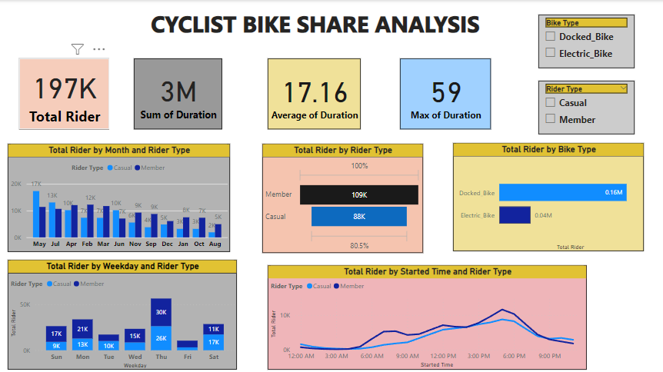

Slide 5
Recommendations for growth
Optimize Station Placement
Utilize insights from popular start and end locations to optimize station placement. By strategically locating stations in areas with high demand, such as popular neighborhoods, tourist attractions, and transportation hubs, you can improve accessibility and convenience for users, thereby increasing ridership and revenue.
Diversify Bike Fleet Analyze
the distribution of different bike types (e.g., docked bikes, electric bikes) and user preferences to diversify the bike fleet accordingly. Introducing electric bikes in areas with longer ride durations or hilly terrain can attract more users and enhance the overall riding experience. Additionally, offering a variety of bike options can cater to the preferences of different user segments, increasing overall satisfaction and loyalty.
Leverage Data Insights
Continuously analyze rider behavior and preferences to inform targeted marketing campaigns, optimize station placement, and develop tailored programs to convert casual riders into loyal members

Slide 6

KEY FINDING FROM THE ANALYSIS
1.Peak ride times and durations, which can inform resource allocation and scheduling.
2. Identification of popular routes and areas of high demand, guiding station placement and infrastructure development.
3.Insights into user behavior, such as preferred ride times, routes, and user type preferences.
4.Seasonal trends in bike usage, with potential implications for marketing and promotional campaigns.
5 Opportunities for service improvements, such as expanding bike fleet options or enhancing user experience features.
By combining these visualizations with the key findings, stakeholders can gain a comprehensive understanding of bike-sharing usage patterns and make data-driven decisions to optimize service delivery and user satisfaction.

Slide 7

Thank You
We appreciate your time and attention. This presentation has provided an indepth analysis of Cyclistic's bike-share program, uncovering valuable insights to drive growth and convert casual riders into loyal members.

