Slide 1
Create a chatbot using python

Slide 2
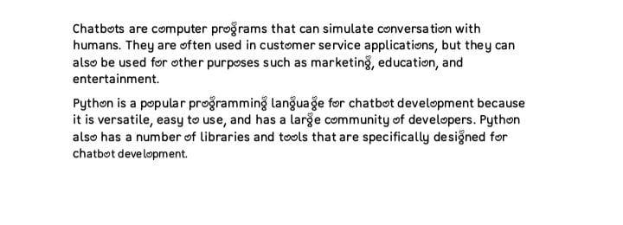
INTRODUCTION

Slide 3
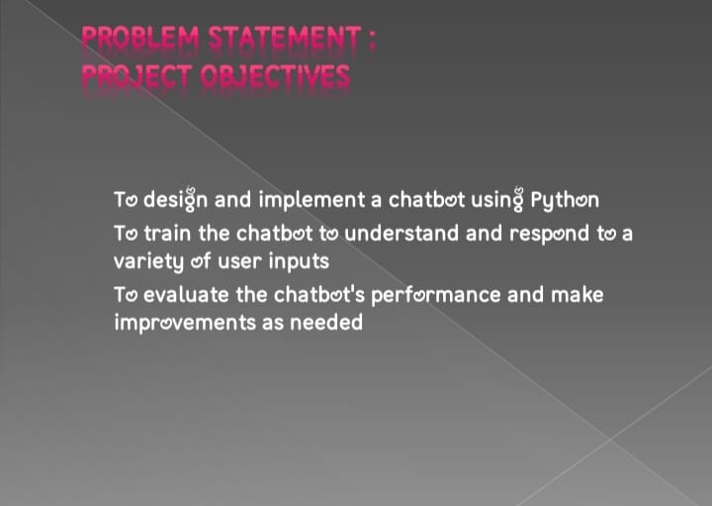

Slide 4
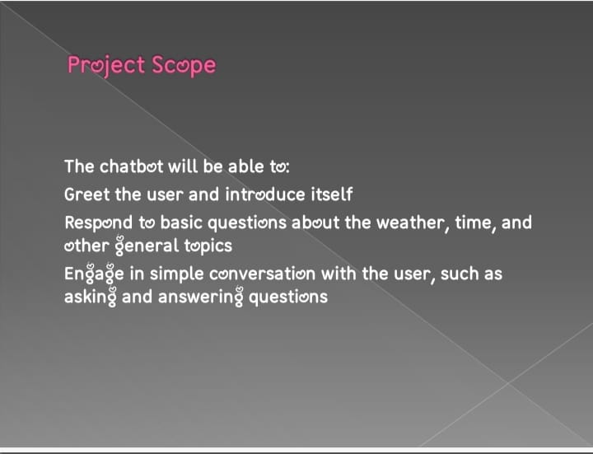

Slide 5
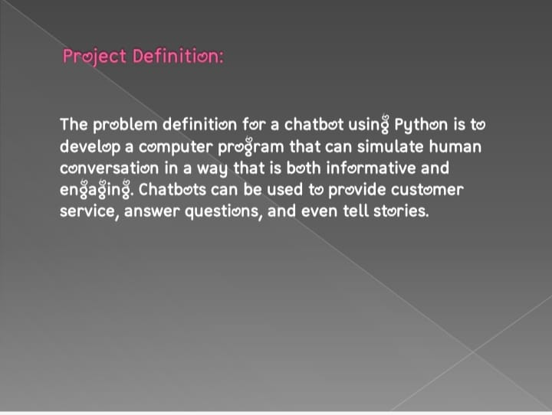

Slide 6
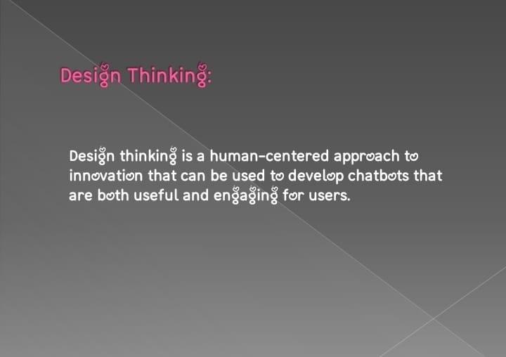

Slide 7
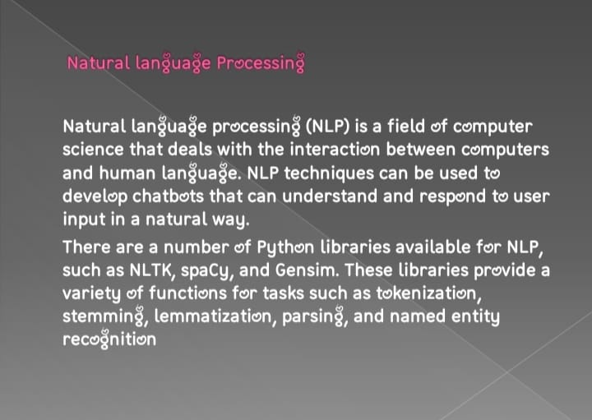

Slide 8
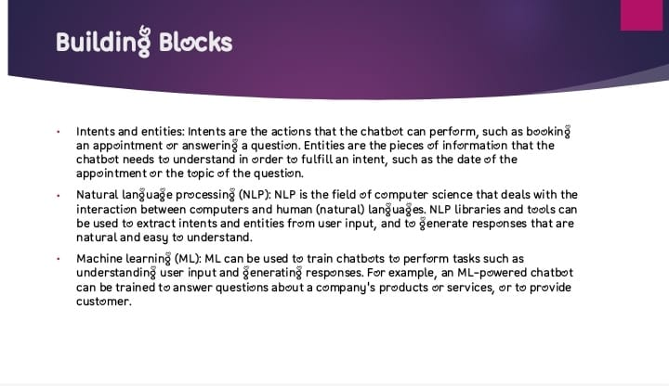

Slide 9
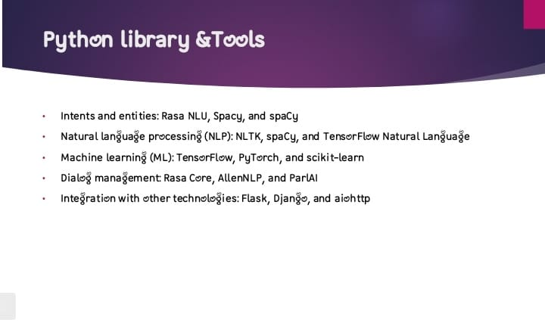

Slide 10
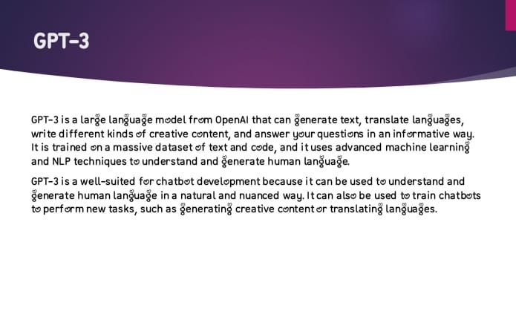

Slide 11
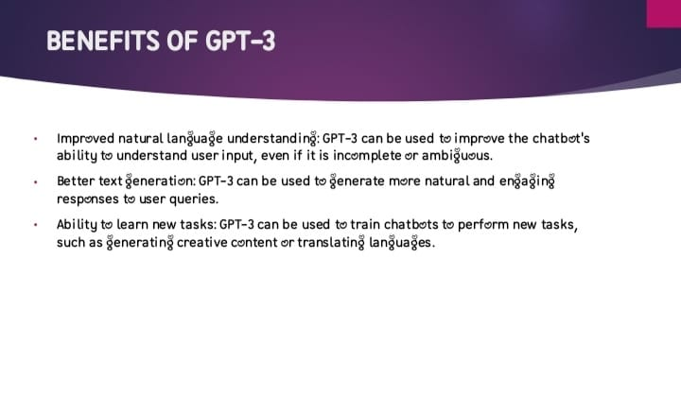

Slide 12
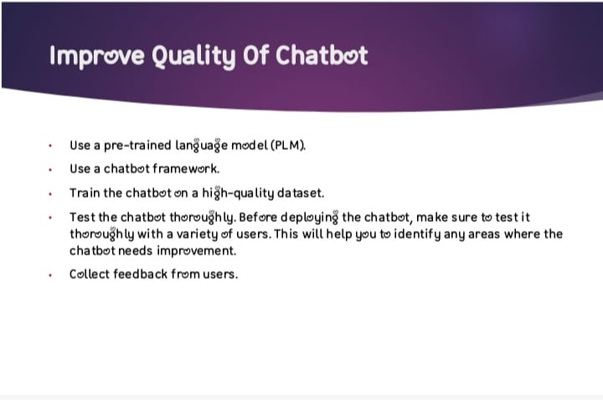

Slide 13
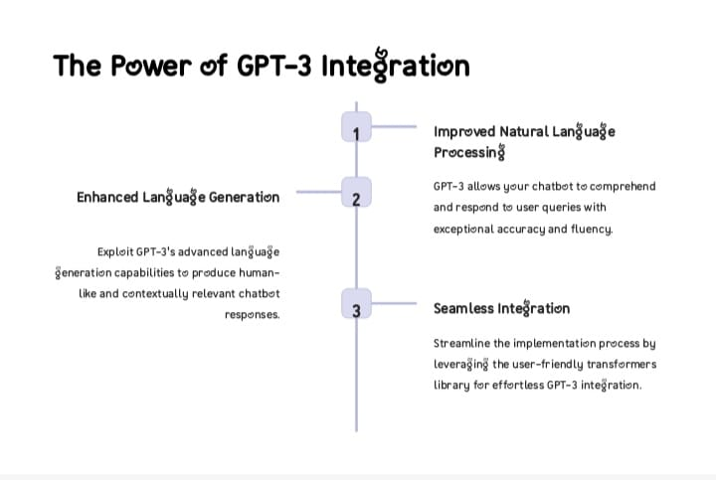

Slide 14
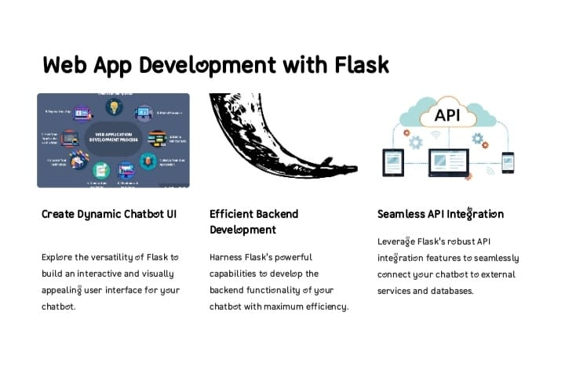

Slide 15
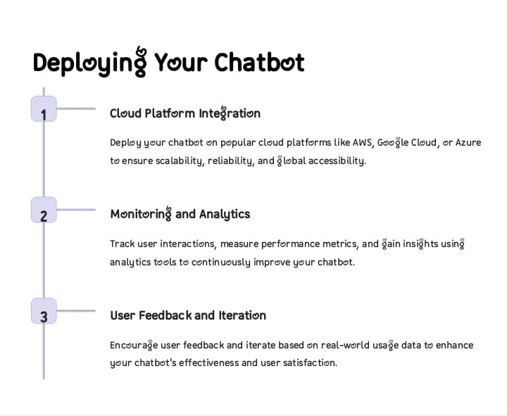

Slide 16
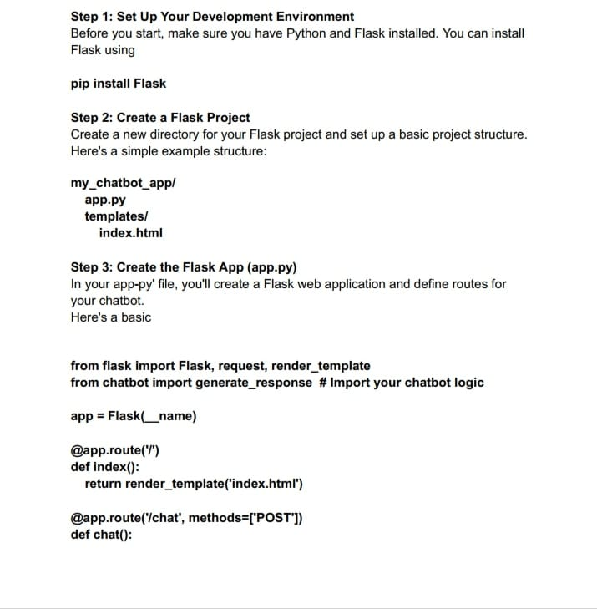

Slide 17
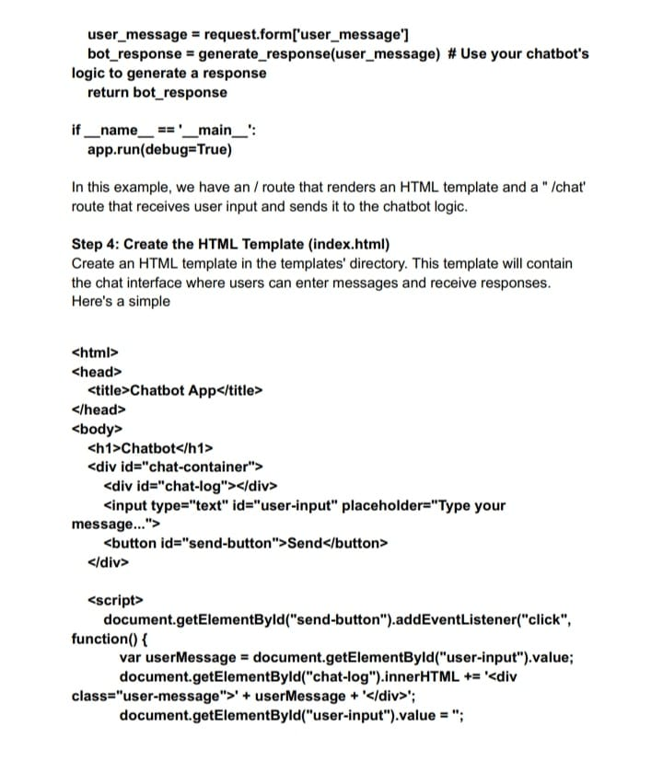

Slide 18
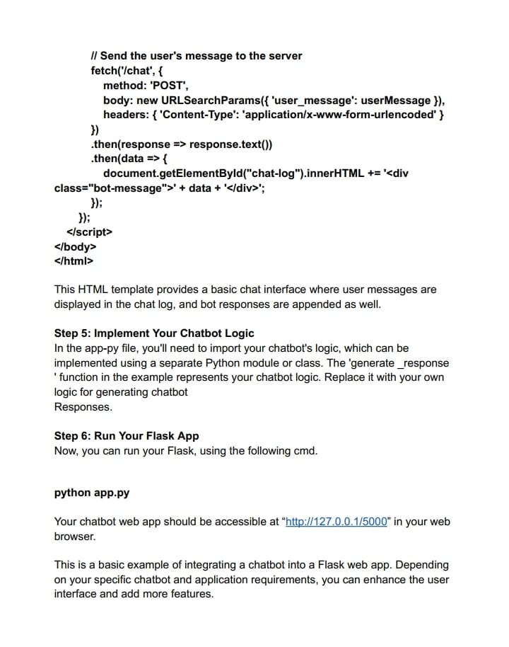

Slide 19
CONCLUSION
In conclusion, creating a chatbot using Python for AI is a dynamic and forward-thinking endeavor that can provide a competitive edge, improve user engagement, and drive efficiency in a wide range of industries. By harnessing the power of Python’s AI and NLP capabilities, you can develop chatbots that can provide intelligent and personalized interactions, contributing to a better user experience and operational success.

