Slide 1

SMART WATER FOUNTATION

Slide 2
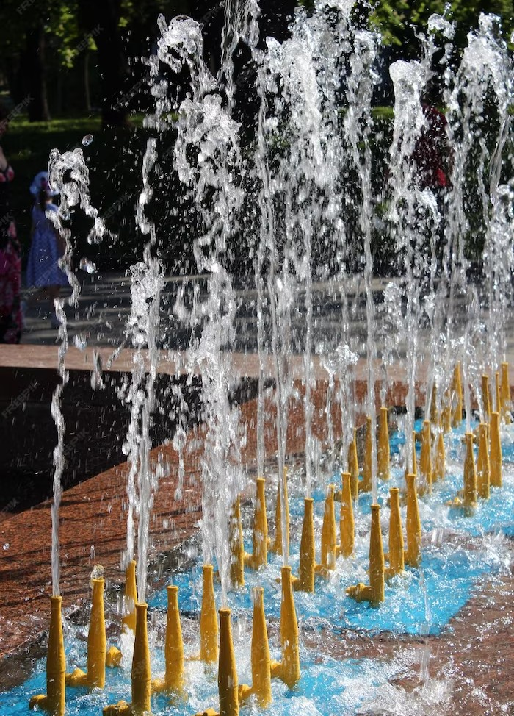
Introduction
01.
About the project
02.
Project Timeline
03.
Deﬁning a target
04.
Where we are

Slide 3
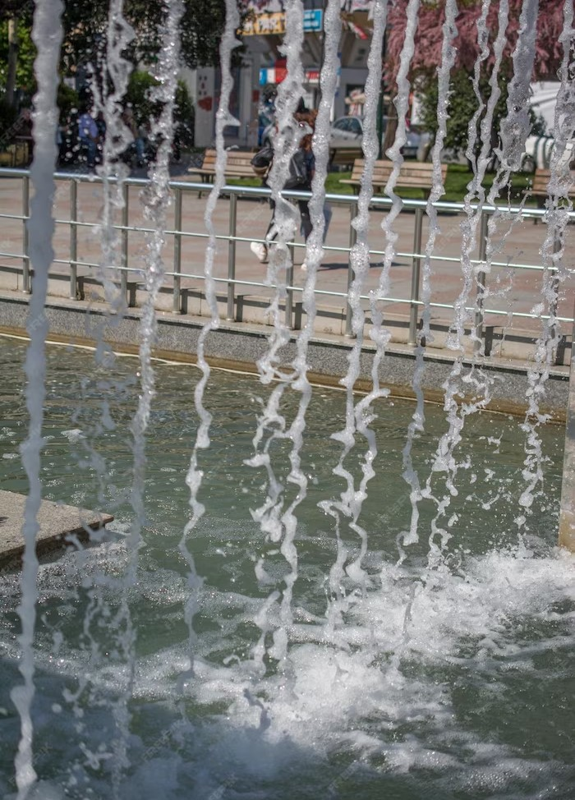
01.
The Need for Smart Water Fountains
About the project
02.
Project Timeline
03.
Deﬁning a target
04.
Where we are

Slide 4
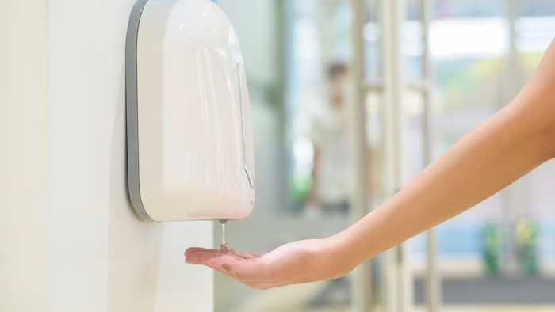
Smart water fountains use advanced technology to provide clean and safe drinking water. They are equipped with sensors that monitor water quality and ensure that it meets the highest standards. Some smart water fountains also have features like bottle-ﬁlling stations and touchless dispensers, making them more convenient and user-friendly.

Slide 5

01.
Beneﬁts of Smart Water Fountains
About the project
02.
Project Timeline
03.
Deﬁning a target
04.
Where we are

Slide 6
Deﬁning a target
Smart Water Fountains and Public Health
Access to clean and safe drinking water is essential for good health. Smart water fountains can help improve public health by providing easy access to clean and safe drinking water.
They can also help reduce the risk of waterborne diseases, which are a major public health concern in many parts of the world.
Aquarius is one of the oldest constellations. Its name means “water bearer,” and its symbol is a representation of water.
2.
Capricornus is the smallest constellation in the zodiac. Its name means “horned goat” and is represented by a goat with a ﬁshtail.
3.
Aries is one of the zodiac constellations, and its symbol represents the ram’s horns. It’s unique because its image has changed over time.
4.
Cassiopeia is a constellation in the northern sky. It is easily recognizable due to its distinctive ‘W’ shape, formed by ﬁve bright stars.

Slide 7
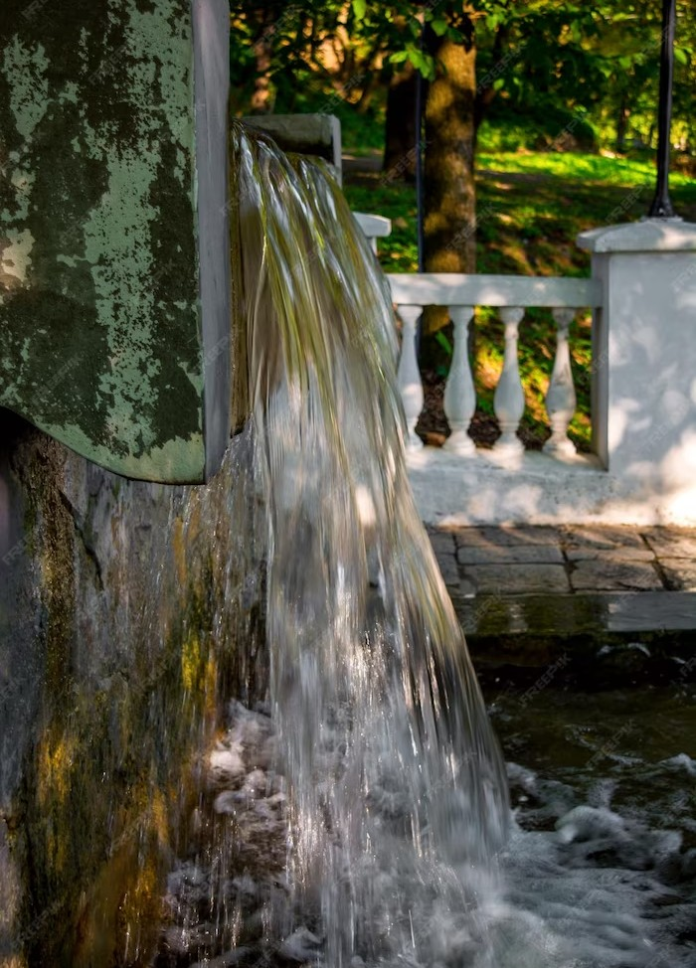
01.
Smart Water Fountains and Sustainability
About the project
02.
Project Timeline
03.
Deﬁning a target
04.
Where we are

Slide 8
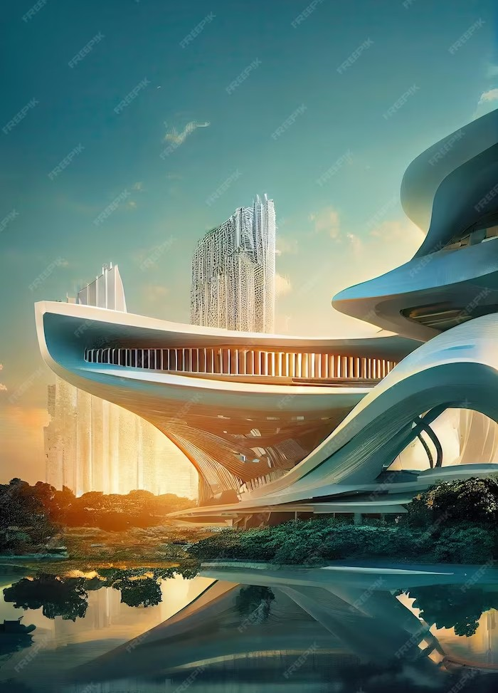
01.
Smart Water Fountains and the Future
About the project
02.
Project Timeline
03.
Deﬁning a target
04.
Where we are

Slide 9
Deﬁning a target
Challenges and Limitations
While smart water fountains offer many beneﬁts, there are also some challenges and limitations to their use. These include the cost of installation and maintenance, the need for reliable access to clean water sources, and the potential for vandalism and misuse. It is important to address these challenges in order to maximize the beneﬁts of smart water fountains.
Aquarius is one of the oldest constellations. Its name means “water bearer,” and its symbol is a representation of water.
2.
Capricornus is the smallest constellation in the zodiac. Its name means “horned goat” and is represented by a goat with a ﬁshtail.
3.
Aries is one of the zodiac constellations, and its symbol represents the ram’s horns. It’s unique because its image has changed over time.
4.
Cassiopeia is a constellation in the northern sky. It is easily recognizable due to its distinctive ‘W’ shape, formed by ﬁve bright stars.

Slide 10

Case Studies
01.
About the project
02.
Project Timeline
03.
Deﬁning a target
04.
Where we are

Slide 11

Conclusi on
Where we are
Smart water fountains are an innovative solution to the problem of access to clean and safe drinking water. They offer a range of beneﬁts, including improved public health, reduced plastic waste, and cost savings. While there are some challenges and limitations to their use, the beneﬁts far outweigh the costs. As more and more cities and public spaces adopt smart water fountains, we can look forward to a healthier and more sustainable future.

Slide 12
Thanks!
Do you have any questions?

