Slide 1

Customer Churn Analysis
Telecom subscription business · SQL + Python + Power BI · Descriptive analytics only
7,043 CUSTOMERS
21 COLUMNS

Slide 2

The Business Problem
In a monthly subscription model, every departing customer takes recurring revenue with them. Leadership needs to know who is leaving, when, and what can be done — using only descriptive analytics.
Churn Rate
Risk Segments
What is the overall rate, and how much MRR does it cost?
Which contract types, services, and payment methods drive the most churn?
Lifecycle Timing
At what point do customers leave, and which segment should retention target first?

Slide 3

The Dataset
IBM Telco Customer Churn
A widely used sample dataset — one row per customer, ready for end-to-end analysis.
7,043 customers across 21 columns
Target: Churn (Yes/No — left in the last month)
Key features: tenure, contract type, internet service, tech support, payment method, monthly charges
Available on Kaggle and IBM's public GitHub

Slide 4

Data Cleaning in Python
Eight steps transform the raw CSV into a clean, analysis-ready file. The cleaned output feeds both SQL and Power BI.
Load & Inspect
Standardize
Read CSV; check dtypes (TotalCharges text)
Rename to snake_case; merge "No internet service"
Diagnose & Fix
Enrich & Export
Coerce numeric; fill 11 NaNs where tenure=0
Create churn_flag, tenure_group; export telco_clean.csv
Result: 7,043 rows, 24 columns, zero missing values — ready for SQL and Power BI.

Slide 5
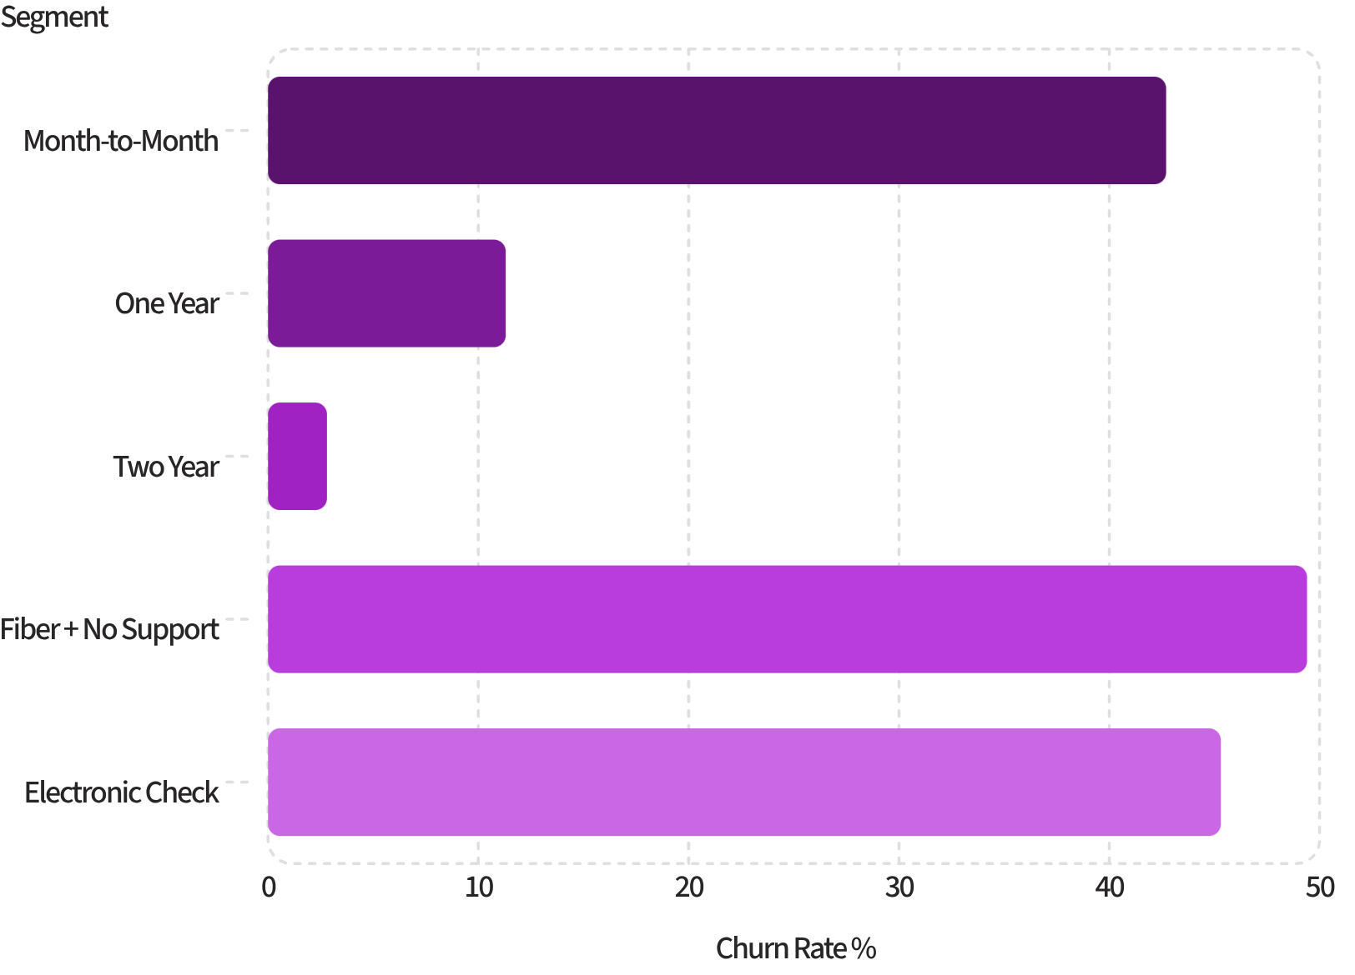
Key SQL Findings
What the Queries Reveal
26.5% of customers churned — 1,869 of 7,043
Month-to-month contract: 42.7% churn vs. 2.8% for two-year
Fiber + no tech support: 49.4% — highest service mix
Electronic check payers: 45.3% churn rate
Month-to-month accounts for 88.6% of all churners

Slide 6
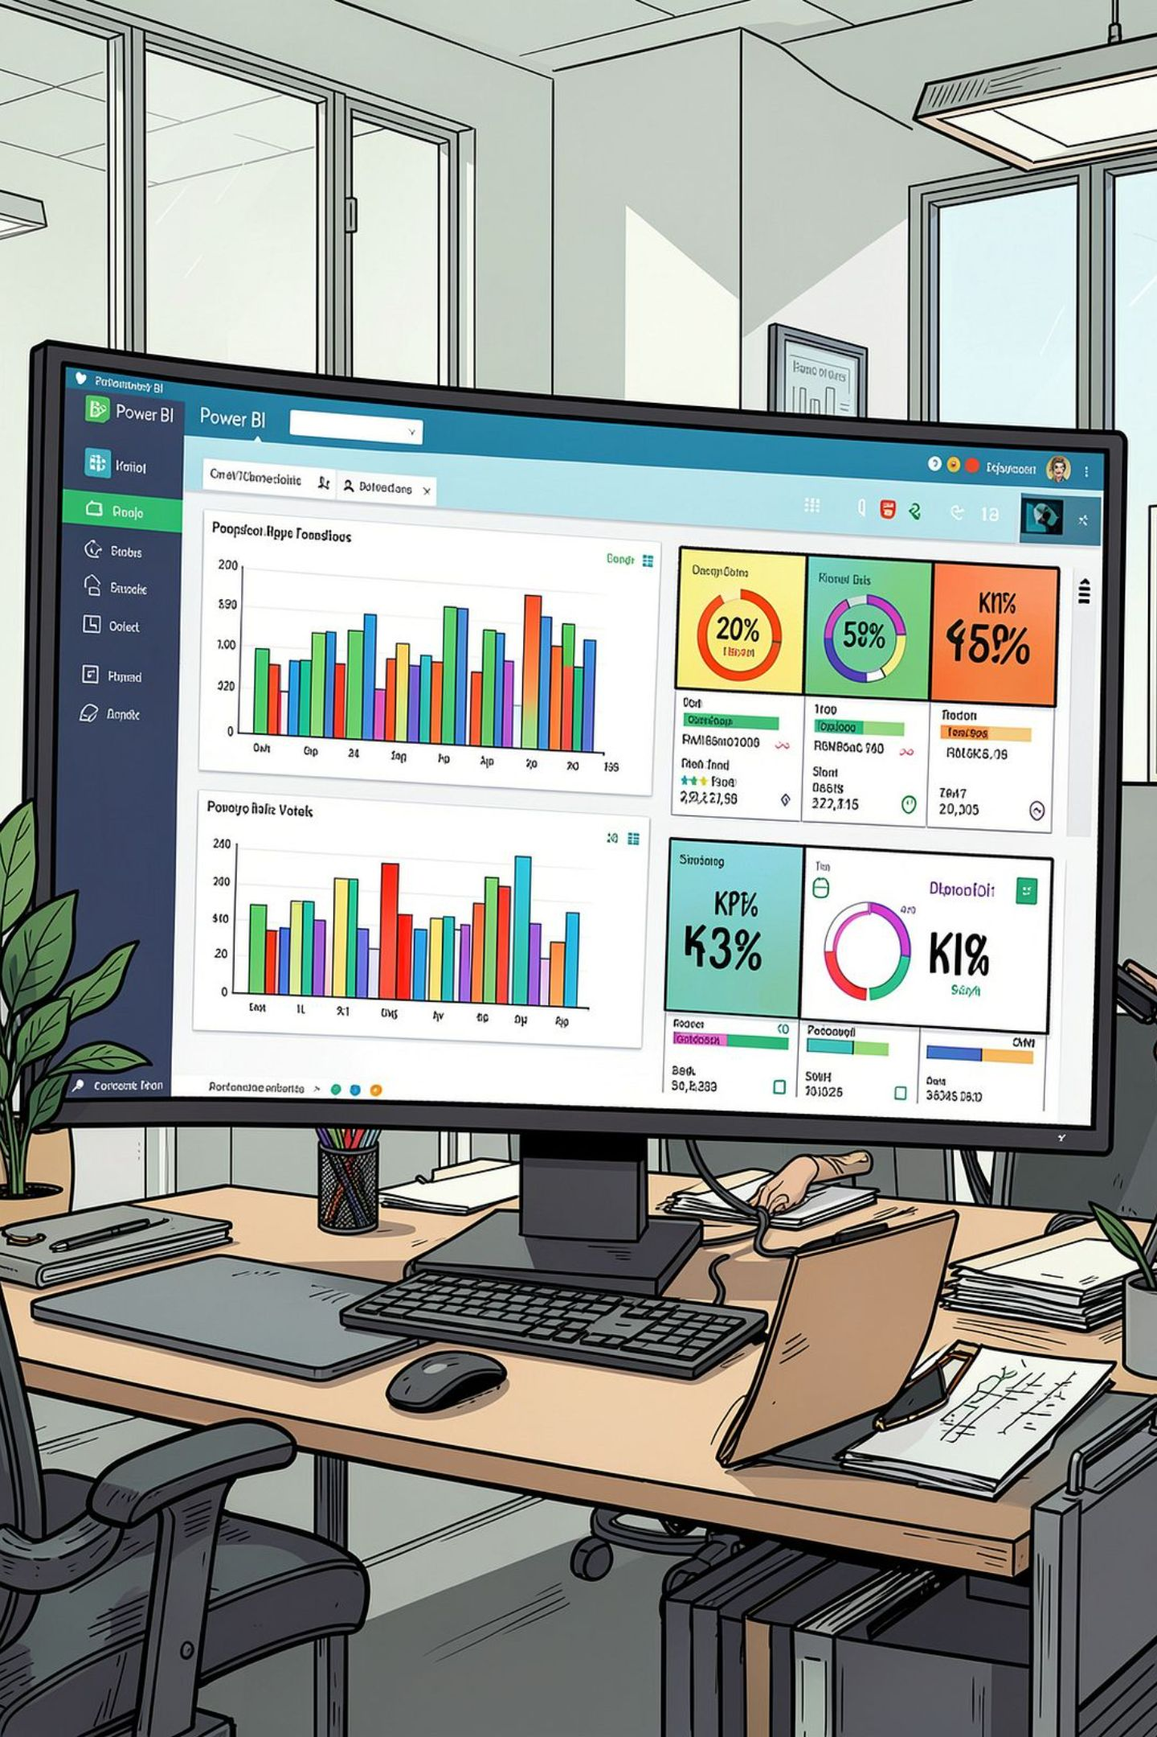


Power BI Dashboard
Eight visuals tell the full churn story — from headline KPIs to a segmented heatmap.
KPI Cards
1
Total customers, churn rate %, MRR lost, MRR lost %
Contract & Lifecycle
2
Clustered bars for contract effect; column chart for tenure-group drop-off
Service Mix & Payment
3
Internet × tech support breakdown; payment method risk bars
Heatmap Matrix
4
Contract × internet service with gradient conditional formatting — the 57.5% cell stands out

Slide 7
The Scale of the Problem
26.5%
$139K
Overall Churn Rate
MRR Lost
1,869 of 7,043 customers left
30.5% of $456K total recurring revenue
47.4%
55%
First-Year Churn
Of All Churners
Highest rate of any tenure segment
Left within their first 12 months
Churned customers averaged $74.44/month vs. $61.27 for retained — the company is losing its highest-value accounts.

Slide 8
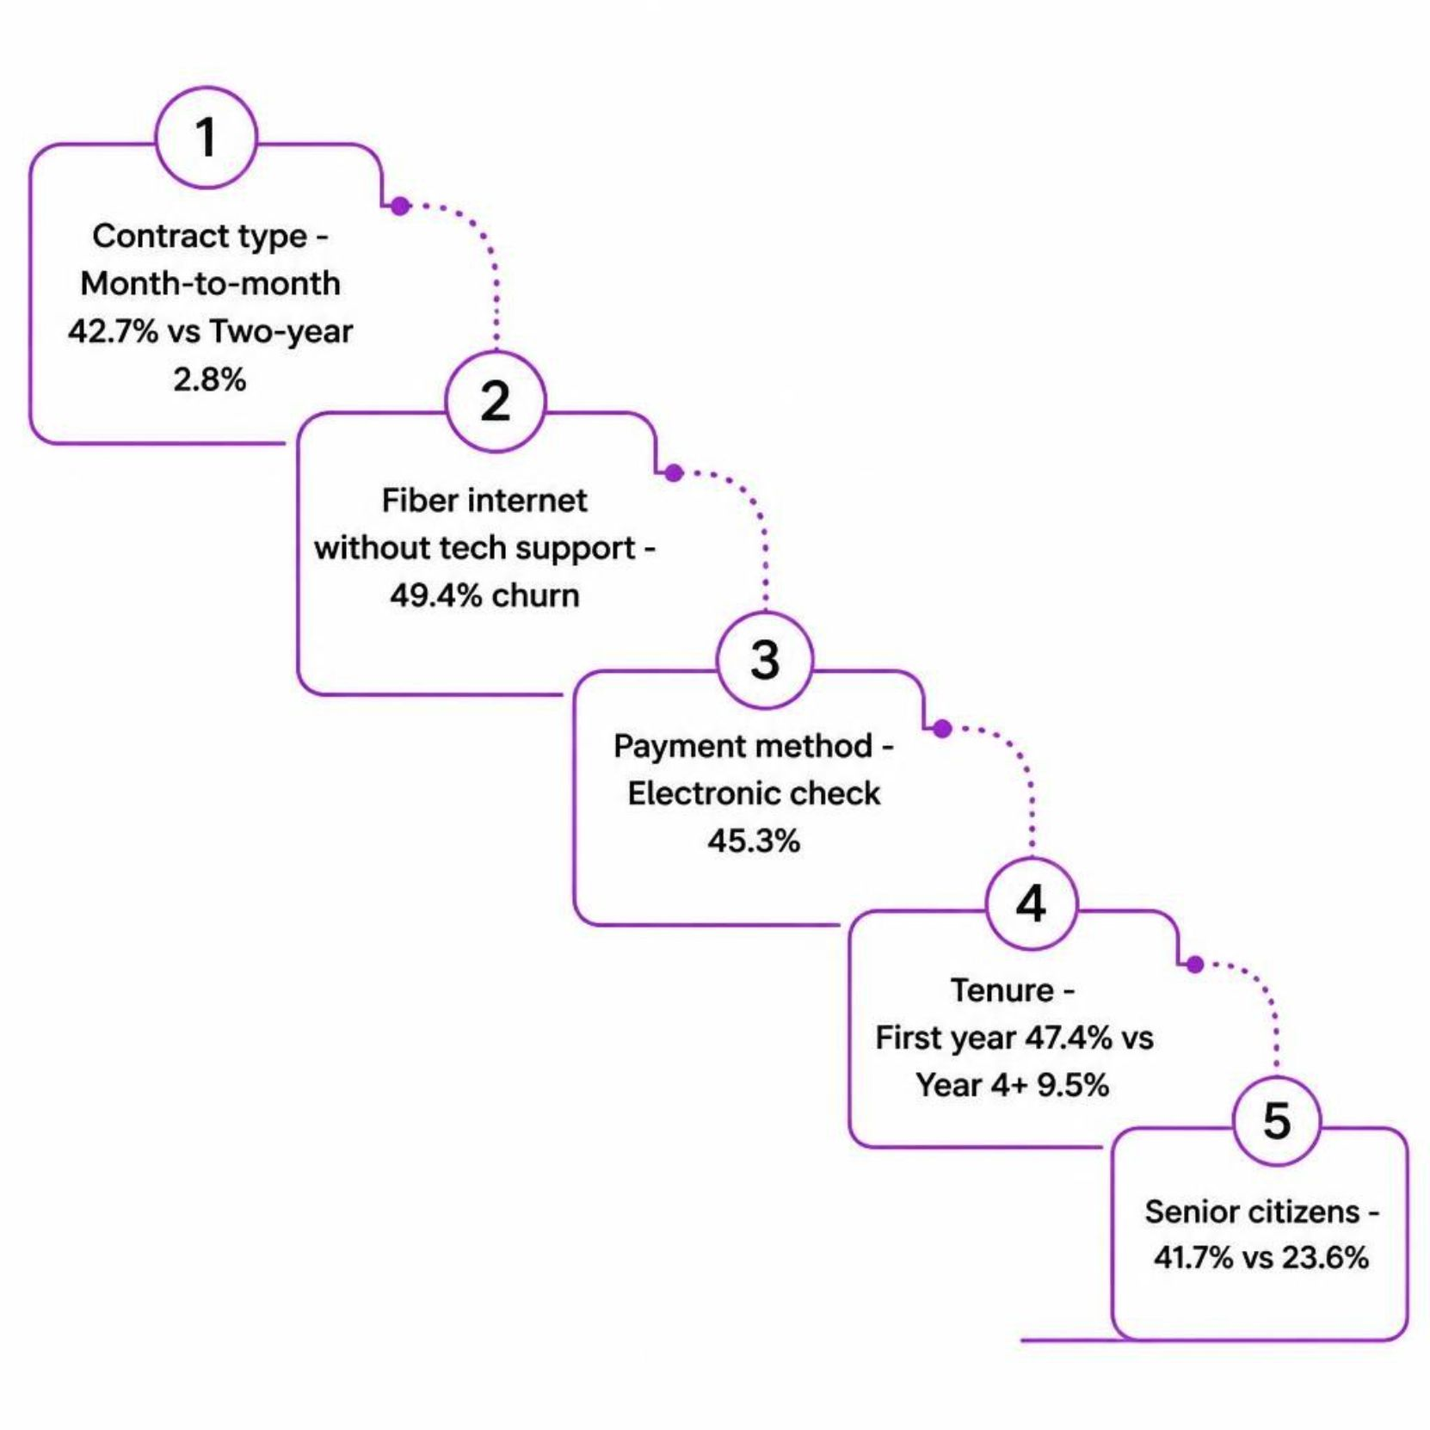
What Drives Churn
Key Patterns
Contract length is the single strongest lever — month-to-month drives 88.6% of all churn
Fiber customers churn at 41.9% vs. 19.0% for DSL — worth investigating pricing or quality
Tech support and online security are protective: no support = 41.6% churn vs. 15.2% with it
Automatic payments correlate with retention — electronic check is a clear red flag

Slide 9



Priority Segment & Recommendations
Top Target: Month-to-month + Fiber + No Tech Support — 1,796 customers, 57.5% churn, 55% of all churners, $88K of lost MRR.
Convert to Annual Plans
Offer a discount or free month — contract length is the strongest lever.
Bundle Support for New Fiber Customers
Free tech support and online security for 3–6 months.
90-Day Onboarding Program
Check-in calls and setup help — over half of churn happens in year one.
Promote Automatic Payments
Bill credit for switching from electronic check to bank transfer or card.

Slide 10
Limitations & Next Steps
What This Analysis Cannot Do
Portfolio Tip
Shows association, not causation — fiber churn may reflect price or coverage gaps not in the data
Contract, payment method, and paperless billing overlap — effects are not independent
Single snapshot — no time trends or prediction attempted
Package the full project in one GitHub repo:
clean.py — Python cleaning script
queries.sql — all seven SQL queries
churn_dashboard.pbix — Power BI file
Dashboard screenshot + README summary

