Slide 1
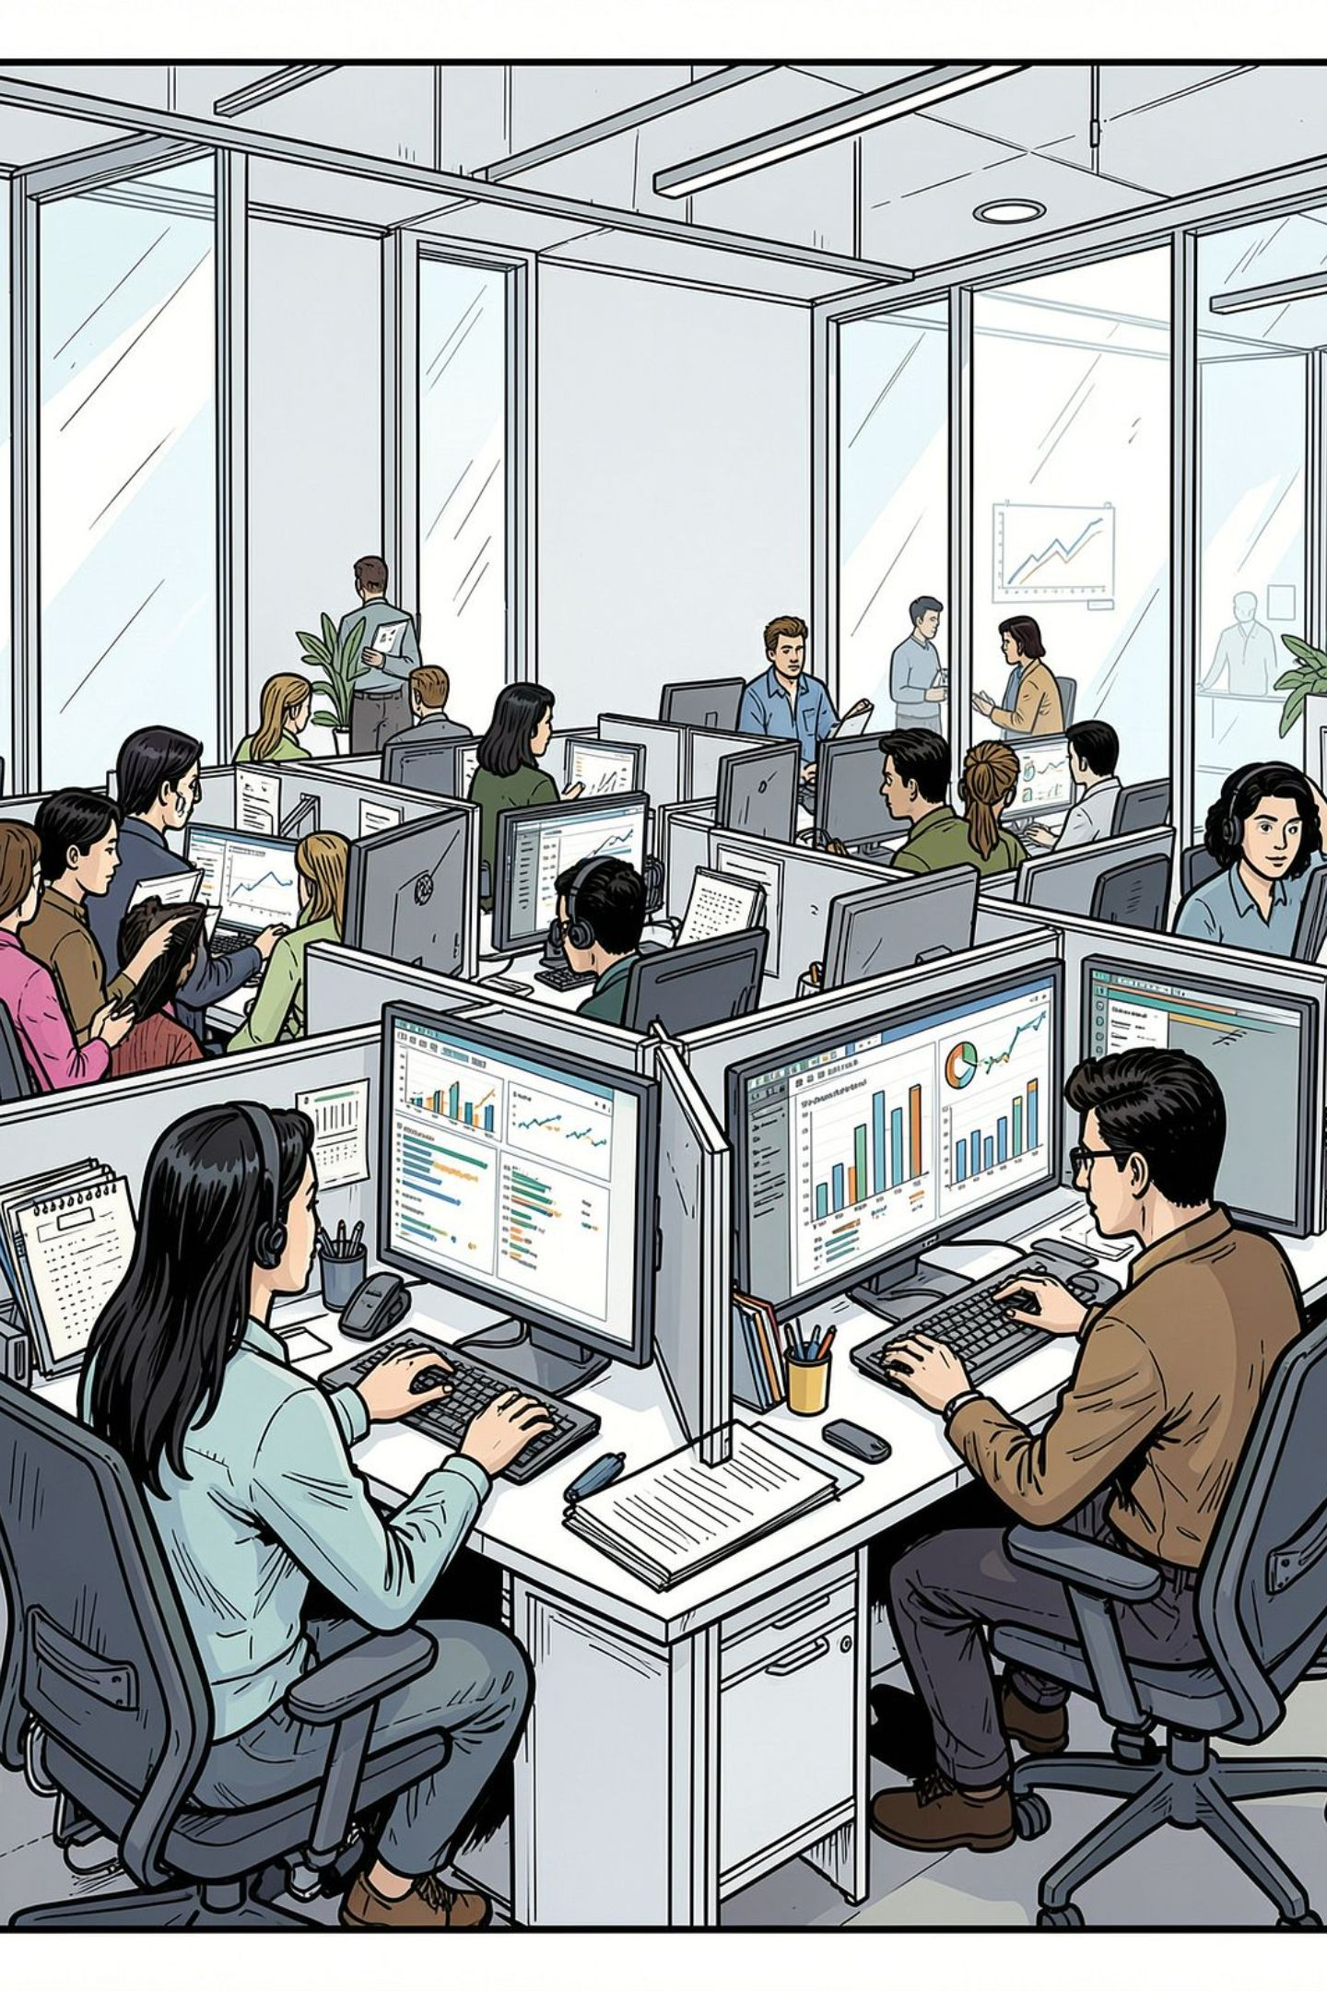
Support Ticket Root Cause Analysis
Identifying persistent issues vs. rapidly emerging problems — a data-driven approach to customer operations
CUSTOMER OPERATIONS
ROOT CAUSE ANALYSIS
POWER BI · SQL · PYTHON

Slide 2


The Business Challenge
What Leadership Needs to Know
Persistent Issues
High-volume, stable categories — chronic pain points demanding structural fixes
Emerging Problems
Low-volume but fast-growing categories — early warning signals
Operational Impact
Resolution time, SLA breaches, and satisfaction scores by category

Slide 3
Data Cleaning: 9-Step Foundation
Clean data before analysis — every metric depends on it.
01
02
03
Validate Ticket ID uniqueness
Convert dates to datetime
Standardize type, status, priority, channel
04
05
06
Inspect missing values
Convert resolution time to numeric
Check impossible durations
07
08
09
Create month/week fields
Create SLA flag
Separate open/pending from resolved

Slide 4
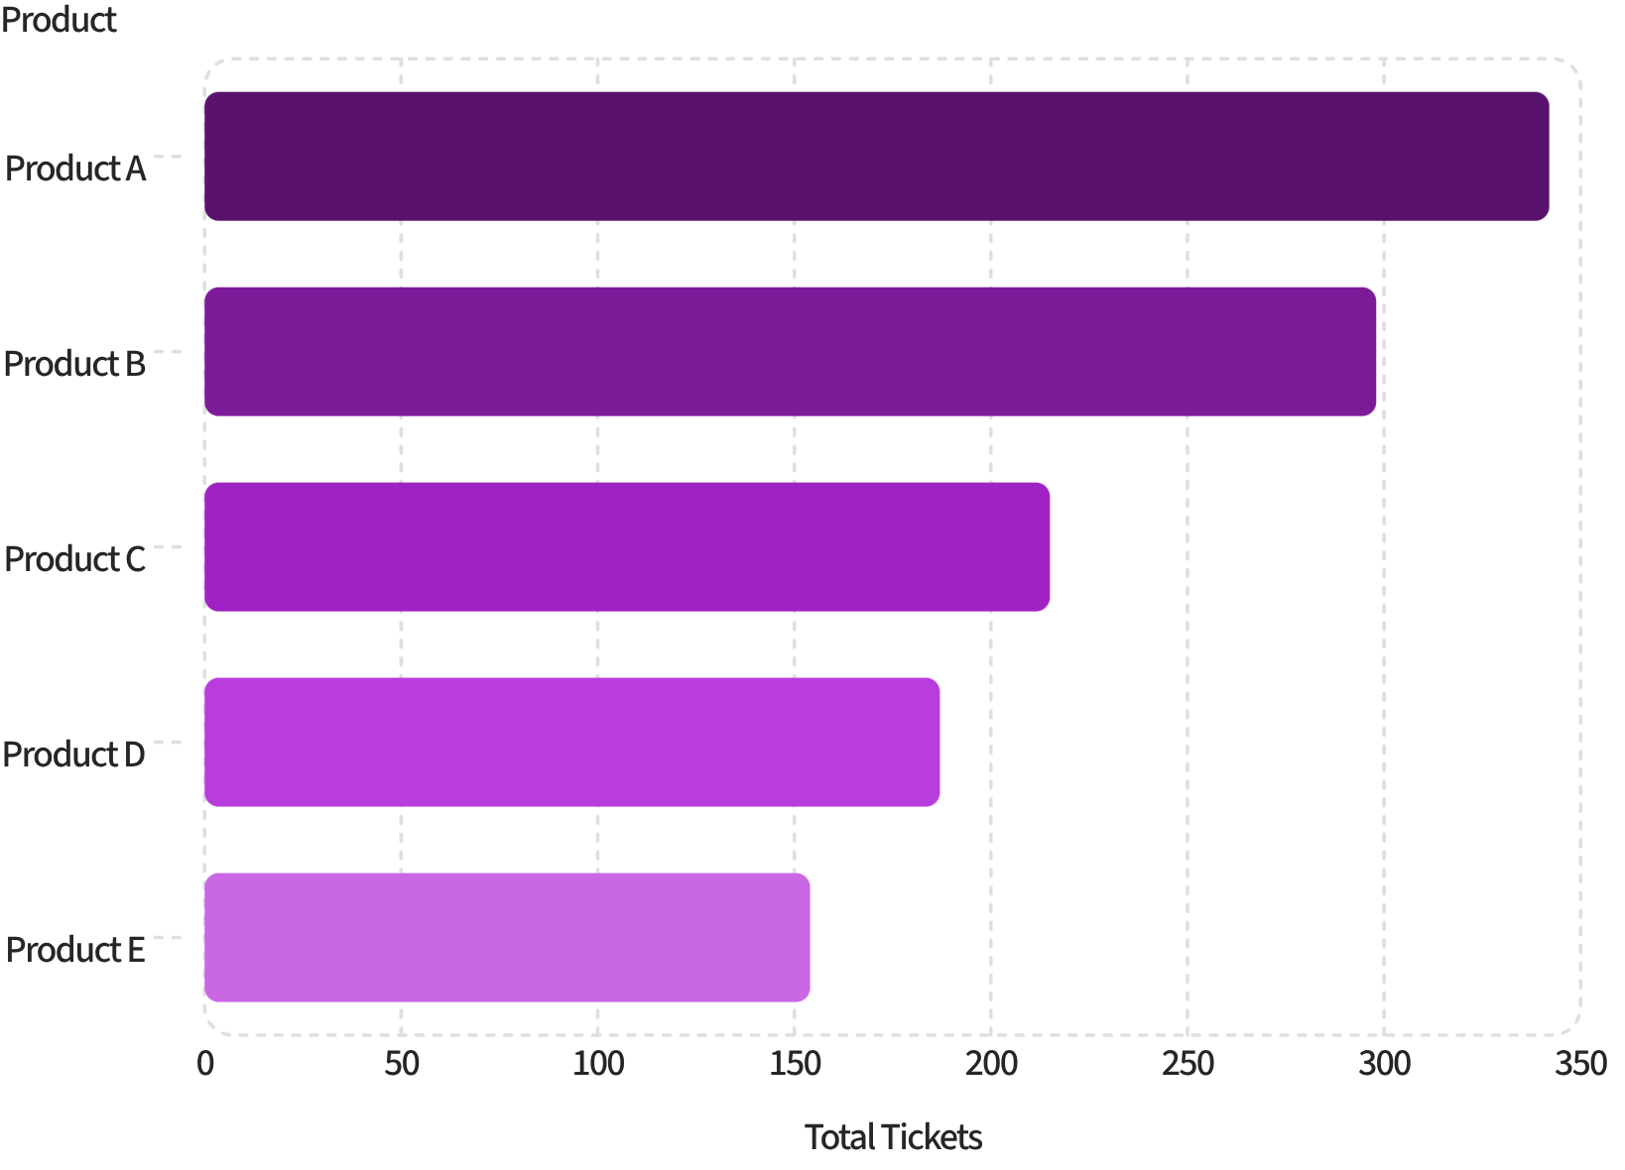
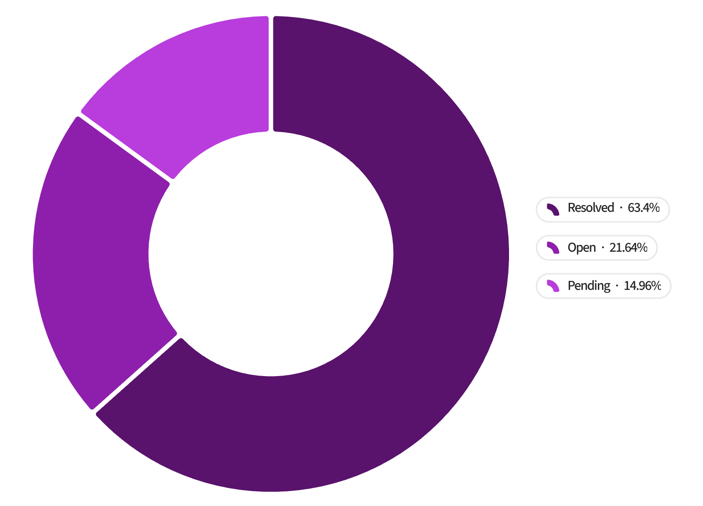
SQL Analysis: Volume & Status
Top Products by Ticket Volume
Ticket Status Distribution
Products A & B drive the highest volume. ~34% of tickets remain unresolved — a key operational risk.

Slide 5
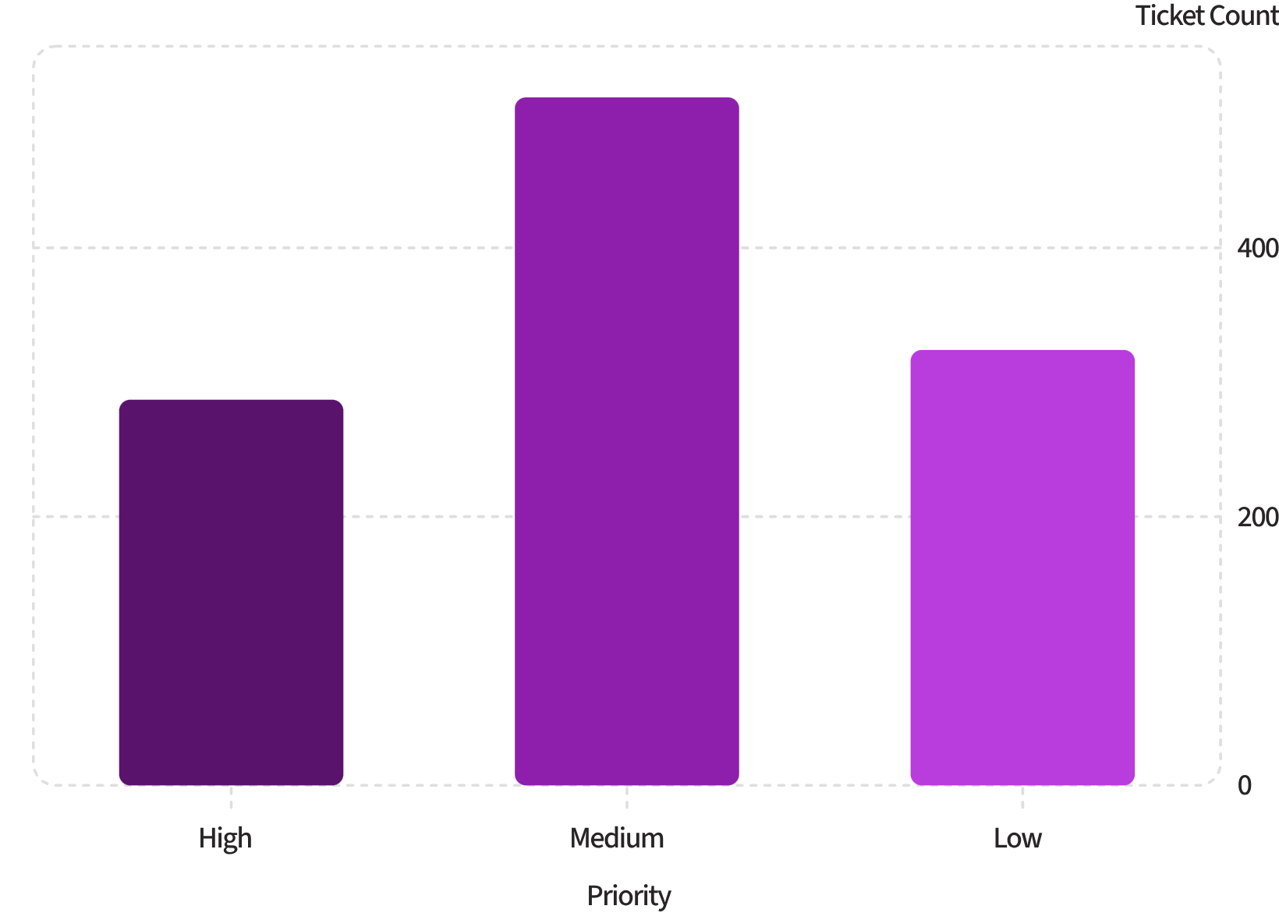
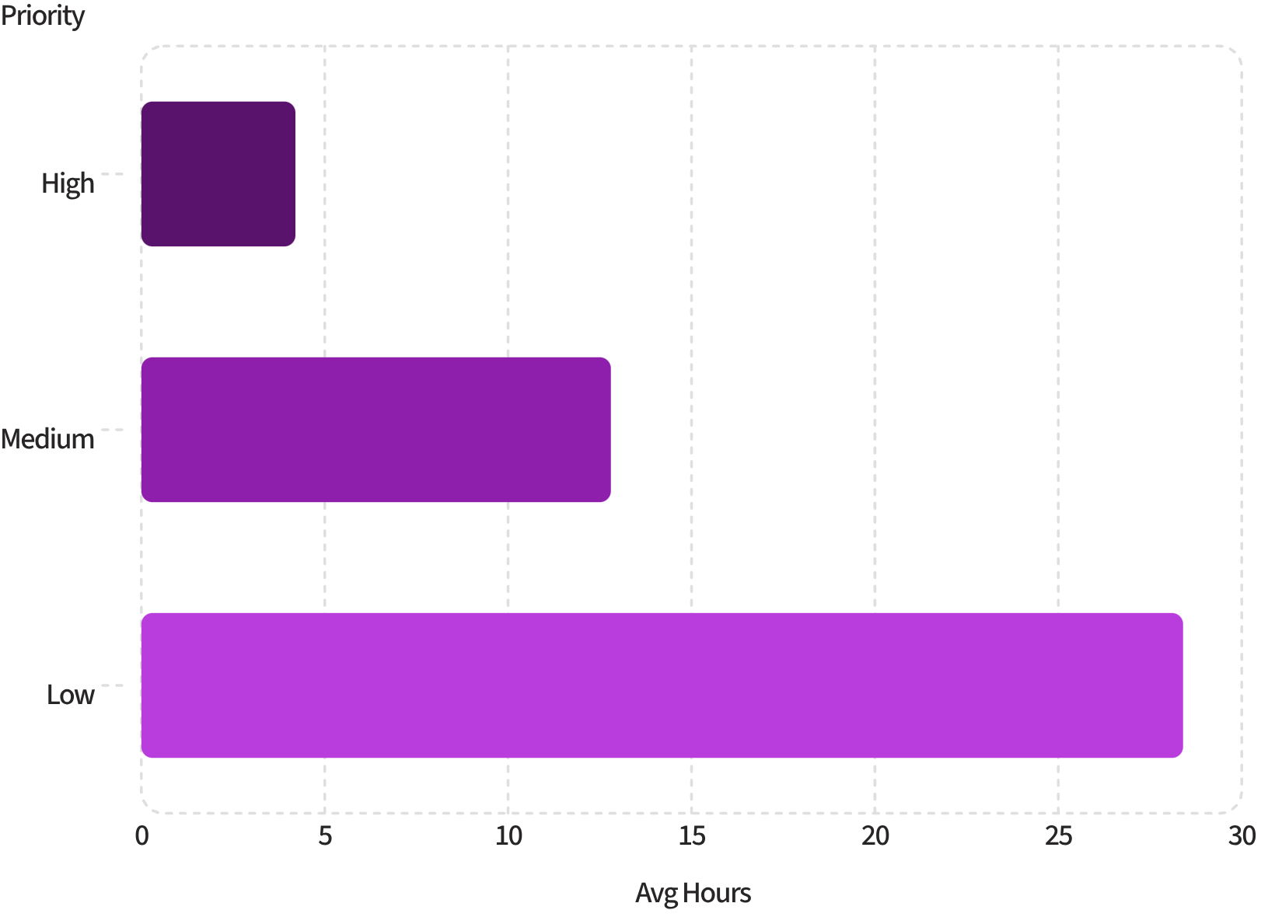

Priority Levels & Resolution Time
Tickets by Priority Level
Avg Resolution Hours by Priority
Low-priority tickets take 6.8× longer to resolve than high-priority — investigate triage rules.

Slide 6

Customer Satisfaction by Channel & Type
4.2
2.8
Top Channel Score
Lowest Channel Score
Email — highest satisfaction
Live Chat — needs attention
3.5
Overall Avg
Across all channels
Live Chat has the highest volume but the lowest satisfaction — a critical gap to close.

Slide 7
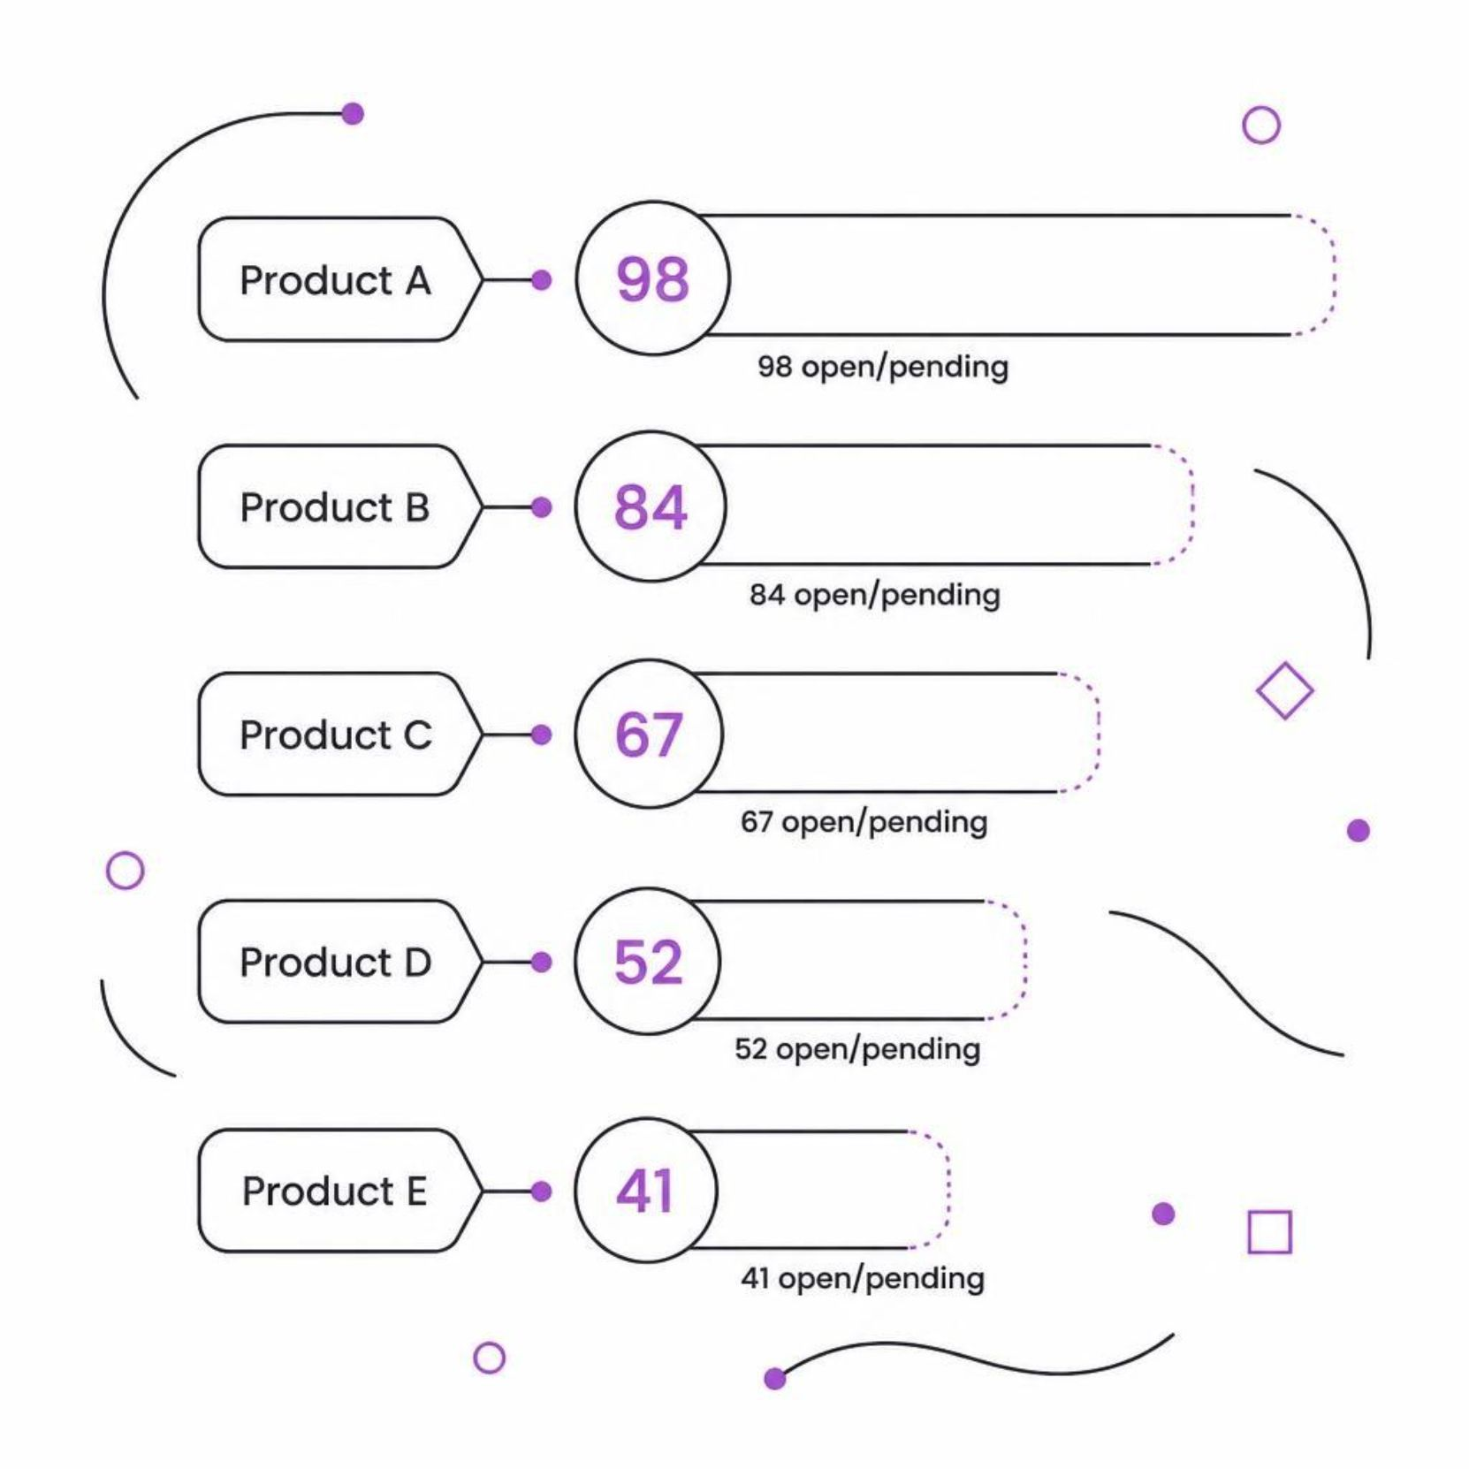
Unresolved Tickets: Where to Focus
Backlog Risk Concentration
Products A and B account for ~45% of all unresolved tickets. These require immediate escalation and dedicated resolution sprints.
Product A
Product B
98 open/pending
84 open/pending

Slide 8
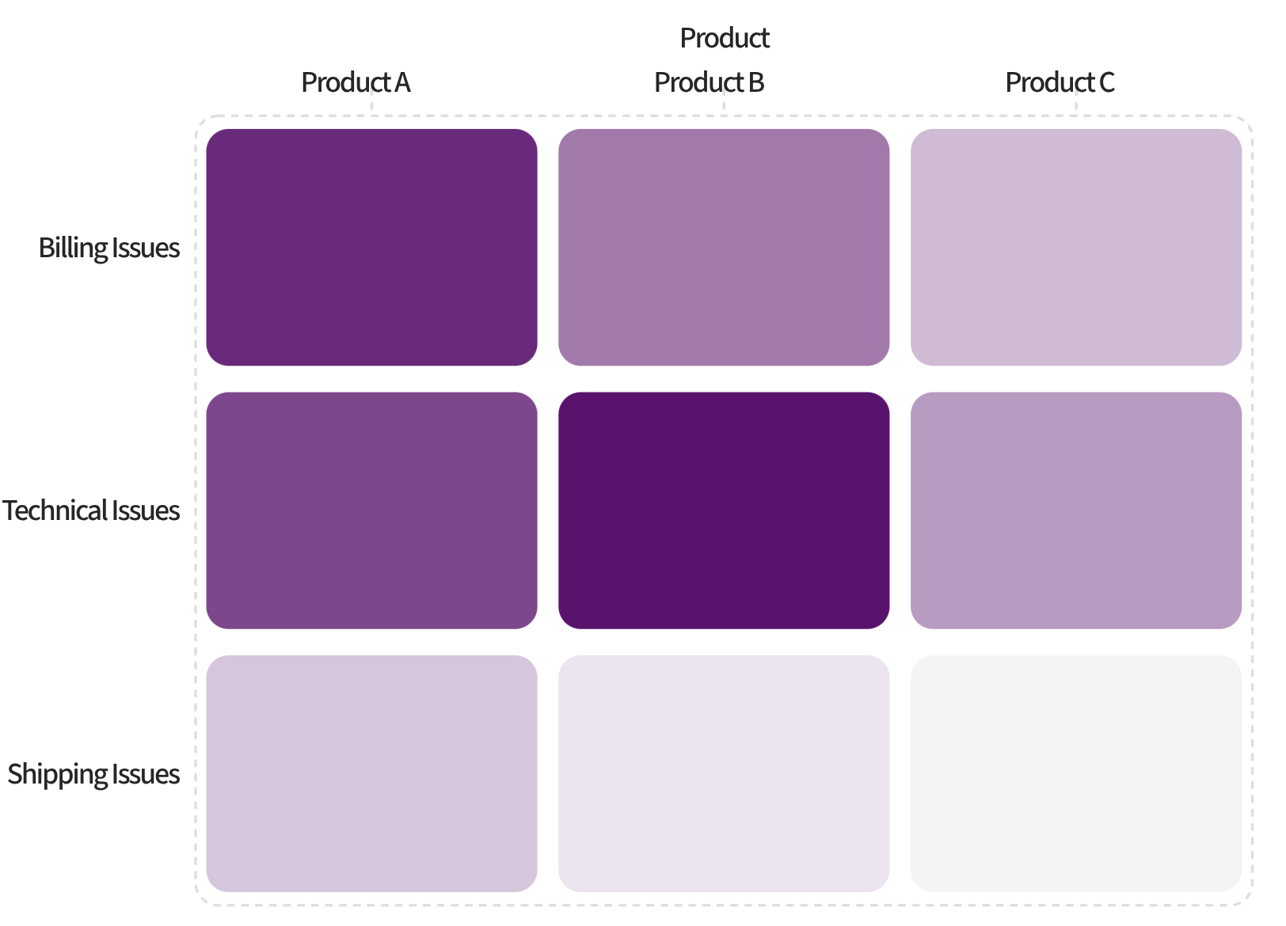

High-Volume + Low Satisfaction: Critical Combinations
Reading the Heatmap
Darker cells = more tickets. Product B + Technical Issues is the highest-volume, lowest-satisfaction combination — the #1 root-cause target.
Prioritize Product B technical root-cause investigation immediately.

Slide 9
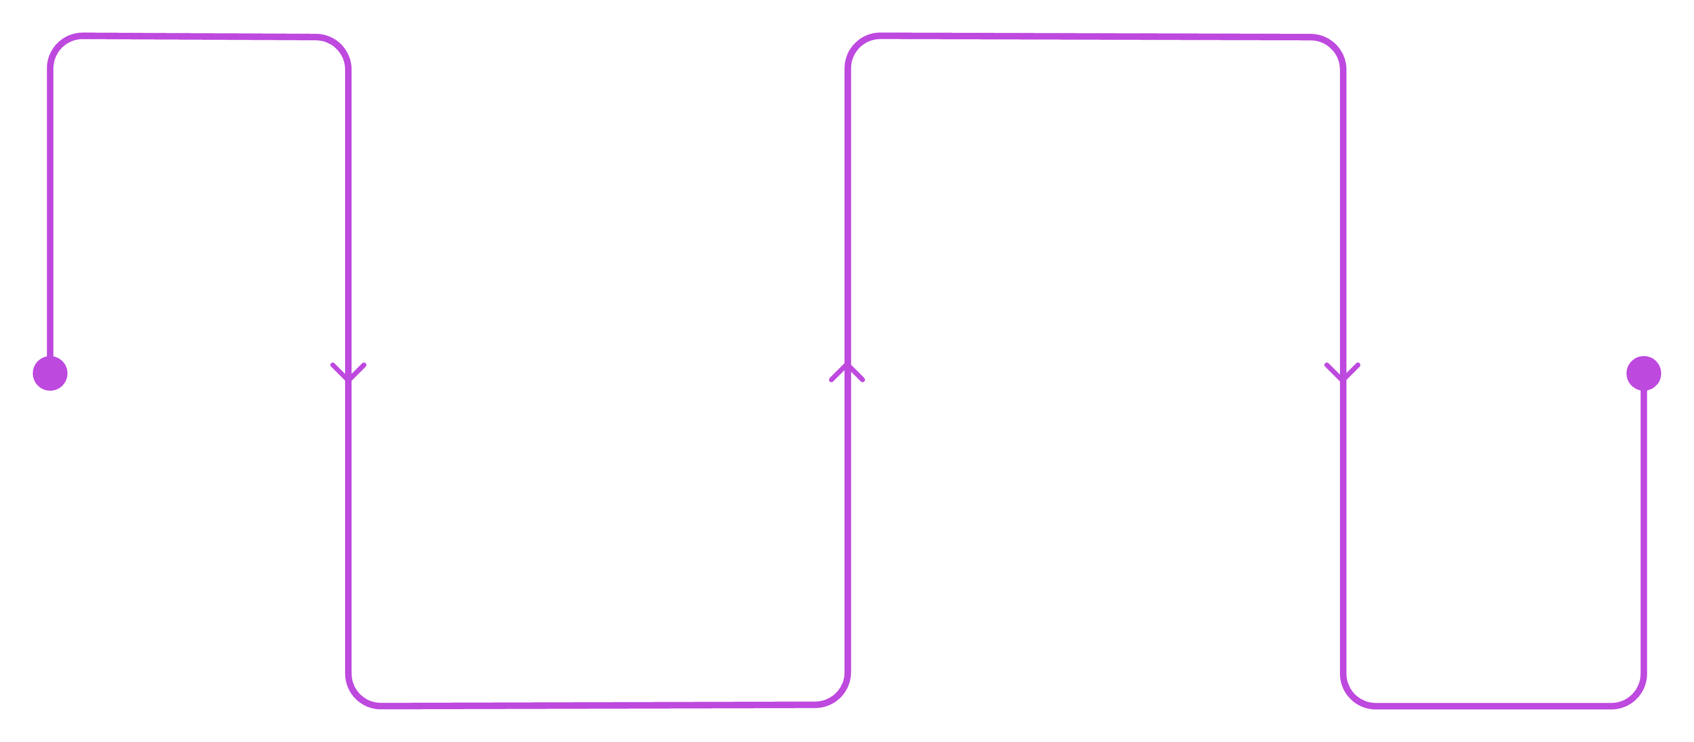
Recommended Dashboard Architecture
Diagnostic
Category split, channel KPIs, RT by priority, product issues
Executive KPI
Ticket trends, CSAT, SLA breaches, open count
Every chart maps directly to a business question. Build the KPI page first for leadership, then the diagnostic page for analysts.

Slide 10


Key Takeaways & Next Steps
Escalate Products A & B
Highest unresolved backlog — assign dedicated resolution teams
Fix Live Chat Experience
Highest volume, lowest satisfaction — audit scripts and training
Investigate Product B Technical Issues
Top volume + low satisfaction — likely systemic product defect
Monitor Emerging Categories
Track MoM growth to catch new issues before they scale

