Slide 1

END-TO-END PROJECT REPORT
Supply Chain & Manufacturing Analytics Platform
A centralized analytical solution connecting procurement, inventory, production, logistics, and demand planning — powered by SQL Server, Python, and Power BI. Designed for organizations experiencing rising logistics costs, stock-outs, supplier delays, and production downtime.

Slide 2
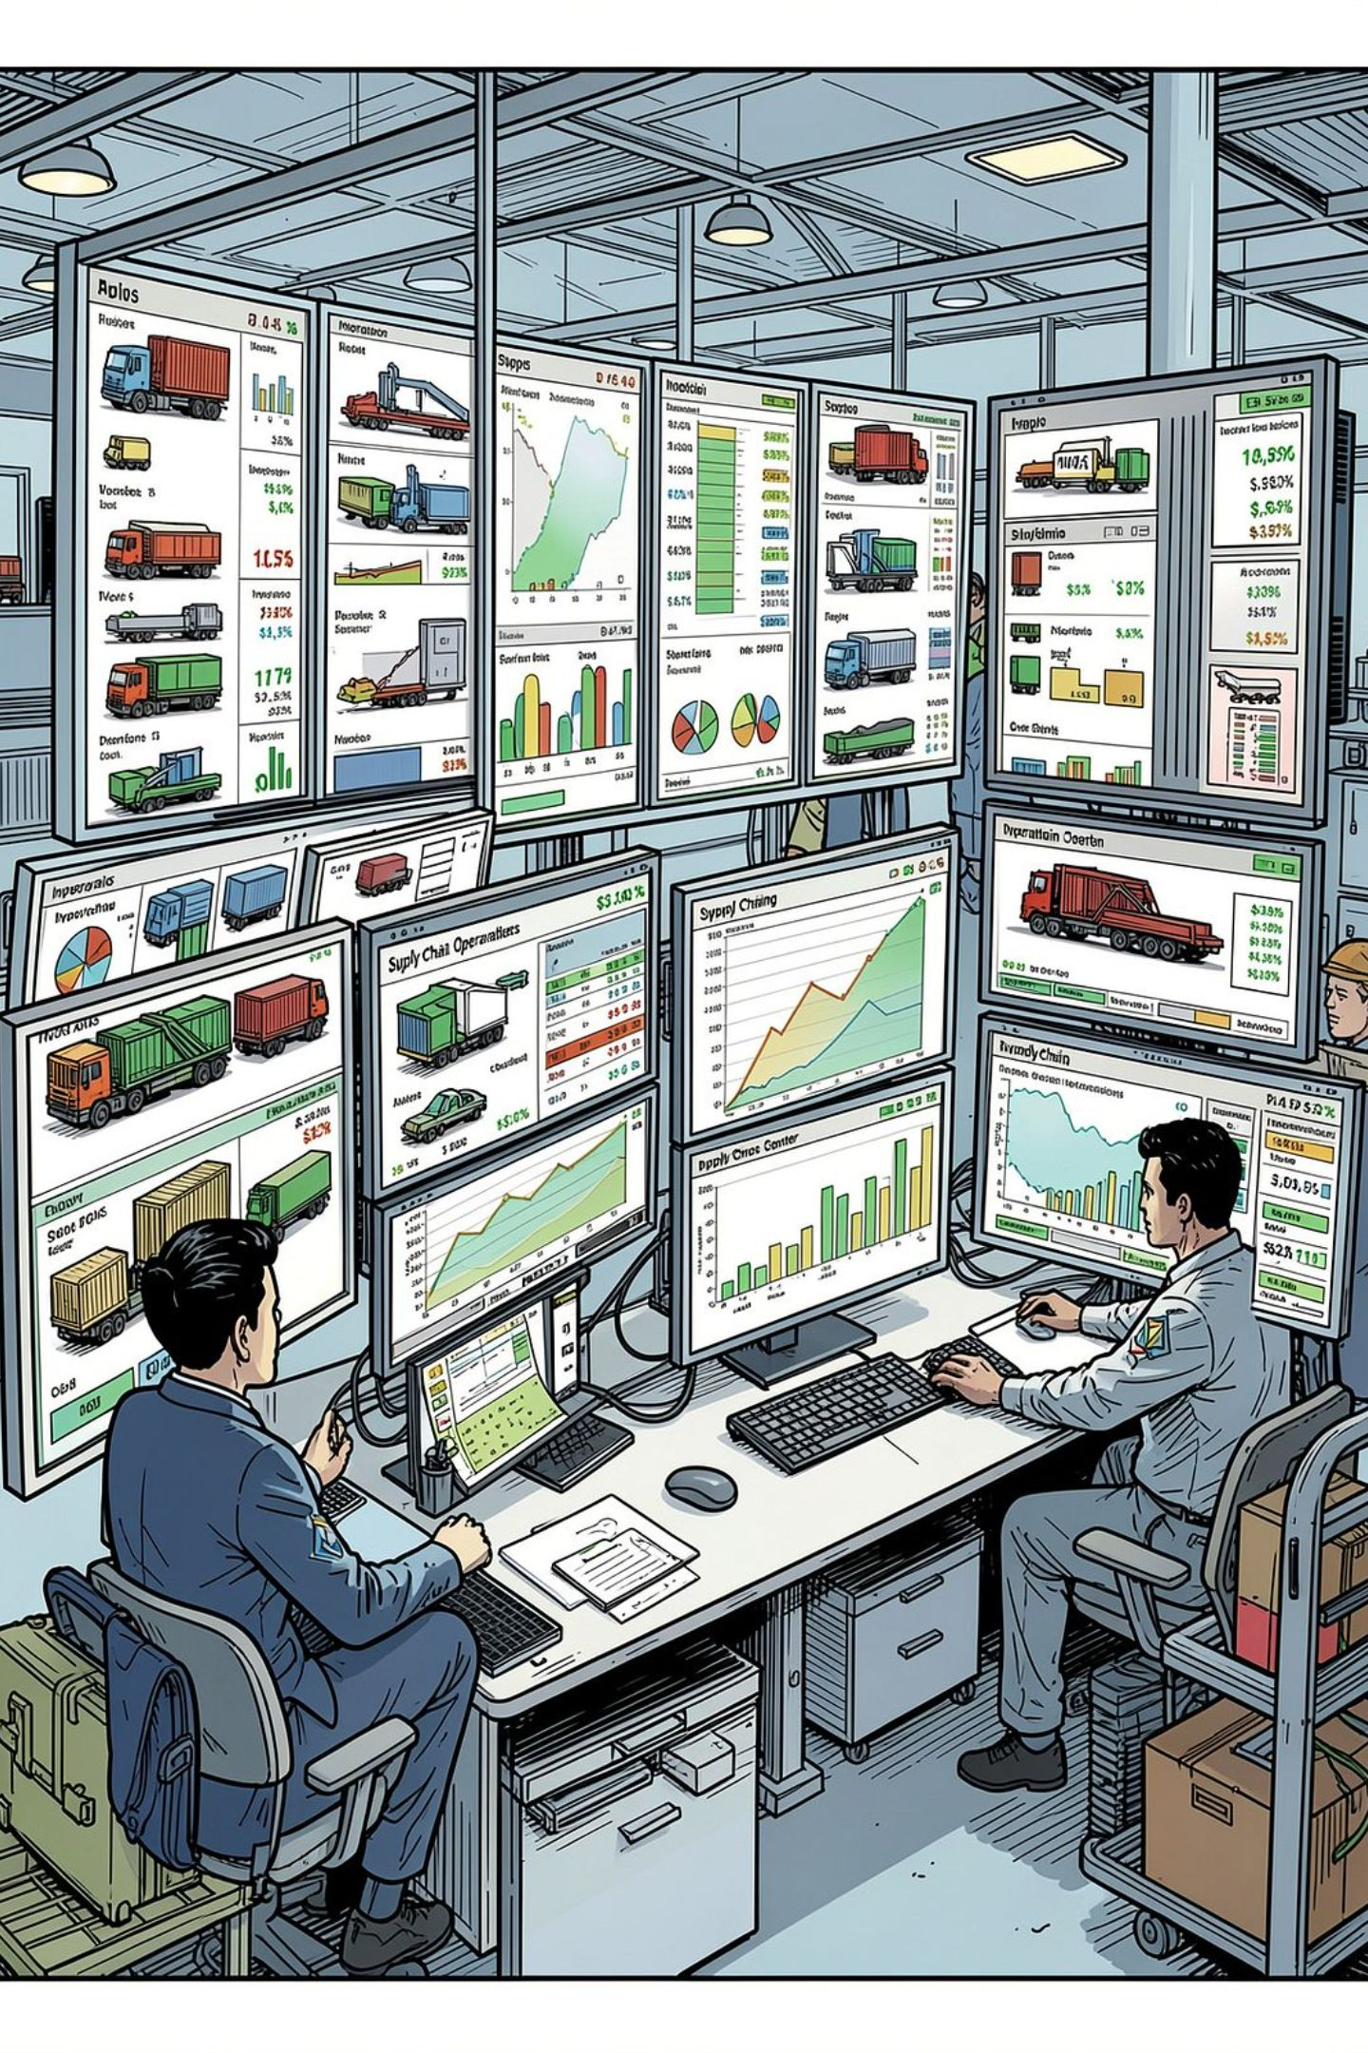
Business Challenges Driving This Solution
Rising Logistics Costs
Transport mode, delays, and inefficient routing erode margins without clear attribution.
Frequent Stock-Outs
Mismatch between demand, inventory policy, and supplier reliability creates service gaps.
Supplier Delivery Delays
Procurement uncertainty propagates into production scheduling and customer commitments.
Fragmented Data Sources
Disconnected CSV files prevent a consistent, auditable view of supply chain performance.

Slide 3

Target Solution Architecture
A layered platform separates raw ingestion from curated analytics — improving traceability and enabling independent development and validation of each phase.
Ingest
Model
Load CSV source files into raw layer
Build star-schema in the warehouse
Clean
Analyze
Data quality checks and standardization
Create SQL views and KPIs
Operating principle: SQL Server is the governed system of record for curated analytics and model outputs. Python handles statistical analysis, model development, and scoring. Power BI delivers decision support and early warning.

Slide 4
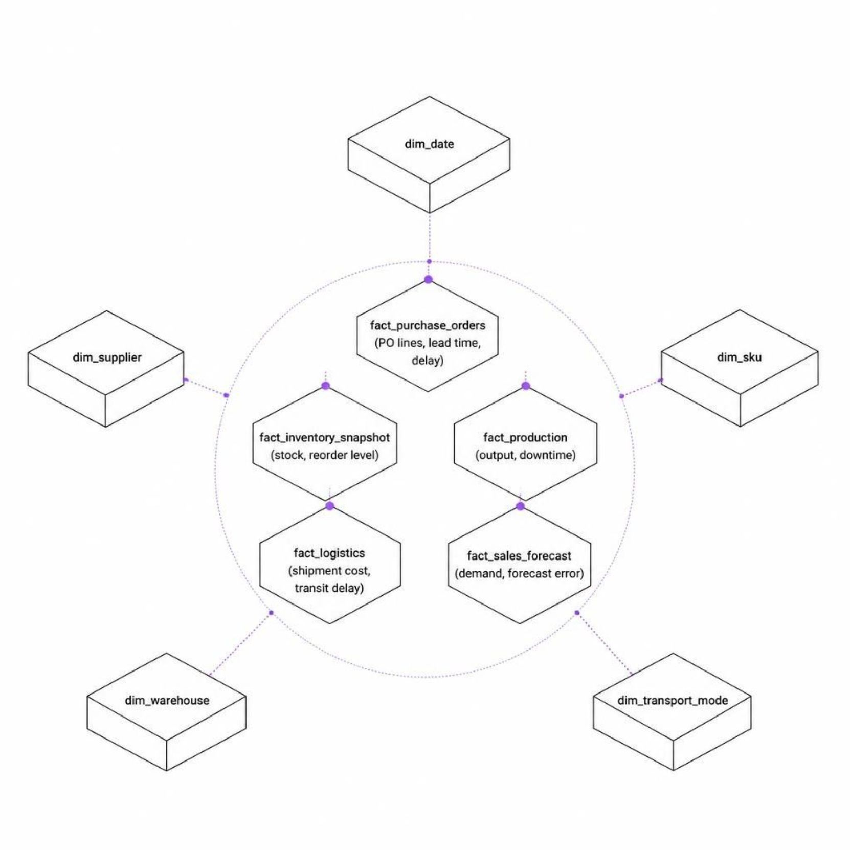

Star Schema Data Model
Design Principles
Dimensions hold descriptive attributes; facts hold measurable business events
Original business keys preserved alongside surrogate keys for reconciliation
Incremental load logic supports repeatable, auditable ETL cycles
Each fact table links to relevant dimensions via foreign keys
Data-modeling rule: preserve original business keys in each fact table even when surrogate keys are used — this supports reconciliation back to staging.

Slide 5
ETL Pipeline & Data Quality Framework
01
02
03
File Validation
Staging Load
Standardization
Schema checks, encoding verification, row-count validation
Raw preservation with ingestion timestamp and source file name
Date conversion, text trimming, categorical normalization
04
05
06
Duplicate Handling
Data Quality Rules
Dimension & Fact Load
Business-key deduplication with documented rules
Non-negative quantities/costs; valid date ranges; referential integrity
Upsert dimensions, resolve keys, insert facts with audit trail
07
Reconciliation
Source-to-warehouse row counts, monetary totals, rejected-record audit

Slide 6
KPI Framework & Power BI Dashboards
Core KPI Definitions
Power BI Dashboard Pages
On-Time Delivery % | On-time POs / eligible POs × 100
Avg. Delivery Delay | Average delay days with documented early-delivery treatment
Inventory Turnover | COGS / average inventory
Stock-Out Rate | Stock-out SKU-date observations / eligible observations
Forecast MAPE | Mean absolute percentage error with zero-demand handling
Executive Overview
Supplier Performance
KPI cards, cost trend, OTD%, stock-out rate, downtime summary
Ranking, average delay, OTD%, monthly trend with drill-through
Inventory & SKU
Risk & Forecast
Stock vs. reorder heatmap, forecast overlay, stock-out exposure
Demand forecast, supplier risk scores, stock-out probability flags

Slide 7

Statistical Analysis & Predictive Strategy
Statistical Questions
Predictive Use Cases
Do supplier delays affect downtime? — Two-sample test / regression with controls
What drives logistics cost? — Multiple linear regression with mode, delay, volume
Does lead time relate to stock-outs? — Pearson/Spearman correlation + regression
Which costs or downtime events are abnormal? — IQR / z-score outlier detection
Demand Forecasting
Supplier Delay Risk
Logistic Regression / Random Forest. Precision, recall, ROC-AUC; business impact measured.
Time-series baseline → regression → Random Forest. Evaluated on RMSE, MAPE, forecast bias.
Stock-Out Probability
Statistical significance is not proof of causality. All findings report effect size, confidence interval, and p-value.
Binary classification with calibrated thresholds. Persisted to SQL Server for BI consumption.

Slide 8





ML Integration: From Training to Dashboard
Python Training
Time-based splits, feature engineering, model comparison against baseline
SQL Server Scoring
ML output tables: ml_demand_forecast, ml_supplier_delay_risk, ml_stockout_risk
Power BI Semantic Model
Risk bands, threshold flags, drill-through from executive KPIs to SKU detail
Operational Action
Alerts, owner assignment, outcome tracking, and model drift monitoring
Key rule: Features must use only information available at the time the prediction would actually be made — no target leakage. Risk-band thresholds are tuned on validation data and frozen before final evaluation.

Slide 9





Business Recommendations Framework
Supplier Management
Inventory Optimization
Logistics Optimization
Segment by delivery reliability, dependency, and criticality. Qualify alternatives for single-source SKUs.
Recalculate reorder points and safety stock using demand variability and supplier lead-time distributions.
Compare cost and delay by mode and lane; investigate high-cost outliers to reduce avoidable freight spend.
Production Planning
Early Warning
Use supplier delay risk and demand forecasts in scheduling to reduce downtime from upstream shortages.
Surface risk scores with owner and action — moving from retrospective reporting to proactive intervention.

Slide 10

Implementation Roadmap & Next Steps
Phase 1: Foundation
1
Data profiling, DDL deployment, staging and dimension tables built
2
Phase 2: ETL & Analytics
Transformation pipelines, KPI views, reconciliation, and audit framework
Phase 3: BI & Statistics
3
Power BI semantic model, dashboards, hypothesis tests, regression analysis
4
Phase 4: ML & Integration
Model training, validation, scoring pipeline, ML output tables, BI refresh
Phase 5: Recommendations
5
Prioritized actions, quantified impact model, executive presentation, handover
Immediate next step: Profile the seven source CSV files — confirm exact columns, keys, date coverage, grain, and data-quality characteristics. DDL, ETL mappings, and model features are then finalized against real data.

