Slide 1

ShopFlick Business Intelligence Dashboard
Anjali Sharma | Khushboo Joshi | Shivam Kumraa | Saravanan Nadanasabesan
PROG8630 - Data Visualization | Instructor: Pramod Vasista
April 04, 2025

Slide 2

Introduction
Welcome to the ShopFlick Business Intelligence Dashboard — a powerful tool that brings together data from four key areas of our business: Sales, Marketing, Supply Chain & Inventory, and Customer Service.
This dashboard aims to help teams make smarter, faster decisions by turning raw data into clear and interactive visuals.
With this dashboard, users can:
Track important KPIs in real time
Spot trends and patterns quickly
Understand what’s working across departments
In this presentation, we’ll walk you through:
The key business questions we’re answering
Where the data comes from
Why we chose Power BI
A tour of each dashboard section
And how we plan to keep everything up to date

Slide 3
Dashboard Mockup – Sales
What are the top-selling products by revenue?
How are sales performing across regions?
What is the revenue trend over time?
Which product categories lead in sales?

Slide 4
Dashboard Mockup – Marketing
• What is the ROI for each campaign?
• What is the Customer Acquisition Cost (CAC)?
• Which channels convert best?
• What is the engagement across platforms?

Slide 5
Dashboard Mockup – Supply Chain & Inventory
Are inventory levels meeting demand?
Which suppliers are most reliable?
What is the order fulfillment efficiency?
How do procurement costs vary over time?

Slide 6
Dashboard Mockup – Customer Service
What are the most common complaints?
How satisfied are customers by region?
What is the average complaint resolution time?
How effective is the issue resolution process?

Slide 7
Data Source
SQL database with structured schema per department.
Tables: Orders, Campaigns, Leads, Inventory, Complaints, NPS.
Data cleaned and validated before Power BI import.
Entity Relationship Diagrams (ERDs) used to model relationships.

Slide 8

Tool Selection
• Power BI chosen for: – Interactive visuals and real-time filtering
– Seamless SQL data integration
– Weekly auto-refresh functionality
– Scalability and industry relevance

Slide 9
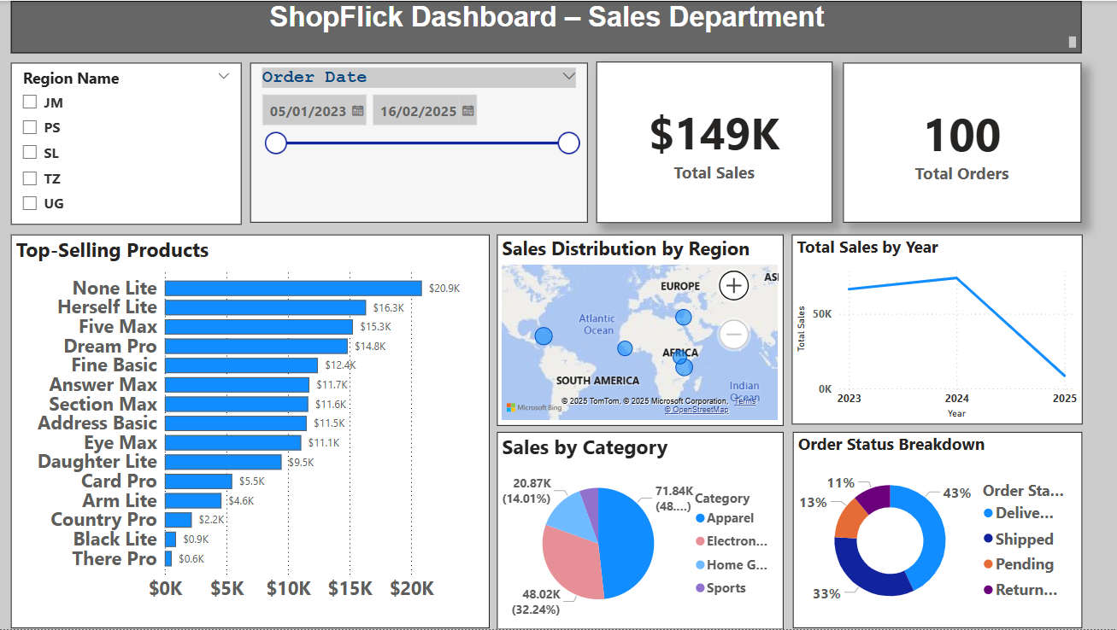
Dashboard Demo – Sales
• Line Chart: Shows total sales trend over time.
• Map Visual: Displays geographic sales distribution.
• Bar Chart: Highlights top-selling products by region.
• Pie Chart: Breaks down product category sales.
• KPIs Cards: Total Sales, Sales Growth, Top Products.

Slide 10
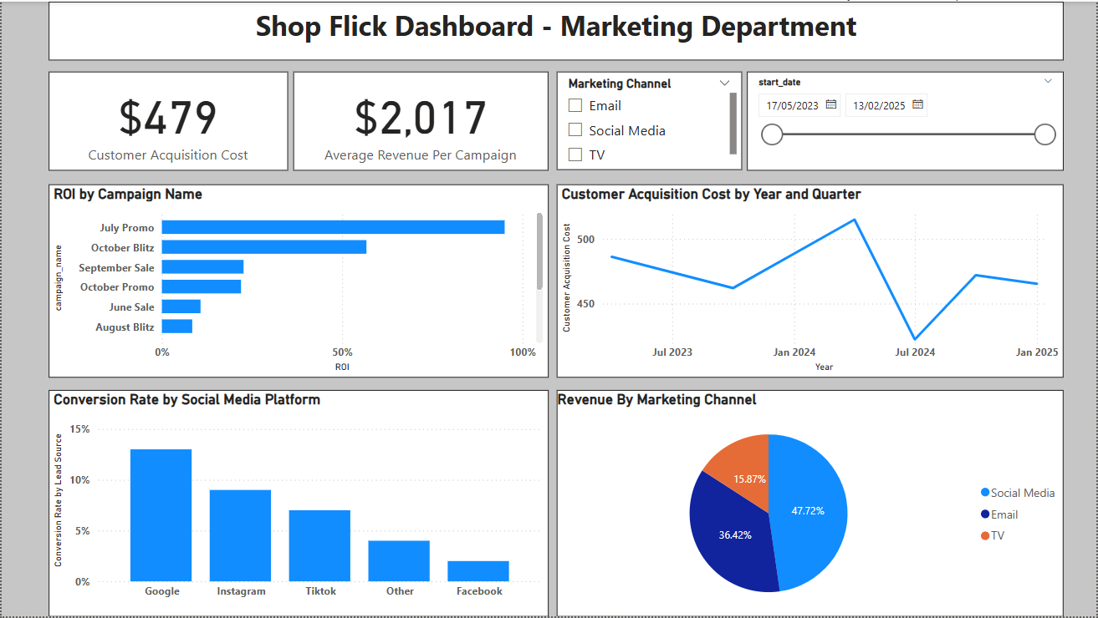
Dashboard Demo – Marketing
• KPI Cards: Show Customer Acquisition Cost and Average Revenue.
• Bar Chart: ROI comparison across campaigns.
• Line Graph: CAC trend over time.
• Funnel Chart: Visualizes customer journey from click to purchase.
• Bar Chart: Platform-wise conversion rate.

Slide 11
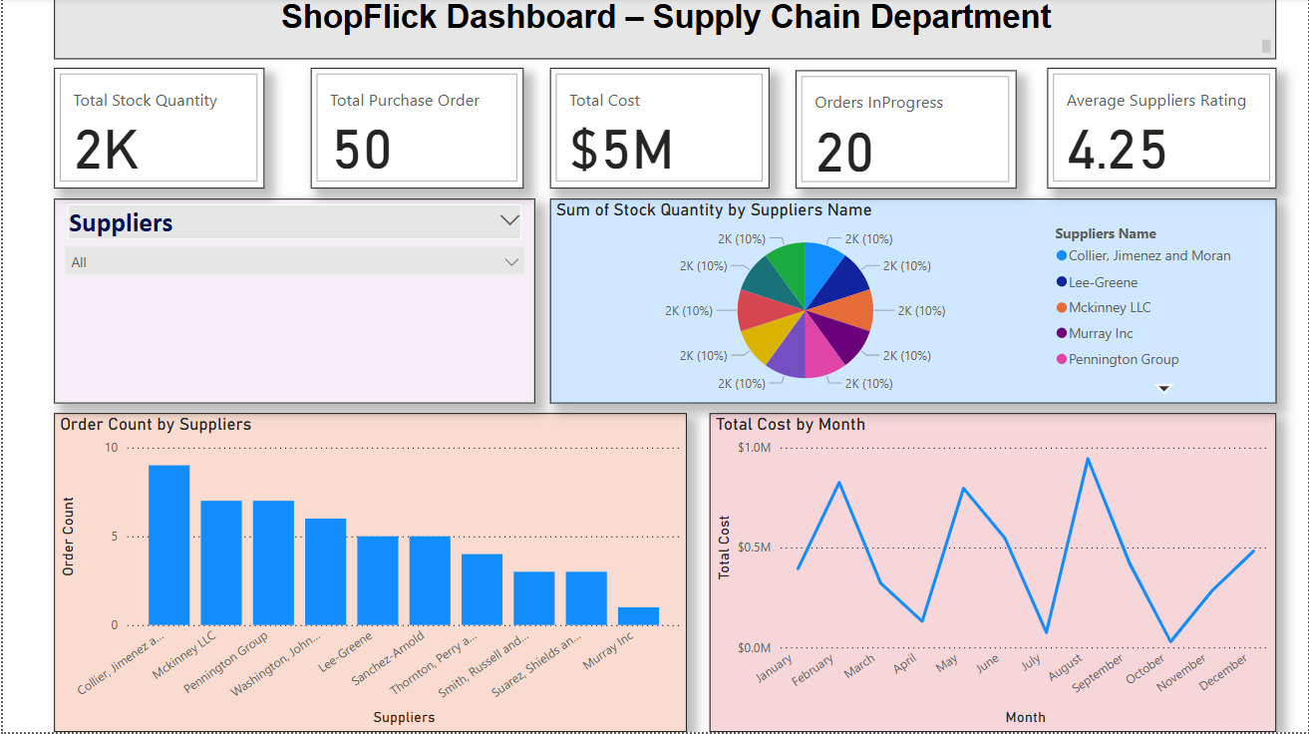
Dashboard Demo – Supply Chain
• KPI Cards: Total Stock, Total Orders, Total Cost, In-progress Orders, Supplier Rating.
• Pie Chart: Stock quantity by supplier.
• Bar Chart: Order count per supplier.
• Line Chart: Total procurement cost over time.

Slide 12
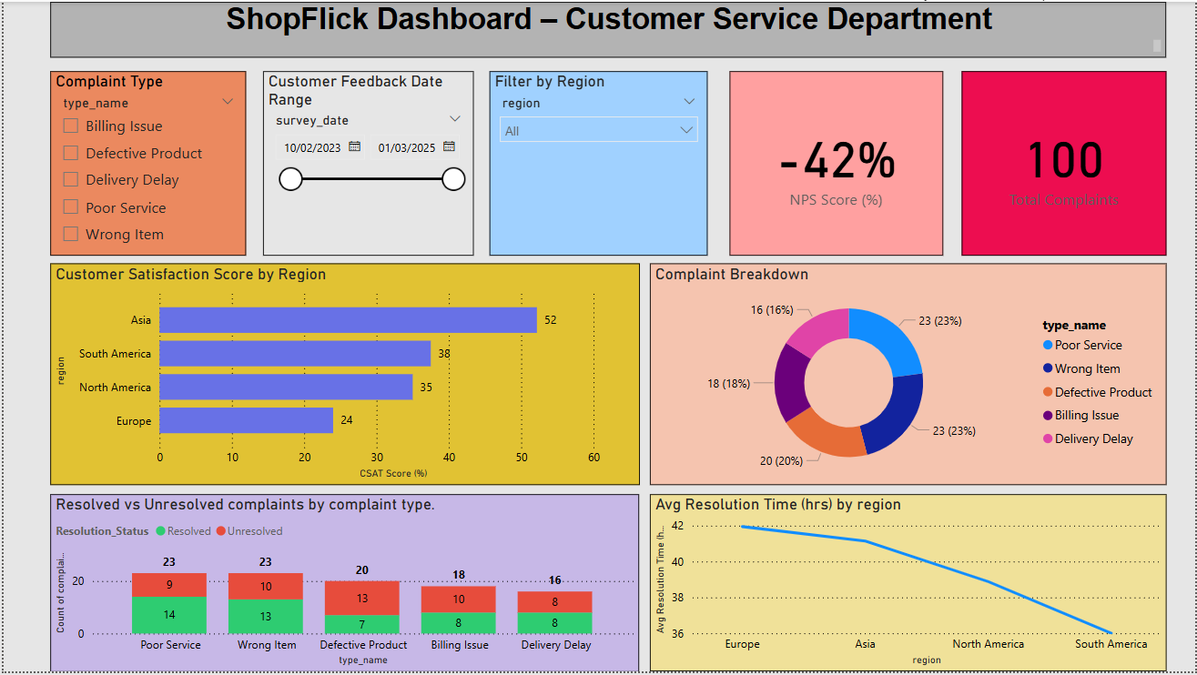
Dashboard Demo – Customer Service
• KPI Cards: NPS Score, Total Complaints.
• Donut Chart: Complaint categories.
• Bar Chart: CSAT score by region.
• Stacked Column Chart: Resolved vs Unresolved complaints.
• Line Graph: Average resolution time by region.

Slide 13

Update Plan
Dashboard refreshes weekly using automated scripts.
Connected directly to SQL data sources.
Updates managed by data analyst.
Manual updates only for schema or dataset changes.

