Slide 1
Fetch Graphics data from Infineon
Scope:
To Achieve the HMI automation with Quality fetching graphics data
From the display port and converting into HDMI output.
Project: GM_Clusters
Proposal:
The Infineon CYT3DL Processor’s display content to be removed from TFT Display and loop back into the HDMI Conversion IT6263
IT6263: Single Chip De-SSC LVDS to HDMI Converter
The IT6263 is a high-performance single-chip De-SSC LVDS to HDMI converter. Combined with LVDS receiver and HDMI 1.4a Transmitter, the IT6263 supports LVDS input and HDMI 1.4 output by conversion function
ITE聯陽 | Product
LVDS2 - Geekworm Wiki
Benefits:
Without using Framegrabber we can Grab the image contents from cluster to testPC
Low-Cost Solution (Approx 12k in Rupees)
Connection Diagram
CYT3DL
30pin
0.5mm Display Port
30 pin
1mm converter
IT6263 HDMI Converter

Slide 2
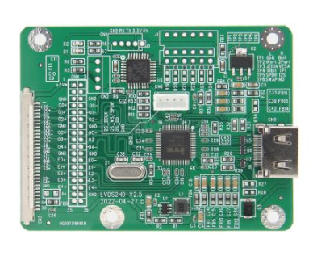
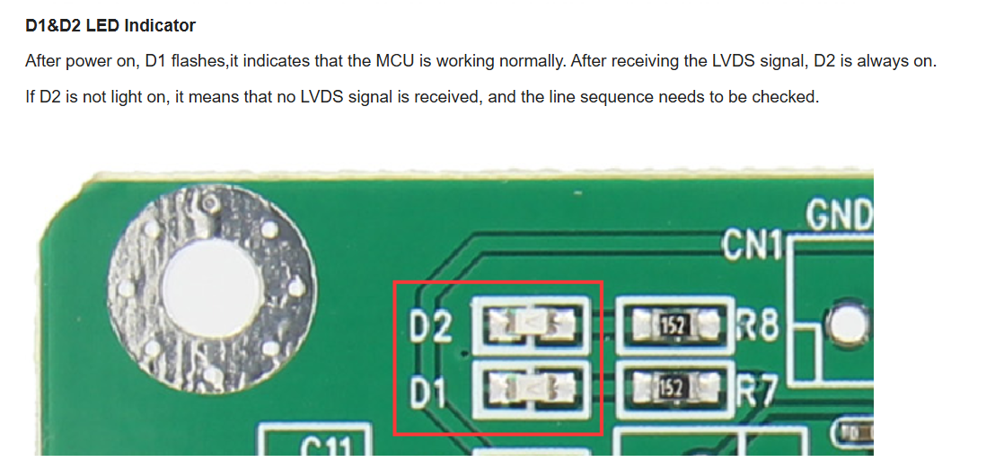
GeekWorm Connectors
Features:
LVDS input signal to HDMI output, the maximum bandwidth can reach 150MHz;
LVDS input interface adopts the general 30-pin socket FI-X30SSLA-HF, which supports dual 8 inputs, and the original screen cable can be used directly;
Double 8 mode in default
I2S sound input in default
VESA standard resolution in default
8bit in default
Not only supports standard HDMI signals, but also supports other graphics format signals, the common formats are as follows: 1920x1200, 1920x1080, 1600x1200, 1280x1024, 1280x720, etc.
Support LVDS signal to spread spectrum
Input Voltage Range:DC 4.8V～5.5V, Powered by 5V in the screen cable

Slide 3
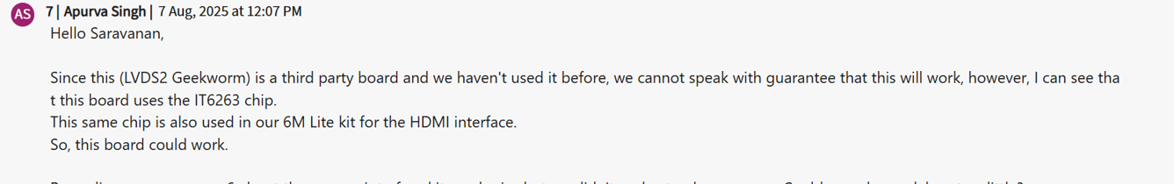
Support Required
Need a Hardware design experts supports to map the Display Port into HDMI conversion
The Feasibility part is confirmed by Infineon the same IC can be used for Conversion, but Infineon doesn't have any solution currently.
Update from Infineon

Slide 4
