Slide 1
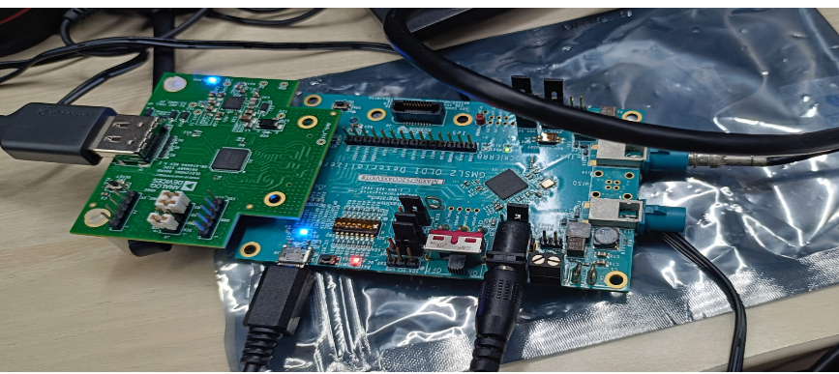
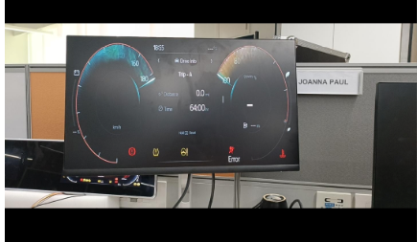
HMI Validation using De-serializer setup
Scope:
To achieve the HMI content into the test PC from SoC
Project: W616- Mahindra
Description:
Functionality of ECU:
The W616 SoC display output is serialized by MAX967 family serializer IC.
In cluster Display the same data is deserialized by MAX967 family Deserializer IC.
Proposed Functionality (Test Setup):
The ECU output is connected to the external deserializer Evkit.
The Evkit output is converted into HDMI by using oLDI to HDMI Converter
The HDMI output is fed into a Vision tool (internally developed by tools team) for capturing images and further HMI automation.
Benefits:
Without using Framegrabber we can Grab the image contents from cluster to testPC
Low-Cost Solution (Approx 60K in Rupees)
Reusable for Future Projects if Same serializers IC’s (MAXIM 967 Family) used.
Connection Diagram
EV Kit with HDMI Converter
Display output

