Slide 1
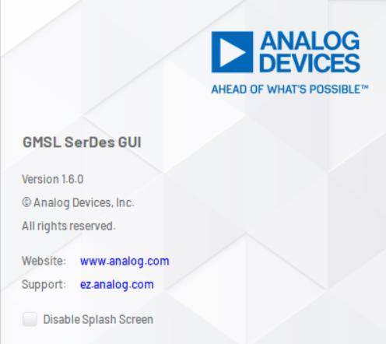
HMI Validation using De-serializer setup
The MAX96752 De-serializer EV kit is used for fetching display data from the Silver Box into Test PC.
Required Components:
Deserializer EVkit (HSD) for SOP1 HW
Deserializer EVkit (Coax) for SOP2 HW
Fakra Cable from Silver Box to EVkit
oLDI to HDMI Converter
Micro USB Cable from EVkit to Test PC
Software
GMSL Software Can be downloaded from: Software Download | Analog Devices
Steps to Configure EVkit
1.Start the GMSL Software
Ensure Sw Version

Slide 2
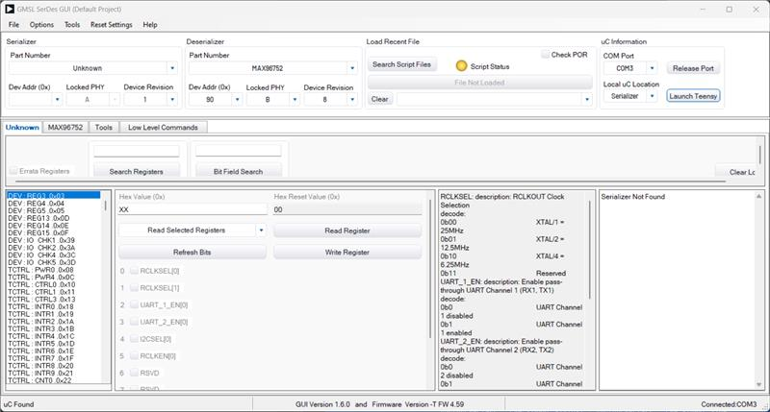
Connect the Evkit to SilverBox after removing Display from Silver Box
After Opening the GMSL Software the below window will be published
De serializer Detected successfully

Slide 3
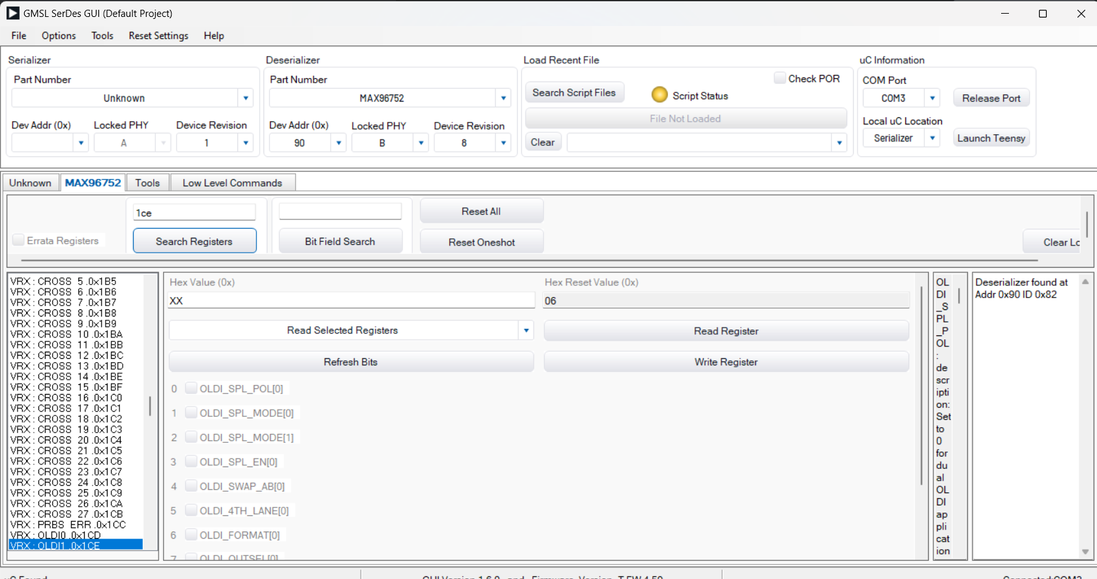
Search for register “0x1CE”

Slide 4
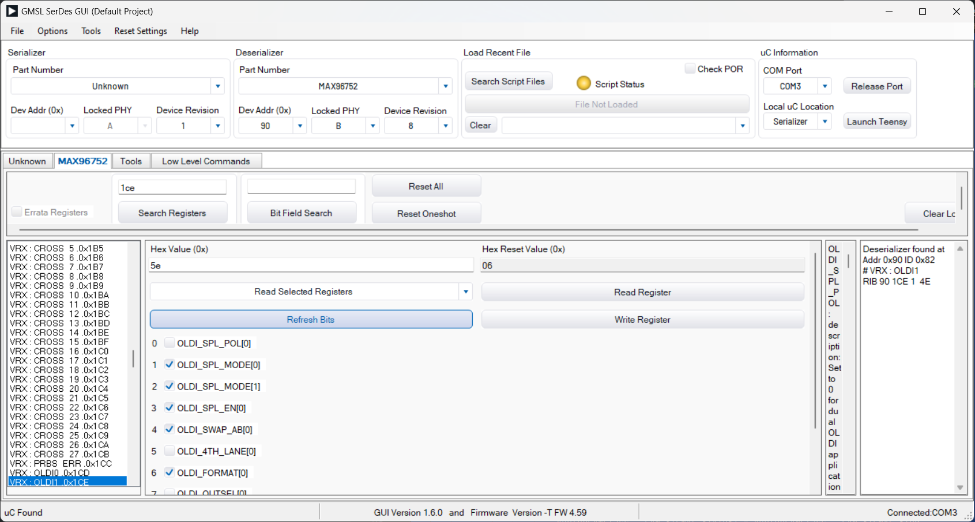
After 1CE selection and write the hex value “5E” in Hex values Row

Slide 5
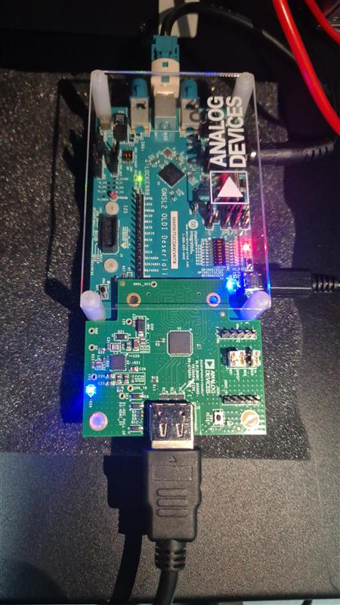
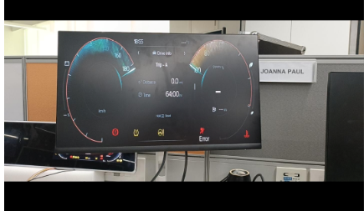
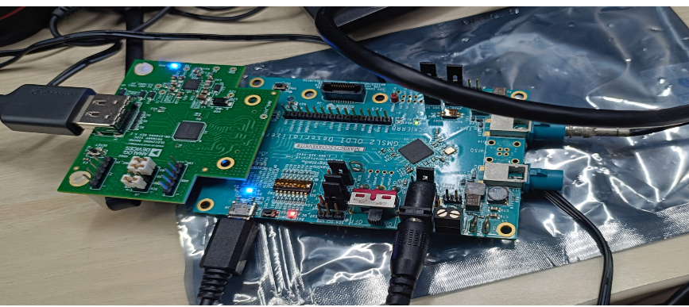
Ensure the “Lock” LED Green is Glowing in EV kit after Writing
After writing ensure the HDMI output connected with monitor

