Slide 1
PayFlow on DOKS
Deploying a Scalable SaaS Application on DigitalOcean Kubernetes Service
Sr. Technical Account Manager Assessment
Saravanan Ramesh | April 2026

Slide 2
Customer Scenario
PayFlow Inc. — Series A FinTech startup building invoicing & billing tools for SMBs. 200+ customers, processing 5,000+ invoices/month, growing 25% QoQ. Looking to containerize and deploy their web application on DigitalOcean Kubernetes Service.
Scalability
Performance
Reliability
Cost Optimization
Handle growing
workloads as users
onboard
Fast response times
for invoice
operations
High availability
with minimal
downtime
Avoid waste while
maintaining
performance
Saravanan Ramesh | Sr. Technical Account Manager | April 2026

Slide 3
Why Kubernetes?
Business and technical case for container orchestration
Business Benefits
Key Kubernetes Components
Scale on demand, pay for what you use
Deployment
Desired state — replicas, update strategy, rollback
Pods scale up during billing cycles and back down after. Only pay for burst capacity when needed.
Service
Stable network endpoint, load balances across pods
Deploy faster, with zero downtime
Rolling deployments go live without maintenance windows. Bad deployments auto-rollback.
Ingress
Routes external HTTP traffic — single entry point
Self-healing infrastructure
HPA
Auto-scales pods based on CPU/memory metrics
Failed pods restart automatically. Health probes pull unhealthy instances before customers notice.
ConfigMap
Non-sensitive config injected at runtime
Predictable costs, no over-provisioning
Secret
Sensitive credentials — never hardcoded in image
Resource requests cap what each pod can use. Right-sizing prevents runaway processes.
PVC
Persistent storage attached to pods
Portable and cloud-independent
Same Kubernetes manifests run on any cloud. No vendor lock-in at the application layer.
Namespace
Logical isolation — environments or teams
Saravanan Ramesh | Sr. Technical Account Manager | April 2026

Slide 4
Why DigitalOcean Kubernetes (DOKS)?
Key advantages over self-managed Kubernetes and competing cloud providers
Free managed control plane
Cluster Autoscaler built-in
DigitalOcean manages the Kubernetes control plane at no cost. AWS EKS charges $72/mo and GKE charges $72/mo per cluster just to run Kubernetes. For PayFlow's architecture, DOKS saves $864/year before a single workload runs.
DO Droplets provision and deprovision automatically as pod demand changes. Burst capacity is billed by the hour — PayFlow only pays for extra nodes during peak billing cycles.
Simple setup — operational from day one
Predictable, transparent pricing
One doctl command provisions a production-ready cluster with autoscaling, kubeconfig, and DO Load Balancer integration. No VPC configuration, IAM roles, or networking expertise required upfront.
No data transfer fees between DO services within the same region. No surprise charges for API calls, secret storage, or log ingestion. PayFlow's full stack runs at $36/mo with no hidden costs.
Native DigitalOcean integrations
Standard Kubernetes — no lock-in
Block Storage, Container Registry, Load Balancers, and Spaces integrate directly with Kubernetes via native drivers — no third-party plugins or complex IAM policies. Billing is unified in one DO account.
DOKS runs upstream Kubernetes. The same manifests — deployment.yaml, ingress.yaml, hpa.yaml — run identically on EKS, GKE, or any other provider. Migrating is a kubeconfig swap, not a rewrite.
Saravanan Ramesh | Sr. Technical Account Manager | April 2026

Slide 5
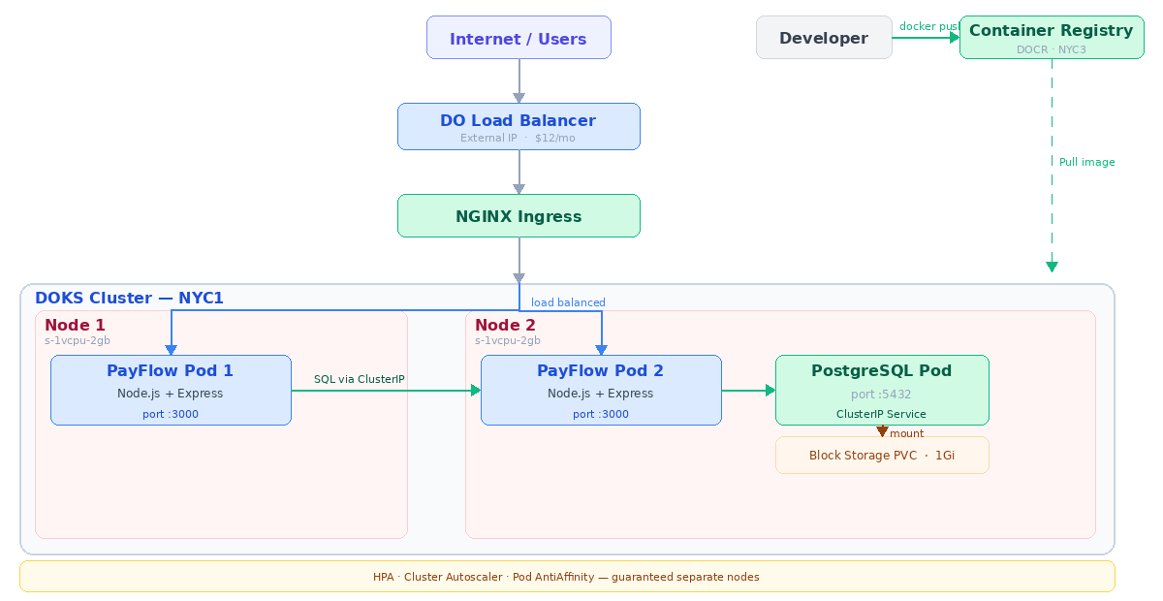
Solution Architecture
Traffic flow — from internet to app to database
Saravanan Ramesh | Sr. Technical Account Manager | April 2026

Slide 6
Deployment Setup Guide
Prerequisites & high-level steps — full details in GitHub README
Prerequisites:
doctl CLI · kubectl · Docker · DigitalOcean account · Container Registry created
Node.js 18+ (local dev) · Git repository with app/ and k8s/ folders
1
Build & push Docker image
• Build the container image targeting linux/amd64 platform
• Tag and push to DO Container Registry
2
Create DOKS cluster
• Provision a DOKS cluster in NYC1 with s-1vcpu-2gb nodes
• Enable cluster autoscaler (min 2 / max 3 nodes)
• Save kubeconfig using doctl
3
Create Kubernetes Secret & deploy manifests
• Create payflow-secrets with ADMIN_PASSWORD and DB_PASSWORD
• Apply all manifests in order: PVC → PostgreSQL → ConfigMap → Deployment → Service → Ingress → HPA
4
Verify deployment & application status
• Confirm 2 nodes Ready, pods on separate nodes, HPA tracking CPU, Ingress has external IP
• Test endpoints: GET /health, POST /invoices, GET /generate-report
Full setup guide & README: github.com/SaravananRamesh/PayFlow/blob/main/README.md
Saravanan Ramesh | Sr. Technical Account Manager | April 2026

Slide 7
Technical Implementation
Technology Stack
Repository Structure
Application
Node.js 18 + Express
payflow-saas/
Container
Docker (Alpine, non-root user)
app/
Orchestration
DOKS (Kubernetes)
server.js
Dockerfile
Ingress
NGINX Ingress Controller (Helm)
package.json
Load Balancing
DO Load Balancer (Layer 4)
k8s/
Autoscaling
HPA + Cluster Autoscaler + Pod AntiAffinity
deployment.yaml
postgres.yaml
Registry
DO Container Registry (NYC3)
configmap.yaml
Storage
PostgreSQL pod + PVC (1Gi Block Storage)
secret.yaml | pvc.yaml
Secrets
K8s Secret (ADMIN_PASSWORD, DB_PASSWORD)
service.yaml | ingress.yaml
Config
K8s ConfigMap (non-sensitive env vars)
hpa.yaml
README.md
Saravanan Ramesh | Sr. Technical Account Manager | April 2026

Slide 8
Live Demo Walkthrough
Key endpoints to demonstrate during the presentation
GET /
Invoice dashboard with live pod identity
Shows the product UI + proves the app is running
GET /health
Health check returning pod hostname
Curl repeatedly to show load balancing across pods
POST /invoices
Create new invoice — admin protected
Unlock with ADMIN_PASSWORD from K8s Secret, invoice persisted to PostgreSQL
GET /generate-report
CPU-intensive report — triggers HPA
Load test this endpoint to show pod scaling and cluster autoscaling live
Demo tip: Run hey -z 120s -c 50 http://<IP>/generate-report then watch kubectl get hpa -w and kubectl get nodes -w to show HPA + cluster autoscaling live
Saravanan Ramesh | Sr. Technical Account Manager | April 2026

Slide 9
Autoscaling in Action
Results from live load test — hey -z 120s -c 50
T+0s
Load test begins
50 concurrent connections to /generate-report
T+30s
CPU crosses 70% threshold
CPU spikes to 248% — HPA detects target exceeded, starts 30s stabilization window
T+60s
HPA triggers — Pod 3 created (Pending)
Required pod anti-affinity means Pod 3 needs its own node — no room on existing 2 nodes, cluster autoscaler triggered
T+116s
Node 3 provisioned — Pod 3 scheduled
New s-1vcpu-2gb worker node Ready in ~56s — Pod 3 immediately scheduled and starts
T+2.5m
CPU stabilizes across 3 pods
Load distributed across 3 pods — CPU drops below 70%, HPA starts 120s scale-down stabilization window
T+5m
Pods scale back 3 → 2, Node 3 removed
After 120s of sustained low CPU, HPA removes 1 pod — Node 3 now empty, cluster autoscaler deletes it
Saravanan Ramesh | Sr. Technical Account Manager | April 2026

Slide 10
Cost & Performance Analysis
Infrastructure Cost
Live Cluster Performance
Component
Spec
$/mo
Avg response time (/health)
~65ms
DOKS Control Plane
Managed, NYC1
$0
Load test concurrency
50 concurrent connections
Worker Nodes (2×)
s-1vcpu-2gb each
$24
HPA scale-up (2 → 3 pods)
~60 seconds at 248% CPU
DO Load Balancer
Standard, Layer 4
$12
Container Registry
Starter tier
$0
Cluster autoscaler (min 2 / max 3)
Node 3 provisioned in ~56s
PVC (PostgreSQL)
1Gi Block Storage
~$0.10
Scale-down (3 → 2 pods)
After 120s cooldown
Total baseline
$36/mo
Pod recovery time
~22 seconds
vs AWS EKS ~$159/mo → saves ~$123/mo (4× cheaper)
Baseline node CPU utilization
5–6%
Cost optimization strategies:
Performance optimization strategies:
Right-sized pod requests — 100m CPU, 128Mi memory
HPA fills existing nodes before triggering new Droplets
Single ingress LB vs $12 per service
Nodepool scale-to-zero cuts idle costs off-peak
Health + readiness probes — zero downtime pod replacement
Rolling update (surge=1, unavail=0) — deploys without traffic loss
DO Spaces CDN — static assets served at edge, reduces pod load
PgBouncer (Managed DB) — connection pooling reduces DB latency
Saravanan Ramesh | Sr. Technical Account Manager | April 2026

Slide 11
Quarterly Business Review
PayFlow Inc. — Q1 2026 summary
99.95%
~65ms
$36/mo
0
Uptime (Q1)
Avg response time
Monthly infra cost
P1 incidents
Key Wins
Risks to Monitor
Containerized deployment with pod antiaffinity HA
HPA + Cluster Autoscaler — 2→3 pods, Node 3 in 56s
K8s Secrets + ConfigMap pattern fully implemented
PostgreSQL persistence — data survives pod restarts
Health probes catch failures before customer impact
No SSL/HTTPS — required before production launch
No user authentication — invoice data exposed
PostgreSQL pod — upgrade to DO Managed DB for HA
Single region (NYC1) — Active-Passive SFO3 by Q3
Account health: GREEN | Renewal risk: Low | Expansion opportunity: High
Saravanan Ramesh | Sr. Technical Account Manager | April 2026

Slide 12
Recommendations & Roadmap
Current quarter priorities and future expansion plan
Q2
2026
SSL/TLS + User Auth + Managed PostgreSQL
+$15/mo
cert-manager + Let's Encrypt. JWT/OAuth2 auth. Replace PostgreSQL pod with DO Managed DB — backups, failover, read replicas.
Critical
Q3
2026
Multi-region Active-Passive deployment
+$36/mo
SFO3 cluster for geographic HA and West Coast latency. Async DB replication via DO Managed PostgreSQL. DNS failover via DO LB.
High
Q3
2026
Observability + CI/CD + DO Spaces CDN
+$5/mo
Prometheus + Grafana + Loki via Helm. GitHub Actions with versioned image tags. DO Spaces ($5/mo) for invoice PDFs with built-in CDN. PgBouncer pooling. Nodepool scale-to-zero.
Medium
Q4
2026
AI expansion + WAF + Reserved Droplet pricing
+$56/mo
AI invoice chatbot via DO Gradient AI Platform — Agent Builder with RAG or Serverless Inference. Cloudflare Pro ($20/mo) for Layer 7 WAF + global CDN. Evaluate 1-year Reserved Droplet pricing.
Low
Saravanan Ramesh | Sr. Technical Account Manager | April 2026

