Slide 1

Fake news detection
Project members
Project mentor
M.Udhai Ram - 111617104100
S.P.Sivananthan - 111617104087
S.T.Saravanan - 111617104078
Mr.Rejin Paul
Professor / Department of Computer Science and Engineering)
Project Review - I

Slide 2
MOTIVATION
In our modern era where the internet is predominant, everyone relies on various online resources for news.
In this times, people tend to consume news in social media platforms like twitter, Facebook, etc.
This causes spreading of misinformation from these fake news sources.
This is a matter of concern that needs to be dealt with in a large scale for the betterment of the people.
Project Review - I

Slide 3
OBJECTIVE
The main objective is to detect the fake news, which is a classic text classification problem with a straight-forward proposition.
It is needed to build a model that can differentiate between “Real” news and “Fake” news
Machine learning helps us achieve this with an impressive accuracy.
Project Review - I

Slide 4
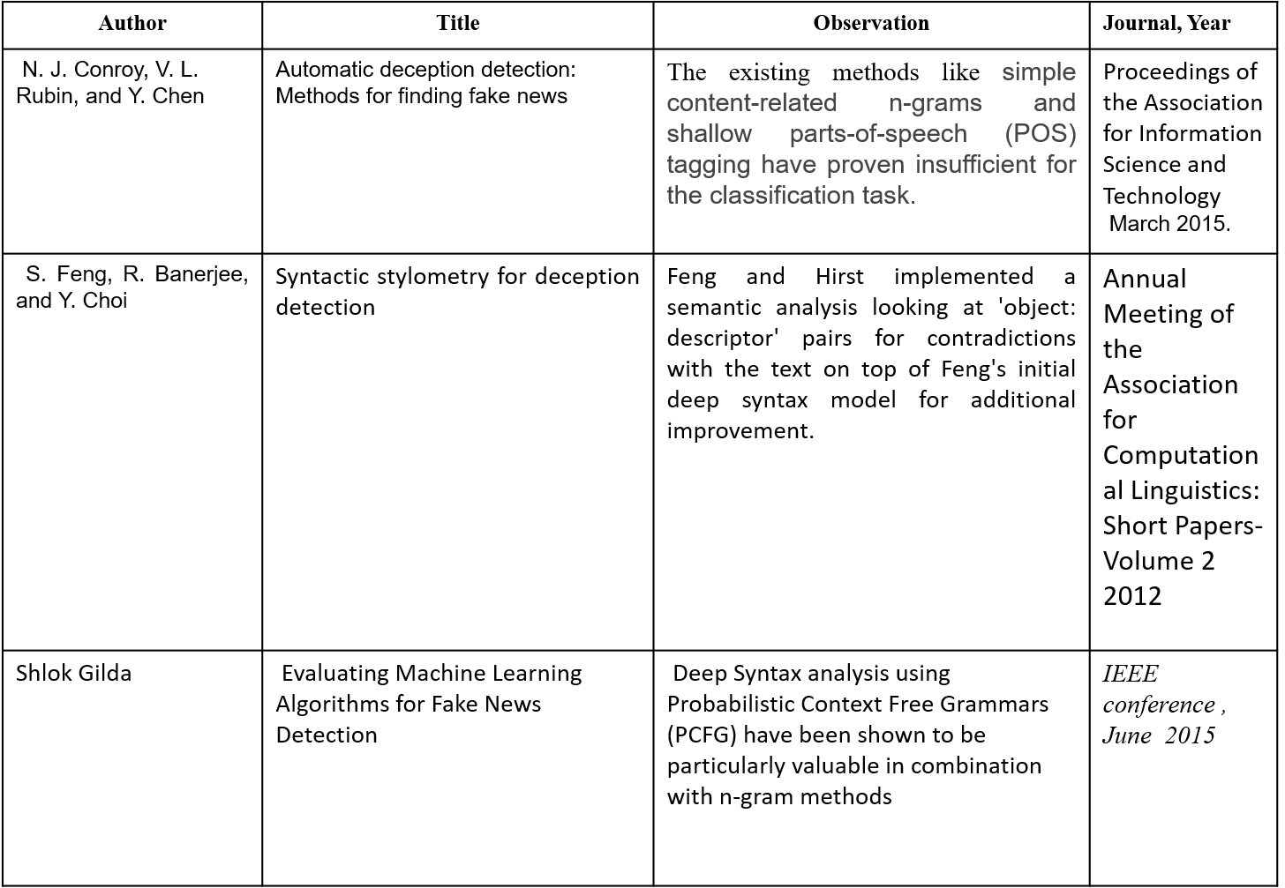
LITERATURE SURVEY
Project Review - I

Slide 5
PROPOSED SYSTEM
We have proposed a technique that involves comprehensive data cleaning and data preprocessing which increases the overall accuracy of the model.
We have used Count Vectorizer, Tf-idf Vectorizer to vectorize the raw sentences which is an important preprocessing step.
These comprehensive data cleaning and preprocessing makes our system an highly efficient one.
Project Review - I

Slide 6
SYSTEM DESIGN
HARDWARE REQUIREMENTS:
PROCESSOR : DUAL CORE 2 DUOS
RAM : 4 GB RAM
MONITOR : 15” COLOR
HARD DISK : 250 GB
SOFTWARE REQUIREMENTS:
LANGUAGE : Python
OPERATING SYSTEM : Windows 10
IDE : Eclipse
Project Review - I

Slide 7
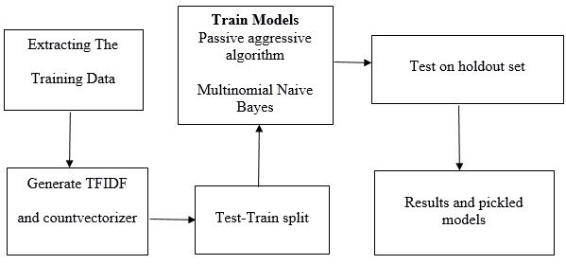
SYSTEM ARCHITECTURE DIAGRAM
Project Review - I

Slide 8
MODULES
Data collection
Data cleaning
Data preprocessing
Test-Train splitting
Model implementation
Graphical representation
Project Review - I

Slide 9
MODULE DRESCRIPTION
DATA COLLECTION
For achieving high accuracy, it is required to get a large and highly reputable data source.
A dataset with the desirable qualities was found in Kaggle and we decided to use the same for the project.
DATA CLEANING
The dataset consists of some unwanted attributes like having NaN values within it.
We analyzed the dataset and performed various cleaning techniques to clean the dataset.
Project Review - I

Slide 10
MODULE DESCRIPTION
DATA PREPROCESSING
Now after data cleaning we have a dataset of raw set of words which can’t be used for the project as it is.
So, we used count vectorizer and Tf-idf vectorizer to vectorize the data to make it easier for execution.
TEST_TRAIN SPLIT
For the model to work we must train the model before testing the model out.
In order to train the model, we must split he model into test and train part.
Project Review - I

Slide 11
MODULE DESCRIPTION
MODEL IMPLEMENTATION
There are several models to perform this task of detecting fake news.
We have chosen Passive aggressive classifier algorithm and MultinomialNB algorithm for our project.
GRAPHICAL REPRESENTATION
The result can be shown in a percentage format, but we feel that a more appropriate way to represent our output is using a graphical representation.
We have made use of confusion matrix plotting technique as it helps understand the output in amore comprehensive fashion.

Slide 12
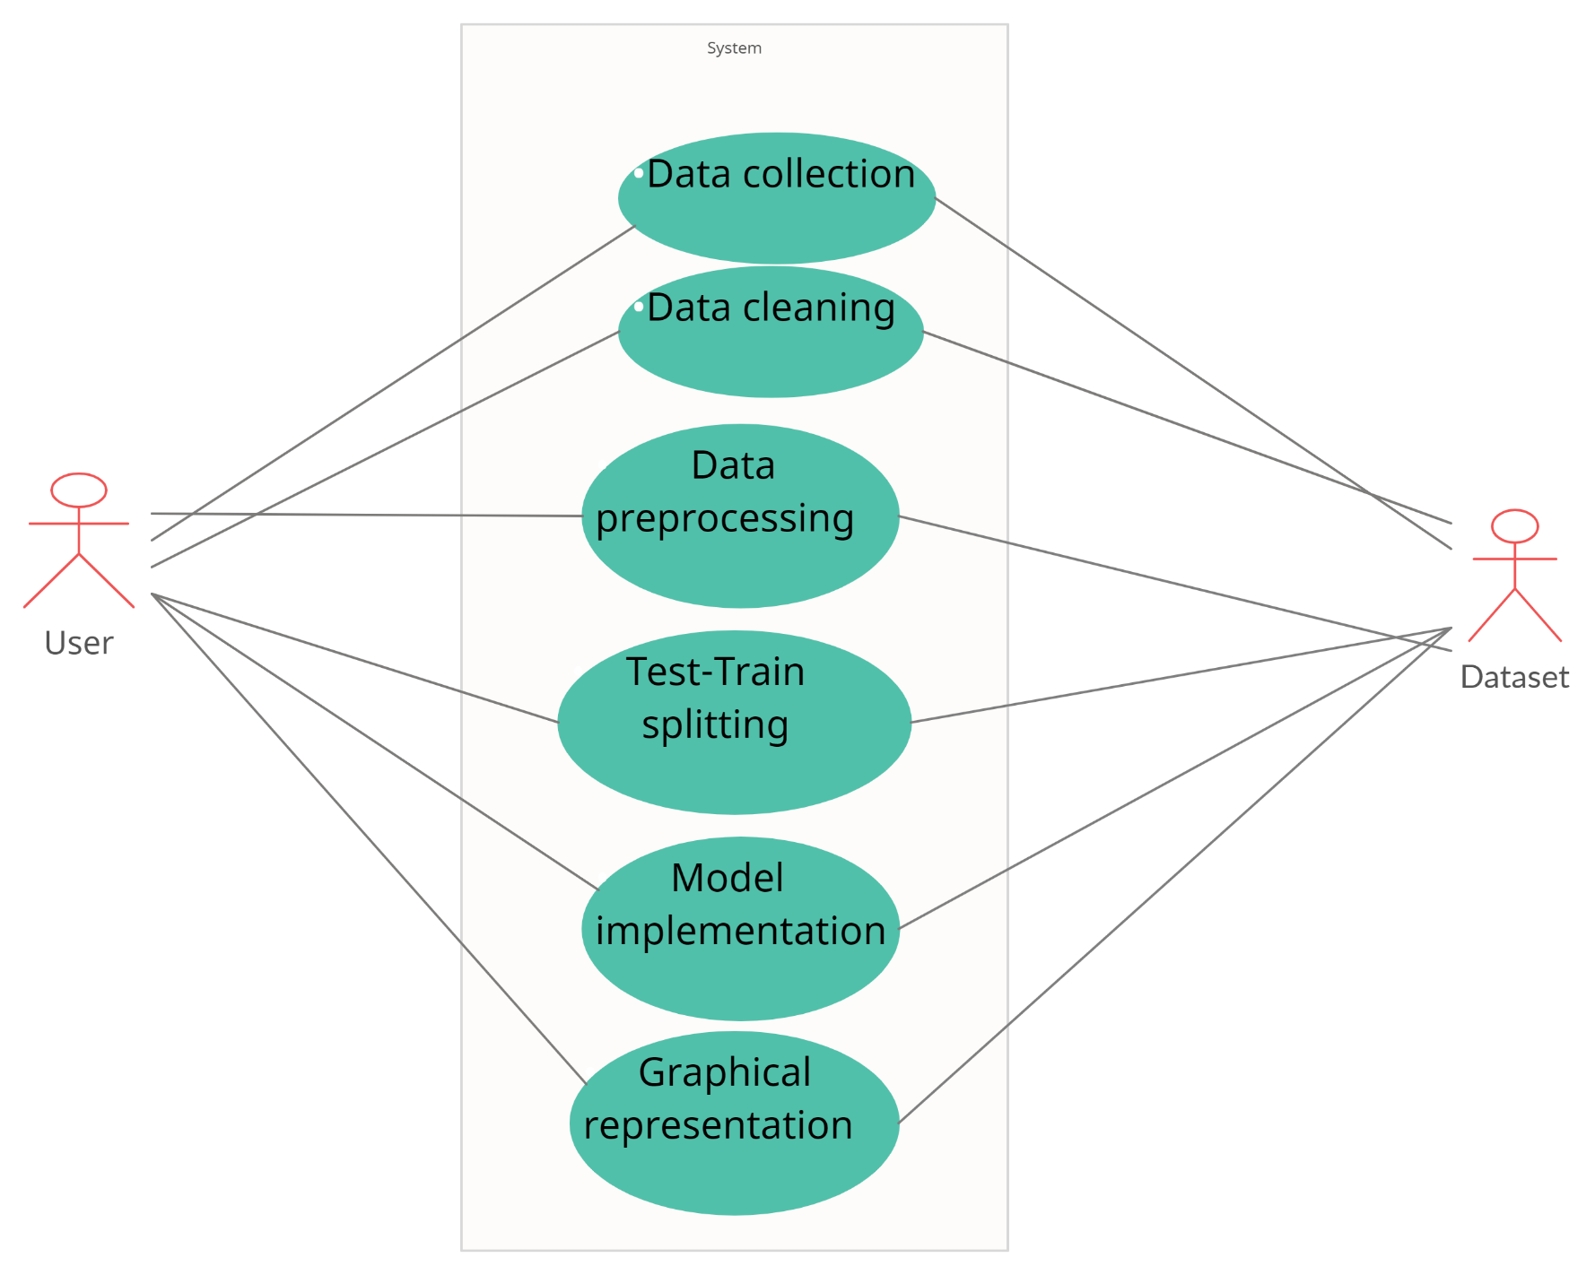
USE CASE DIAGRAM
Project Review - I

Slide 13
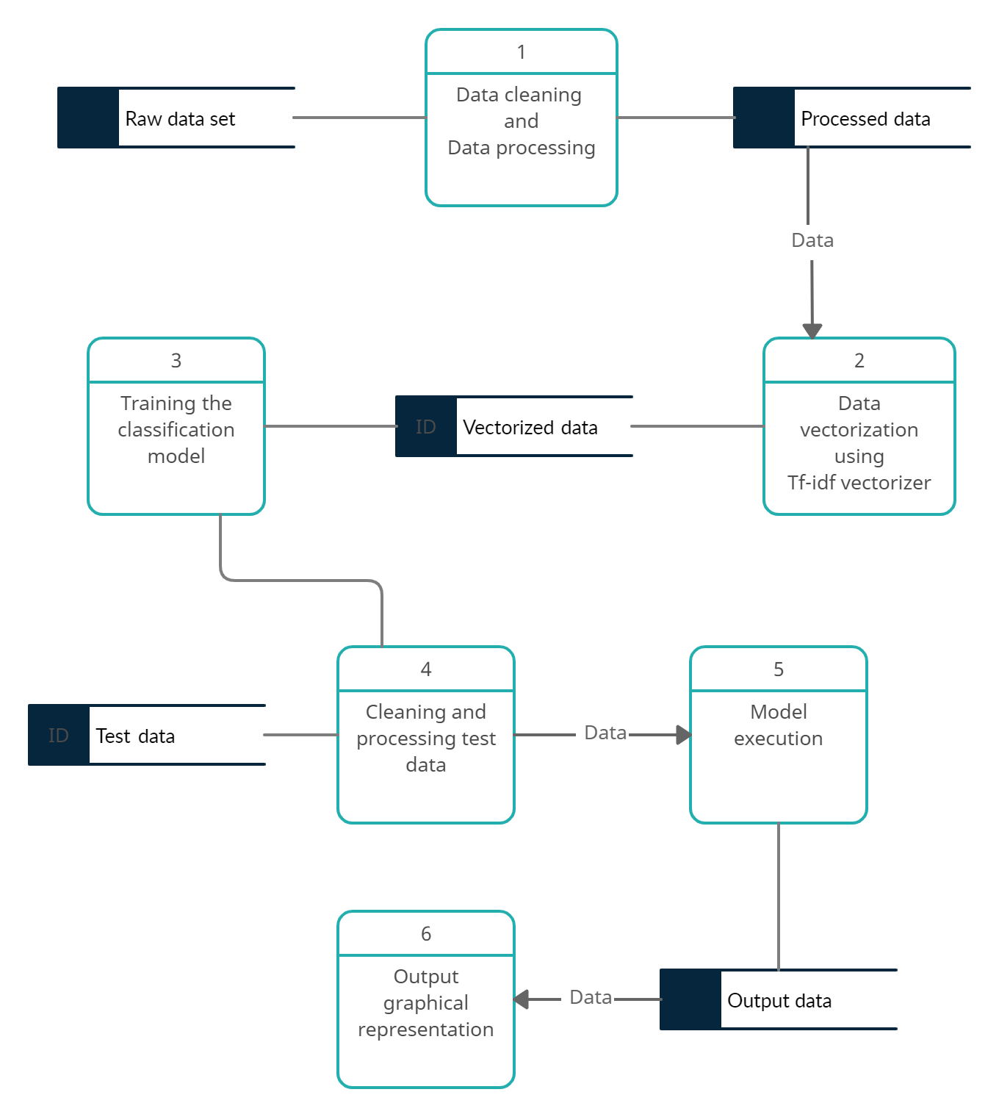
DATA FLOW DIAGRAM
Project Review - I

Slide 14
CODE
GitHub link:
https://github.com/SaravananST/Fake_News_Detection
Project Review - I

Slide 15
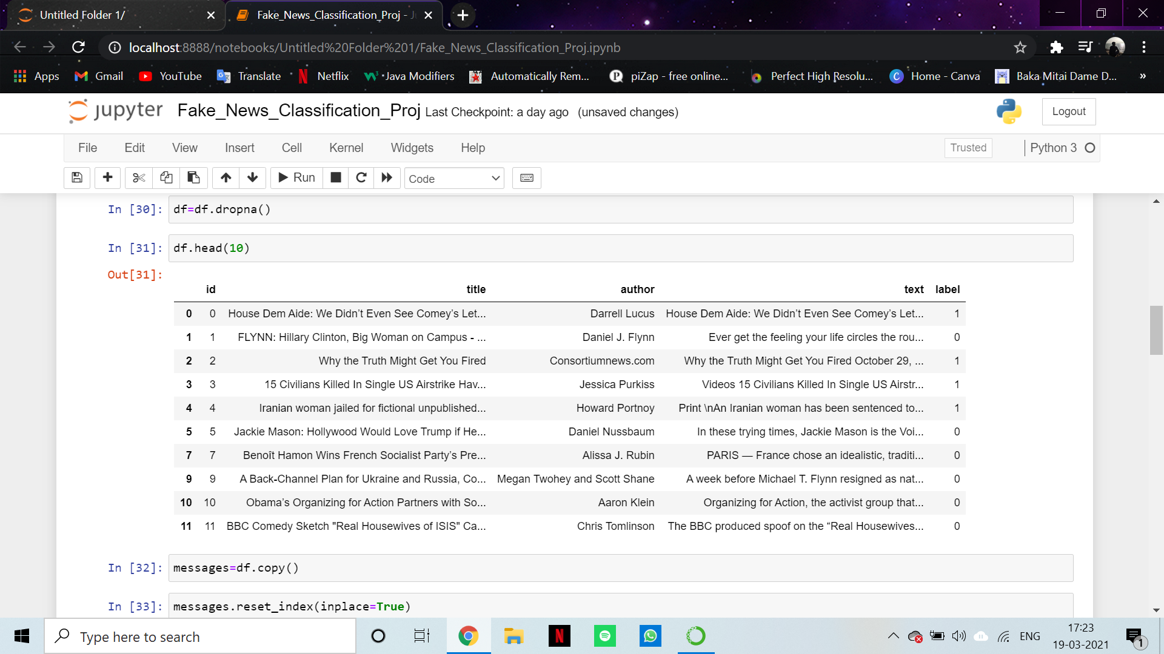
OUTPUT SCREENSHOTS
Project Review - I

Slide 16
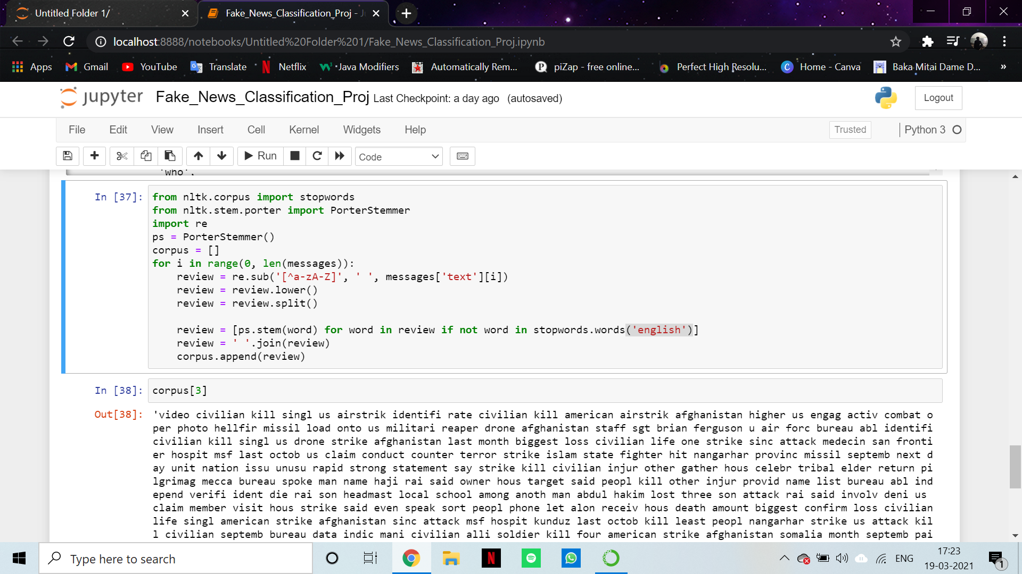
OUTPUT SCREENSHOTS
Project Review - I

Slide 17
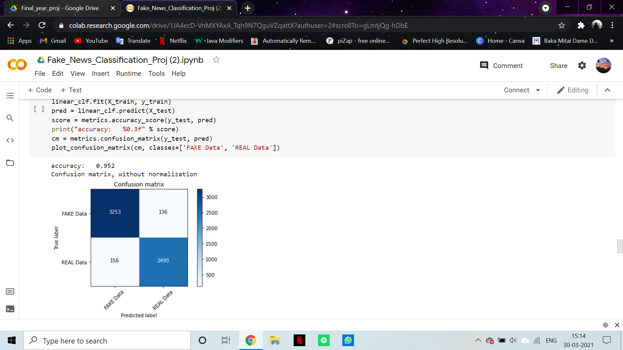
OUTPUT SCREENSHOTS
Project Review - I

Slide 18
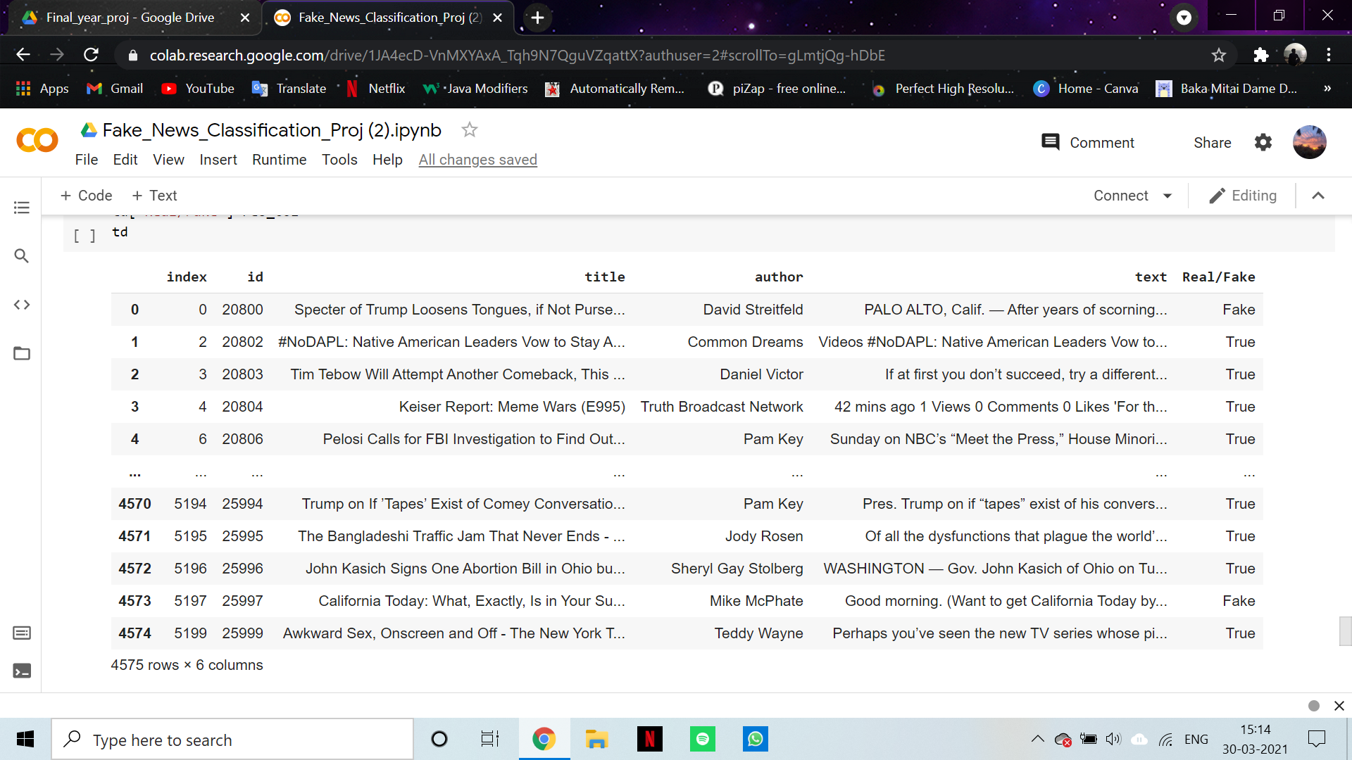
OUTPUT SCREENSHOTS
Project Review - I

Slide 19
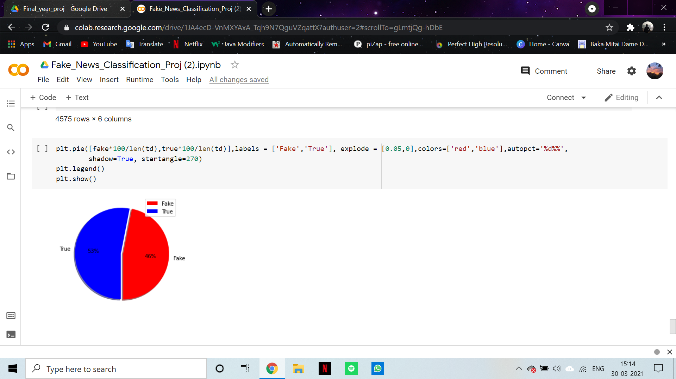
OUTPUT SCREENSHOTS
Project Review - I

Slide 20
REFERENCES
N. J. Conroy, V. L. Rubin, and Y. Chen, “Automatic deception detection: Methods for finding fake news,”, vol. 52, no. 1, pp. 1–4, 2
S. Feng, R. Banerjee, and Y. Choi, “Syntactic stylometry for deception detection,” in Association for Computational Linguistics: Short Papers-Volume 2, Association for Computational Linguistics, 2012.
3. Shlok Gilda,Department of Computer Engineering, Evaluating Machine Learning Algorithms for Fake News Detection,2017 IEEE 15th Student Conference on Research and Development (SCOReD)
Project Review - I

Slide 21
THANK YOU
Project Review - I

