Slide 1

MY LITTLE HOUSE
PLAY SCHOOL
A little house.
A much clearer digital front door.
My Little House Play School
Rooted in Sarawak,
growing every child.
We redesigned the parent journey for a real childcare centre in Bintulu — making it easier to discover, understand and enquire
Warm, play-based childcare in Bintulu
BOOK A VISIT
VIEW PROGRAMS
PLAY-BASED
3 MONTHS - 9 YEARS
INCLUSIVE PROGRAMME
Infant & Toddler · Preschool · Transit

Slide 2
THE OPPORTUNITY
Turn information into parent confidence
A parent should not have to hunt for the basics before deciding whether to make contact
01
02
03
“Is this right for my child?”
“Can I trust what I’m seeing?”
“What do I do next?”
Make age groups and programmes immediately visible
Use real programme facts, curriculum and local identity — not generic childcare copy
Give parents a simple path to visit, enquire and check availability
DISCOVER
UNDERSTAND
TRUST
ENQUIRE
One simple parent journey
from first visit to first enquiry

Slide 3
WHAT WE BUILT
A website designed around how parents decide
Warm enough for a childcare brand. Structured enough to help a busy parent move quickly
1
Immediate fit
Age range + location are visible above the fold
My Little House
Home About Programs Gallery Contact
2
Real programme detail
NOW ENROLLING · BINTULU, SARAWAK
Programmes, curriculum and 1:3 infant ratio are surfaced clearly
Rooted in Sarawak,
growing every child.
BOOK A VISIT
PROGRAMS
3
Local identity
Play-based learning for ages 3 months to 9 years.
“Rooted in Sarawak” gives the site a distinctive sense of place
Infant & Toddler
Preschool
Transit Care
Inclusive
4
Clear next step
3 - 24 months
3 - 6 years
7 - 9 years
Early intervention
Visit and programme actions are prominent, not buried
Notes:
About 40 seconds: “Here is the core of what we built. The homepage immediately answers where the centre is, who it serves and what makes it distinctive. Real programme information is brought forward — including the age groups, play-based approach and the confirmed one-teacher-to-three-babies ratio for infant care. We kept the language warm and local with ‘Rooted in Sarawak’, but the structure stays practical: parents can quickly move to programmes or book a visit.”

Slide 4
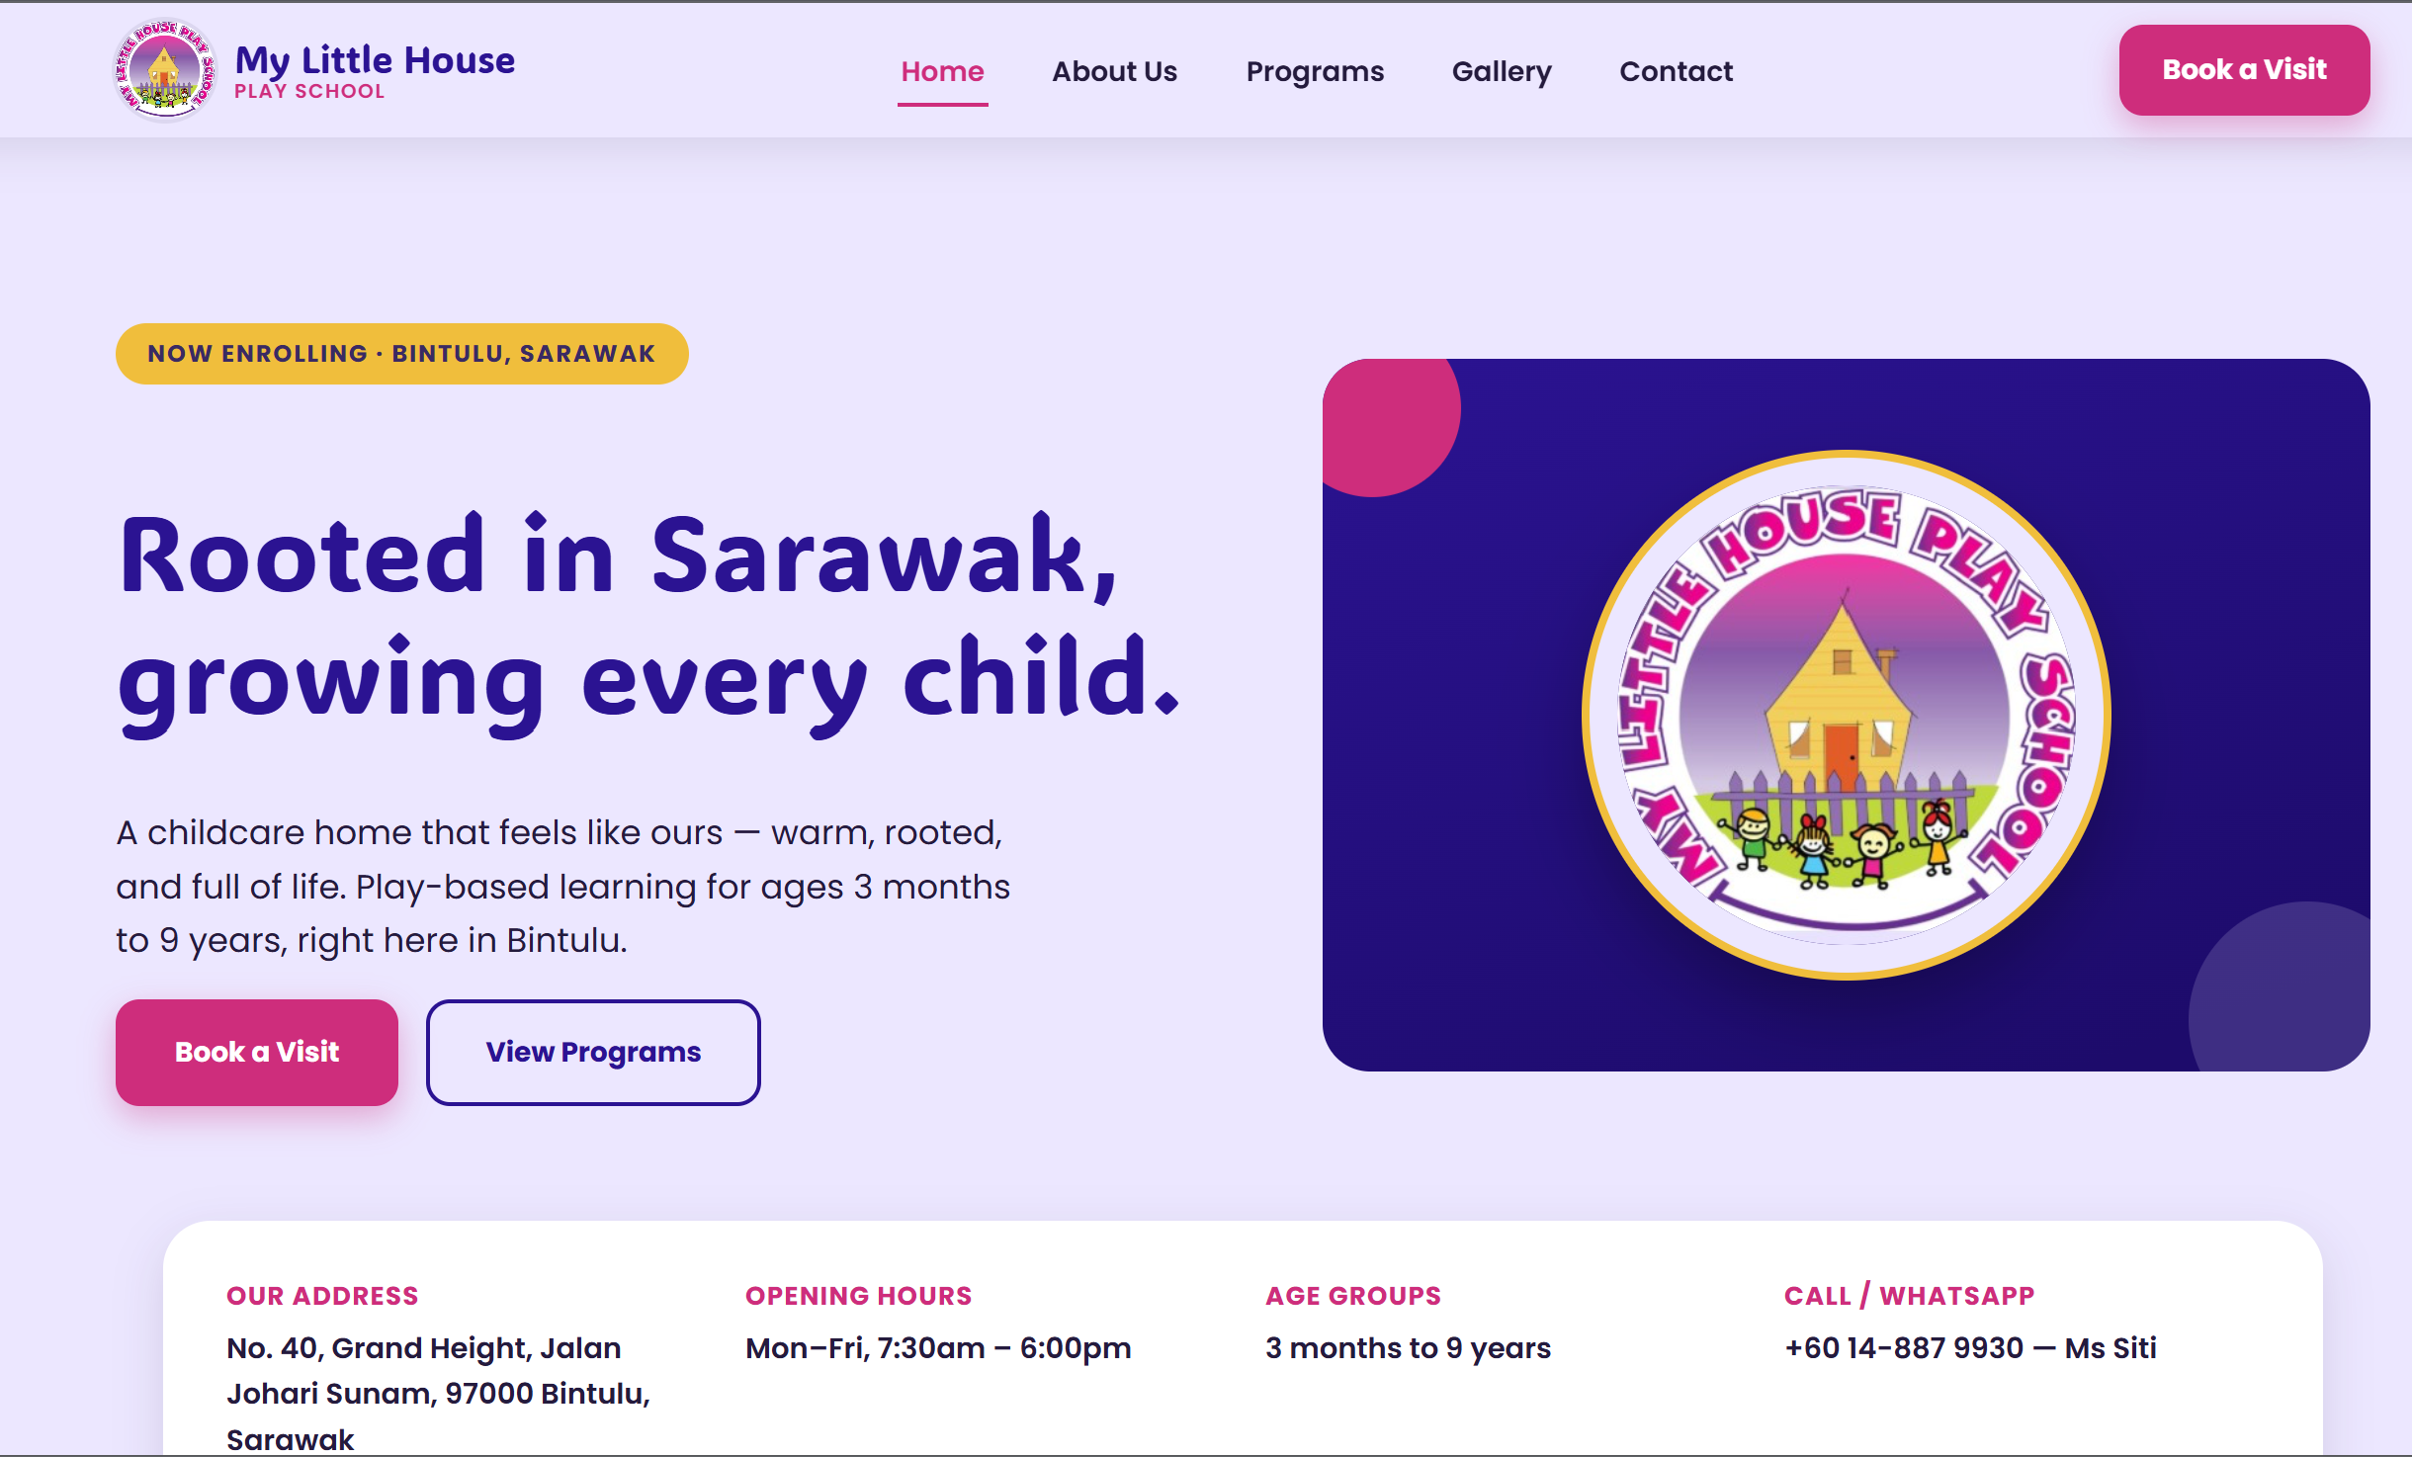
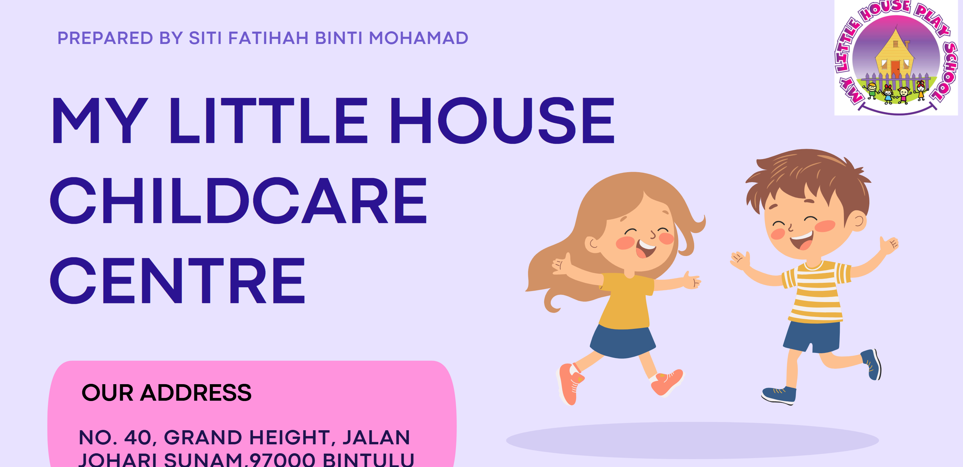
THE TRANSFORMATION
From slide deck to digital front door
Same centre, same warmth. What changed is how clearly a parent can act on it.
BEFORE
AFTER
A slide export, not a website — no menu, no clear next step for a parent
A real website — clear menu, warm local story, one obvious next step
3a
Notes:
About 25 seconds: “Here is the same centre, side by side. Before, the online presence was a slide-deck export — warm, but with no navigation and no clear next step for a parent. After, it’s a real website: a clear menu, the same warm local story, and one obvious path to book a visit.”

Slide 5
THE EXPERIENCE
Five pages. One simple journey.
Each page has a job — no filler, no dead-end content
HOME
PROGRAMS
ABOUT
GALLERY
CONTACT
Orient
Match
Reassure
Humanise
Convert
Who we are
What we offer
Ages, care types
Curriculum
Story, founder
Care philosophy
Real centre life
with consent
Visit, enquire
WhatsApp
DESIGN PRINCIPLE
Every click should answer a parent question or move them one step closer to contact
Notes:
About 35 seconds: “The full site is five pages, but it behaves like one journey. Home orients. Programs helps a parent match their child to the right option. About builds reassurance. Gallery makes the centre feel real and human. Contact turns interest into action. The design principle was simple: every click should either answer a parent question or move them one step closer to contact.”

Slide 6
THE OUTCOME
Find faster. Trust sooner. Enquire easier.
The website is designed to create clarity today — and a stronger digital foundation for tomorrow
FIND
TRUST
ENQUIRE
Key facts upfront
Real facts, local voice
Clear calls to action
Age range, location and programmes are immediately visible.
Confirmed programme details replace generic claims wherever possible.
Parents have an obvious next step instead of a dead end.
Before launch, we keep it responsible:
“Rooted in Sarawak,
growing every child.”
✓
Confirm WhatsApp, email, hours and fees
✓
Use real photos only with parental consent
Thank you
✓
Keep every claim evidence-based
Notes:
Closing (about 35 seconds): “So what does success look like? Parents find the essentials faster, trust the information sooner, and have an easier path to enquire. We also built with a launch mindset: the remaining placeholders — contact details, hours, fees and photos — should only go live once confirmed, and any identifiable child photos need parental consent. Our goal was not just to make a prettier website. It was to create a clearer bridge between a trusted local childcare centre and the families looking for it. Rooted in Sarawak, growing every child. Thank you.”

