Slide 1
Private pension size and reforms OECD countries, 2005-2020
Data & Machine Learning
Final Project
Final Project
Sara Gonzales

Slide 2
Project Overview
Data & Machine Learning
Final Project
1. Motivation
2. Original reform data
3. Natural Language Processing (NLP):
Supervised
Unsupervised
4. Exploratory Data Analysis
5. Regression models for predicting PFA
6. Conclusions

Slide 3
Motivation
Data & Machine Learning
Final Project
International financial institutions advocate for the development of private pensions (World Bank 1994; Anderson 2019; Brooks 2005; Hinrichs 2020; Carone et al. 2016; Thomas and Spataro 2016)
Highly heterogenous private pension designs (Barr and Diamond 2009; Fouejieu et al.2021).
Political and economic determinants of pension reforms (Lora and Oliver 2004; Brooks 2002, 2005, 2007; Verbič and Spuk 2019; Fong and Leibrecht 2020; Beetsma et al.2020; Brooks and Kurtz 2007)
Have private pension reforms in OECD countries boosted pension funds’ size in the short run?
Notes:
Multipillar WB 1994 report “Averaging the Old Age Crisis” (1) A mandatory publicly managed tax-financed public pension. (2) Mandatory privately managed, fully funded benefits (3) Voluntary privately managed fully funded personal savings.
There is no single best pension design (Barr and Diamond 2009), but it matters (Fouejieu et al.2021).
Crisis (Lora and Oliver), political diffusion – based on decision made in peer nations – (Brooks 2005, 2007), political institutions like concentration of legislative power, chief executive’s constraints, political competition and fiscal federalism (Brooks 2002, Verbic and Spruk 2019), globalization (Fong 2020), business cycles (Beestma 2020, Brooks 2007

Slide 4
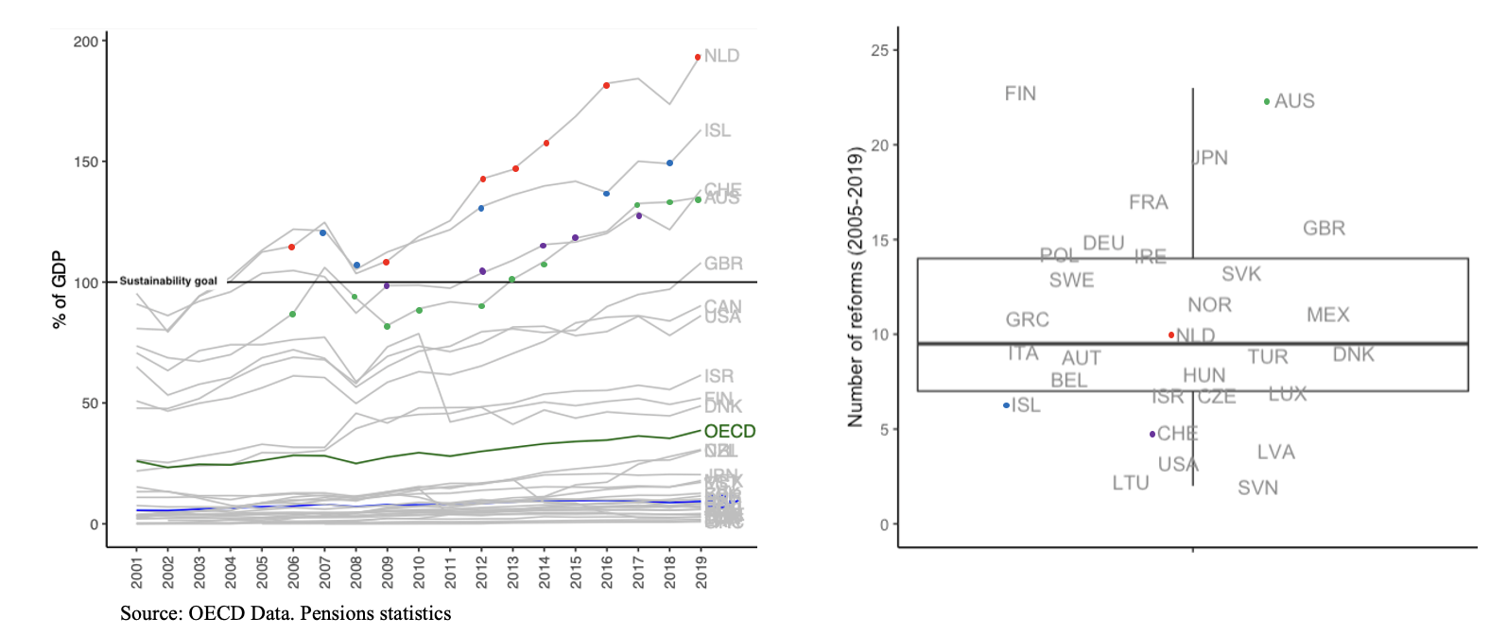
Motivation: Pension funds’ assets and PP Reforms
Data & Machine Learning
Final Project
Notes:
Significant differences remain across countries between the level of assets in pension funds relative to the size of the domestic economy.
OECD definition: “assets bought with the contributions to a pension plan for the exclusive purpose of financing pension plan benefits. The pension fund is a pool of assets forming an independent legal entity.” This indicator has been used to capture the strength of pension fund and as a basic one-dimension indicator of financialization levels of pension schemes.
Assets exceeded the size of the domestic economy in five countries: the Netherlands (210.3%), Iceland (194.3%), Switzerland (149.1%), Australia (128.7%) and the United Kingdom (118.5%). In contrast, pension fund assets remained much smaller in countries such as Albania, Greece and France, accounting for 0.2%, 1% and 2.6% of GDP respectively. Spain 9.29 and Sweden 4.21
In some countries, retirement savings are accumulated in vehicles other than pension funds. Examples include provisions in employers’ books (e.g. Austria, Germany, Sweden); pension insurance contracts (e.g. Belgium, Denmark, France, Sweden); and, vehicles offered and managed by banks, investment companies or other entities (e.g. Belgium, Denmark, the United States)
Nordic countries have the most sustainable and adequate pension systems (Mercer, 2021). Nonetheless, other European countries, as the Southern countries, are still out of the scheme and rely entirely on the first pillar
The Netherlands retirement income system comprises a flat-rate public pension and a quasi-mandatory earnings-related occupational pension linked to industrial agreements.
Iceland’s retirement income system comprises a state pension with two components (both of which are income tested according to different rules); mandatory occupational pension schemes with contributions from both employers and employees; and voluntary contributions in government-approved pension products.
Spain’s retirement income system comprises an earnings-related public pension system and a minimum means-tested social assistance benefit. Voluntary personal and occupational pension schemes exist but coverage is low compared to the public pension.

Slide 5
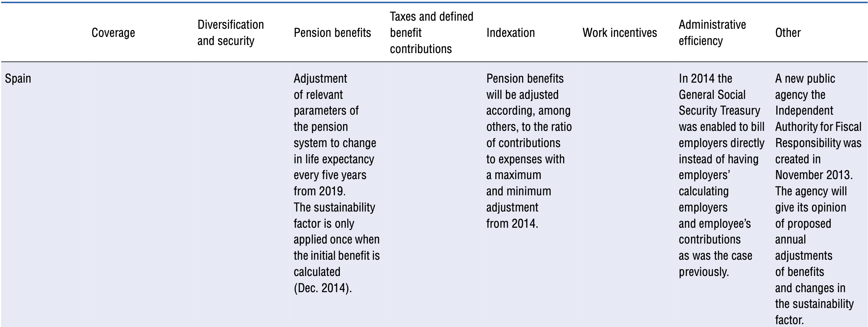
Pension reforms
Data & Machine Learning
Final Project
Notes:
Parametric reforms aimed at modifying concrete aspects of the pension systems parameters: changing the eligibility (i.e. increasing retirement age), changing generosity (i.e. benefits including benefits over time -indexation-, pensionable earnings, )
Pension reforms from September 2013 to September 2015. Details of pension reforms by country and prime objective. OECD changes the objectives in some reports
OECD: Pensions at a Glance and Pensions outlook.

Slide 6
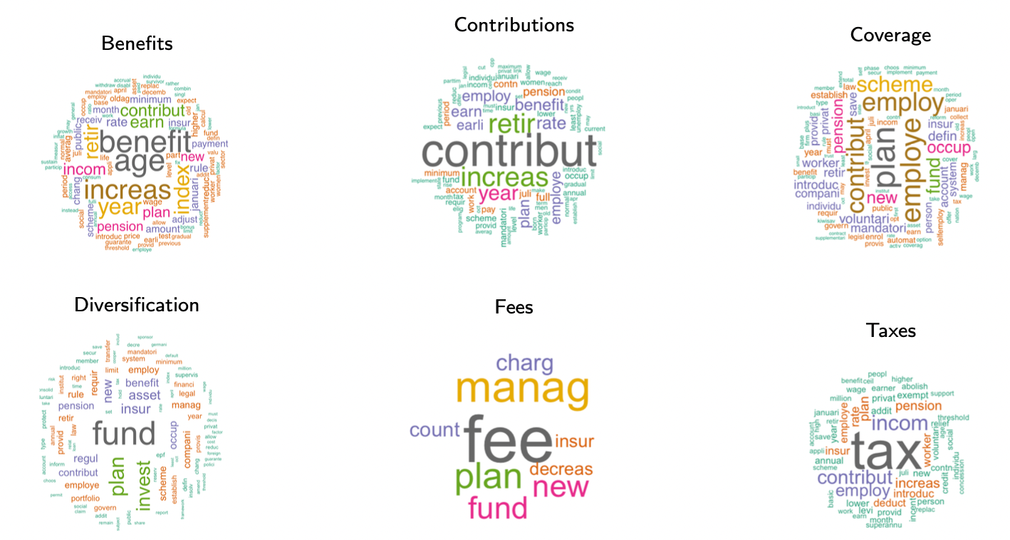
Original coding: 446 coded pension reforms
Data & Machine Learning
Final Project

Slide 7
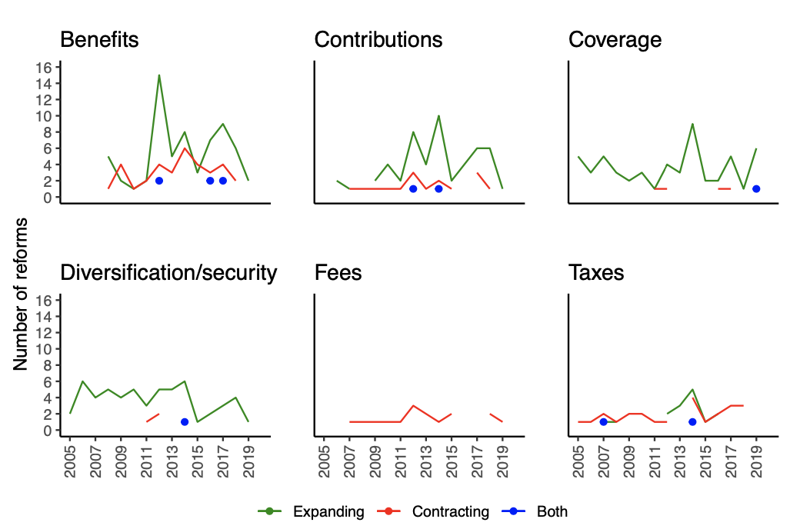
Original coding:
Notes:
Number of (country, year)-combinations by direction and topic of reforms.
Phasing-out or closure of some plans. Ex. Czech Republic closed a voluntary individual account due to low take-up.
Diversification: regulations on the investment activity such as changes in solvency rules (Canada 2009) or share in the permitted foreign assets (Chile 2012).

Slide 8
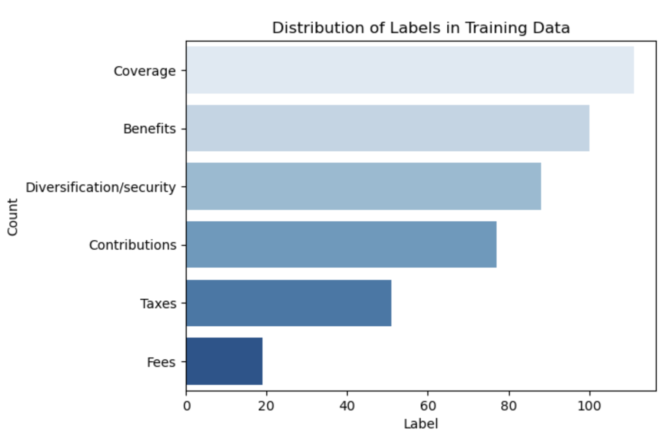
Supervised NLP
Data & Machine Learning
Final Project
Techniques (NLTK library):
Lowercase conversion,
Punctuation removal,
Stopword removal,
Lemmatization.
Word embedding techniques (Vectorization):
TF-IDF (Term Frequency - Inverse Document Frequency)
Word2Vec (neural network-based technique that learns continuous word embeddings, capturing the semantic relationships between words.)
Models
Naive Bayes
Random Forest
Linear Model

Slide 9
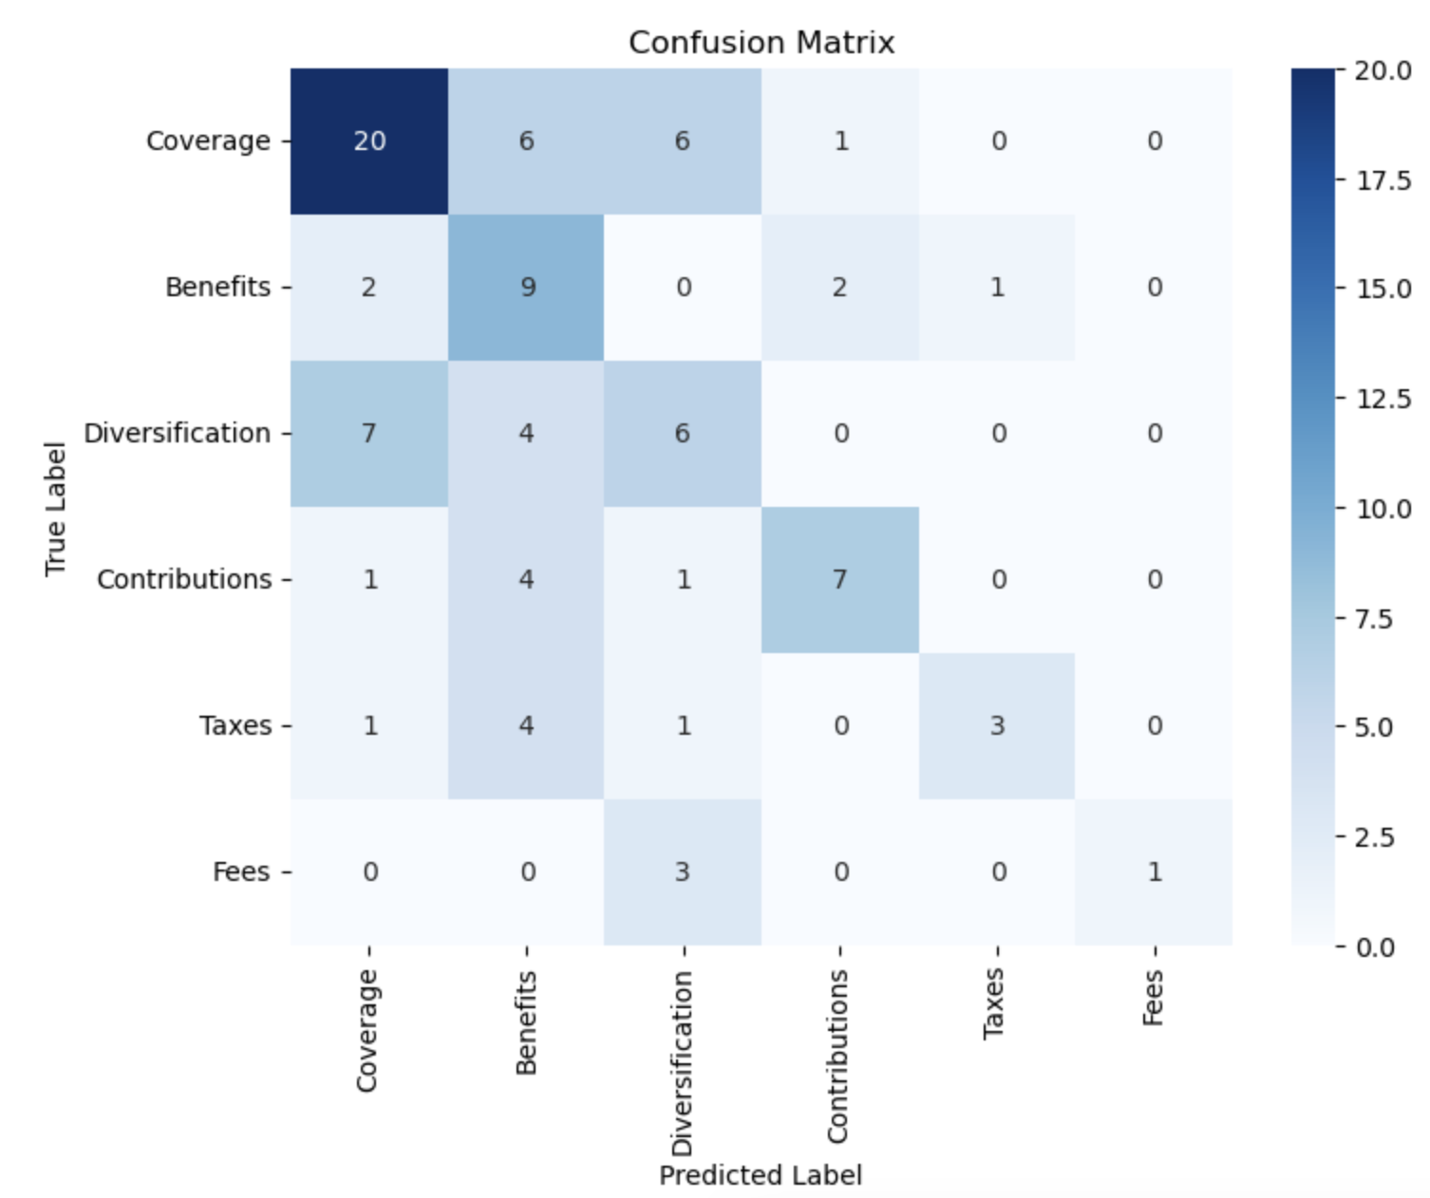
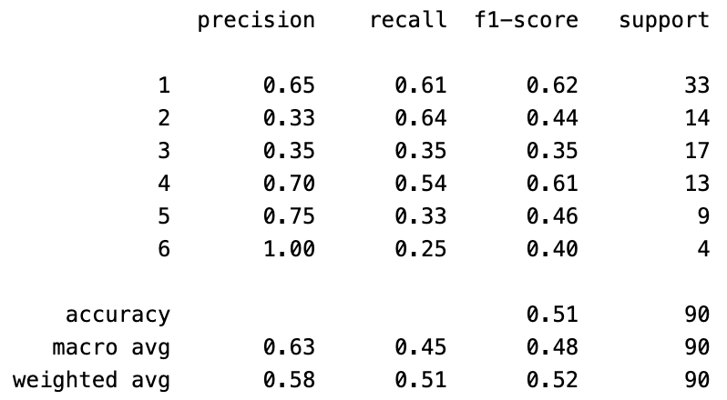
Supervised NLP: Best model
Data & Machine Learning
Final Project
Classification report
Cross Validation report

Slide 10
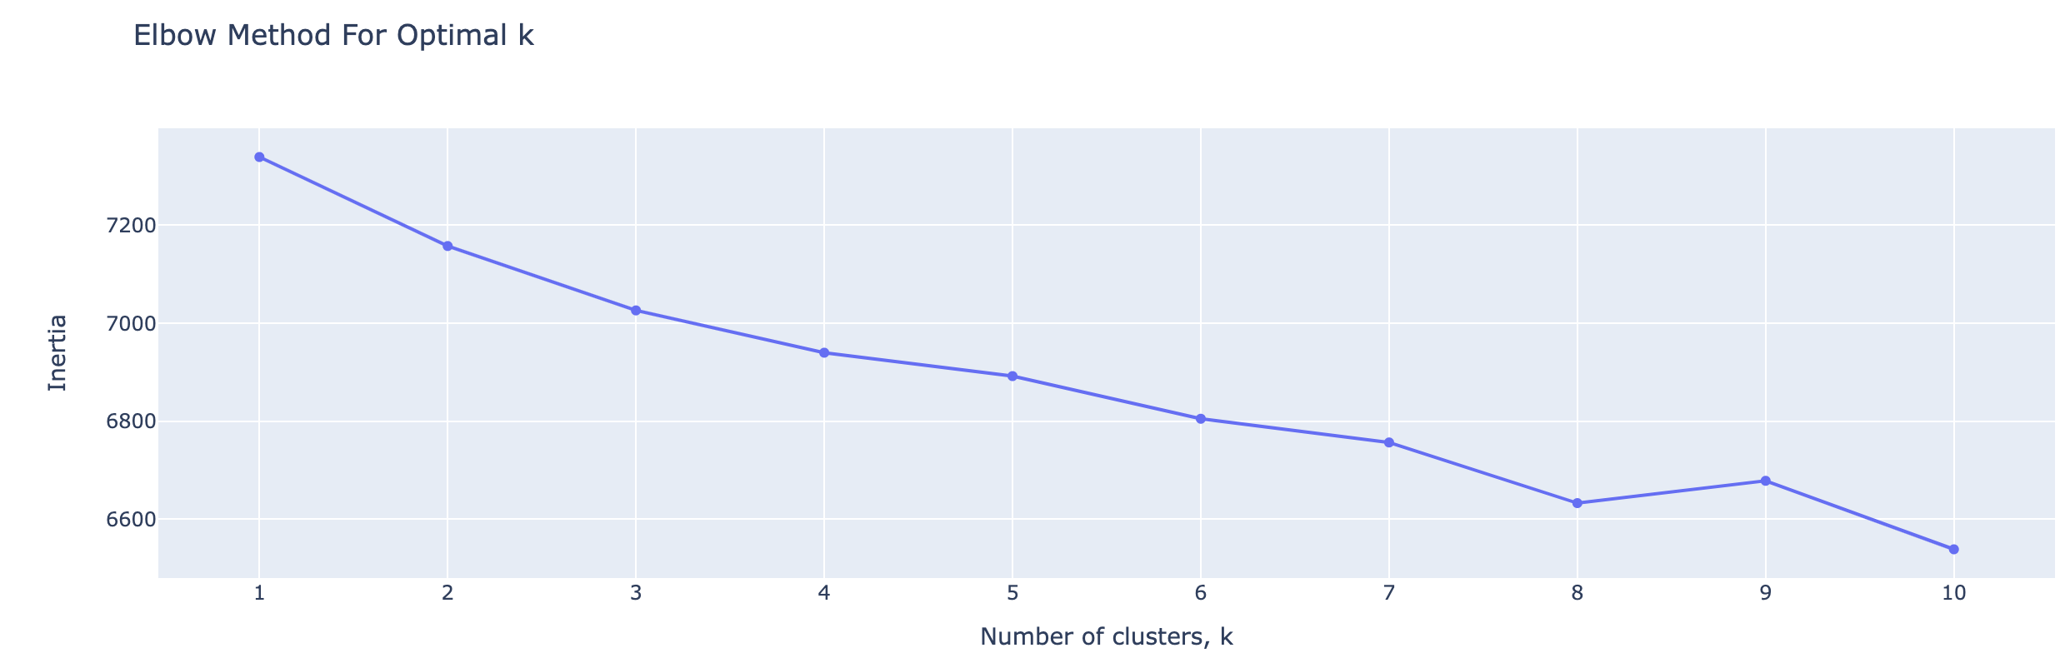
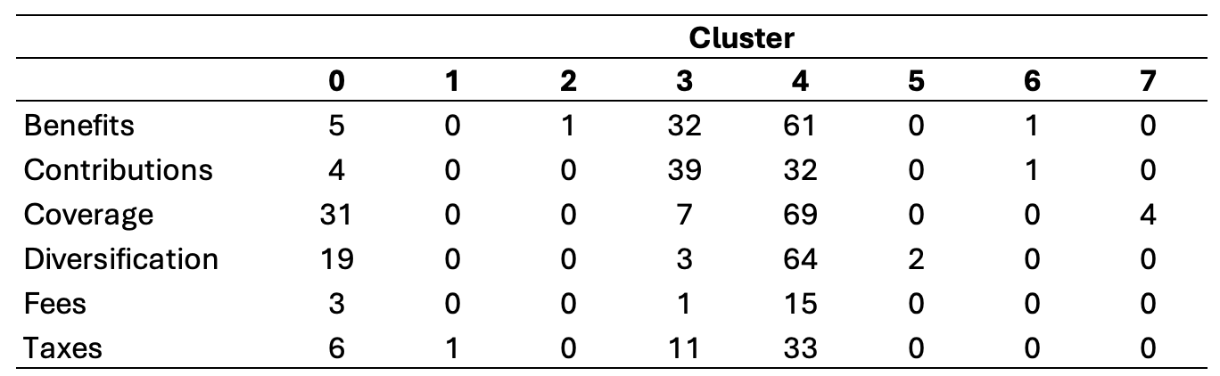
Unsupervised NLP
Data & Machine Learning
Final Project
K Means Clustering:
Elbow Method For Optimal K,
Knee Method Optimal Clustering : 8

Slide 11
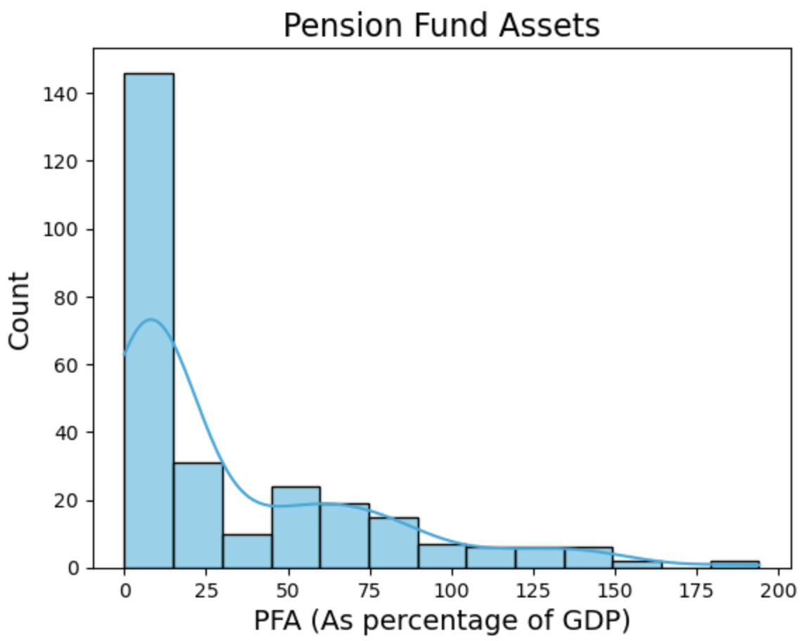
Regression Model: Target “PFA”
Data & Machine Learning
Final Project
Count | 274.00
Mean | 33.44
Std. | 40.55
Min. | 0.00
25% | 5.77
50% | 12.44
75% | 55.23
Max. | 194.19

Slide 12
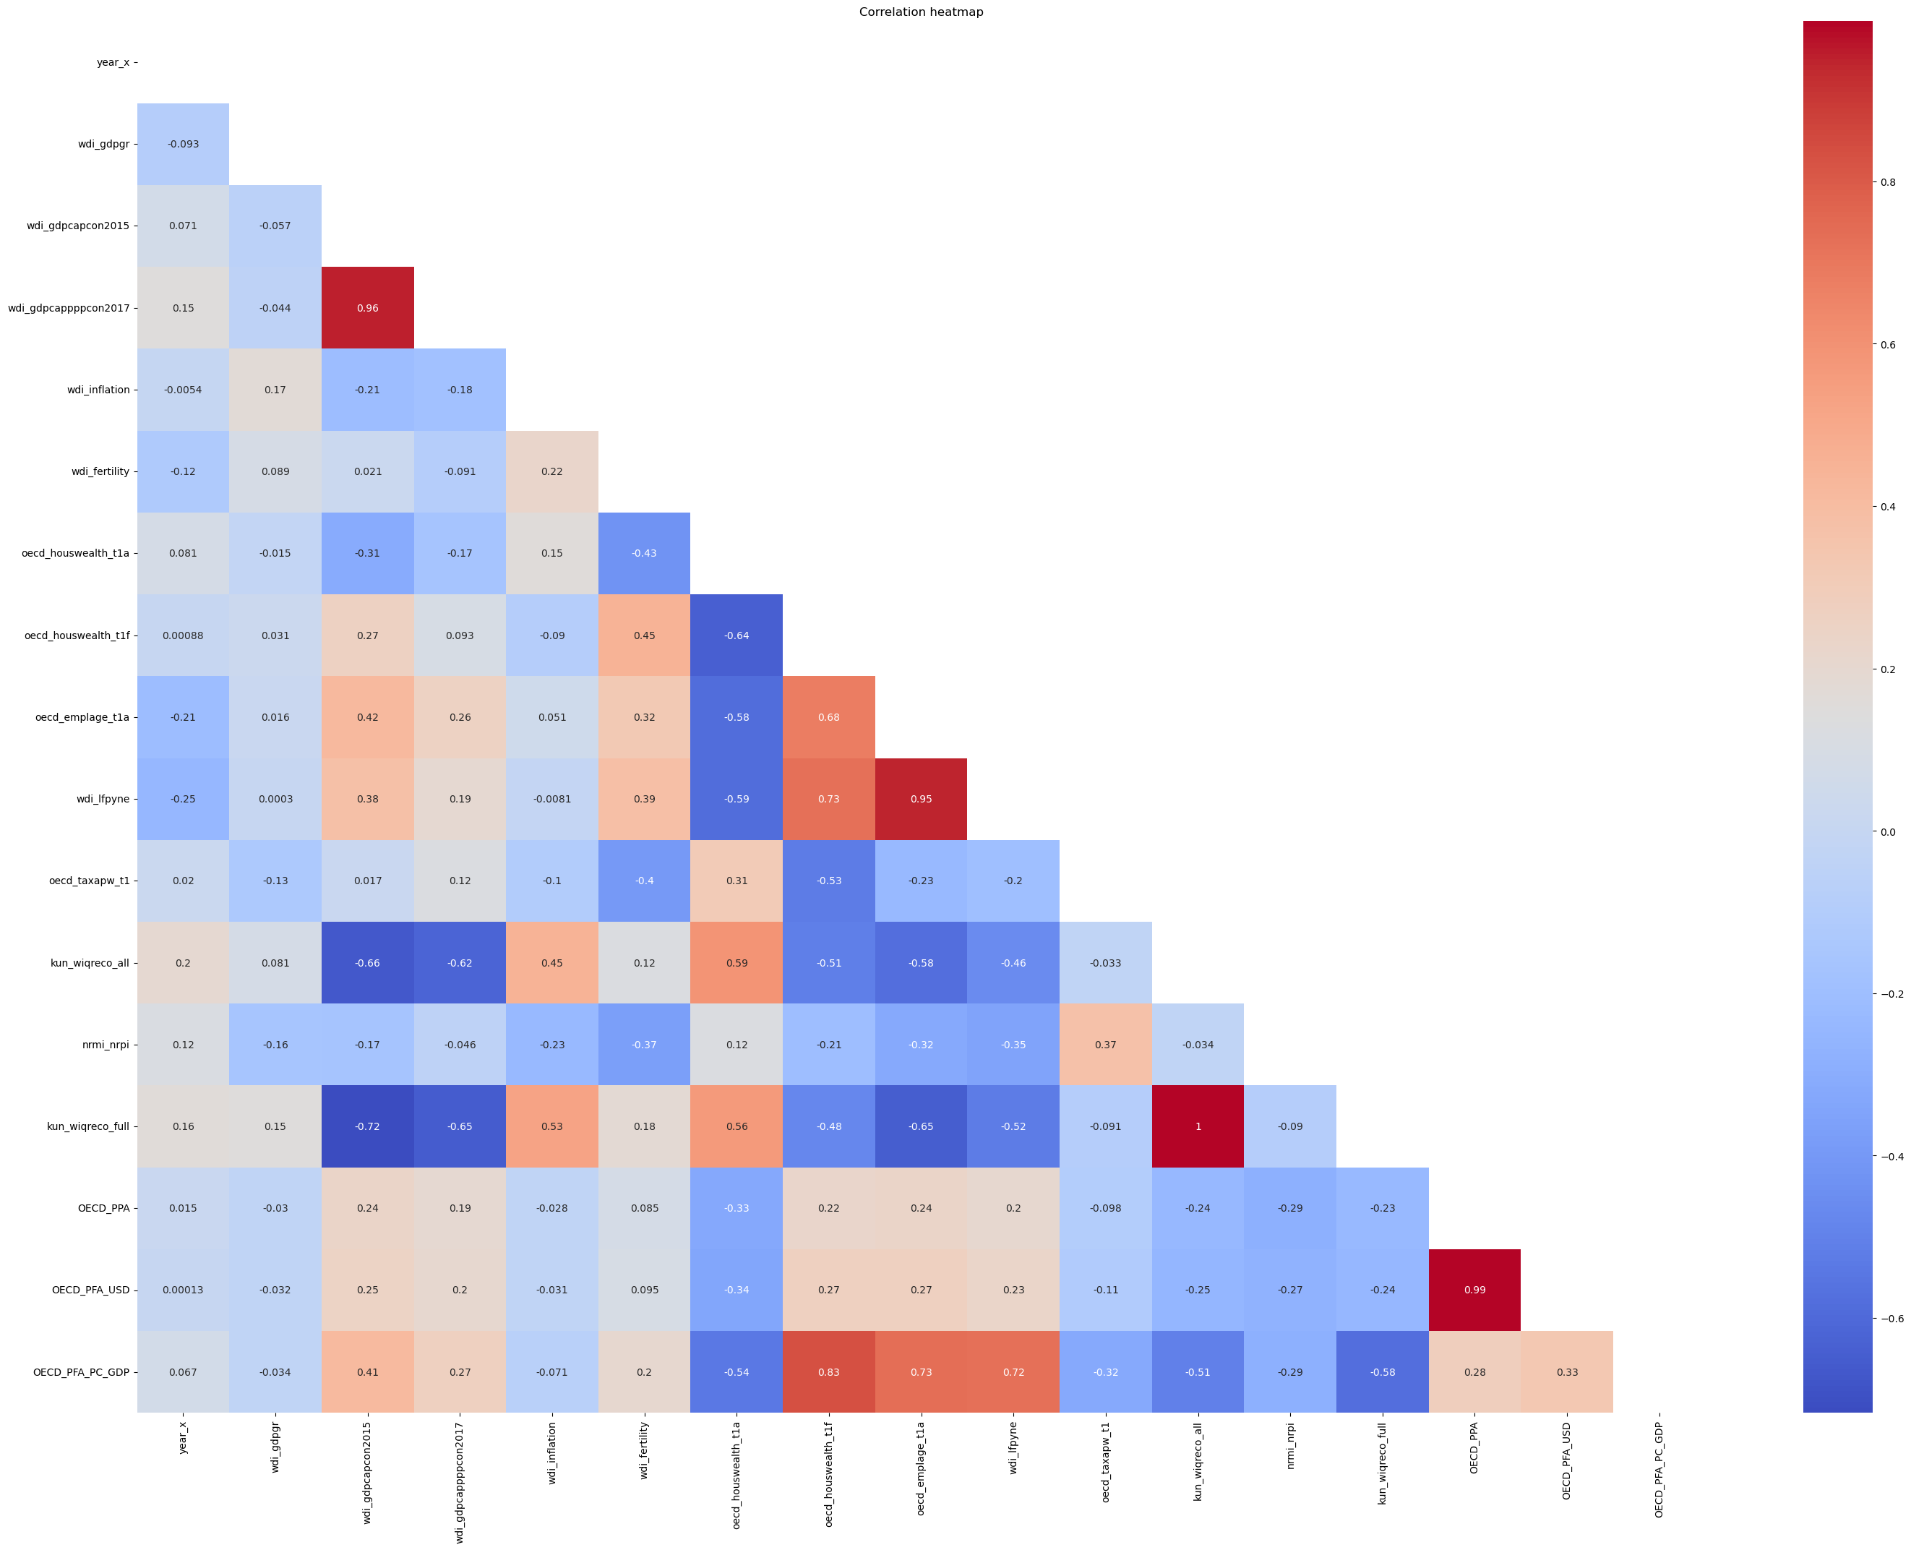
Exploratory Data Analysis
Data & Machine Learning
Final Project
PFA (%GDP) Correlation
GDP per capita | 0.462448
Fertility | 0.155465
Year | 0.140678
Reforms | 0.093531
GDP Growth | 0.002792
Inflation | -0.103258
Notes:
**Theory variables**
- **wdi_gdpgr: GDP growth (annual %)**
Annual percentage growth rate of GDP at market prices based on constant local currency. Aggregates are based on constant 2010 U.S. dollars. GDP is the sum of gross value added by all resident producers in the economy plus any product taxes and minus any subsidies not included in the value of the products. It is calculated without making deductions for depreciation of fabricated assets or for depletion and degradation of natural resources.
Times series: 1961-2022. Countries: 40
- **wdi_gdpcapcon2015: GDP per capita (constant 2015 US dollar)**
GDP per capita is gross domestic product divided by midyear population. GDP is the sum of gross value added by all resident producers in the economy plus any product taxes and minus any subsidies not included in the value of the products. It is calculated without making deductions for depreciation of fabricated assets or for depletion and degradation of natural resources. Data are in constant 2015 U.S. dollars.
Times series: 1960-2022. Countries: 40
- **wdi_gdpcappppcon2017: GDP per capita, PPP (constant 2017 international dollar)**
GDP per capita based on purchasing power parity (PPP). PPP GDP is gross domestic product converted to international dollars using purchasing power parity rates. An international dollar has the same purchasing power over GDP as the U.S. dollar has in the United States. GDP at purchaser’s prices is the sum of gross value added by all resident producers in the economy plus any product taxes and minus any subsidies not included in the value of the products. It is calculated without making deductions for depreciation of fabricated assets or for depletion and degradation of natural resources.
Data are in constant 2017 international dollars.
Times series: 1990-2022. Countries: 39
- **wdi_inflation: Inflation, consumer prices (annual %)**
Inflation as measured by the consumer price index reflects the annual percentage change in the cost to the average consumer of acquiring a basket of goods and services that may be fixed or changed at specified intervals, such as yearly. The Laspeyres formula is generally used.
Times series: 1960-2022. Countries: 40
- **wdi_fertility: Fertility rate, total (births per woman)**
Total fertility rate represents the number of children that would be born to a woman if she were to live to the end of her childbearing years and bear children in accordance with age-specific fertility rates of the specified year.
Times series: 1960-2021. Countries: 40
**Variables with the highest correlations**
- **oecd_houswealth_t1a: Financial asset of households - Currency and deposits :**
Financial asset of households as a percentage of total financial assets: currency and deposits
Times series: 1995-2018. Countries: 36
- **oecd_houswealth_t1f: Financial asset of households: Pension funds :**
Financial asset of households as a percentage of total financial assets: pension funds
Times series: 1995-2018. Countries: 33
- **oecd_emplage_t1a: Employment rates for age group 15-24**
Employment rates for age group 15-24 as a percentage of population in that age group
Times series: 1955-2018. Countries: 37
- **wdi_lfpyne: Labor force participation rate 15-24, total (%) (national est.)**
Labor force participation rate 15-24, total (%) (national estimate). Labor force participation rate for ages 15-24 is the proportion of the population ages 15-24 that is economically active: all people who supply labor for the production of goods and services during a specified period.
Times series: 1960-2022. Countries: 40
- **oecd_taxapw_t1: Taxes on the average worker**
Taxes on the average worker as a percentage of labour cost
Times series: 2000-2018. Countries: 36
- **kun_wiqreco_all: Economic World Institutional Quality Ranking (all countries)**
Economic World Institutional Quality Ranking (all countries).
Times series: 1990-2010. Countries: 39
- **nrmi_nrpi: Natural Resource Protection Indicator**
Natural Resource Protection Indicator assesses whether a country is protecting at least 17% of all of its biomes (e.g. deserts, forests, grasslands, aquatic, and tundra). It is designed to capture the comprehensiveness of a government’s commitment to habitat preservation and biodiversity protection. The World Wildlife Fund provides the underlying biome data, and the United Nations Environment Program World Conservation Monitoring Center provides the underlying data on protected areas.
Times series: 1995-2022. Countries: 38
- **kun_wiqreco_full: Economic World Institutional Quality Ranking (full obs.)**
Economic World Institutional Quality Ranking (countries with full observations).
Times series: 1990-2010. Countries: 32

Slide 13
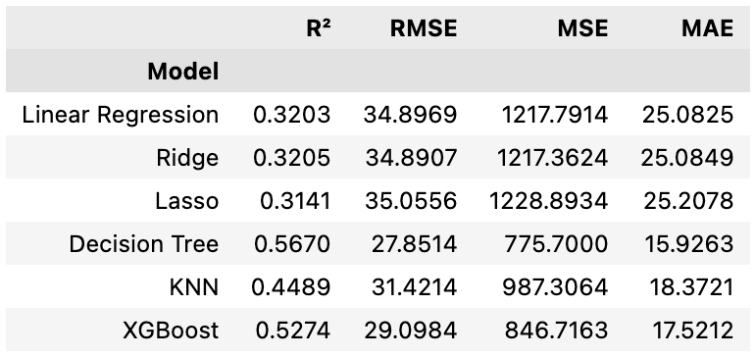
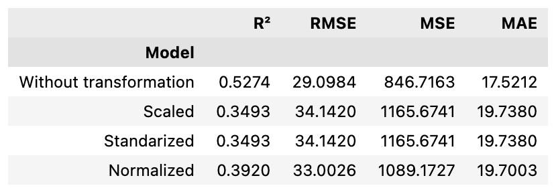
Model Comparison
Data & Machine Learning
Final Project
With original data
Improving XGBoost
Notes:
1. Coefficient of determination ($R^{2}$)
2. Mean Absolute Error (MAE)
3. Mean Squared Error (MSE)
4. Root Mean Squared Error (RMSE)

Slide 14
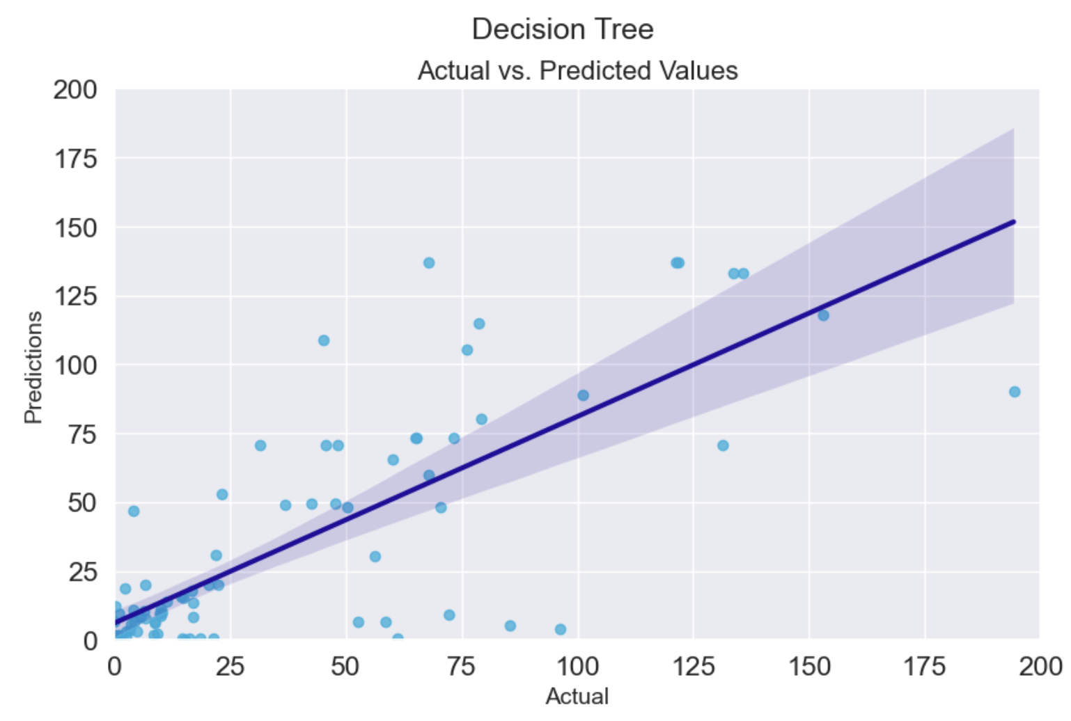
Best Regression Model
Data & Machine Learning
Final Project
Notes:
A Decision Tree is a versatile machine learning model that is used for both classification and regression tasks. It's called a decision tree because it uses a tree-like model of decisions.
### Key Concepts of Decision Trees:
1. **Structure**:
- **Nodes**: Each node represents a feature or attribute. Internal nodes represent tests on an attribute, and leaf nodes represent the outcome or decision.
- **Branches**: A branch represents the outcome of a test on an attribute and leads to another node or leaf.
- **Root Node**: The top node in a tree which starts the decision-making process.
2. **How It Works**:
- **Splitting Criteria**: The tree splits based on criteria that maximize some metric (like Gini impurity or entropy in classification trees, and variance reduction in regression trees).
- **Recursive Splitting**: The tree grows by splitting the data into subsets based on attribute values to create nodes and branches.
- **Stopping Criteria**: The tree stops growing when it reaches a specified maximum depth, or when additional splits no longer significantly improve the model.
3. **Advantages**:
- **Interpretability**: Decision trees are easy to understand and interpret. They can be visualized, allowing you to see how decisions are made.
- **Non-parametric**: They do not assume any specific structure of the underlying data distribution.
- **Flexible with Missing Values**: Can handle both numerical and categorical data, and handle missing values relatively well.
4. **Disadvantages**:
- **Overfitting**: Decision trees can become complex and overfit to the training data, especially if not controlled with parameters like maximum depth or minimum samples per leaf.
- **Instability**: A small change in the data can lead to a completely different tree structure.
### Applications:
- Commonly used for decision-making processes, like credit scoring, medical diagnosis, and customer segmentation.
Decision trees form the basis for more advanced models like Random Forests and Gradient Boosted Trees, which enhance performance by building multiple trees. If you have more specific questions or need further clarification, feel free to ask!

Slide 15
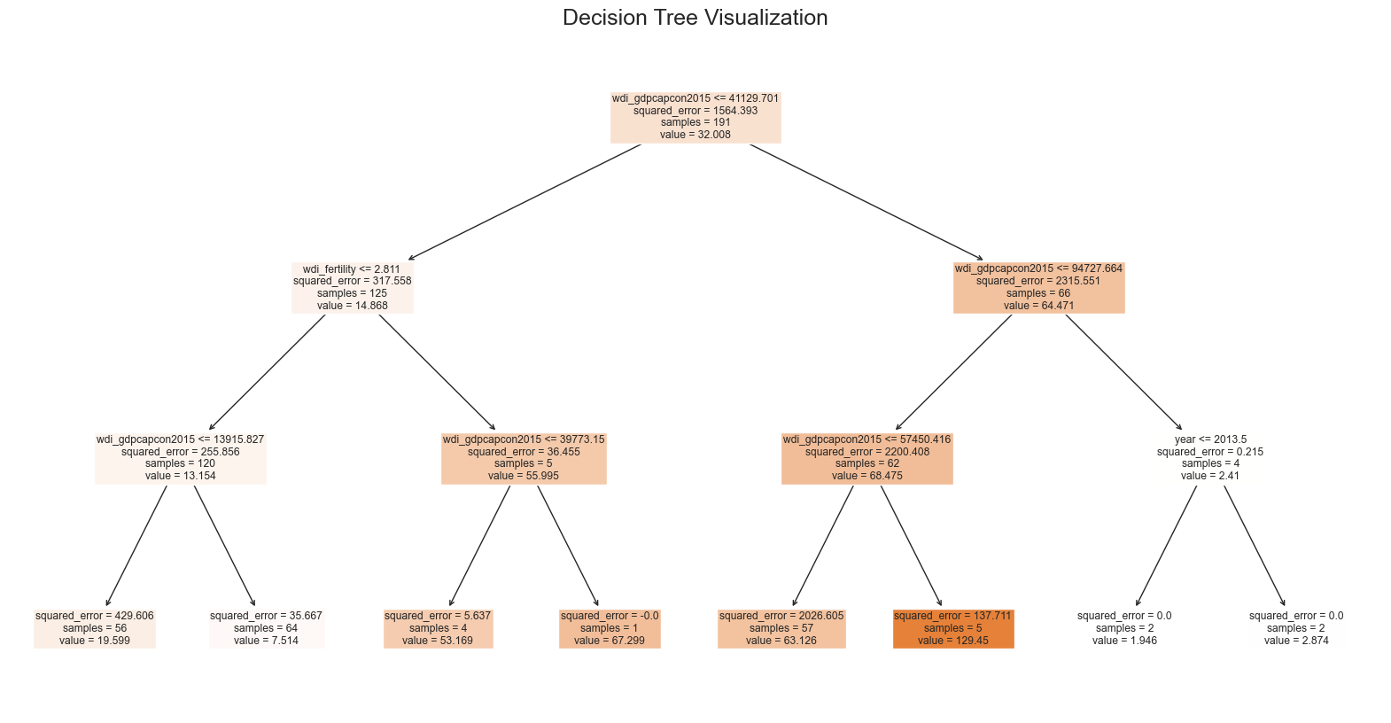
Best Regression Model
Data & Machine Learning
Final Project

Slide 16
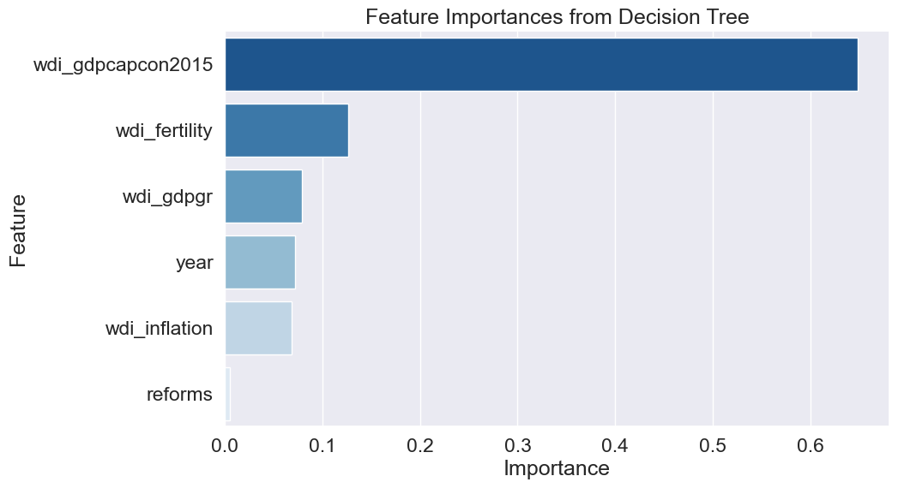
Feature importance
Data & Machine Learning
Final Project
Notes:
Understanding Feature Importances in Decision Trees
Calculation: The importance of a feature is computed as the (normalized) total reduction of the impurity brought by that feature. It is weighted by the probability of reaching the node (which is approximated by the proportion of samples reaching the node).
Interpretation: The higher the feature importance, the more significant the feature is likely to be for making predictions. Features with zero importance are not used in the decision-making process of the tree.

Slide 17
Conclusions
Data & Machine Learning
Final Project
Need more data!
The simplest models work better
NLP Challenge: too much … too little?
Success: Predictions
There is hope for private pension reforms
Tableau still is challenging

Slide 18
Thank you!
Data & Machine Learning
Final Project
Private Pension Size and Private Pension Reforms
OECD Countries, 2005-2020

