Slide 1
Reddit Project
October 19, 2023
Modify code to correct errors in generating tree structure within comments
Run tests with two variations of Method 2-
(i)unit level as submission, and
(ii) unit level as subreddit

Slide 2
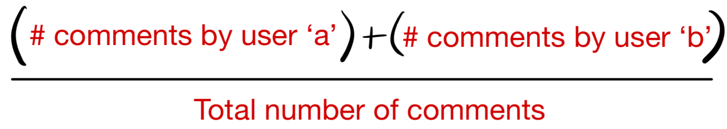
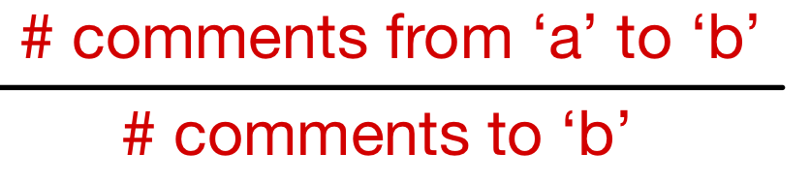
Eliminate Method 1 and Continue With Method 2
Method 1
Method 2
Capture user interaction between user ‘a’ and user ‘b’ if they are commenting on the same submission
For a given submission, consider a pair of users. The edge weight is defined as
Aggregate these edge weights at a subreddit level by taking the average of all edges between the same two user nodes
This graph is an undirected graph
Capture the number of times user ‘a’ replies to user ‘b’ and vice versa
For a given submission, consider a pair of users. The edge weight is defined as
Aggregate these edge weights at a subreddit level by taking the average of all edges between the same two user nodes
This graph is a directed graph

Slide 3
Findings While Modifying Code for Method 2
Nomenclature -
Two Types of Comments
Primary Comment
Secondary Comment
A direct response to a submission/post
A response to another primary comment / secondary comment
A row will not represent a submission/post; each row represents either a primary comment or a secondary comment
The edges in the graph generated only represent the secondary comments (we cannot create edges for primary comments because we do not know the information about the submission e.g., author of the submission, etc.)
To confirm: The ‘parent_id’ in a comment is another comment’s ‘id’ without the first 3 characters
child comment
Parent comment

Slide 4
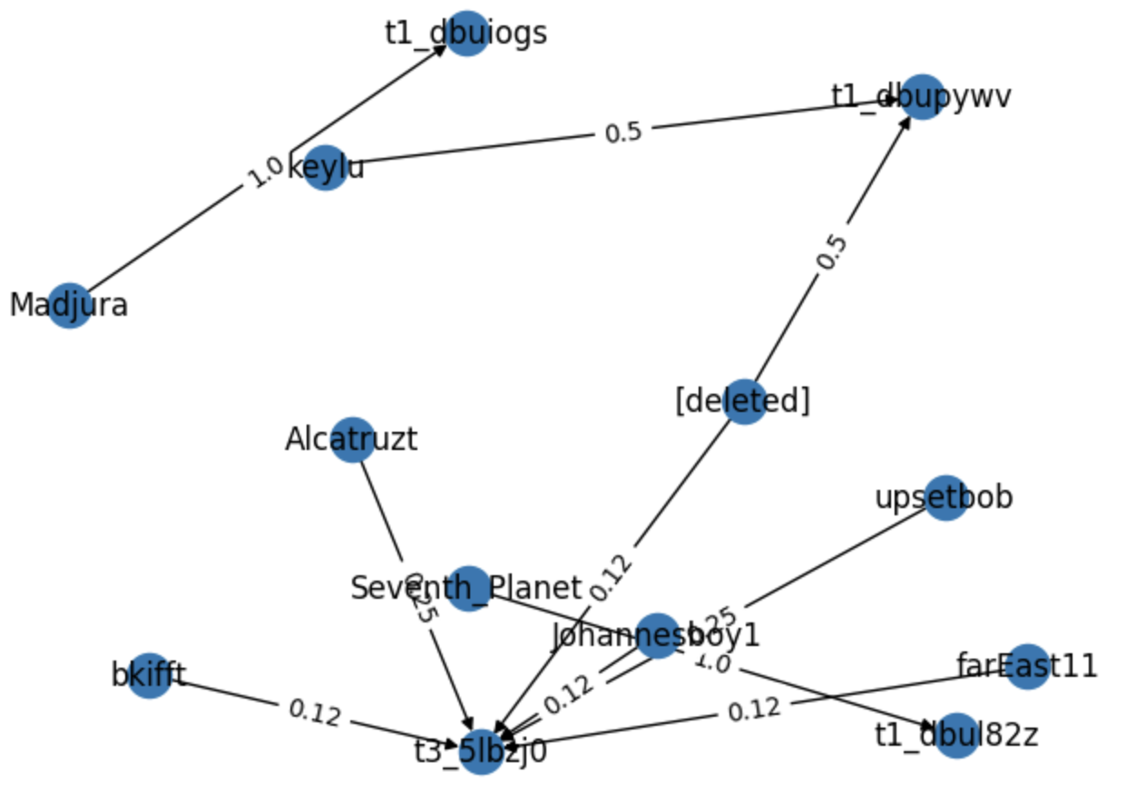
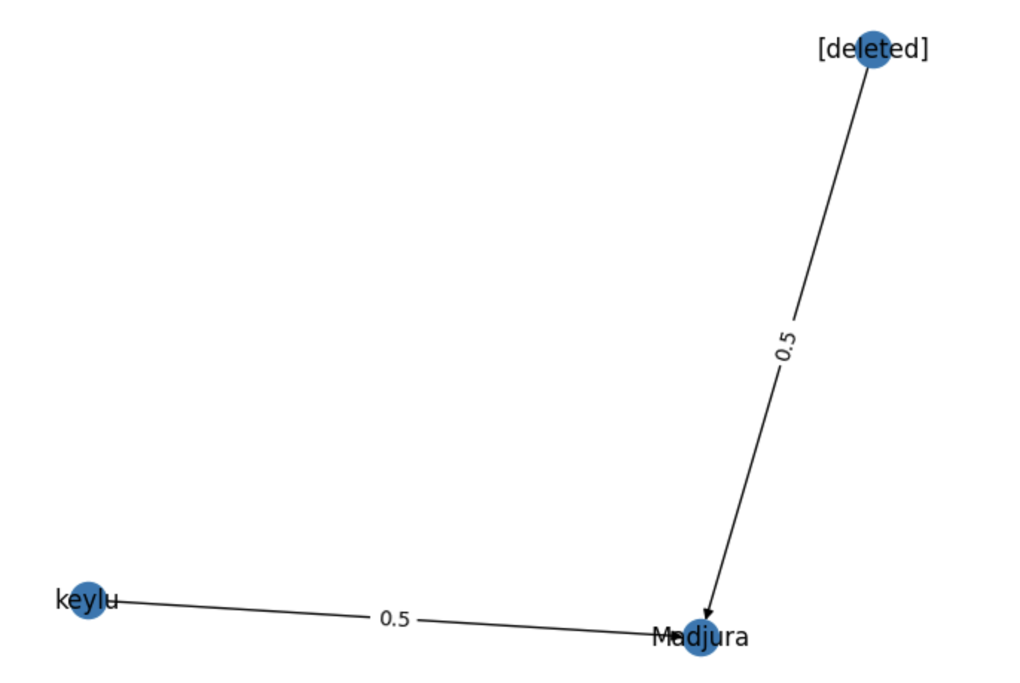
Corrected the Code for Method 2
Consider a single submission with id = ‘t3_5lbzj0’, having a total of 9 different users interacting across 12 comments
Incorrect Graph
CODE MODIFIED
Sparse graph which considered only secondary comments

Slide 5
Two Variations of Method 2
Method 2a
Method 2b
Unit of analysis is a submission
For each user pair,
average the edge weights across all submissions in a subreddit
Gives too much importance to obscure submissions
This graph is a directed graph
Unit of analysis is a subreddit
For each user pair,
Aggregate the numerator and denominator of the edge weights across all submissions in a subreddit, and then take a ratio of the aggregate of the numerator and aggregate of the denominator
Gives more importance to longer submissions than shorter/smaller submissions
This graph is a directed graph

Slide 6
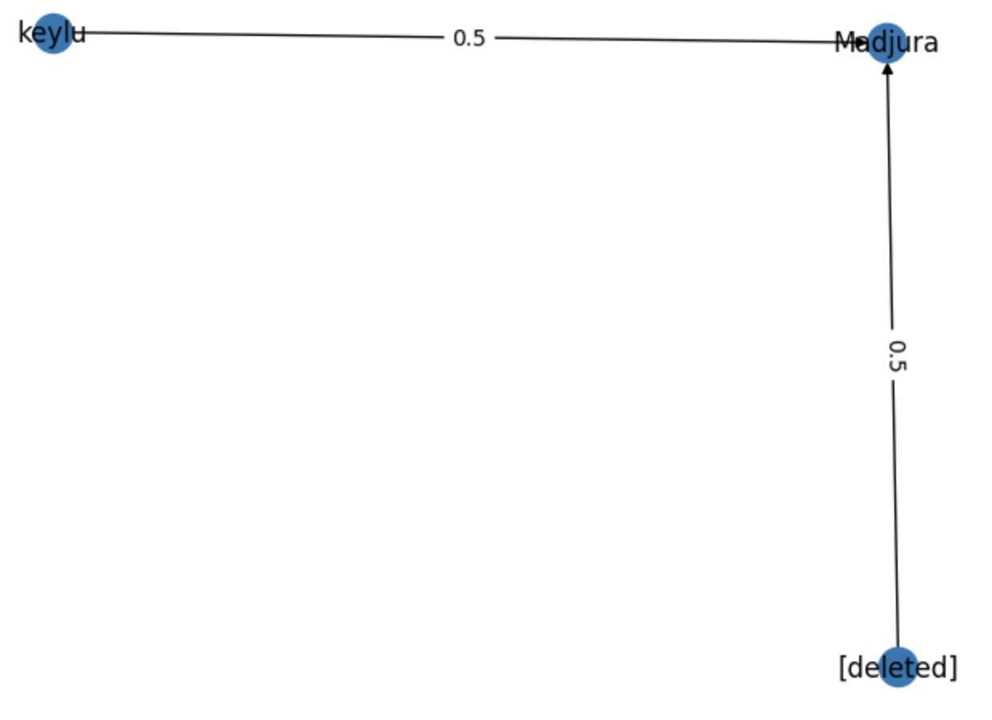
Consider One Small Submission
Consider the same submission (with id = ‘t3_5lbzj0’) having a total of 9 users interacting across 12 comments
Method 2a: Unit Level Submission
Method 2b: Unit Level Subreddit

Slide 7
Consider One Small Submission
Consider the same submission (with id = ‘t3_5lbzj0’) having a total of 9 users interacting across 12 comments
8 primary comments
2 comments did not have valid parent comments
2 Secondary comments found
Method 2a: Unit Level Submission
Method 2b: Unit Level Subreddit
No Difference In Edge Weights in Both Graphs.
Method 2a and 2b resulted in the same graph here

Slide 8
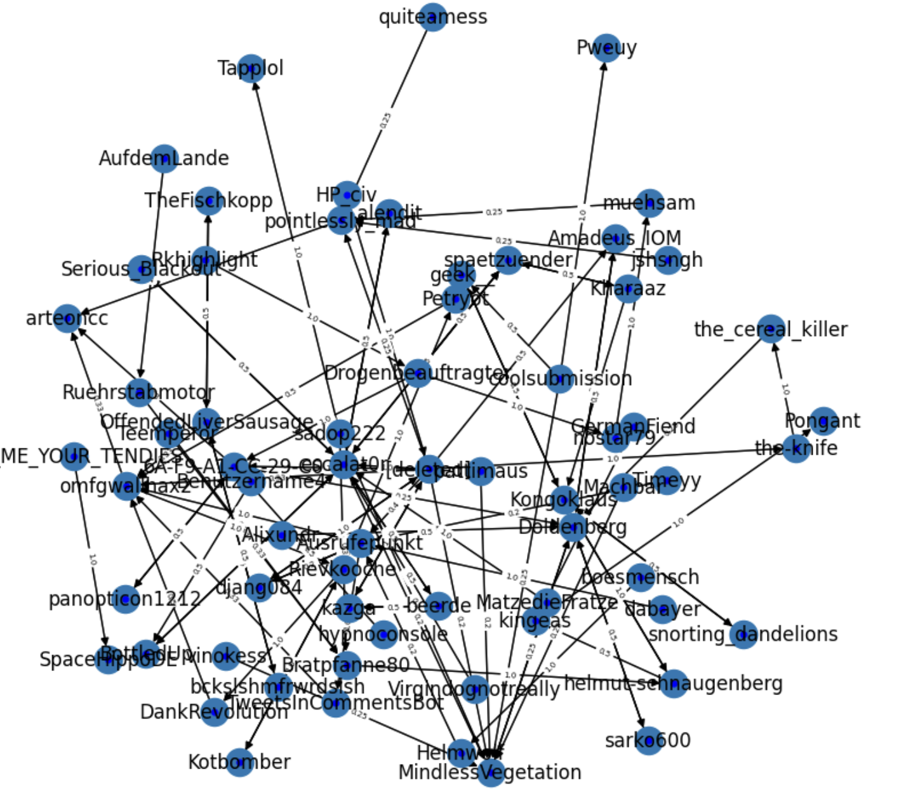
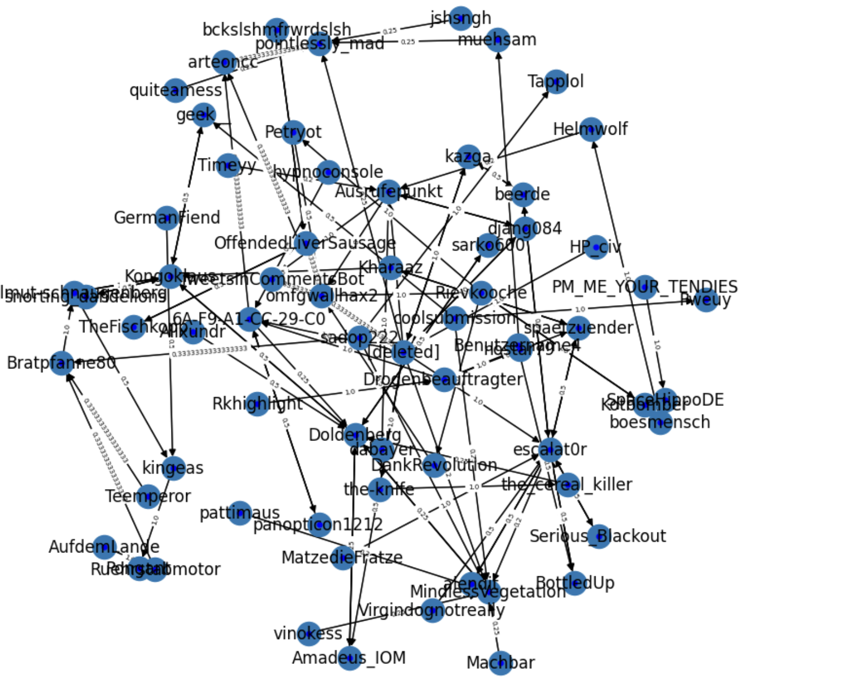
Method 2 on a Larger Submission
Now consider a larger submission with 136 comments and 68 users
Method 2a: Unit Level Submission
Method 2b: Unit Level Subreddit

Slide 9
Method 2 on a Larger Submission
Now consider a larger submission with 136 comments and 68 users
Method 2a: Unit Level Submission
Method 2b: Unit Level Subreddit
Both graphs may initially look different, but upon closer inspection there was No Difference In Edge Weights among all the unique user-pairs in Both Graphs
Thus, Method 2a and 2b resulted in the same graph again

Slide 10
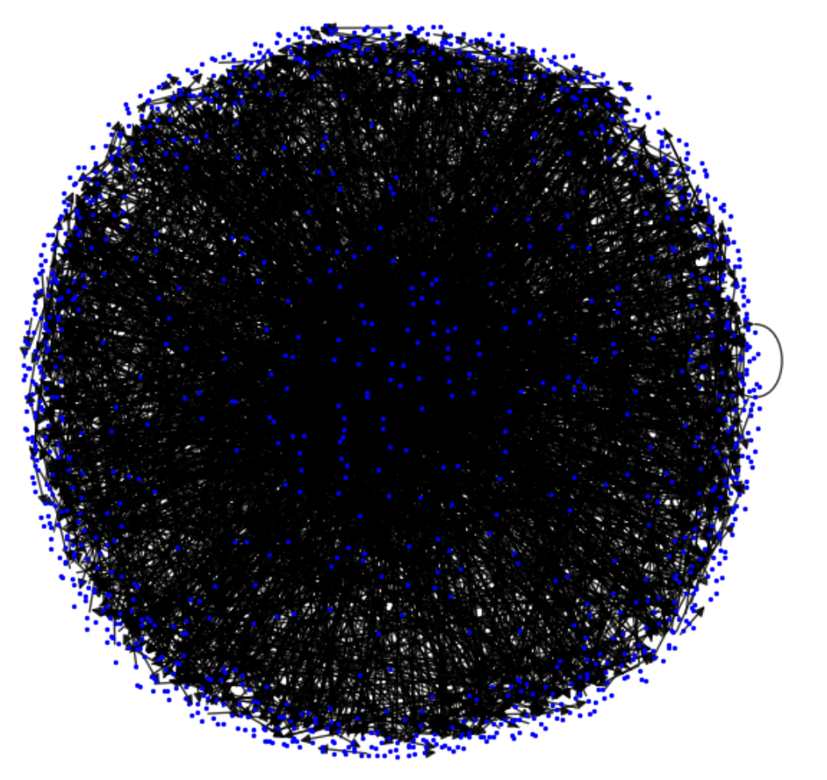
Method 2 on One Subreddit
Method 2a
Now consider an entire Subreddit with 253 submissions, with a total of 6142 comments.
Both Method 2a and Method 2b visually generate a similar graph (only Method 2a graph is shown).
However, out of 3454 pairs of user interactions identified, only 114 had different weights in both methods.
Thus, only around 3% of the edge weights differed.
Subreddit_id = ’t5_22i0’

Slide 11
Tests Run - Method 2a and Method 2b
Input Data | Number of Comments | Number of Submissions | Number of Authors | Difference between Edge Weights in Method 2a and 2b? | Percentage of different edge weights for SAME unique pairs identified in method 2a and 2b
1 submission (small) | 12 | 1 | 9 | No | 0%
1 submission (large) | 136 | 1 | 68 | No | 0%
5 submissions | 330 | 5 | 163 | No | 0%
1 subreddit | 6142 (2853 missing parent comments) | 253 | 1441 | Yes | 3%
10 subreddits | 29621 (18633 missing parent comments) | 2045 | 10669 | Yes | *Confirmed the YES; yet to get the exact percentage as the program was taking 2+ hours to run

Slide 12
Test Run Results - Explanation
It is often the case that user-pairs interacting in one submission are not interacting in other submissions
As the number of submissions in the subreddit grows, the likelihood of repeated user-pair interactions across submissions increases.
This is why, there is no difference in the edge weights from Method 2a and Method 2b when we consider a small number of submissions.
When the subreddit has 253 submissions (row 4 of table on previous slide) there was a difference in the edge weights; however, this difference was small (3%)
Significant difference in edge weights from these two methods is likely to arise when a larger number of subreddits is considered.

