Slide 1
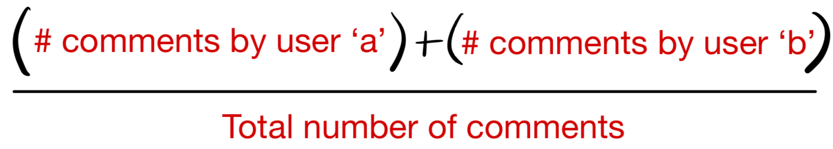
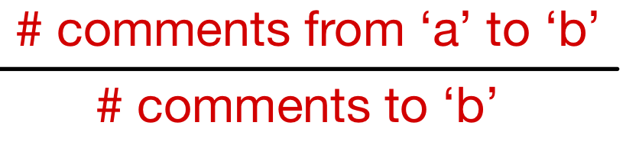
Two approaches Used to Capture User Interaction and Generate Graphs
Method 1
Method 2
Capture user interaction between user ‘a’ and user ‘b’ if they are commenting on the same submission
For a given submission, consider a pair of users. The edge weight is defined as
Aggregate these edge weights at a subreddit level by taking the average of all edges between the same two user nodes
This graph is an undirected graph
Capture the number of times user ‘a’ replies to user ‘b’ and vice versa
For a given submission, consider a pair of users. The edge weight is defined as
Aggregate these edge weights at a subreddit level by taking the average of all edges between the same two user nodes
This graph is a directed graph

Slide 2
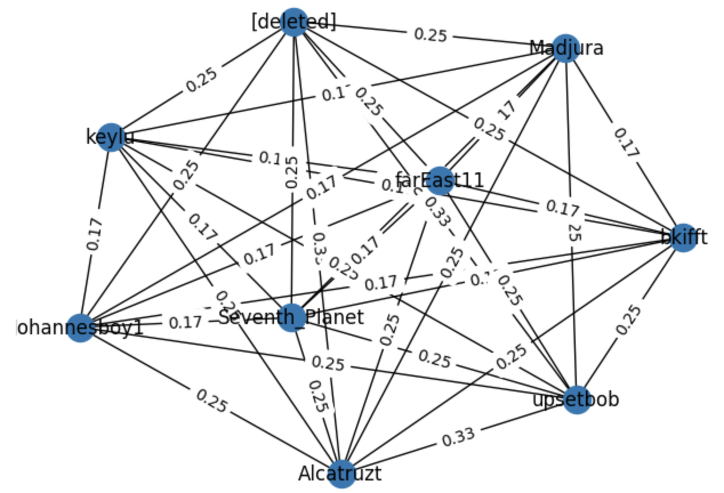
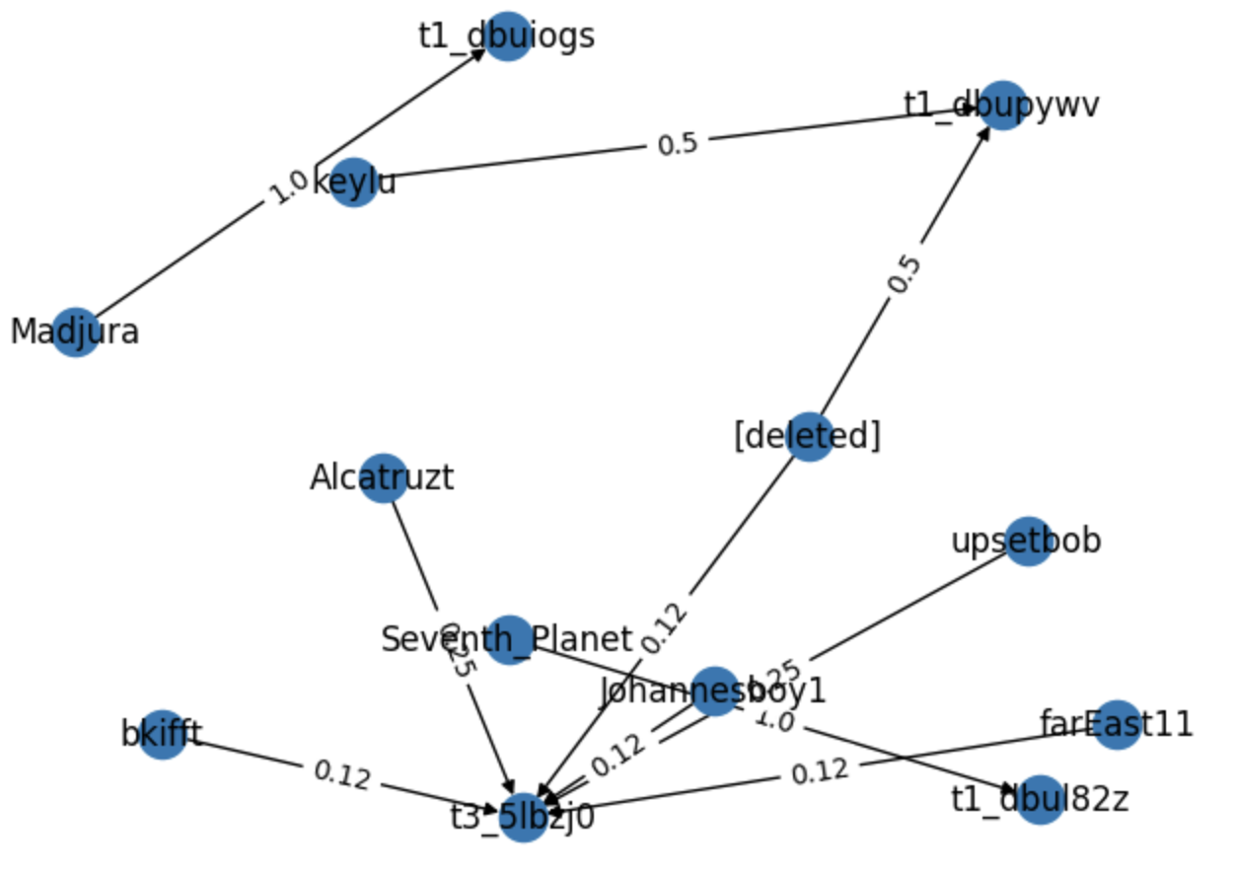
Graphs Generated For a Single Submission
Consider a single submission with id = ‘t3_5lbzj0’, having a total of 9 different users interacting across 12 comments
Method 1
Method 2
Highly connected graph
Relatively sparse graph

Slide 3
Top 10 ‘Closest’ Users (to a Given User)
Graph generated by Method 1
‘captnkaposzta’
Graph generated by Method 2
Author on the reddit platform
Sl.no | Author name | Cosine similarity
1. | 'markulatura’ | 0.9922357
2. | ‘Aporitis’ | 0.9911500
3. | ‘Uhl-zak’ | 0.9904530
4. | ‘TheGreening’ | 0.9903629
5. | ‘fydel’ | 0.9895782
6. | ‘ScanianMoose’ | 0.9895190
7. | 'NinjaPizzaCat’ | 0.9891165
8. | ‘InZehInterfector’ | 0.9889990
9. | ‘hanyonkyu’ | 0.9884629
10. | ‘Dukelix’ | 0.9883385
Sl.no | Author name | Cosine similarity
1. | 't1_dbwurok’ | 0.6102774
2. | ‘PAV3LOW’ | 0.6084694
3. | ‘mac_question’ | 0.6081311
4. | ‘Claide’ | 0.6070218
5. | ‘SchindetNemo’ | 0.6049954
6. | ‘t1_dbwzzmj’ | 0.6045657
7. | 'c4mmi’ | 0.6045107
8. | ‘throway65486’ | 0.6041142
9. | ‘Cactus2535’ | 0.6040175
10. | ‘B4rtBlu3’ | 0.6035223
Top 10 users with most similar node embeddings to node embeddings of user ‘captnkaposzta’
Top 10 users with most similar node embeddings to node embeddings of user ‘captnkaposzta’

