Slide 1

Automated Library Assistant
An IoT and Machine Learning Integrated System
Presented By: Sarbjot Singh & Munish Kumar
University Roll No: 2233367 & 2233361
For: Bachelor of Technology in Data Science

Slide 2
The Problem with Traditional Libraries
Traditional library systems, while foundational, often grapple with significant operational inefficiencies and limitations. These issues directly impact user experience and the effective management of resources.
Manual & Inefficient Processes
Prone to Human Error
Slow checkout and return procedures lead to long queues, consuming valuable time for both students and library staff. This bottleneck hinders the smooth flow of library services.
Reliance on manual tracking for inventory records frequently results in inaccuracies, misplaced books, and inconsistent data, complicating resource availability.
Lack of Data Insights
Suboptimal User Experience
Traditional systems typically do not collect or analyse data on user borrowing habits or book popularity, making it challenging to optimise the book collection and service offerings.
Limited accessibility and the absence of modern, engaging features deter users, failing to meet the expectations of today's tech-savvy generation.

Slide 3
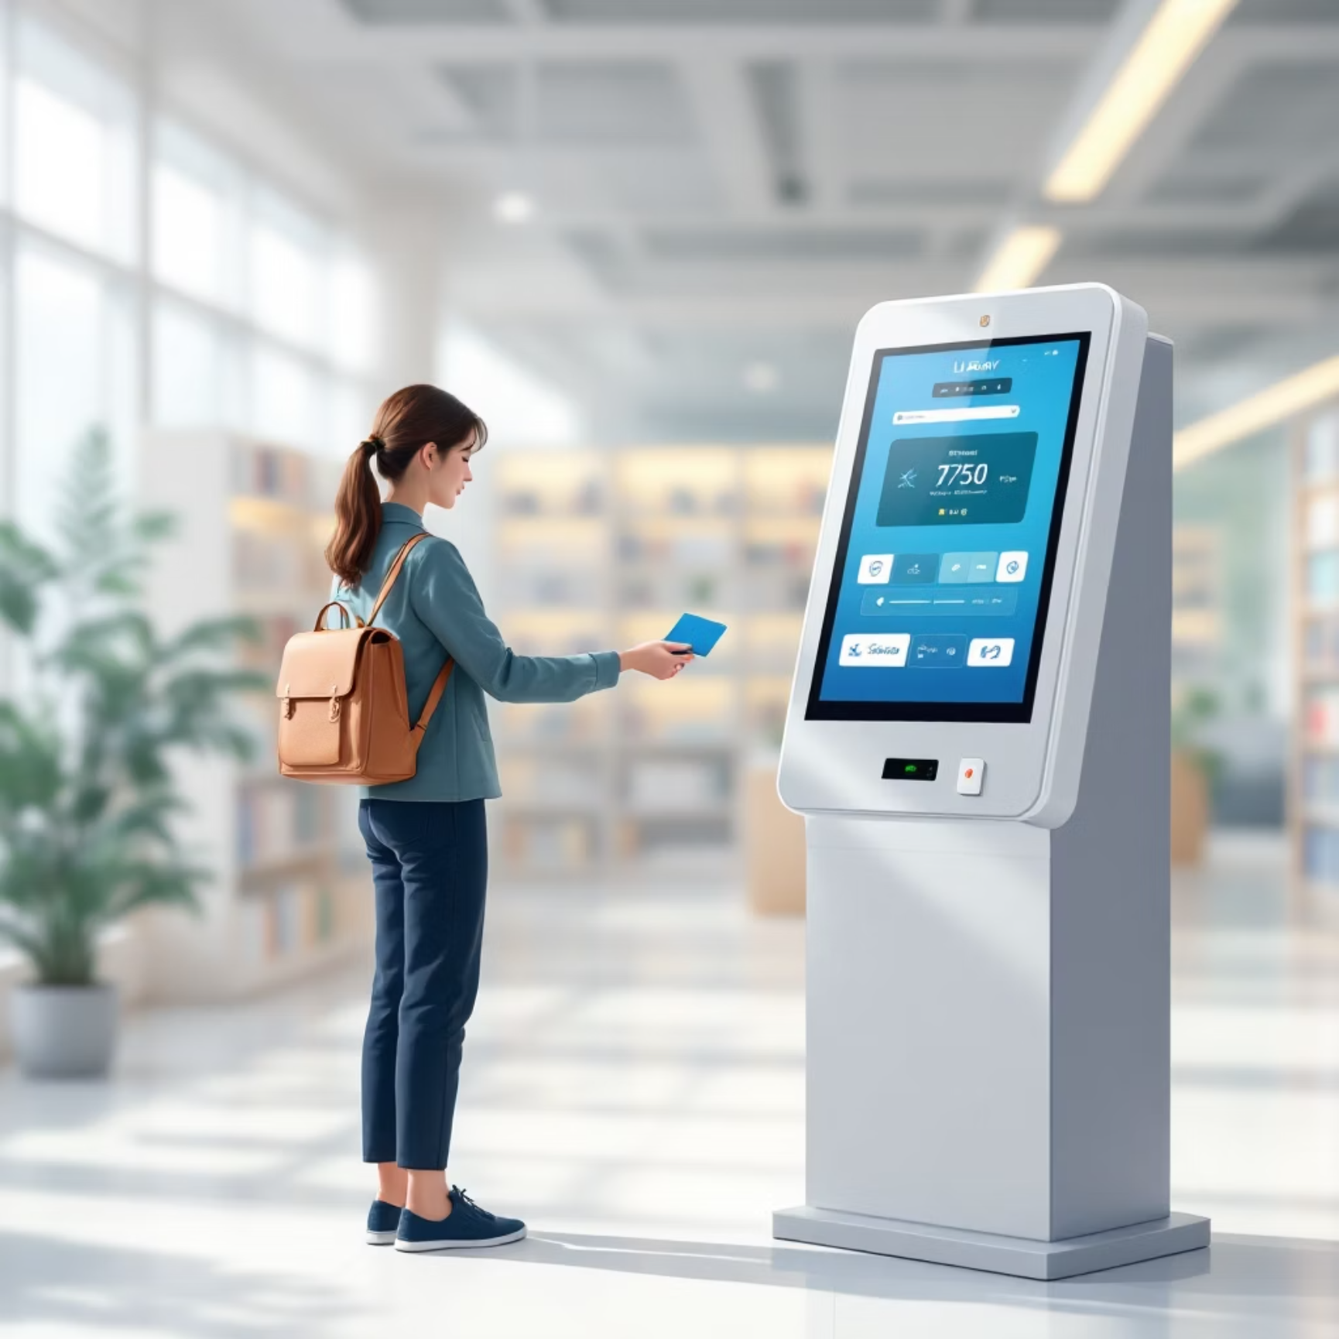
Our Solution: A Modern, Intelligent System
We propose the "Automated Library Assistant", a forward-thinking solution designed to revolutionise library operations through seamless integration of IoT and Machine Learning.
Hybrid System Approach
Combines a physical IoT kiosk for on-site interactions with a robust web application for remote management.
Enhanced Security & Efficiency
RFID-based authentication ensures secure, rapid, and accurate physical transactions, mitigating human error.
Data-Driven Optimisation
Leverages machine learning algorithms to provide intelligent, value-added features that enhance user experience and operational insights.
User-Friendly Accessibility
A modern web portal enables users to manage accounts and discover books from any internet-connected device, anytime, anywhere.

Slide 4








Project Objectives
Our project set out to achieve specific, measurable goals to deliver a comprehensive and intelligent library management system.
Secure IoT Kiosk Development
Robust Backend Creation
To develop a robust and secure IoT kiosk utilizing Arduino and RFID technology for seamless physical authentication of users and transactions.
To build a scalable and efficient backend infrastructure using Python and Flask, capable of handling all transaction logic and data management.
Dynamic Web Portal
Core Data Science Features
To create an intuitive, real-time web portal providing a seamless user experience for book discovery, account management, and transaction initiation.
To implement three key data science functionalities: a Book Recommendation System, Late Return Prediction, and an Answering Chatbot to enhance user engagement and operational intelligence.

Slide 5
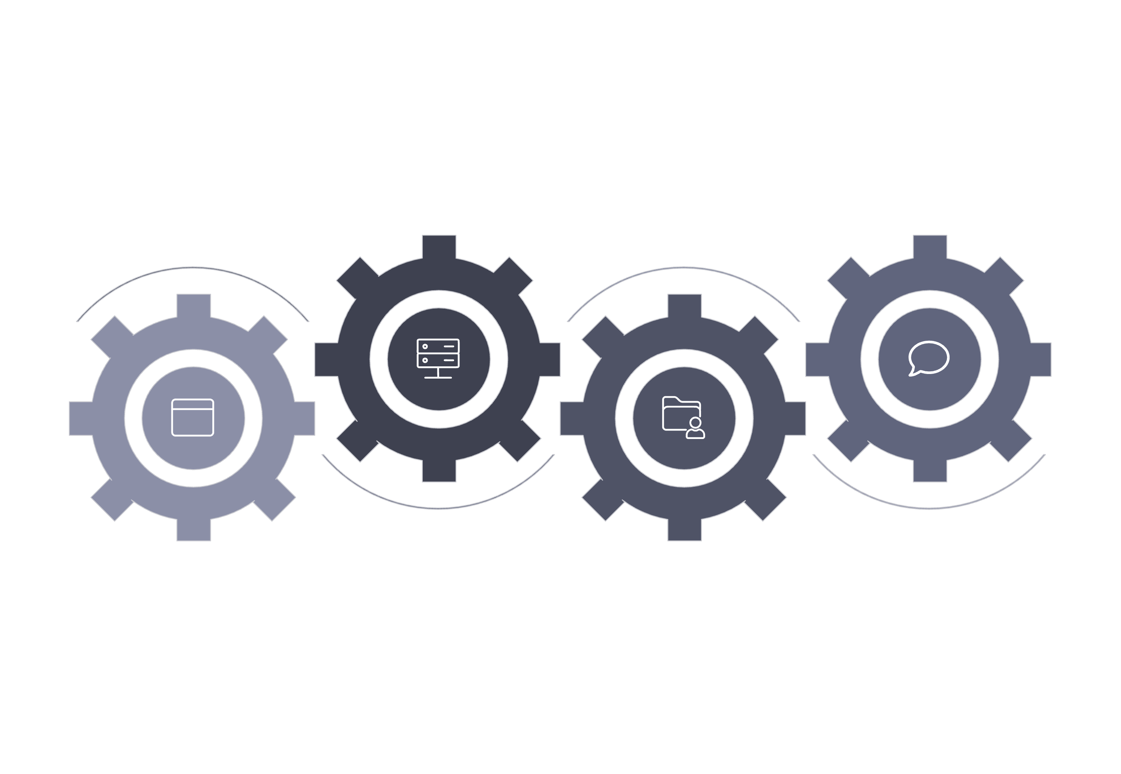




System Architecture: How It All Works Together
Flask Backend
IoT Kiosk
Server API and logic
Arduino + RFID terminal
Web Frontend
MySQL Database
User's device interface
Persistent data store
The system architecture illustrates the interconnected components that enable the Automated Library Assistant's functionality. The Web Frontend serves as the user's interface, communicating with the Flask Backend. The Backend, the central processing unit, interacts with both the MySQL Database for data storage and the IoT Kiosk for physical transactions. The IoT Kiosk, equipped with Arduino and RFID, facilitates secure interactions at the physical point of transaction.

Slide 6
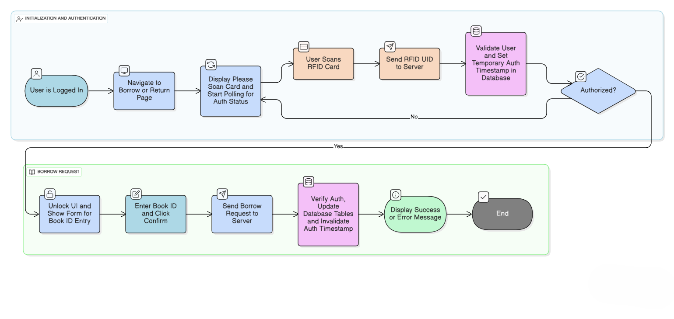
Workflow / Methodology
The system architecture illustrates the interconnected components that enable the Automated Library Assistant's functionality. The Web Frontend serves as the user's interface, communicating with the Flask Backend. The Backend, the central processing unit, interacts with both the MySQL Database for data storage and the IoT Kiosk for physical transactions. The IoT Kiosk, equipped with Arduino and RFID, facilitates secure interactions at the physical point of transaction.

Slide 7





The Secure Transaction Workflow
Our system employs a carefully designed workflow to ensure secure and efficient borrow/return processes, leveraging RFID for authentication and a temporary access window for enhanced security.
1. Login & Navigate
User logs into the web portal via their device and selects the desired transaction (borrow or return).
2. Scan Card
To initiate the physical transaction, the user scans their unique RFID card at the IoT kiosk.
3. Authorize
Upon successful card scan, the Flask Backend grants a temporary, single-use access window, unlocking the web portal UI for input.
4. Enter Book ID
The user enters the Book ID(s) directly into the now-active web portal interface.
5. Confirm
The server processes the transaction, updates the database, and immediately revokes the temporary access window, ensuring security.

Slide 8





Technology Stack
Our project utilizes a robust and modern technology stack, carefully selected to ensure scalability, performance, and ease of development across all components.
Python & Flask (Backend)
HTML, CSS, JavaScript (Frontend)
MySQL (Database)
Python serves as the primary language for backend logic and data processing, with Flask providing a lightweight and flexible web framework for API development.
Standard web technologies ensure a responsive and intuitive user interface, providing a seamless experience across various devices.
A powerful relational database management system chosen for its reliability and efficiency in storing and managing extensive library data, including user, book, and transaction records.
Arduino (C++) & RFID (IoT)
Scikit-learn & Jupyter Notebook (ML)
Arduino, programmed in C++, controls the IoT kiosk hardware, integrating RFID technology for secure and rapid identification and authentication.
Scikit-learn facilitates the development of machine learning models, while Jupyter Notebook provides an interactive environment for data analysis and model prototyping.

Slide 9

Intelligent Features: The Data Science Core
Our system's intelligence is powered by three key machine learning models, designed to provide enhanced value and insights to both users and library administrators.
Book Recommendation System
Late Return Prediction
Library Chatbot
A classification model that analyses user borrowing patterns and book attributes to predict the probability of an overdue return, enabling proactive reminders.
A simple Natural Language Processing (NLP) model developed to answer frequently asked questions regarding library hours, fine policies, and general enquiries.
Utilizes collaborative filtering algorithms on historical borrowing data to suggest relevant books, personalizing the discovery experience for each user.

Slide 10
Conclusion & Future Scope
Conclusion
Future Scope
Successfully conceptualized and designed the ‘Automated Library Assistant,’ demonstrating the feasibility of the integrated system
Payment Gateway Integration: Implement a secure payment gateway for seamless online payment of late fees and other charges.
The system significantly improves operational efficiency, enhances security through RFID, and provides a modern, intuitive user experience.
Mobile Application Development: Develop dedicated iOS and Android mobile applications to extend accessibility and user convenience.
Seamless integration of IoT hardware with a data-driven web application was achieved, proving the interdisciplinary approach.
Advanced NLP for Chatbot: Expand the chatbot's capabilities using more sophisticated Natural Language Processing models for richer interactions and a wider range of queries.

Slide 11


