Slide 1



Name of Project:
AI-Powered Plant Disease Detection for Sustainable Agriculture
AICTE Internship Student Registration ID : STU67cbf78016f321741420416
AICTE Internship ID : INTERNSHIP_17513641056863b20937d78

Slide 2

Learning Objectives
To execute an end-to-end Deep Learning project, from data collection and analysis to final deployment.
To apply Transfer Learning to build a highly accurate image classification model with limited data.
To master the use of TensorFlow for model creation and Streamlit for building an interactive web application.
To create a practical, real-world tool that addresses a key challenge in sustainable agriculture.
GOAL
Source :
www.freepik.com/

Slide 3
Tools and Technology used
Language: Python
Deep Learning: TensorFlow, Keras
Web Framework: Streamlit
Data Analysis & Visualization: NumPy, Matplotlib
Version Control: Git & GitHub (with Git LFS for data handling)
Development Environment: Jupyter Notebook

Slide 4
Methodology
Data Collection & EDA: Sourced over 5,700 images of potato leaves from the Plant Village dataset. Performed Exploratory Data Analysis (EDA) to visualize the data and confirm a balanced class distribution.
Model Building (Transfer Learning): Utilized the pre-trained MobileNetV2 architecture. Froze the base layers and added a custom classifier with Dropout for regularization.
Model Training & Evaluation: Trained the model for 10 epochs, achieving a final validation accuracy of over 97%.
Model Saving: Saved the trained model into a single .h5 file for deployment.
Web App Deployment: Built an intuitive user interface with Streamlit that allows users to upload a leaf image and receive an instant prediction from the saved model.

Slide 5
Problem Statement:
Traditional methods of identifying crop diseases are often slow and require agricultural experts. This delay leads to:
Significant crop yield reduction and financial loss for farmers.
Late or incorrect application of treatments.
Overuse of chemical pesticides, which harms soil health, the environment, and increases operational costs.

Slide 6
Solution:
An end-to-end AI application that provides an immediate diagnosis.
The AI Core: A highly accurate Convolutional Neural Network (CNN) trained to distinguish between Healthy leaves, Early Blight, and Late Blight.
The Web Interface: A user-friendly Streamlit application where a farmer can simply upload a photo from their phone or computer.
The Result: The application displays the diagnosis in seconds with a confidence score, enabling fast and informed decision-making.

Slide 7
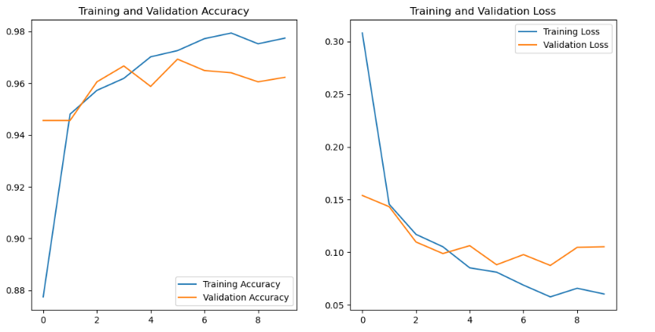
Screenshot of Output:
Model Performance

Slide 8
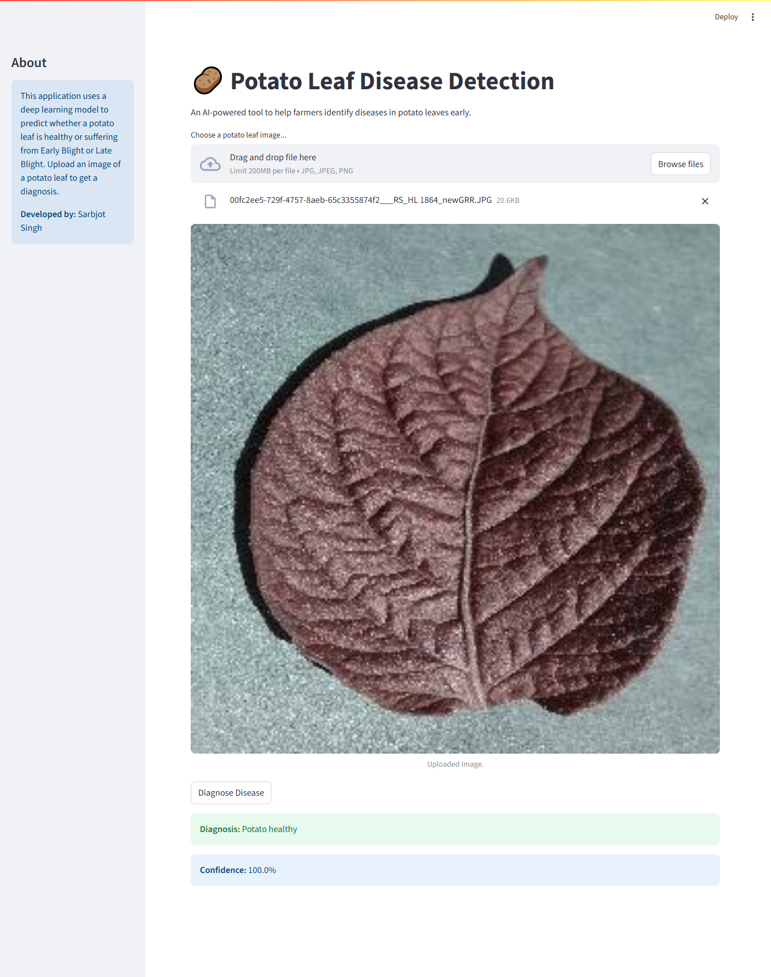
The final Streamlit application provides a clean interface for users to upload an image and get an instant, reliable prediction with a confidence score.

Slide 9
Conclusion:
This project successfully demonstrates the creation of a complete, end-to-end AI solution for a real-world problem in sustainable agriculture.
The use of Transfer Learning was highly effective, resulting in a robust and accurate model without the need for massive computational resources.
The final Streamlit application makes this powerful technology accessible to anyone, bridging the gap between complex AI and practical farm use.
Future Work: The model could be expanded to include more crops and diseases, and the app could be enhanced with features like treatment recommendations.

