Slide 1
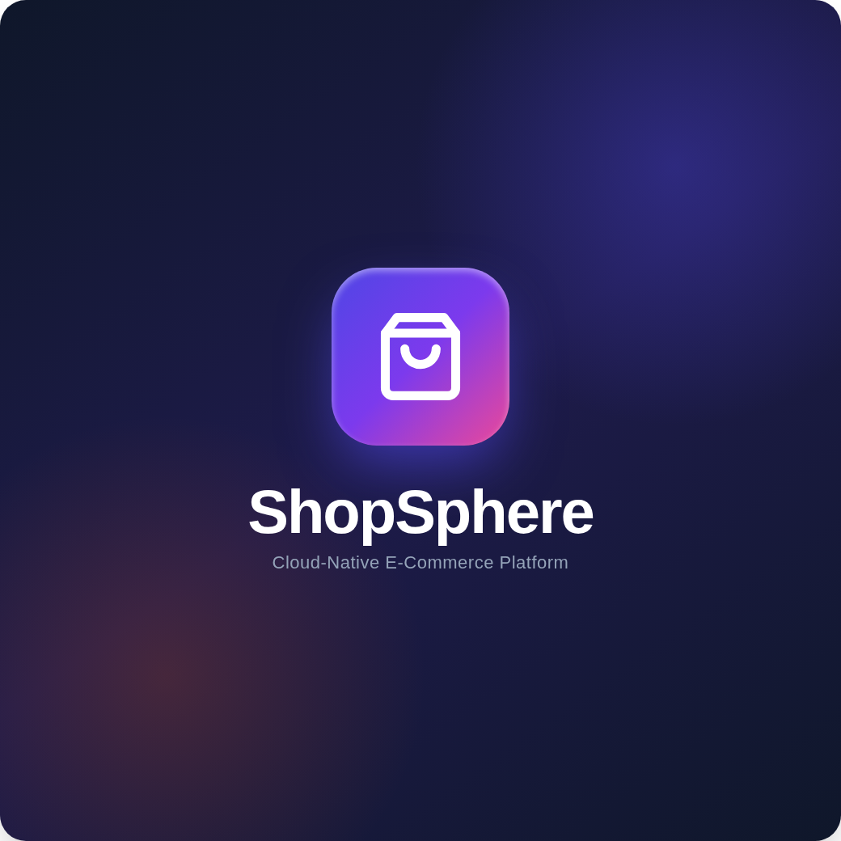
MCA INTEGRATED PROJECT | AWT
ShopSphere
A Scalable, Dual-Persistence Full-Stack E-Commerce Platform with Simulated Payment Gateway & Serverless Deployment
PROJECT TEAM (BY ENROLLMENT NO.)
A010145025006 ABHISHEK GHOSH — Backend & PayNova Gateway
A010145025015 SATYAM CHAUDHARY — Database & Order Lifecycle
A010145025019 SARBANANDA TAW — System Architecture & Docs Lead
A010145025044 RAJA TEOTIA — Frontend UI/UX & Theming
A010145025054 ABHISHEK KUMAR — Security, Auth & QA (71 Tests)
Under the Guidance of: [Faculty Guide Name], [Designation]

Slide 2
ShopSphere 2026 | Introduction
02
Accelerating modern e-commerce through cloud-native serverless architecture.
The Modern Landscape & Serverless Paradox
As digital retail transitions from monolithic infrastructures to serverless environments, applications gain rapid scalability and zero idle hosting costs. However, serverless execution sandboxes (such as Vercel and AWS Lambda) enforce strictly ephemeral, read-only file systems (/var/task).
Traditional embedded databases like SQLite, while optimal for local development and lightning-fast unit testing, cannot maintain persistent state across cold-start serverless container lifecycles. This creates an architectural friction between fast local iteration and reliable cloud persistence.
The ShopSphere Architectural Breakthrough
ShopSphere resolves this contradiction by introducing an intelligent dual-mode data access layer (database.py). During automated test execution and offline development, the system routes queries to an isolated local SQLite engine, maintaining 100% test isolation with zero network overhead.
In production, the application transparently connects over encrypted WebSockets to Turso (libSQL) cloud database hosted on AWS Mumbai (ap-south-1). Paired with an end-to-end simulated banking gateway (PayNova), ShopSphere delivers an enterprise-grade retail experience with deterministic reliability.

Slide 3
ShopSphere 2026 | Abstract & Impact
03
A full-stack architecture built for verifiable reliability and zero-cost cloud delivery.
71
Abstract Summary
ShopSphere demonstrates that full-stack electronic commerce platforms can achieve production-grade persistence and reliability without complex, costly database clusters. Engineered with Python 3.12, Flask 3.0, and libSQL, the application features an end-to-end customer purchasing lifecycle: faceted catalog search across 25 curated products, persistent shopping carts, dynamic 18% GST calculation, tiered shipping fee waivers, and promo discount codes.
A central contribution is the PayNova payment simulation subsystem, which implements the Luhn algorithm (MOD 10), multi-rail routing (Cards, UPI, NetBanking, COD), and an interactive OTP state machine with automated restock on cancellation.
Governed by Husky v9 and Commitlint adhering to Conventional Commits, the application is deployed live on Vercel Serverless Functions backed by Turso on AWS Mumbai.
AUTOMATED TESTS
Unit and integration test suite executing with 100% pass rate in <25 seconds.
< 20ms
CLOUD QUERY LATENCY
Turso libSQL instance hosted in AWS Mumbai (ap-south-1) for real-time reads.
100%
ZERO RECURRING COST
Architected completely on modern cloud free tiers (Vercel + Turso starter).

Slide 4
ShopSphere 2026 | Key Highlights
04
An integrated shopping, payment, and inventory management ecosystem.
01
Curated Catalogue & Search
25 products across 6 departments with professional Unsplash studio photography, faceted filtering, and real-time SQL text search.
02
Cart & Dynamic Taxation
Session-backed basket enforcing live inventory limits, automatic 18% GST calculation, tiered shipping waivers, and coupon rules.
03
PayNova Banking Mock
Full multi-rail simulation: Luhn MOD 10 card validation, network detection (Visa, MC, RuPay), UPI parsing, and 3-attempt OTP challenge.
04
Order Finite-State Machine
Deterministic workflow progression (Pending ➔ Confirmed ➔ Shipped ➔ Delivered) with automated inventory restocking upon cancellation.
05
Administrative Command Center
Executive KPI analytics (Sales, Orders, Low-Stock alerts), inventory adjustments with logged reasons, and transaction ledgers.
06
Responsive Design System
Zero-FOUC Light/Dark theme switcher with client-side localStorage state persistence and lightweight Lucide SVG inline sprites.

Slide 5
ShopSphere 2026 | System Specifications
05
Technical execution and deployment prerequisites.
Software Architecture & Runtimes
Operating System Linux (Ubuntu / Debian), macOS, Windows 10/11
Backend Language Python 3.12 (CPython Standard Runtime)
Web Framework Flask 3.0+ & Werkzeug (WSGI + Cryptography)
Local Database SQLite 3 (Built-in CPython module for testing)
Cloud Database Turso libSQL Server (AWS Mumbai via Hrana WSS)
Cloud Hosting Vercel Serverless Functions (@vercel/python)
Governance Tooling Git 2.40+, Node.js 22, Husky v9, Commitlint
Frontend Assets HTML5, CSS3 Custom Properties, Vanilla ES6, Lucide
Hardware & Cloud Infrastructure
Client Hardware Cross-platform: Desktop, Laptop, Tablet, Mobile
Development Processor 2.0 GHz Dual-Core x86_64 or Apple Silicon (M-series)
Memory (RAM) Minimum 4 GB (8 GB recommended for development)
Disk Storage 500 MB free space for repository and local database
Display Resolution Responsive (1024x768 to 1920x1080 Full HD)
Vercel Serverless Specs 2 vCPU, 8192 MB allocated memory per function
Turso Cloud Specs Hosted on AWS Mumbai (ap-south-1) for <20ms latency
Network Bandwidth Broadband internet connection for libSQL synchronization

Slide 6
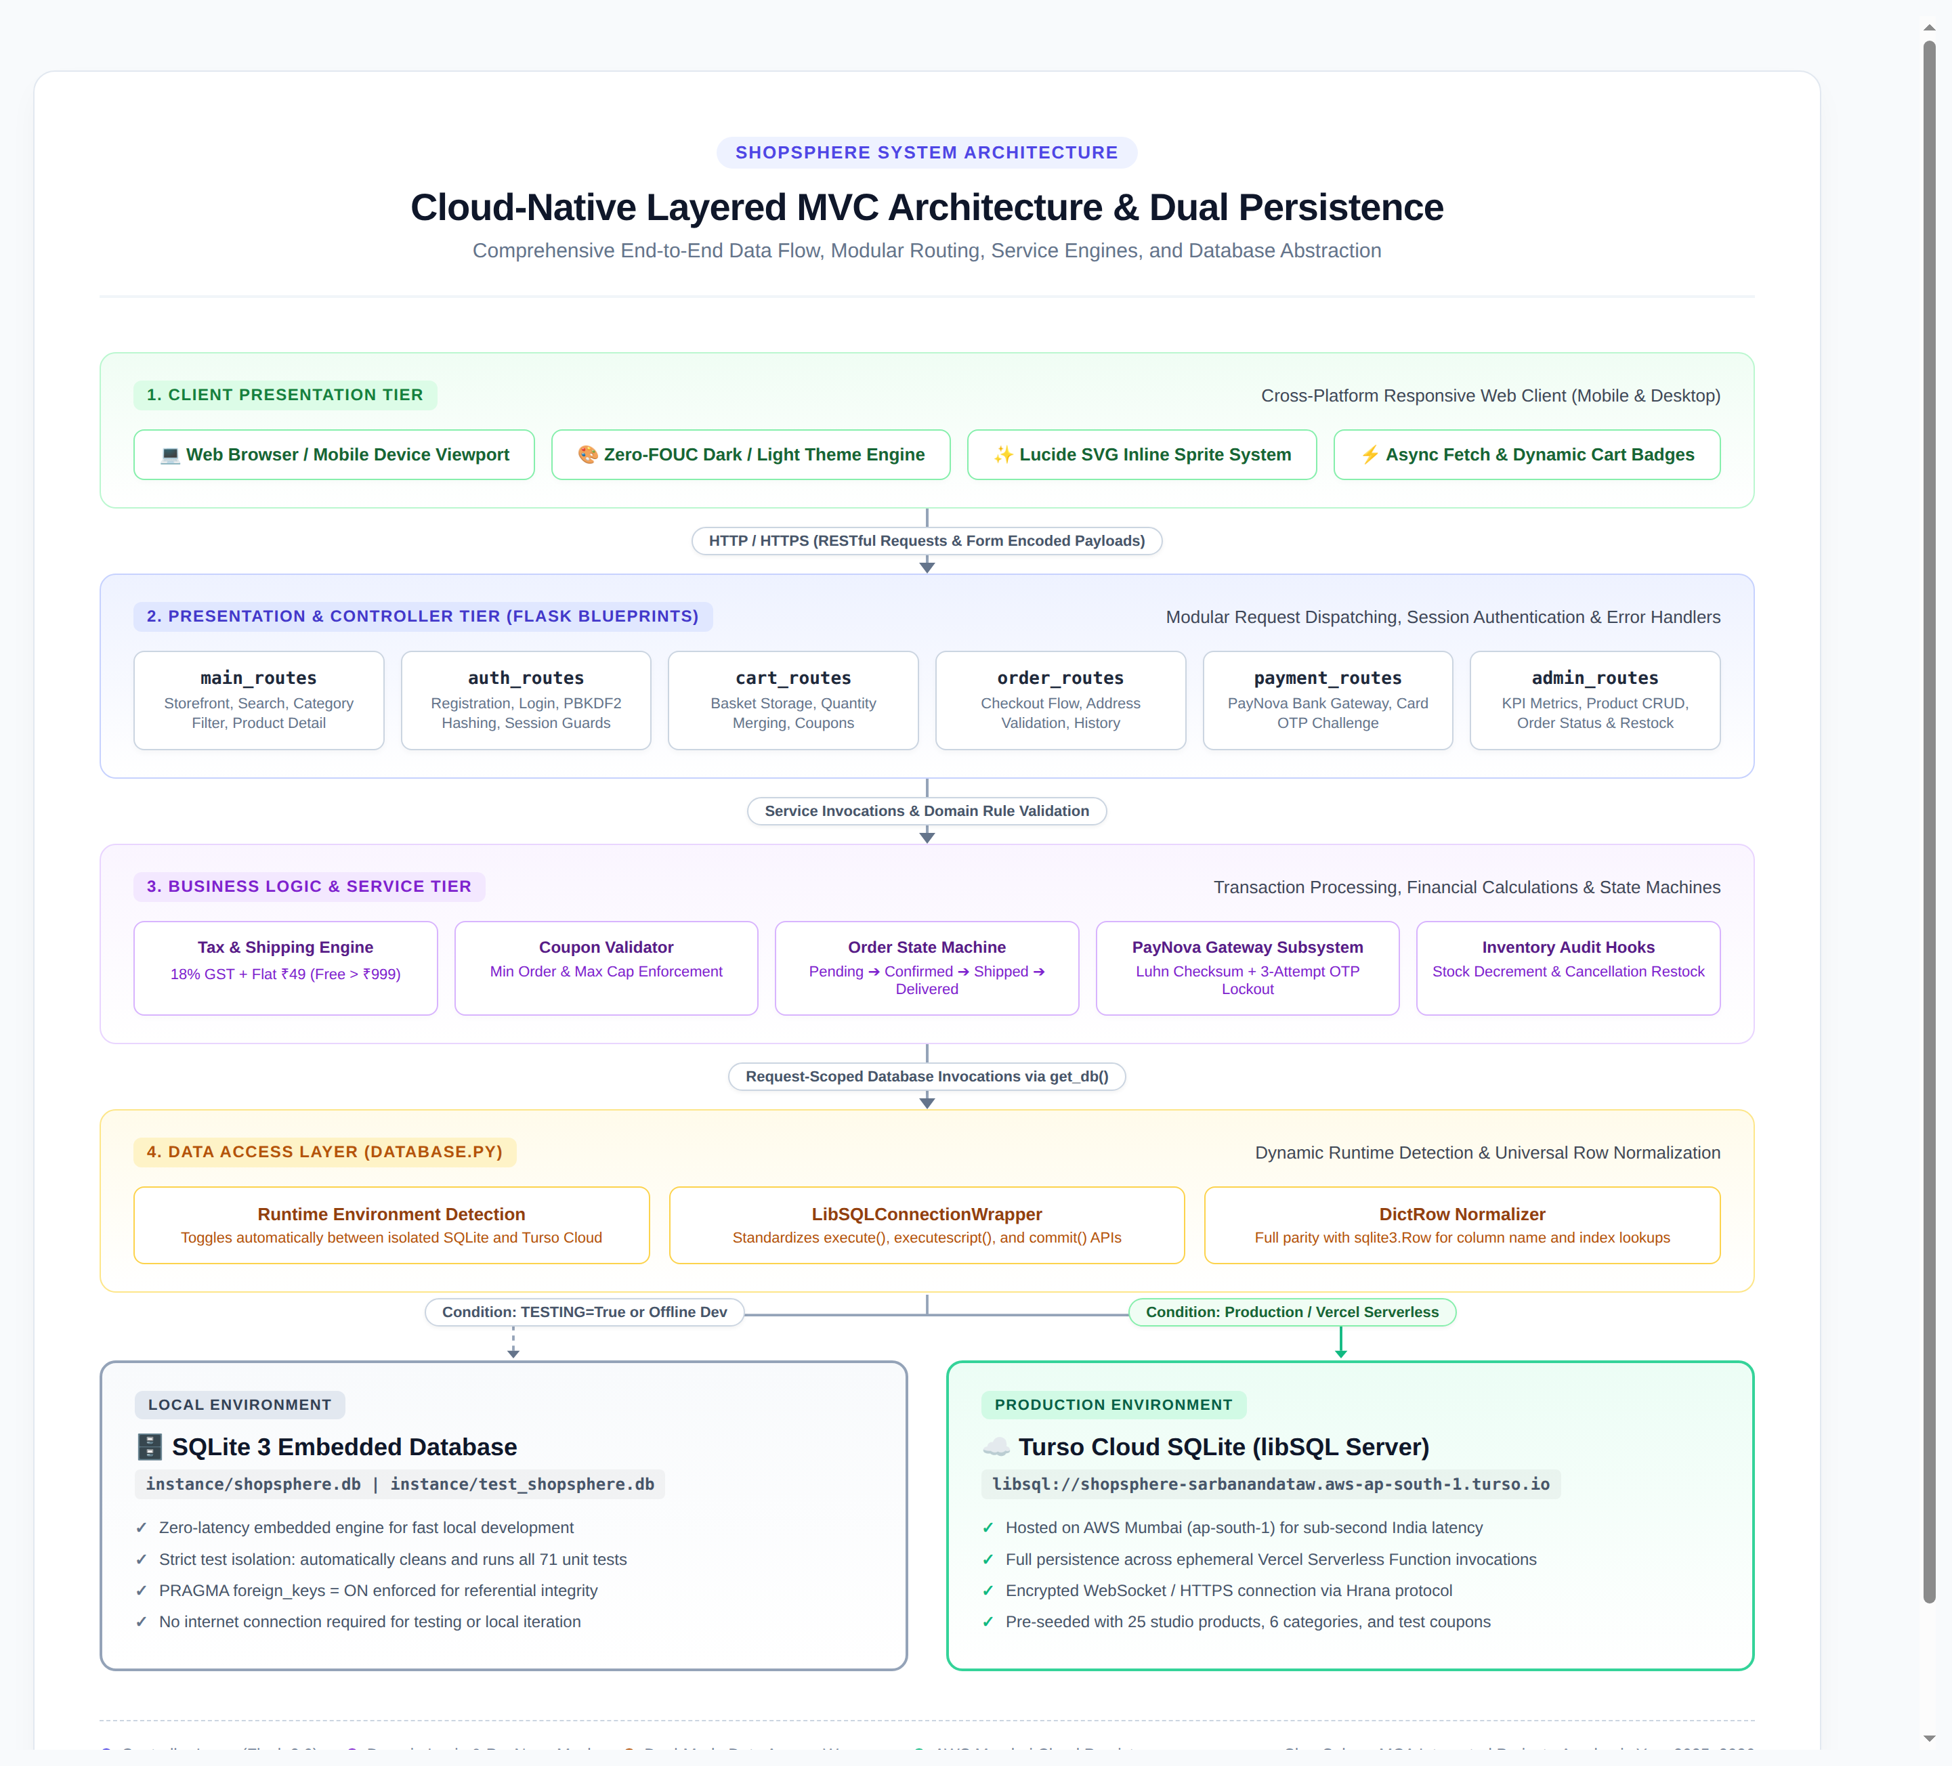
ShopSphere 2026 | Implementation
06
Layered MVC architecture paired with dual-persistence data access.
• Modular Blueprint Routing: Divided into 6 route controllers (main, auth, cart, order, payment, admin) ensuring separation of concerns.
• Dual-Mode Data Access (database.py): get_db() dynamically inspects runtime flags, serving isolated SQLite for unit tests and Turso libSQL for live production.
• Universal Row Parity (DictRow): Custom wrapper enables dictionary access (row['name']) across both local and cloud cursors without rewriting queries.
• PayNova Banking State Machine: Simulated gateway implementing Luhn algorithm verification, test cards, and automated refund restock hooks.
• Serverless Packaging (vercel.json): config.includeFiles bundles templates, static files, and modules into AWS Lambda execution containers.

Slide 7
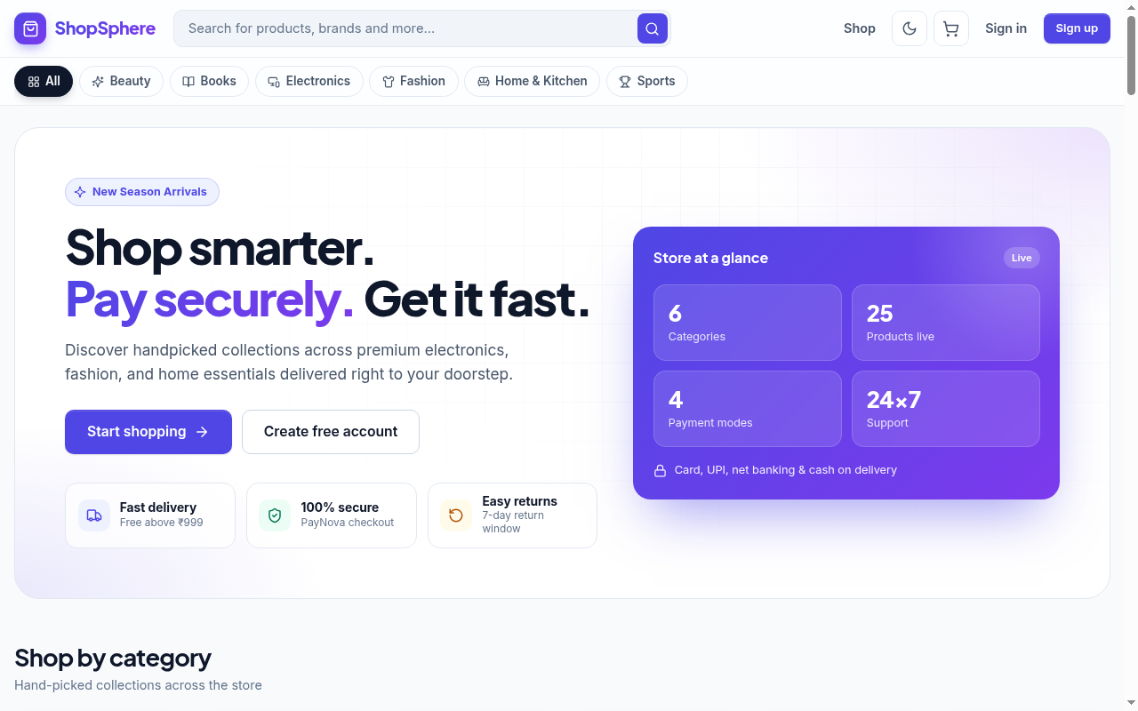
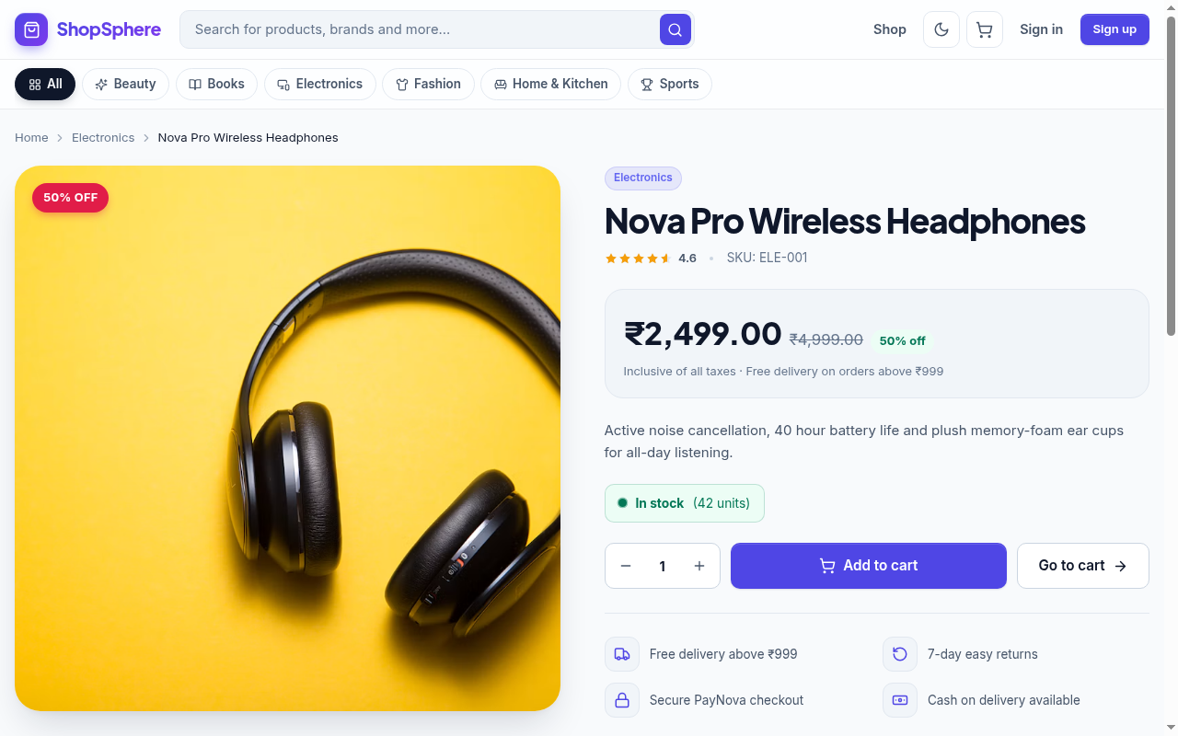
ShopSphere 2026 | Production Output
07
Live storefront & responsive product experience.
Storefront Home: Curated Products, Category Chips & Theme Toggle
Product Detail View: Dynamic Pricing, Stock Alerts & Add to Cart
LIVE DEPLOYMENT: https://shop-sphere-black-omega.vercel.app • Cloud DB: Turso libSQL (AWS Mumbai)

Slide 8
ShopSphere 2026 | Conclusion
08
Reliability achieved through architectural simplicity and test-driven engineering.
01 Serverless Persistence Verified — Proved that lightweight Python/Flask applications can overcome serverless ephemeral file restrictions by dynamically routing queries to Turso Cloud libSQL without altering standard SQLite semantics.
02 High-Fidelity Banking Simulation — Engineered the PayNova payment engine to faithfully simulate real-world financial gateways (Luhn MOD 10 validation, network classification, OTP challenge, and restock reconciliation).
03 100% Test-Driven Quality — Constructed and validated an automated test suite of 71 unit and integration tests executing in under 25 seconds, completely eliminating regression risks across all 6 core blueprints.
04 Zero Infrastructure Overhead — Achieved full production deployment on Vercel Serverless Functions paired with Turso on AWS Mumbai, delivering sub-second response times at zero recurring hosting cost.

Slide 9
ShopSphere 2026 | Future Scope
09
Scaling toward microservices, real-time tracking, and intelligent commerce.
01 Live Payment Gateway Webhooks — Integrate live webhook endpoints for enterprise payment gateways (Razorpay, Stripe, Cashfree) to operate in tandem with the PayNova simulation engine.
02 Microservices Decomposition — Transition monolithic Flask blueprints into containerized microservices (Catalog, Cart, Payment, Notification) coordinated via Apache Kafka.
03 AI Recommendation Engine — Incorporate collaborative filtering algorithms and natural language embeddings to generate personalized product recommendations ('Frequently bought together').
04 Real-Time WebSocket Order Tracking — Implement WebSockets or Server-Sent Events (SSE) to push live GPS driver locations and fulfillment state updates directly to customer dashboards.
05 Multi-Vendor Marketplace Expansion — Expand relational schemas to support third-party merchant registration, independent inventory management, commission calculations, and seller analytics.

Slide 10
ShopSphere 2026 | References
10
Academic literature and industry specifications.
[01] Grinberg, M. (2018). Flask Web Development: Developing Web Applications with Python. 2nd Edition. O'Reilly Media.
[02] Owens, M., & Allen, G. (2010). The Definitive Guide to SQLite. 2nd Edition. Apress.
[03] Vercel Foundation (2026). Serverless Functions with Python on Vercel. https://vercel.com/docs/functions/runtimes/python
[04] Turso / libSQL Foundation (2026). libSQL: An Open-Source Fork of SQLite for Serverless. https://docs.turso.tech/
[05] Jones, M., Bradley, J., & Sakimura, N. (2015). RFC 7519: JSON Web Token (JWT). IETF.
[06] Luhn, H. P. (1960). Computer for Verifying Numbers (Luhn Checksum Algorithm). U.S. Patent No. 2,950,048.
[07] Pallets Projects (2024). Werkzeug: The Comprehensive WSGI Web Application Library. https://palletsprojects.com/p/werkzeug/
[08] Conventional Commits Specification (2024). Conventional Commits 1.0.0 for Git Versioning. https://www.conventionalcommits.org/
[09] Mozilla Developer Network (MDN) (2026). CSS Custom Properties (Variables) & Semantic HTML.
[10] Lucide Project (2026). Lucide Icons: Consistent & Beautiful Open-Source SVG Icons. https://lucide.dev/

