Slide 2




LIVE TRAINING SESSION
45 minutes
Master the art of building, testing, packaging, and deploying AutoIt-based PSM Universal Connectors with security-by-design principles for privileged session management.
Target Audience Key Objectives
TECHNICAL DEEP DIVE
Version 12.6
PSM Custom Connector Development Training
Scope
Senior CyberArk Automation Engineers Build custom connectors
Technical Architects & Developers Implement secure automation
Security Engineers Deploy to production
Connection Components
AutoIt API Usage
Deployment Strategies
Security-First Design
CyberArk PSM v12.6 | AutoIt 3.3.14.2

Slide 3








PSM Connectors & Connection Components
Technical Overview
What are PSM Connectors?
PSM connectors enable users to connect to target machines on a platform-by-platform basis, affecting all accounts associated with the platform.
Connection Components are managed in PVWA and drive client invocation and session behavior for privileged sessions.
During PSM installation, a series of supported PSM connectors are created. You can use these with default settings or customize them.
PVWA Configuration Screenshot
Insert PVWA screenshot here
Administration > Configuration Options > Connection Components
Note: When you install PSM in a new environment, connection components not available out-of-the- box can be downloaded from the CyberArk Marketplace.
Key Points
Target Connection: Connectors are defined per platform and affect all associated accounts
Customization: Change existing parameters or add additional parameters manually
Marketplace: Download additional connectors from CyberArk Marketplace
Connection Component Types
Type Description Default
PSM-SSH SSH connection component for secure shell access Enabled
PSM-RDP RDP connection for remote desktop protocol Enabled
PSM-Telnet Telnet connection component Enabled
PSM-TOAD TOAD database client connection Enabled

Slide 4







OOTB vs Custom Universal Connectors
Comparison and Characteristics
Connector Comparison Table
Type | Source | Characteristics | Examples
OOTB | Installed with PSM | Preconfigured: Ready for immediate use with default settings Configurable: Can be customized by changing parameters Supported: Official CyberArk maintenance and support | PSM-SSH, PSM-RDP, PSM-Telnet PSM-TOAD, PSM-SQLPlus, PSM-PTA PSM-WinSCP, PSMP-SSH/SCP/SFTP
Custom Universal | Developed/Downloaded | AutoIt-based: Automation for client launch/login Full lifecycle: Complete development and management Task-specific: Can automate specific privileged tasks | VNC sample connector Task-specific automation Custom application integration
Key Differences and Usage
Security & Maintenance
OOTB connectors receive official CyberArk updates and support. Custom connectors require periodic maintenance and regression testing after version updates.
Development & Deployment
Custom connectors can be developed using AutoIt and deployed via PSMUniversalConnectors Safe for automatic distribution across all PSM servers.
User Experience
OOTB connectors provide immediate functionality. Custom connectors offer tailored automation for specific application requirements.

Slide 5
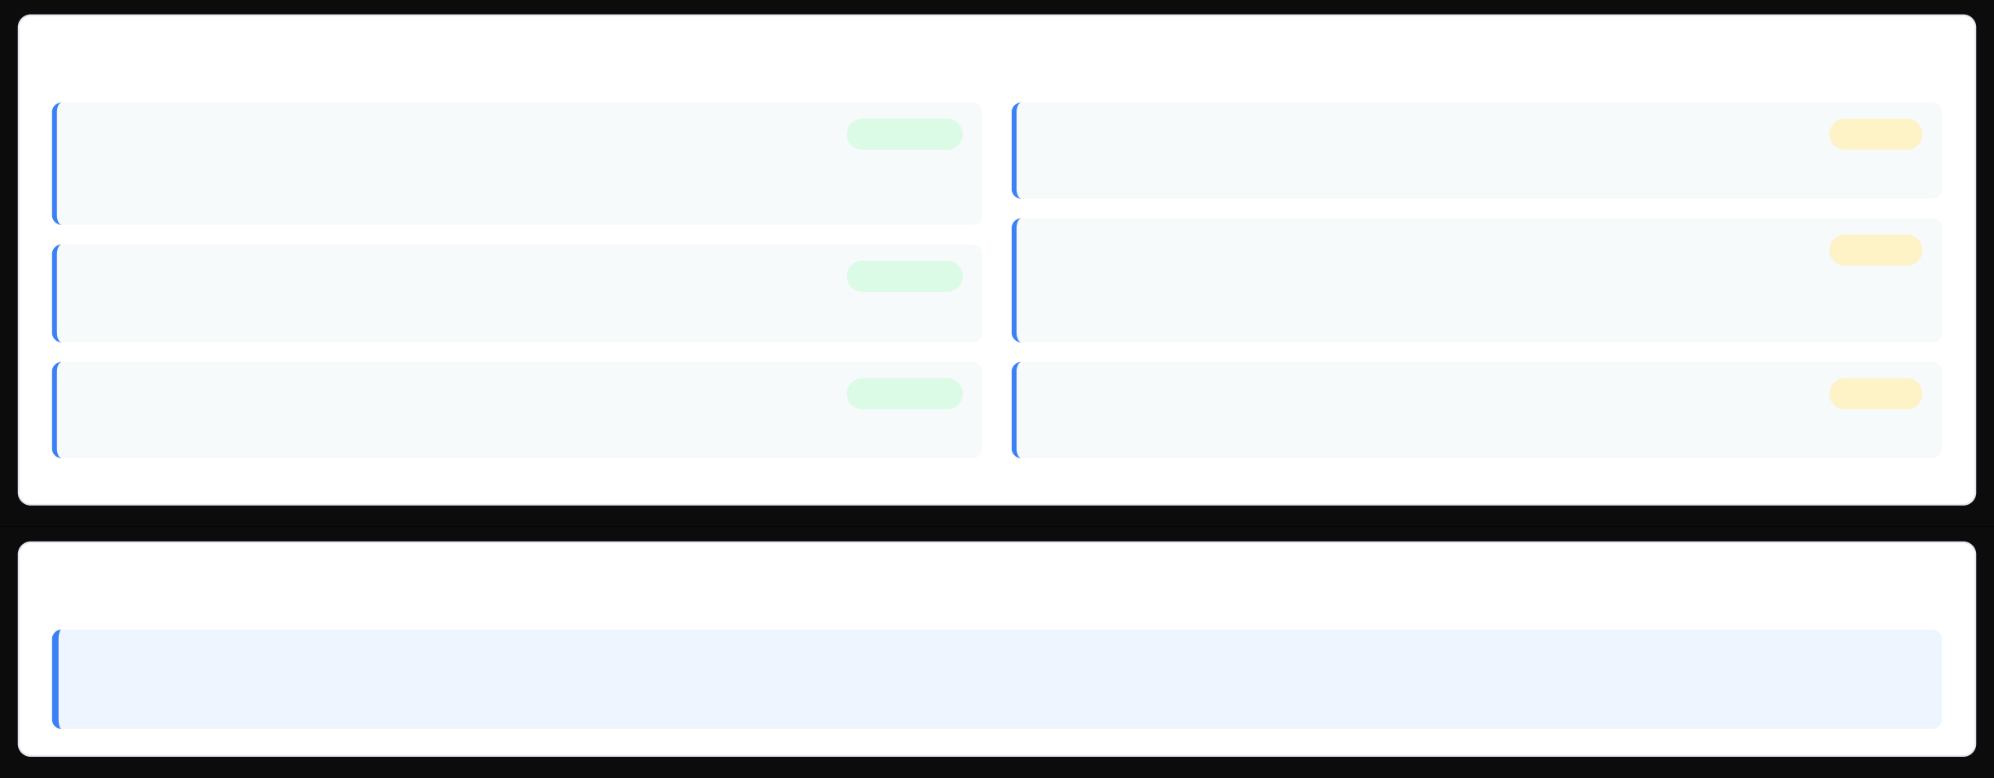








Prerequisites: AutoIt3 v3.3.14.2
Development Environment Setup
Installation Checklist
Download AutoIt3 v3.3.14.2
Completed
Copy PSMAutoItDispatcherSkeleton.au3
Copy the skeleton file to your development environment and rename it
Pending
Download and install AutoIt3 version 3.3.14.2 from the official website. Default installation path:
%ProgramFiles%\AutoIt3
Copy Required Files
Copy PSMGenericClientDriver.dll, PSMGenericClientDriver.xml, and PSMGenericClientWrapper.au3
Pending
Configure Development Environment
Set up a separate development machine for AutoIt script development and testing
Completed
Install Target Application
Install the application client you want to integrate on the development machine
Completed
Configure Test Environment
Update PSMGenericClientDriver.xml with test values for session properties
Pending
Important Notes
Security Recommendation: When using AutoIt based connection components, we recommend that you compile the Autoit script to an executable form and use that binary. Running AutoIt scripts directly using AutoIt3.exe might introduce security risks.

Slide 6
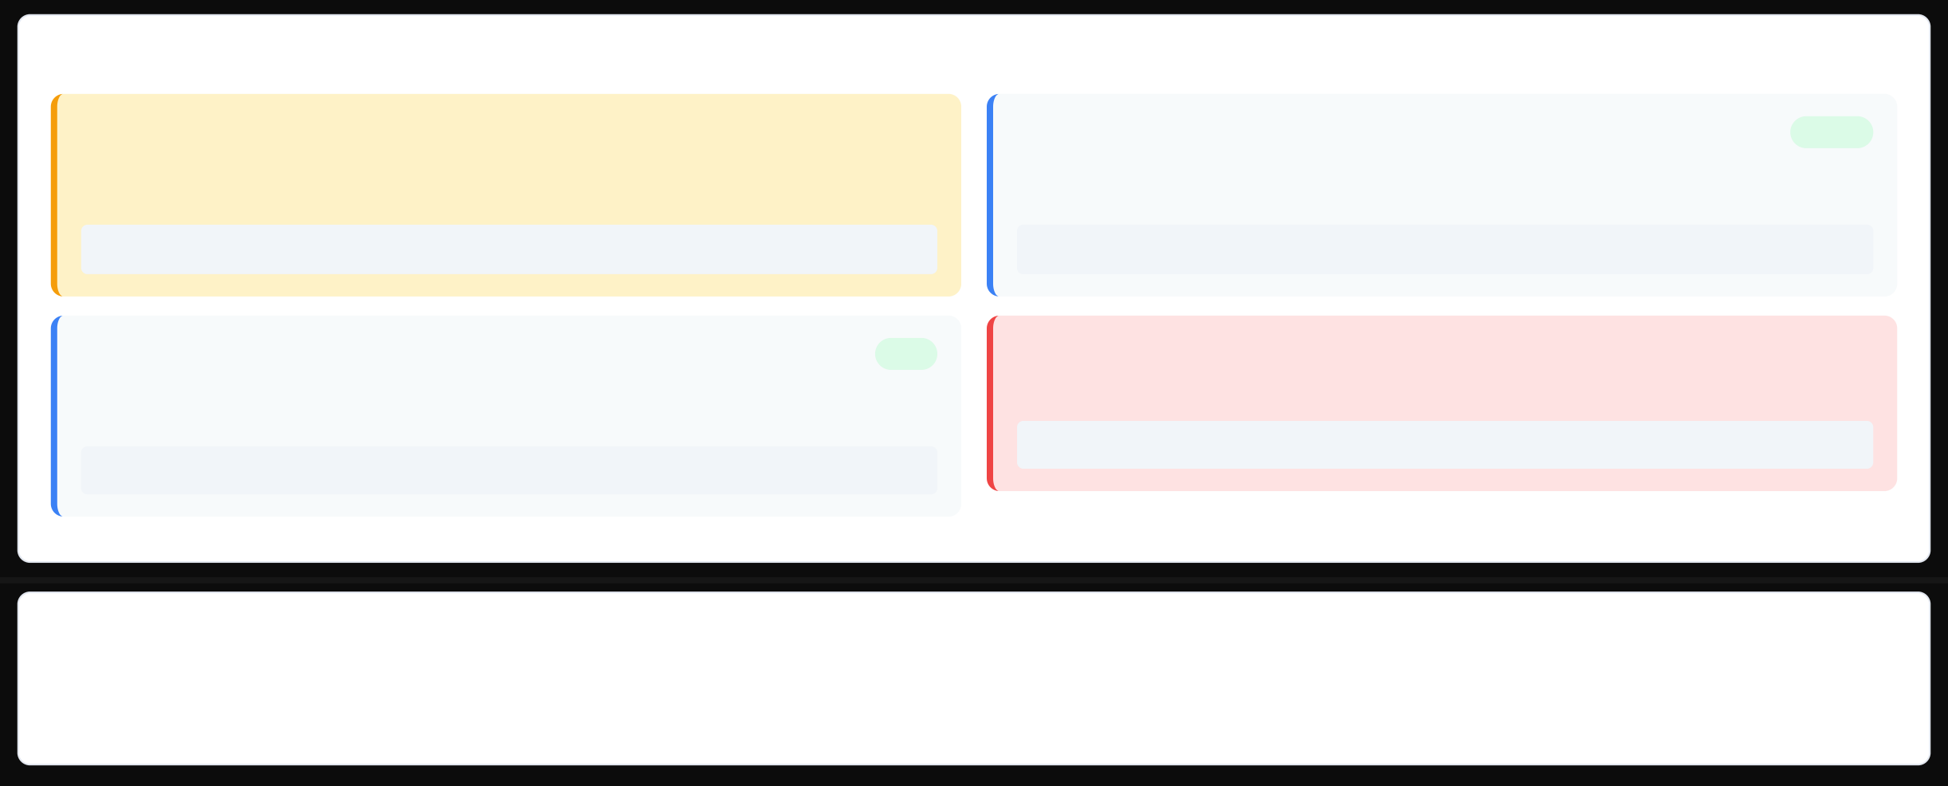





Security Considerations: .au3 vs Compiled .exe
AutoIt Script Security
Security Comparison: Source vs Compiled
.au3 Source Files
Warning
Password Protection
Secure
Running .au3 scripts directly using AutoIt3.exe may introduce security risks. Source code is visible and can be modified without detection.
Ensure password used by the PSM Universal Connector connection client cannot be exposed to the user interface.
⚠ Risk: Source code exposure, easier to modify, no integrity checks
Best Practice: Never display passwords in UI or logs
Compiled .exe Files
Compile AutoIt scripts to executables for deployment. Compiled binaries are harder to reverse engineer.
Safe
Sensitive Data Storage
Make sure that sensitive data will not be saved to the disk during the session.
Critical
⚠ Critical: Clean sensitive data from disk as part of the AutoIt script
Recommended: Use compiled .exe for production deployment
Security Checklist
Compile .au3 to .exe for deployment Use secure credential handling
Use separate development machine
Never run .au3 directly in production
Implement password protection
Clean sensitive data from disk

Slide 7
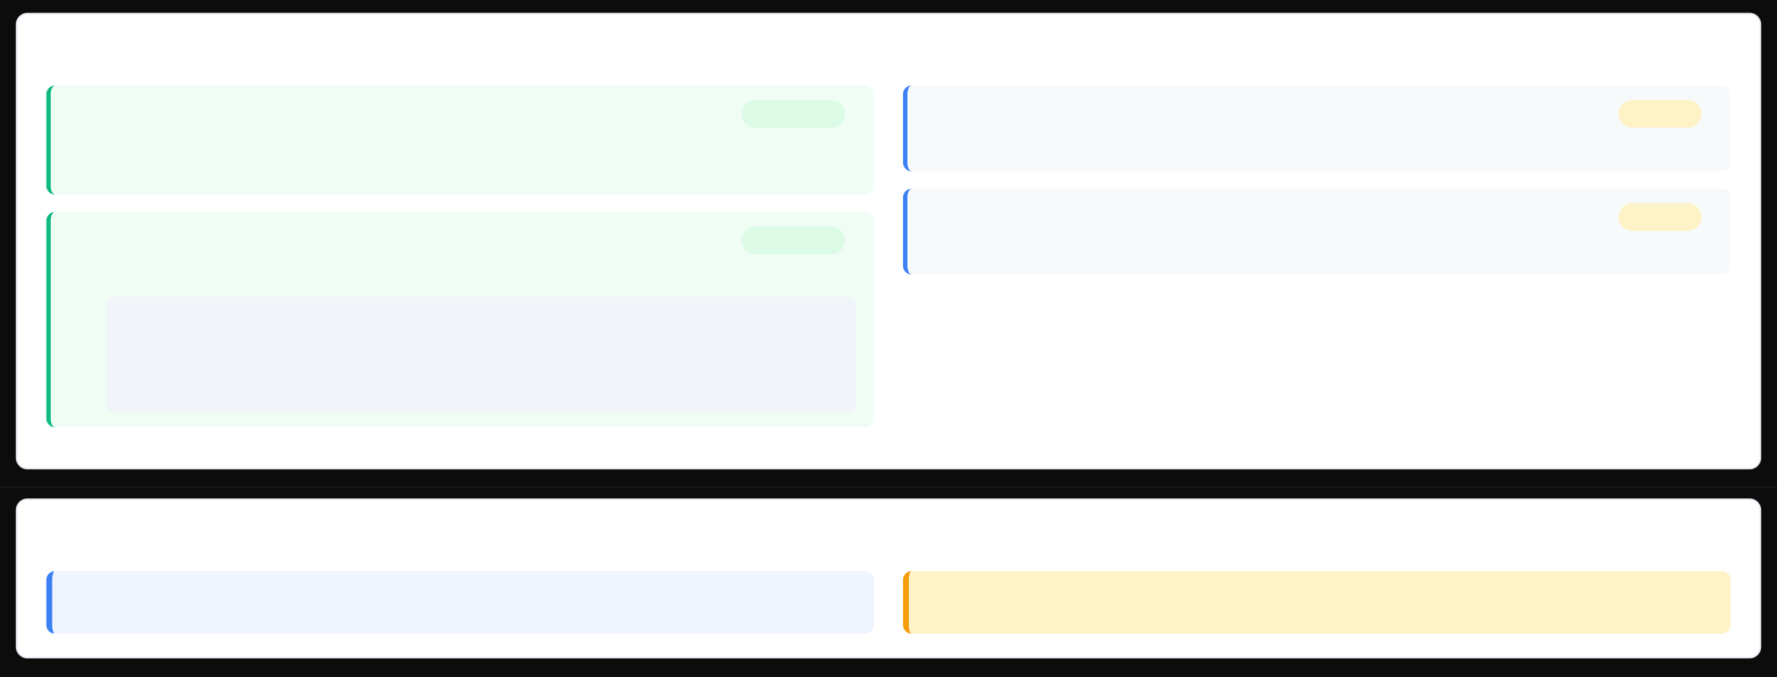


Development Machine Setup
Configure Development Environment
Setup Checklist
Copy PSMAutoItDispatcherSkeleton.au3
Copy the skeleton file from PSM\Components to your development environment and rename it (keep .au3 extension)
Copy Required Files from PSM\Components
Copy the following files to your development folder:
PSMGenericClientDriver.dll PSMGenericClientDriver.xml PSMGenericClientWrapper.au3
Completed
Copy PSMAutoItDispatcherSkeleton.au3
Update SessionProperties section with test values for your application
Pending
Set up Test Environment
Run test driver to verify the connection component works correctly
Pending
Completed
Key Configuration Points
File Location: Place all files in a dedicated subfolder, not directly under C:\ drive
Security Note: Do not modify PSMGenericClientWrapper.au3 - it's for API calls only

Slide 8
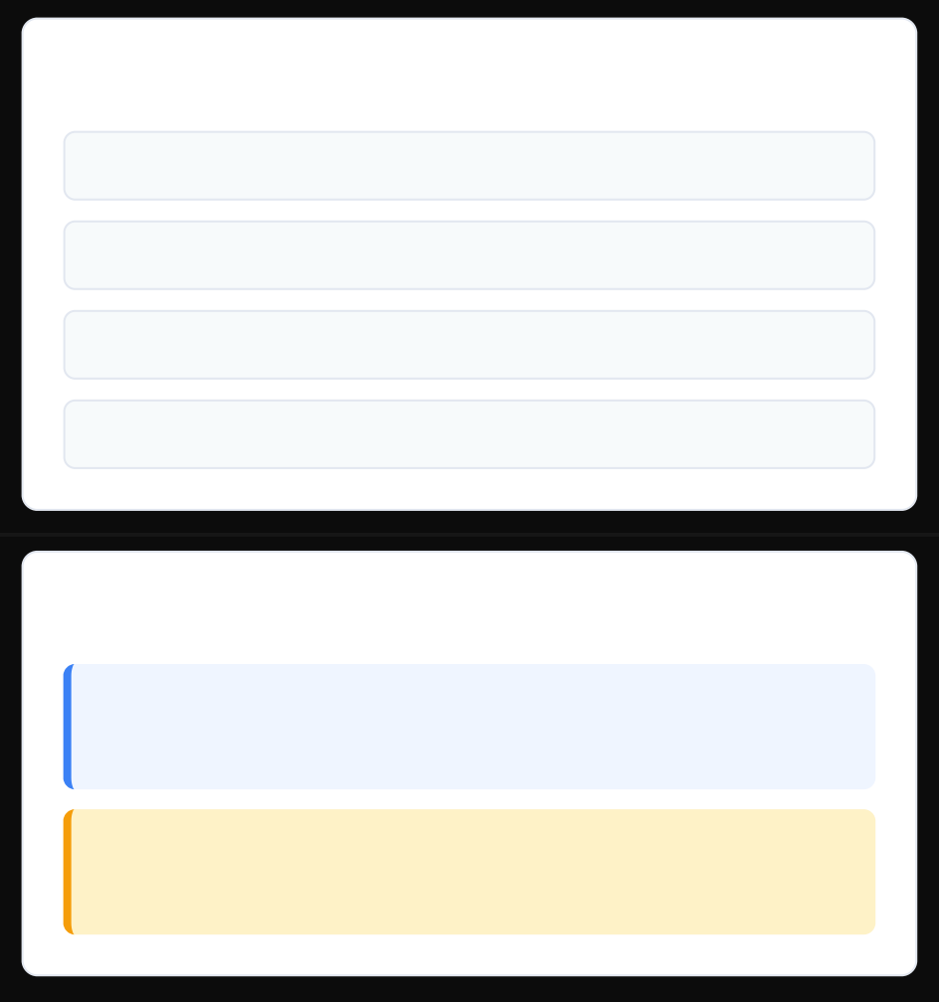





PSMAutoItDispatcherSkeleton.au3 Overview
AutoIt Script Development Guide
Base AutoIt Script Structure
The PSMAutoItDispatcherSkeleton.au3 is the foundation for developing PSM Universal Connector dispatchers. It provides a skeleton script that you customize for your specific application.
Required Files
PSMAutoItDispatcherSkeleton.au3
Base skeleton script
; Include the PSM wrapper for API functions
#include "PSMGenericClientWrapper.au3" ; Do not modify this file
; CHANGE_ME: Replace with your application path
Global Const $CLIENT_EXECUTABLE = "C:\Program Files\Vendor\Application.exe" Global Const $CLIENT_ARGS = "" ; Optional arguments
PSMGenericClientWrapper.au3
API wrapper (don't modify)
PSMGenericClientDriver.dll
Test driver
PSMGenericClientDriver.xml
Test configuration
Development Tips
Key Editing Points
$CLIENT_EXECUTABLE: Specify the full path to the application executable you want to launch.
Best Practice: Compile your AutoIt script to .exe for production deployment to avoid security risks.
Main() function: Replace the "Handle login here!" comment with your login automation logic.
Security: Never expose credentials in the UI or write sensitive data to disk.
API Integration: Use PSM Universal Connector API functions for session management.

Slide 9




PSM Custom Connector Development
Editing $CLIENT_EXECUTABLE Path
Step 2 of 4: Configure the target application path
Configuration Steps
Set $CLIENT_EXECUTABLE
Specify the full path to the application executable
Configure $CLIENT_ARGS
Add optional command line arguments if needed
Update LaunchClient()
Implement the function to launch the application
AutoIt Code Implementation
1
; Include required files #include <Array.au3>
#include "PSMGenericClientWrapper.au3" ; Do not modify this file
; Define the path to the client executable
Global Const $CLIENT_EXECUTABLE = "C:\Program Files\Vendor\ClientApp.exe" ; CHANGE_ME Global Const $CLIENT_ARGS = "" ; optional args
; Function to launch the client application Func LaunchClient ()
Local $pid = Run ( '"' & $CLIENT_EXECUTABLE & '" ' & $CLIENT_ARGS , "" , @SW_SHOW )
If $pid = 0 Then
PSMDispatcherUtilsWrapper_LogWrite ( "Failed to launch client" , $LOG_LEVEL_ERROR ) Exit 1
EndIf
Return $pid EndFunc
2
3
Important Notes
Use full path with quotes for paths containing spaces
Verify the executable exists before deployment
Test with the actual application on the PSM server

Slide 10
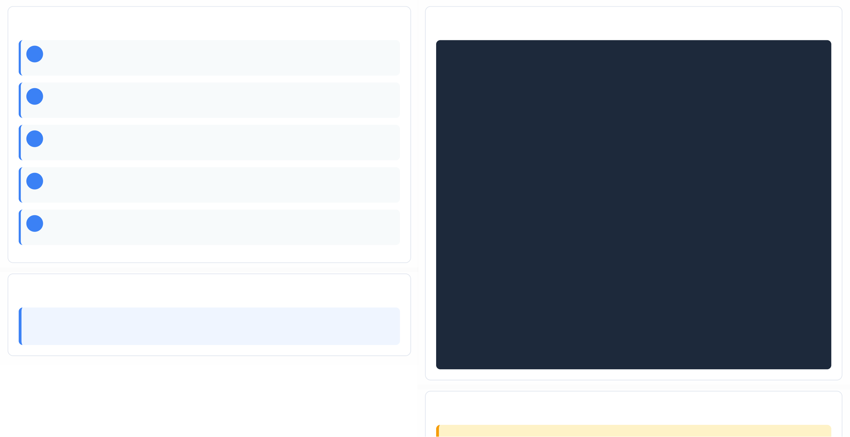

Main() Function Logic
AutoIt Implementation Guide
Implementation Steps
Complete AutoIt Code Example
FuncMain()
; Initialize PSM API
IfPSMDispatcherUtilsWrapper_Init() <>$PSM_ERROR_SUCCESSThen
MsgBox(16,"Error",PSMDispatcherUtilsWrapper_PSMGetLastErrorString()) Exit1
EndIf
; Fetch session properties Local$addr,$user,$pass
PSMDispatcherUtilsWrapper_GetSessionProperty("Address",$addr) PSMDispatcherUtilsWrapper_GetSessionProperty("Username",$user) PSMDispatcherUtilsWrapper_GetSessionProperty("Password",$pass)
; Launch client and automate login Local$pid=LaunchClient()
; TODO: Handle login here! (ControlSetText/Send for $user/$pass/$addr)
; Wait until authentication completes
; Only AFTER login completes, report PID PSMDispatcherUtilsWrapper_SendPID($pid)
; Cleanup and terminate
PSMDispatcherUtilsWrapper_Term() EndFunc
1
Initialize PSM API
Call Init() to initialize the dispatcher API before any other calls
2
Fetch Session Properties
Use GetSessionProperty to retrieve credentials and connection details
3
Launch Client & Automate Login
Start the application and handle authentication logic
4
SendPID After Login
Report PID to PSM only after login completes
5
Cleanup & Terminate
Call Term() to free resources and end session
Key Points
SendPID Timing: Must only be called after login procedure is complete to ensure user input is blocked correctly during automation.
Best Practices

Slide 11
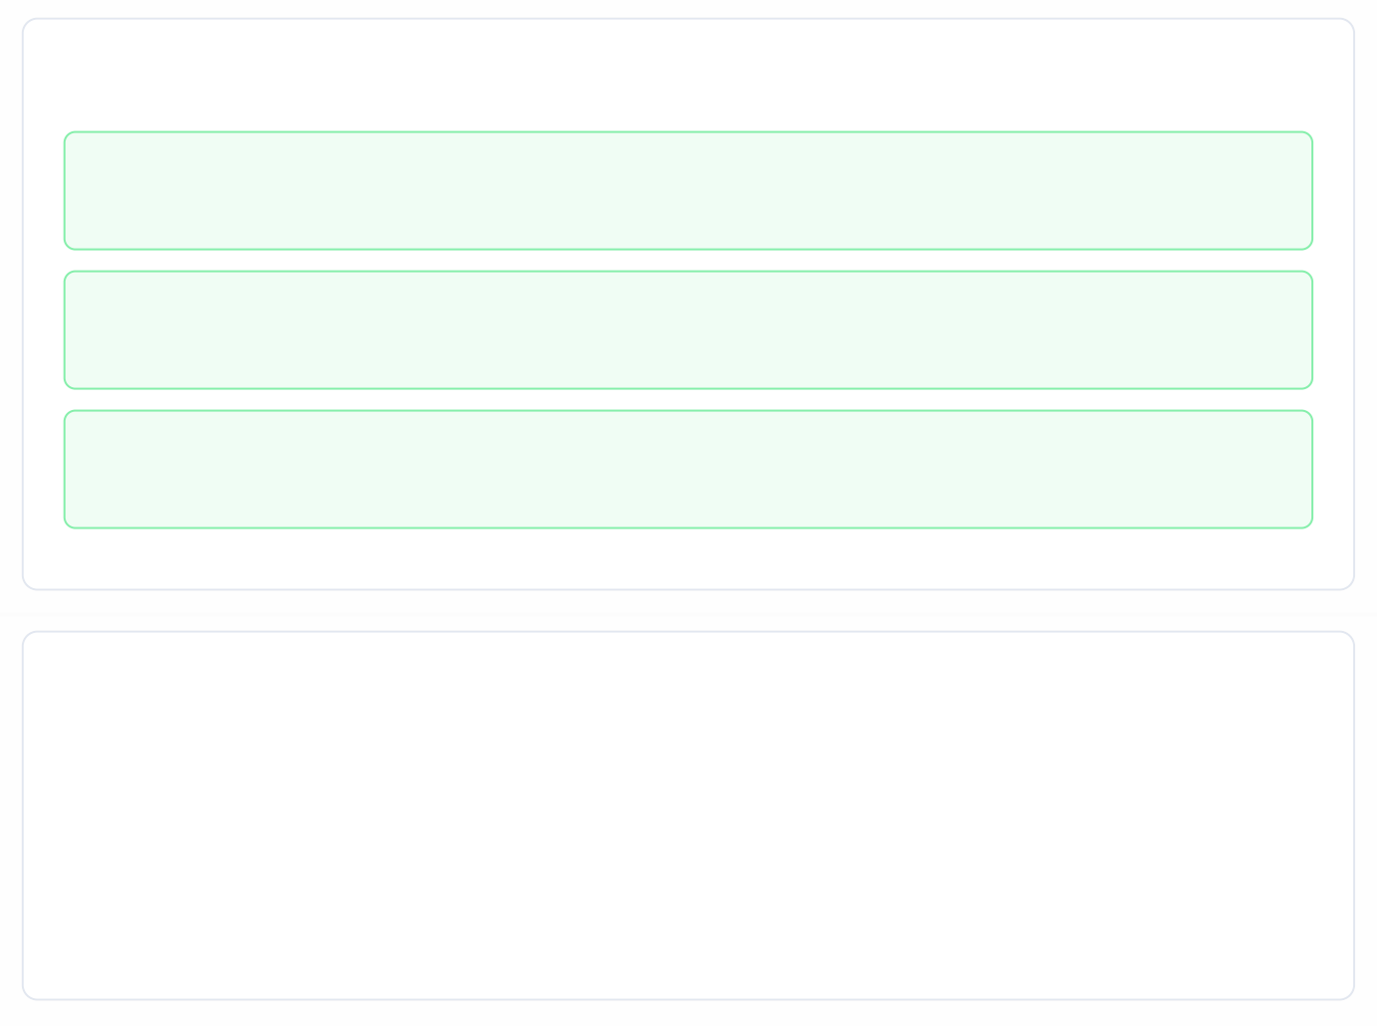

Code Structure Best Practices
Error Handling, Security, and API Usage
17/30
Security & Error Handling
Centralize Error Handling
Use robust error handling with try-catch blocks and log all errors using LogWrite with context
Window Synchronization
Use MainWindowTitle/MainWindowClass for reliable window identification with configurable timeouts
Prevent Password Exposure
Never echo secrets to logs/UI; sanitize strings before logging
Code Example: Error Handling
; Example of proper error handling Func LaunchClient()
Local $pid = Run('"' & $CLIENT_EXECUTABLE & '"', "", @SW_SHOW)
If $pid = 0 Then
PSMDispatcherUtilsWrapper_LogWrite("Failed to launch client", $LOG_LEVEL_ERROR)
Return $PSM_ERROR_FAILURE EndIf
Return $pid
EndFunc
API Best Practices
Control APIs: Prefer Control* APIs over Send() for reliability Timeouts: Use configurable timeouts; avoid busy-waits Cleanup: Clean up resources and call Term() in all exit paths
Key Recommendations
Robust Window Sync: Use specific window identifiers with timeouts
Secure Credentials: Never log sensitive data to files
Resource Cleanup: Always call Term() before exit

Slide 12
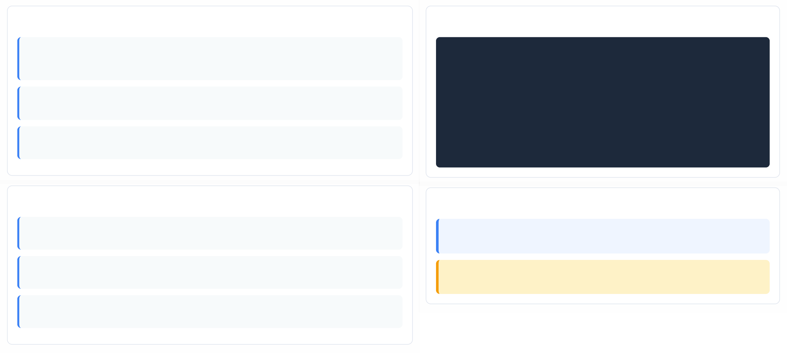


API: Init and Term Functions
PSM Universal Connector API Reference
18/30
Init Function
PSMDispatcherUtilsWrapper_Init()
Initializes PSM's dispatcher API library. Must be called once at the beginning of the AutoIt script before any other API calls.
Parameters
No parameters required
Return Values
$PSM_ERROR_SUCCESS - API library initialized successfully. Any other value indicates error.
Implementation Example
; Initialize PSM API before any other calls Local$rc=PSMDispatcherUtilsWrapper_Init() If$rc<>$PSM_ERROR_SUCCESSThen
PSMDispatcherUtilsWrapper_LogWrite(PSMDispatcherUtilsWrapper_PSMGet Exit 1
EndIf
; ... your automation code here ...
; Terminate API after done to free resources PSMDispatcherUtilsWrapper_Term()
Term Function
PSMDispatcherUtilsWrapper_Term()
Terminates PSM's dispatcher API library. Must be called once after all API usage to free consumed resources.
Parameters
No parameters required
Return Values
No return value
Best Practices
Initialization Order: Always call Init() first before any other API function. Check return value for success before proceeding.
Resource Cleanup: Always call Term() at the end of your script to free resources, even if errors occur during execution.

Slide 13
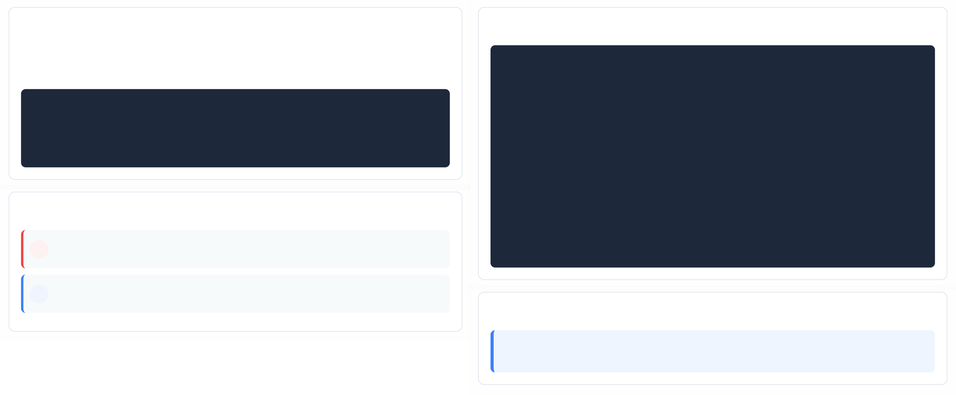




LogWrite API and LogLevel Constants
PSM Universal Connector API Reference
19/30
LogWrite Function Overview
Purpose: Write operational and error events to the PSM dispatcher log file.
Used for debugging and monitoring connector behavior during execution.
PSMDispatcherUtilsWrapper_LogWrite($Message,$LogLevel)
; Parameters:
; $Message - The message to write in the log file
; $LogLevel - The log level (use constants below)
Implementation Example
; Write an error message to the log PSMDispatcherUtilsWrapper_LogWrite(
"Failed to connect to target server",
$LOG_LEVEL_ERROR
; Write a trace message to the log PSMDispatcherUtilsWrapper_LogWrite(
"Login automation started for user: "&$user,
$LOG_LEVEL_TRACE
; Check if log write was successful If@errorThen
PSMDispatcherUtilsWrapper_LogWrite("Log write failed",$LOG_LEVEL_ERROR) EndIf
)
)
LogLevel Constants
$LOG_LEVEL_ERROR
Error messages - use for critical failures
$LOG_LEVEL_TRACE
Trace messages - use for debugging info
Best Practices
Logging Strategy: Use ERROR level for failures that impact functionality, TRACE for debugging details. Avoid logging sensitive data like passwords.

Slide 14
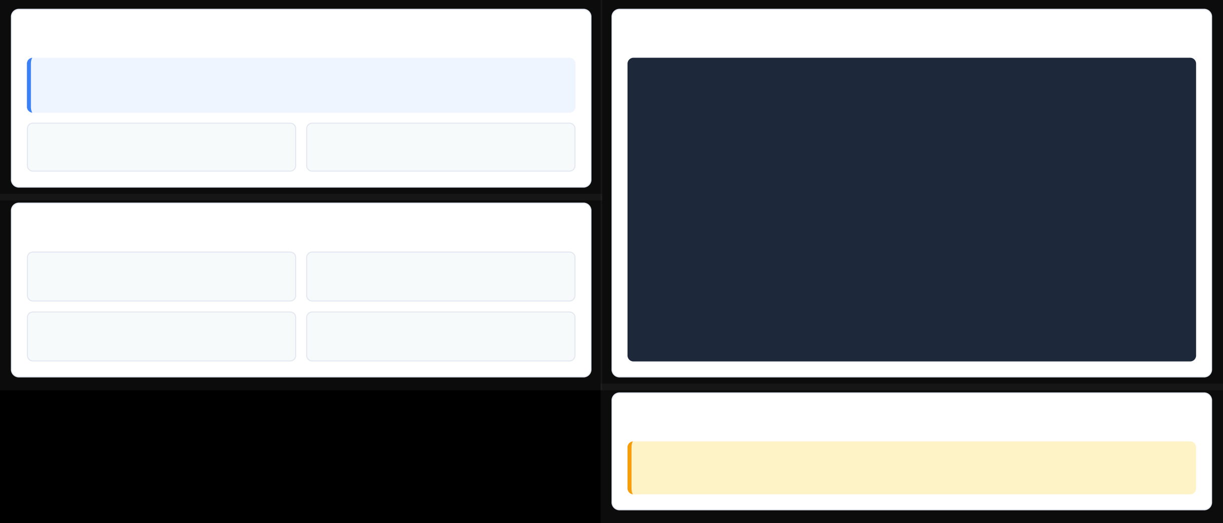



GetSessionProperty API
Retrieving Credentials and Session Properties
20/30
API Overview
Code Implementation
GetSessionProperty retrieves session properties (address, user, password) from PSM by passing the property name as a parameter. Returns $PSM_ERROR_SUCCESS on success.
; GetSessionProperty API Usage Local$addr,$user,$pass
Local$result
SessionPropertyName
Property name to retrieve (IN parameter)
SessionProperty
Value of the property (OUT parameter)
; Retrieve Address property
$result=PSMDispatcherUtilsWrapper_GetSessionProperty("Address",$addr) If$result<>$PSM_ERROR_SUCCESSThen
PSMDispatcherUtilsWrapper_LogWrite("Failed to get Address",$LOG_LEVEL_ERROR)
EndIf
Available Properties
; Retrieve Username property
PSMDispatcherUtilsWrapper_GetSessionProperty("Username",$user)
Address
Target machine IP/hostname
Username
Authentication username
; Retrieve Password property
PSMDispatcherUtilsWrapper_GetSessionProperty("Password",$pass)
Password
Authentication password
SessionUUID
Unique session identifier
; Use credentials securely - avoid logging $pass
PSMDispatcherUtilsWrapper_LogWrite("Connected to: "&$addr,$LOG_LEVEL_TRACE)
Security Considerations
Important: Never log or display the password value. Use GetSessionProperty securely and clean sensitive data from memory after use.

Slide 15
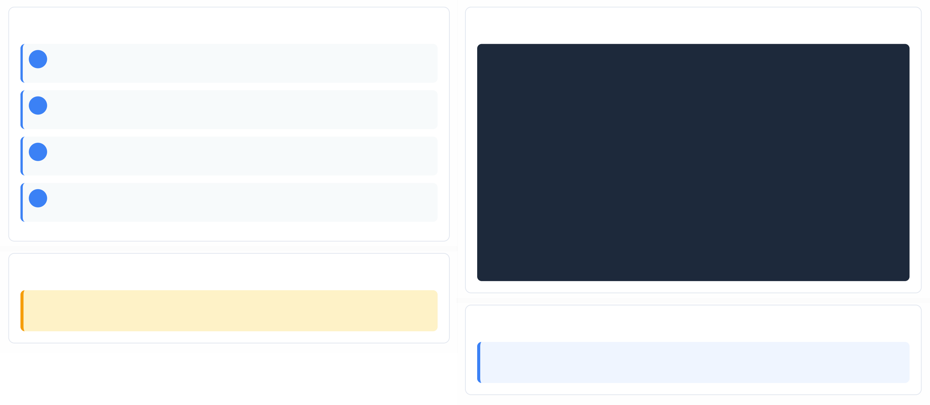

SendPID API and Session Monitoring
Critical Timing Requirements
21/30
Timing Requirements
SendPID Implementation
; Launch client and get PID
Local$pid = Run("C:\Path\To\Client.exe", "", @SW_SHOW)
; Wait for login window to appear
WinWait("Login Window Title", "", 30)
; Automate login (fill credentials, click buttons)
ControlSetText("Login Window Title", "", "[CLASS:Edit; INSTANCE:1]", $username) ControlSetText("Login Window Title", "", "[CLASS:Edit; INSTANCE:2]", $password) ControlClick("Login Window Title", "", "[CLASS:Button; TEXT:Login]")
; Wait for login to complete (check for main window) WinWait("Main Application Window", "", 30)
; ONLY after login is complete, report PID to PSM PSMDispatcherUtilsWrapper_SendPID($pid)
1
Launch Client
Start the application and get the process ID
2
Automate Login
Handle authentication logic and credential entry
3
Verify Login Complete
Confirm successful authentication before proceeding
4
Call SendPID
Report PID to PSM only after login is complete
Critical Warning
SendPID must only be called AFTER the login procedure is complete to ensure user input is blocked correctly during automation.
Key Points
Why timing matters: Calling SendPID too early may allow user input during authentication, compromising security.

Slide 16
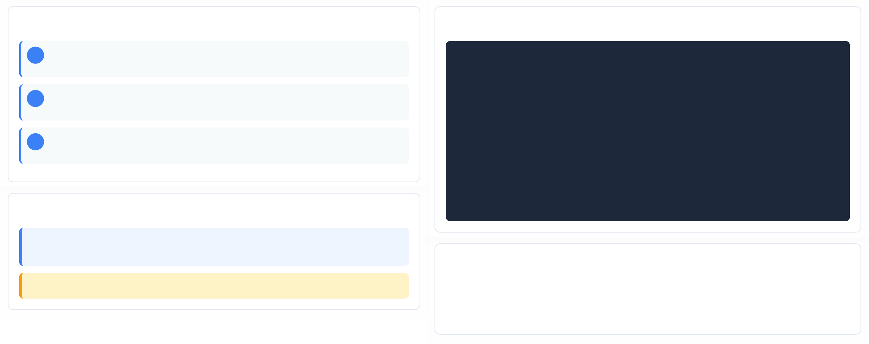



MapTSDrives API Function
Drive Mapping for Non-Standard Clients
22/30
Function Overview
AutoIt Code Example
1
Purpose
Enable RDP local drive mapping for clients that don't support Windows Shell Extensions
; MapTSDrives API Function
Local$rc=PSMDispatcherUtilsWrapper_MapTSDrives()
If$rc<>$PSM_ERROR_SUCCESSThen
PSMDispatcherUtilsWrapper_LogWrite("MapTSDrives&PSMDispatcherUtilsWrapper_PSMGetLastErro
failed: "
Exit1 EndIf
; Verify drive mapping was successful
Local$mappedDrives=DriveGetDrive("NETWORK") If@errorThen
PSMDispatcherUtilsWrapper_LogWrite("Failed to verify drive mapping",$LOG_LEVEL_ERROR) EndIf
2
When to Use
When connection client doesn't display standard File Open/Save windows
3
Result
Allocates drive letters for mapped drives to appear in any File Open/Save window
Key Details
Windows Shell Extensions: Standard method for drive mapping that may not work with all client applications.
Note: This function is specifically for clients that don't support standard Windows Shell Extensions.
Usage Checklist
Check if client supports standard Windows Shell Extensions Call MapTSDrives before file operations
Verify drive letters are allocated successfully

Slide 17
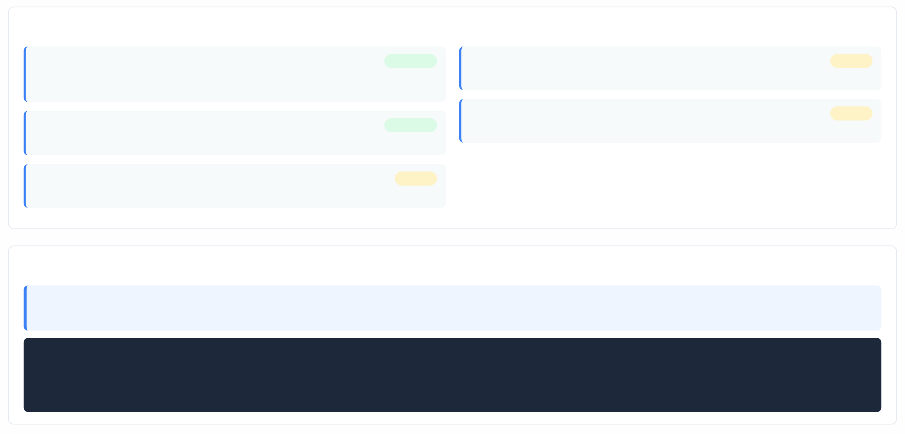


Testing: PSMGenericClientDriver Setup
Development Machine Testing Configuration
23/30
PSMGenericClientDriver Setup Checklist
Copy Required Files from PSM\Components
Copy PSMGenericClientDriver.dll, PSMGenericClientDriver.xml, and PSMGenericClientWrapper.au3
Completed
Run Test Driver
Execute test driver using: autoit3.exe your-script.au3 "C:\path\" /test
Pending
Review Test Logs
Check PSMGenericClientDriver.txt for log output and errors
Pending
Place Files in Development Folder
Place files in the same folder as your new .au3 script for testing
Completed
Update PSMGenericClientDriver.xml
Update SessionProperties section with test values for your application
Pending
Important Testing Notes
Testing Configuration: The PSMGenericClientDriver.xml file contains the Functions and SessionProperties sections. Update the SessionProperties with realistic test values for Address, Username, and Password to simulate actual session data.
<!-- Example SessionProperties configuration -->
<SessionProperty Name="Address" Value="10.10.10.10" />
<SessionProperty Name="Username" Value="administrator" />
<SessionProperty Name="Password" Value="test-password" />

Slide 18
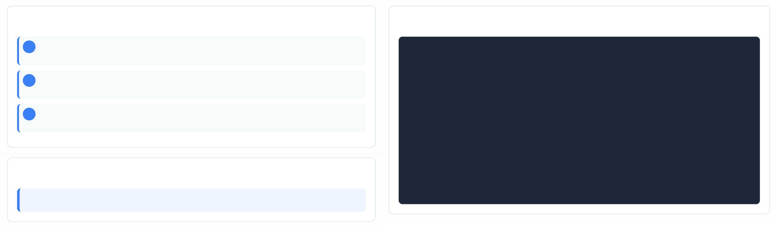
Sample PSMGenericClientDriver.xml
Test Configuration for Development
24/30
Configuration Overview
PSMGenericClientDriver.xml
<?xml version="1.0" encoding="utf-8" ?>
<PSMGenericClientDriver>
<Functions>
<FunctionName="SendPID"Return="Success"/>
<FunctionName="MapTSDrives"Return="Success"/>
<FunctionName="GetSessionPropertyBufferLength"Return="Success"/>
<FunctionName="GetSessionProperty"Return="Success"/>
<FunctionName="LogWrite"Return="Success"/>
</Functions>
<SessionProperties>
<SessionPropertyName="SessionUUID"Value="0b4d3135-d824-4044-8a3f-555a72b72577"/>
<SessionPropertyName="Username"Value="administrator"/>
<SessionPropertyName="Address"Value="10.10.10.10"/>
<SessionPropertyName="Password"Value="very-secured-pass"/>
</SessionProperties>
</PSMGenericClientDriver>
1
Functions Section
Defines API functions to test (SendPID, MapTSDrives, etc.)
2
SessionProperties Section
Contains test values for credentials and connection details
3
Test Values
Set realistic values for username, password, address
Key Points
Important: The XML file must be placed in the same folder as your AutoIt script and the DLL file.

Slide 19






Testing: Running and Debugging
PSMGenericClientDriver Test Execution
25/30
Running the Test Driver
Command: Run AutoIt3.exe with the test script and driver path
Format: autoit3.exe <script.au3> "<driver_path>" /test
Parameter: The second parameter must end with a backslash
# Run from development machine
C:\Path\to\autoit3.exe C:\Your\script.au3 "C:\FolderWithDriverDLL\" /test
Test Execution Steps
Copy Test Files
Copy PSMGenericClientDriver.dll, PSMGenericClientDriver.xml, and PSMGenericClientWrapper.au3 to your development folder
Configure Session Properties
Update SessionProperties in XML with realistic test values
Run Test Command
Execute the AutoIt script with the /test parameter
Review Logs
Check PSMGenericClientDriver.txt for output and errors
Important: The second parameter specifies the path to the folder containing the driver's DLL. This parameter must end with a backslash.
Key Notes
Test driver simulates PSM environment for development
No actual PSM session is created during testing Use for debugging before deploying to PSM
Debugging Information
Log File: PSMGenericClientDriver.txt will be created with log output
Window Info: Share MainWindowTitle/Class with admin for Lock Application Window

Slide 20
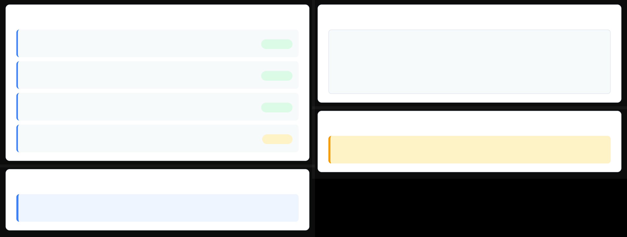






Packaging the Connector
ZIP Archive Requirements
26/30
Required Files in ZIP
Directory Structure
Dispatcher Executable (.exe)
Compiled AutoIt script for the connector
PSMConnectorPackage/
MyDispatcher.exe package.json
Required
package.json
AppLocker configuration for executable paths
PSMDispatcherUtils.dll Additional files...
Required
PSMDispatcherUtils.dll
PSM utility library for the connector
Required
Security Notes
Additional Dependencies
Any DLLs or EXEs required by the connector
Optional
Warning: The package.json file must appear at the root of the ZIP archive. Special characters [ ] are not supported in the package name.
Key Requirements
Important: Do not place the executable directly under C:\. Place it in a dedicated subfolder to avoid security issues and ensure proper AppLocker integration.

Slide 21
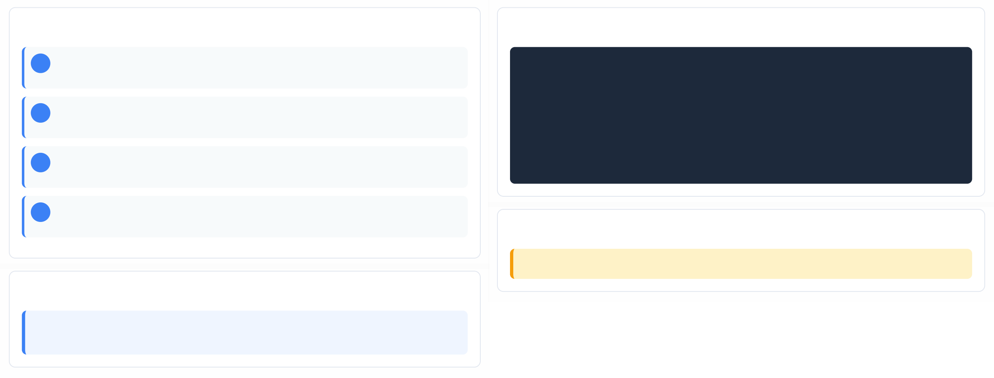
package.json for AppLocker
ClientAppPaths Configuration
27/30
Configuration Requirements
package.json Example
1
PackageName
Unique identifier for the connector package
{
"PackageName":"PSMRealVNCDispatcherSample", "ClientAppPaths": [
{
"Path":"C:\\NewSubfolder\\VNC-Viewer-5.0.5-Windows-64bit.exe"
}
]
2
ClientAppPaths
Array of paths to applications for AppLocker rules
3
Path
Full path to executable file
}
4
Placement
Must be at root of ZIP archive
Important Notes
Warning: Do not place the executable directly under C:\. Place it in a dedicated subfolder for security.
Key Points
AppLocker Integration: The package.json is critical for PSM to automatically update AppLocker rules.

Slide 22
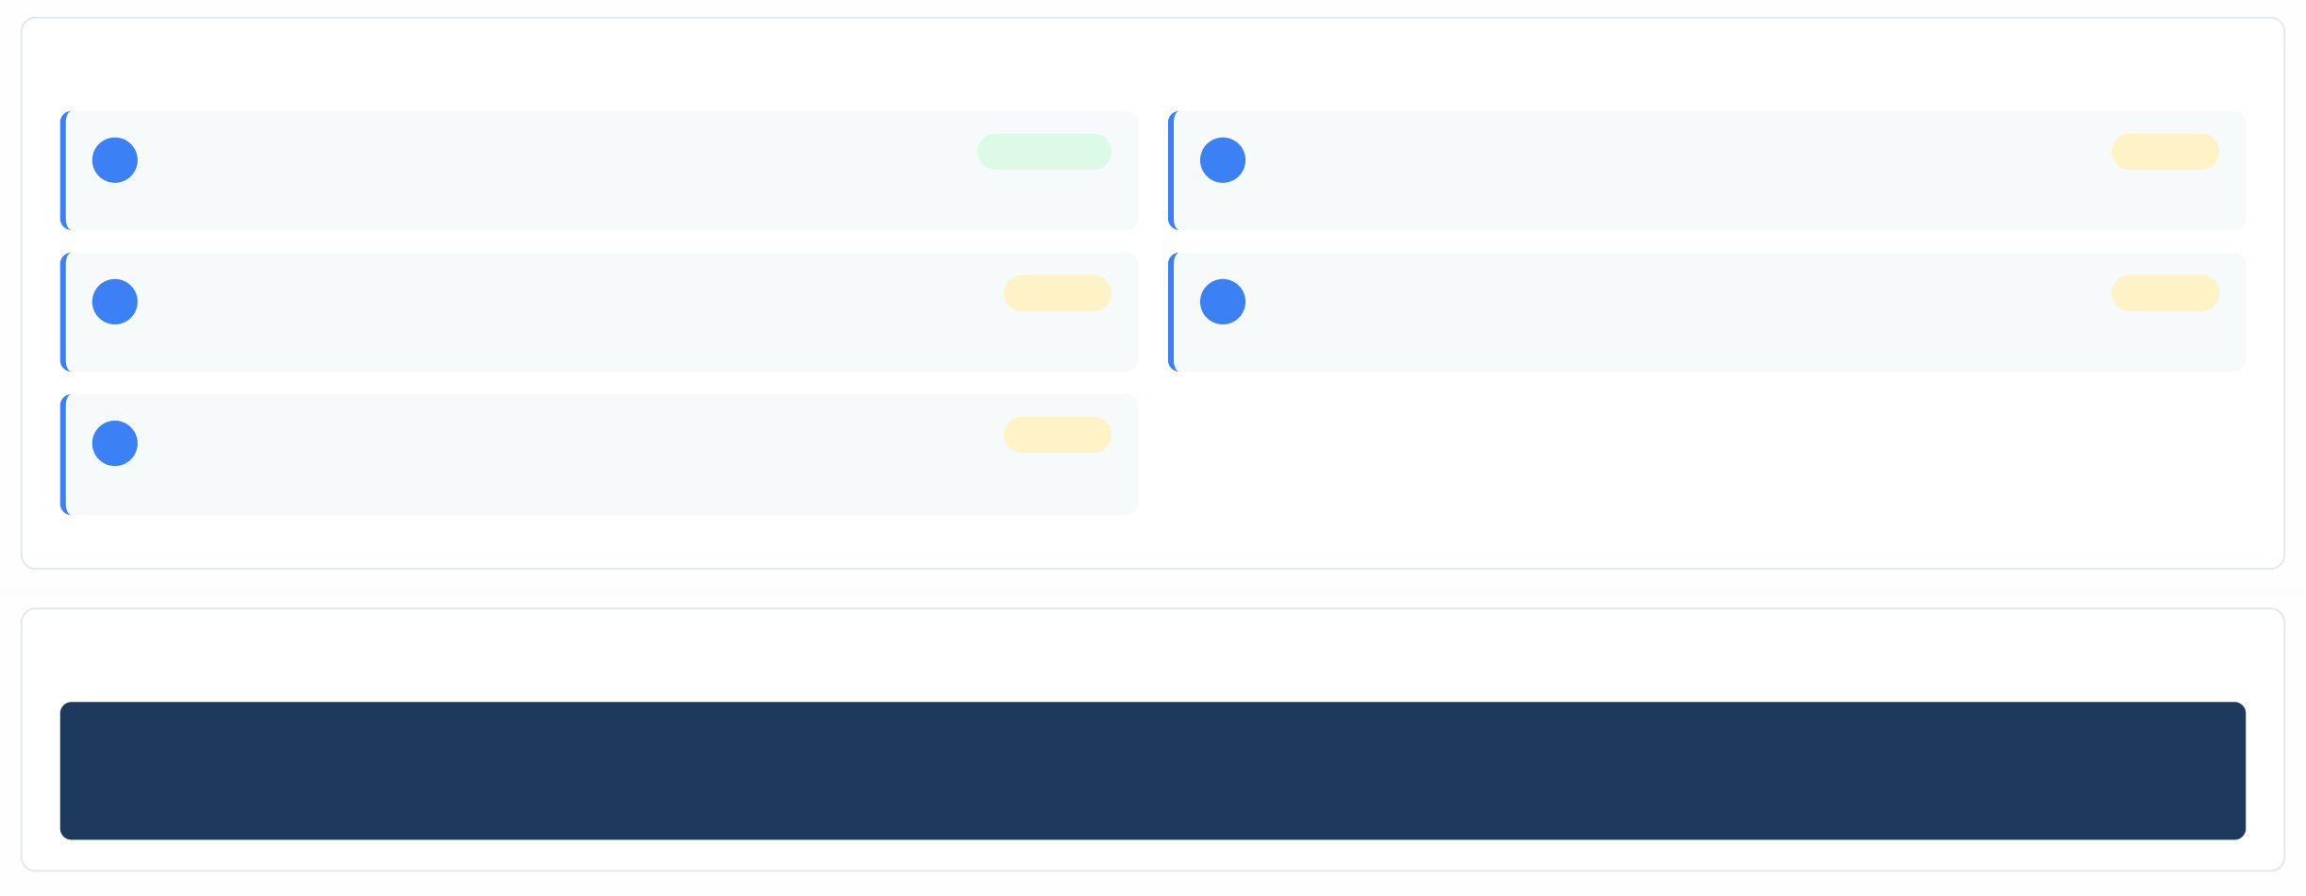



Deployment Strategy: Single PSM (Manual)
Manual deployment for single PSM server
28/30
Deployment Steps
1
Place Connector Package
Completed
4
Verify Configuration
Test the connection to ensure the connector works as expected
Pending
Copy your connector executable/package to PSM\Components folder on the target PSM server
2
Configure ClientDispatcher
In PVWA, configure Target Settings > ClientDispatcher to point to your compiled EXE
Pending
5
Lock Application Window
Configure MainWindowTitle and MainWindowClass for window locking
Pending
3
Add to Platform
Add the Connection Component to the target platform(s) in PVWA
Pending
Configuration Example
PSM\Components\PSMRealVNCDispatcher.exe
# Configure in PVWA: Administration > Configuration Options > Connection Components # Target Settings > ClientDispatcher: PSMRealVNCDispatcher.exe

Slide 23
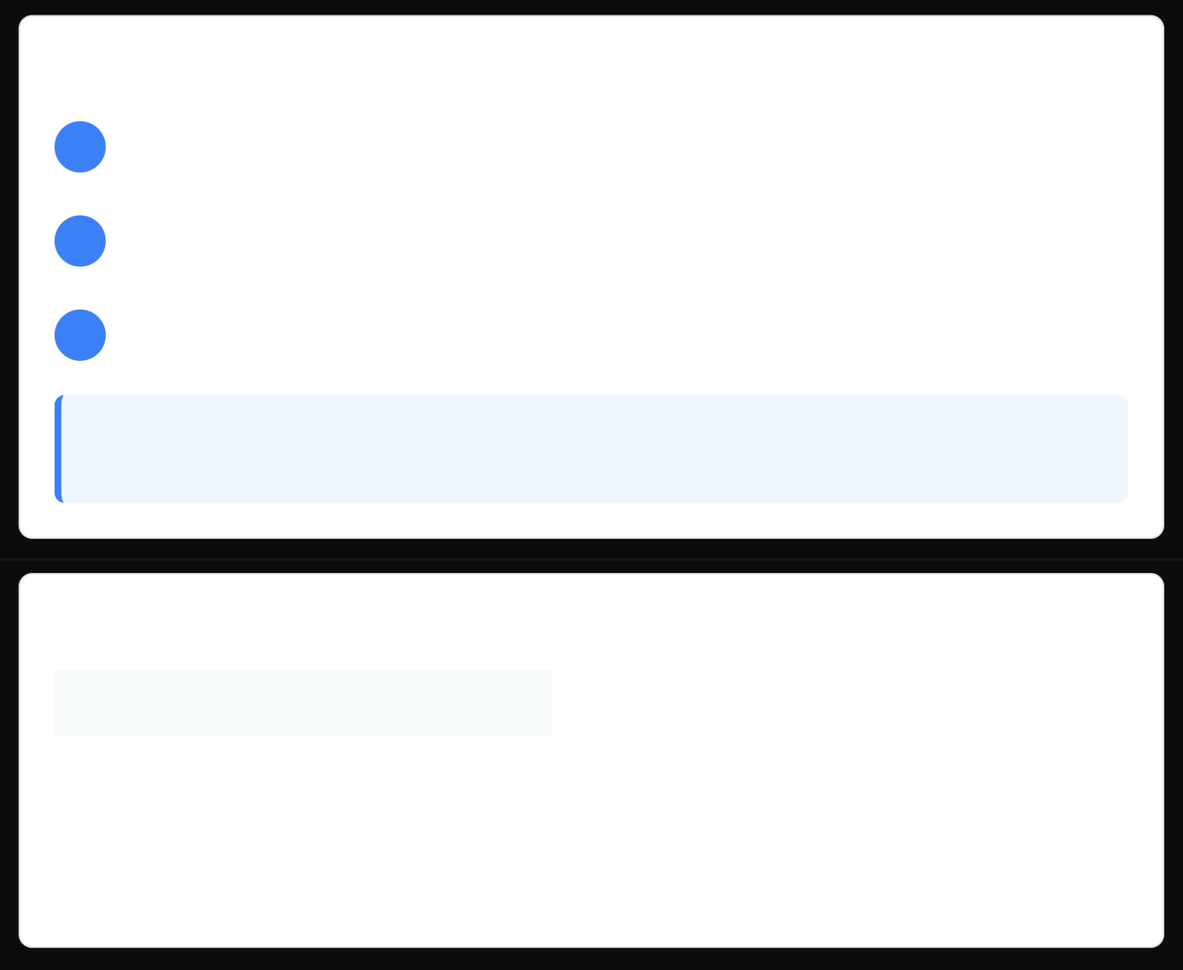
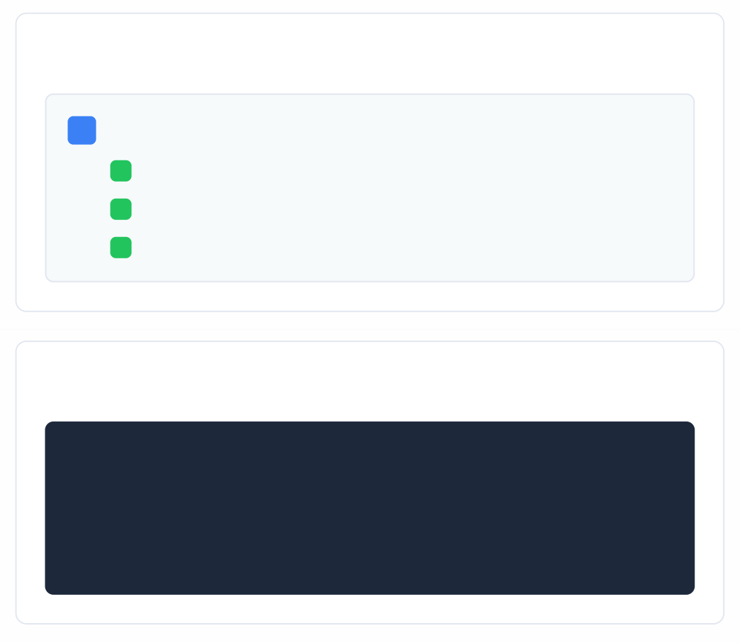



Shared/Automatic Deployment Strategy
PSMUniversalConnectors Safe with 10-minute refresh
29/30
Centralized Deployment via PSMUniversalConnectors Safe
Deployment Architecture
Upload Package to Safe
Upload the connector package to the PSMUniversalConnectors Safe for automatic distribution
Automatic Deployment
All universal connectors in the Safe are deployed during the next configuration refresh (10 minutes)
Version Management
If the package is updated, it is deployed to all PSMs; if deleted, it is removed from PSM
1
PSMUniversalConnectors Safe
PSM Server 1
PSM Server 2
PSM Server 3
2
3
Key Point: This method simplifies management of PSM connectors and ensures all servers are aligned with identical connectors.
Key Configuration
# PowerShell script for deployment
$SafeName = "PSMUniversalConnectors"
$PackagePath = "C:\Connectors\MyConnector.zip"
Upload-PVFile -Safe $SafeName -FilePath $PackagePath
Configuration Refresh Interval
Parameter
Value
Description
Refresh Interval
10 minutes
Default time between configuration checks
Deployment Time
~2-3 minutes
Time to deploy package to PSM server
Update Frequency
On change
Immediate when package is modified

Slide 24
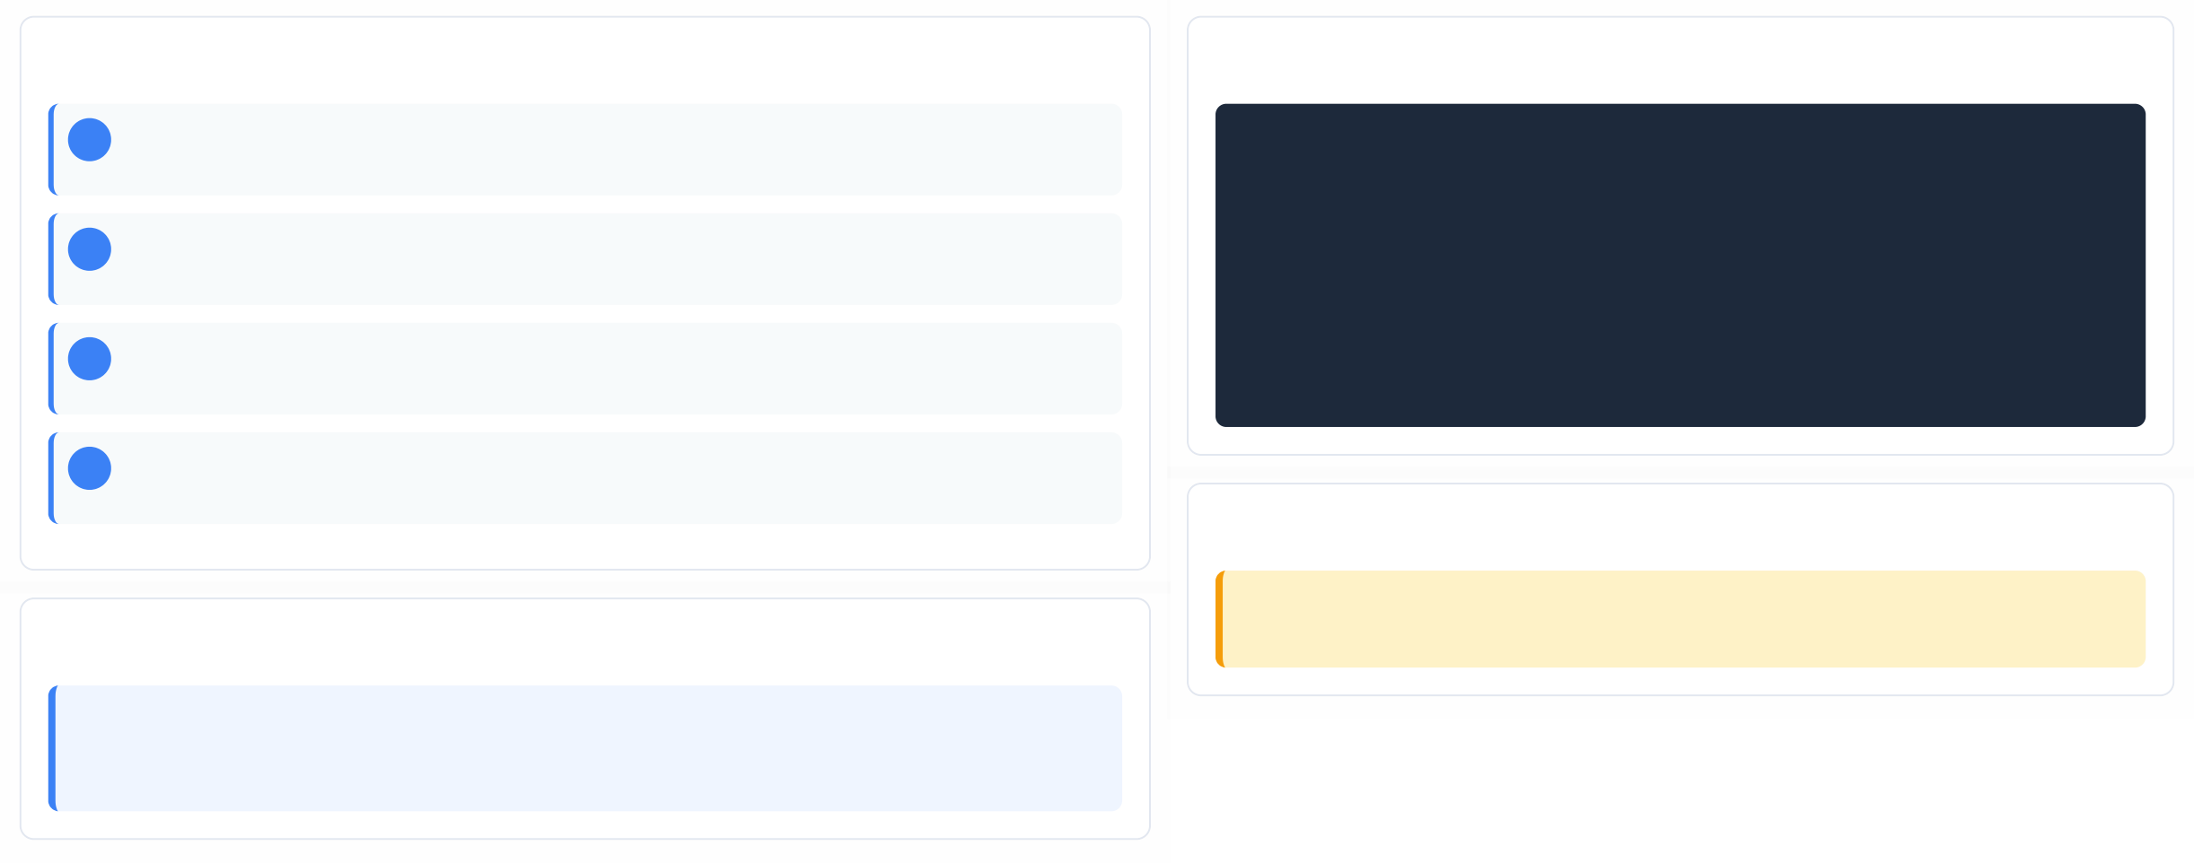

Deploy-Connectors.ps1 - Test Deployment
PowerShell Script for Connector Testing
30/30
Test Deployment Process
PowerShell Script Usage
# Navigate to PSM Scripts directory
Set-Location"C:\Program Files (x86)\CyberArk\PSM\Scripts"
# Run deployment script with verbose output
./Deploy-Connectors.ps1-Verbose
# Or run without verbose for minimal output
./Deploy-Connectors.ps1
# Check deployment status
Get-ChildItem"C:\Program Files (x86)\CyberArk\PSM\Components\Connectors"
1
Copy Package to PSM\Packages
Place your connector package in the PSM\Packages folder on the target PSM server
2
Navigate to Scripts Directory
Change to the PSM\Scripts folder where Deploy-Connectors.ps1 is located
3
Run Deployment Script
Execute the script with optional -Verbose flag for detailed logging
4
Verify Deployment
Check logs in PSM\Logs\Scripts for troubleshooting
Best Practices
Important: Always test connectors in a development environment before deploying to production. Use -Verbose flag for detailed logging during troubleshooting.
Key Points
Location: C:\Program Files (x86)\CyberArk\PSM\Scripts\Deploy-Connectors.ps1
Purpose: Test connector before distributing to all PSMs
Logs: Check PSM\Logs\Scripts for detailed output

Slide 25
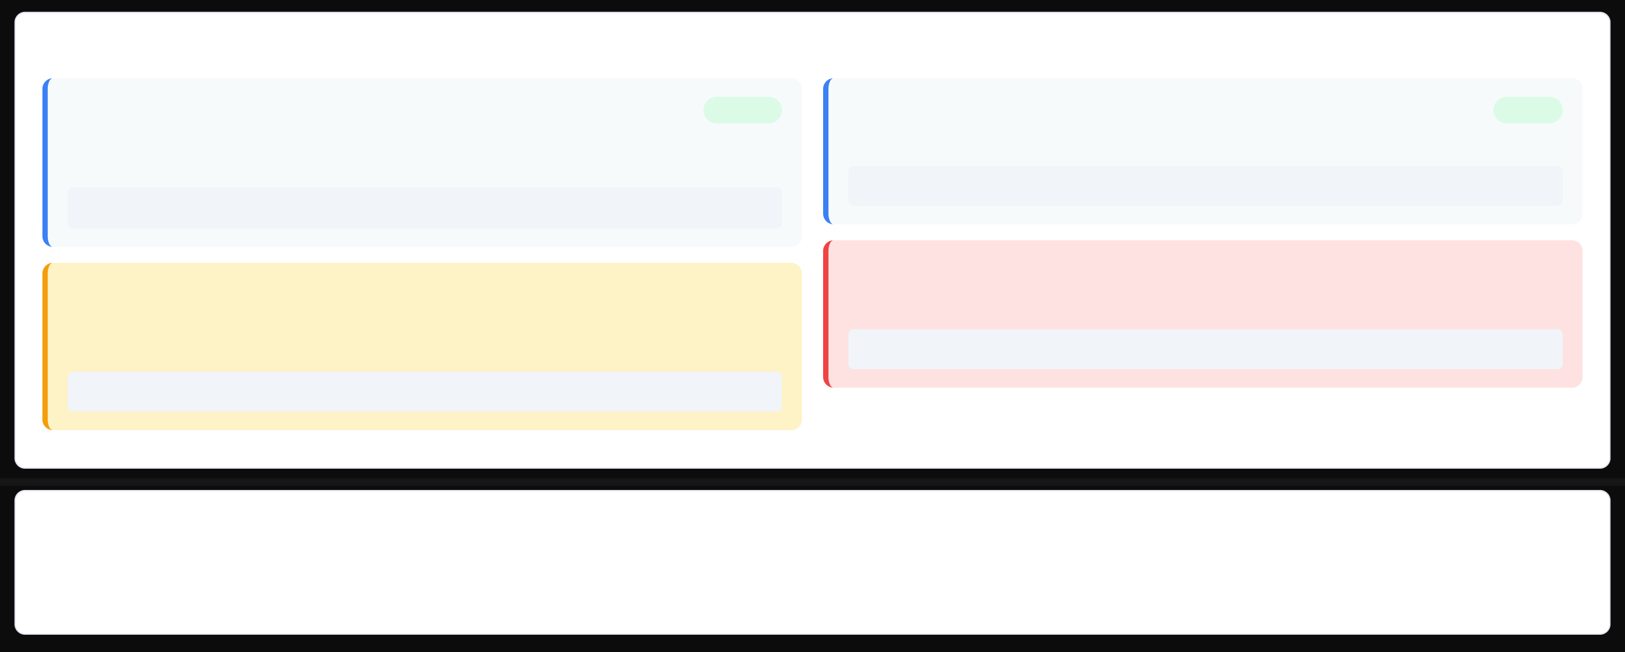



Security Best Practices
PSM Universal Connector Security
31/30
Critical Security Controls
BlockUserInput
PSM blocks user input during login until SendPID is called. This prevents user interference during credential entry.
Best Practice: Keep BlockUserInput enabled unless user input is required during login
Enabled
Password Protection
Ensure password used by PSM Universal Connector cannot be exposed to the user interface.
Secure
Best Practice: Never display passwords in UI or logs
Clean Sensitive Data
Critical
Make sure sensitive data is not saved to disk during the session; clean data as part of AutoIt script.
⚠ Critical: Clean sensitive data from disk after session
SendPID Timing
Call SendPID only AFTER login procedure completes to ensure user input is blocked correctly during automation.
⚠ Important: SendPID must be called after login completes
Critical
Security Implementation Checklist
Enable BlockUserInput during login | Call SendPID after login completes | Hide passwords from UI exposure | Clean sensitive data from disk | Use secure credential handling
Implement proper session cleanup | Validate window titles/classes | Use compiled .exe for deployment

Slide 26
https://docs.cyberark.com/pam-self-hosted/latest/en/content/pasimp/psm_connectors.htm
https://docs.cyberark.com/pam-self-hosted/latest/en/content/pasimp/psm_cc_connection_components.htm
https://docs.cyberark.com/pam-self-hosted/latest/en/content/psm/psm_universalconnectors.htm
https://community.cyberark.com/s/article/Creating-a-CyberArk-Privileged-Session-Manager-Connection-Component-for-a-Web-Application
https://docs.cyberark.com/pam-self-hosted/latest/en/content/pasimp/psm_develop_universal_connector.htm
https://docs.cyberark.com/pam-self-hosted/latest/en/content/pasimp/psm_webapplication.htm
https://docs.cyberark.com/pam-self-hosted/latest/en/content/pasimp/configurepsmuniversalconnector.htm
https://docs.cyberark.com/pam-self-hosted/latest/en/content/webservices/importconncomponent.htm
https://docs.cyberark.com/pam-self-hosted/latest/en/content/pasimp/psm_configure_universal_connector.htm
===

