Slide 1
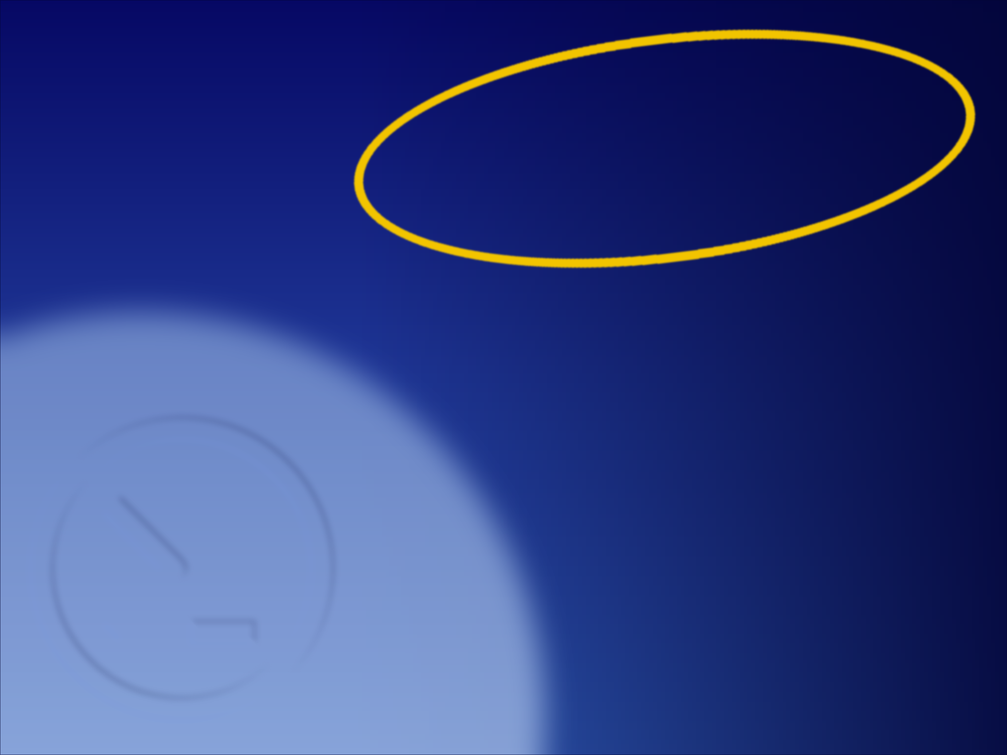
OPERATING SYSTEMS
Module 0
The lab
Building MS‑DOS 4.00 from its own source, booting it, and a FreeBSD 15.1 machine
MS-DOS 4.00
FreeBSD 15.1
Francesco Valerio Buccoli
francesco@buccoli.com
Sources: MS‑DOS 2d04cac · FreeBSD release/15.1.0

Slide 2

01
Two systems, one PC
MS‑DOS 4.00 × FreeBSD 15.1 · Module 0 · F. V. Buccoli
2
Notes:
This module sets up everything the course uses. Both systems are studied from their real source at fixed commits, and both are run, not just read.

Slide 3

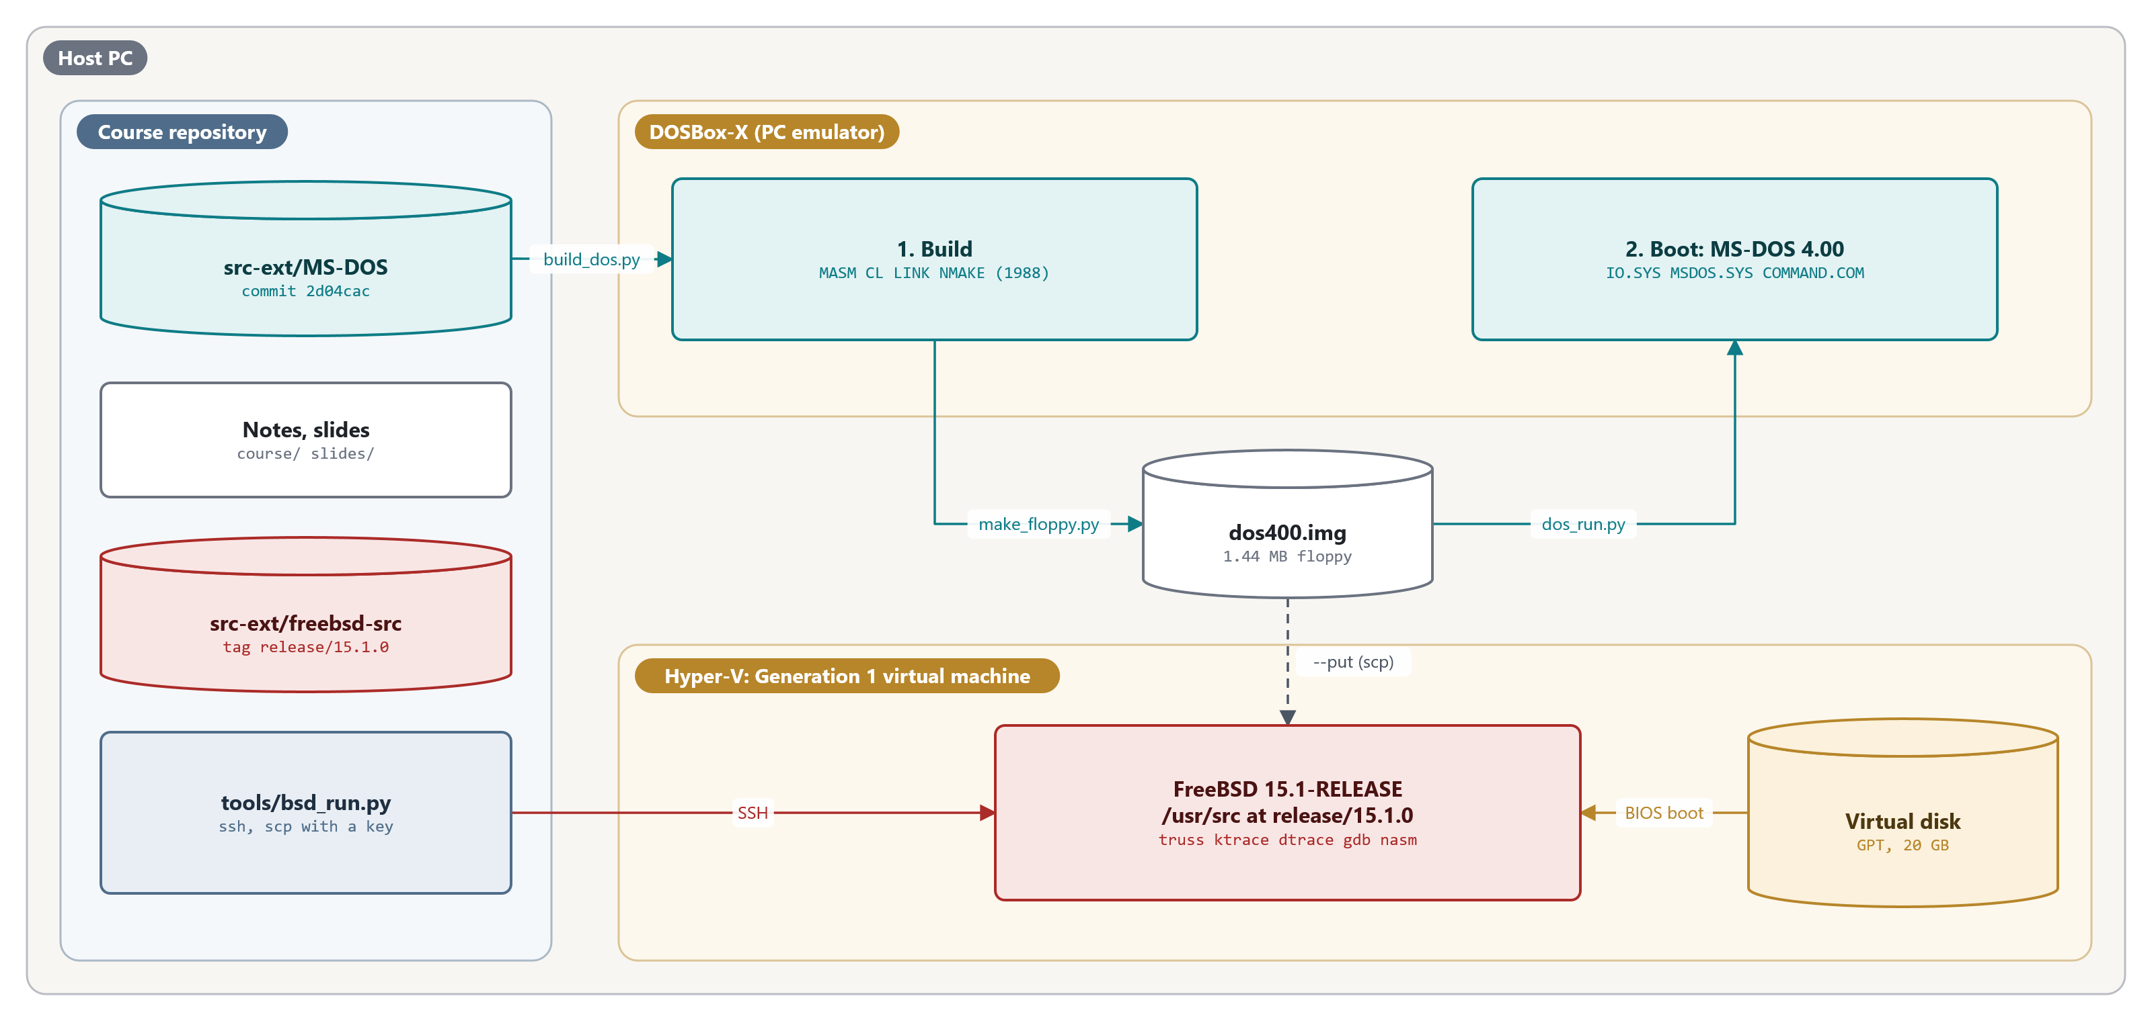
The lab at a glance
One host PC: DOSBox-X builds and boots MS-DOS 4.00; a Hyper-V Generation 1 VM runs FreeBSD 15.1
MS‑DOS 4.00 × FreeBSD 15.1 · Module 0 · F. V. Buccoli
3
Notes:
Left: the course repository with both source trees pinned. Top: DOSBox-X runs the 1988 toolchain over the MS-DOS source (build_dos.py), make_floppy.py writes dos400.img, and dos_run.py boots it. Bottom: the FreeBSD VM boots through the BIOS from its GPT disk; bsd_run.py reaches it over SSH and copies files, the DOS image included, with scp.

Slide 4
What the lab contains
Part | What it is | Used in
Course repository | Notes, tools, slides, citation checker | All modules
src‑ext/MS‑DOS | microsoft/MS‑DOS at commit 2d04cac | All modules
src‑ext/freebsd‑src | freebsd/freebsd‑src at release/15.1.0 | All modules
DOSBox‑X | PC emulator: runs the 1988 build tools, boots our DOS | All modules
dos400.img | 1.44 MB floppy with MS‑DOS 4.00 built from source | Modules 1‑3
FreeBSD 15.1 VM | BIOS‑booting VM with /usr/src at the same tag | Modules 1‑3
MS‑DOS 4.00 × FreeBSD 15.1 · Module 0 · F. V. Buccoli
4
Notes:
Everything is pinned. The FreeBSD release's own REVISION file names the same commit, 96841ea08dcf, so the VM's binaries and the source we cite match.

Slide 5
Every claim points at a source line
Listings link to exact lines at the pinned commits
A line with only ⋮ means lines were left out
tools/check_citations.py verifies every listing mechanically
--excerpt prints any range, ready to paste
Code on slides is checked against the source too
MS‑DOS 4.00 × FreeBSD 15.1 · Module 0 · F. V. Buccoli
5
Notes:
Show one link live: click it and land on the highlighted lines on GitHub. Then run check_citations.py --excerpt on the same range.

Slide 6
02
MS‑DOS 4.00 from source
MS‑DOS 4.00 × FreeBSD 15.1 · Module 0 · F. V. Buccoli
6
Notes:
The 2024 release includes the complete build tree with its own compilers. It does not build as published; four small problems stop it.

Slide 7
The build environment the release expects
MS-DOS 4.00
SETENV.BAT lines 1-12
@echo off
echo setting up system to build the MS-DOS 4.01 SOURCE BAK...
set CL=
set LINK=
set MASM=
set COUNTRY=usa-ms
set BAKROOT=d:
rem BAKROOT points to the home drive/directory of the sources.
set LIB=%BAKROOT%\src\tools\lib
set INIT=%BAKROOT%\src\tools
set INCLUDE=%BAKROOT%\src\tools\inc
set PATH=%BAKROOT%\src\tools
Source: microsoft/MS‑DOS @ 2d04cac, v4.0/src/SETENV.BAT, lines 1‑12
1
Calls itself 4.01; the binaries say 4.00
2
tools\lib and tools\inc do not exist
3
The C headers and libraries are in TOOLS\BLD
MS‑DOS 4.00 × FreeBSD 15.1 · Module 0 · F. V. Buccoli
7
Notes:
SETENV.BAT is the official setup. Its LIB and INCLUDE paths point at folders that are not in the release; the compiler's files are under TOOLS\BLD. Our generated BUILD.BAT has the corrected paths.

Slide 8
Four problems, four fixes
Problem | Symptom | Fix in prepare_dos_build.py
LF line endings in git | 1988 tools expect CR LF | Convert text files, detected by content
U+FFFD in 20 files | MASM: line too long (GETMSG.ASM 473) | Map each back to one byte
Wrong LIB/INCLUDE paths | Compiler cannot find headers | Generated BUILD.BAT with TOOLS\BLD
Emulator clock behind host | NMAKE reruns NOSRVBLD, which hangs | Fixed past date on all sources
MS‑DOS 4.00 × FreeBSD 15.1 · Module 0 · F. V. Buccoli
8
Notes:
Each problem was found by a failing build. Line endings, character encodings, environment assumptions and make's reliance on file times: a small lesson in why a source release is not yet a build.

Slide 9
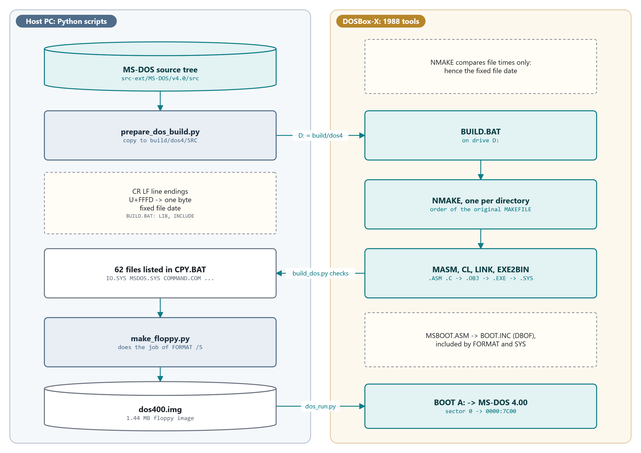
The build pipeline
Python on the host prepares the tree and makes the floppy; the 1988 tools run inside DOSBox-X
MS‑DOS 4.00 × FreeBSD 15.1 · Module 0 · F. V. Buccoli
9
Notes:
Follow the arrows: prepare_dos_build.py copies the tree to build/dos4 and applies the four fixes; DOSBox-X mounts it as D: and BUILD.BAT runs one NMAKE per directory, which calls MASM, CL, LINK and EXE2BIN. build_dos.py then checks BUILD.LOG and the 62 files of CPY.BAT, make_floppy.py writes dos400.img, and dos_run.py boots it with BOOT A:.

Slide 10
The build, measured
1.7 min
62
0
for the whole tree in DOSBox‑X
programs and drivers listed in CPY.BAT
bytes differ between two clean builds
MS‑DOS 4.00 × FreeBSD 15.1 · Module 0 · F. V. Buccoli
10
Notes:
The build is reproducible: no 1988 tool writes a date, time or path into its output. Exercise 0.1 asks students to compare hashes with classmates and explain why they match.

Slide 11
Why the floppy layout is not arbitrary
MS-DOS 4.00
MSBOOT.ASM lines 256-268
MOV DI,BX
MOV CX,11
MOV SI,OFFSET BIO ; point to "ibmbio com"
REPZ CMPSB ; see if the same
JNZ CKERR ; if not there advise the user
;
; Found the BIOS. Check the second directory entry.
;
LEA DI,[BX+20h]
MOV SI,OFFSET DOS ; point to "ibmdos com"
MOV CX,11
REPZ CMPSB
JZ DoLoad
Source: microsoft/MS‑DOS @ 2d04cac, v4.0/src/BOOT/MSBOOT.ASM, lines 256‑268
1
Entry 1 must be IO.SYS, entry 2 MSDOS.SYS
2
Names compared as 11 bytes, as stored on disk
3
Then 3 sectors are read from the data start
MS‑DOS 4.00 × FreeBSD 15.1 · Module 0 · F. V. Buccoli
11
Notes:
MSBOOT is 512 bytes, so it assumes a lot: the first two directory entries and IO.SYS starting at the first data sector. make_floppy.py builds the image to satisfy exactly these rules, playing the role of FORMAT /S.

Slide 12
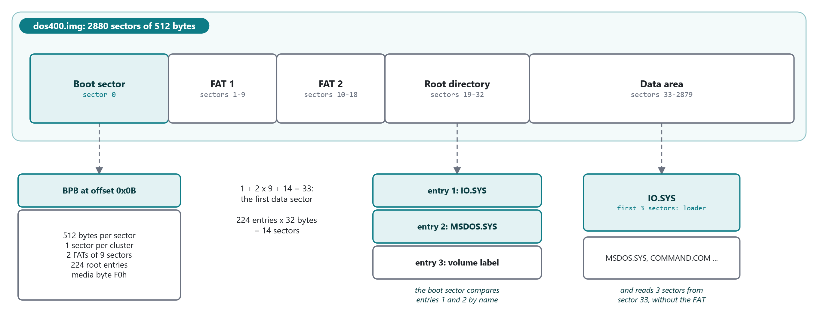
The 1.44 MB lab floppy
IO.SYS must be directory entry 1 and start at the first data sector, sector 33
MS‑DOS 4.00 × FreeBSD 15.1 · Module 0 · F. V. Buccoli
12
Notes:
Walk through the arithmetic: 1 reserved sector, two FATs of 9 sectors, 14 root directory sectors, so data starts at sector 33. The boot sector checks the first two directory entries by name and reads three sectors from sector 33 without looking at the FAT. Exercise 1.1 in Module 1 decodes this boot sector byte by byte.

Slide 13
Running MS‑DOS 4.00
python tools/dos_run.py: boot the image and work at A:\>
With commands: run them and print their output
Output travels over COM1 into a file DOSBox‑X writes
DIR *. | SORT shows two temporary files: the pipe
nasm assembles .COM programs; --file copies them in
MS‑DOS 4.00 × FreeBSD 15.1 · Module 0 · F. V. Buccoli
13
Notes:
Demo live: dos_run.py "DIR *. | SORT". Two zero-byte files with hexadecimal names appear in the listing. Ask the class where they come from; Module 3 answers it from TPIPE.ASM.

Slide 14
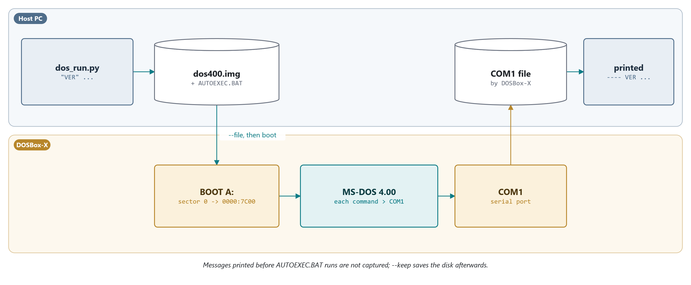
How dos_run.py captures output
Commands go in through a temporary AUTOEXEC.BAT; their output leaves through COM1 into a file on the host
MS‑DOS 4.00 × FreeBSD 15.1 · Module 0 · F. V. Buccoli
14
Notes:
dos_run.py writes a temporary AUTOEXEC.BAT that redirects each command to COM1, and tells DOSBox-X to write everything sent to COM1 into a file. After BOOT A: the machine runs only our boot sector, IO.SYS, MSDOS.SYS and COMMAND.COM. SYSINIT's messages come before AUTOEXEC.BAT and are not captured; tools/screen.asm can copy the screen to the output.

Slide 15
03
FreeBSD 15.1
MS‑DOS 4.00 × FreeBSD 15.1 · Module 0 · F. V. Buccoli
15
Notes:
The FreeBSD side is a normal virtual machine, installed so that it boots through the BIOS like the DOS image does.

Slide 16
The FreeBSD machine
Hyper‑V Generation 1, QEMU or VirtualBox without EFI
Install from disc1.iso, UFS, automatic partitioning
pkg install git nasm gdb
git clone release/15.1.0 into /usr/src, check the commit
mdconfig and mount -t msdosfs read the DOS image
MS‑DOS 4.00 × FreeBSD 15.1 · Module 0 · F. V. Buccoli
16
Notes:
BIOS boot matters for Module 1, which studies boot0, boot1, boot2 and BTX. Boot code experiments go on memory disks, never on the VM's own boot disk.

Slide 17
Homework
Exercise 0.1: check your lab end to end
Print a listing with --excerpt and follow its link
Build MS‑DOS 4.00, compare hashes, explain the match
Run your own .COM program in MS‑DOS 4.00
Mount the image in FreeBSD and count its files
MS‑DOS 4.00 × FreeBSD 15.1 · Module 0 · F. V. Buccoli
17
Notes:
Deliverable: a one-page lab report. The file count in step 5 differs from CHKDSK's; the volume label explains it.

Slide 18
Key takeaways
Both systems are studied from pinned source and run
A source release is not a build: four fixes needed
The 1988 toolchain builds the same bytes every time
512‑byte boot code dictates the disk layout
The same FAT image is read by both kernels
MS‑DOS 4.00 × FreeBSD 15.1 · Module 0 · F. V. Buccoli
18
Notes:
Close by connecting to Module 1: we have a disk that boots. Next we follow it from the BIOS jump to 0x7C00 all the way to COMMAND.COM and /sbin/init.

Slide 19
Questions?
Module 0: The lab
Notes, labs and homework: course/ and labs/
Every listing links to its exact source lines
Francesco Valerio Buccoli
francesco@buccoli.com

