Slide 1

OPERATING SYSTEMS
Module 7
Disks and file systems:
FAT against UFS2
MS‑DOS 4.00 and FreeBSD 15.1, from raw sectors to files
MS-DOS 4.00
FreeBSD 15.1
Francesco Valerio Buccoli
francesco@buccoli.com
Sources: MS‑DOS 2d04cac · FreeBSD release/15.1.0

Slide 2

01
Disks as arrays of sectors
MS‑DOS 4.00 × FreeBSD 15.1 · Module 7 · F. V. Buccoli
2

Slide 3

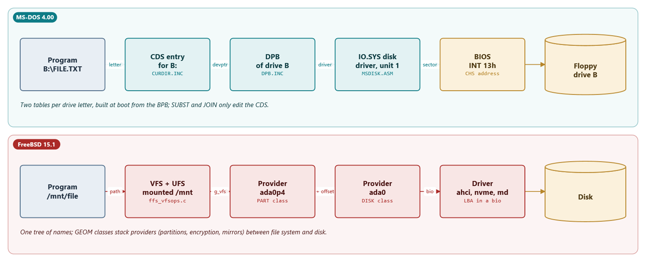
From a name to a sector
Drive letter, CDS and DPB on MS-DOS; GEOM providers on FreeBSD
MS‑DOS 4.00 × FreeBSD 15.1 · Module 7 · F. V. Buccoli
3
Notes:
Start from what a program names. On MS-DOS a drive letter selects a CDS entry, which points to the DPB built from the BPB at boot, which points to the driver unit; the driver turns a logical sector into CHS for INT 13h. On FreeBSD a path leads to a mounted file system, which is a consumer of a GEOM provider such as ada0p4; the PART class adds the partition offset and passes a bio to the disk.

Slide 4
The Drive Parameter Block
MS-DOS 4.00
DPB.INC lines 8-26
dpb_drive DB ? ; Logical drive # assoc with DPB (A=0,B=1,...)
dpb_UNIT DB ? ; Driver unit number of DPB
dpb_sector_size DW ? ; Size of physical sector in bytes
dpb_cluster_mask DB ? ; Sectors/cluster - 1
dpb_cluster_shift DB ? ; Log2 of sectors/cluster
dpb_first_FAT DW ? ; Starting record of FATs
dpb_FAT_count DB ? ; Number of FATs for this drive
dpb_root_entries DW ? ; Number of directory entries
dpb_first_sector DW ? ; First sector of first cluster
dpb_max_cluster DW ? ; Number of clusters on drive + 1
… (lines omitted)
dpb_first_access DB ? ; This is initialized to -1 to force a media
; check the first time this DPB is used
dpb_next_dpb DD ? ; Pointer to next Drive parameter block
dpb_next_free DW ? ; Cluster # of last allocated cluster
dpb_free_cnt DW ? ; Count of free clusters, -1 if unknown
Source: microsoft/MS‑DOS @ 2d04cac, v4.0/src/INC/DPB.INC, lines 8‑26
1
Geometry digested from the BPB
2
Shift and mask avoid DIV
3
next_free: the allocation cursor
4
free_cnt: -1 when unknown
MS‑DOS 4.00 × FreeBSD 15.1 · Module 7 · F. V. Buccoli
4
Notes:
One DPB per drive letter. Point at dpb_cluster_mask and dpb_cluster_shift: the kernel turns cluster numbers into sectors with shifts. dpb_next_free and dpb_free_cnt come back in Lab 7.3 and Exercise 7.5, where DPBINFO.C prints them.

Slide 5
Partitions and disks in the
official FreeBSD VM image
Partition | Type | LBA range | Size
p1 | freebsd‑boot | 34 - 154 | 0.1 MiB
p2 | efi (a FAT file system) | 155 - 66738 | 32.5 MiB
p3 | freebsd‑swap | 66739 - 2163890 | 1 GiB
p4 | freebsd‑ufs | 2163891 - 12649650 | 5 GiB
MS‑DOS 4.00 × FreeBSD 15.1 · Module 7 · F. V. Buccoli
5
Notes:
Real output of vhdpart.py on FreeBSD-15.1-RELEASE-amd64-ufs.vhd.xz. A GPT disk with a protective MBR of type EEh. Note that the EFI system partition is FAT: firmware everywhere reads FAT, which is part of the essay question.

Slide 6
02
FAT12 and FAT16
in MS‑DOS 4.00
MS‑DOS 4.00 × FreeBSD 15.1 · Module 7 · F. V. Buccoli
6

Slide 7
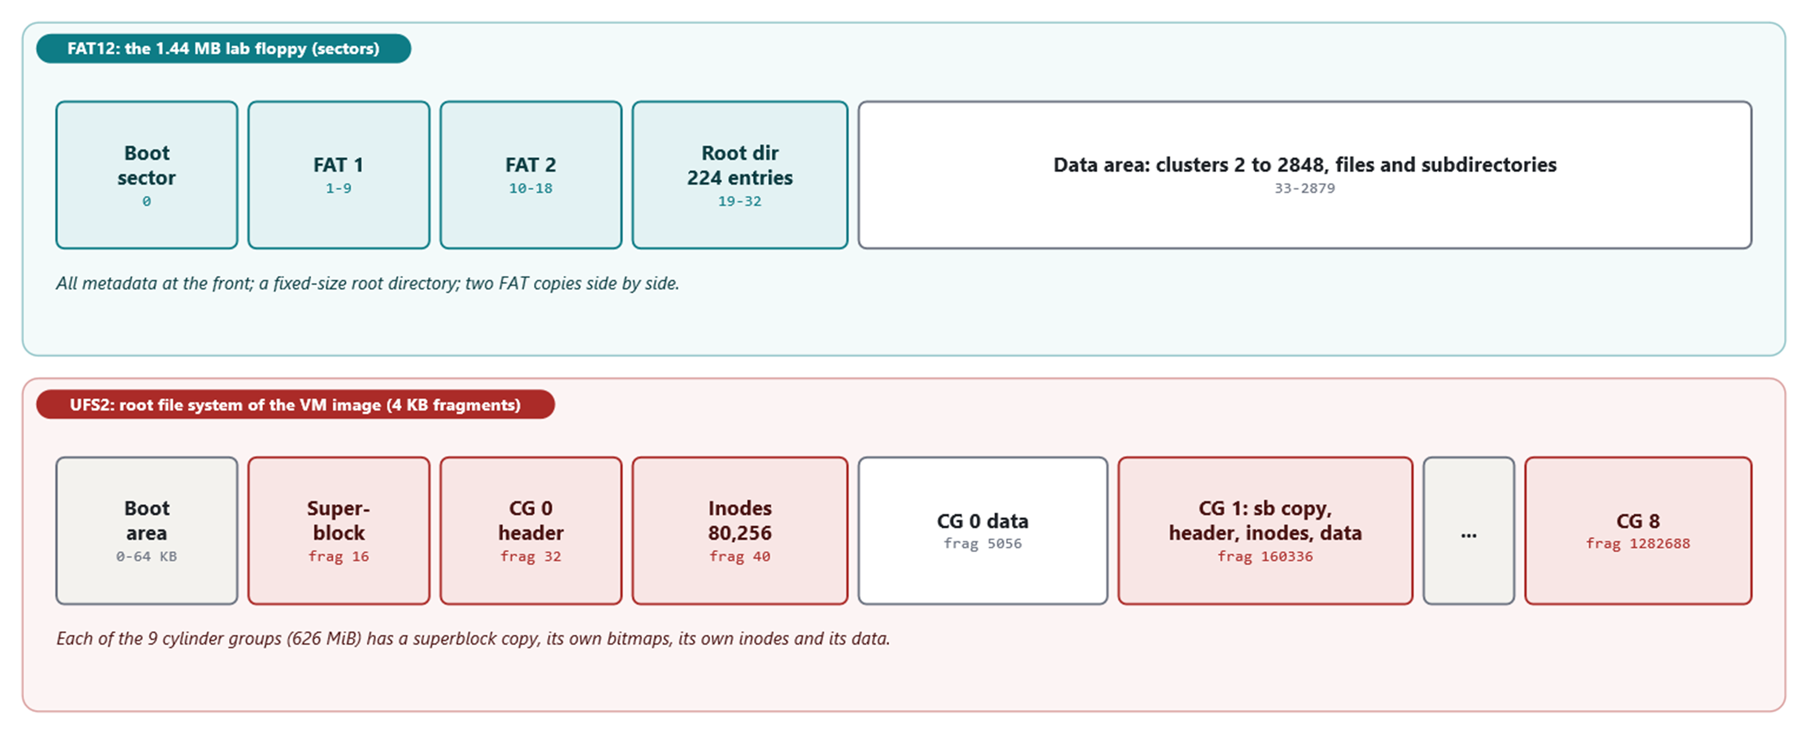
Two layouts
FAT keeps all metadata at the front; UFS2 repeats it in every cylinder group
MS‑DOS 4.00 × FreeBSD 15.1 · Module 7 · F. V. Buccoli
7
Notes:
Numbers are real: the lab floppy (sectors) and the root file system of the VM image (4 KB fragments). FAT: boot sector, two FATs side by side, fixed root directory, data. UFS2: superblock at 64 KB, then nine cylinder groups each with a superblock copy, bitmaps, 80,256 inodes and data.

Slide 8
A directory entry is the file's whole description
MS-DOS 4.00
DIRENT.INC lines 28-40
dir_entry STRUC
dir_name DB 11 DUP (?) ; file name
dir_attr DB ? ; attribute bits
dir_codepg dw ? ; code page DOS 4.00
dir_extcluster dw ? ; extended attribute starting cluster
dir_attr2 db ? ; reserved
dir_pad DB 5 DUP (?) ; reserved for expansion
dir_time DW ? ; time of last write
dir_date DW ? ; date of last write
dir_first DW ? ; first allocation unit of file
dir_size_l DW ? ; low 16 bits of file size
dir_size_h DW ? ; high 16 bits of file size
dir_entry ENDS
Source: microsoft/MS‑DOS @ 2d04cac, v4.0/src/INC/DIRENT.INC, lines 28‑40
1
11 bytes of name, no dot
2
Attributes: R H S V D A
3
Time and date packed in 16 bits each
4
First cluster; the FAT has the rest
MS‑DOS 4.00 × FreeBSD 15.1 · Module 7 · F. V. Buccoli
8
Notes:
Decode Output 7.4 live: 4916h is 9:08:44, 5D69h is 2026-11-09. Ask why a directory's size field is 0, and why two names for one file are impossible when the metadata lives here.

Slide 9
ALLOCATE: next fit from dpb_next_free
MS-DOS 4.00
ROM.ASM lines 663-699
mov bx,es:[bp.dpb_next_free]
cmp bx,2
ja findfre
… (lines omitted)
FINDFRE:
INC BX
… (lines omitted)
aupk:
invoke UNPACK ; check out this cluster
jc ads4 ; FAT error [INTERR?]
jnz findfre ; not free, keep on truckin
; Have found a free cluster. Chain it to the file
;
; (BX) = found free cluster #
; (DX) = current last cluster in file
mov es:[bp.dpb_next_free],bx ; next time start search here
Source: microsoft/MS‑DOS @ 2d04cac, v4.0/src/DOS/ROM.ASM, lines 663‑699
1
Start at the cursor, not at cluster 2
2
UNPACK: is this cluster free?
3
Remember where we stopped
MS‑DOS 4.00 × FreeBSD 15.1 · Module 7 · F. V. Buccoli
9
Notes:
The search continues from the last cluster allocated. Apart from the wrap-around to cluster 2 at the end of the disk, the cursor is reset only when the DPB is rebuilt, which happens whenever the floppy driver answers 'don't know' to a media check, for example after an access to another drive. That is the whole explanation of Lab 7.3.

Slide 10
Lab 7.3: the same batch file, two layouts
FRAG.BAT run from A:
FRAG.BAT run from B:
COMMAND reads each line from A:
Every B: access follows an A: access
Media check: don't know, DPB rebuilt
Allocation restarts at cluster 2
All specified file(s) are contiguous
Only B: is touched
Door latch: not changed, DPB kept
Cursor continues after C.DAT
A.DAT grows to 29‑32, hole 13‑20 stays
A.DAT Contains 2 non‑contiguous blocks
MS‑DOS 4.00 × FreeBSD 15.1 · Module 7 · F. V. Buccoli
10
Notes:
Real CHKDSK output from both runs. Ask the class to predict the layout before showing it. The lesson: on FAT, placement depends on a single global cursor and on the driver's guess about media changes; UFS2 decides per cylinder group from bitmaps.

Slide 11
Limits of the 4.00 formats
4,084
65,525
max clusters of FAT12 (max_cluster < 4086)
cluster numbers of FAT16 (2 to FFF6h)
2 GB
32 MB
FAT16 with 32 KB clusters
the old limit of the 16‑bit sector count
MS‑DOS 4.00 × FreeBSD 15.1 · Module 7 · F. V. Buccoli
11
Notes:
DOS 4.00 added the 32-bit total in the extended BPB and 32-bit sector numbers in the kernel (HIGH_SECTOR). The IO.SYS table goes to 128 sectors per cluster, but 64 KB clusters overflow 16-bit byte counts in the utilities, so 2 GB is the practical limit. Exercise 7.2 asks for the derivation.

Slide 12
03
UFS2 in FreeBSD 15.1
MS‑DOS 4.00 × FreeBSD 15.1 · Module 7 · F. V. Buccoli
12

Slide 13
The superblock of the official VM image (real)
Field | Value | Meaning
fs_magic | 0x19540119 | UFS2
fs_bsize / fs_fsize | 32768 / 4096 | block and fragment
fs_ncg x fs_fpg | 9 x 160336 frags | 626 MiB per cylinder group
fs_ipg | 80256 | inodes per group
fs_nindir | 4096 | pointers per indirect block
fs_flags | 0x2 | soft updates, no journal
fs_maxfilesize | 2252349704110079 | about 2 PiB
MS‑DOS 4.00 × FreeBSD 15.1 · Module 7 · F. V. Buccoli
13
Notes:
From ufsx.py sb on the root partition copied out of the .vhd.xz with vhdpart.py. Every value is a field of struct fs in fs.h. fs_maxfilesize is computed by mkfs from bsize and NINDIR: 12 direct blocks plus single, double and triple indirect.

Slide 14
struct ufs2_dinode: 256 bytes per file
FreeBSD 15.1
dinode.h lines 125-151
struct ufs2_dinode {
uint16_t di_mode; /* 0: IFMT, permissions; see below. */
uint16_t di_nlink; /* 2: File link count. */
uint32_t di_uid; /* 4: File owner. */
uint32_t di_gid; /* 8: File group. */
uint32_t di_blksize; /* 12: Inode blocksize. */
uint64_t di_size; /* 16: File byte count. */
uint64_t di_blocks; /* 24: Blocks actually held. */
ufs_time_t di_atime; /* 32: Last access time. */
ufs_time_t di_mtime; /* 40: Last modified time. */
ufs_time_t di_ctime; /* 48: Last inode change time. */
… (lines omitted)
ufs2_daddr_t di_db /* 112: Direct disk blocks. */
[UFS_NDADDR];
ufs2_daddr_t di_ib /* 208: Indirect disk blocks. */
[UFS_NIADDR];
Source: freebsd/freebsd‑src @ 96841ea, sys/ufs/ufs/dinode.h, lines 125‑151
1
Mode, links, owner, group
2
64‑bit size and times
3
12 direct, 3 indirect pointers
MS‑DOS 4.00 × FreeBSD 15.1 · Module 7 · F. V. Buccoli
14
Notes:
Compare with the 32-byte DOS entry. Everything except the name is here; the directory only maps names to inode numbers. Pointers count 4 KB fragments: di_db[0] = 5057 for the root directory means byte 5057 x 4096 of the partition.

Slide 15
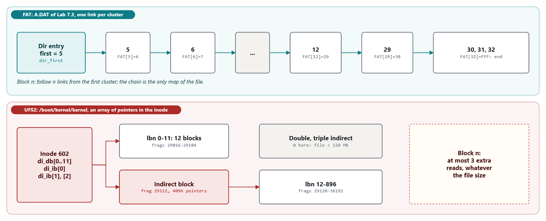
Where is block n?
A FAT chain of links against direct and indirect pointers
MS‑DOS 4.00 × FreeBSD 15.1 · Module 7 · F. V. Buccoli
15
Notes:
Real data: A.DAT of Lab 7.3 and /boot/kernel/kernel of the VM image, 897 blocks, 12 direct and 885 through one indirect block at fragment 29112, placed right after the last direct block as ffs_blkpref_ufs2 says. Study case 7.A: byte 100,000 costs 195 links on the floppy, one array lookup on UFS2.

Slide 16
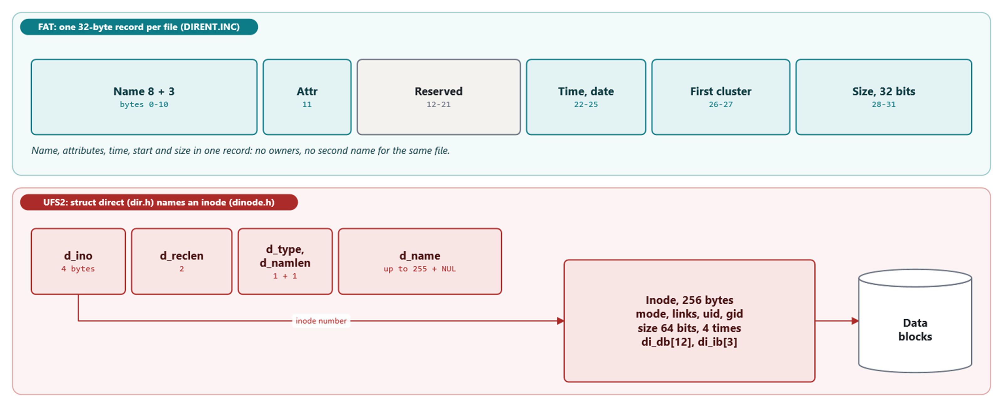
Directory entries
FAT's entry is the metadata; UFS2's entry only names an inode
MS‑DOS 4.00 × FreeBSD 15.1 · Module 7 · F. V. Buccoli
16
Notes:
UFS directory records have variable length (d_reclen) inside 512-byte chunks; the last record of a chunk absorbs the free space. The root directory of the image is 20 records in 512 bytes, the last one 240 bytes long. Hard links are just two records with the same d_ino.

Slide 17
Soft updates: roll back, write, roll forward
FreeBSD 15.1
softdep.h lines 43-55
/*
* Allocation dependencies are handled with undo/redo on the in-memory
* copy of the data. A particular data dependency is eliminated when
* it is ALLCOMPLETE: that is ATTACHED, DEPCOMPLETE, and COMPLETE.
*
* The ATTACHED flag means that the data is not currently being written
* to disk.
*
* The UNDONE flag means that the data has been rolled back to a safe
* state for writing to the disk. When the I/O completes, the data is
* restored to its current form and the state reverts to ATTACHED.
* The data must be locked throughout the rollback, I/O, and roll
* forward so that the rolled back information is never visible to
Source: freebsd/freebsd‑src @ 96841ea, sys/ufs/ffs/softdep.h, lines 43‑55
1
Dependencies tracked in memory
2
Unsafe changes rolled back in the copy written
3
Restored after the I/O
MS‑DOS 4.00 × FreeBSD 15.1 · Module 7 · F. V. Buccoli
17
Notes:
The goal: whatever subset of writes reaches the disk, the only damage is leaked blocks and inodes. SU+J adds a small journal so fsck_ffs replays instead of scanning. newfs -j runs tunefs -j enable after mkfs.

Slide 18
04
Comparing the two,
and the I/O path
MS‑DOS 4.00 × FreeBSD 15.1 · Module 7 · F. V. Buccoli
18

Slide 19
FAT against UFS2
 | FAT12/16 (MS‑DOS 4.00) | UFS2 (FreeBSD 15.1)
File map | Linked list in the FAT | Pointer array in the inode
Free space | FAT entries = 0, next‑fit cursor | Bitmap per cylinder group
Names | 8.3, upper case | Up to 255 bytes
Owners, permissions | None (R, H, S, A) | uid, gid, mode, ACLs
Links, sparse files | No | Yes
After a crash | CHKDSK by hand | Leaks only; background fsck or journal
MS‑DOS 4.00 × FreeBSD 15.1 · Module 7 · F. V. Buccoli
19
Notes:
Each row has a permalink in section 7.4. Be fair to FAT: it is tiny, needs no notion of users, and every firmware can read it. That is why the EFI partition of the FreeBSD image is FAT.

Slide 20
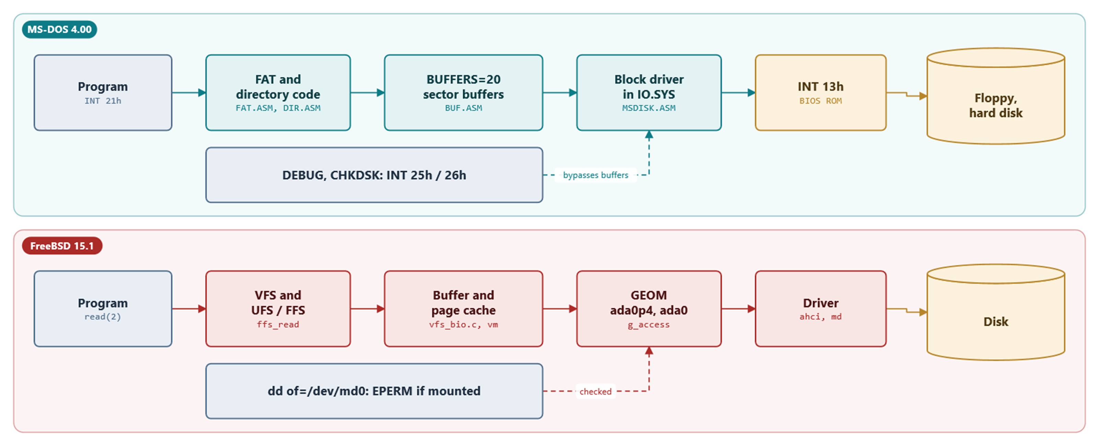
The disk I/O path
INT 25h/26h bypass the DOS buffers; GEOM refuses writes under a mounted file system
MS‑DOS 4.00 × FreeBSD 15.1 · Module 7 · F. V. Buccoli
20
Notes:
DOS: BUFFERS=20 one-sector buffers, then the IO.SYS driver and INT 13h. INT 26h goes straight to the driver and does not update a buffer holding the same sector. FreeBSD: buffer and page cache, then GEOM; a write open of a provider that a mounted file system holds exclusively fails with EPERM.

Slide 21
GEOM says no
FreeBSD 15.1
geom_subr.c lines 1017-1025
;
/* If we try exclusive but already write: fail */
else if (dce > 0 && pw > 0)
return (EPERM);
/* If we try write but already exclusive: fail */
else if (dcw > 0 && pe > 0)
return (EPERM);
/* If we try to open more but provider is error'ed: fail */
else if ((dcr > 0 || dcw > 0 || dce > 0) && pp->error != 0) {
Source: freebsd/freebsd‑src @ 96841ea, sys/geom/geom_subr.c, lines 1017‑1025
1
Foot‑shooting flag: only for debugging
2
Exclusive holder present: write refused
MS‑DOS 4.00 × FreeBSD 15.1 · Module 7 · F. V. Buccoli
21
Notes:
UFS opens its provider with read, write and exclusive access (g_vfs_open). dd of=/dev/md0 then asks for write access and gets EPERM. kern.geom.debugflags=0x10 lifts the check on disks; its name says what the developers think of it.

Slide 22
05
Labs
MS‑DOS 4.00 × FreeBSD 15.1 · Module 7 · F. V. Buccoli
22

Slide 23
Labs 7.1 and 7.2: sectors and a FAT explorer
7.1: DEBUG L reads sectors 0, 1 and 19 of the boot disk
Decode the BPB, the FAT and IO.SYS's entry by hand
7.2: fatx.py info, ls, chain, entry, check on a kept image
Every number matches DIR and CHKDSK
CHKDSK's third hidden file is the volume label
MS‑DOS 4.00 × FreeBSD 15.1 · Module 7 · F. V. Buccoli
23
Notes:
All outputs are real, from MS-DOS 4.00 built from source. The label quirk is in CHKPROC.ASM: in pass one a volume label jumps straight to the hidden-file counter. Give students time to read fatx.py next to DIRENT.INC and FAT.ASM.

Slide 24
Labs 7.3 and 7.4: fragmentation and damage
7.3: one batch file, two layouts (next‑fit cursor)
7.4: setfat makes a lost chain and a cross‑link
CHKDSK hangs: label + cross‑link + media F0h
The kernel's IsEof accepts FF0h; CROSSLOOK does not
FILE0000.CHK dated 1994: SHL AL,CL loses the year
MS‑DOS 4.00 × FreeBSD 15.1 · Module 7 · F. V. Buccoli
24
Notes:
Two real bugs in the 1988 CHKDSK, both explained from the source: the second pass follows the label's cluster 0 into FAT entry 0 = FF0h and walks off the FAT; Systime shifts the year inside the 8-bit AL, so only 1980-1995 work.

Slide 25
CROSSLOOK stops only at EOFVAL
MS-DOS 4.00
CHKPROC.ASM lines 781-791
CHLP:
PUSH BX ;an014;bgb
CALL UNPACK ;an014;bgb
POP BX ;an014;bgb
XCHG SI,DI ;an014;bgb
CMP SI,[EOFVAL] ;an014;bgb
jae chaindone ;an014;bgb ;an014;bgb
;;;;;;;;JAE Check_XA_Cross ;an014;bgb ;an014;bgb
CALL CROSSCHK ;an014;bgb
JZ CHLP ;an014;bgb
JMP SHORT CROSSLINK ;an014;bgb
Source: microsoft/MS‑DOS @ 2d04cac, v4.0/src/CMD/CHKDSK/CHKPROC.ASM, lines 781‑791
1
UNPACK(0) returns FAT[0] = FF0h on a 1.44 MB disk
2
FF0h < FF8h: treated as a cluster
3
The loop reads past the FAT table
MS‑DOS 4.00 × FreeBSD 15.1 · Module 7 · F. V. Buccoli
25
Notes:
Remove the volume label with DEBUG W (or empty files) and CHKDSK completes and reports the cross-link. On a hard disk, media F8h, FAT[0] is FF8h and the loop ends at once. The kernel fixed the same problem in IsEof in 1986.

Slide 26
Labs 7.5 to 7.7: UFS2 and msdosfs
7.5: mkufs.sh in the VM; ufsx.py on the real VM image
Superblock, cylinder group 0, inodes, /etc/rc.conf
7.6: one file on both: 32 + 3 bytes against 256 + 16
7.7: msdosfs makes up owner, mode, links and inode numbers
Inode number = position of the directory entry
MS‑DOS 4.00 × FreeBSD 15.1 · Module 7 · F. V. Buccoli
26
Notes:
All VM outputs were captured in the course VM. In 7.5, dir lands in cylinder group 3 (inode 3456): ffs_dirpref at work; fsdb -r refuses cd because FL_ST is 0x0003 and overlaps the write flags, so the script uses inode N. In 7.7, IO.SYS is inode 304: root directory sector 19 times 16 entries per sector, entry 0.

Slide 27
msdosfs_getattr invents what FAT lacks
FreeBSD 15.1
msdosfs_vnops.c lines 283-290
mode = S_IRWXU|S_IRWXG|S_IRWXO;
if (dep->de_Attributes & ATTR_READONLY)
mode &= ~(S_IWUSR|S_IWGRP|S_IWOTH);
vap->va_mode = mode &
(ap->a_vp->v_type == VDIR ? pmp->pm_dirmask : pmp->pm_mask);
vap->va_uid = pmp->pm_uid;
vap->va_gid = pmp->pm_gid;
vap->va_nlink = 1;
Source: freebsd/freebsd‑src @ 96841ea, sys/fs/msdosfs/msdosfs_vnops.c, lines 283‑290
1
All permissions, minus write if read‑only
2
Then the mount's mask
3
Owner and group from the mount
4
Always one link
MS‑DOS 4.00 × FreeBSD 15.1 · Module 7 · F. V. Buccoli
27
Notes:
The only per-file inputs are the DOS attributes. Defaults come from the mount point directory (mount_msdosfs.c). Ask what chmod does on such a file system.

Slide 28
Homework
7.1: fatx.py put and rm, verified with CHKDSK
7.2: maximum file and volume sizes, derived
7.3: BOOTINFO.COM with INT 25h (32‑bit packet)
7.4: sbinfo.c with <ufs/ffs/fs.h> and pread
7.5: DPBINFO.C with MS C 5.10 and INT 21h 32h
7.6: frag.sh on UFS2; 7.7: essay on FAT's survival
MS‑DOS 4.00 × FreeBSD 15.1 · Module 7 · F. V. Buccoli
28
Notes:
Every DOS program must be run on the lab system with dos_run.py or dosb.py. The FreeBSD programs run in the VM. Exercise 7.1 is the core one: it forces students to write both FATs and think about the order of writes.

Slide 29
Key takeaways
FAT: one global table, metadata in the directory entry
UFS2: inodes, bitmaps and data spread over cylinder groups
Finding byte n: n/cluster links against at most 3 indirect blocks
FAT repairs after the fact; soft updates order the writes
Raw disk writes: unchecked on DOS, refused by GEOM when mounted
MS‑DOS 4.00 × FreeBSD 15.1 · Module 7 · F. V. Buccoli
29
Notes:
Close with the essay question: FAT lost on every technical axis except simplicity and universality, and those turned out to matter most for removable media and firmware. Next module: memory.

Slide 30
Questions?
Module 7: Disks and file
systems: FAT against UFS2
Notes, labs and homework: course/ and labs/
Every listing links to its exact source lines
Francesco Valerio Buccoli
francesco@buccoli.com

