Slide 1

OPERATING SYSTEMS
Module 9
Toolsmith: the same
tools on both systems
ARGS, WC, HD, SYSINFO, ASK and BACKUP on MS‑DOS 4.00 and FreeBSD 15.1
MS-DOS 4.00
FreeBSD 15.1
Francesco Valerio Buccoli
francesco@buccoli.com
Sources: MS‑DOS 2d04cac · FreeBSD release/15.1.0

Slide 2

01
The contract between
a tool and the system
MS‑DOS 4.00 × FreeBSD 15.1 · Module 9 · F. V. Buccoli
2

Slide 3

What a tool receives from each system
Need | MS‑DOS 4.00 | FreeBSD 15.1
Arguments | One tail of at most 127 bytes at PSP:81h, length at 80h | argc and argv strings on the new stack, up to ARG_MAX = 512 KB
Wildcards | Each program, if it wants (SETARGV.OBJ) | The shell, before execve
Program name | Full path after the environment strings | argv[0] as the caller chose; AT_EXECPATH
Standard streams | Handles 0‑4 in the PSP's Job File Table | Descriptors 0, 1 and 2
First instruction | .COM: CS = DS = ES = SS = PSP, IP = 100h | rip = ELF entry, rdi = address of argc
Exit code | AL of function 4Ch; exit type in AH | _exit(rval); 8 bits reach wait4
MS‑DOS 4.00 × FreeBSD 15.1 · Module 9 · F. V. Buccoli
3
Notes:
Table 9.1 condensed. Neither kernel knows about options, wildcards or quoting: those are conventions of the shell and of the C library. Everything in the module follows from the first row: a single 127-byte string on MS-DOS against an array of finished words on FreeBSD.

Slide 4
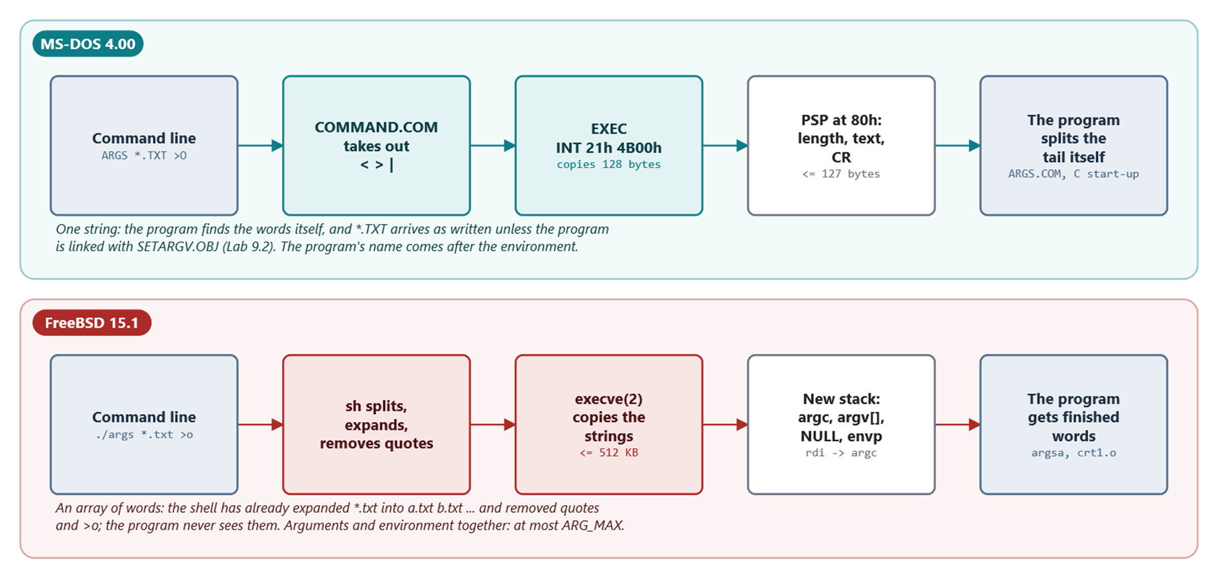
How the arguments travel
COMMAND.COM passes text and the program splits it; sh passes words and execve copies them
MS‑DOS 4.00 × FreeBSD 15.1 · Module 9 · F. V. Buccoli
4
Notes:
On MS-DOS, COMMAND.COM removes the redirections, builds the tail and calls EXEC, which copies 128 bytes into the new PSP. The C start-up code splits the tail into argv. On FreeBSD sh splits, expands and removes quotes; exec_copyout_strings copies the strings and builds argv and envp; rdi points at argc when the program starts.

Slide 5
EXEC copies the command tail into the PSP
MS-DOS 4.00
EXEC.ASM lines 719-727
POP SI ; get block (last time)
POP DS
LDS SI,[SI.exec0_com_line] ; command line
;
; DS points to user space 80 command line
;
OR CL,80h
MOV DI,CX
REP MOVSB ; Wham!
Source: microsoft/MS‑DOS @ 2d04cac, v4.0/src/DOS/EXEC.ASM, lines 719‑727
1
CX is 0 after the FCB copy
2
OR CL,80h: 128 is both the count and the offset
3
Splitting into words is the program's job
MS‑DOS 4.00 × FreeBSD 15.1 · Module 9 · F. V. Buccoli
5
Notes:
Listing 9.1. The two FCBs at 5Ch and 6Ch were parsed from the first two words just before this, a convention left over from CP/M. The program's own name is not in the tail: EXEC writes it after the environment strings (Module 3, section 3.7), and ARGS.COM prints it as word 0 in Lab 9.1.

Slide 6
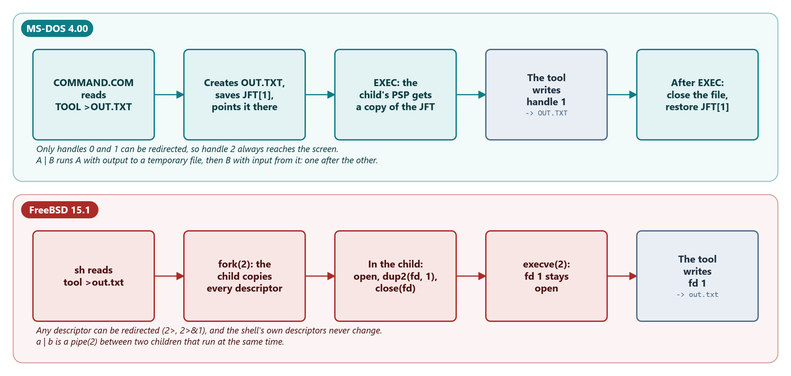
Redirection around a tool
COMMAND.COM edits its Job File Table before EXEC; sh calls dup2 in the child before execve
MS‑DOS 4.00 × FreeBSD 15.1 · Module 9 · F. V. Buccoli
6
Notes:
Either way the tool just reads handle 0 and writes handle 1. Two differences matter for tools: COMMAND.COM can redirect only handles 0 and 1, so a message on handle 2 always reaches the screen; and a DOS pipe is two temporary files and two programs run one after the other (Module 3).

Slide 7
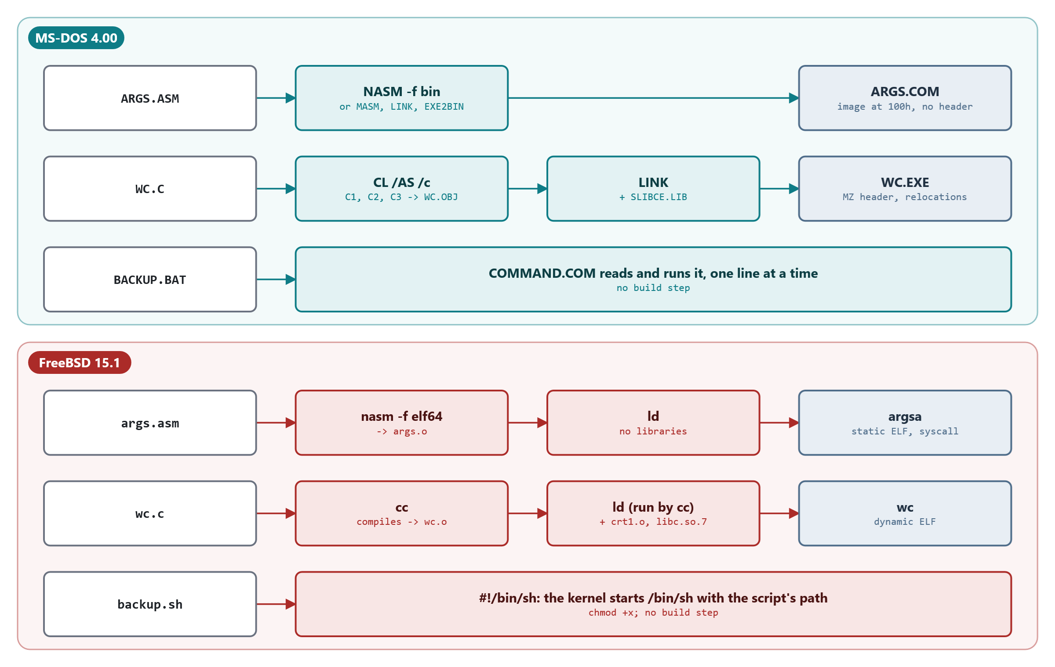
Three ways to build a tool on each system
Assembly without a library, C with its library, and a script read by the shell
MS‑DOS 4.00 × FreeBSD 15.1 · Module 9 · F. V. Buccoli
7
Notes:
nasm -f bin writes a .COM image with no header; MASM, LINK and EXE2BIN do the same for ASK.COM. CL /AS links SLIBCE.LIB into an MZ .EXE. On FreeBSD nasm -f elf64 and ld make a static ELF file, and cc links against crt1.o and libc.so.7. A .BAT file is not a process and has no exit code; a #! script is a program like any other.

Slide 8
Sizes of the built tools, in bytes
Tool | MS‑DOS assembly | MS‑DOS C | FreeBSD assembly | FreeBSD C
ARGS | 251 | 7,287 (8,407 with SETARGV) | 2,176 (960 stripped) | 9,984
WC | 215 | 10,537 | 2,136 | 11,528
HD | 254 | 9,721 | 2,384 | 12,048
SYSINFO | 428 | 7,735 | -- | 11,176
ASK | 377 | -- | -- | --
MS‑DOS 4.00 × FreeBSD 15.1 · Module 9 · F. V. Buccoli
8
Notes:
Table 9.5. The DOS assembly tools are instructions and strings, nothing else. The DOS C tools carry printf and the start-up code copied from SLIBCE.LIB. The FreeBSD assembly tools carry an ELF header, program headers and a symbol table; the FreeBSD C tools are 10 to 12 KB even though printf stays in libc.so.7. The scripts: ask.sh 1,186, BACKUP.BAT 1,514, backup.sh 989.

Slide 9
02
Text, binary and exit codes
MS‑DOS 4.00 × FreeBSD 15.1 · Module 9 · F. V. Buccoli
9

Slide 10
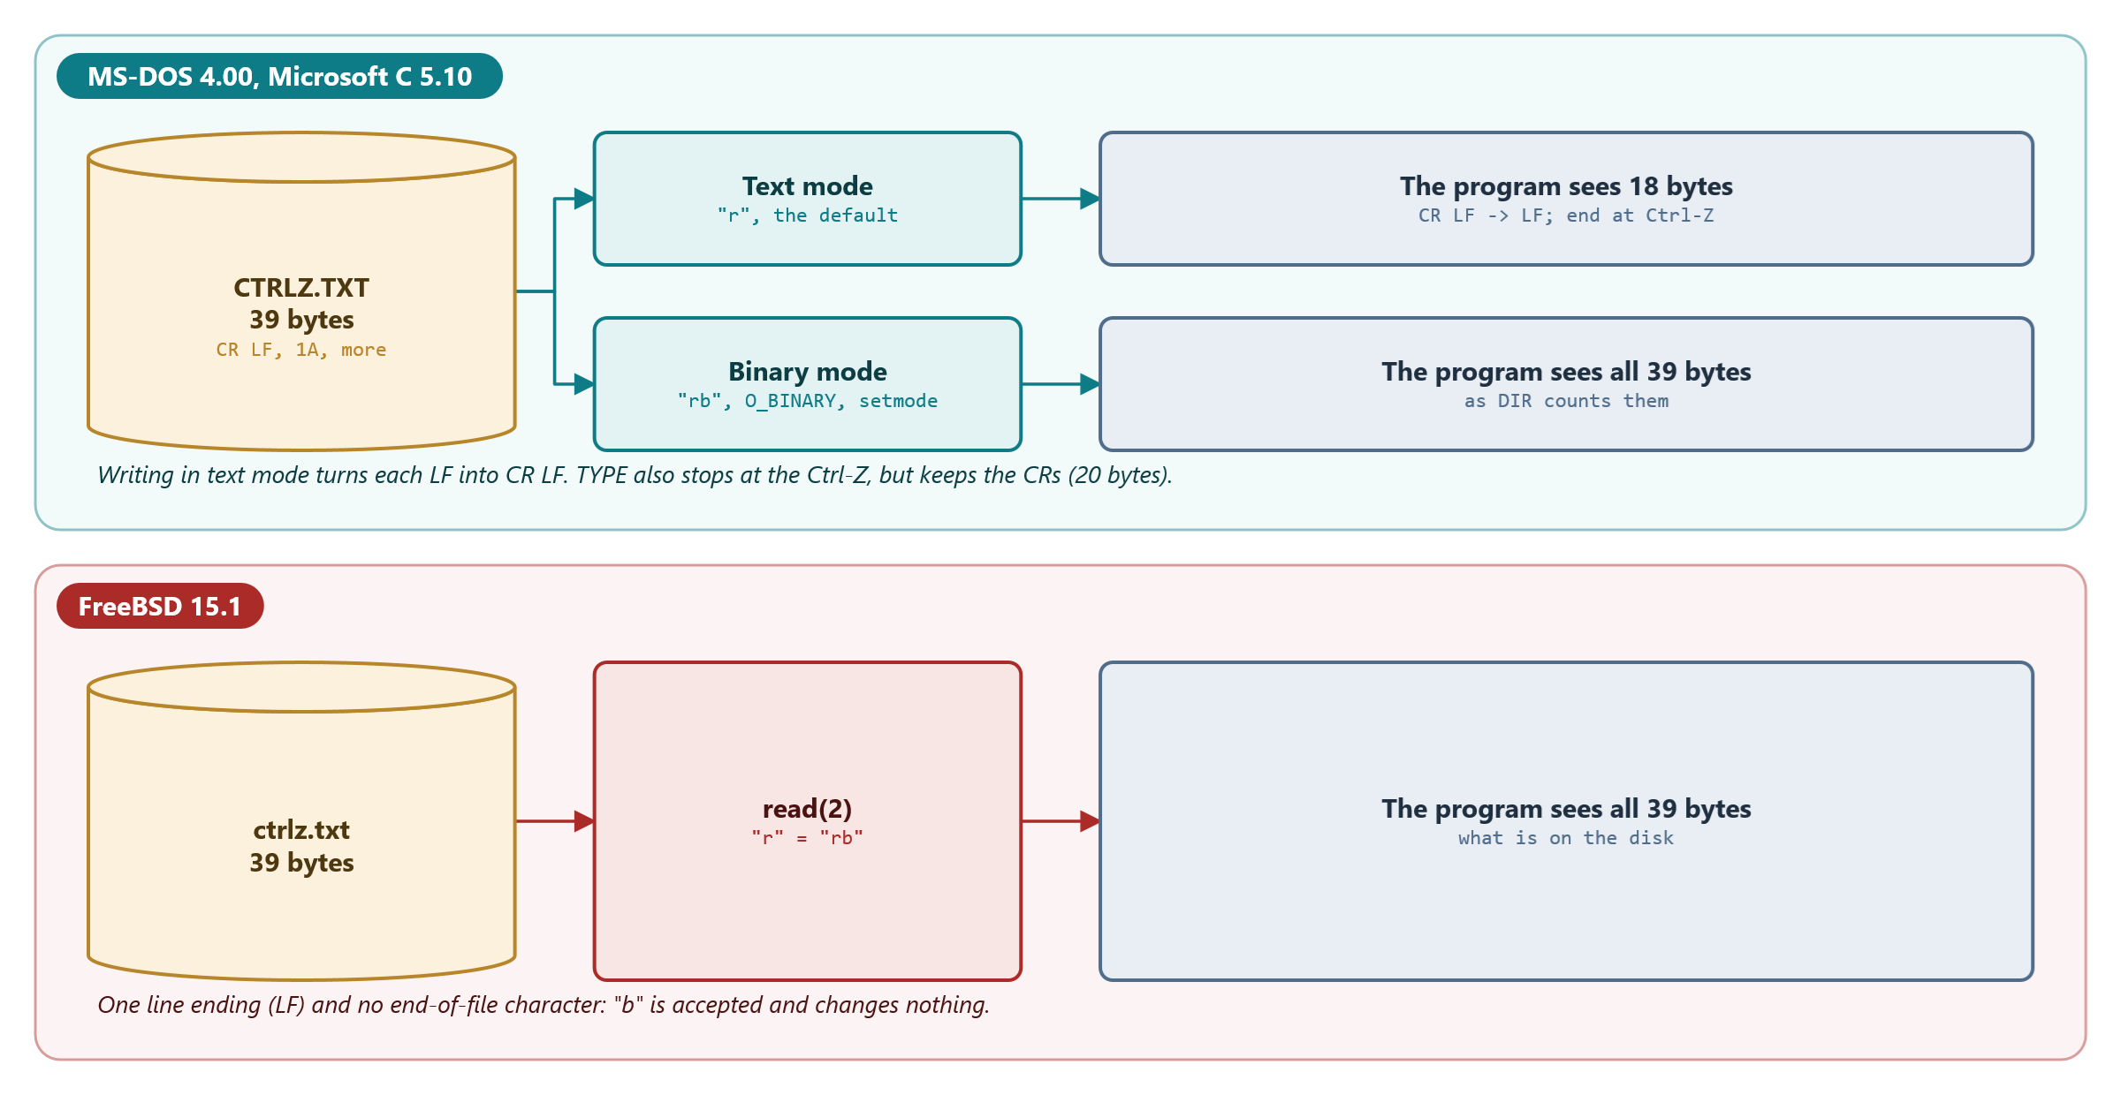
Text and binary mode in Microsoft C 5.10
Text mode turns CR LF into LF and stops at Ctrl-Z on read, and writes LF as CR LF
MS‑DOS 4.00 × FreeBSD 15.1 · Module 9 · F. V. Buccoli
10
Notes:
FCNTL.H documents only the CR LF translation; the Ctrl-Z stop was measured in Lab 9.4, because the runtime's source is not in the MS-DOS tree. Binary mode: "rb" in fopen, O_BINARY in open, setmode for standard input, or _fmode. FreeBSD's fopen accepts "b" and ignores it.

Slide 11
One 39‑byte file, four answers
39
21
bytes on the disk: DIR, HD in binary mode, WC
bytes after COPY /A, which adds a Ctrl‑Z to 20 of text
20
18
bytes that TYPE sends to a pipe; it stops at Ctrl‑Z
bytes that HD -t reads: CR LF becomes LF, end of file at Ctrl‑Z
MS‑DOS 4.00 × FreeBSD 15.1 · Module 9 · F. V. Buccoli
11
Notes:
CTRLZ.TXT has two lines, a Ctrl-Z and a third line (Outputs 9.1 and 9.11). Only the binary readers agree with the directory entry. On FreeBSD all four would say 39: the Ctrl-Z is one more byte.

Slide 12
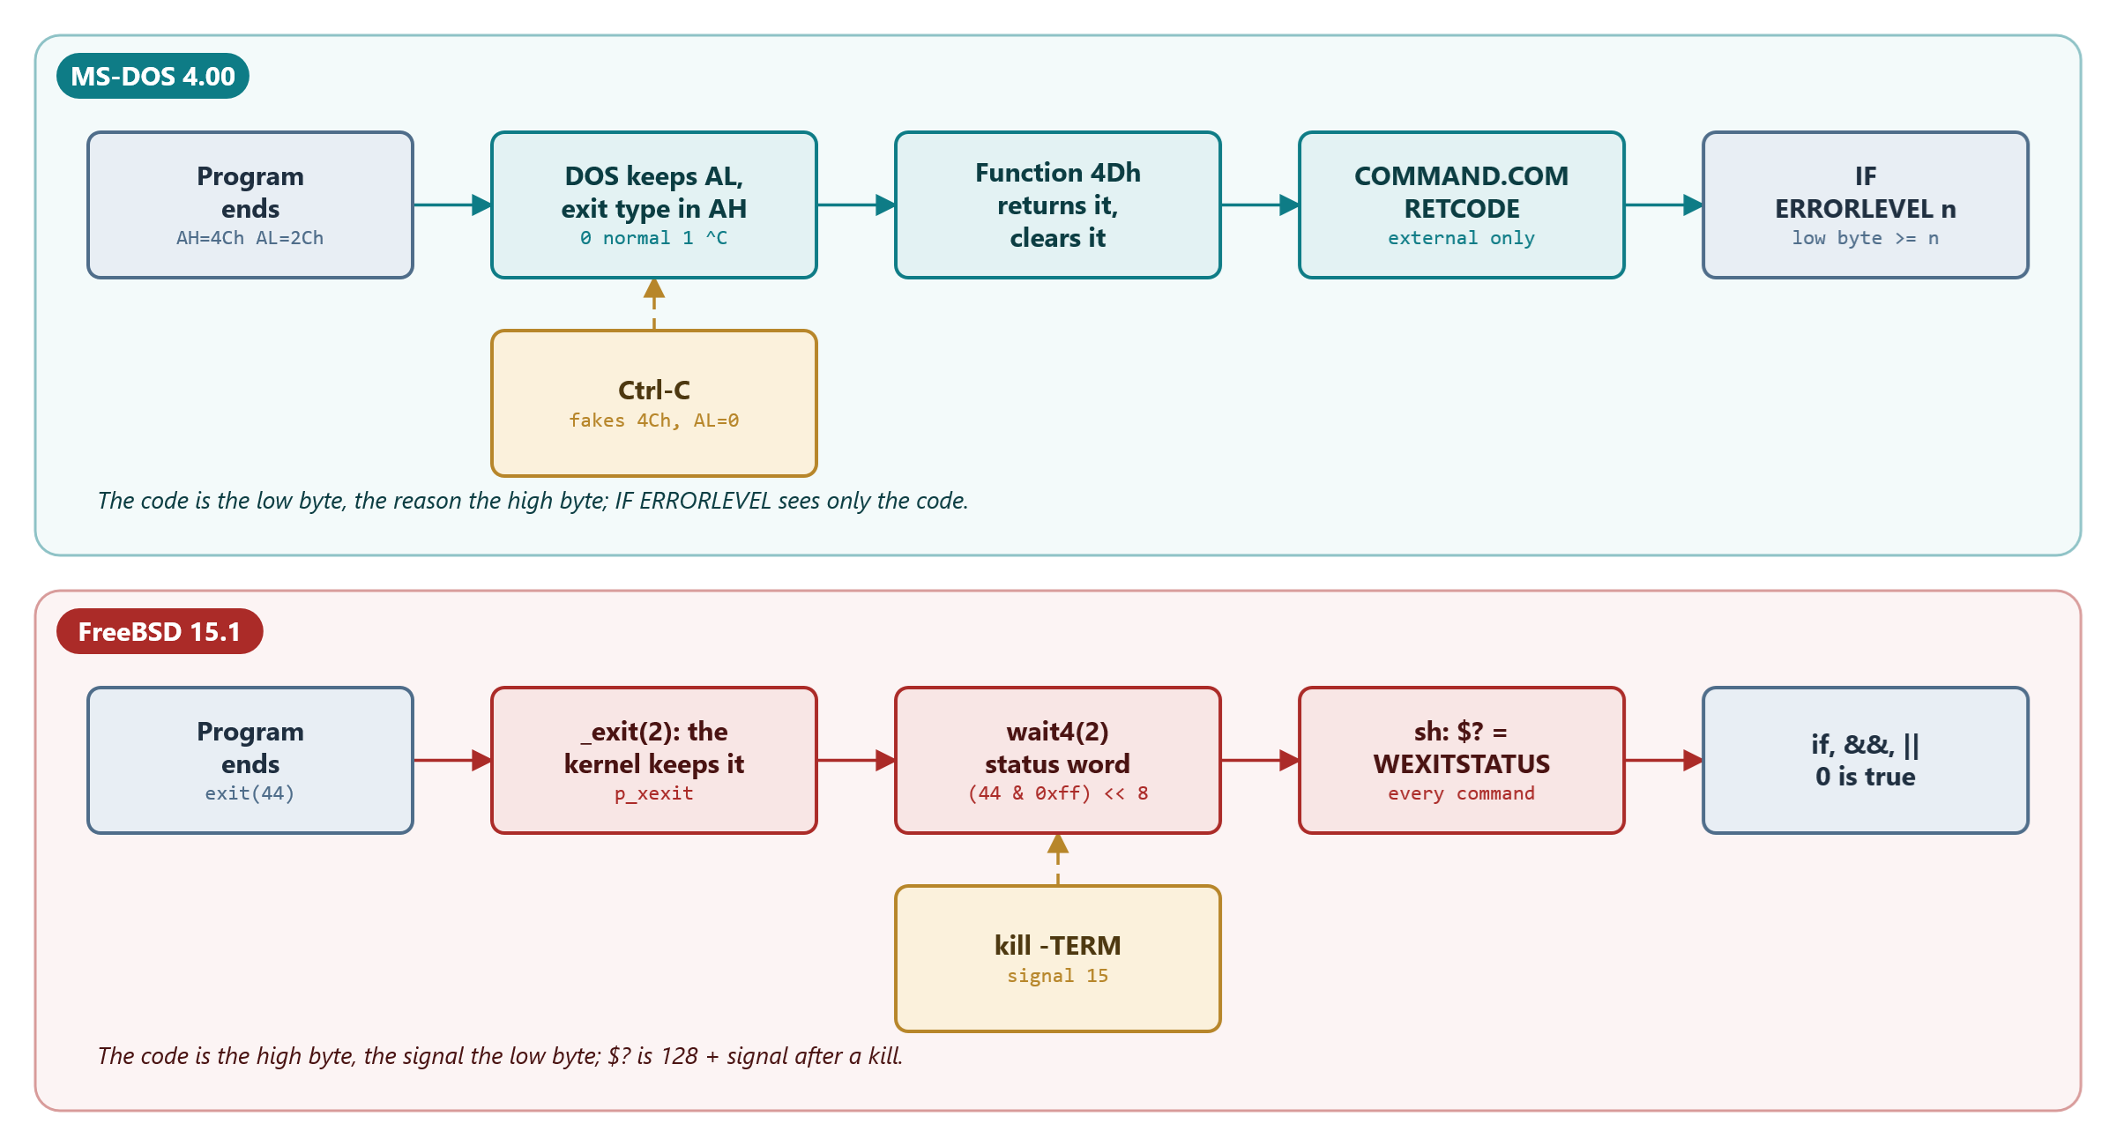
An exit code's journey
DOS: code in the low byte, reason in the high byte. FreeBSD: code in the high byte, signal in the low
MS‑DOS 4.00 × FreeBSD 15.1 · Module 9 · F. V. Buccoli
12
Notes:
COMMAND.COM sets RETCODE only after an external program; internal commands and "Bad command or file name" leave it alone. sh sets $? after every command. exit 300 gives 44 on both systems (Outputs 9.2 and 9.3).

Slide 13
IF ERRORLEVEL n compares one byte
MS-DOS 4.00
TBATCH2.ASM lines 424-435
GOTNUM:
PUSH DS
MOV DS,[RESSEG]
ASSUME DS:RESGROUP
MOV AH,BYTE PTR [RETCODE]
POP DS
ASSUME DS:TRANGROUP
XOR AL,AL
CMP AH,BL
JAE IFRET
DEC AL
JMP SHORT IFRET
Source: microsoft/MS‑DOS @ 2d04cac, v4.0/src/CMD/COMMAND/TBATCH2.ASM, lines 424‑435
1
Only the low byte of RETCODE: the Ctrl‑C exit type in AH is invisible
2
JAE: "n or more", so test the largest value first
3
n was built in BL without a check: ERRORLEVEL 300 is ERRORLEVEL 44
MS‑DOS 4.00 × FreeBSD 15.1 · Module 9 · F. V. Buccoli
13
Notes:
End of Listing 9.11. The loop above GOTNUM multiplies by 10 in an 8-bit register. When DOS stops a program for Ctrl-C it fakes function 4Ch with AL = 0, so an interrupted program looks like one that succeeded.

Slide 14
sh turns a wait status into $?
FreeBSD 15.1
jobs.c lines 1102-1113
status = getjobstatus(jp);
if (signaled != NULL)
*signaled = WIFSIGNALED(status);
/* convert to 8 bits */
if (WIFEXITED(status))
st = WEXITSTATUS(status);
#if JOBS
else if (WIFSTOPPED(status))
st = WSTOPSIG(status) + 128;
#endif
else
st = WTERMSIG(status) + 128;
Source: freebsd/freebsd‑src @ 96841ea, bin/sh/jobs.c, lines 1102‑1113
1
Only 8 bits travel: KW_EXITCODE masks with 0xff
2
Killed by a signal: 128 + its number (kill -TERM gives 143)
3
Every command sets $?, builtins included; not found is 127
MS‑DOS 4.00 × FreeBSD 15.1 · Module 9 · F. V. Buccoli
14
Notes:
Listing 9.13. The status word is the mirror image of DOS's: code in the high byte, signal in the low byte. The timeout test of Lab 9.6 shows 130 = 128 + SIGINT, so a script can tell "interrupted" from "no answer".

Slide 15
03
The six tools
MS‑DOS 4.00 × FreeBSD 15.1 · Module 9 · F. V. Buccoli
15

Slide 16
The tool matrix: every cell built and run
Tool | Lab | MS‑DOS 4.00 | FreeBSD 15.1
ARGS | 9.1, 9.2 | ARGS.COM (NASM); ARGS.EXE, ARGSW.EXE (CL) | argsa (nasm, ld); args (cc)
WC | 9.3 | WCA.COM; WC.EXE and text‑mode WCT.EXE | wca; wc from the same C source
HD | 9.4 | HDA.COM; HD.EXE | hda; hd from the same C source
SYSINFO | 9.5 | SYSINFOA.COM; SYSINFO.EXE | sysinfo (C)
ASK | 9.6 | ASK.COM (MASM, LINK, EXE2BIN); ASKDEMO.BAT | ask.sh, askdemo.sh
BACKUP | 9.7 | BACKUP.BAT with XCOPY, FC, FIND, RC | backup.sh
MS‑DOS 4.00 × FreeBSD 15.1 · Module 9 · F. V. Buccoli
16
Notes:
Table 9.4. The DOS programs were built with tools/dos_tools.py (or NASM) and run on MS-DOS 4.00 with dos_run.py; the FreeBSD programs were built and run in the course VM. WC and HD are one C source each; the only system-dependent line is an #ifdef MSDOS around setmode. EXPECTED.TXT and expected.txt hold the captured outputs for self-checking.

Slide 17
Lab 9.1: ARGS in assembly
MS‑DOS: walk the tail at PSP:81h and the path after the environment
The tail is the text as typed: blanks, a tab, quotes, but no >OUT.TXT
FreeBSD: argc at [rdi], then argv, envp and AT_EXECPATH
rsp is on argc in only some runs: the stack top moves by multiples of 8
ARGS.COM is 251 bytes; argsa 2,176, and 960 after strip
MS‑DOS 4.00 × FreeBSD 15.1 · Module 9 · F. V. Buccoli
17
Notes:
Output 9.5: "two words" arrives as two words, *.TXT as three characters. rsprdi printed 0 0 8 0 8 8 8 0 with ASLR and 8 every time without it (Listing 9.15), which is why the starter takes argc from rdi and not from rsp.

Slide 18
Lab 9.2: ARGS in C, and who expands *.TXT
The C start‑up code splits the tail and honours double quotes
Linked with SETARGV.OBJ (/link /NOE) it expands *.TXT, sorted
A pattern that matches nothing stays as it is, as in sh
On FreeBSD the shell expands once, the same for every program
Through a symbolic link: argv[0] is ./nick, AT_EXECPATH the real file
MS‑DOS 4.00 × FreeBSD 15.1 · Module 9 · F. V. Buccoli
18
Notes:
Output 9.7: DIR lists the files in directory order, ARGSW sorts them. ARGS.EXE and ARGSW.EXE come from the same source and disagree about *.TXT: on MS-DOS each program decides. Without /NOE the link fails with L2044, because the library's own _setargv is pulled in too.

Slide 19
Lab 9.3: WC, one source on both systems
One #ifdef MSDOS: setmode puts standard input in binary mode
The same counts as FreeBSD's wc: POEM.TXT 6 30 155
Text‑mode WCT: 149 bytes for POEM.TXT, 18 for CTRLZ.TXT
TYPE CTRLZ.TXT | WCA counts 20 bytes: TYPE stops at the Ctrl‑Z
Counters are unsigned long: a 16‑bit int wraps at 32,767
MS‑DOS 4.00 × FreeBSD 15.1 · Module 9 · F. V. Buccoli
19
Notes:
COMMAND.COM is 37,556 bytes; WCI.C with int counters printed -27,980. WCA and wca read standard input only and must handle short reads. On FreeBSD, wca < /tmp fails in read (status 1), while wca < /nonexistent-dir never starts: sh reports the failed open and sets 2.

Slide 20
Lab 9.4: HD, and why binary mode matters
The format of FreeBSD's hd, which is hexdump under a third name
HD -t shows the text mode: CR LF becomes LF, end of file at Ctrl‑Z
hda must collect 16 bytes per line: a pipe delivered 10, then 10
hd and hda match hd -v on /bin/sh byte for byte
HD RC.COM: be 81 00 is MOV SI,81h, b4 4c cd 21 the exit
MS‑DOS 4.00 × FreeBSD 15.1 · Module 9 · F. V. Buccoli
20
Notes:
Output 9.11: three programs, three answers for the same 39 bytes. hexdump looks at the end of argv[0] and installs the -C format when it is hd (hexsyntax.c lines 50-57; the Makefile links hd and od to hexdump). A 66,000-byte file gave identical dumps from HDA.COM and HD.EXE: both keep a 32-bit offset.

Slide 21
Lab 9.5: SYSINFO, asking the system about itself
MS‑DOS: INT 21h functions 30h, 19h, 47h, 36h and 48h
MKDIR WORK cost one 512‑byte cluster
SYSINFO.EXE sees 71,088 bytes less free memory than SYSINFOA
Renamed IBMCACHE.COM, the same program is told MS‑DOS 3.40
FreeBSD: sysctl, getcwd, statfs, getrlimit; UNAME_r fakes the release
MS‑DOS 4.00 × FreeBSD 15.1 · Module 9 · F. V. Buccoli
21
Notes:
The 71,088 bytes are 256 + 6,240 + 65,536 - 944: SYSINFO.EXE keeps its code and a whole 64 KB DGROUP. The version lie comes from Version_Fake_Table in MSINIT.ASM (Listing 9.18). Module 8, Exercise 8.2 builds the full memory report; SYSINFO stays short on purpose.

Slide 22
Programs that MS‑DOS 4.00 lies to
MS-DOS 4.00
MSINIT.ASM lines 646-661
;The following entries don't expect version 4.0
;The entry format: name_length, name, expected version, fake count
;fake_count: ff means the version will be reset when Abort or Exec is encountered
; n means the version will be reset after n DOS version calls are issued
;
Version_Fake_Table: ;AN007 starting address for special
DB 12,"IBMCACHE.COM",3,40,255 ;AN007 ibmcache 1
DB 12,"IBMCACHE.SYS",3,40,255 ;AN007 ibmcache 2
DB 12,"DXMA0MOD.SYS",3,40,255 ;AN007 lan support 3
DB 10,"WIN200.BIN" ,3,40,4 ;AN008 windows 4
DB 9,"PSCPG.COM" ,3,40,255 ;AN008 vittoria 5
DB 11,"DCJSS02.EXE" ,3,40,255 ;AN008 netview 6
DB 8,"ISAM.EXE" ,3,40,255 ;AN008 basic 7
DB 9,"ISAM2.EXE" ,3,40,255 ;AN008 basic 8
DB 12,"DFIA0MOD.SYS",3,40,255 ;AN008 lan support 9
DB 20 dup(0) ;AN007
Source: microsoft/MS‑DOS @ 2d04cac, v4.0/src/DOS/MSINIT.ASM, lines 646‑661
1
Name, expected version 3.40, fake count
2
255: reset at the next Abort or Exec
3
WIN200.BIN: four calls are told 3.40, the fifth gets 4.00
MS‑DOS 4.00 × FreeBSD 15.1 · Module 9 · F. V. Buccoli
22
Notes:
Listing 9.18. GETSET.ASM (Listing 9.19) returns the fake version while the count allows it. SYSINFOA copied to IBMCACHE.COM printed MS-DOS 3.40 in Output 9.13; the next SYSINFOA was back to 4.00. A test program copied to WIN200.BIN got 3.40 four times, then 4.00; an unused count carried over to the next program.

Slide 23
Lab 9.6: ASK, an answer as an exit code
IOCTL 4400h: is standard input the keyboard?
Keyboard: one key with function 08h; a file: skip wrong lines
Ctrl‑C: exit type 1, but IF ERRORLEVEL sees only 0
FreeBSD: SIGINT goes to the whole process group; $? = 130
COMMAND /C ASKDEMO <EMPTY.ANS hangs at "Abort, Fail?"
MS‑DOS 4.00 × FreeBSD 15.1 · Module 9 · F. V. Buccoli
23
Notes:
MS-DOS 4.00 has no CHOICE command, so ASK fills the gap. ASK.COM is built with MASM, LINK and EXE2BIN. STUFF.COM types keys into the BIOS buffer; CCTEST shows exit type 1 from function 4Dh. COMMAND /F avoids the hang by failing every critical error.

Slide 24
Why ASKDEMO hangs: the
bit that cannot be cleared
MS-DOS 4.00
IOCTL.ASM lines 275-286
ioctl_check_device:
TEST AL,devid_device ; can I set this handle?
JZ do_exception ; no, it is a file.
OR DL,devid_device ; Make sure user doesn't turn off the
; device bit!! He can muck with the
; others at will.
MOV [EXTERR_LOCUS],errLOC_SerDev
MOV BYTE PTR ES:[DI.sf_flags],DL ;AC000;MS.; Set flags
do_exception:
OR BYTE PTR ES:[DI.sf_flags+1],DH;AN000;MS.;set 100H bit for disk full
transfer SYS_RET_OK
Source: microsoft/MS‑DOS @ 2d04cac, v4.0/src/DOS/IOCTL.ASM, lines 275‑286
1
On a file, 4400h gave DH = 0
2
SETSTDINON sends DH = 1, SETSTDINOFF sends DH = 0
3
OR with 0 changes nothing: the bit set before ECHO stays set
MS‑DOS 4.00 × FreeBSD 15.1 · Module 9 · F. V. Buccoli
24
Notes:
Listing 9.23. COMMAND.COM sets bit 8 before an internal command and tries to clear it before EXEC (Listing 9.22). In a batch file every line shares one SFT, so ASK's read at the end of the file becomes a critical error, and the Abort, Fail? question reads the same empty file. The fix would be an AND before the OR.

Slide 25
Lab 9.7: BACKUP, a script that trusts exit codes
FOR runs one command: the batch file calls itself with :ONE
IF EXIST, then FC /B to compare, then XCOPY to copy
COPY sets no ERRORLEVEL; XCOPY returns 0 for "File not found"
A batch file has no exit code: RC 0 or RC 1 runs last
backup.sh: [ -nt ], cp -p and $((n + 1)); status 0, 1 or 2
MS‑DOS 4.00 × FreeBSD 15.1 · Module 9 · F. V. Buccoli
25
Notes:
Plain BACKUP runs MS-DOS's own BACKUP.COM, which wins over .BAT. FOR drops a pattern that matches nothing (Listing 9.27), so *.XYZ is silently ignored. COPY of an empty file deletes the copy. CALL BACKUP.BAT >BAK.LOG leaves BAK.LOG empty; COMMAND /C BACKUP.BAT >BAK.LOG works.

Slide 26
Study case 9.A: 127 bytes or 512 KB
MS‑DOS 4.00
FreeBSD 15.1
127‑byte tail, 128‑byte command buffer
A long batch line is cut without a message
ARGS received 122 of 150 digits
Each program expands wildcards its own way
ARG_MAX = 524,288 bytes for arguments and environment
1 to 100,000 take 588,895 bytes: E2BIG, nothing runs
The shell expands, the same way for every program
xargs ran /bin/echo 20 times instead
MS‑DOS 4.00 × FreeBSD 15.1 · Module 9 · F. V. Buccoli
26
Notes:
Listing 9.28: RDBAT counts every byte, including what %1 expands to, and TooLong discards the rest of the line. The cut also removed the >COM1 that dos_run.py appends. MS-DOS runs a different command without saying so; FreeBSD refuses to run anything and says why.

Slide 27
Study case 9.B: what an exit code promises
Tool | Yes | No | Cannot check | Wrong usage
FIND | 0 | 0 | 0 | 2
FC | 0 | 1 | 1 | 1
XCOPY | 0 | -- | 0 (File not found); 4 (Access denied) | 4
COPY | unchanged | -- | unchanged | unchanged
grep | 0 | 1 | 2 | 2
cmp | 0 | 1 | 2 | 2
cp | 0 | -- | 1 | 64
MS‑DOS 4.00 × FreeBSD 15.1 · Module 9 · F. V. Buccoli
27
Notes:
Outputs 9.23 and 9.24. Both systems carry 8 bits; only FreeBSD's tools agree on what they mean. cp's 64 is EX_USAGE from sysexits.h, which the header itself deprecates for the base system (Listing 9.30). A DOS batch file can trust FC and its own RC.COM, and must check everything else with IF EXIST.

Slide 28
Homework
9.1 HD -s and -n: seek or read and discard, 32‑bit offsets
9.2 pwc: count one file with N processes, pread and a pipe
9.3 MENU.BAT and menu.sh around ASK
9.4 Port FreeBSD's cat to Microsoft C 5.10
9.5 TEE in NASM and in C
9.6 Essay: writing a tool in 1988 and today
MS‑DOS 4.00 × FreeBSD 15.1 · Module 9 · F. V. Buccoli
28
Notes:
Every program is built and run on its system: dos_tools.py and dos_run.py with --timeout on MS-DOS, the VM on FreeBSD. Warn about the last line of a batch file: a final label without CR LF makes COMMAND.COM 4.00 run the previous command again, and a GOTO to it from a CALLed batch file never returns to the caller.

Slide 29
Key takeaways
A tool's contract: arguments, environment, three streams, one small number
DOS hands over 127 bytes of text; FreeBSD hands over finished words
Text mode is a C library convention; files hold raw bytes on both
Both carry 8 bits of exit code; only FreeBSD's tools agree on them
Test by redirection, compare with a reference, read the source when surprised
MS‑DOS 4.00 × FreeBSD 15.1 · Module 9 · F. V. Buccoli
29
Notes:
Close with the tool matrix: the same six tools, built three ways on two systems, and every difference in their behaviour traced to a line of source. The surprises of MS-DOS 4.00 in this module (the cut batch line, the exit codes of XCOPY and FIND, the SFT bit) were all found by running the tools and explained by reading the code.

Slide 30
Questions?
Module 9: Toolsmith: the
same tools on both systems
Notes, labs and homework: course/ and labs/
Every listing links to its exact source lines
Francesco Valerio Buccoli
francesco@buccoli.com

