Slide 1
OPERATING SYSTEMS · MODULE 1
Booting: from the BIOS to the first user program
MS-DOS 4.00 and FreeBSD 15.1, from 0x7C00 to the first user process
MS-DOS 4.00
FreeBSD 15.1
Francesco Valerio Buccoli · francesco@buccoli.com
Sources: microsoft/MS-DOS @ 2d04cac · freebsd/freebsd-src @ release/15.1.0

Slide 2
01
The PC BIOS boot contract
MS-DOS 4.00 × FreeBSD 15.1 · Module 1 · F. V. Buccoli
2

Slide 3
MODULE 1 · BOOTING
Real mode in one slide
1
Linear address = segment * 16 + offset, 20 bits, 1 MB
2
0000:7C00, 07C0:0000 and 0700:0C00 are the same byte
3
IVT at 0x0000, BIOS data area at 0x0400
4
BIOS services via INT 10h, 13h, 16h, 12h, 19h
5
Boot code reloads all segment registers and the stack
MS-DOS 4.00 × FreeBSD 15.1 · Module 1 · F. V. Buccoli
3
Notes:
Every x86 CPU starts in real mode, the 8086's execution mode. Work two or three conversions on the board before showing any code. Stress that boot sectors set DS, ES and SS to zero so that offsets equal linear addresses.

Slide 4
MODULE 1 · BOOTING
Numbers that shape every boot sector
512
0x7C00
0x55AA
640 KB
bytes in a boot sector
where the BIOS loads it
signature at offset 0x1FE
conventional memory, still the loader's limit
MS-DOS 4.00 × FreeBSD 15.1 · Module 1 · F. V. Buccoli
4
Notes:
These four numbers appear in both code bases. The 640 KB limit is not only history: FreeBSD's loader Makefile still caps the loader at 500,000 bytes so that it fits below the video memory when booting through the BIOS.

Slide 5
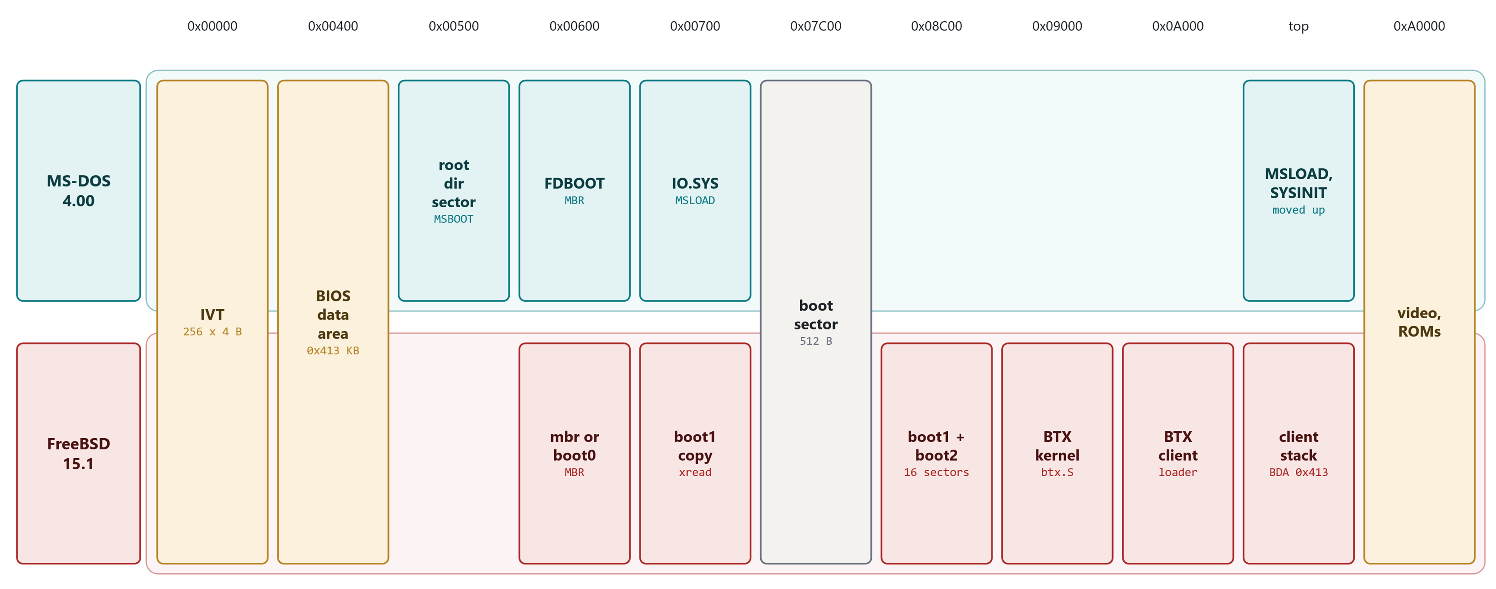
MODULE 1 · BOOTING
The first megabyte during boot
Linear addresses, not to scale. Both MBRs run at 0x600; FreeBSD fills 0x8C00-0xA000 with BTX and its client
MS-DOS 4.00 × FreeBSD 15.1 · Module 1 · F. V. Buccoli
5
Notes:
All addresses are linear. The FreeBSD addresses come from .set lines in boot1.S and btx.S, the MS-DOS ones from EQUs in MSBOOT.ASM. The top of conventional memory is not a constant: both systems ask the BIOS.

Slide 6
02
Master boot records
MS-DOS 4.00 × FreeBSD 15.1 · Module 1 · F. V. Buccoli
6

Slide 7
MODULE 1 · BOOTING
FDBOOT moves itself out of the way
MS-DOS 4.00
FDBOOT.ASM lines 26-34
1
Copies 256 words from 0:7C00 to 0:0600
sti ;interrupts ok now
cld
mov di,0600h ;where to relocate this boot record to
mov cx,100h
repnz movsw ;relocate to 0:0600
; jmp entry2
db 0eah
dw $+4,0
entry2:
2
Far jump assembled by hand: EA, offset, segment
3
Frees 0x7C00 for the partition's boot sector
Source: microsoft/MS-DOS @ 2d04cac, v4.0/src/CMD/FDISK/FDBOOT.ASM, lines 26-34
MS-DOS 4.00 × FreeBSD 15.1 · Module 1 · F. V. Buccoli
7
Notes:
Every MBR must load the next sector to 0x7C00, where it is itself running, so it relocates first. Both MS-DOS and FreeBSD pick 0x600. The hand-assembled far jump is worth decoding with the class.

Slide 8
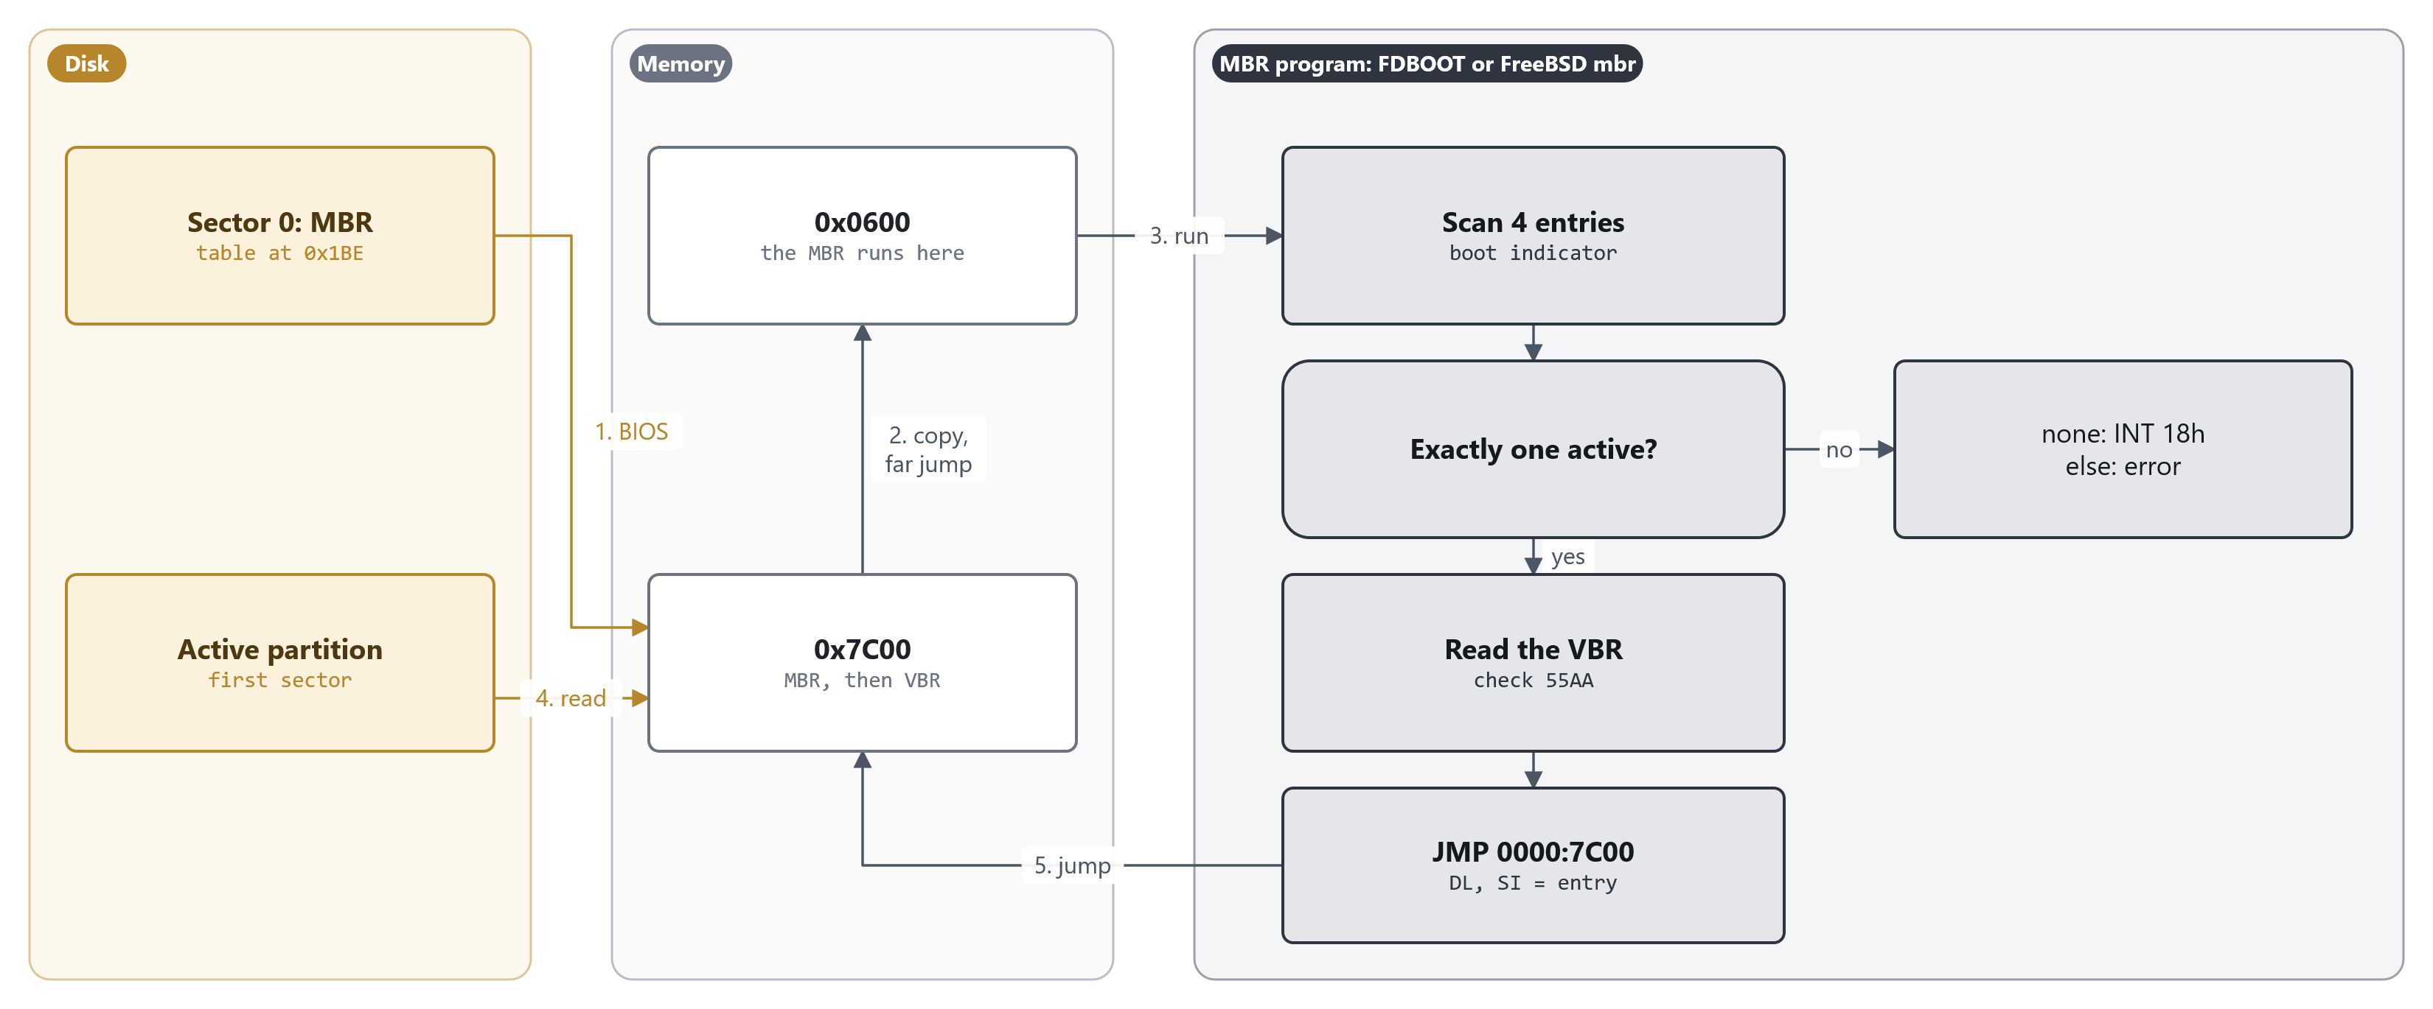
MODULE 1 · BOOTING
What every MBR does
Relocate to 0x600, find the single active entry, load its first sector to 0x7C00, jump. boot0 replaces step 3 with a menu
MS-DOS 4.00 × FreeBSD 15.1 · Module 1 · F. V. Buccoli
8
Notes:
Number the steps with the class. 1: the BIOS loads sector 0 to 0x7C00. 2: the MBR copies itself to 0x600 and far-jumps into the copy. 3: it scans the four entries at 0x1BE; none active means INT 18h, an invalid boot indicator or a second active entry means an error. 4: it reads the active partition's first sector to 0x7C00 and checks 55AA. 5: it jumps there with DL naming the drive and SI pointing at the entry. FDBOOT uses CHS and drive 0x80; mbr.S prefers EDD and trusts DL when valid.

Slide 9
MODULE 1 · BOOTING
Three MBR programs
MS-DOS 4.00 FDBOOT
FreeBSD 15.1 mbr / boot0
Exactly one 0x80 entry, else 'Invalid partition table'
CHS reads only, five retries
Always reads BIOS drive 0x80
Never writes; FDISK keeps an existing MBR
mbr: same policy, same three messages
EDD packet reads when available, CHS fallback
boot0: F-key menu with timeout
boot0 writes the chosen default back to sector 0
MS-DOS 4.00 × FreeBSD 15.1 · Module 1 · F. V. Buccoli
9
Notes:
mbr.S is the closest FreeBSD relative of FDBOOT; even its error strings match. boot0 adds a user interface in the same 512 bytes. boot0cfg(8) edits boot0's configuration bytes from user space.

Slide 10
MODULE 1 · BOOTING
boot0 remembers your choice
FreeBSD 15.1
boot0.S lines 448-463
1
The selected entry becomes active
shlb $0x4,%al # Point to
addw $partbl,%ax # selected
xchgw %bx,%ax # partition
movb $0x80,(%bx) # Flag active
/*
* If not asked to do a write-back (flags 0x40) don't do one.
* Around the call, save the partition pointer to %bx and
* restore to %si which is where the next stage expects it.
*/
1: pushw %bx # Save
testb $NOUPDATE,_FLAGS(%bp) # No updates?
jnz 2f # skip update
movw $start,%bx # Data to write
movb $0x3,%ah # Write sector
callw intx13 # to disk
2: popw %si # Restore
2
Whole sector at 0x600 written to LBA 0
3
Skipped when NOUPDATE is set (timeout, noupdate)
Source: freebsd/freebsd-src @ 96841ea, stand/i386/boot0/boot0.S, lines 448-463
MS-DOS 4.00 × FreeBSD 15.1 · Module 1 · F. V. Buccoli
10
Notes:
The write happens before the selected boot sector is read and checked. Its return status is ignored. Study case 1.B contrasts this with gptboot's checksummed GPT update and with MS-DOS boot code, which never writes.

Slide 11
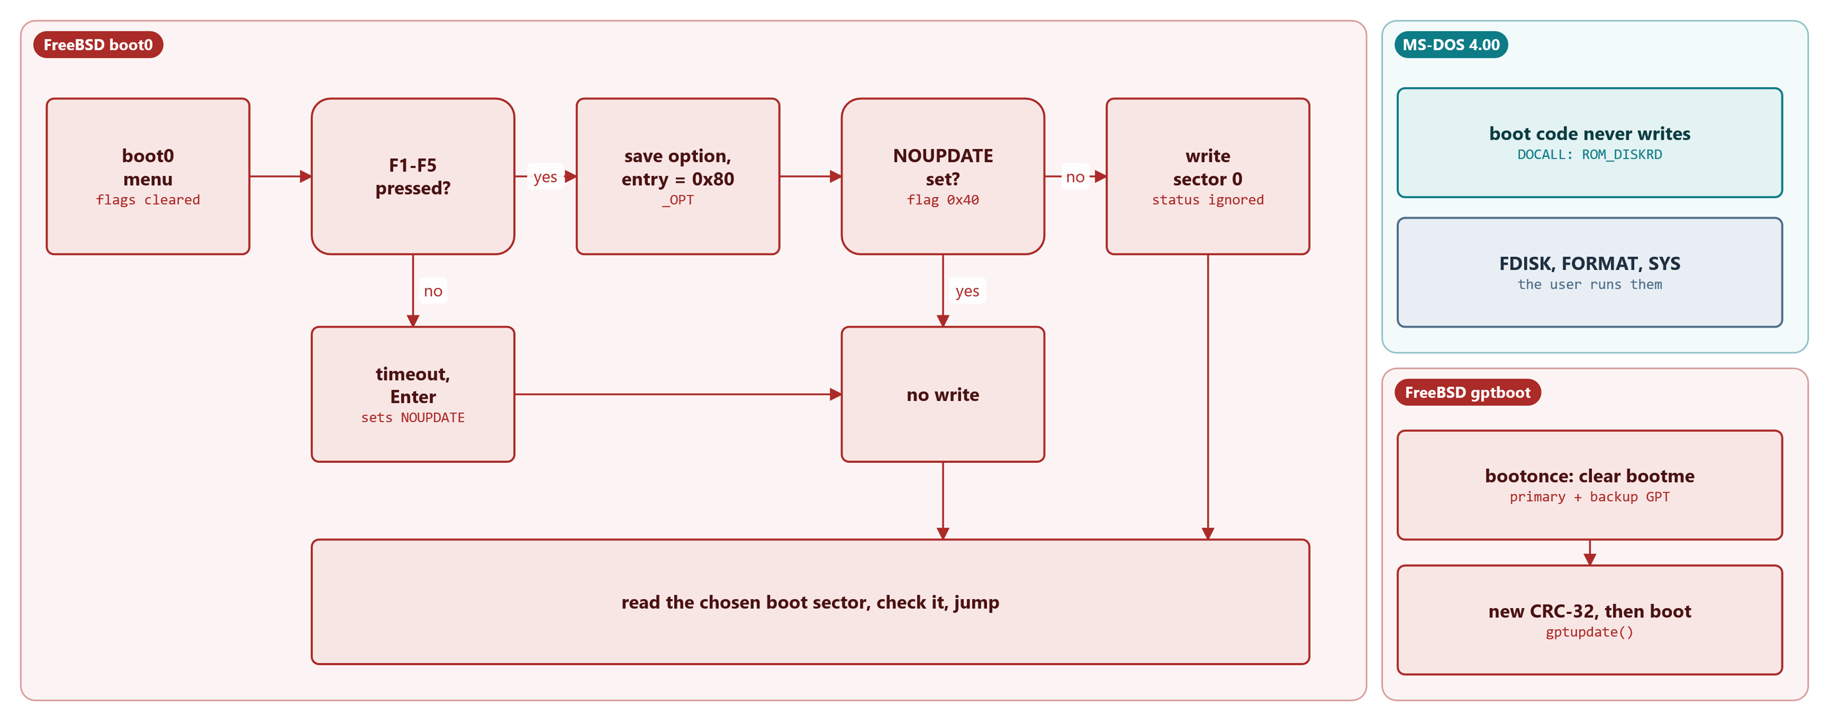
MODULE 1 · BOOTING
When boot code writes to the disk
boot0 rewrites sector 0 only after a key press and unless NOUPDATE is set; MS-DOS boot code only reads
MS-DOS 4.00 × FreeBSD 15.1 · Module 1 · F. V. Buccoli
11
Notes:
Trace both paths through boot0: a key press saves the option, marks the entry active and, unless flag 0x40 is set, writes the whole sector back before the chosen boot sector is even read. Timeout or Enter sets NOUPDATE, so nothing is written. Right: MS-DOS leaves all writing to FDISK, FORMAT and SYS; gptboot writes too, but to two checksummed GPT copies.

Slide 12
03
The first stage
MS-DOS 4.00 × FreeBSD 15.1 · Module 1 · F. V. Buccoli
12

Slide 13
MODULE 1 · BOOTING
MSBOOT's BIOS Parameter Block (selected fields)
Offset | Field | Assembled default
0x00B | Bytes per sector | 0x0200
0x00D | Sectors per cluster | 8
0x00E | Reserved sectors | 1
0x010 | Number of FATs | 2
0x011 | Root directory entries | 512
0x016 | Sectors per FAT | 8
0x018 / 0x01A | Sectors per track / heads | 17 / 4
0x01C | Hidden sectors (32-bit) | 1
0x024 | Phydrv (drive for reads) | 0x80
0x026 | Extended boot signature | 0x29
MS-DOS 4.00 × FreeBSD 15.1 · Module 1 · F. V. Buccoli
13
Notes:
The defaults describe a small hard disk; FORMAT overwrites them with the real medium's BPB and patches Phydrv. Offsets were checked against a sector assembled from this tree. Fields from 0x01C on are new in 4.00.

Slide 14
MODULE 1 · BOOTING
MSBOOT checks the first two directory entries
MS-DOS 4.00
MSBOOT.ASM lines 256-268
1
Directory sector was read to 0:0500
MOV DI,BX
MOV CX,11
MOV SI,OFFSET BIO ; point to "ibmbio com"
REPZ CMPSB ; see if the same
JNZ CKERR ; if not there advise the user
;
; Found the BIOS. Check the second directory entry.
;
LEA DI,[BX+20h]
MOV SI,OFFSET DOS ; point to "ibmdos com"
MOV CX,11
REPZ CMPSB
JZ DoLoad
2
Names are IO.SYS and MSDOS.SYS in this build
3
Mismatch: 'Non-System disk or disk error'
Source: microsoft/MS-DOS @ 2d04cac, v4.0/src/BOOT/MSBOOT.ASM, lines 256-268
MS-DOS 4.00 × FreeBSD 15.1 · Module 1 · F. V. Buccoli
14
Notes:
The comments still mention IBMBIO and IBMDOS, but IBMCOPYRIGHT is FALSE in VERSION.INC, so this tree assembles the Microsoft names. Ask students where the names sit in the sector: offsets 0x1DB to 0x1F0.

Slide 15
MODULE 1 · BOOTING
Constraints MSBOOT puts on a bootable disk
1
IO.SYS and MSDOS.SYS must be the first two directory entries
2
IO.SYS must start at the first data sector
3
Its first three sectors (MSLOAD) must be contiguous
4
Sector numbers must stay below SECLIM * 65536
5
No retries; 11 bytes of the sector left free
MS-DOS 4.00 × FreeBSD 15.1 · Module 1 · F. V. Buccoli
15
Notes:
Each constraint maps to a few lines of code: the two REPZ CMPSB comparisons, the DoLoad loop, IBMLOADSIZE, and the overflow guard in DODIV. This is why SYS.COM exists. MSLOAD in IO.SYS lifts the contiguity limit for the rest of the file.

Slide 16
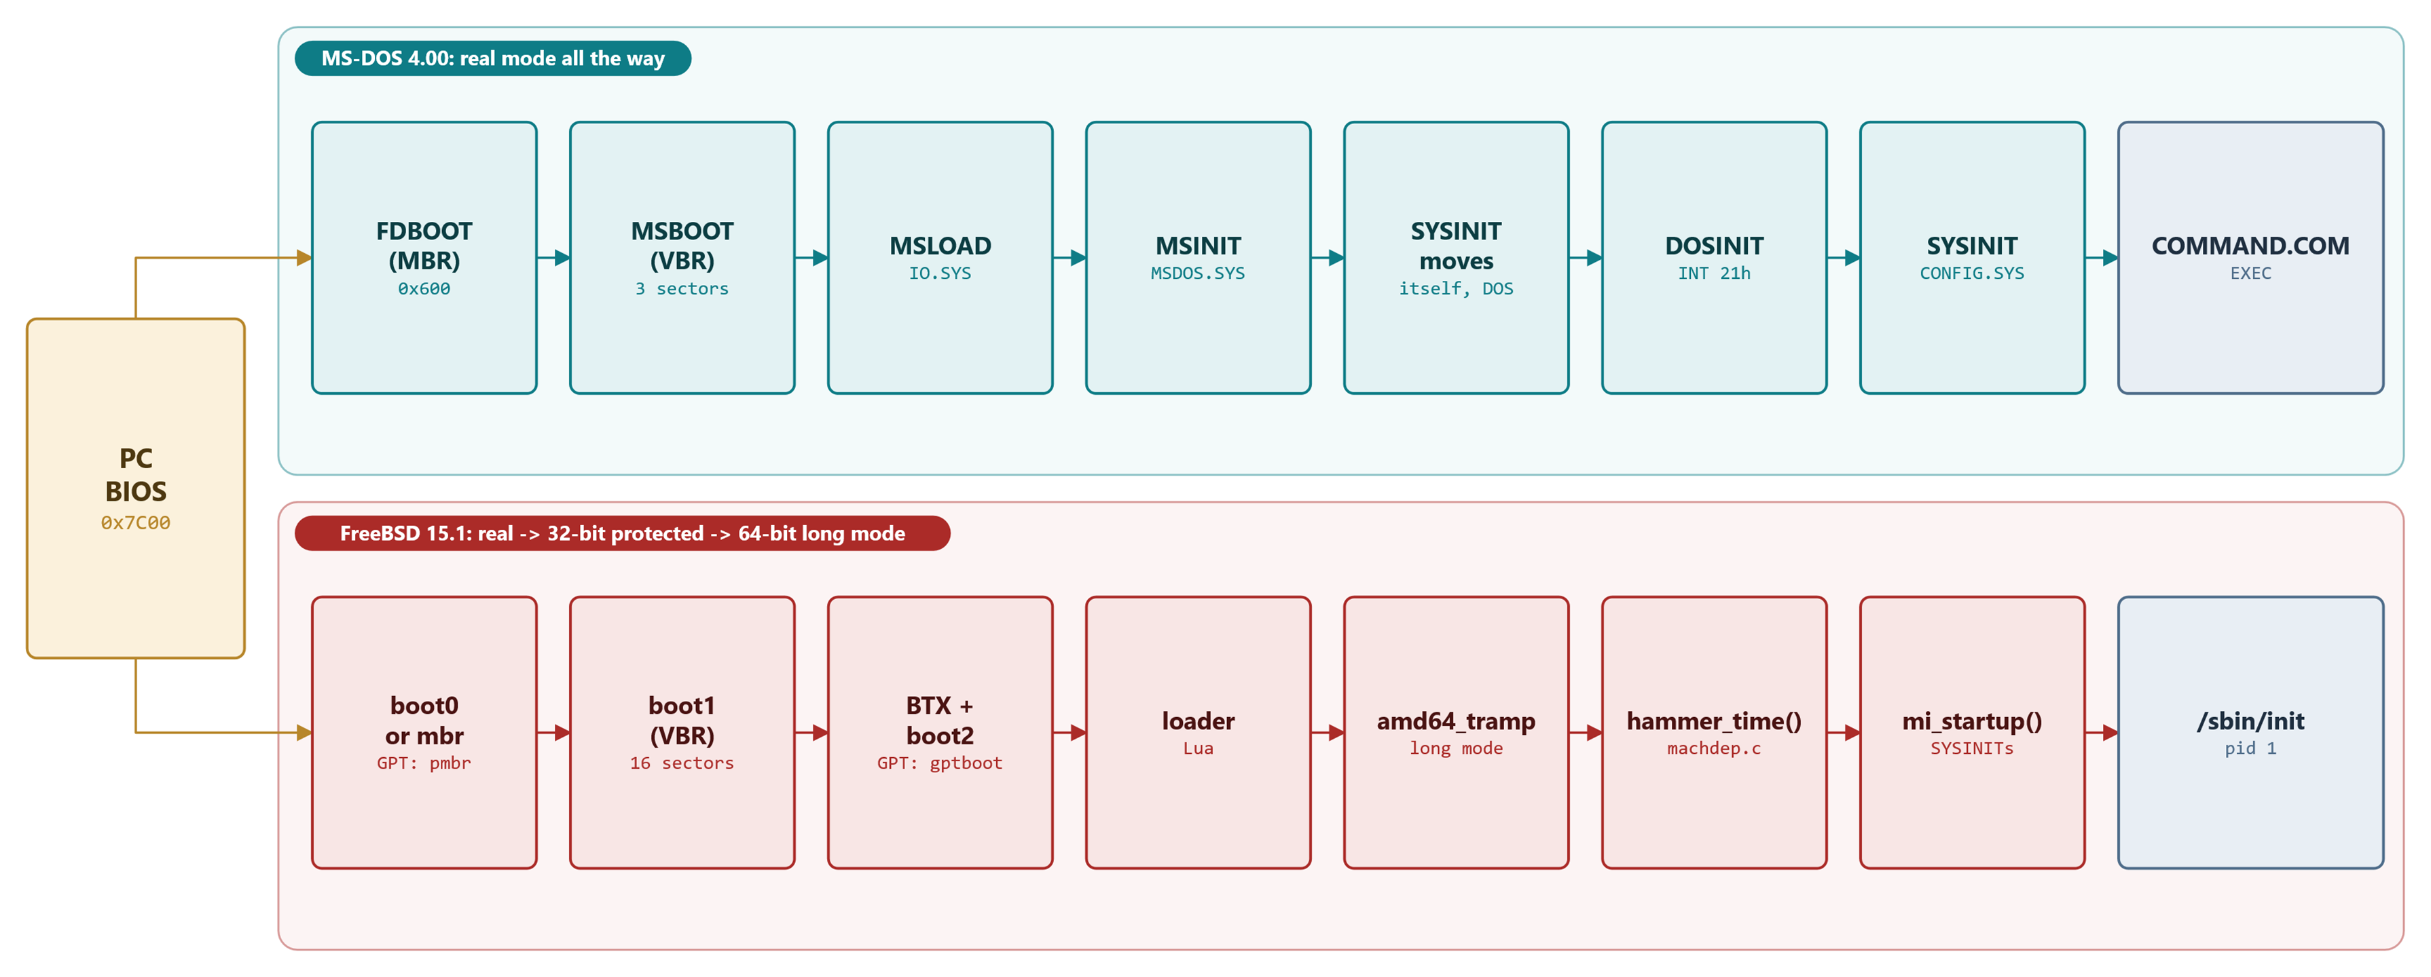
MODULE 1 · BOOTING
Two boot chains
On GPT disks, pmbr replaces boot0 or mbr, and gptboot replaces boot1 and boot2
MS-DOS 4.00 × FreeBSD 15.1 · Module 1 · F. V. Buccoli
16
Notes:
MS-DOS needs three small loaders and never leaves real mode. FreeBSD needs a protected-mode environment early because its loaders are C programs that read UFS, ELF and Lua. On GPT disks, pmbr and gptboot replace boot0/mbr and boot1/boot2.

Slide 17
MODULE 1 · BOOTING
BTX calls the BIOS in real mode, not V86 mode
FreeBSD 15.1
btx.S lines 570-584
1
Clears CR0.PE: back to real mode
intusr.7: movl %cr0,%eax # Leave
dec %al # protected
movl %eax,%cr0 # mode
ljmpw $0x0,$intusr.8
intusr.8: xorw %ax,%ax # Reset %ds
movw %ax,%ds # and
movw %ax,%ss # %ss
lidt ivtdesc # Set IVT
popl %es # Restore
popl %ds # seg
popl %fs # regs
popl %gs
popal # Restore gp regs
movw $MEM_ESPR-0x16,%sp # Switch to real mode stack
iret # Call target routine
2
Reloads the real-mode IVT
3
IRET into the BIOS routine; rret_tramp returns
Source: freebsd/freebsd-src @ 96841ea, stand/i386/btx/btx/btx.S, lines 570-584
MS-DOS 4.00 × FreeBSD 15.1 · Module 1 · F. V. Buccoli
17
Notes:
The interface is still named v86, but nothing in the 15.1 btx.S sets PSL_VM. Clients such as boot2 fill a v86 structure and execute INT 31h; BTX switches modes around the BIOS call. Check older descriptions against the pinned source.

Slide 18
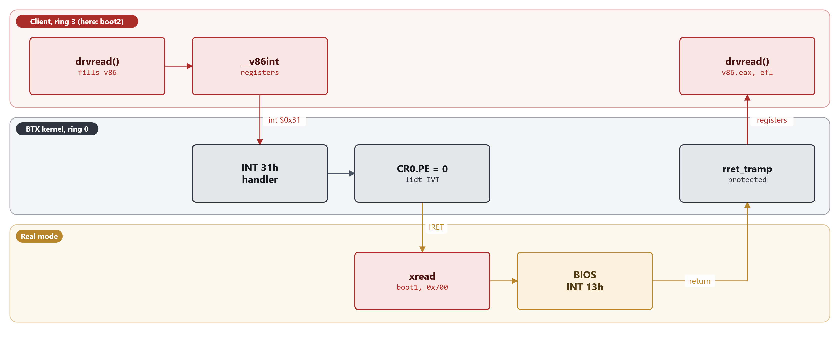
MODULE 1 · BOOTING
One BIOS call from a BTX client
Client in ring 3, BTX in ring 0, the BIOS in real mode: every disk read makes this round trip
MS-DOS 4.00 × FreeBSD 15.1 · Module 1 · F. V. Buccoli
18
Notes:
Follow boot2's drvread(): it fills struct v86 and __v86int executes INT 31h. BTX sets up rret_tramp as the return address, clears CR0.PE, reloads the real-mode IVT and IRETs into xread in the relocated boot1, which calls the BIOS. The return lands in rret_tramp, which re-enters protected mode and hands the registers back to the client.

Slide 19
04
Kernel initialisation
MS-DOS 4.00 × FreeBSD 15.1 · Module 1 · F. V. Buccoli
19

Slide 20
MODULE 1 · BOOTING
MSINIT finds MSDOS.SYS with MSBOOT's leftovers
MS-DOS 4.00
MSINIT.ASM lines 1368-1374
1
53Ah = 500h + 20h + 1Ah
; THE BOOT PROGRAM HAS LEFT THE DIRECTORY AT 0:500
PUSH DS
XOR DI,DI
MOV DS,DI ; ES:DI POINTS TO LOAD LOCATION
MOV BX,DS:WORD PTR [53AH] ; CLUS=*53A;
POP DS ;
2
Starting cluster of the second directory entry
3
The boot sector's buffer is part of the interface
Source: microsoft/MS-DOS @ 2d04cac, v4.0/src/BIOS/MSINIT.ASM, lines 1368-1374
MS-DOS 4.00 × FreeBSD 15.1 · Module 1 · F. V. Buccoli
20
Notes:
MSINIT does not search the directory again; it reads the cluster number straight from the sector MSBOOT left at 0:0500. Then it follows the FAT chain and jumps to SYSINIT.

Slide 21
MODULE 1 · BOOTING
SYSINIT starts the first user program
MS-DOS 4.00
SYSINIT1.ASM lines 835-849
1
INT 21h function 4Bh, AL=0: load and execute
MOV BX,OFFSET COMEXE ; Point to EXEC block
MOV WORD PTR [BX.EXEC0_COM_LINE+2],CS ; Set segments
MOV WORD PTR [BX.EXEC0_5C_FCB+2],CS
MOV WORD PTR [BX.EXEC0_6C_FCB+2],CS
XOR AX,AX ;Load and go
MOV AH,EXEC
STC ;IN CASE OF INT 24
INT 21H ;GO START UP COMMAND
ENDIF
; NOTE FALL THROUGH IF EXEC RETURNS (an error)
COMERR:
MOV DX,OFFSET BADCOM ;WANT TO PRINT COMMAND ERROR
INVOKE BADFIL
STALL: JMP STALL
2
Default program \COMMAND.COM /P, or SHELL=
3
If EXEC returns: error message, then STALL
Source: microsoft/MS-DOS @ 2d04cac, v4.0/src/BIOS/SYSINIT1.ASM, lines 835-849
MS-DOS 4.00 × FreeBSD 15.1 · Module 1 · F. V. Buccoli
21
Notes:
By this point SYSINIT has moved itself to the top of memory, moved MSDOS.SYS into place, called DOSINIT, and processed CONFIG.SYS in several passes. The EXEC of the shell is where this module ends on the MS-DOS side.

Slide 22
MODULE 1 · BOOTING
From the loader into 64-bit long mode
FreeBSD 15.1
amd64_tramp.S lines 97-111
1
Paging on, in compatibility mode
/* Now we're in compatibility mode. set %cs for long mode */
movl $VTOP(gdtdesc), %eax
movl VTOP(entry_hi), %esi
movl VTOP(entry_lo), %edi
lgdt (%eax)
ljmp $0x8, $VTOP(longmode)
.code64
longmode:
/* We're still running V=P, jump to entry point */
movl %esi, %eax
salq $32, %rax
orq %rdi, %rax
pushq %rax
ret
2
Far jump to a 64-bit code segment
3
Push the kernel entry, then ret
Source: freebsd/freebsd-src @ 96841ea, stand/i386/libi386/amd64_tramp.S, lines 97-111
MS-DOS 4.00 × FreeBSD 15.1 · Module 1 · F. V. Buccoli
22
Notes:
The Lua loader (loader.lua, config.lua) reads loader.conf and loads the kernel and modules; elf64_exec() then builds the module metadata and simple page tables and calls this trampoline through BTX's exec service. The kernel's btext receives modulep and kernend on the stack.

Slide 23
MODULE 1 · BOOTING
mi_startup(): the whole kernel start-up loop
FreeBSD 15.1
init_main.c lines 291-335
1
Always takes the first (lowest) entry
while ((sip = STAILQ_FIRST(&sysinit_list)) != NULL) {
STAILQ_REMOVE_HEAD(&sysinit_list, next);
STAILQ_INSERT_TAIL(&sysinit_done_list, sip, next);
if (sip->subsystem == SI_SUB_DUMMY)
continue; /* skip dummy task(s)*/
⋮ (lines omitted)
/* Call function */
(*(sip->func))(sip->udata);
⋮ (lines omitted)
/* Check off the one we're just done */
last = sip->subsystem;
}
2
Entries added during boot are merged in order
3
Never returns: thread0 sleeps afterwards
Source: freebsd/freebsd-src @ 96841ea, sys/kern/init_main.c, lines 291-335
MS-DOS 4.00 × FreeBSD 15.1 · Module 1 · F. V. Buccoli
23
Notes:
Before this, locore.S btext passed modulep and kernend to hammer_time(), which parsed the loader metadata and set up the CPU. After hammer_time() returns a stack, mi_startup() runs every SYSINIT in sorted order.

Slide 24
MODULE 1 · BOOTING
start_init(): becoming /sbin/init
FreeBSD 15.1
init_main.c lines 797-811
1
Runs in process 1, created by create_init()
error = kern_execve(td, &args, NULL, oldvmspace);
KASSERT(error != 0,
("kern_execve returned success, not EJUSTRETURN"));
if (error == EJUSTRETURN) {
exec_cleanup(td, oldvmspace);
free(free_init_path, M_TEMP);
TSEXIT();
return;
}
if (error != ENOENT)
printf("exec %s: error %d\n", path, error);
}
free(free_init_path, M_TEMP);
printf("init: not found in path %s\n", init_path);
panic("no init");
2
Tries each entry of init_path
3
EJUSTRETURN: return to user mode as init
Source: freebsd/freebsd-src @ 96841ea, sys/kern/init_main.c, lines 797-811
MS-DOS 4.00 × FreeBSD 15.1 · Module 1 · F. V. Buccoli
24
Notes:
create_init() forked process 1 at SI_SUB_CREATE_INIT; kick_init() made it runnable at SI_SUB_KTHREAD_INIT. start_init() mounts root, then execs /sbin/init. If nothing can be executed, the kernel panics with 'no init'.

Slide 25
05
Two SYSINITs
MS-DOS 4.00 × FreeBSD 15.1 · Module 1 · F. V. Buccoli
25

Slide 26
MODULE 1 · BOOTING
MS-DOS SYSINIT: CONFIG.SYS keywords
MS-DOS 4.00
SYSINIT2.ASM lines 1502-1516
1
ORGANIZE turns each keyword into a letter
DB 7,"BUFFERS", 'B'
DB 5,"BREAK", 'C'
DB 6,"DEVICE", 'D'
DB 5,"FILES", 'F'
DB 4,"FCBS", 'X'
DB 9,"LASTDRIVE",'L'
db 10,"MULTITRACK", 'M' ;AN002;
DB 8,"DRIVPARM", 'P' ; RS for DOS 3.2
IF STACKSW
DB 6,"STACKS", 'K' ; BAS for DOS 3.2
ENDIF
DB 7,"COUNTRY", 'Q'
DB 5,"SHELL", 'S'
db 7,"INSTALL", 'I' ;AN000;
db 3,"IFS", 'J' ;AN000;
2
Unknown keywords become Z
3
INSTALL= lines run in a later pass
Source: microsoft/MS-DOS @ 2d04cac, v4.0/src/BIOS/SYSINIT2.ASM, lines 1502-1516
MS-DOS 4.00 × FreeBSD 15.1 · Module 1 · F. V. Buccoli
26
Notes:
SYSINIT is a one-shot module that interprets a text file. Order of work is order of instructions plus fixed passes over the file. Third-party drivers join through DEVICE= and are linked at the head of the device chain.

Slide 27
MODULE 1 · BOOTING
FreeBSD SYSINIT(): a declaration in a linker set
FreeBSD 15.1
kernel.h lines 269-282
1
Static struct sysinit per use
#define C_SYSINIT(uniquifier, subsystem, order, func, ident) \
static struct sysinit uniquifier ## _sys_init = { \
subsystem, \
order, \
{ NULL }, \
func, \
(ident) \
}; \
DATA_WSET(sysinit_set, uniquifier ## _sys_init)
#endif
#define SYSINIT(uniquifier, subsystem, order, func, ident) \
C_SYSINIT(uniquifier, subsystem, order, \
(sysinit_cfunc_t)(sysinit_nfunc_t)func, (void *)(ident))
2
Pointer placed in ELF section set_sysinit_set
3
Sorted by subsystem, then order
Source: freebsd/freebsd-src @ 96841ea, sys/sys/kernel.h, lines 269-282
MS-DOS 4.00 × FreeBSD 15.1 · Module 1 · F. V. Buccoli
27
Notes:
Any kernel file or module can declare work for any stage. The linker collects the pointers; mi_startup() sorts them. Preloaded modules' entries are merged into the same list; kldload'ed modules run their own entries at load time.

Slide 28
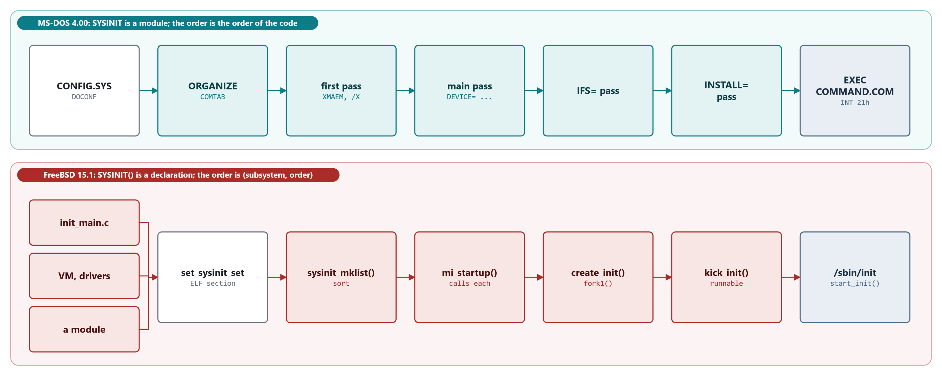
MODULE 1 · BOOTING
Two SYSINITs side by side
MS-DOS: fixed passes over CONFIG.SYS, then EXEC of the shell. FreeBSD: a sorted linker set, then /sbin/init
MS-DOS 4.00 × FreeBSD 15.1 · Module 1 · F. V. Buccoli
28
Notes:
Top: SYSINIT reads CONFIG.SYS, ORGANIZE turns keywords into letters, and the passes run in a fixed order, so every INSTALL= program runs after every DEVICE= driver. Bottom: no central list; SYSINIT() entries from any file or module land in set_sysinit_set, mi_startup() sorts them by (subsystem, order) and calls each, and two of them create and start process 1.

Slide 29
MODULE 1 · BOOTING
Same name, different ideas
 | MS-DOS 4.00 | FreeBSD 15.1
What it is | Relocating init module in IO.SYS | Macro adding to a linker set
Ordering | Instruction order, CONFIG.SYS passes | (subsystem, order) numbers, sorted
Configuration | CONFIG.SYS parsed by SYSINIT | loader.conf, passed as kernel environment
Extensions | DEVICE=, IFS=, INSTALL= | Modules with their own SYSINITs
Ends with | EXEC of COMMAND.COM | kern_execve() of /sbin/init
MS-DOS 4.00 × FreeBSD 15.1 · Module 1 · F. V. Buccoli
29
Notes:
Use this table to close the lecture. Students should be able to explain each row with one listing from each system. Study case 1.C goes deeper into how third-party code joins the boot.

Slide 30
MODULE 1 · BOOTING
Homework
1
1.1 Decode the DOS and FreeBSD boot sectors byte by byte
2
1.2 Trace MSBOOT into IO.SYS with QEMU and GDB
3
1.3 Write a two-sector boot program in NASM
4
1.4-1.5 CONFIG.SYS experiments; watch boot0 write back
5
1.6-1.7 Order SYSINITs with a module; essay on extensibility
MS-DOS 4.00 × FreeBSD 15.1 · Module 1 · F. V. Buccoli
30
Notes:
Exercises 1.1 to 1.5 need only the Module 0 lab. Exercise 1.6 needs the FreeBSD VM with /usr/src; its optional part needs a GENERIC-DEBUG kernel. Remind students that every claim needs a pinned permalink.

Slide 31
MODULE 1 · BOOTING
Key takeaways
1
Both systems start from the same 512-byte BIOS contract
2
MS-DOS: three tiny real-mode loaders, then SYSINIT and COMMAND.COM
3
FreeBSD: BTX, a C loader in protected mode, then long mode
4
Boot code that writes to disk trades safety for convenience
5
SYSINIT: a one-shot module versus a sorted declarative table
MS-DOS 4.00 × FreeBSD 15.1 · Module 1 · F. V. Buccoli
31
Notes:
Ask students which design decisions follow from 1980s hardware and which are still visible today. Point out that FreeBSD's BIOS path still lives within the same 640 KB and 512-byte limits that shaped MS-DOS.

