Slide 1
OPERATING SYSTEMS · MODULE 2
The kernel: system calls, files, memory and programs
MS-DOS 4.00 and FreeBSD 15.1, side by side in the source
MS-DOS 4.00
FreeBSD 15.1
Francesco Valerio Buccoli · francesco@buccoli.com
Sources: microsoft/MS-DOS @ 2d04cac · freebsd/freebsd-src @ release/15.1.0

Slide 2
01
What "kernel" means in each system
MS-DOS 4.00 × FreeBSD 15.1 · Module 2 · F. V. Buccoli
2

Slide 3
MODULE 2 · THE KERNEL
Two very different kernels
MS-DOS 4.00
FreeBSD 15.1
Real mode: segment:offset, 1 MB, no protection
MSDOS.SYS: shared library behind INT 21h
Any program may rewrite the interrupt vectors
One program runs; TSRs borrow the CPU
8086 assembly; MSDOS.SYS links 55 objects
Long mode, paging, ring 0 versus ring 3
Monolithic kernel entered only by syscalls and traps
Entry points set by the kernel (MSR_LSTAR)
Many processes and threads on many CPUs
C, generated syscall tables, loadable modules
MS-DOS 4.00 × FreeBSD 15.1 · Module 2 · F. V. Buccoli
3
Notes:
Start from the hardware: the 8088 offers no protection, so MS-DOS could not have any. DOS behaves like a library that every program shares, including its data. FreeBSD relies on paging and privilege levels so that the kernel alone controls its entry points. Keep this contrast in mind for every later topic.

Slide 4
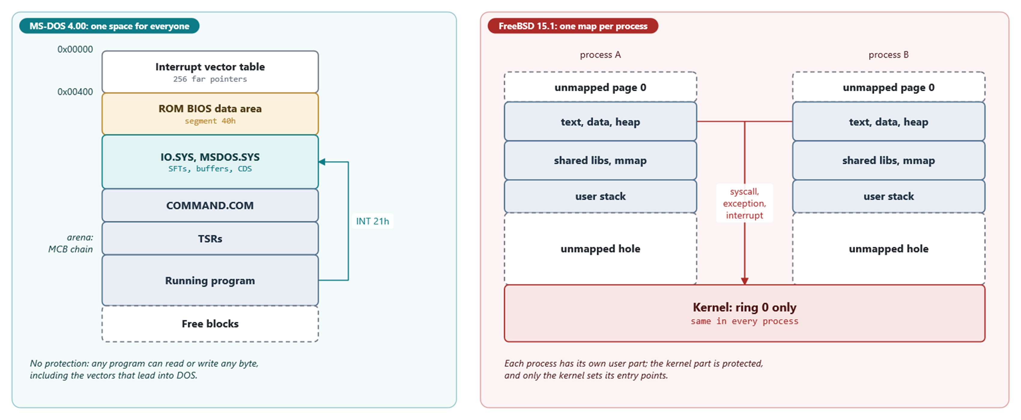
MODULE 2 · THE KERNEL
Address spaces side by side
One real-mode space for everyone versus one map per process
MS-DOS 4.00 × FreeBSD 15.1 · Module 2 · F. V. Buccoli
4
Notes:
The left side is schematic; SYSINIT decides the exact order of the DOS tables. The right side is exactly what procstat -v prints for a process. Point out that the DOS arena headers live inside the memory they describe, and that INT 21h goes through a vector any program may rewrite, while FreeBSD is entered only through syscalls, exceptions and interrupts whose entry points the kernel sets.

Slide 5
02
Entering the kernel
MS-DOS 4.00 × FreeBSD 15.1 · Module 2 · F. V. Buccoli
5

Slide 6
MODULE 2 · THE KERNEL
INT 21h: save registers, enter DOS, switch stacks
MS-DOS 4.00
DISP.ASM lines 261-299
1
save_world pushes the caller's registers on the caller's stack
CALL save_world
MOV [SaveDS],DS
MOV [SaveBX],BX
MOV BX,CS
MOV DS,BX
ASSUME DS:DOSGROUP
INC [INDOS] ; Flag that we're in the DOS
⋮ (lines omitted)
MOV BX,CS ; no holes here.
MOV SS,BX
ASSUME SS:DOSGROUP
entry REDISP
MOV SP,OFFSET DOSGROUP:AUXSTACK ; Enough stack for interrupts
STI ; stack is in our space now...
2
INDOS counts calls in progress
3
SS becomes DOSGROUP; SP the top of AUXSTACK
4
Interrupts are enabled only after the switch
Source: microsoft/MS-DOS @ 2d04cac, v4.0/src/DOS/DISP.ASM, lines 261-299
MS-DOS 4.00 × FreeBSD 15.1 · Module 2 · F. V. Buccoli
6
Notes:
This is the heart of the dispatcher in DISP.ASM. The caller's frame stays on the caller's stack, and its address is saved in User_SS:User_SP and in the PSP. Only then does DOS switch to its own stack and re-enable interrupts.

Slide 7
MODULE 2 · THE KERNEL
Three global stacks of 384 bytes
Stack | Used by | Reason
AUXSTACK | every call briefly; 59h; 01h-0Ch inside INT 24h | works while a critical error is handled
IOSTACK | calls 01h-0Ch (console I/O) | may wait for a key and issue INT 28h
DSKSTACK | everything else, including 00h | disk calls that may raise INT 24h
MS-DOS 4.00 × FreeBSD 15.1 · Module 2 · F. V. Buccoli
7
Notes:
StackSize is 180h bytes in MS_DATA.ASM. Because these stacks are global, a second disk call started from an interrupt handler would overwrite the first one's frames. This is the concrete reason why MS-DOS is not re-entrant.

Slide 8
MODULE 2 · THE KERNEL
MS-DOS reports errors in the caller's saved carry flag
MS-DOS 4.00
MS_CODE.ASM lines 294-309
1
get_user_stack returns DS:SI pointing at the saved frame
entry SYS_RET_OK
invoke FETCHI_CHECK ; TAG checking for FETCHI
invoke get_user_stack
AND [SI.user_F],NOT f_Carry ; turn off user's carry flag
⋮ (lines omitted)
entry SYS_RET_ERR
XOR AH,AH ; hack to allow for smaller error rets
⋮ (lines omitted)
invoke get_user_stack
OR [SI.user_F],f_Carry ; signal carry to user
STC ; also, signal internal error
DO_RET:
MOV [SI.user_AX],AX ; Really only sets AH
2
user_F is the FLAGS word pushed by INT 21h
3
IRET later reloads FLAGS, so the caller sees CF
Source: microsoft/MS-DOS @ 2d04cac, v4.0/src/DOS/MS_CODE.ASM, lines 294-309
MS-DOS 4.00 × FreeBSD 15.1 · Module 2 · F. V. Buccoli
8
Notes:
Every handle-style call ends here. The kernel never touches the live flags; it edits the copy that INT pushed, and IRET makes the edit visible. Keep this slide up while showing the FreeBSD equivalent on the next one.

Slide 9
MODULE 2 · THE KERNEL
FreeBSD does the same with PSL_C in the trap frame
FreeBSD 15.1
vm_machdep.c lines 550-581
1
Success: clear PSL_C, results in %rax and %rdx
if (__predict_true(error == 0)) {
frame->tf_rax = td->td_retval[0];
frame->tf_rdx = td->td_retval[1];
frame->tf_rflags &= ~PSL_C;
return;
⋮ (lines omitted)
default:
frame->tf_rax = error;
frame->tf_rflags |= PSL_C;
2
Failure: errno value in %rax, PSL_C set
3
libsys stub: jb cerror stores errno and returns -1
Source: freebsd/freebsd-src @ 96841ea, sys/amd64/amd64/vm_machdep.c, lines 550-581
MS-DOS 4.00 × FreeBSD 15.1 · Module 2 · F. V. Buccoli
9
Notes:
cpu_set_syscall_retval edits the saved RFLAGS just like SYS_RET_ERR edits the saved FLAGS. The C library then turns carry into errno and -1 in cerror.S. Ask students why both designs return the error in the accumulator.

Slide 10
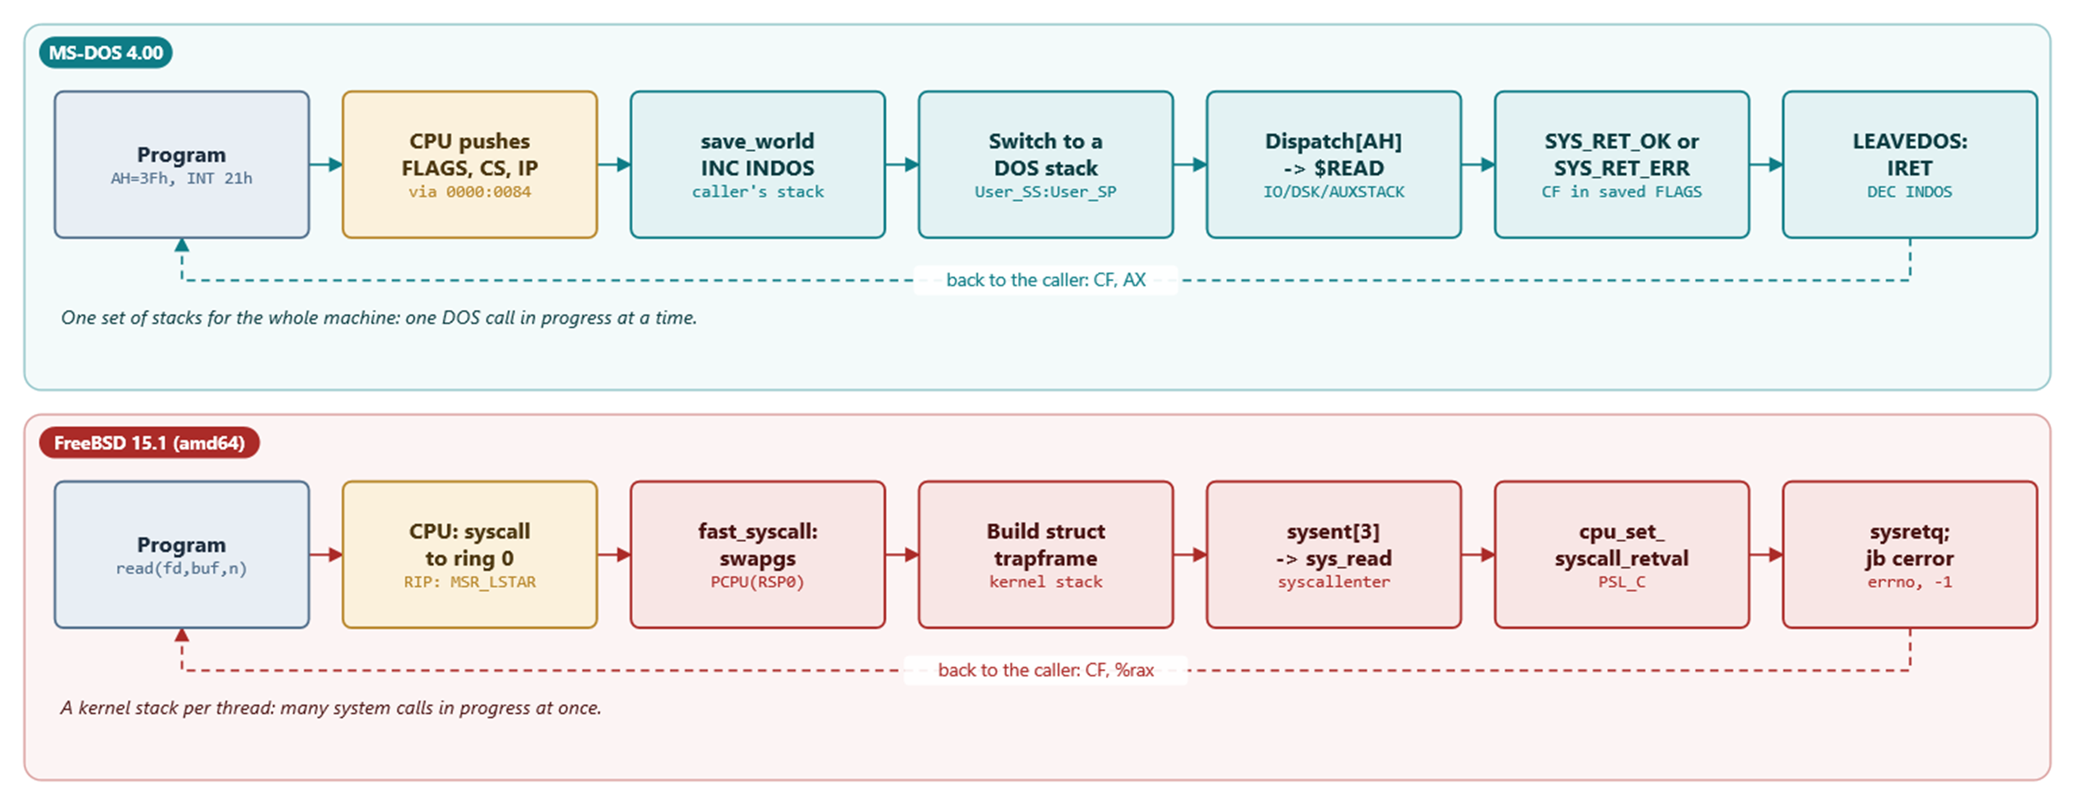
MODULE 2 · THE KERNEL
Two ways into the kernel, step by step
INT 21h saves on the caller's stack, then switches to a global DOS stack; syscall switches to a per-thread kernel stack
MS-DOS 4.00 × FreeBSD 15.1 · Module 2 · F. V. Buccoli
10
Notes:
Read both rows left to right. The CPU step is hardware in both cases: INT pushes FLAGS, CS and IP and jumps through the vector table; syscall jumps to the address the kernel put in MSR_LSTAR. MS-DOS saves the registers on the caller's stack and then moves to AUXSTACK, IOSTACK or DSKSTACK, shared by the whole machine; FreeBSD switches to the thread's own kernel stack first and builds a trap frame there. Both return by editing the carry bit in the saved flags.

Slide 11
MODULE 2 · THE KERNEL
System call entry compared
 | MS-DOS 4.00 | FreeBSD 15.1
Instruction | INT 21h | syscall
Number | AH | %eax (read = 3)
Caller state | on the caller's stack | trap frame on kernel stack
Kernel stack | 3 global stacks | one per thread
Table | DISPATCH, near pointers | sysent[] from syscalls.master
Error | CF=1, AX = DOS code | CF=1, %rax = errno
MS-DOS 4.00 × FreeBSD 15.1 · Module 2 · F. V. Buccoli
11
Notes:
Walk the rows top to bottom while pointing at the listings in the notes. The decisive difference is the per-thread kernel stack. Everything else is surprisingly parallel.

Slide 12
MODULE 2 · THE KERNEL
InDOS, critical errors and INT 28h
1
Function 34h returns ES:BX of INDOS; ErrorMode is the byte before
2
TSRs may call DOS only when both flags are zero
3
Console waits call SPOOLINT, which issues INT 28h
4
During INT 28h the interrupted call is on IOSTACK
5
So an INT 28h handler may use calls above 0Ch
MS-DOS 4.00 × FreeBSD 15.1 · Module 2 · F. V. Buccoli
12
Notes:
This is the protocol that made background printing and pop-up utilities possible. It is a convention, not a mechanism: nothing enforces it. Exercise 2.5 asks students to reason about exactly these rules.

Slide 13
03
Files and handles
MS-DOS 4.00 × FreeBSD 15.1 · Module 2 · F. V. Buccoli
13

Slide 14
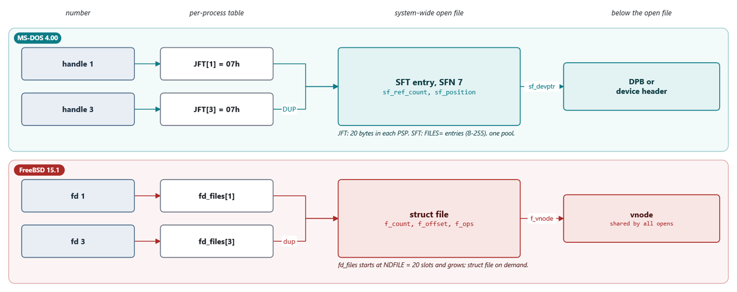
MODULE 2 · THE KERNEL
Three levels in both systems
After DUP or dup, two numbers share one open file and one position
MS-DOS 4.00 × FreeBSD 15.1 · Module 2 · F. V. Buccoli
14
Notes:
Both systems separate the per-process number from the shared open file. That is why dup shares a file position in both. Mention that FreeBSD's initial table has NDFILE = 20 slots, the same historical 20 as FilPerProc.

Slide 15
MODULE 2 · THE KERNEL
Handles versus descriptors
 | MS-DOS 4.00 | FreeBSD 15.1
Open-file pool | fixed by FILES= (8-255) | allocated on demand
Reference count | sf_ref_count | f_count (fhold/fdrop)
dup2 | close target, then duplicate | duplicate, then close, atomically
No inheritance | sf_no_inherit per open file | close-on-fork/exec per descriptor
MS-DOS 4.00 × FreeBSD 15.1 · Module 2 · F. V. Buccoli
15
Notes:
The dup2 row is a nice example of SMP thinking: FreeBSD never lets another thread see the target descriptor closed. MS-DOS has no other observer, so the simple order is fine. Exercise 2.6 shows that FORCEDUP of a handle onto itself closes it.

Slide 16
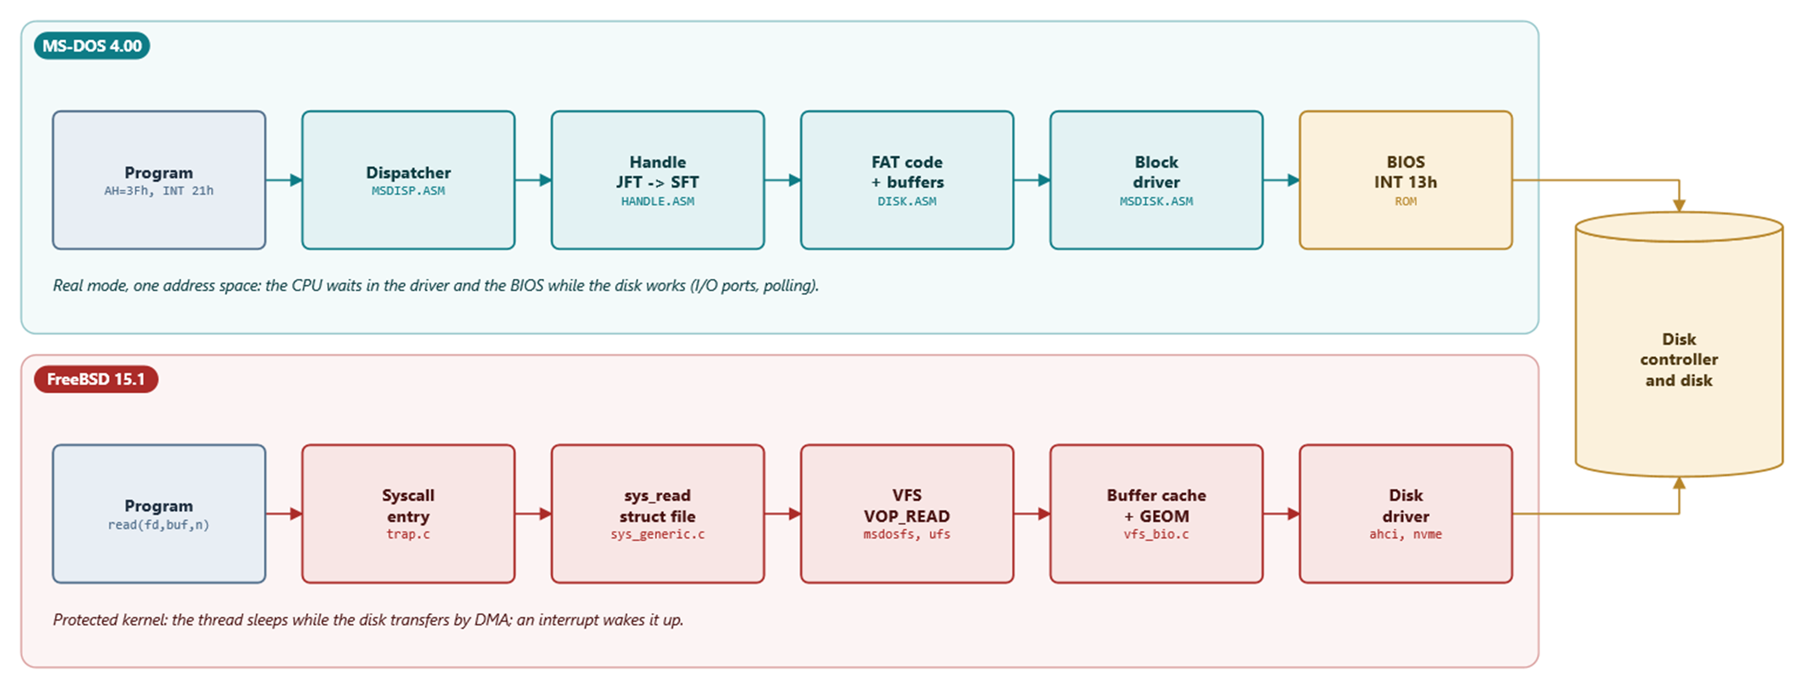
MODULE 2 · THE KERNEL
One read, two kernels
Study case 2.A follows every hop with a source line
MS-DOS 4.00 × FreeBSD 15.1 · Module 2 · F. V. Buccoli
16
Notes:
Walk down both columns together. MS-DOS has fewer layers and the CPU busy-waits inside the driver and the BIOS; FreeBSD adds the VFS, the buffer cache and GEOM, and the thread sleeps while the disk does DMA and raises an interrupt.

Slide 17
04
The FAT file system, implemented twice
MS-DOS 4.00 × FreeBSD 15.1 · Module 2 · F. V. Buccoli
17

Slide 18
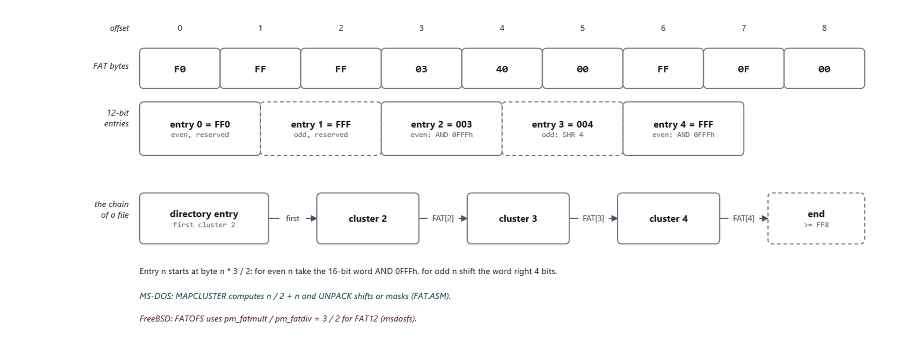
MODULE 2 · THE KERNEL
FAT12: two entries in three bytes
The worked example of Study case 2.B: bytes F0 FF FF 03 40 00 FF 0F 00 encode the chain 2 -> 3 -> 4
MS-DOS 4.00 × FreeBSD 15.1 · Module 2 · F. V. Buccoli
18
Notes:
Entry n starts at byte n*3/2. Even entries take the low 12 bits of the 16-bit word, odd entries the high 12 bits, so two entries share the middle byte. Decode entry 3 with the class: word 0040h at offset 4, odd, shift right 4 bits, 004. MS-DOS does this in MAPCLUSTER and UNPACK; msdosfs encodes the 1.5 with pm_fatmult/pm_fatdiv = 3/2.

Slide 19
MODULE 2 · THE KERNEL
MS-DOS: unpack a FAT12 entry
MS-DOS 4.00
FAT.ASM lines 113-132
1
MAPCLUSTER returns a pointer to byte n*1.5
CMP BX,ES:[BP.dpb_max_cluster]
JA HURTFAT
CALL MAPCLUSTER
ASSUME DS:NOTHING
jc DoContext
MOV DI,[DI]
JNZ High12 ; MZ if high 12 bits, go get 'em
⋮ (lines omitted)
High12:
SHR DI,1
SHR DI,1
SHR DI,1
SHR DI,1
Unpack12:
AND DI,0FFFH ; Clears carry
2
Zero flag clear means odd entry: use the high 12 bits
3
Even entry: mask with 0FFFh
Source: microsoft/MS-DOS @ 2d04cac, v4.0/src/DOS/FAT.ASM, lines 113-132
MS-DOS 4.00 × FreeBSD 15.1 · Module 2 · F. V. Buccoli
19
Notes:
Work the example F0 FF FF 03 40 00 FF 0F 00 on the board first. Then show that the assembly does exactly the three steps. Mention the CLUSSPLIT case for entries that straddle two sectors.

Slide 20
MODULE 2 · THE KERNEL
FreeBSD: the same three steps in C
FreeBSD 15.1
msdosfs_fat.c lines 517-528
1
getushort is a little-endian 16-bit load
if (function & FAT_GET) {
if (FAT32(pmp))
readcn = getulong(bp->b_data + bo);
else
readcn = getushort(bp->b_data + bo);
if (FAT12(pmp) & (cn & 1))
readcn >>= 4;
readcn &= pmp->pm_fatmask;
/* map reserved FAT entries to same values for all FATs */
if ((readcn | ~pmp->pm_fatmask) >= CLUST_RSRVD)
readcn |= ~pmp->pm_fatmask;
*oldcontents = readcn;
2
Odd FAT12 entries are shifted right by 4
3
Reserved values are normalised for all FAT types
Source: freebsd/freebsd-src @ 96841ea, sys/fs/msdosfs/msdosfs_fat.c, lines 517-528
MS-DOS 4.00 × FreeBSD 15.1 · Module 2 · F. V. Buccoli
20
Notes:
Point out the single ampersand on the odd test; it works because FAT12() yields 0 or 1. msdosfs avoids the straddling case by reading the FAT in blocks of three sectors. Same format, entirely different engineering trade-offs.

Slide 21
MODULE 2 · THE KERNEL
Numbers fixed by the format
4086
1.5
3 x 512
32
FAT12 if clusters + 1 < 4086, in both kernels
bytes per FAT12 entry
msdosfs FAT12 block: 1024 whole entries
bytes per directory entry
MS-DOS 4.00 × FreeBSD 15.1 · Module 2 · F. V. Buccoli
21
Notes:
Both kernels compare the highest cluster number with 4086: 4096-10 in FAT.ASM and CLUST_RSRVD & FAT12_MASK in msdosfs. The three-sector block is why msdosfs needs no split-entry code. Directory entries are 32 bytes in both, but bytes 12-21 were interpreted differently over time.

Slide 22
05
Memory, programs and drivers
MS-DOS 4.00 × FreeBSD 15.1 · Module 2 · F. V. Buccoli
22

Slide 23
MODULE 2 · THE KERNEL
The MS-DOS memory control block
MS-DOS 4.00
ARENA.INC lines 10-26
1
16 bytes, one paragraph below each block
arena STRUC
arena_signature DB ? ; 4D for valid item, 5A for last item
arena_owner DW ? ; owner of arena item
arena_size DW ? ; size in paragraphs of item
arena_reserved DB 3 DUP(?) ; reserved
arena_name DB 8 DUP(?) ; owner file name
arena ENDS
⋮ (lines omitted)
arena_owner_system EQU 0 ; free block indication
arena_signature_normal EQU 4Dh ; valid signature, not end of arena
arena_signature_end EQU 5Ah ; valid signature, last block in arena
2
Owner 0 = free; next = segment + size + 1
3
First MCB: the word at ES:[BX-2] after function 52h
Source: microsoft/MS-DOS @ 2d04cac, v4.0/src/INC/ARENA.INC, lines 10-26
MS-DOS 4.00 × FreeBSD 15.1 · Module 2 · F. V. Buccoli
23
Notes:
The arena is a linked list stored inside the memory it manages. A single stray write corrupts it: allocation (48h), and with it EXEC, then fails with error 7 when the walk reaches the bad header. Contrast with vm_map entries, which live in kernel memory behind a lock.

Slide 24
MODULE 2 · THE KERNEL
EXEC versus fork + execve
MS-DOS 4.00 EXEC
FreeBSD 15.1
One call: load, build PSP, jump
.EXE relocation adds the load segment
Parent frozen inside its INT 21h
Child inherits JFT, environment copy
Exit code read once with 4Dh
fork copies the process, copy-on-write
execve maps PT_LOAD segments, no reading
Parent and child run concurrently
fdcopy at fork, close-on-exec at exec
Status per child via wait4
MS-DOS 4.00 × FreeBSD 15.1 · Module 2 · F. V. Buccoli
24
Notes:
MS-DOS cannot fork: images contain absolute segment values and there is no paging or scheduler. EXEC keeps the parent suspended and resumes it through the INT 22h address when the child exits. vfork is the closest FreeBSD relative of this model.

Slide 25
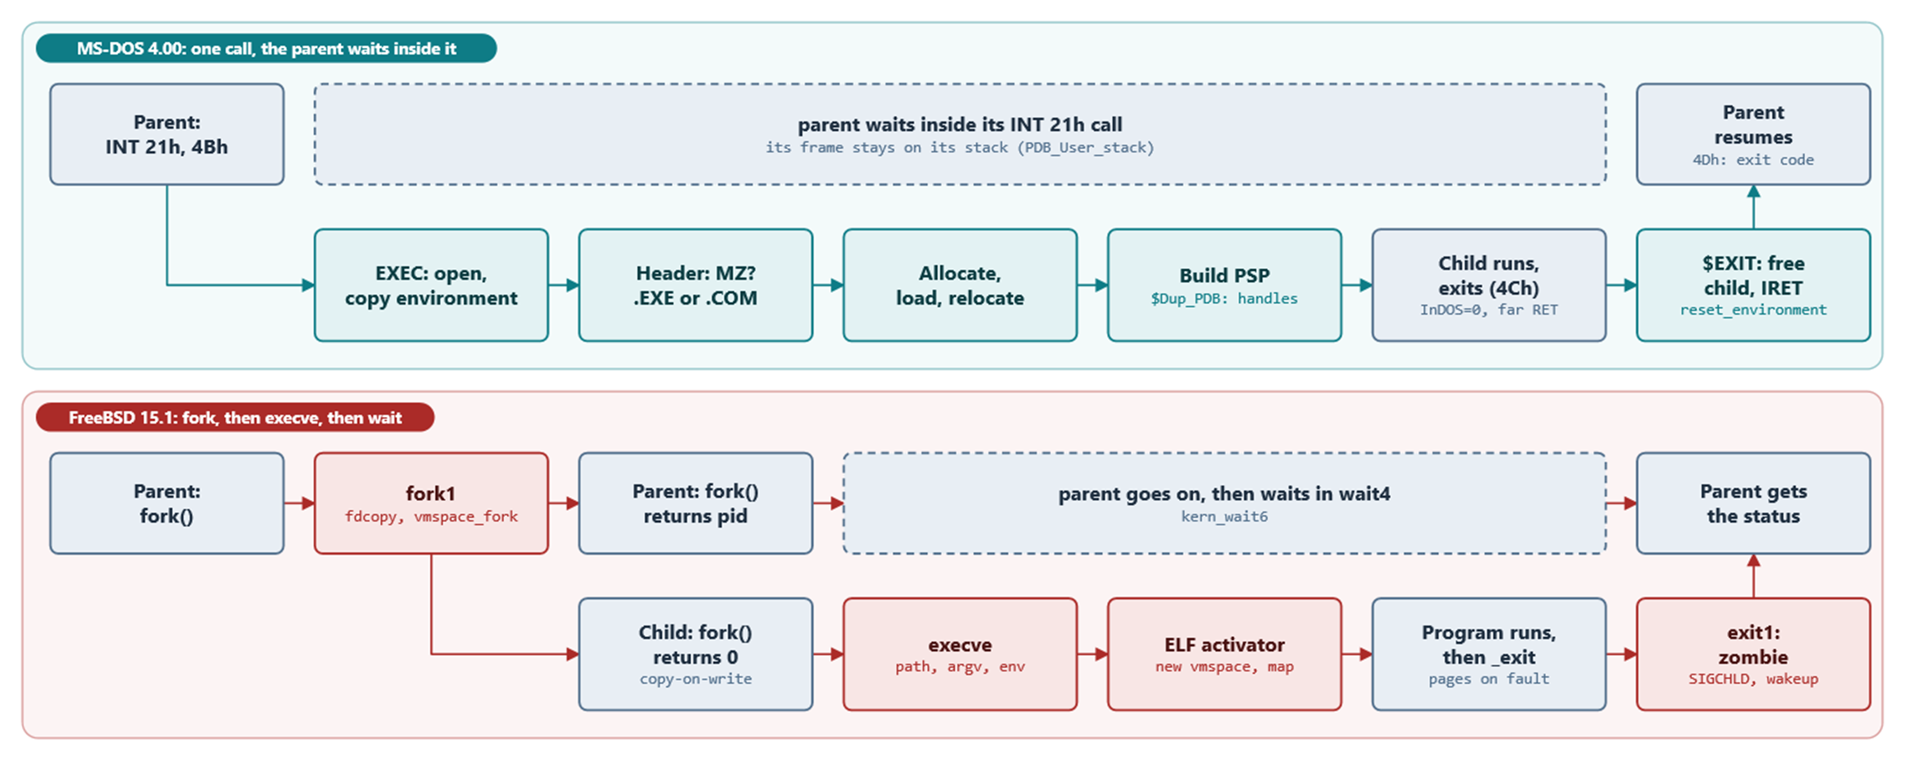
MODULE 2 · THE KERNEL
EXEC versus fork + execve, as a timeline
MS-DOS: the whole child lifetime happens inside the parent's INT 21h call; FreeBSD: two processes
MS-DOS 4.00 × FreeBSD 15.1 · Module 2 · F. V. Buccoli
25
Notes:
Follow the top lane: the parent issues 4Bh and does not run again until $EXIT IRETs to the instruction after its INT 21h; 4Dh then reads the exit code. In the bottom lane fork1 returns twice, pid in the parent and 0 in the child; the child calls execve, which replaces its address space, and exit1 makes it a zombie and wakes the parent in wait4.

Slide 26
MODULE 2 · THE KERNEL
Starting the child: InDOS = 0 and a far return
MS-DOS 4.00
EXEC.ASM lines 788-805
1
The child's SS:SP and entry point come from the header
CLI
MOV BYTE PTR INDOS,0
ASSUME SS:NOTHING
MOV SS,AX ; set up user's stack
MOV SP,DI ; and SP
STI
PUSH DS ; fake long call to entry
PUSH SI
MOV ES,DX ; set up proper seg registers
MOV DS,DX
MOV AX,BX ; set up proper AX
⋮ (lines omitted)
RET
2
DS = ES = PSP segment, AX = drive validity flags
3
RET jumps to the child; the parent never left INT 21h
Source: microsoft/MS-DOS @ 2d04cac, v4.0/src/DOS/EXEC.ASM, lines 788-805
MS-DOS 4.00 × FreeBSD 15.1 · Module 2 · F. V. Buccoli
26
Notes:
This is the only place where DOS clears InDOS without returning to the caller. The parent's frame stays on the parent's stack until reset_environment resumes it. Ask what happens to the parent's registers in the meantime.

Slide 27
MODULE 2 · THE KERNEL
Device drivers
MS-DOS 4.00
FreeBSD 15.1
Header: next, attributes, strategy, interrupt, name
Request packet: unit, command, status
DEVIOCALL: far call strategy, then interrupt
NUL device built into MSDOS.SYS
struct cdevsw: one function per operation
/dev/null: null_write consumes the uio
Disks go through GEOM and struct bio
Strategy survives: VOP_STRATEGY, d_strategy
MS-DOS 4.00 × FreeBSD 15.1 · Module 2 · F. V. Buccoli
27
Notes:
The two-step strategy/interrupt interface would allow queuing, which MS-DOS 4.00 never uses. FreeBSD's strategy routines really do queue requests and complete them asynchronously. Show null.c next to the NUL device header in SYSINITVAR.

Slide 28
MODULE 2 · THE KERNEL
Concurrency
MS-DOS 4.00
FreeBSD 15.1
One DOS call at a time
CLI/STI around stack switches
EnterCrit stubs are a single RET
The sharer patches them into INT 2Ah calls
Many threads in the kernel on many CPUs
mutex: one atomic compare-and-set when free
Spin mutexes disable interrupts per CPU
Locks on fd tables, vnodes, maps
MS-DOS 4.00 × FreeBSD 15.1 · Module 2 · F. V. Buccoli
28
Notes:
CRIT.ASM shows how cheaply MS-DOS reserved hooks for multitasking. FreeBSD has to lock every shared structure; the fast path of mtx_lock is one atomic instruction. spinlock_enter is the per-CPU, nestable descendant of CLI.

Slide 29
MODULE 2 · THE KERNEL
Homework
1
2.1 MCB walker in nasm; 2.2 FAT12 reader in Python
2
2.3 truss and ktrace of a read on msdosfs
3
2.4 A system call module with SYSCALL_MODULE
4
2.5 A TSR counting INT 21h calls; re-entrancy questions
5
2.6 DUP versus dup2; 2.7 essay on protection
MS-DOS 4.00 × FreeBSD 15.1 · Module 2 · F. V. Buccoli
29
Notes:
Exercises 2.1, 2.2 and 2.5 run in the MS-DOS lab image; 2.3 and 2.4 in the FreeBSD VM. Remind students to cite source lines for every explanation. Exercise 2.5 is the hardest; suggest starting from the template in the notes.

Slide 30
MODULE 2 · THE KERNEL
Key takeaways
1
Both kernels report errors by setting the caller's saved carry flag
2
MS-DOS is not re-entrant: global stacks and state
3
Same handle model: per-process table, shared open file
4
Same FAT rules, opposite engineering trade-offs
5
Protection and processes need hardware MS-DOS never had
MS-DOS 4.00 × FreeBSD 15.1 · Module 2 · F. V. Buccoli
30
Notes:
Close by returning to the first slide: almost every difference follows from the hardware and the compatibility promises each system made. The similarities come from MS-DOS 2.x borrowing the Unix model. Next module: the shells that run on top of these kernels.

