Slide 1
OPERATING SYSTEMS · MODULE 3
The shell: COMMAND.COM and /bin/sh
MS-DOS 4.00 vs FreeBSD 15.1, read from the source
MS-DOS 4.00
FreeBSD 15.1
Francesco Valerio Buccoli · francesco@buccoli.com
Sources: microsoft/MS-DOS @ 2d04cac · freebsd/freebsd-src @ release/15.1.0

Slide 2
01
Two shells: COMMAND.COM and /bin/sh
MS-DOS 4.00 × FreeBSD 15.1 · Module 3 · F. V. Buccoli
2

Slide 3
MODULE 3 · THE SHELL
What a shell is
1
A user program that reads commands and gets them carried out
2
Internal commands (DOS) or builtins (Unix) run inside the shell
3
External commands are program files found on disk
4
Neither kernel treats its shell specially
5
Same job, very different designs: hardware and kernel decide
MS-DOS 4.00 × FreeBSD 15.1 · Module 3 · F. V. Buccoli
3
Notes:
Start from the definition and the internal/external distinction, because the whole module keeps returning to it. Stress that both kernels simply run whatever program they are told to run as the shell. The interesting differences come from what the kernel underneath offers: one program at a time and 640 KB in DOS, processes and paging in FreeBSD.

Slide 4
MODULE 3 · THE SHELL
Who starts the shell
MS-DOS 4.00
FreeBSD 15.1
SYSINIT EXECs \COMMAND.COM /P after CONFIG.SYS
SHELL= replaces name and arguments: /P must be repeated
/P: permanent, own parent, installs INT 2Eh
AUTOEXEC.BAT, or the date and time prompts
COMSPEC records where COMMAND.COM lives
login(1) execs pw_shell with argv[0] = "-sh"
Leading dash or -l means login shell
Reads /etc/profile, ~/.profile, then $ENV
Scripts: #! activator runs a new sh process
sh -c string runs one command
MS-DOS 4.00 × FreeBSD 15.1 · Module 3 · F. V. Buccoli
4
Notes:
Show SYSCONF.ASM line 2299: SHELL= erases the default /P, a classic configuration mistake explained by one line of code. On FreeBSD, login prefixes argv[0] with a dash and sh checks for it in procargs. Both systems have a 'top-level' marker and a startup script, but the mechanisms are completely different.

Slide 5
MODULE 3 · THE SHELL
The three-part design of COMMAND.COM
MS-DOS 4.00
COMMAND1.ASM lines 13-28
1
Resident: INT 22h/23h/24h, INT 2Eh, reload code
; FUNCTION: This version of COMMAND is divided into three distinct
; parts. First is the resident portion, which includes
; handlers for interrupts 23H (Cntrl-C), 24H (fatal
; error), and 2EH (command line execute); it also has
; code to test and, if necessary, reload the transient
; portion. Following the resident is the init code, which
; is overwritten after use. Then comes the transient
; portion, which includes all command processing (whether
; internal or external). The transient portion loads at
; the end of physical memory, and it may be overlayed by
; programs that need as much memory as possible. When the
; resident portion of command regains control from a user
; program, a check sum is performed on the transient
; portion to see if it must be reloaded. Thus programs
; which do not need maximum memory will save the time
; required to reload COMMAND when they terminate.
2
Init: overwritten after use
3
Transient: at the top of memory, may be overlaid
4
Checksum decides whether to reload
Source: microsoft/MS-DOS @ 2d04cac, v4.0/src/CMD/COMMAND/COMMAND1.ASM, lines 13-28
MS-DOS 4.00 × FreeBSD 15.1 · Module 3 · F. V. Buccoli
5
Notes:
This comment is the best summary of the design and it is worth reading aloud. Ask the class why a shell would let programs overwrite part of itself. The answer is the memory constraint of 1980s PCs: every kilobyte the shell keeps is a kilobyte a program cannot use.

Slide 6
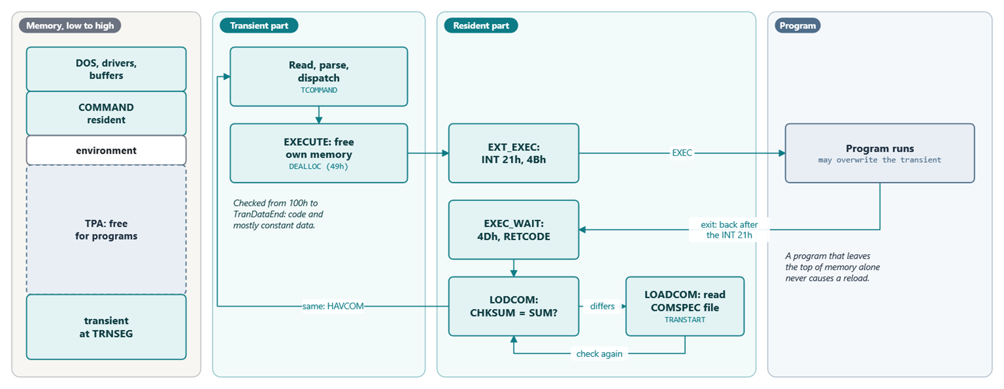
MODULE 3 · THE SHELL
Memory while COMMAND.COM waits, and the reload check
The transient sits at the top of memory, where a program may grow over it
MS-DOS 4.00 × FreeBSD 15.1 · Module 3 · F. V. Buccoli
6
Notes:
INIT computes TRNSEG as the end of the block minus the transient size, then moves the transient up and shrinks itself to the resident size. Before an external command runs, the transient frees its memory, so a large program receives the area where the transient lives. The resident part survives because it is allocated and owns the interrupt vectors. When the program ends, the resident reads the exit code with 4Dh and LODCOM compares CHKSUM with SUM; only if they differ does LOADCOM read the transient back from the COMSPEC file.

Slide 7
MODULE 3 · THE SHELL
Is the transient still there? CHKSUM
MS-DOS 4.00
COMMAND2.ASM lines 526-540
1
Sums words from 100h to TranDataEnd
CHKSUM: ; Compute transient checksum
PUSH DS
MOV DS,[TRNSEG]
MOV SI,100H
MOV CX,OFFSET TRANGROUP:TranDataEnd - 100H
CHECK_SUM:
CLD
SHR CX,1
XOR DX,DX
CHK:
LODSW
ADD DX,AX
ADC DX,0
LOOP CHK
2
ADC DX,0: ones' complement sum
3
Covers code and messages, not TRANSPACE variables
4
Compared with SUM saved by INIT
Source: microsoft/MS-DOS @ 2d04cac, v4.0/src/CMD/COMMAND/COMMAND2.ASM, lines 526-540
MS-DOS 4.00 × FreeBSD 15.1 · Module 3 · F. V. Buccoli
7
Notes:
After every external program LODCOM1 calls CHKSUM and compares the result with SUM. If they differ, LOADCOM reopens the COMSPEC file, seeks to TRANSTART and reads the transient back. Ask what happens if the floppy with COMMAND.COM has been removed: the shell prompts for it, or halts on a fixed disk.

Slide 8
MODULE 3 · THE SHELL
Resident/transient vs one process
MS-DOS 4.00
FreeBSD 15.1
Transient frees its memory before EXEC
Resident code issues INT 21h 4Bh
Checksum, then reload from COMSPEC
INT 2Eh: run a command in the top shell
sh stays mapped, sleeping in wait
Child created with fork or vfork, then execve
Text pages shared and paged on demand
system(3) forks and execs sh -c
MS-DOS 4.00 × FreeBSD 15.1 · Module 3 · F. V. Buccoli
8
Notes:
The kernel gives sh, transparently and for every program, what COMMAND.COM implements by hand for itself. Separate address spaces mean nothing can overwrite the sleeping shell. Writing to a running executable even fails with ETXTBSY in FreeBSD, where DOS can only detect a changed file after the fact.

Slide 9
02
The command loop
MS-DOS 4.00 × FreeBSD 15.1 · Module 3 · F. V. Buccoli
9

Slide 10
MODULE 3 · THE SHELL
COMTAB: the internal command table
MS-DOS 4.00
TDATA.ASM lines 280-314
1
Length byte, name, flag byte, handler offset
; Table for internal command names
COMTAB DB 3,"DIR",fSwitchAllowed+fCheckDrive
DW OFFSET TRANGROUP:CATALOG ; In TCMD1.ASM
DB 4,"CALL",fSwitchAllowed
DW OFFSET TRANGROUP:$CALL ; In TBATCH2.ASM
⋮ (lines omitted)
DB 2,"CD",fSwitchAllowed+fCheckDrive ;AC018; P3903
DW OFFSET TRANGROUP:$CHDIR ; In TENV.ASM
DB 5,"CHDIR",fSwitchAllowed+fCheckDrive ;AC018; P3903
DW OFFSET TRANGROUP:$CHDIR ; In TENV.ASM
2
fndcom scans it linearly
3
No match: search current dir and PATH
4
.COM beats .EXE beats .BAT
Source: microsoft/MS-DOS @ 2d04cac, v4.0/src/CMD/COMMAND/TDATA.ASM, lines 280-314
MS-DOS 4.00 × FreeBSD 15.1 · Module 3 · F. V. Buccoli
10
Notes:
The line is read with INT 21h function 0Ah, PRESCAN strips redirections, and fndcom scans this table. If nothing matches, path_search uses FIND FIRST and FIND NEXT in the current directory and each PATH element, every time, with no cache. Compare the table format with sh's generated builtincmd table on the next slides.

Slide 11
MODULE 3 · THE SHELL
sh: parse a command, then evaluate the tree
FreeBSD 15.1
main.c lines 207-222
1
parsecmd builds a node tree
n = parsecmd(inter);
/* showtree(n); DEBUG */
if (n == NEOF) {
if (!top || numeof >= 50)
break;
if (!stoppedjobs()) {
if (!Iflag)
break;
out2fmt_flush("\nUse \"exit\" to leave shell.\n");
}
numeof++;
} else if (n != NULL && nflag == 0) {
job_warning = (job_warning == 2) ? 1 : 0;
numeof = 0;
evaltree(n, 0);
}
2
evaltree walks it
3
Builtins run in the shell process
4
Externals: hashed PATH lookup, fork, execve
Source: freebsd/freebsd-src @ 96841ea, bin/sh/main.c, lines 207-222
MS-DOS 4.00 × FreeBSD 15.1 · Module 3 · F. V. Buccoli
11
Notes:
sh separates parsing from execution: parsecmd returns a tree of NCMD, NPIPE, NIF and other nodes, and evaltree dispatches on the node type. find_command caches PATH lookups in a 31-bucket hash table, and builtins come from a table generated from builtins.def with the same length-name layout as COMTAB. Only external commands cause a fork.

Slide 12
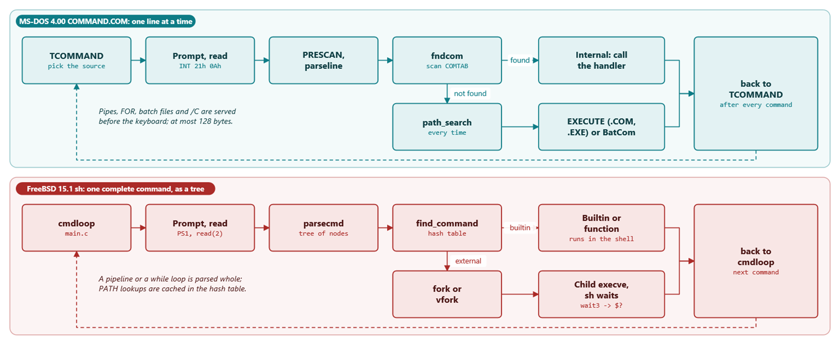
MODULE 3 · THE SHELL
Two command loops
Both shells try internal commands first; only sh parses a whole command first and caches PATH lookups
MS-DOS 4.00 × FreeBSD 15.1 · Module 3 · F. V. Buccoli
12
Notes:
Top lane: every command and every error ends at TCOMMAND, which first serves a pipe, FOR, batch file or /C and only then prompts; fndcom scans COMTAB linearly, and path_search searches PATH again for every external command. Bottom lane: sh parses a complete command into a tree first; find_command checks the hash table, builtins run in the shell, and only an external command costs a fork or vfork, after which the shell waits in wait3.

Slide 13
MODULE 3 · THE SHELL
The main loop side by side
 | MS-DOS 4.00 | FreeBSD 15.1
Read | INT 21h 0Ah, 128-byte line | read(2), BUFSIZ 1024
Parse | PRESCAN edits text in place | recursive descent, node tree
Internal lookup | linear scan of COMTAB | hash table, then builtincmd[]
External lookup | FIND FIRST per PATH entry, every time | stat along PATH once, cached
Run and wait | resident EXEC, then 4Dh | fork/vfork, execve, wait3
MS-DOS 4.00 × FreeBSD 15.1 · Module 3 · F. V. Buccoli
13
Notes:
Use this table as the recap of section 3.3. The most visible practical difference is caching: COMMAND.COM searches the disk for every external command, sh remembers. The structural difference is that sh has a real parser and a tree, which is what makes its control structures possible.

Slide 14
03
Redirection and pipes
MS-DOS 4.00 × FreeBSD 15.1 · Module 3 · F. V. Buccoli
14

Slide 15
MODULE 3 · THE SHELL
COMMAND.COM: "mega sleaze" redirection
MS-DOS 4.00
TMISC2.ASM lines 223-236
1
Open the file, get a new handle
MOV DX,OFFSET tranGROUP:RE_INSTR
MOV AX,(OPEN SHL 8)
MOV BX,AX
INT int_command
POP DS
JC REDIRERR
MOV BX,AX
MOV AL,0FFH
;
; Mega sleaze!! We move the SFN from the new handle spot into the old stdin
; spot. We invalidate the new JFN we got.
;
XCHG AL,[BX.PDB_JFN_Table]
MOV DS:[PDB_JFN_Table],AL
2
Move its SFT index into JFT slot 0
3
Invalidate the new slot (0FFh)
4
IO_SAVE holds the console; HEADFIX restores
Source: microsoft/MS-DOS @ 2d04cac, v4.0/src/CMD/COMMAND/TMISC2.ASM, lines 223-236
MS-DOS 4.00 × FreeBSD 15.1 · Module 3 · F. V. Buccoli
15
Notes:
COMMAND.COM does not use the DUP calls here; it edits the Job File Table in its own PSP directly. A child EXECed afterwards inherits a copy of that table, so its standard input is the file. HEADFIX later compares slots 0 and 1 with IO_SAVE, closes the files and writes the saved indexes back, and closes handles 5 to 19.

Slide 16
MODULE 3 · THE SHELL
sh: save, dup2, restore
FreeBSD 15.1
redir.c lines 136-151
1
Only builtins need REDIR_PUSH
if ((flags & REDIR_PUSH) && sv->renamed[fd] == EMPTY) {
INTOFF;
if ((i = fcntl(fd, F_DUPFD_CLOEXEC, 10)) == -1) {
switch (errno) {
case EBADF:
i = CLOSED;
break;
default:
INTON;
error("%d: %s", fd, strerror(errno));
break;
}
}
sv->renamed[fd] = i;
INTON;
}
2
F_DUPFD_CLOEXEC copies the old fd to 10+
3
openredirect then dup2s the file into place
4
popredir restores from the redirtab stack
Source: freebsd/freebsd-src @ 96841ea, bin/sh/redir.c, lines 136-151
MS-DOS 4.00 × FreeBSD 15.1 · Module 3 · F. V. Buccoli
16
Notes:
For an external command, sh applies redirections in the child after fork, so nothing needs undoing. Builtins run in the shell, so the old descriptor is first copied to a number of at least 10 with the close-on-exec flag. The saved descriptors form a stack so nested redirections unwind correctly.

Slide 17
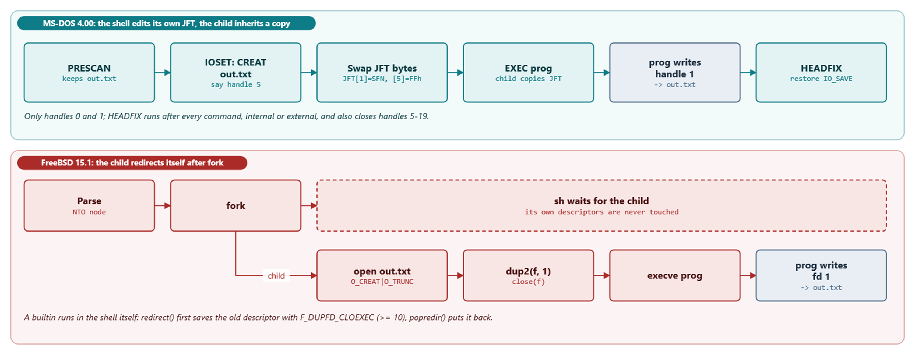
MODULE 3 · THE SHELL
prog > out.txt in both shells
COMMAND.COM changes its own JFT around the EXEC; sh redirects in the child, between fork and execve
MS-DOS 4.00 × FreeBSD 15.1 · Module 3 · F. V. Buccoli
17
Notes:
Top lane: the file is created as some free handle, say 5, and its SFT index is moved into JFT slot 1 of the shell's own PSP; the child inherits a copy at EXEC, and HEADFIX puts the console back from IO_SAVE afterwards. Bottom lane: the child opens the file and dup2s it onto 1 before execve, so the shell never has anything to undo.

Slide 18
MODULE 3 · THE SHELL
DOS pipes: two temporary files
MS-DOS 4.00
TPIPE.ASM lines 175-189
1
Root of the current drive, no TEMP variable
INC [PIPEFILES] ; Flag that the pipe files exist
MOV AH,Get_Default_Drive ; Get current drive
INT int_command
ADD AL,capital_A
MOV [PIPE2],AL ; Make pipe files in root of def drv
MOV BX,OFFSET RESGROUP:PIPE1
MOV [BX],AL
xor ah,ah ; nul terminate path names
mov [Pipe1T],ah
mov [Pipe2T],ah
MOV DX,BX
XOR CX,CX
mov ah,CreateTempFile ; the CreateTemp call
INT int_command
JC PIPEERR ; Couldn't create
2
INT 21h 5Ah creates a unique name
3
Stages run one after another
4
PIPEDEL unlinks both files at the end
Source: microsoft/MS-DOS @ 2d04cac, v4.0/src/CMD/COMMAND/TPIPE.ASM, lines 175-189
MS-DOS 4.00 × FreeBSD 15.1 · Module 3 · F. V. Buccoli
18
Notes:
PIPEPROCSTRT creates both files before the first stage runs. Each stage reads one file and writes the other, and the names are swapped after every stage, so two files serve any number of stages. The consequences are direct: sequential execution, the whole intermediate output on disk, and failure on a write-protected disk or a full root directory.

Slide 19
MODULE 3 · THE SHELL
sh pipes: concurrent children
FreeBSD 15.1
eval.c lines 585-600
1
One pipe(2) per |, one child per stage
if (forkshell(jp, lp->n, n->npipe.backgnd) == 0) {
INTON;
if (prevfd > 0) {
dup2(prevfd, 0);
close(prevfd);
}
if (pip[1] >= 0) {
if (!(prevfd >= 0 && pip[0] == 0))
close(pip[0]);
if (pip[1] != 1) {
dup2(pip[1], 1);
close(pip[1]);
}
}
evaltree(lp->n, EV_EXIT);
}
2
Child dup2s the pipe ends onto 0 and 1
3
Parent closes its copies, does not wait
4
waitforjob after all stages exist
Source: freebsd/freebsd-src @ 96841ea, bin/sh/eval.c, lines 585-600
MS-DOS 4.00 × FreeBSD 15.1 · Module 3 · F. V. Buccoli
19
Notes:
All stages run at the same time, connected by kernel pipes with a 16 KiB buffer that can grow to 64 KiB. A full buffer puts the writer to sleep and an empty one the reader, so the pipeline regulates itself. If the reader exits, the writer gets EPIPE and SIGPIPE, which is how yes | head terminates.

Slide 20
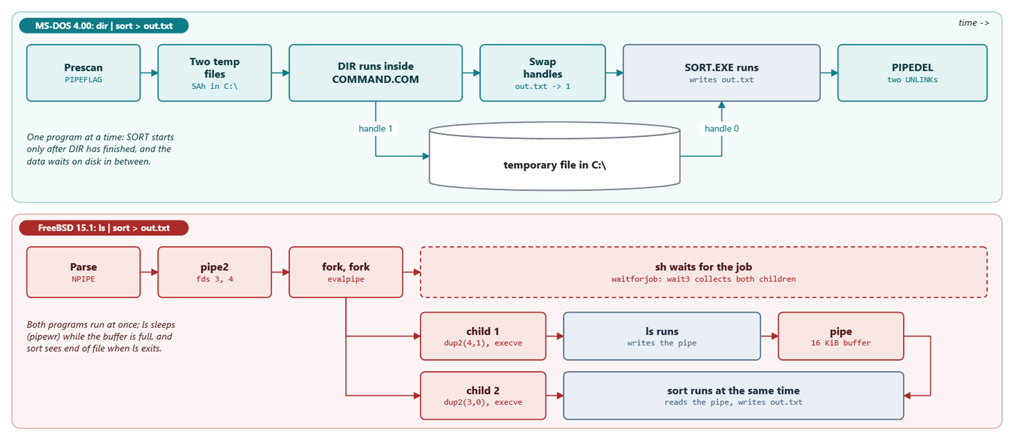
MODULE 3 · THE SHELL
dir | sort > out.txt as a timeline
Top: one stage after the other, data on disk. Bottom: two children at once, data in a kernel buffer
MS-DOS 4.00 × FreeBSD 15.1 · Module 3 · F. V. Buccoli
20
Notes:
Read the top lane left to right: COMMAND.COM creates two temporary files with 5Ah, runs DIR inside itself with handle 1 on one of them, swaps the handles, runs SORT.EXE with that file on handle 0 and out.txt on handle 1, and finally deletes both files. In the bottom lane sh calls pipe2, forks two children that dup2 the pipe ends and execve ls and sort, and waits for both; the two programs overlap in time.

Slide 21
MODULE 3 · THE SHELL
dir | sort > out.txt
 | MS-DOS 4.00 | FreeBSD 15.1
Intermediate data | two files in C:\ (5Ah) | kernel pipe buffer
Processes | one at a time; DIR inside COMMAND | two children, concurrent
Plumbing | JFT byte swaps in the shell's PSP | dup2 in each child
out.txt opened by | the shell, before SORT runs | the second child, before execve
Cleanup | PIPEDEL: two UNLINK calls | last close frees the pipe
MS-DOS 4.00 × FreeBSD 15.1 · Module 3 · F. V. Buccoli
21
Notes:
Walk through study case 3.A with this table on the screen. Emphasise that in DOS all the plumbing happens in the shell's own handle table, one stage at a time, while sh does it in each child. Ask which program suffers most from the DOS design: MORE, because it cannot show anything until the producer has finished.

Slide 22
MODULE 3 · THE SHELL
Numbers from the source
128
32
20
bytes in a COMMAND.COM command line (COMBUFLEN)
byte buffer for reading batch files (BatLen)
handles per DOS process (FilPerProc)
16 KiB
1024
initial FreeBSD pipe buffer (PIPE_SIZE)
bytes per sh input read (BUFSIZ)
MS-DOS 4.00 × FreeBSD 15.1 · Module 3 · F. V. Buccoli
22
Notes:
Every number here comes from an EQU or a #define in the pinned sources: COMEQU.ASM, PDB.INC, sys/pipe.h and stdio.h. They summarise the scale difference between the two systems. Ask students to find each definition as a quick exercise.

Slide 23
04
Scripts, environment, signals
MS-DOS 4.00 × FreeBSD 15.1 · Module 3 · F. V. Buccoli
23

Slide 24
MODULE 3 · THE SHELL
Batch files: reopen and seek for every line
MS-DOS 4.00
TBATCH2.ASM lines 720-735
1
Batch file reopened by name each line
MOV DX,BatFile
MOV AX,OPEN SHL 8
INT int_command ; Open the batch file
JC SETERRDL
MOV DX,WORD PTR DS:[BatSeek]
MOV CX,WORD PTR DS:[BatSeek+2]
POP DS
ASSUME DS:RESGROUP
MOV [BATHAND],AX
MOV BX,AX
MOV AX,LSEEK SHL 8 ; Go to the right spot
INT int_command
MOV BatBufPos,-1 ; nuke batch buffer position
return
2
Seek to BatSeek, a byte offset
3
Closed again after the line
4
Edits change what runs next
Source: microsoft/MS-DOS @ 2d04cac, v4.0/src/CMD/COMMAND/TBATCH2.ASM, lines 720-735
MS-DOS 4.00 × FreeBSD 15.1 · Module 3 · F. V. Buccoli
24
Notes:
ReadBat calls BatOpen for every line, reads through a 32-byte buffer while counting consumed bytes in BatSeek, and closes the file at the end of the line. Editing a running batch file therefore changes the next line read, at the old byte offset. GOTO rewinds BatSeek to 0 and rescans the whole file for the label each time.

Slide 25
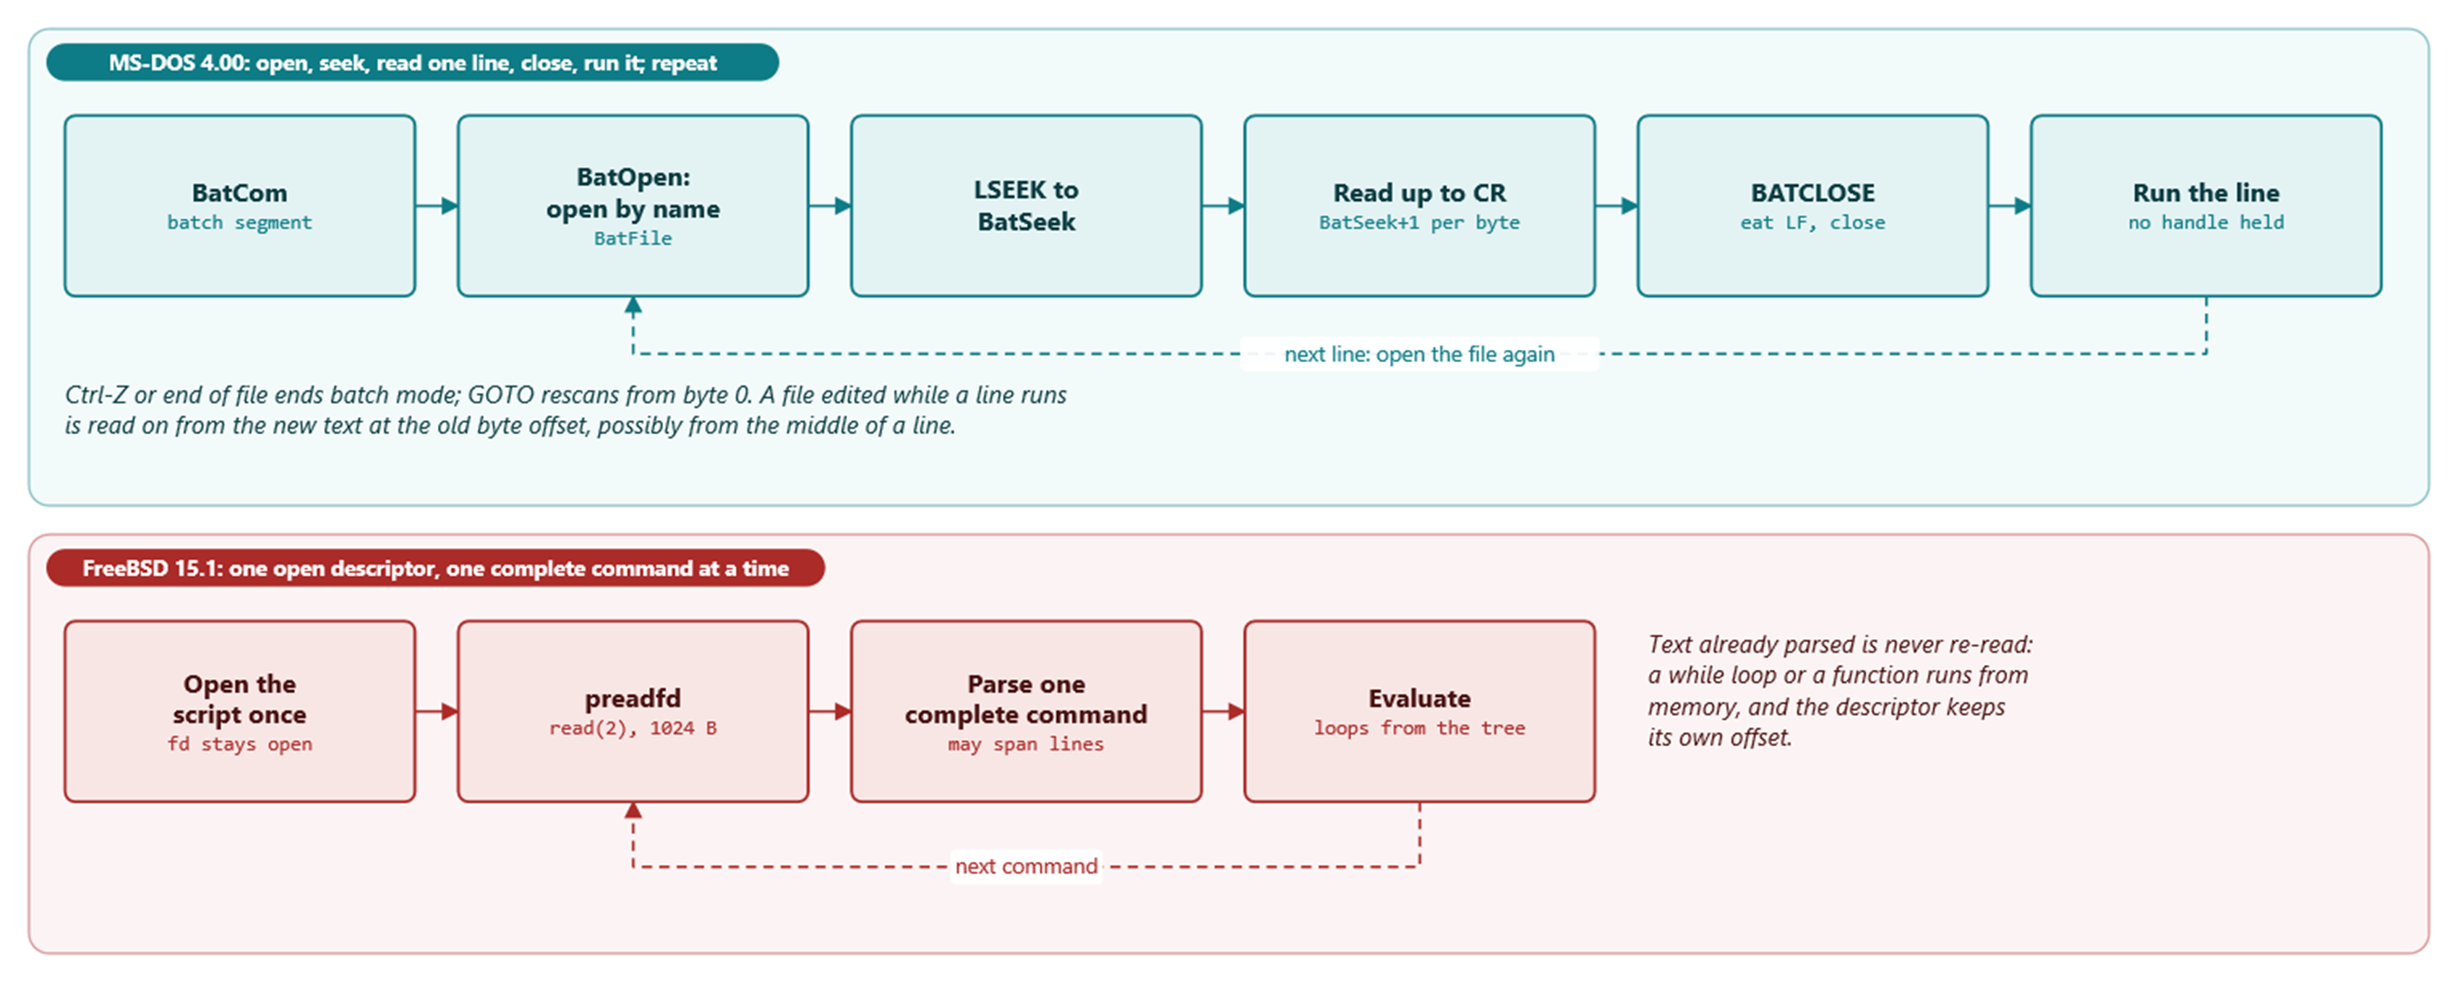
MODULE 3 · THE SHELL
One line at a time versus one command at a time
COMMAND.COM keeps only a byte offset between lines; sh keeps an open descriptor and a parse tree
MS-DOS 4.00 × FreeBSD 15.1 · Module 3 · F. V. Buccoli
25
Notes:
The dashed arrow in the top lane is the key: before every line COMMAND.COM opens the file again by name and seeks to BatSeek, and no handle is held while the line runs. Exercise 3.3 edits a running batch file to show the consequence. sh reads 1024-byte blocks through one descriptor and parses a complete command, so a while loop or a function is read once and runs from memory.

Slide 26
MODULE 3 · THE SHELL
Batch file vs sh script
MS-DOS 4.00
FreeBSD 15.1
Interpreted line by line from the file
%0-%9, SHIFT, %NAME% from the environment
GOTO scans from byte 0; one-level FOR
IF ERRORLEVEL n means exit code >= n
CALL keeps the caller's batch segment
Parsed into trees, one command at a time
One open descriptor, 1024-byte reads
while/for/case run from memory
Functions, local variables, arithmetic
Here-documents through a pipe
MS-DOS 4.00 × FreeBSD 15.1 · Module 3 · F. V. Buccoli
26
Notes:
The key contrast is the unit of interpretation: a line read from the file each time versus a complete command parsed into a tree. This explains both the cost of loops and the effect of editing a running file. Point out that CALL exists in MS-DOS 4.00 and was added in 3.30 according to the revision log.

Slide 27
MODULE 3 · THE SHELL
The environment
MS-DOS 4.00
FreeBSD 15.1
Block of NAME=value strings, segment at PSP:2Ch
SET edits the shell's own block in place
Grows with SETBLOCK up to 32 KB, or fails
EXEC copies the block for the child
SET must be internal
Variables in a hash table in the shell
Exported ones flagged VEXPORT
environment() builds envp per execve
VAR=x cmd exports only to the child
execve copies strings into the new image
MS-DOS 4.00 × FreeBSD 15.1 · Module 3 · F. V. Buccoli
27
Notes:
Both systems give the child a copy, so a child can never change its parent's environment; that is why SET and export are internal. In DOS the copy is sized exactly, which is why 'Out of environment space' was a familiar message and why /E exists. In sh the environment array is rebuilt from the exported variables for every exec.

Slide 28
MODULE 3 · THE SHELL
Ctrl-C and job control
MS-DOS 4.00
FreeBSD 15.1
DOS calls INT 23h during console I/O
CONTC asks 'Terminate batch job (Y/N)?'
STC; RET tells DOS to abort the program
One foreground program, no suspend
Terminal sends SIGINT to the foreground group
One process group per job (setpgid)
tcsetpgrp hands the terminal to the job
Ctrl-Z, fg, bg, jobs; SIGCONT to the group
MS-DOS 4.00 × FreeBSD 15.1 · Module 3 · F. V. Buccoli
28
Notes:
In DOS the Ctrl-C handler is code in the resident shell, called in the context of whatever program is running. In FreeBSD the terminal driver delivers a signal to a process group, and the shell protects itself by living in a different group. Demonstrate Ctrl-Z, jobs, bg and fg in the FreeBSD VM.

Slide 29
MODULE 3 · THE SHELL
Why cd must be a builtin in FreeBSD
FreeBSD 15.1
filedesc.h lines 94-108
1
cwd lives in the process's struct pwd
struct pwd {
u_int pwd_refcount;
struct vnode *pwd_cdir; /* current directory */
struct vnode *pwd_rdir; /* root directory */
struct vnode *pwd_jdir; /* jail root directory */
struct vnode *pwd_adir; /* abi root directory */
};
typedef SMR_POINTER(struct pwd *) smrpwd_t;
struct pwddesc {
struct mtx pd_lock; /* protects members of this struct */
smrpwd_t pd_pwd; /* directories */
u_int pd_refcount;
u_short pd_cmask; /* mask for file creation */
};
2
fork copies it; chdir changes only the caller
3
/usr/bin/cd runs the builtin in a new shell: no effect
4
DOS keeps cwd globally in the CDS: external CD would work
Source: freebsd/freebsd-src @ 96841ea, sys/sys/filedesc.h, lines 94-108
MS-DOS 4.00 × FreeBSD 15.1 · Module 3 · F. V. Buccoli
29
Notes:
This is study case 3.D. The PSP in DOS has no current-directory field, and $CHDIR updates the system-wide CDS, so any program can change the directory for everyone. In FreeBSD the directory is per process, so only code running in the shell can change the shell's directory. In DOS the command that must be internal is SET, because the environment is per process.

Slide 30
MODULE 3 · THE SHELL
Homework
1
3.1 Exit codes, IF ERRORLEVEL, size of the transient
2
3.2-3.3 Watch pipe files; edit a running batch file
3
3.4 nasm .COM program printing its PSP
4
3.5 Add a builtin to FreeBSD sh and trace it
5
3.6 yes | head vs temporary files; 3.7 essay
MS-DOS 4.00 × FreeBSD 15.1 · Module 3 · F. V. Buccoli
30
Notes:
Exercises 3.2 to 3.4 need the MS-DOS lab images from Module 0, and 3.5 and 3.6 need the FreeBSD VM with /usr/src. Encourage students to predict results from the source before running anything. Every answer must cite pinned permalinks.

Slide 31
MODULE 3 · THE SHELL
Key takeaways
1
Memory limits shaped COMMAND.COM: resident part, transient, checksum
2
One program at a time forced temporary-file pipes
3
Batch files run line by line; sh scripts run from parse trees
4
Redirection: JFT byte swaps vs dup2 in the child
5
Builtins exist where the kernel keeps per-process state
MS-DOS 4.00 × FreeBSD 15.1 · Module 3 · F. V. Buccoli
31
Notes:
Close by connecting each design back to its cause. Most of COMMAND.COM's peculiarities follow from small memory and a single-tasking kernel, while sh relies on processes, pipes and paging. The cd question shows that 'must be built in' is decided by where the kernel keeps state, not by habit.

