Slide 1
OPERATING SYSTEMS · MODULE 5
From C to a running program
Compilers, linkers, executables and libraries: MS-DOS 4.00 vs FreeBSD 15.1
MS-DOS 4.00
FreeBSD 15.1
Francesco Valerio Buccoli · francesco@buccoli.com
Sources: microsoft/MS-DOS @ 2d04cac · freebsd/freebsd-src @ release/15.1.0

Slide 2
01
From source text to a process
Preprocess, compile, assemble, link, load: on both systems
MS-DOS 4.00 × FreeBSD 15.1 · Module 5 · F. V. Buccoli
2

Slide 3
MODULE 5 · FROM C TO A RUNNING PROGRAM
Five stages, five kinds of file
1
Preprocess: #include and #define expanded, comments gone (CL /P, cc -E)
2
Compile: C to instructions for one CPU and one calling convention
3
Assemble: bytes + names defined + names needed + relocations = object file
4
Link: combine objects and library members, fix addresses, write the executable
5
Load: copy or map it, finish relocation, jump to the entry point
6
FreeBSD adds a sixth step: the run-time linker attaches shared libraries
MS-DOS 4.00 × FreeBSD 15.1 · Module 5 · F. V. Buccoli
3
Notes:
Define the vocabulary first: translation unit, object file, relocation (Microsoft says fixup), executable, library, loader. Every later slide is one of these stages seen in a real file. Stress that both systems were built with exactly these tools: MS C 5.10 and LINK 3.65 are in v4.0/src/TOOLS, and every FreeBSD 15.1 binary names clang 19.1.7 and LLD 19.1.7 in its .comment section.

Slide 4
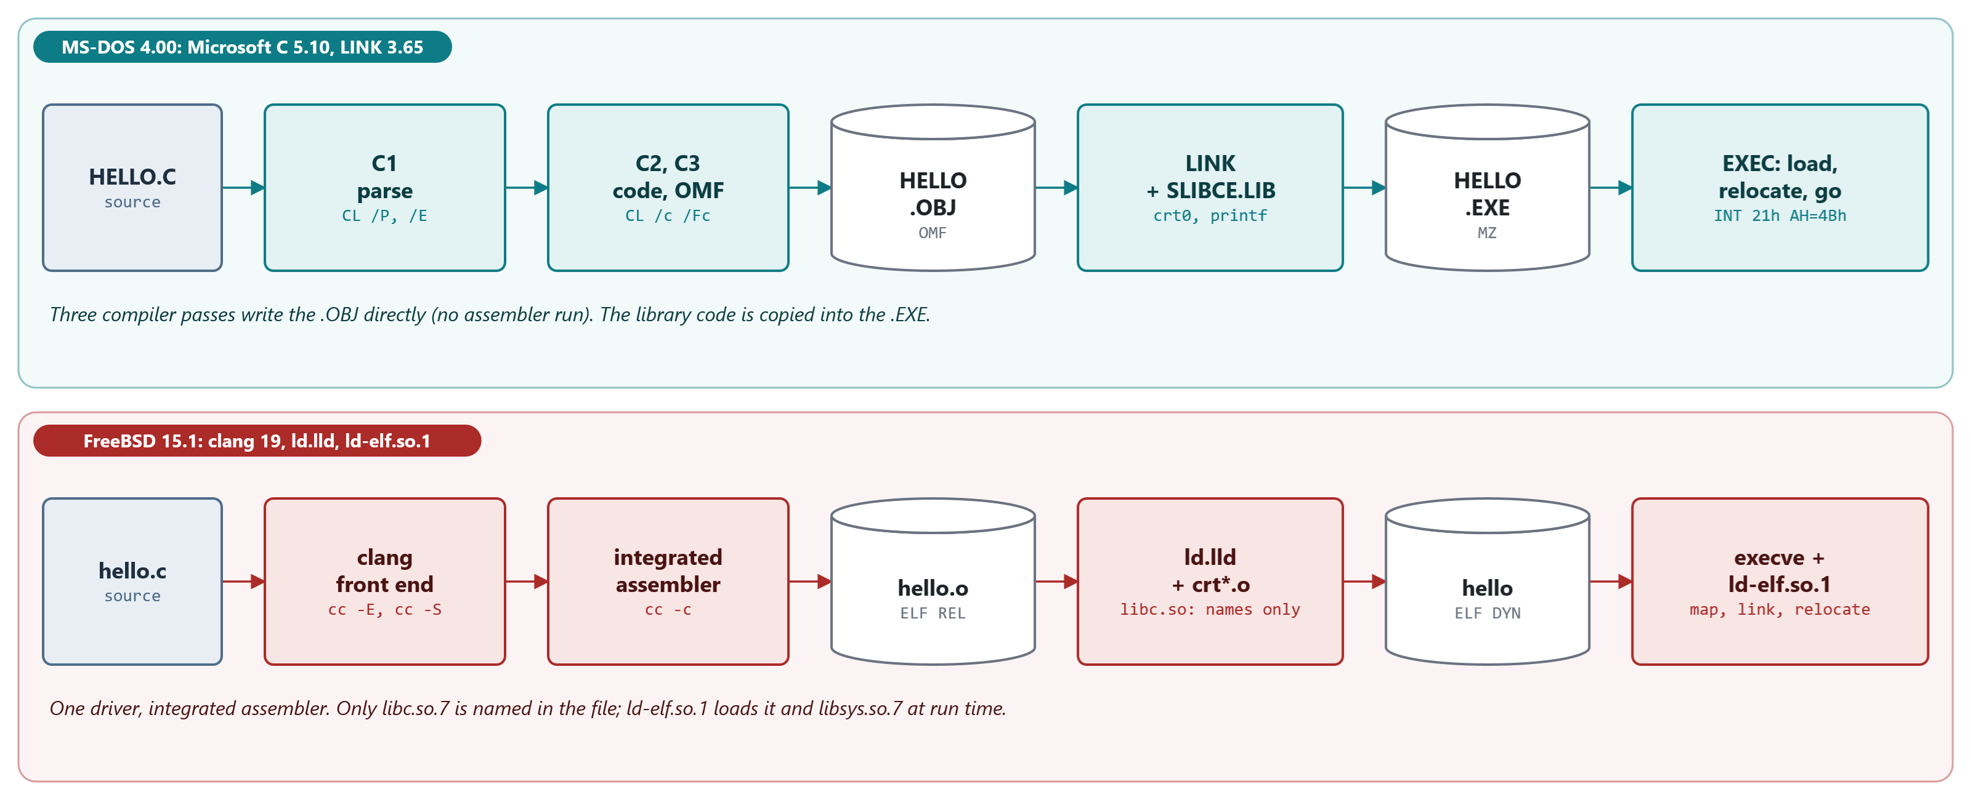
MODULE 5 · FROM C TO A RUNNING PROGRAM
The pipeline on both systems
MS C 5.10 writes OMF directly from pass 3; clang has an integrated assembler. Only FreeBSD links at run time.
MS-DOS 4.00 × FreeBSD 15.1 · Module 5 · F. V. Buccoli
4
Notes:
Walk left to right on both lanes. The striking point on MS-DOS is that there is no assembler run: C3 writes the object file. On FreeBSD the program file only names libc.so.7; the run-time linker brings in libc and libsys when the program starts.

Slide 5
MODULE 5 · FROM C TO A RUNNING PROGRAM
How MS-DOS 4.00 compiles its own C programs
MS-DOS 4.00
TOOLS.INI lines 35-55
1
-AS: small memory model
cc =cl
cflags =-AS -Os -Zp $(extcsw)
cinc =-I. -I$(hinc)
⋮ (lines omitted)
.c.obj:
$(cc) -c $(cflags) $(cinc) -Fo$*.obj $*.c
2
-Os: optimize for size
3
-Zp: packed structures
4
FDISK, MEM, ATTRIB, REPLACE ... are C
Source: microsoft/MS-DOS @ 2d04cac, v4.0/src/TOOLS/TOOLS.INI, lines 35-55
MS-DOS 4.00 × FreeBSD 15.1 · Module 5 · F. V. Buccoli
5
Notes:
The build counted bytes. Small model, size optimization, packed structs. The kernel, IO.SYS and COMMAND.COM are assembly; about a dozen utilities are C. MEM.EXE has the same C run-time segments as the students' HELLO.EXE.

Slide 6
MODULE 5 · FROM C TO A RUNNING PROGRAM
Lab 5.1: CL runs three passes (CL /Bd)
CL /Bd /c HELLO.C
P1 : ` T:\c1.exe -il 014595 -f HELLO.C ... -A snd -Ze -DM_I86 -DMSDOS
-DM_I86SM -DM_I8086 -I T:/BLD/INC -W 1 '
P2 : ` T:\c2.exe -il 014595 -ef T:\c23.err -Oc -Ot -G0 -A snd -W 1 '
P3 : ` T:\c3.exe -il 014595 ... -FPi -Ot -c HELLO.OBJ -A snd -CC 0sO '
C1: preprocess + parse C2: optimize, generate code C3: write OMF
No MASM pass. /B1 T:\C1L.EXE swaps pass 1: same object, byte for byte.
MS-DOS 4.00 × FreeBSD 15.1 · Module 5 · F. V. Buccoli
6
Notes:
Real output, abridged. /Bd is not in CL.HLP; we found it in the strings of CL.EXE. It plays the role of cc -### on FreeBSD. In the lab, students run CL /P, CL /c /Fc and LINK /MAP and read every intermediate file: HELLO.I, HELLO.COD, HELLO.OBJ, HELLO.MAP, then run HELLO.EXE on MS-DOS 4.00.

Slide 7
MODULE 5 · FROM C TO A RUNNING PROGRAM
One line of C, two compilers: abs()
MS-DOS 4.00: MS C 5.10 /Ox
FreeBSD 15.1: clang 19 -O2
Argument on the stack: [bp+4]
cmp, jge, neg: two return paths
No conditional move on the 8086
/Ox drops the __chkstk call
_myabs: names get an underscore
Argument in a register: %edi
mov, neg, cmovs: no branch
Result in %eax, 7 instructions
Real code from /lib/libc.so.7
abs: no underscore
MS-DOS 4.00 × FreeBSD 15.1 · Module 5 · F. V. Buccoli
7
Notes:
Outputs 5.7 and 5.8. The source is the same line, return(j < 0 ? -j : j). The differences are the calling convention (stack versus registers), the instruction set (cmovs exists only from the Pentium Pro), and the optimizer. Ask the class to count bytes: 21 for MS C, 13 for clang.

Slide 8
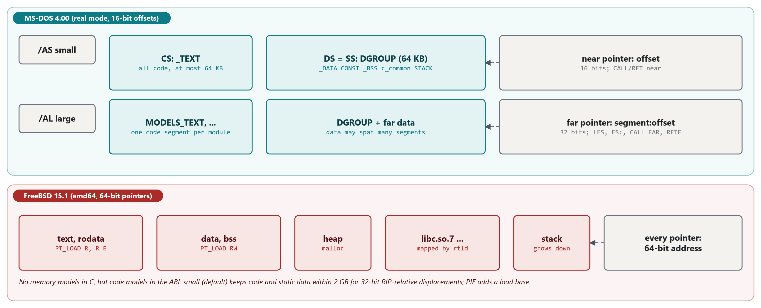
MODULE 5 · FROM C TO A RUNNING PROGRAM
Memory models: near and far
A near pointer is a 16-bit offset; a far pointer is segment:offset. 64-bit FreeBSD has only code models.
MS-DOS 4.00 × FreeBSD 15.1 · Module 5 · F. V. Buccoli
8
Notes:
The 8086 reaches 64 KB per segment register. Memory models decide which pointers and calls are near. DS = SS = DGROUP in every model, which is why a near pointer can point at globals and at locals. On amd64 the small code model keeps code and static data within 2 GB so that RIP-relative 32-bit displacements work.

Slide 9
MODULE 5 · FROM C TO A RUNNING PROGRAM
Lab 5.2: the same function, /AS and /AL
/AS small /AL large
_sum PROC NEAR _sum PROC FAR
mov si,[bp+4] 8b 76 04 les si,[bp+6] c4 76 06
mov ax,[bx][si] 8b 00 mov ax,es:[bx][si] 26 8b 00
ret c3 retf cb
call _sum e8 ba ff push ds / push cs / call _sum
call _printf e8 00 00 call FAR PTR _printf 9a 00 00 00 00
MODS.EXE 7,301 bytes, 4 relocations MODL.EXE 10,033 bytes, 70 relocations
MS-DOS 4.00 × FreeBSD 15.1 · Module 5 · F. V. Buccoli
9
Notes:
Real .COD output, condensed (Output 5.10). Arguments move up by 2 because the return address is 4 bytes. Every far call holds a segment value, so every far call becomes a relocation in the .EXE: 3 in the user module, 55 in the library code, 12 in library data. push cs plus a near call fakes a far call to a function in the same segment.

Slide 10
02
Object files, linking and start-up
OMF records and ELF sections; crt0 and crt1
MS-DOS 4.00 × FreeBSD 15.1 · Module 5 · F. V. Buccoli
10

Slide 11
MODULE 5 · FROM C TO A RUNNING PROGRAM
What an object file must say
Information | OMF (.OBJ) | ELF (.o)
Pieces | SEGDEF, GRPDEF | section headers
Bytes | LEDATA | section contents
Names defined | PUBDEF | .symtab, defined
Names needed | EXTDEF, COMDEF | .symtab, UND
Relocations | FIXUPP: target + frame | .rela.*: symbol, type, addend
Linker hints | COMENT: default library, DOSSEG | notes; -lc on the command line
MS-DOS 4.00 × FreeBSD 15.1 · Module 5 · F. V. Buccoli
11
Notes:
The same six kinds of information in two encodings. OMF is a stream of records with names numbered by order of appearance; ELF is a set of tables. The frame in an OMF fixup has no ELF counterpart: it exists because 8086 addresses are relative to a segment register.

Slide 12
MODULE 5 · FROM C TO A RUNNING PROGRAM
Lab 5.3: reading HELLO.OBJ with omfdump.py
1
COMENT 9Fh 'SLIBCE': the library name travels inside the object
2
EXTDEF __acrtused, _printf; COMDEF _table (200 bytes); PUBDEF _main
3
Fixup +017h: target _DATA, frame DGROUP: LINK stores 42h, not 0
4
call _square needs no fixup; call _printf does
5
CL /Zl removes the library comment: LINK fails with L2029
MS-DOS 4.00 × FreeBSD 15.1 · Module 5 · F. V. Buccoli
12
Notes:
Run omfdump live and match each fixup offset with an instruction in HELLO.COD. The frame/target distinction is the hard part: draw DGROUP, _DATA and _counter on a line. Then dump SLIBCE.LIB --member "dos\crt0.asm" to show where __acrtused (absolute 9876h), the STACK segment and the start address come from.

Slide 13
MODULE 5 · FROM C TO A RUNNING PROGRAM
FreeBSD's entry point: _start
FreeBSD 15.1
crt1_s.S lines 41-80
1
argc, argv, env from the initial stack
_start:
⋮ (lines omitted)
pushq %rbp /* Align stack, terminate call chain. */
⋮ (lines omitted)
movq %rsp, %rbp
⋮ (lines omitted)
movq %rsi, %rcx /* cleanup */
movslq (%rdi), %rax /* long *ap; tmpargc = *ap */
leaq 0x8(%rdi), %rsi /* argv = ap + 1 */
leaq 0x10(%rdi, %rax, 8), %rdx /* env = ap + 2 + tmpargc */
movl %eax, %edi /* argc = tmpargc */
⋮ (lines omitted)
/* __libc_start1(argc, argv, env, cleanup, main) */
callq __libc_start1
2
cleanup: from the run-time linker
3
(omitted lines) main's address into %r8
4
__libc_start1 calls main, then exit
Source: freebsd/freebsd-src @ 96841ea, lib/csu/amd64/crt1_s.S, lines 41-80
MS-DOS 4.00 × FreeBSD 15.1 · Module 5 · F. V. Buccoli
13
Notes:
crt1.o is FreeBSD's crt0. The kernel or the run-time linker leaves argc, argv, NULL, envp, NULL on the stack; _start turns that into C arguments. __libc_start1 in libc registers cleanup with atexit, runs static initializers in static programs, sets errno to 0 and calls exit(main(...)).

Slide 14
MODULE 5 · FROM C TO A RUNNING PROGRAM
Before main: crt0 and crt1
MS-DOS 4.00: __astart (crt0)
FreeBSD 15.1: _start (crt1.o)
INT 21h AH=30h: refuse DOS 1.x
SS = DS = DGROUP, set SP
AH=4Ah: give back unused memory
Clear BSS with REP STOSB
Build argv, environ; call _main
exit: flush, __nullcheck, AH=4Ch
Kernel built the stack and auxv
Run-time linker ran the initializers
Kernel zero-fills BSS pages
__libc_start1: environ, __progname
errno = 0; exit(main(...))
atexit(cleanup) from ld-elf.so.1
MS-DOS 4.00 × FreeBSD 15.1 · Module 5 · F. V. Buccoli
14
Notes:
The jobs that crt0 must do itself (switch stack, shrink the memory block, clear BSS) are done by the kernel on FreeBSD. __nullcheck is a fun detail: it XORs the 42h bytes at DS:0 and prints R6001 null pointer assignment, changing exit code 0 to 255.

Slide 15
03
Executable files and libraries
.COM, MZ, ELF; static and shared libraries
MS-DOS 4.00 × FreeBSD 15.1 · Module 5 · F. V. Buccoli
15

Slide 16
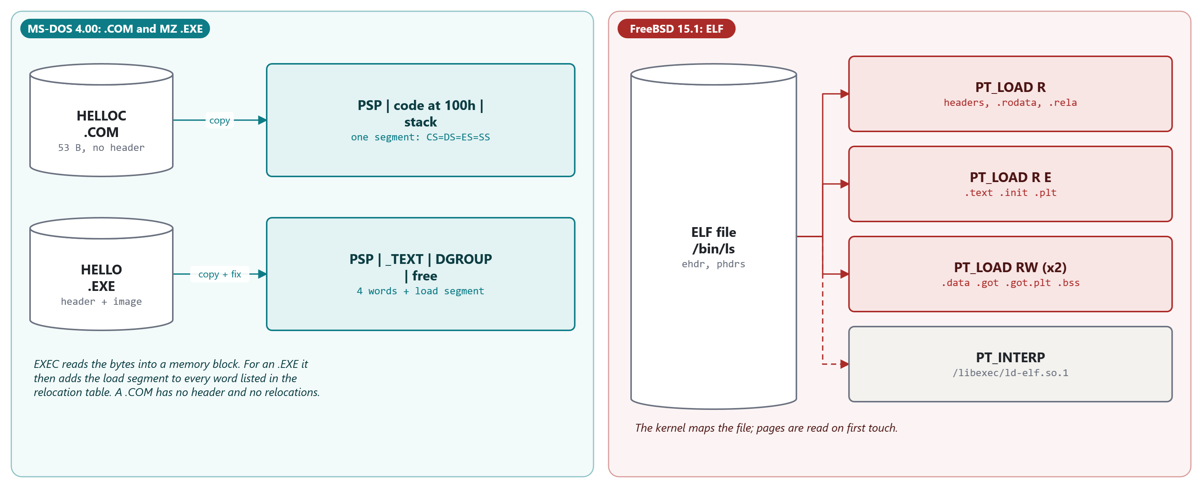
MODULE 5 · FROM C TO A RUNNING PROGRAM
Three executable formats
.COM: a memory image. MZ: header, relocation table, image. ELF: program headers the kernel maps.
MS-DOS 4.00 × FreeBSD 15.1 · Module 5 · F. V. Buccoli
16
Notes:
EXEC decides .COM or .EXE by the first two bytes, not by the name. ELF segments are what the kernel maps; sections are for linkers and debuggers. FileSiz smaller than MemSiz in the last LOAD is BSS, the counterpart of e_minalloc (in ls's third LOAD the excess is only .relro_padding).

Slide 17
MODULE 5 · FROM C TO A RUNNING PROGRAM
The MZ header in EXE.INC
MS-DOS 4.00
EXE.INC lines 52-68
1
MZ: Mark Zbikowski ('zibo')
EXE_file STRUC
exe_signature DW ? ; must contain 4D5A (yay zibo!)
exe_len_mod_512 DW ? ; low 9 bits of length
exe_pages DW ? ; number of 512b pages in file
exe_rle_count DW ? ; count of reloc entries
exe_par_dir DW ? ; number of paragraphs before image
exe_min_BSS DW ? ; minimum number of para of BSS
exe_max_BSS DW ? ; max number of para of BSS
exe_SS DW ? ; stack of image
exe_SP DW ? ; SP of image
exe_chksum DW ? ; checksum of file (ignored)
exe_IP DW ? ; IP of entry
exe_CS DW ? ; CS of entry
exe_rle_table DW ? ; byte offset of reloc table
exe_iov DW ? ; overlay number (0 for root)
exe_sym_tab DD ? ; offset of symbol table in file
EXE_file ENDS
2
Size in 512-byte pages
3
Relocation table: count, offset
4
SS:SP and CS:IP relative to the image
Source: microsoft/MS-DOS @ 2d04cac, v4.0/src/INC/EXE.INC, lines 52-68
MS-DOS 4.00 × FreeBSD 15.1 · Module 5 · F. V. Buccoli
17
Notes:
Every field can be checked against HELLO.MAP: CS:IP = 0000:0040 is __astart, SS:SP = 0216:0800 is the end of STACK. e_minalloc is the BSS and stack that are not in the file; e_maxalloc = FFFFh asks for all memory, which is why crt0 gives memory back.

Slide 18
MODULE 5 · FROM C TO A RUNNING PROGRAM
EXEC relocates an .EXE
MS-DOS 4.00
EXEC.ASM lines 515-529
1
SI = load segment
MOV SI,exec_rel_fac
exec_reloc_one:
OR DX,DX ; Any more entries?
JE exec_set_PDBJ
exec_get_addr:
LDS BX,DWORD PTR ES:[DI] ; Get ra/sa of entry
MOV AX,DS ; Relocate address of item
ADD AX,SI
MOV DS,AX
ADD [BX],SI
ADD DI,4
DEC DX
LOOP exec_reloc_one ; End of internal buffer?
2
Entry: seg:off of a word
3
ADD [BX],SI: the whole relocation
4
No names, no types: one kind
Source: microsoft/MS-DOS @ 2d04cac, v4.0/src/DOS/EXEC.ASM, lines 515-529
MS-DOS 4.00 × FreeBSD 15.1 · Module 5 · F. V. Buccoli
18
Notes:
This is the entire relocation step of MS-DOS: add the load segment to every listed word. In SEGS.EXE the 4 words hold 0173h, DGROUP's paragraph; on our DOS they became 1387h (load segment 1214h). Offsets never change. The EXEPACK unpacker and CONVERT's stub contain copies of this loop.

Slide 19
MODULE 5 · FROM C TO A RUNNING PROGRAM
Lab 5.4: numbers from the real MS-DOS 4.00
65,279
53
8
11
bytes: largest .COM that MS-DOS 4.00 EXEC runs
bytes: HELLOC.COM made by EXE2BIN from an 821-byte .EXE
MS-DOS 4.00 .COM files that are .EXEs wrapped by CONVERT
bytes SORT.EXE is shorter than its header says
MS-DOS 4.00 × FreeBSD 15.1 · Module 5 · F. V. Buccoli
19
Notes:
All measured in the lab. 65,280 bytes gives Program too big to fit in memory: EXEC asks for FF00h bytes and treats a full read as no memory (EXEC.ASM lines 597-598). EXE2BIN refuses SEGREF (one fixup) and HELLO.EXE (a stack segment). BACKUP.COM starts with a JMP, the word Converted and a complete MZ header.

Slide 20
MODULE 5 · FROM C TO A RUNNING PROGRAM
Lab 5.5: a static library with LIB
1
LIB MYLIB +ADDUP +TIMES; builds a 2-member library
2
LINK /MAP USELIB,,,MYLIB; pulls ADDUP only: _times is not in the map
3
Without the library: L2029 Unresolved externals: _addup
4
Two objects defining _addup: L2025 symbol defined more than once
5
Same rules for ar and .a files on FreeBSD
MS-DOS 4.00 × FreeBSD 15.1 · Module 5 · F. V. Buccoli
20
Notes:
Members are linked whole, only when they define a name that is still undefined; object files named on the command line are always linked. That is why the C library has one function per module: printf.c is 60 bytes and calls __output, which is 2,267 bytes.

Slide 21
MODULE 5 · FROM C TO A RUNNING PROGRAM
Lab 5.6: an ELF object (nasm -f elf64 bump.asm)
readelf -r bump.o
Offset Type Symbol + Addend
0x02 R_X86_64_PC32 counter - 4 mov 0x0(%rip),%eax
0x08 R_X86_64_PC32 .data - 4 add 0x0(%rip),%eax
0x0e R_X86_64_PC32 counter - 4 mov %eax,0x0(%rip)
0x15 R_X86_64_PLT32 report - 4 jmp report
PC32: S + A - P. A = -4: the CPU adds to the next instruction's address.
crt1.o: R_X86_64_64 main (movabs), R_X86_64_PLT32 __libc_start1
MS-DOS 4.00 × FreeBSD 15.1 · Module 5 · F. V. Buccoli
21
Notes:
Real output, condensed. Even a reference to a variable in the same file (step in .data) needs a relocation, because .data has no address yet. Compare with the OMF self-relative fixup: same arithmetic. Ask students to compute the bytes for a given S and P.

Slide 22
MODULE 5 · FROM C TO A RUNNING PROGRAM
Lab 5.7: FreeBSD 15.1 binaries, read with readelf
File | Type | INTERP | NEEDED / SONAME
/bin/ls | DYN (PIE) | /libexec/ld-elf.so.1 | libutil.so.10, libtinfow.so.9, libc.so.7
/sbin/init | EXEC (static) | none | none (NO_SHARED)
/lib/libc.so.7 | DYN | none | NEEDED and AUXILIARY libsys.so.7
/lib/libsys.so.7 | DYN | none | SONAME libsys.so.7, no NEEDED
/libexec/ld-elf.so.1 | DYN | none | none: relocates itself (291 RELATIVE)
MS-DOS 4.00 × FreeBSD 15.1 · Module 5 · F. V. Buccoli
22
Notes:
Real static facts from base.txz, confirmed in the course VM. 189 of the 191 ELF programs in /bin and /sbin are PIEs; init is static so that the first process does not depend on shared libraries, and /sbin/nologin is a symlink to a static /usr/sbin/nologin. In the VM, readelf, objdump and nm are the LLVM tools: same facts, slightly different layout. libsys.so.7 is new in FreeBSD 15: the system call stubs moved there; libc's write calls __sys_write through an interposing table.

Slide 23
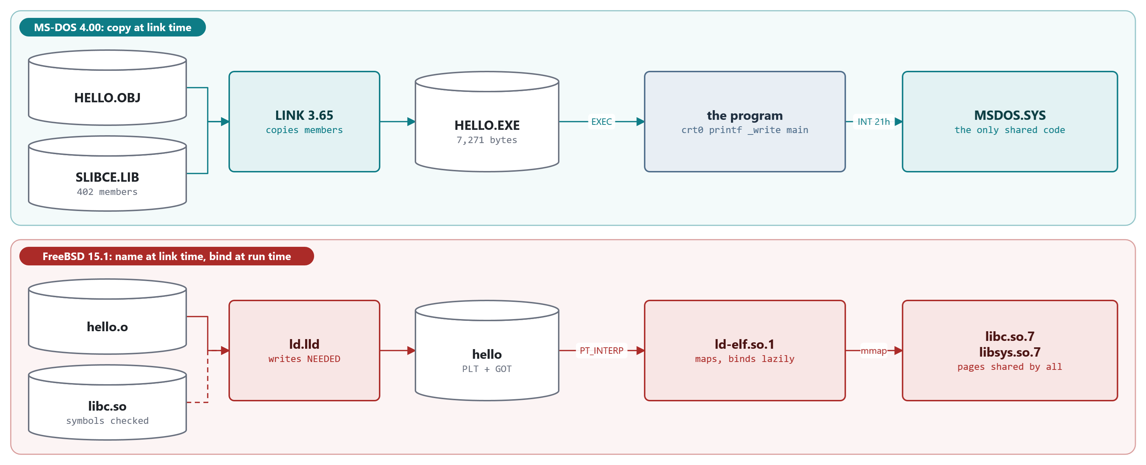
MODULE 5 · FROM C TO A RUNNING PROGRAM
Static and dynamic linking
MS-DOS copies library code into every .EXE; FreeBSD records NEEDED and binds at run time.
MS-DOS 4.00 × FreeBSD 15.1 · Module 5 · F. V. Buccoli
23
Notes:
On MS-DOS the only shared code is the OS itself, reached by INT 21h. On FreeBSD a few hundred programs share one libc.so.7, on disk and in memory, because code pages are mapped from the same file and never written.

Slide 24
MODULE 5 · FROM C TO A RUNNING PROGRAM
Lazy binding: the first call
FreeBSD 15.1
rtld.c lines 1056-1104
1
PLT -> GOT slot -> back into the PLT
Elf_Addr
_rtld_bind(Obj_Entry *obj, Elf_Size reloff)
{
⋮ (lines omitted)
where = (Elf_Addr *)(obj->relocbase + rel->r_offset);
def = find_symdef(ELF_R_SYM(rel->r_info), obj, &defobj, SYMLOOK_IN_PLT,
NULL, &lockstate);
if (def == NULL)
rtld_die();
⋮ (lines omitted)
target = reloc_jmpslot(where, target, defobj, obj, rel);
lock_release(rtld_bind_lock, &lockstate);
return (target);
}
2
PLT0 jumps to _rtld_bind_start
3
Look the symbol up by name
4
Store it in the GOT slot: later calls go direct
Source: freebsd/freebsd-src @ 96841ea, libexec/rtld-elf/rtld.c, lines 1056-1104
MS-DOS 4.00 × FreeBSD 15.1 · Module 5 · F. V. Buccoli
24
Notes:
In /bin/ls the GOT slot of __libc_start1 initially holds 0x8506, the push instruction in its own PLT entry. GOT[1] and GOT[2] are filled by init_pltgot with the object and _rtld_bind_start. LD_BIND_NOW binds everything at start-up instead.

Slide 25
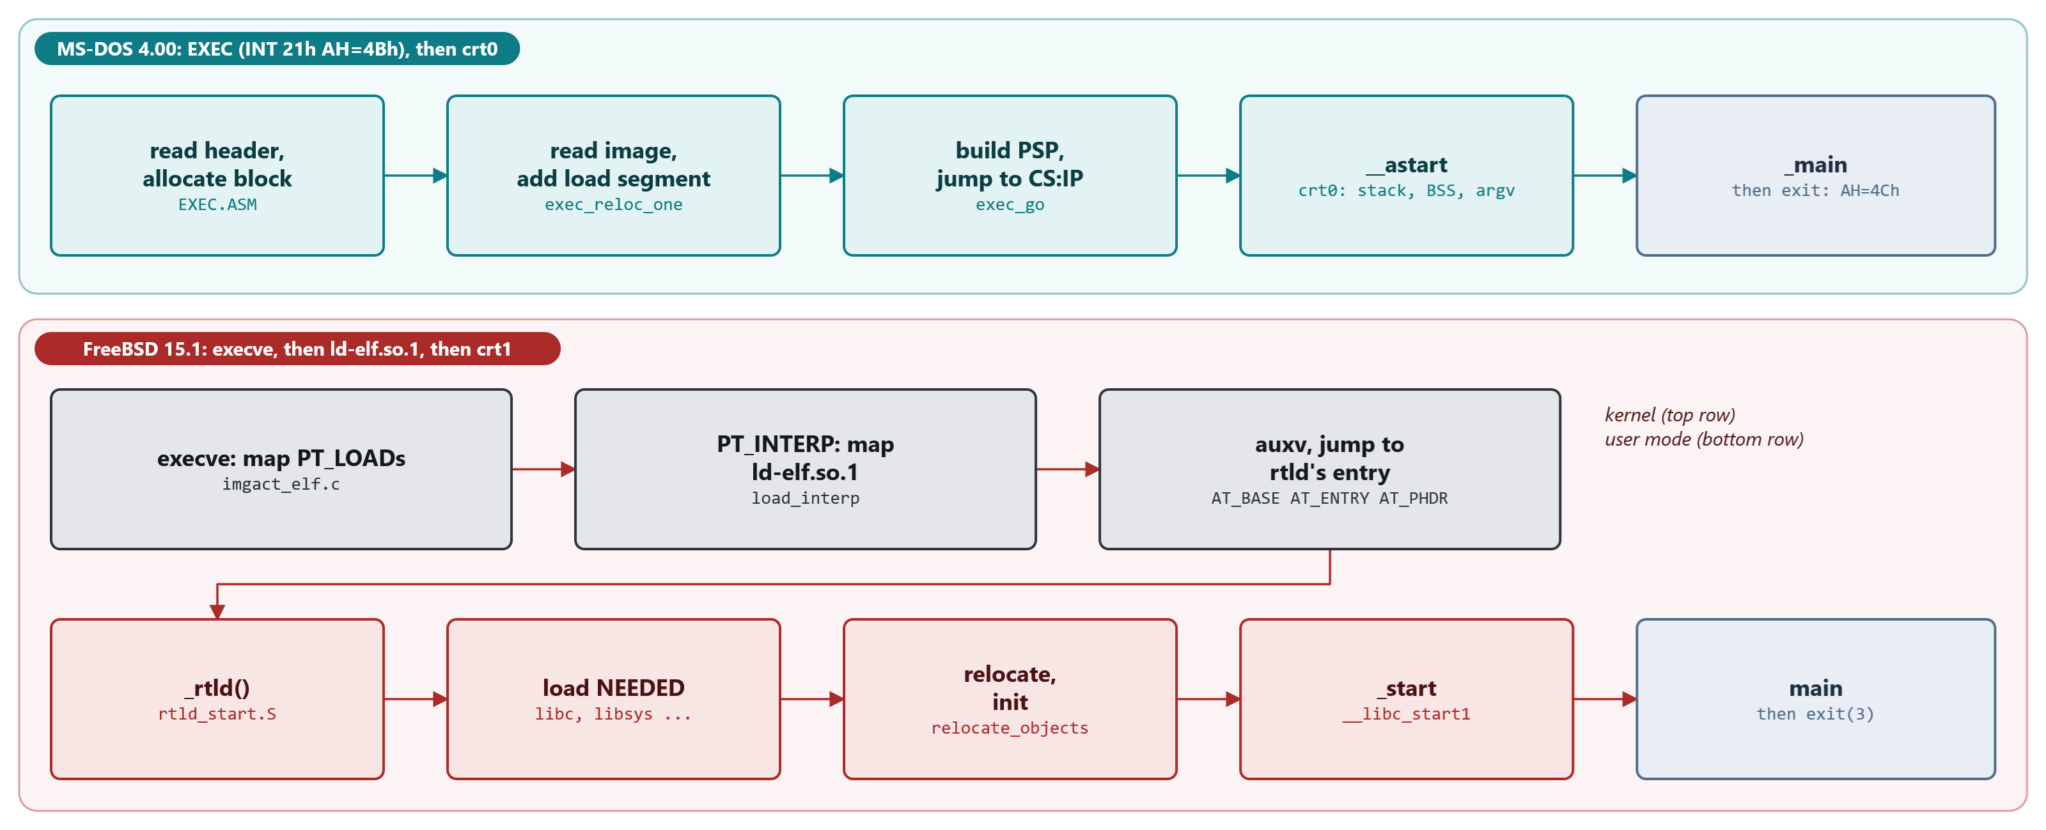
MODULE 5 · FROM C TO A RUNNING PROGRAM
From exec to main
EXEC does everything inside one INT 21h call; execve maps and starts ld-elf.so.1, which loads, relocates and jumps.
MS-DOS 4.00 × FreeBSD 15.1 · Module 5 · F. V. Buccoli
25
Notes:
The kernel sets the entry point to the interpreter's and passes AT_PHDR, AT_ENTRY and AT_BASE in the auxiliary vector. _rtld relocates itself, loads NEEDED objects breadth-first, relocates, runs initializers and returns the program's entry. ldd stops it right after loading: LD_TRACE_LOADED_OBJECTS.

Slide 26
MODULE 5 · FROM C TO A RUNNING PROGRAM
Lab 5.8: the FreeBSD toolchain at work (VM)
1
cc -###: in-process clang -cc1, then ld with crt1.o, crtbegin.o, -lc
2
No PIE unless asked: hello is EXEC at 0x200000
3
ldd and LD_TRACE_LOADED_OBJECTS: libc, libsys, [vdso]
4
truss: libmap.conf, hints, open + mmap per library, then write
5
Sizes: hello 9,832; hello-static 4,402,664; HELLO.EXE 7,271
MS-DOS 4.00 × FreeBSD 15.1 · Module 5 · F. V. Buccoli
26
Notes:
Outputs 5.40-5.45, captured in the course VM. Ask which file in the cc -### command plays the role of crt0 (crt1.o, not Scrt1.o: no PIE by default; the base system adds -fPIE -pie in bsd.prog.mk), and how each linker learns the name of the C library (COMENT 9Fh versus -lc). hello-static is big because of DWARF from libc.a, not code.

Slide 27
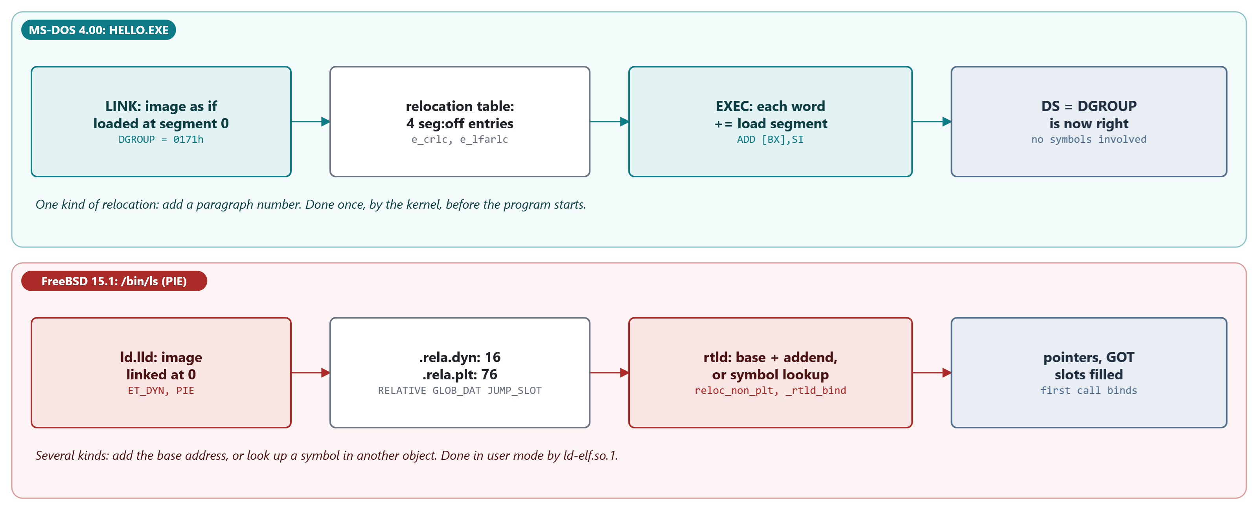
MODULE 5 · FROM C TO A RUNNING PROGRAM
Study case 5.B: relocation twice
MZ: add the load segment to listed words, in the kernel. ELF: base + addend or symbol lookup, in the process.
MS-DOS 4.00 × FreeBSD 15.1 · Module 5 · F. V. Buccoli
27
Notes:
SEGS.EXE on our DOS: PSP 1204h, image at 1214h, DGROUP 1387h = 1214h + 173h. In ls, R_X86_64_RELATIVE writes B + 0x1d78 at B + 0x99e0. The GOT exists so that code is never patched and can stay shared.

Slide 28
MODULE 5 · FROM C TO A RUNNING PROGRAM
Homework
1
5.1 One function, two compilers: sizes and instruction choice
2
5.2 mzdump.py: entry point and relocations as file offsets
3
5.3 A static library in C and assembly on both systems
4
5.4 Two link errors, and a FreeBSD error at run time
5
5.5 needed.py: ldd without running the program
6
5.6 Scripts that classify executables (sh and .BAT)
7
5.7 Essay: what executable formats assume
MS-DOS 4.00 × FreeBSD 15.1 · Module 5 · F. V. Buccoli
28
Notes:
Exercise 5.3 has a trap on purpose: MASM 5.10 upper-cases public names unless /Mx, and CL links with /NOI. Exercise 5.6: a batch file called from a batch file without CALL never returns.

Slide 29
MODULE 5 · FROM C TO A RUNNING PROGRAM
Key takeaways
1
The same five stages on both systems; the files they leave are readable
2
Object files: code + names defined + names needed + relocations
3
MS-DOS relocates only segment values, once, inside EXEC
4
FreeBSD resolves names at run time: NEEDED, PLT, GOT, ld-elf.so.1
5
Memory models existed because of 64 KB segments; amd64 has code models
6
No shared libraries on MS-DOS: INT 21h and INT 2Fh played that role
MS-DOS 4.00 × FreeBSD 15.1 · Module 5 · F. V. Buccoli
29
Notes:
Close with the comparison tables of sections 5.6 and 5.8. The design difference is where names are resolved: before the file exists (MS-DOS) or when the process starts (FreeBSD).

