Slide 1
OPERATING SYSTEMS · MODULE 6
Talking to the hardware: BIOS, ports, interrupts, drivers and consoles
MS-DOS 4.00 and FreeBSD 15.1, from IN and OUT to the terminal
MS-DOS 4.00
FreeBSD 15.1
Francesco Valerio Buccoli · francesco@buccoli.com
Sources: microsoft/MS-DOS @ 2d04cac · freebsd/freebsd-src @ release/15.1.0

Slide 2
01
The PC as a programmer sees it
Device memory, I/O ports, interrupts
MS-DOS 4.00 × FreeBSD 15.1 · Module 6 · F. V. Buccoli
2
Notes:
Start from the hardware both systems share: the same chips, the same ports, the same IRQ lines.

Slide 3
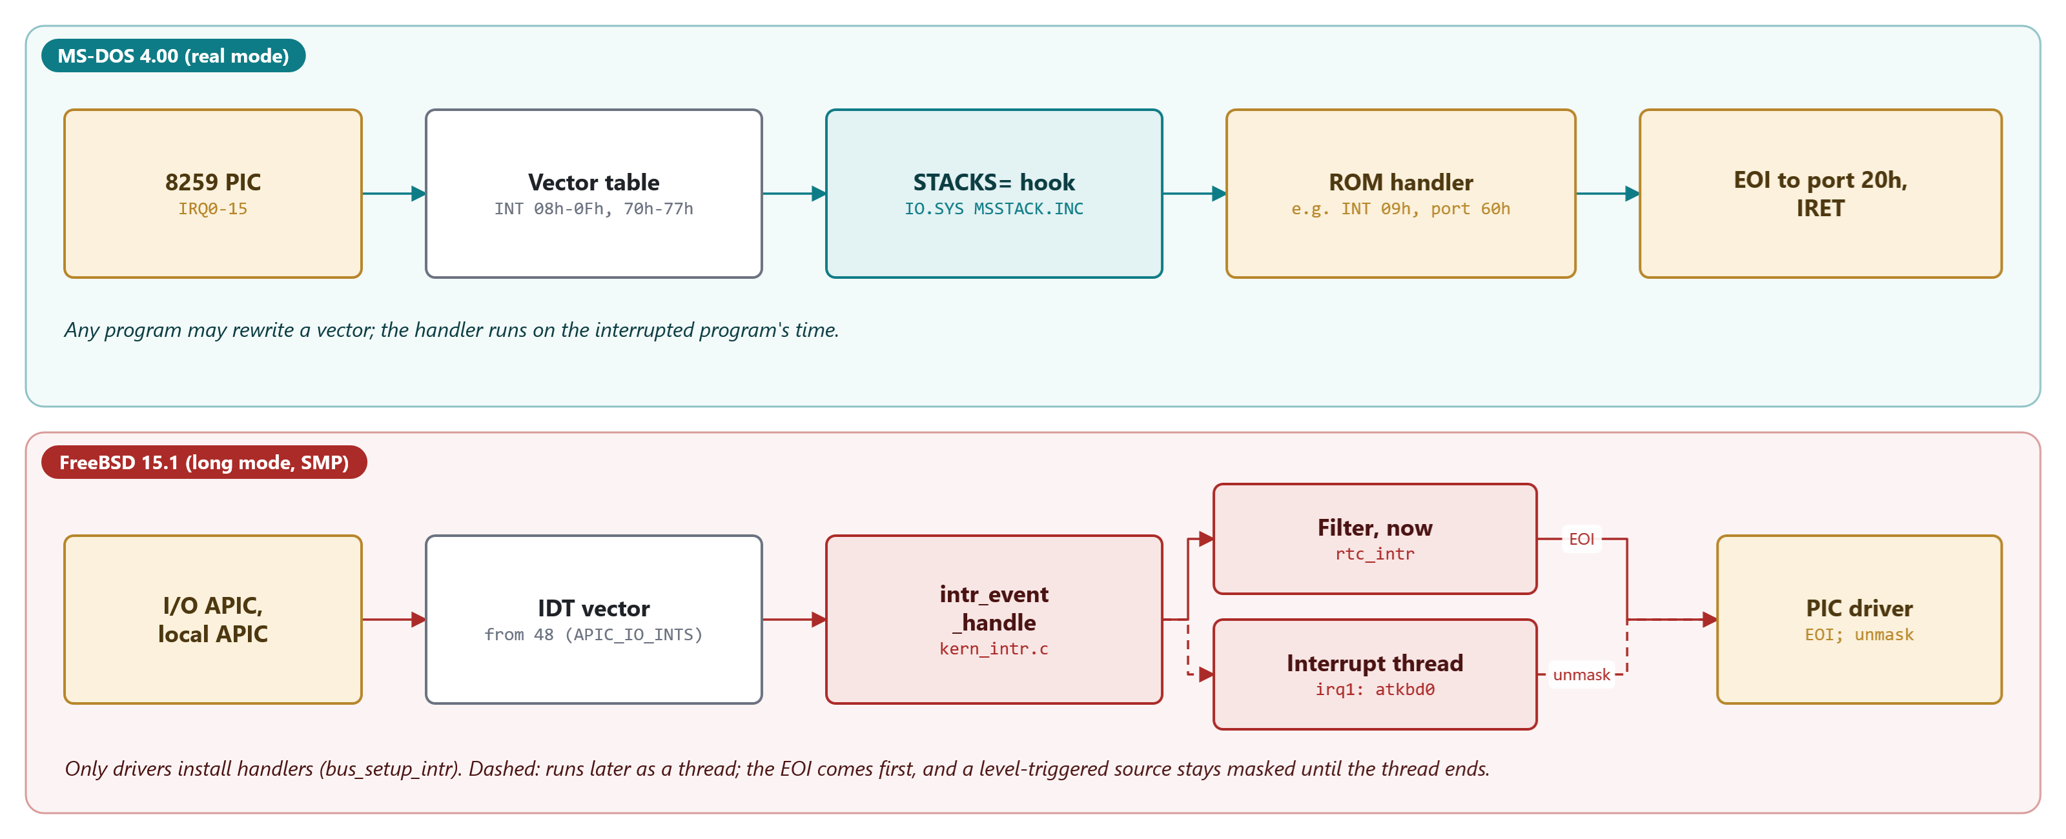
MODULE 6 · TALKING TO THE HARDWARE
From an interrupt request to a handler
Figure 6.1: PIC and vector table on MS-DOS; APIC, IDT, filters and interrupt threads on FreeBSD
MS-DOS 4.00 × FreeBSD 15.1 · Module 6 · F. V. Buccoli
3
Notes:
Trace IRQ1 on both lanes. On MS-DOS any program can rewrite the vector; the handler runs on the interrupted program's time. On FreeBSD only drivers install handlers, and the work is split into a filter that runs at once and a thread that is scheduled. Ask why vector 8 cannot be IRQ0 in protected mode: it is the double fault.

Slide 4
MODULE 6 · TALKING TO THE HARDWARE
Reading the CMOS clock on MS-DOS: ports 70h and 71h
MS-DOS 4.00
MSINIT.ASM lines 2737-2752
1
CLI: one CPU, one program, enough
cli
push bx
push ax ;save user NMI state
or al,NMI ;disable NMI for us
out CMOS_PORT,al
nop ;undocumented delay needed
in al,CMOS_DATA ;get data value
;set NMI state to user specified
mov bx,ax ;save data value
pop ax ;get user NMI
and al,NMI
or al,CMOS_SHUT_DOWN
out CMOS_PORT,al
nop
in al,CMOS_DATA
2
Index to 70h, data from 71h
3
NOP: the chip needed time
4
Bit 7 of the index masks NMI
Source: microsoft/MS-DOS @ 2d04cac, v4.0/src/BIOS/MSINIT.ASM, lines 2737-2752
MS-DOS 4.00 × FreeBSD 15.1 · Module 6 · F. V. Buccoli
4
Notes:
This is CMOS_READ in IO.SYS. Point out the undocumented delay and the NMI bit. MS-DOS uses this only to repair the RTC rate registers on early ATs; for time it asks the BIOS.

Slide 5
MODULE 6 · TALKING TO THE HARDWARE
The same chip from FreeBSD's atrtc driver
FreeBSD 15.1
atrtc.c lines 98-109
1
Same index/data protocol
static inline u_char
rtcin_locked(int reg)
{
if (rtc_reg != reg) {
inb(0x84);
outb(IO_RTC, reg);
rtc_reg = reg;
inb(0x84);
}
return (inb(IO_RTC + 1));
}
2
inb(0x84) is the delay
3
rtc_reg caches the selected register
4
Callers hold the spin mutex atrtc_lock
Source: freebsd/freebsd-src @ 96841ea, sys/x86/isa/atrtc.c, lines 98-109
MS-DOS 4.00 × FreeBSD 15.1 · Module 6 · F. V. Buccoli
5
Notes:
Put this next to the previous slide. The protocol is identical; the locking is not: a spin mutex disables interrupts on this CPU and keeps the others out.

Slide 6
02
Three layers on MS-DOS
BIOS, IO.SYS drivers, ANSI.SYS
MS-DOS 4.00 × FreeBSD 15.1 · Module 6 · F. V. Buccoli
6
Notes:
DOS, BIOS, hardware: programs used all three.

Slide 7
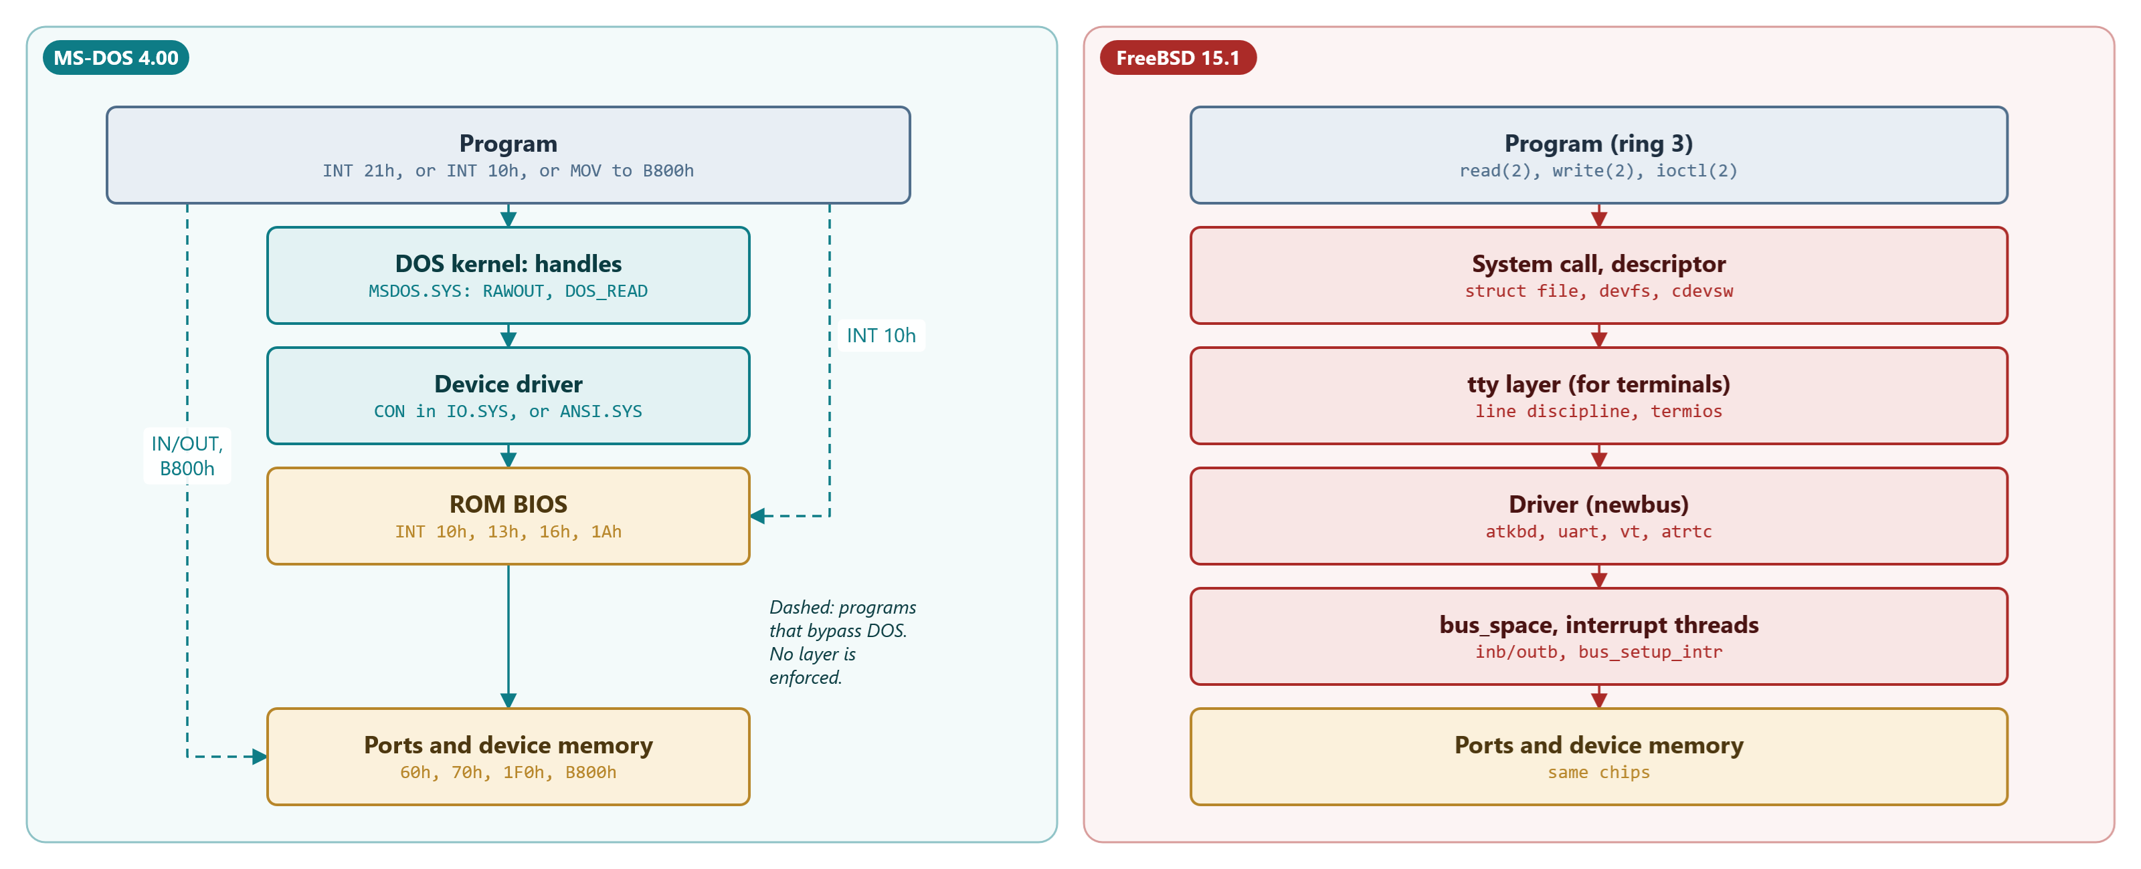
MODULE 6 · TALKING TO THE HARDWARE
The layers between a program and a device
Figure 6.2: on MS-DOS nothing enforces the layers; on FreeBSD the kernel does
MS-DOS 4.00 × FreeBSD 15.1 · Module 6 · F. V. Buccoli
7
Notes:
The dashed arrows are the programs that bypass DOS. On FreeBSD there are no dashed arrows: IN and OUT fault in user mode.

Slide 8
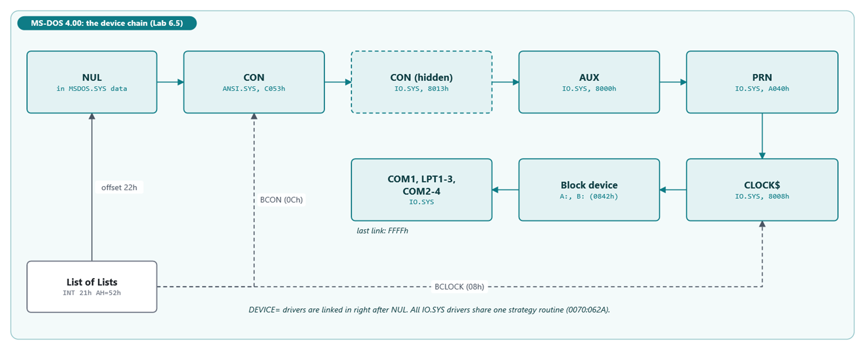
MODULE 6 · TALKING TO THE HARDWARE
The MS-DOS device driver chain after boot
Figure 6.3: NUL first, DEVICE= drivers after it, BCON and BCLOCK pointers in the List of Lists
MS-DOS 4.00 × FreeBSD 15.1 · Module 6 · F. V. Buccoli
8
Notes:
This is what Lab 6.5 prints. ANSI.SYS hides the IO.SYS console by coming first in the name search, and SYSINIT points BCON at it.

Slide 9
MODULE 6 · TALKING TO THE HARDWARE
DOS writes console characters with INT 29h
MS-DOS 4.00
CPMIO.ASM lines 369-382
1
Is standard output a special device?
PUSH DS
LDS BX,[SI.sf_devptr] ; output to special?
TEST BYTE PTR [BX+SDEVATT],ISSPEC
POP DS
JZ RAWNORM ; if not, do normally
INT int_fastcon ; quickly output the char
RAWRET:
CLC
RAWRET1:
POP BX
return
RAWNORM:
CALL RAWOUT3
JMP RAWRET
2
Then one INT 29h per character
3
Otherwise RAWOUT3 and IOFUNC
Source: microsoft/MS-DOS @ 2d04cac, v4.0/src/DOS/CPMIO.ASM, lines 369-382
MS-DOS 4.00 × FreeBSD 15.1 · Module 6 · F. V. Buccoli
9
Notes:
RAWOUT is where the console output of functions 01h-0Ch ends. The special bit (bit 4) means the device owns INT 29h. This is why ANSI.SYS must hook vector 29h; a device without the bit, or a file when output is redirected, is reached through IOFUNC instead.

Slide 10
MODULE 6 · TALKING TO THE HARDWARE
The ANSI.SYS escape-sequence state machine
MS-DOS 4.00
ANSI.ASM lines 831-848
1
STATE holds the address of the current state
VIDEO: MOV SI,OFFSET STATE
JMP [SI]
S2: CMP AL,'['
JZ S22
JMP S1
S22: MOV WORD PTR [SI],OFFSET S3
XOR BX,BX
MOV WORD PTR INQ,BX
JMP SHORT S3B
S3: CMP AL,';'
JNZ S3C
S3A: INC PRMCNT
S3B: CALL GETPTR
XOR AX,AX
MOV WORD PTR [BX],AX ;DEFAULT VALUE IS ZERO
RET
2
S2: expect '['
3
S3: collect numeric parameters
4
A letter ends the sequence (S7)
Source: microsoft/MS-DOS @ 2d04cac, v4.0/src/DEV/ANSI/ANSI.ASM, lines 831-848
MS-DOS 4.00 × FreeBSD 15.1 · Module 6 · F. V. Buccoli
10
Notes:
Show Lab 6.4 next: the same file with and without the driver. Mention the two features that write into the keyboard stream: the cursor report and key reassignment.

Slide 11
MODULE 6 · TALKING TO THE HARDWARE
Programs that bypass DOS
1
Speed: one REP MOVSW into B800h versus a long call chain per character
2
No redirection: INT 10h and B800h never pass a handle (Lab 6.1)
3
No arbitration: the last program to hook a vector wins (the INT 1Ch story)
4
Later systems had to emulate the hardware: EMM386 traps ports in V86 mode
5
FreeBSD: IN and OUT fault; /dev/io is a controlled exception
MS-DOS 4.00 × FreeBSD 15.1 · Module 6 · F. V. Buccoli
11
Notes:
Use the BASCOM comment in MSBIO1.ASM as the story. Be fair: on a 4.77 MHz 8088 these shortcuts were what made software usable.

Slide 12
03
FreeBSD: buses, drivers, interrupts
newbus, bus_space, interrupt threads
MS-DOS 4.00 × FreeBSD 15.1 · Module 6 · F. V. Buccoli
12
Notes:
No BIOS after boot: the kernel finds the devices itself.

Slide 13
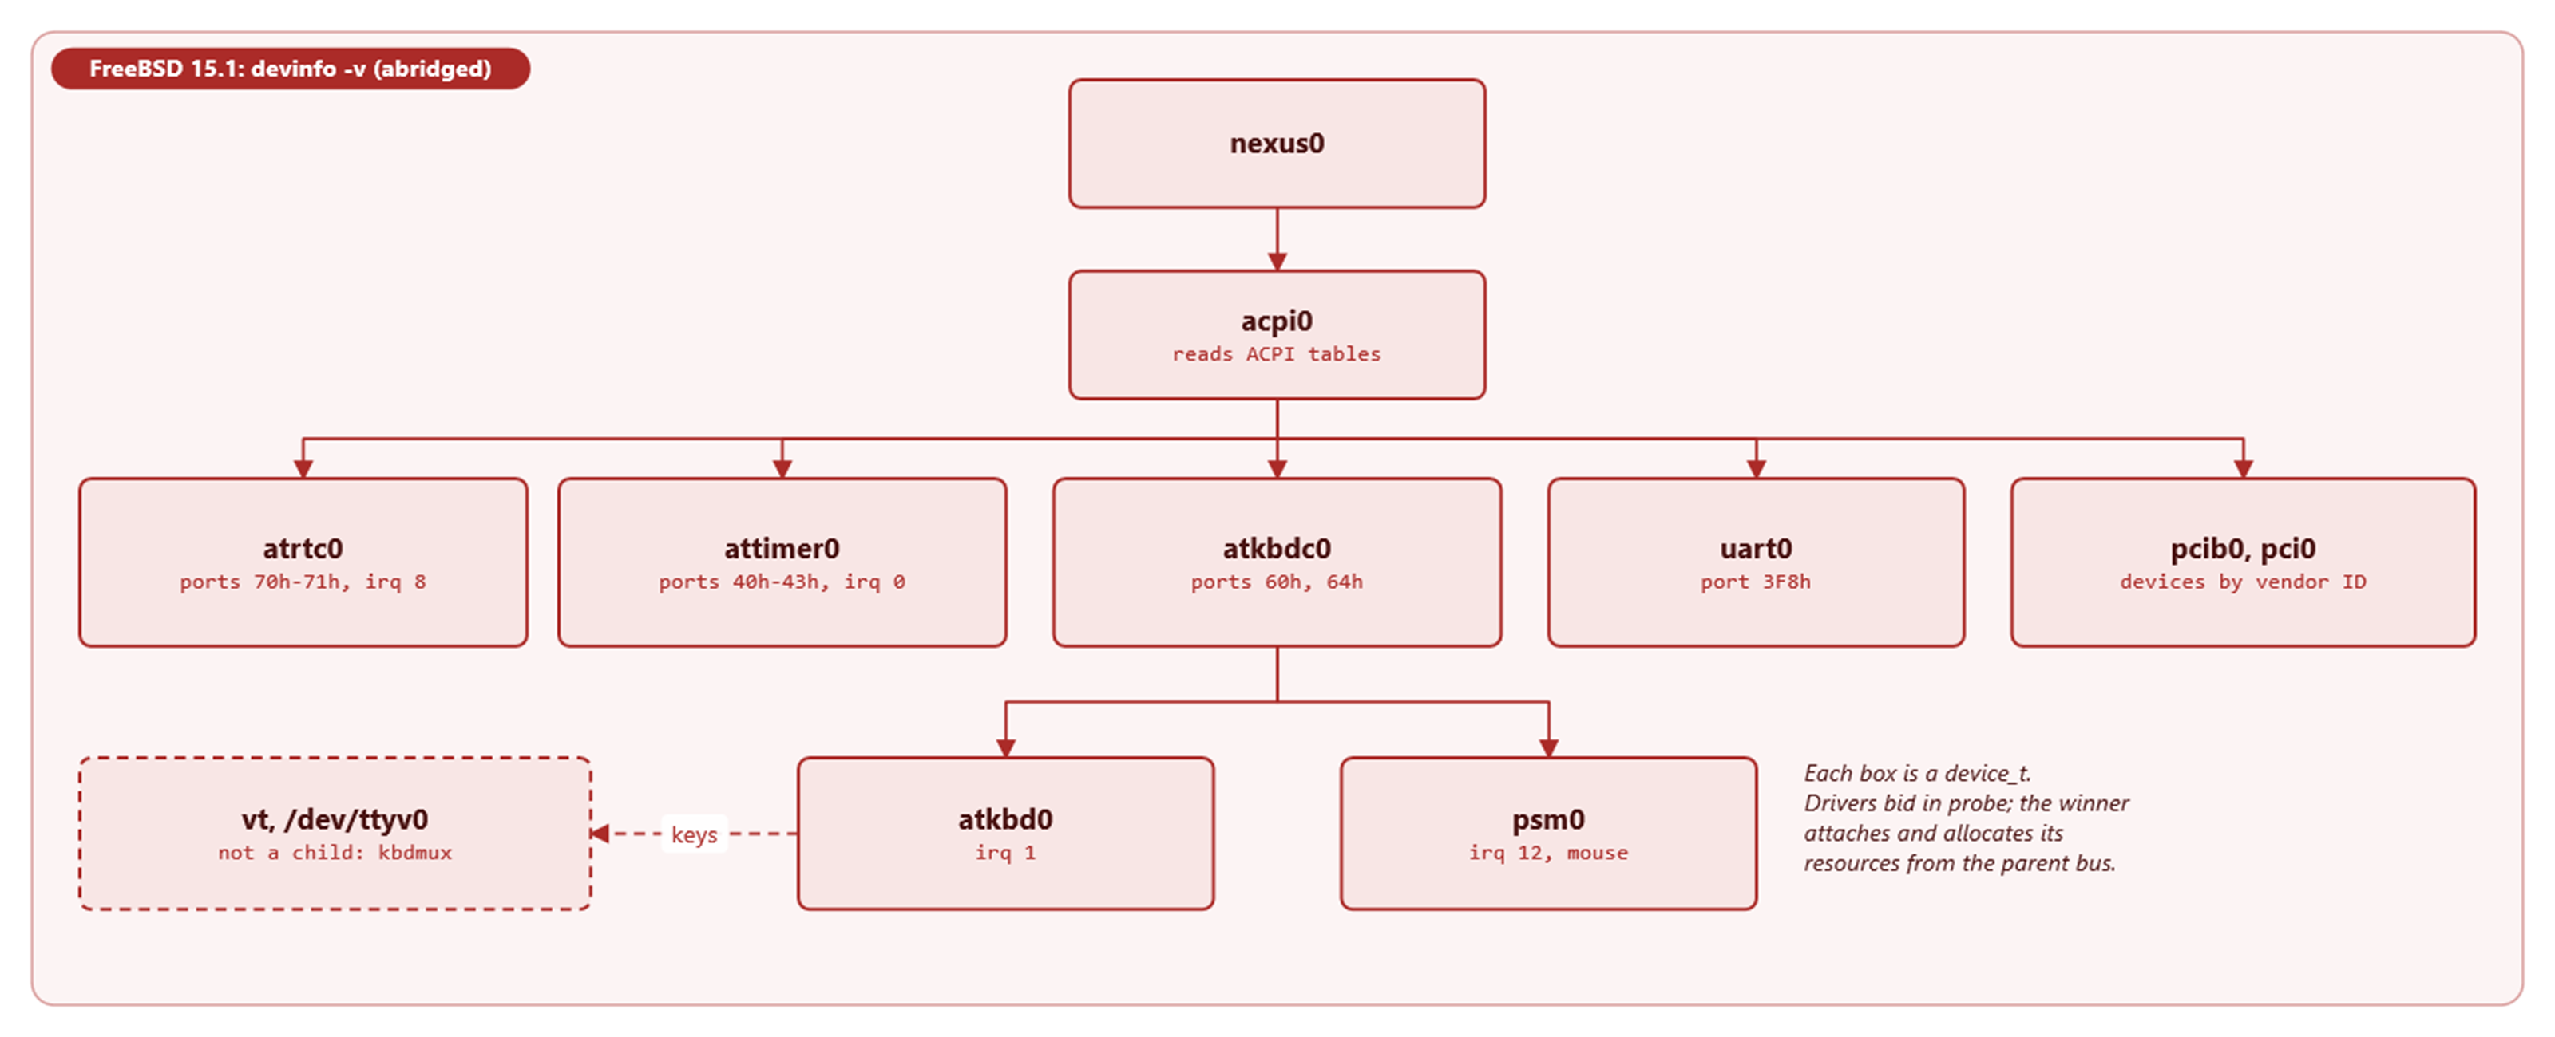
MODULE 6 · TALKING TO THE HARDWARE
Part of the newbus device tree
Figure 6.4: each box is a device_t; drivers bid in probe, the winner attaches
MS-DOS 4.00 × FreeBSD 15.1 · Module 6 · F. V. Buccoli
13
Notes:
Compare with the DOS chain: a flat list loaded on command versus a tree discovered by buses. Resources come from the parent bus and are recorded, so two drivers cannot own the same port.

Slide 14
MODULE 6 · TALKING TO THE HARDWARE
Filters run now; handlers run in a thread
FreeBSD 15.1
kern_intr.c lines 1389-1451
1
A handler without a filter means: schedule the thread
if (ih->ih_filter == NULL) {
thread = true;
continue;
}
CTR4(KTR_INTR, "%s: exec %p(%p) for %s", __func__,
ih->ih_filter, ih->ih_argument, ih->ih_name);
ret = ih->ih_filter(ih->ih_argument);
⋮ (lines omitted)
/* Schedule the ithread if needed. */
if (thread) {
int error __unused;
error = intr_event_schedule_thread(ie, frame);
KASSERT(error == 0, ("bad stray interrupt"));
}
2
Filters run in interrupt context
3
intr_event_schedule_thread wakes the ithread
Source: freebsd/freebsd-src @ 96841ea, sys/kern/kern_intr.c, lines 1389-1451
MS-DOS 4.00 × FreeBSD 15.1 · Module 6 · F. V. Buccoli
14
Notes:
atrtc installs a filter, atkbd a threaded handler. On x86 the EOI is sent before the thread runs; a level-triggered source is also masked until the thread has run, an edge-triggered one such as IRQ1 is not.

Slide 15
04
Consoles
CON, cooked and raw; the tty line discipline
MS-DOS 4.00 × FreeBSD 15.1 · Module 6 · F. V. Buccoli
15
Notes:
The device every program uses first.

Slide 16
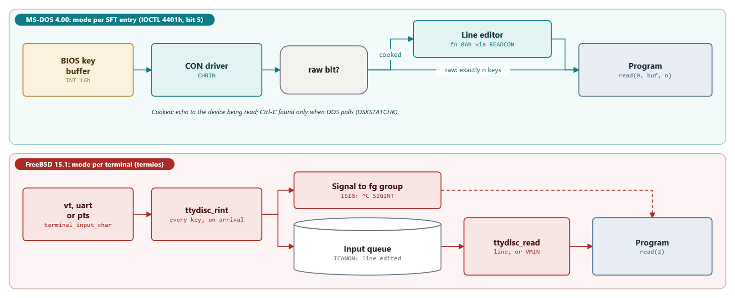
MODULE 6 · TALKING TO THE HARDWARE
Cooked and raw input on both systems
Figure 6.5: the line editor runs when DOS reads; the line discipline runs when the key arrives
MS-DOS 4.00 × FreeBSD 15.1 · Module 6 · F. V. Buccoli
16
Notes:
Raw mode is per SFT entry on MS-DOS, per terminal on FreeBSD; neither is per process.

Slide 17
MODULE 6 · TALKING TO THE HARDWARE
DOS_READ on a device: raw or cooked
MS-DOS 4.00
DISK.ASM lines 239-248
1
Bit 5 of the device information: raw
;
; We need to hit the device. Figure out if we do a raw read or we do the
; bizarre std_con_string_input.
;
TESTRAW:
TEST BL,devid_device_raw ; Raw mode?
JNZ DVRDRAW ; Yes, let the device do all local editing
TEST BL,devid_device_con_in ; Is it console device?
JZ NOTRDCON
JMP READCON
2
Raw: one request for the full count
3
Cooked console: the line editor of function 0Ah
Source: microsoft/MS-DOS @ 2d04cac, v4.0/src/DOS/DISK.ASM, lines 239-248
MS-DOS 4.00 × FreeBSD 15.1 · Module 6 · F. V. Buccoli
17
Notes:
IOCTL 4401h sets this bit. Run Lab 6.3 step 3 live: Ctrl-C, Ctrl-S and Ctrl-Z arrive as bytes.

Slide 18
MODULE 6 · TALKING TO THE HARDWARE
MS-DOS CON versus the FreeBSD terminal
 | MS-DOS 4.00 | FreeBSD 15.1
Line editing | DOS function 0Ah, when read | ttydisc_rint, on arrival
Raw mode | IOCTL 4401h bit 5, per SFT entry | termios without ICANON, per terminal
Ctrl-C | polled, then INT 23h | SIGINT to the foreground group at once
End of file | Ctrl-Z | Ctrl-D (VEOF)
Escape sequences | ANSI.SYS if installed | teken, always
Remote console | CTTY COM1 | ssh and a pseudo-terminal
MS-DOS 4.00 × FreeBSD 15.1 · Module 6 · F. V. Buccoli
18
Notes:
Two Ctrl-Zs: end of file on DOS, suspend on FreeBSD.

Slide 19
MODULE 6 · TALKING TO THE HARDWARE
Time: a count of interrupts versus a counter
1
MS-DOS: the BIOS counts IRQ0 ticks (18.2 Hz); CLOCK$ converts ticks to h:m:s.hh
2
IO.SYS reads only the date from the CMOS clock at boot
3
A lost interrupt makes the DOS clock late; two missed midnights lose a day
4
FreeBSD: the RTC once at boot (inittodr), then a timecounter (TSC; Hyper-V-TSC in the course VM)
5
time = timehands offset + scale x counter delta, often computed in user space
MS-DOS 4.00 × FreeBSD 15.1 · Module 6 · F. V. Buccoli
19
Notes:
Show Lab 6.2's output: four readings of the same clock. DOSBox-X's CMOS held UTC.

Slide 20
05
Labs
Five on MS-DOS 4.00, two on FreeBSD 15.1
MS-DOS 4.00 × FreeBSD 15.1 · Module 6 · F. V. Buccoli
20
Notes:
Every MS-DOS output in the labs is a real capture from the MS-DOS 4.00 built from source.

Slide 21
MODULE 6 · TALKING TO THE HARDWARE
Lab 6.1: three ways to print, one redirection
---- THREE (to) OUT.TXT
---- TYPE OUT.TXT
1 DOS INT 21h AH=02h
---- SCREEN
2 BIOS INT 10h AH=0Eh
3 VIDEO B800:row*160
2 BIOS INT 10h AH=0Eh
3 VIDEO B800:row*160
MS-DOS 4.00 × FreeBSD 15.1 · Module 6 · F. V. Buccoli
21
Notes:
Only the INT 21h line reaches the file; the BIOS and video lines stay on the screen, twice.

Slide 22
MODULE 6 · TALKING TO THE HARDWARE
Lab 6.2: the clock read four ways
1
INT 21h 2Ah/2Ch: binary, from CLOCK$
2
INT 1Ah 00h: 612,333 ticks = 9:20:32.7
3
INT 1Ah 04h/02h and ports 70h/71h: BCD from the chip
4
Register A 26h, B 03h: 24-hour, BCD
5
All one hour behind the host: DOSBox-X's CMOS held UTC
MS-DOS 4.00 × FreeBSD 15.1 · Module 6 · F. V. Buccoli
22
Notes:
Ask students to redo the tick conversion by hand with the formula in MSCLOCK.ASM.

Slide 23
MODULE 6 · TALKING TO THE HARDWARE
Lab 6.3: cooked, raw, and a sticky end of file
handle 0 switched to raw
handle 0: DX=C0F3 ISDEV NOTEOF RAW SPECL ISCOT ISCIN
handle 1: DX=80C0 ISDEV NOTEOF
handle 2: DX=C0F3 ISDEV NOTEOF RAW SPECL ISCOT ISCIN
read returned 0009h bytes: 61 62 08 63 0D 1A 03 13 71
After a Ctrl-Z in a previous program:
---- STUFF hi^M
---- KEYS
handle 0: DX=C093 ISDEV SPECL ISCOT ISCIN
handle 1: DX=80C0 ISDEV NOTEOF
handle 2: DX=C093 ISDEV SPECL ISCOT ISCIN
cooked read(0, buf, 40)
read returned 0000h bytes:
MS-DOS 4.00 × FreeBSD 15.1 · Module 6 · F. V. Buccoli
23
Notes:
Raw: nine keys, nine bytes. The second part is the surprise: the end-of-file bit lives in the shared SFT entry of CON and only a write through it resets it.

Slide 24
MODULE 6 · TALKING TO THE HARDWARE
Lab 6.4: ANSI.SYS
1
Without the driver, ESC is printed as a glyph
2
With it, cursor moves and colours work
3
ESC[97;"hello"p: typing a now types hello
4
ESC[6n: the reply arrives as keyboard input
5
FreeBSD's emulator has the reply code under #if 0: the VM console never answers
MS-DOS 4.00 × FreeBSD 15.1 · Module 6 · F. V. Buccoli
24
Notes:
The key reassignment is the memorable part: a text file changed the keyboard.

Slide 25
MODULE 6 · TALKING TO THE HARDWARE
Lab 6.5: the driver chain, walked from NUL
# header attr strat intr name flags
1 02C1:0048 8004 18DB 18E1 NUL char NUL
2 0BA3:0000 C053 00C1 00CC CON char STDIN STDOUT INT29 IOCTL GENIOCTL
3 0070:016E 8013 062A 0635 CON char STDIN STDOUT INT29
4 0070:0180 8000 062A 063B AUX char
5 0070:0192 A040 062A 0658 PRN char OUTBUSY GENIOCTL
6 0070:01A4 8008 062A 067E CLOCK$ char CLOCK
7 0070:01B6 0842 062A 0684 2 units block 32BIT OPCL GENIOCTL
8 0070:01CA 8000 062A 063B COM1 char
MS-DOS 4.00 × FreeBSD 15.1 · Module 6 · F. V. Buccoli
25
Notes:
All IO.SYS drivers share the strategy routine at 062A; AUX and COM1 even share an interrupt entry. ANSI.SYS's CON comes first.

Slide 26
MODULE 6 · TALKING TO THE HARDWARE
Labs 6.6 and 6.7: FreeBSD drivers and termios
1
grep DRIVER_MODULE: the same driver registers with isa and acpi
2
devinfo -u in the VM: the classic ports and IRQs, each with its driver
3
tcsetattr is ioctl(TIOCSETA = 0x802c7414) in the real libc.so.7
4
The VM has atkbd0 and Hyper-V's hvkbd0; console keys come through hvkbd0
5
rawkeys -r on the console: 61 62 08 63 0D 1A 03 13 71, as on MS-DOS
MS-DOS 4.00 × FreeBSD 15.1 · Module 6 · F. V. Buccoli
26
Notes:
All outputs were captured in the course VM. rawkeys on the vt console: canonical 61 63 0A; raw 61 62 08 63 0D 1A 03 13 71, the same nine bytes as MS-DOS in Lab 6.3 (Backspace sends 08 on vt). In vmstat -i, irq1: atkbd0 does not move when you type on the Hyper-V console; the cpuN:hyperv lines do.

Slide 27
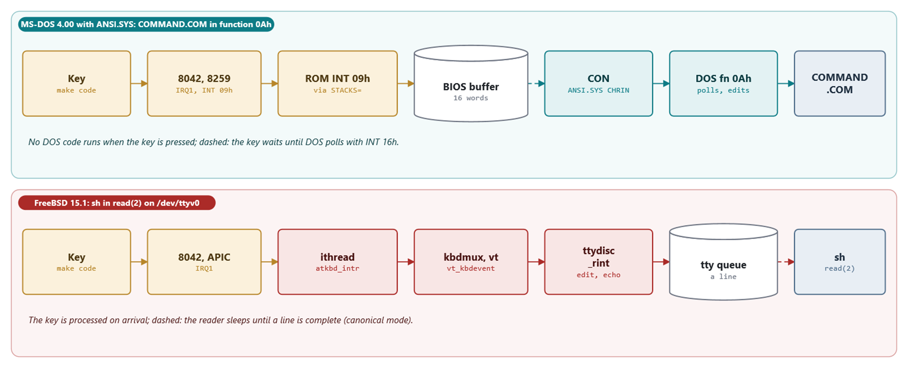
MODULE 6 · TALKING TO THE HARDWARE
Study case: one key press, end to end
Figure 6.7: on MS-DOS the key waits until DOS polls; on FreeBSD it is processed on arrival
MS-DOS 4.00 × FreeBSD 15.1 · Module 6 · F. V. Buccoli
27
Notes:
Walk the seven steps on both lanes, then the comparison table of Study case 6.A.

Slide 28
MODULE 6 · TALKING TO THE HARDWARE
Homework
1
6.1 ZERO$: a character device driver loaded with DEVICE=
2
6.2 /dev/zeroish as a FreeBSD kernel module
3
6.3 Scan codes on both systems
4
6.4 Measuring time: INT 1Ch versus clock_gettime
5
6.5 Is the driver installed? C, batch and sh
6
6.6 Essay: what bypassing the OS costs
MS-DOS 4.00 × FreeBSD 15.1 · Module 6 · F. V. Buccoli
28
Notes:
Exercise 6.1 is the centrepiece: students will meet COPY's refusal to read a device in binary.

Slide 29
MODULE 6 · TALKING TO THE HARDWARE
Key takeaways
1
Same chips, same ports, same IRQs; different rules about who may touch them
2
MS-DOS layers are conventions; FreeBSD layers are enforced
3
DOS drivers: a header, a packet, a chain; FreeBSD: newbus, kobj methods, resources
4
Console input: polled and edited on demand versus processed on arrival
5
Time: counting interrupts versus reading a counter
MS-DOS 4.00 × FreeBSD 15.1 · Module 6 · F. V. Buccoli
29
Notes:
Close by asking which design choice students would keep for a small embedded system today.

