Slide 1

Gulistan Shah Abdul Latif Boy’s Higher Secondary School
Class Presentation Of Topics:
Biological Method with example of Dengue Fever
Theory
Law
Presented by: Muhammad Sahal Shahzad

Slide 2
1. Biological Method with example of Dengue Fever
1.1: Biological Method
The system of advancing knowledge by formulating a question, collecting data about it through observation and experiment, and testing a hypothetical answer about living things is called biological method.
1.2: Steps Of Biological Method
1.2: Biological Problems
You are familiar with the disease of dengue which spread through a female Aedes aegypti mosquito. For a long time, Dengue Fever caused illness in many people, but its actual cause was unknown. It was thought that the dengue is caused by heat and normal fever.

Slide 3
1.3: Observation
In the 1940s, several cases of dengue fever appeared in the city of Nagasaki, Japan. A Japanese scientist, Dr. Susumu Hotta, studied these patients closely. In 1943, he successfully isolated the dengue virus from a patient's blood for the first time. He examined the blood samples of dengue patients under the microscope and through laboratory tests, and found a virus in them, which was later named the Dengue Virus.
So the observation was: "Dengue Virus is present in the blood of dengue patients."
Before Dr. Hotta's discovery, two American scientists — Ashburn and Craig — had shown in 1907 that dengue was caused by a "filterable agent" (i.e., a virus), not bacteria. However, the credit for actually isolating the dengue virus goes to Dr. Hotta in 1943.

Slide 4
1.4: Hypothesis
Based on this observation, in 1943, Dr. Hotta formed an intelligent guess (hypothesis): "Dengue Virus is the cause of Dengue Fever.“
This was only a guess, which needed to be tested.
1.5: Reasoning (Deductive)
An "if-then" statement was used to form a deduction: "If Dengue Virus is the cause of dengue, then all dengue patients should have this virus in their blood."
1.6: Experiment
To test this deduction, two groups were formed:
Experimental Group: Blood samples of dengue patients
Control Group: Blood samples of healthy people
Both groups' blood samples were examined in the laboratory.

Slide 5
1.7: Result
All dengue patients (experimental group) had Dengue Virus present in their blood
Healthy people (control group) had no Dengue Virus in their blood
1.8: Conclusion
"Dengue Virus is the actual cause of Dengue Fever." This confirmed (supported) the hypothesis, as the experimental results matched it.

Slide 6
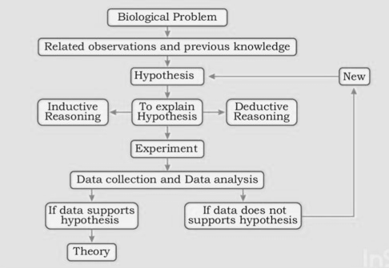
1.9: Flowchart of Biological Method

Slide 7
1.10: Life Cycle of Dengue Virus
Biting an infected person: A female Aedes aegypti mosquito bites a person who is already infected with the dengue virus, and sucks their blood.
Virus enters the mosquito: Along with the blood, the dengue virus enters the mosquito's body.
Virus develops inside the mosquito: Inside the mosquito's body, the virus multiplies and moves into its salivary glands. This stage usually takes about 8–12 days and is called the Extrinsic Incubation Period.
Mosquito becomes infectious: Once the virus reaches the salivary glands, the mosquito becomes capable of spreading the virus for the rest of its life.
Biting a healthy person: When this infected mosquito bites a healthy person, it injects its saliva (containing the virus) into that person's blood.
Virus enters human body: The dengue virus now enters the healthy person's bloodstream and starts multiplying.
Incubation period in humans: After 4–10 days (called the Intrinsic Incubation Period), the person starts showing symptoms of dengue fever, such as high fever, headache, joint pain, and rashes.
Cycle continues: If another mosquito bites this newly infected person, the cycle repeats and the disease keeps spreading.

Slide 8
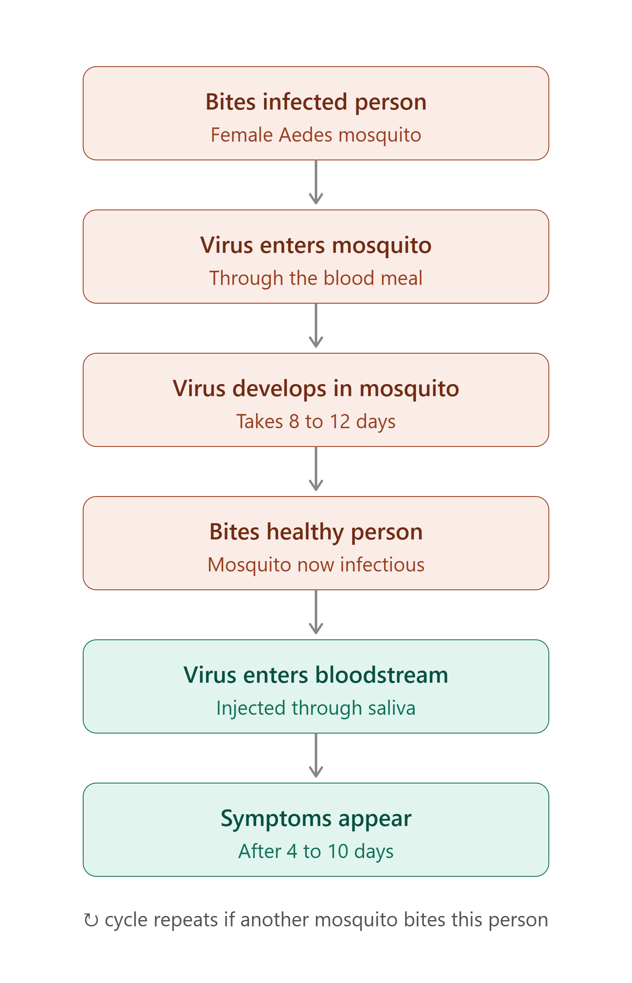
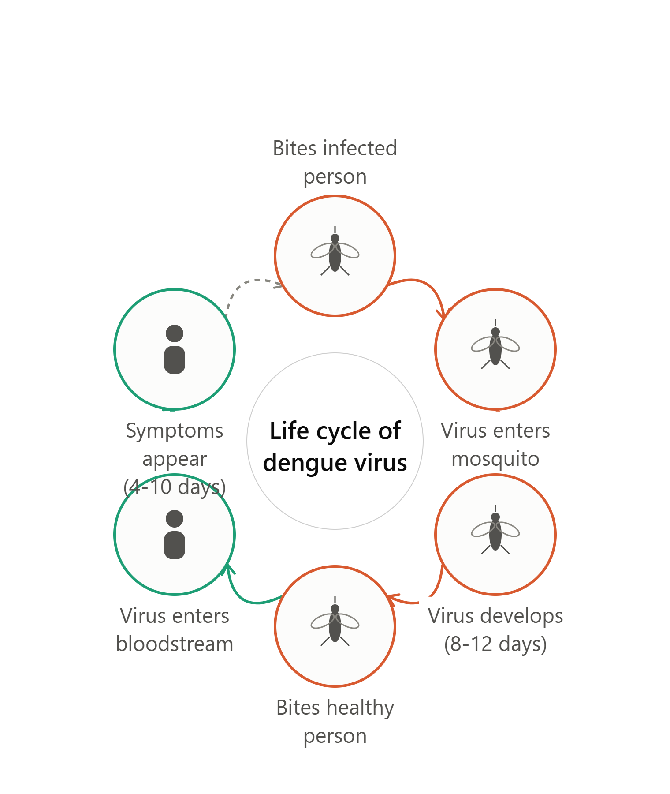
1.11: Diagrams of Lifecycle of Dengue Virus

Slide 9
2. Theory
After the conclusion is reached, if the same hypothesis is tested again and again by many different scientists, in different places, and every time the results support it — then that hypothesis becomes stronger and stronger.
When a hypothesis has been tested repeatedly over a long period of time, and is supported by a large amount of evidence from many experiments, it becomes a Theory.
2.1: Definition
A theory is a well-tested, well-supported explanation of some aspect of the natural world, based on facts that have been repeatedly confirmed through observation and experimentation.

Slide 10
2.2: Key points about Theory
A theory is not just a guess — it is much stronger than a hypothesis, because it has been proven correct many times.
A theory can still be changed or improved in the future if new evidence is found.
A theory helps explain why something happens, not just what happens.
2.3: Example (connected to our topic)
The idea that "microorganisms (germs) like viruses, bacteria, and parasites cause disease" was tested again and again by many scientists over many years — for malaria (Plasmodium), for dengue (Dengue Virus), and for many other diseases. Because this idea was proven correct so many times, it became an accepted scientific theory called the Germ Theory of Disease.

Slide 11
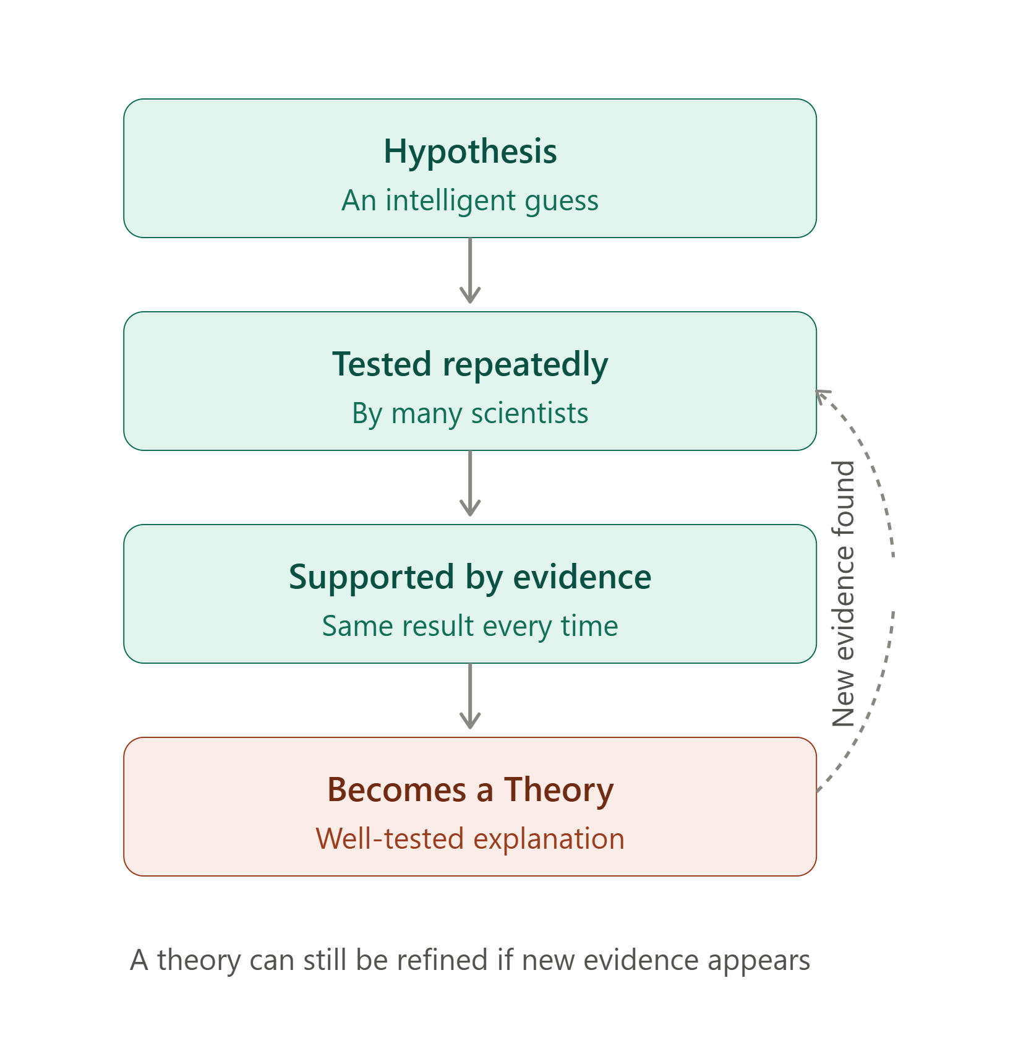
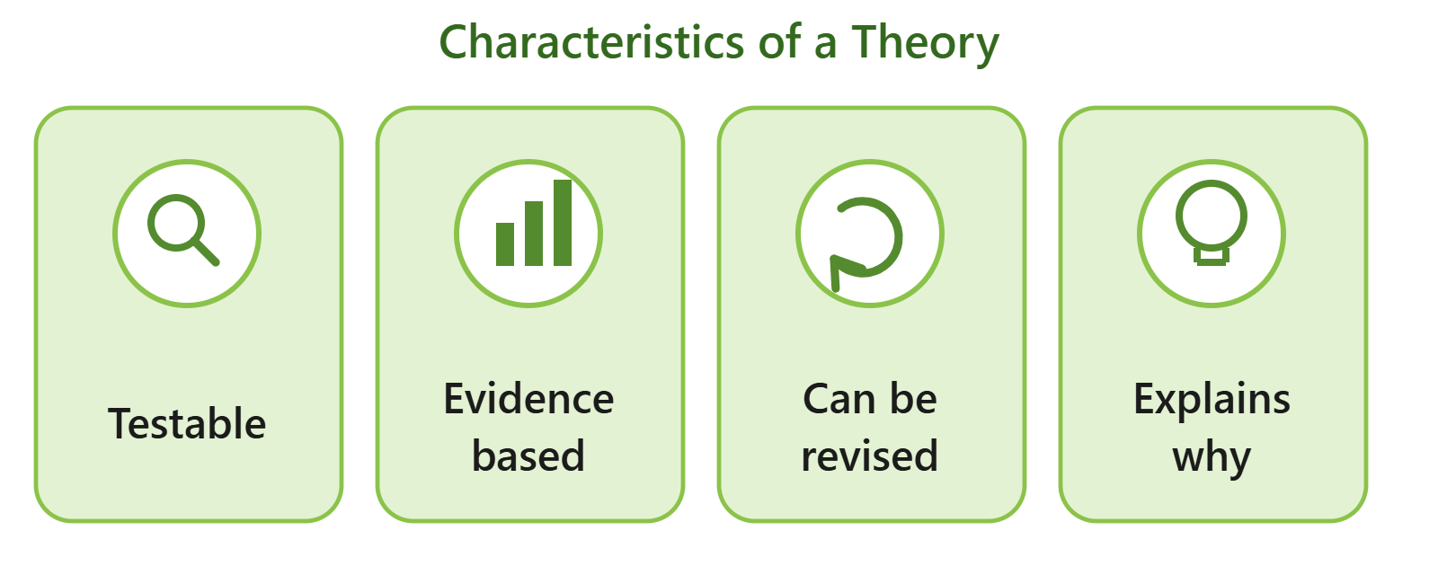
2.4: Difference between Theory and Hypothesis
Hypothesis | Theory
An initial guess | A well-tested explanation
Based on limited observation | Based on many experiments and evidence
Needs to be tested | Already tested many times
2.5: Diagrams related to theory

Slide 12
3. Law
A scientific law is a uniform or constant fact of nature — meaning it is something that always happens the same way, without exception, everywhere in nature.
A law is considered to be virtually an irrefutable theory — this means a law is actually a theory that has been tested so many times, in so many situations, without a single exception, that scientists now consider it almost impossible to prove wrong (irrefutable = cannot be refuted/disproven).
3.1: Difference between theory and law
Theory | Law
Explains why something happens | Describes what always happens
A well-tested explanation, based on evidence | A uniform, constant fact of nature
Can still be refined with new evidence | Virtually irrefutable — almost no exceptions

Slide 13
Jazak Allah
Thanks For Watching

