Slide 1
GLOBAL E-BUSINESS AND COLLABORATION
Chapter 2
VIDEO CASES
Case 1: How FedEx Works: Enterprise Systems
Case 2: Oracle's Austin Data Center Instructional Video 1: FedEx Improves Customer Experience with Integrated Mapping and Location Data

Slide 2
CHAPTER 2: GLOBAL E-BUSINESS AND COLLABORATION
Learning Objectives
Define and describe business processes and their relationship to information systems.
Evaluate the role played by systems serving the various levels of management in a business and their relationship to each other.
Explain how enterprise applications improve organizational performance.
Notes:
This chapter is designed to provide students quick overview of the kinds of systems found in a typical corporation. Some of the concepts were introduced in Chapter 1. You could ask students to recall and describe the different levels of management in a business, intranets, and business processes using information from the previous chapter. Some are new – like enterprise wide systems.

Slide 3
CHAPTER 2: GLOBAL E-BUSINESS AND COLLABORATION
Learning Objectives (cont.)
Explain the importance of collaboration and teamwork in business and how they are supported by technology.
Assess the role of the information systems function in a business.
Notes:
This is a good time to get students to talk about their experience working in organizations. How is collaboration and teamwork important in their business experience? Or the lack of team work. What kinds of work experiences do your students have? What did they think were the key organizational goals where they worked? How were information systems important (or not important)?

Slide 4
CHAPTER 2: GLOBAL E-BUSINESS AND COLLABORATION
Business Processes and Information Systems
Businesses: Can be seen as collection of business processes
Business processes may be assets or liabilities
Business processes:
Workflows of material, information, knowledge
Sets of activities, steps
May be tied to functional area or be cross-functional
Notes:
Business processes are at the heart of every business. Ask students if they can give any examples of business processes that they come in contact with everyday. This could include anything from ordering a hamburger at McDonalds, to applying for a driver’s license at the DMV. Emphasize that studying a firm’s business processes is an excellent way to learn a great deal about how that business actually works. How could a business process be a liability? Think of some dysfunctional business processes or ask the students to come up with some really poor business processes.

Slide 5
CHAPTER 2: GLOBAL E-BUSINESS AND COLLABORATION
Business Processes and Information Systems
Examples of functional business processes
Manufacturing and production
Assembling the product
Sales and marketing
Identifying customers
Finance and accounting
Creating financial statements
Human resources
Hiring employees
Notes:
Other examples include checking the product for quality (manufacturing and production), selling the product (sales and marketing), paying creditors (finance and accounting), and evaluating job performance (human resources). You could ask students to contribute other examples of business processes and describe which of the four types they are.

Slide 6
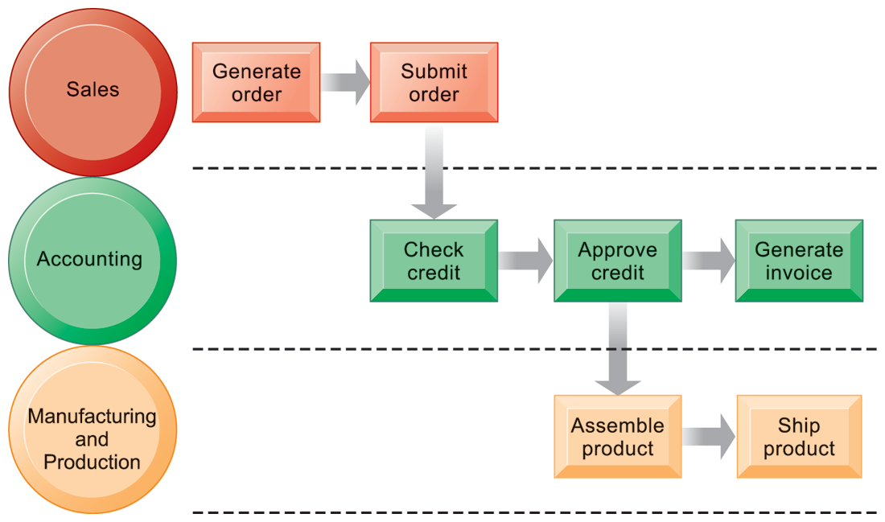
CHAPTER 2: GLOBAL E-BUSINESS AND COLLABORATION
Business Processes and Information Systems
The Order Fulfillment Process
FIGURE 2-1
Fulfilling a customer order involves a complex set of steps that requires the close coordination of the sales, accounting, and manufacturing functions.
Notes:
Emphasize that each rectangle represents one part of the larger business process of order fulfillment. Notice that this business process spans several different functional areas of the business from sales (orders), to accounting, and to manufacturing. Important business processes typically span several different functional areas or divisions in a business.

Slide 7
CHAPTER 2: GLOBAL E-BUSINESS AND COLLABORATION
Business Processes and Information Systems
Information technology enhances business processes in two main ways:
Increasing efficiency of existing processes
Automating steps that were manual
Enabling entirely new processes that are capable of transforming the businesses
Change flow of information
Replace sequential steps with parallel steps
Eliminate delays in decision making
Notes:
Examples of entirely new business processes made possible by information technology are downloading a song from iTunes or buying a book or e-book from Amazon. You might also mention the Amazon book reader Kindle which is continuously connected to the Internet and allows customers to download books and pay for them using Amazon’s one click purchase method. Ask students if they can name any other business processes that have been transformed in the last few years.

Slide 8
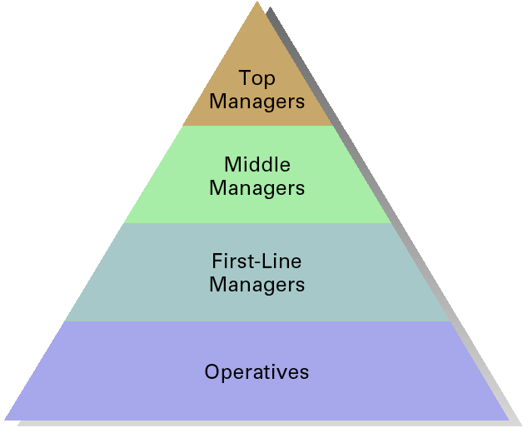
Organizational Levels and Information Systems
ESS: Executive Support System
MIS & DSS: Decision Support System
TPS: Transaction processing System
EXHIBIT 1.2
1–8

Slide 9
Transaction Processing System

Slide 10
CHAPTER 2: GLOBAL E-BUSINESS AND COLLABORATION
Types of Information Systems
Transaction processing systems
Perform and record daily routine transactions necessary to conduct business
Examples: sales order entry, payroll, shipping
Allow managers to monitor status of operations and relations with external environment
Serve operational levels
Serve predefined, structured goals and decision making
Notes:
The purpose of these systems is to answer routine questions about the flow of transactions through the organization. These systems are a necessity for any business.

Slide 11
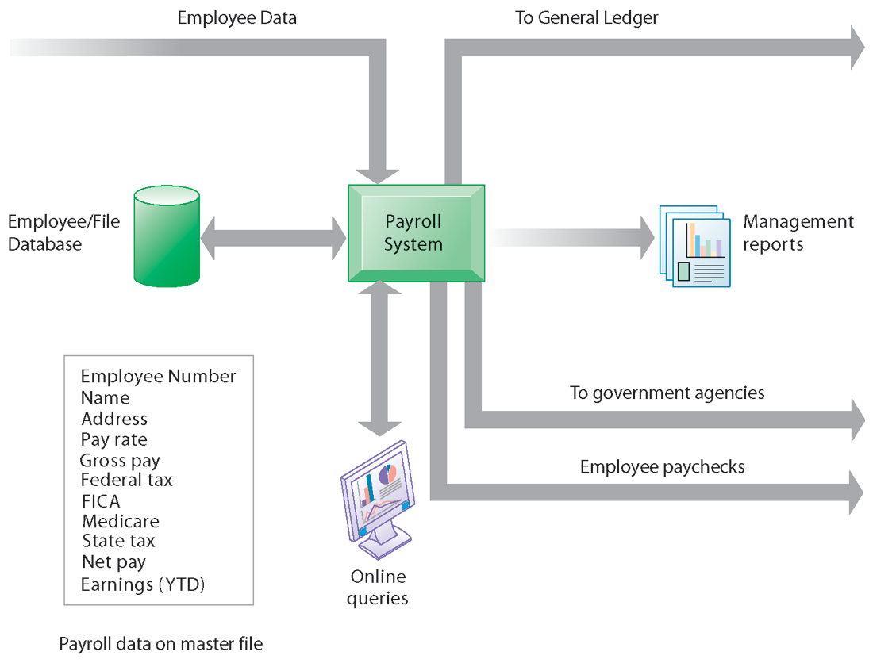
CHAPTER 2: GLOBAL E-BUSINESS AND COLLABORATION
Types of Information Systems
A Payroll TPS
A TPS for payroll processing captures employee payment transaction data (such as a time card). System outputs include online and hard-copy reports for management and employee paychecks.
FIGURE 2-2
Notes:
Note that the outputs of the payroll system are useful not only within the company to managers, but also to regulatory agencies and other entities relying on the accuracy of the reported data.

Slide 12
Management Information System

Slide 13
CHAPTER 2: GLOBAL E-BUSINESS AND COLLABORATION
Types of Information Systems
Management information systems
Serve middle management
Provide reports on firm’s current performance, based on data from TPS
Provide answers to routine questions with predefined procedure for answering them
Typically have little analytic capability
Notes:
Emphasize to students that management information systems is a specific category of information systems for middle management. It has the same name, but a very different meaning from the term introduced in Chapter 1 (the study of information systems in business and management). In other words, the study of management information systems involves looking at all the systems used in business. An MIS system is a specific type of an IS. It’s easy to get the two confused.

Slide 14
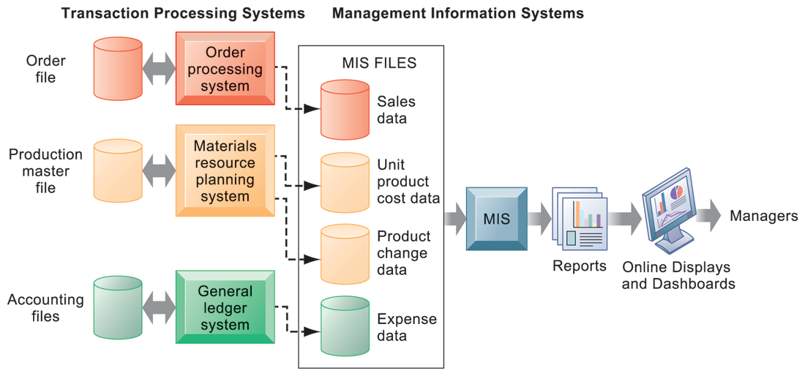
CHAPTER 2: GLOBAL E-BUSINESS AND COLLABORATION
Types of Information Systems
How Management Information Systems Obtain Their Data from the Organization’s TPS
FIGURE 2-3
In the system illustrated by this diagram, three TPS supply summarized transaction data to the MIS reporting system at the end of the time period. Managers gain access to the organizational data through the MIS, which provides them with the appropriate reports.
Notes:
Emphasize the relationship between TPS and MIS here. MIS receive data from an organization’s TPS systems and create outputs that management can use to make strategic decisions.

Slide 15
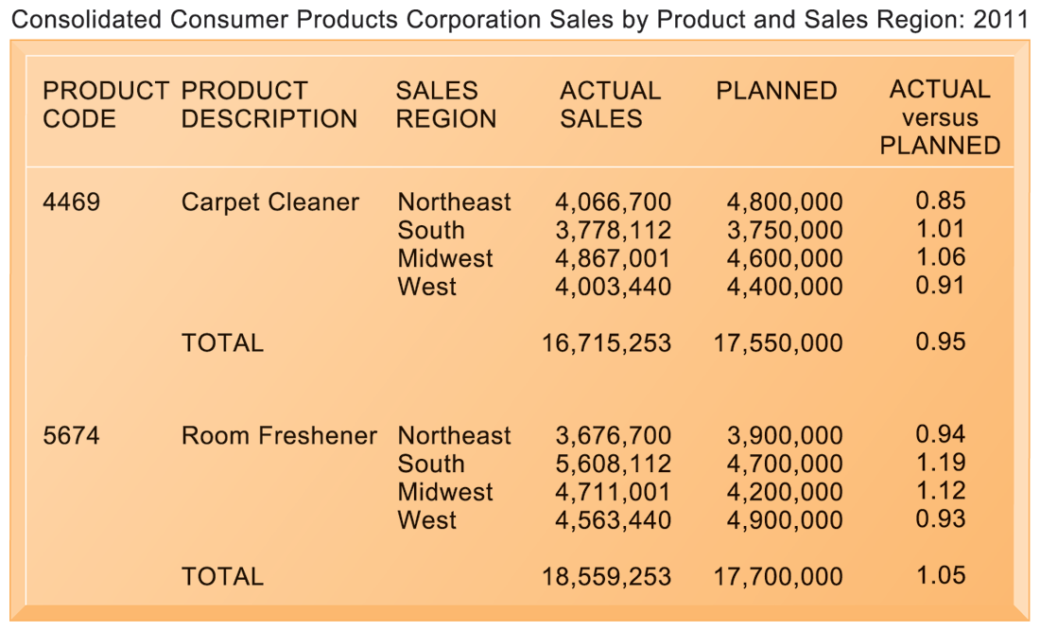
CHAPTER 2: GLOBAL E-BUSINESS AND COLLABORATION
Types of Information Systems
Sample MIS Report
FIGURE 2-4
This report, showing summarized annual sales data, was produced by the MIS in Figure 2-3.
Notes:
This graphic represents the “reports” portion of the previous figure, 2-3. Emphasize this to students, perhaps referencing that slide again to drive home that point. Students may not understand the decimals in the “ACTUAL versus PLANNED” category, where anything above 1.00 represents more sales than planned and anything less represents a disappointing result of fewer sales than planned.

Slide 16
CHAPTER 2: GLOBAL E-BUSINESS AND COLLABORATION
Types of Information Systems
Decision support systems
Serve middle management
Support non-routine decision making
Example: What is impact on production schedule if December sales doubled?
Often use external information as well from TPS and MIS
Model driven DSS
Voyage-estimating systems
Data driven DSS
Intrawest’s marketing analysis systems
Notes:
You could ask whether or not students understand what is meant by non-routine decision making, as opposed to routine decision making, and why DSS are specifically designed to assist managers in making that type of decision. Ask students for examples of non-routine decisions they make or have made in the past as managers or employees.

Slide 17
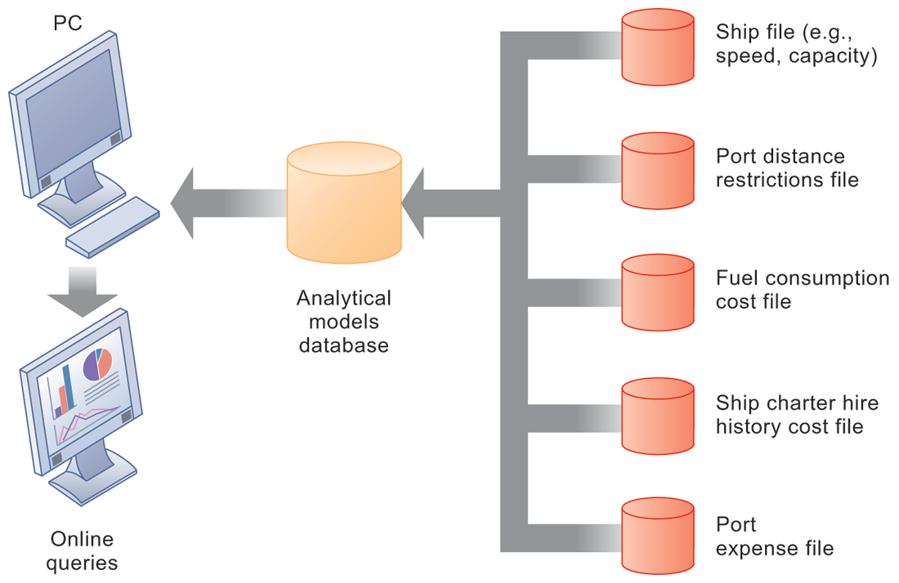
CHAPTER 2: GLOBAL E-BUSINESS AND COLLABORATION
Types of Information Systems
Voyage-Estimating Decision Support System
FIGURE 2-5
This DSS operates on a powerful PC. It is used daily by managers who must develop bids on shipping contracts.
Notes:
DSS can rely on either analytical models or large databases to provide valuable information. You could ask which of these two types the above figure best resembles (analytical models). You could also ask them what types of decisions does this system help its users make? Examples include what vessels to send to particular destinations to maximize profit, the optimal loading pattern for cargo, and the optimal rate at which vessels should travel to maximize efficiency while still meeting their schedules, and so forth.

Slide 18
CHAPTER 2: GLOBAL E-BUSINESS AND COLLABORATION
Types of Information Systems
Business intelligence
Class of software applications
Analyze current and historical data to find patterns and trends and aid decision-making
Used in systems that support middle and senior management
Data-driven DSS
Executive support systems (ESS)
Notes:
This slide emphasizes the relationship between the class of software called “business intelligence” and the decision-support systems used by middle and senior management, DSS and ESS. Business intelligence is a type of software used in analyzing data, and is used in both DSS and ES. As an example, the BMW Oracle boat described in the chapter opening case was using business intelligence – the software analyzed huge amounts of data, including real-time data, to determine hidden factors and correlations that make a sailboat go faster, and help the sailors make decisions in navigating and managing the boat.

Slide 19
CHAPTER 2: GLOBAL E-BUSINESS AND COLLABORATION
Types of Information Systems
Executive support systems
Support senior management
Address non-routine decisions
Requiring judgment, evaluation, and insight
Incorporate data about external events (e.g. new tax laws or competitors) as well as summarized information from internal MIS and DSS
Example: Digital dashboard with real-time view of firm’s financial performance: working capital, accounts receivable, accounts payable, cash flow, and inventory
Notes:
Emphasize the connection between ESS, MIS, and DSS. ESS rely on accurate inputs from a firm’s MIS and DSS to provide useful information to executives. These systems should not exist in isolation from one another. If they are isolated from each other, it is a kind of organizational dysfunction, probably inherited from the past. Note that the digital dashboard is a common feature of modern-day ESS. Emphasize that a critical feature of ESS is ease of use and simplicity of display. Executives using an ESS want quick access to the most critical data affecting their firm.

Slide 20
CHAPTER 2: GLOBAL E-BUSINESS AND COLLABORATION
Types of Information Systems
Systems from a constituency perspective
Transaction processing systems: supporting operational level employees
Management information systems and decision-support systems: supporting managers
Executive support systems: supporting executives
Notes:
This slide is a recap of the previous slides describing these types of systems. In a constituency perspective, systems are distinguished on the basis of who uses the system– operational managers, middle management, senior management. Systems are often designed to fit the specific needs of each of these groups in a firm. These groups form “constituencies” that CIOs must appeal to for support.

Slide 21
CHAPTER 2: GLOBAL E-BUSINESS AND COLLABORATION
Types of Information Systems
Relationship of systems to one another
TPS: Major source of data for other systems
ESS: Recipient of data from lower-level systems
Data may be exchanged between systems
In reality, most businesses’ systems are only loosely integrated (but they are getting better!)
Notes:
This slide once again emphasizes the relationship between different types of systems, but explain that actually achieving such a high level of integration is rare. You could ask students to offer reasons why it might be difficult to do this. Firms have been and continue to make large investments in enterprise-wide systems that promise to integrate the many data flows that exist in all large organizations.

Slide 22
CHAPTER 2: GLOBAL E-BUSINESS AND COLLABORATION
Types of Information Systems
Enterprise applications
Systems for linking the enterprise
Span functional areas
Execute business processes across firm
Include all levels of management
Four major applications:
Enterprise systems
Supply chain management systems
Customer relationship management systems
Knowledge management systems
Notes:
Enterprise applications are used to manage the information used in the systems discussed previously. In other words, enterprise applications are used to ensure that TPS, MIS, DSS, and ESS work together smoothly.

Slide 23
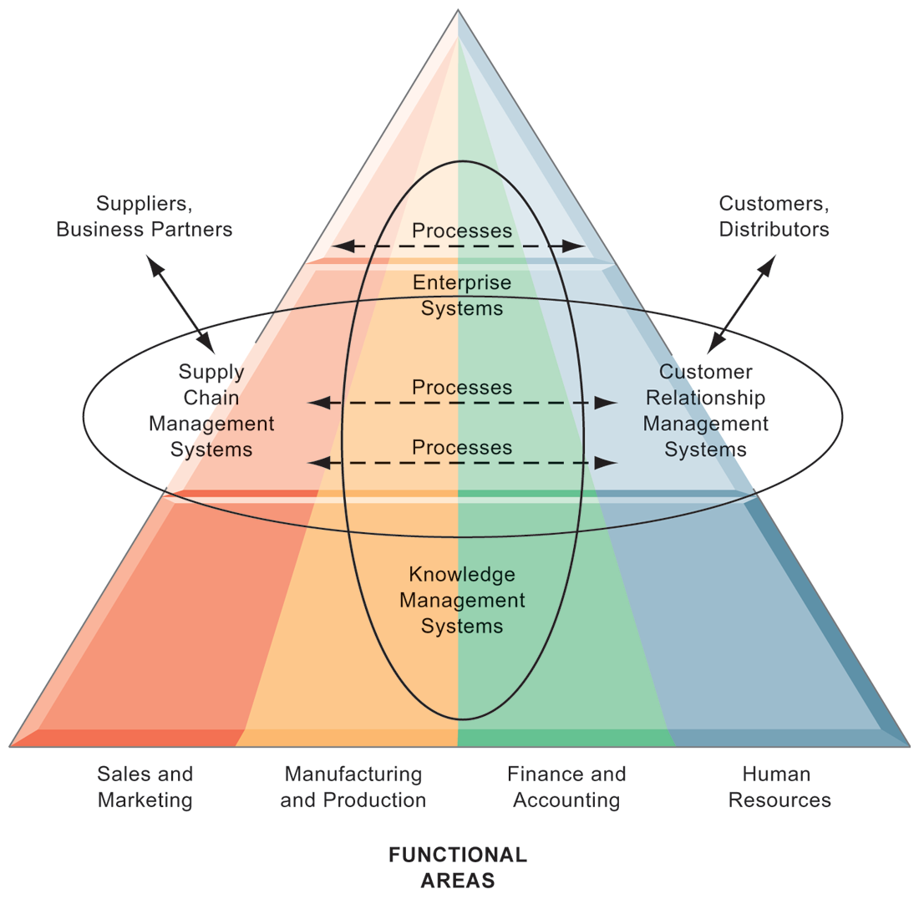
CHAPTER 2: GLOBAL E-BUSINESS AND COLLABORATION
Types of Information Systems
Enterprise Application Architecture
Enterprise applications automate processes that span multiple business functions and organizational levels and may extend outside the organization.
FIGURE 2-6
Notes:
The purpose of this graphic is simply to illustrate that enterprise systems are very large and diverse databases that pull information from many parts of the firm and enable processes both across the firm, at different organizational levels, as well as with suppliers and customers.
The triangle represents the organization, with different colors for the four main business functions. The ovals show that an enterprise application architecture incorporates systems used in sales and marketing, enabling these to communicate with each other and externally, with suppliers and customers. It also incorporates information supplied by knowledge management systems, manufacturing and finance systems, and other enterprise systems. The purpose of incorporating data and information from all of these sources is to enable and automate cross-functional business processes and supply accurate information to aid decision making.

Slide 24
CHAPTER 2: GLOBAL E-BUSINESS AND COLLABORATION
Types of Information Systems
Enterprise systems
Collects data from different firm functions and stores data in single central data repository
Resolves problem of fragmented, redundant data sets and systems
Enable:
Coordination of daily activities
Efficient response to customer orders (production, inventory)
Provide valuable information for improving management decision making
Notes:
This slide emphasizes the singularity of enterprise systems (one system) that integrates information flows from a variety of sources and serves a wide variety of groups and purposes in the firm. Remind students of the difference between enterprise applications and enterprise systems: Enterprise applications are any applications that span the enterprise, and types of enterprise applications include CRM, SCM,KMS and enterprise systems. Enterprise systems refers to the larger database environment within which these applications reside and operate.
Note that enterprise systems are referred to in some first as “enterprise resource planning systems (ERP).

Slide 25
CHAPTER 2: GLOBAL E-BUSINESS AND COLLABORATION
Types of Information Systems
Supply chain management (SCM) systems
Manage firm’s relationships with suppliers
Share information about
Orders, production, inventory levels, delivery of products and services
Goal:
Right amount of products to destination with least amount of time and lowest cost
Notes:
Emphasize that SCM systems are inter-organizational systems, automating the flow of information across organizational boundaries. This distinction is important because SCM systems must be designed with the business processes of potential partners and suppliers in mind.

Slide 26
CHAPTER 2: GLOBAL E-BUSINESS AND COLLABORATION
Types of Information Systems
Customer relationship management systems:
Provide information to coordinate all of the business processes that deal with customers in sales, marketing, and service to optimize revenue, customer satisfaction, and customer retention
Integrate firm’s customer-related processes and consolidate customer information from multiple communication channels
Notes:
CRM systems are extremely important for both marketing and customer service. You could ask students if they’ve ever filled out a survey for a company. Then connect that to information systems, perhaps explaining that the information they entered was provided as input to a CRM system for analysis.

Slide 27
CHAPTER 2: GLOBAL E-BUSINESS AND COLLABORATION
Types of Information Systems
Knowledge management systems (KMS)
Support processes for acquiring, creating, storing, distributing, applying, integrating knowledge
How to create, produce, distribute products and services
Collect internal knowledge and experience within firm and make it available to employees
Link to external sources of knowledge
Notes:
The idea that business firms are repositories of knowledge may be new to many students. Ask students for examples of firm knowledge; for instance, the knowledge required to run a fast food restaurant, or the knowledge required to operate a Web site like Amazon.
Explain that knowledge management systems are useful for helping a firm’s employees understand how to perform certain business processes or how to solve problems. What might the consequences be for a firm with poor knowledge management systems?

Slide 28
CHAPTER 2: GLOBAL E-BUSINESS AND COLLABORATION
Types of Information Systems
Alternative tools that increase integration and expedite the flow of information
Intranets:
Internal company Web sites accessible only by employees
Extranets:
Company Web sites accessible externally only to vendors and suppliers
Often used to coordinate supply chain
Notes:
Enterprise applications are typically extremely expensive as well as difficult to implement. Ask students why this would be so…
Intranets and extranets use Internet technology to communicate internally to employees, allow employees to communicate with each other and share documents, and to help communication with vendors. They are essentially password protected Web sites. The simplest intranets and extranets may use static web pages to relay information, while more sophisticated versions may be database-driven and enable key business processes. Ask students if they have used an intranet or extranet before and what services or information it provided. Does their school have an intranet/extranet? Generally universities have a Web site with different levels of access for the general public, registered students, faculty and administrators. The public-facing part of the Web site can be thought of as the “extranet,” while the part of the Web site serving students and faculty can be thought of as the “intranet.” These terms (intranet and extranet) are fading from use, but students will occasionally find firms still using these terms.

Slide 29
CHAPTER 2: GLOBAL E-BUSINESS AND COLLABORATION
Types of Information Systems
E-business
Use of digital technology and Internet to drive major business processes
E-commerce
Subset of e-business
Buying and selling goods and services through Internet
E-government:
Using Internet technology to deliver information and services to citizens, employees, and businesses
Notes:
The use of Internet technology has transformed and continues to transform businesses and business activity. This slide aims to distinguish different terminology used in the book. E-business refers to the use of the Internet and networking to enable all parts of the business, while e-commerce refers to just that part of business that involves selling goods and services over the Internet.
Internet technology has also brought similar changes in the public sector – the use of Internet and networking technologies in government is referred to as e-government. Ask students what changes in businesses or government due to new Internet technologies they have noticed.

Slide 30
CHAPTER 2: GLOBAL E-BUSINESS AND COLLABORATION
Systems for Collaboration and Teamwork
Collaboration:
Short-lived or long-term
Informal or formal (teams)
Growing importance of collaboration:
Changing nature of work
Growth of professional work – “interaction jobs”
Changing organization of the firm
Changing scope of the firm
Emphasis on innovation
Changing culture of work
Notes:
A number of factors are leading to a growing emphasis on collaboration in the firm. Work is changing, requiring more cooperation and coordination. Professions play a larger role in firms than before, and this often requires more consultation among experts than before. Organizations are flatter, with many more decisions made far down in the hierarchy. Organizations are more far flung around the globe, in multiple locations. There’s an emphasis on finding and sharing ideas which requires collaboration. Finally, what it means to be a “good” employee these days is in part an ability to work with others, and collaborate effectively. The culture of work has changed.

Slide 31
CHAPTER 2: GLOBAL E-BUSINESS AND COLLABORATION
Systems for Collaboration and Teamwork
Business benefits of collaboration and teamwork
Investments in collaboration technology can produce organizational improvements returning high ROI
Benefits:
Productivity
Quality
Innovation
Customer service
Financial performance
Profitability, sales, sales growth
Notes:
Research regarding the business benefits of collaboration is anecdotal, however, business and academic communities generally regard collaboration as an essential driving factor in business success: Firms that collaborate more make more money.
Ask students to give examples of how collaboration can improve productivity, product quality, and customer service. Has anyone had a fruitful collaborative experience in which an aspect of a company they worked at or an organization they were in?

Slide 32
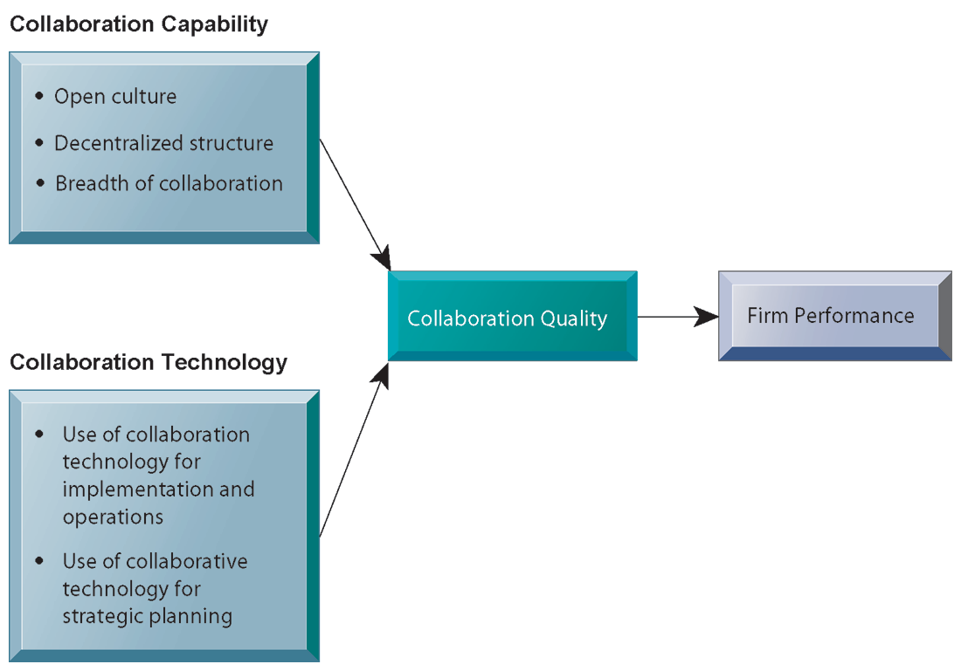
CHAPTER 2: GLOBAL E-BUSINESS AND COLLABORATION
Systems for Collaboration and Teamwork
Requirements for Collaboration
FIGURE 2-7
Successful collaboration requires an appropriate organizational structure and culture, along with appropriate collaboration technology.
Notes:
This slide graphically describes how collaboration is believed to impact business performance. Two primary ingredients are needed: Collaboration capability (including how much collaboration is possible) and collaboration technology or means. The quality of these two factors directly affects firm performance – the higher quality of collaboration means better firm performance. Ask students how collaboration can be high or low quality? An example of low-quality collaboration could be a team put together to solve a business problem but is unable to effectively work together because of internal politics. Have students any experience of poor collaboration?

Slide 33
CHAPTER 2: GLOBAL E-BUSINESS AND COLLABORATION
Systems for Collaboration and Teamwork
Building a collaborative culture and business processes
“Command and control” organizations
No value placed on teamwork or lower-level participation in decisions
Collaborative business culture
Senior managers rely on teams of employees
Policies, products, designs, processes, systems rely on teams
Managers purpose is to build teams
Notes:
Collaboration is not something that spontaneously arises – it must be enabled and nurtured. Collaborative culture is an essential factor – simply having collaborative technology will not result in collaboration if it isn’t seen as part of the business and rewarded. Have any students worked at “command and control” organizations? If so, were they able to see aspects of the business that could be improved but were unable to make contributions because of the firm’s culture? Are there any businesses or business functions that benefit by less collaboration? Are there any disadvantages to collaboration?

Slide 34
CHAPTER 2: GLOBAL E-BUSINESS AND COLLABORATION
Systems for Collaboration and Teamwork
Technology for collaboration and teamwork
15 categories of collaborative software tools
Email and instant messaging White boarding
Collaborative writing Web presenting
Collaborative reviewing Work scheduling
Event scheduling Document sharing /wikis
File sharing Mind mapping
Screen sharing Large audience Webinars
Audio conferencing Co-browsing
Video conferencing
Notes:
Information systems enable collaboration. There are thousands of tools available ranging from free to very expensive. Ask students which of these tools they have used for work or schoolwork – and which of these they have found the most useful.

Slide 35
CHAPTER 2: GLOBAL E-BUSINESS AND COLLABORATION
Systems for Collaboration and Teamwork
Technology for collaboration and teamwork (cont.)
Social Networking
Wikis
Virtual Worlds
Internet-Based Collaboration Environments
Virtual meeting systems (telepresence)
Google Apps/Google sites
Microsoft SharePoint
Lotus Notes
Notes:
The text goes into more depth on each of these tools. Give an example for each type of tool . A business use of social networking is Facebook accounts for businesses; using wiki’ as extended, more complete FAQs, and virtual worlds to conduct online meetings for employees around the world. Distinguish these individual tools from Internet-based collaboration environments, which are suites of collected collaboration tools, enabling communication and data-sharing between tools.

Slide 36
CHAPTER 2: GLOBAL E-BUSINESS AND COLLABORATION
Systems for Collaboration and Teamwork
VIRTUAL MEETINGS: SMART MANAGEMENT
What are the advantages of using videoconferencing technologies? What are the disadvantages?
What is telepresence and what sorts of companies are best suited to use it as a communications tool?
What kinds of companies could benefit from using videoconferencing? Are there any companies that might not derive any benefits from this technology?
Notes:
You could ask students if they’ve ever used any form of videoconferencing or video chat and whether or not they thought it was useful or effective. Many students will have used Skype video. You could also ask students to describe the impact of videoconferencing on areas other than the businesses using it, such as the airline industry (negative impact due to the potential reduction in airline travel) or the environment (positive impact). Ask students if they have used Web-based conferencing on their PC to connect with family members or friends. Do they think video conferencing on cell phones would be useful to business? Has business travel declined because of video conferencing?

Slide 37
CHAPTER 2: GLOBAL E-BUSINESS AND COLLABORATION
Systems for Collaboration and Teamwork
Two dimensions of collaboration technologies
Space (or location) – remote or colocated
Time – synchronous or asynchronous
Six steps in evaluating software tools
What are your firm’s collaboration challenges?
What kinds of solutions are available?
Analyze available products’ cost and benefits
Evaluate security risks
Consult users for implementation and training issues
Evaluate product vendors
Notes:
When evaluating collaboration tools for your businesses, the first step is to identify the kind of problem you have. The key problems are time and location. Generally, no one has enough time and often key people are not in the right place. Some teams may need to work together in real-time, while others may simply need shared documentation. In analyzing collaboration tools by the space/time dimensions you can determine what types of tools will solve your problem. The six steps in evaluating software is applicable not only for collaboration tools but any software solution for your company. First determine the challenge or problem, look for solutions for this particular problem and so forth.

Slide 38
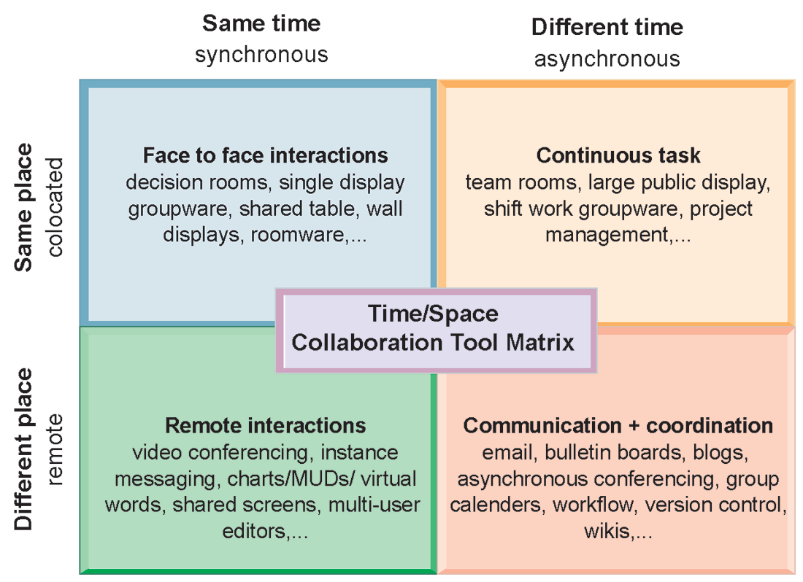
CHAPTER 2: GLOBAL E-BUSINESS AND COLLABORATION
Systems for Collaboration and Teamwork
The Time/Space Collaboration Tool Matrix
FIGURE 2-8
Collaboration technologies can be classified in terms of whether they support interactions at the same or different time or place whether these interactions are remote or co-located.
Notes:
You can use this matrix to identify solutions to the time/location issues that face a firm, and to choose specific collaboration technologies.

Slide 39
CHAPTER 2: GLOBAL E-BUSINESS AND COLLABORATION
The Information Systems Function in Business
Information systems department:
Formal organizational unit responsible for information technology services
Often headed by chief information officer (CIO)
Other senior positions include chief security officer (CSO), chief knowledge officer (CKO), chief privacy officer (CPO)
Programmers
Systems analysts
Information systems managers
Notes:
Defined simply, the information systems department of a firm is responsible for coordinating all of the systems previously mentioned in this chapter. How the department is organized depends on the nature and size of the business. Small companies may not have a formal department, while large companies may have several departments for different business functions, or they have an IT Department in each corporate division. Ask students what types of information systems departments they have had experience with.

Slide 40
CHAPTER 2: GLOBAL E-BUSINESS AND COLLABORATION
The Information Systems Function in Business
End users
Representatives of other departments for whom applications are developed
Increasing role in system design, development
IT Governance:
Strategies and policies for using IT in the organization
Decision rights
Accountability
Organization of information systems function
Centralized, decentralized, etc.
Notes:
As the development of business information systems matures, end users have been increasingly recognized as pivotal to developing a successful system. In addition, the information systems department has also been recognized as a powerful resource for developing new products, services and efficiencies. As such, IT governance is a central business concern – being able to use IT efficiently and effectively has become more and more essential to a business’ success.

