Slide 1
INFORMATION SYSTEMS IN BUSINESS TODAY
Chapter 1
Case 1: UPS Global Operations with the DIAD IV
Case 2: IBM, Cisco, Google: Global Warming by Computer

Slide 2
Management Information System
WHAT’S NEW IN MIS?
(Importance of the Course)
IT Innovations.
  Examples; cloud computing, smart-phones, tablet computers etc.
New Business Models.
  Examples; online video stores like Netflix for streaming, and Apple iTunes for downloading

Slide 3
Management Information System
WHAT’S NEW IN MIS?
(Importance of the Course)
E-commerce Expanding.
  Examples; Amazon.com, OLX.com.pk
Management Changes.
  Examples; with new IT innovations, remote salespeople on the road are only seconds away from their managers’ questions and oversight and have online, nearly instant, access to the really important information needed for accurate and timely decisions.

Slide 4
Management Information System
WHAT’S NEW IN MIS?
(Importance of the Course)
Changes in Firms and Organizations:
  Examples;
    less emphasis on hierarchy and structure
    More emphasis on employee’s skills, competencies
    More emphasis on fast and timely decision making
    More awareness of technology changes, customers, employees, suppliers etc.

Slide 5
Why Study MIS
After successful completion of this course, You will be able to
  understand the Information System environment
  handle different situations with appropriate Information Systems
  have sufficient knowledge of business process and business functions
  have sufficient information regarding business organizations
  suggest the organizational and management solutions with the help of technology

Slide 6
Managing the Digital firm
The Role of Information Systems in Business Today
HOW ARE INFORMATION SYSTEMS TRANSFORMING BUSINESS, AND WHY ARE THEY SO ESSENTIAL FOR RUNNING AND MANAGING A BUSINESS TODAY?
© Prentice Hall 2011

Slide 7
CHAPTER 1: INFORMATION IN BUSINESS SYSTEMS TODAY
The Role of Information Systems in Business Today
How information systems are transforming business
  Increase in wireless technology use, Web sites
  Increased business use of Web 2.0 technologies
  Cloud computing, mobile digital platform allow more distributed work, decision-making, and collaboration
Globalization opportunities
  Internet has drastically reduced costs of operating on global scale
  Presents both challenges and opportunities
© Prentice Hall 2011
Notes:
New federal security and accounting laws that require companies to store e-mail for 5 years have spurred the growth of digital information, which is increasing at a rate of 5 exabytes annually. Students may be surprised to learn that 5 exabytes of data is equivalent to 37,000 Libraries of Congress. Ask the students to think about what difference it makes to the world economy, or the U.S. economy, if global operations become much less expensive? What are the challenges to American suppliers of goods and services, and to labor?

Slide 8
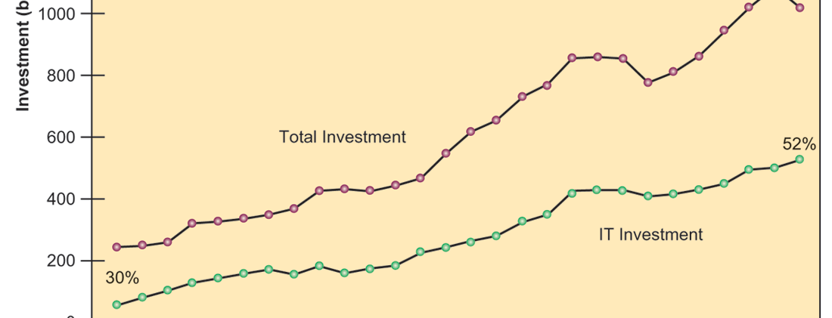
CHAPTER 1: INFORMATION IN BUSINESS SYSTEMS TODAY
The Role of Information Systems in Business Today
Information Technology Capital Investment
FIGURE 1-1
Information technology capital investment, defined as hardware, software, and communications equipment, grew from 32 percent to 52 percent of all invested capital between 1980 and 2009.
© Prentice Hall 2011
Notes:
Emphasize to students that total investment is over one trillion dollars in 2010, and that over 550 billion dollars of that was invested in information technology. You could ask them why it is that the percentage of total investment devoted to IT has increased so much since 1980? Other kinds of capital investment are machinery and buildings. Why would firms increase IT investment faster than machinery and buildings. The answer is capital substitution: the price of IT capital has been falling exponentially, while the price of machine and buildings has been growing at slightly more than the rate of inflation. Wherever possible, firms would much rather invest in more IT than machinery or buildings because the returns on the investment are greater.

Slide 9
CHAPTER 1: INFORMATION IN BUSINESS SYSTEMS TODAY
The Role of Information Systems in Business Today
In the emerging, fully digital firm
  Significant business relationships (such as with customer and supplier) are digitally managed.
  Core business processes are accomplished through digital networks
  Key corporate assets are managed digitally
Digital firms offer greater flexibility in organization and management
  Time shifting, space shifting
  Example: Such as Cisco Systems, 3M, and IBM
© Prentice Hall 2011
Notes:
Time shifting and space shifting are connected to globalization. You could ask students to explain why a digital firm is more likely to benefit from globalization than a traditional firm. One answer is that by allowing business to be conducted at any time (time shifting) and any place (space shifting), digital firms are ideally suited for global operations which take place in remote locations and very different time zones.

Slide 10
CHAPTER 1: INFORMATION IN BUSINESS SYSTEMS TODAY
The Role of Information Systems in Business Today
Advantages of using IS in businesses.
  Business firms invest heavily in information systems to achieve six strategic business objectives:
  Operational excellence
  New products, services, and business models
  Customer and supplier intimacy
  Improved decision making
  Competitive advantage
  Survival
© Prentice Hall 2011
Notes:
In the Yankee Stadium opening case, the UPS Interactive Session later in the chapter, and with many of the Interactive Sessions and opening cases in the book, it will be useful to ask students to explain how various information systems succeeded or failed in achieving the six strategic business objectives. For example, in the Yankee Stadium case, information systems helped the Yankees achieve greater customer intimacy and offer new services. You might ask the students to think about some other business objectives and think about how IT might help firms achieve them. For instance, speed to market is very important to firms introducing new products. How can IT help achieve that objective?

Slide 11
CHAPTER 1: INFORMATION IN BUSINESS SYSTEMS TODAY
The Role of Information Systems in Business Today
Operational excellence:
  Achieving Efficiency and Effectiveness in Business Processes and ultimately achieving higher productivity and profitability.
  Walmart’s RetailLink system links suppliers to stores for superior replenishment system
© Prentice Hall 2011
Notes:
Walmart is the most efficient retailer in the industry and exemplifies operational excellence. You could ask students to name other businesses that they believe to exhibit a high level of operational excellence. Do customers perceive operational excellence? Does it make a difference for customer purchasing? What Web sites strike students as really excellent in terms of customer service? If you have a podium computer, you might want to visit the Walmart site and the Amazon site to compare them in terms of ease of use.

Slide 12
Discuss Examples
© Prentice Hall 2011

Slide 13
Discuss Examples
Restaurant in Lahore
© Prentice Hall 2011

Slide 14
CHAPTER 1: INFORMATION IN BUSINESS SYSTEMS TODAY
The Role of Information Systems in Business Today
New products, services, and business models:
  Business model: describes how company produces, delivers, and sells product or service to create wealth
  Information systems and technology a major enabling tool for new products, services, business models
© Prentice Hall 2011
Notes:
You could ask students to name other new products or business models that they’ve encountered and how they might relate to new information systems or new technology. One way to encourage participation is ask students to help you list on the blackboard some really interesting recent digital product innovations. Discussing “green technologies” like wind, solar, and hybrid vehicles is always fun. In this context, what role will IT be playing in the development of these technologies?

Slide 15
Discuss Examples
Apple’s iPod,
iTunes, iPhone,
iPad, Google’s Android OS,
and Netflix
© Prentice Hall 2011

Slide 16
CHAPTER 1: INFORMATION IN BUSINESS SYSTEMS TODAY
The Role of Information Systems in Business Today
Customer and supplier intimacy:
  Serving customers well leads to customers returning, which raises revenues and profits
    Example: High-end hotels that use computers to track customer preferences and use to monitor and customize environment
  Intimacy with suppliers allows them to provide vital inputs, which lowers costs
    Example: J.C.Penney’s information system which links sales records to contract manufacturer
© Prentice Hall 2011
Notes:
You could ask students what types of companies might rely more on customer and supplier intimacy than others and which companies they feel have served them exceptionally well. Ask the students to identify online sites that achieve a high degree of customer intimacy. Sites to visit would include Netflix, Amazon, and other sites which have recommender systems to suggest purchase ideas to consumers.

Slide 17
Discuss Examples
Customer Intimacy Businesses
  Restaurants
Supplier Intimacy
© Prentice Hall 2011

Slide 18
CHAPTER 1: INFORMATION IN BUSINESS SYSTEMS TODAY
The Role of Information Systems in Business Today
Improved decision making
  Without accurate information:
    Managers must use forecasts, best guesses, luck
    Leads to:
      Overproduction, underproduction of goods and services
      Misallocation of resources
      Poor response times
    Poor outcomes raise costs, lose customers
  Example: Verizon’s Web-based digital dashboard to provide managers with real-time data on customer complaints, network performance, line outages, etc.
© Prentice Hall 2011
Notes:
You could ask students if they have ever been recipients of exceptional service from a company made possible by improved decision-making and whether or not information systems contributed to that level of service. For example, perhaps they had a power outage and it took a very short (or very long) time for the utility company to correct the error.

Slide 19
Discuss Examples
Use of LED lights and Dashboard in Cricket
© Prentice Hall 2011

Slide 20
CHAPTER 1: INFORMATION IN BUSINESS SYSTEMS TODAY
The Role of Information Systems in Business Today
Operational excellence:
  Improvement of efficiency to attain higher profitability
New products, services, and business models:
  Enabled by technology
Customer and supplier intimacy:
  Serving customers raises revenues and profits
  Better communication with suppliers lowers costs
Improved decision making
  More accurate data leads to better decisions
© Prentice Hall 2011
Notes:
This slide is a recap of the previous four slides. You might ask students which business objective they believe to be most critical to the success of a business, or whether they all carry equal weight.

Slide 21
Discuss Examples
© Prentice Hall 2011

Slide 22
CHAPTER 1: INFORMATION IN BUSINESS SYSTEMS TODAY
The Role of Information Systems in Business Today
Competitive advantage
  Delivering better performance
  Charging less for superior products
  Responding to customers and suppliers in real time
  Examples: Apple, Walmart,
© Prentice Hall 2011
Notes:
Emphasize that achieving any of the previous four business objectives represents the achievement of a competitive advantage as well.

Slide 23
CHAPTER 1: INFORMATION IN BUSINESS SYSTEMS TODAY
The Role of Information Systems in Business Today
Survival
  Information technologies as necessity of business
  May be:
    Industry-level changes, e.g. introduction of ATMs in Banks
    Governmental regulations requiring record-keeping
      Examples: Toxic Substances Control Act, Sarbanes-Oxley Act
© Prentice Hall 2011
Notes:
Ask students if they can name any examples of companies that failed to survive due to unwillingness or inability to update their information systems. The Sarbanes-Oxley Act requires that public firms keep all data, including e-mail, on record for 5 years. You could ask students if they appreciate why information systems would be useful towards meeting the standards imposed by this legislation.

Slide 24
Discuss Examples
© Prentice Hall 2011

Slide 25
CHAPTER 1: INFORMATION IN BUSINESS SYSTEMS TODAY
Perspectives on Information Systems
Information system:
  Set of interrelated components
  Collect, process, store, and distribute information
  Support decision making, coordination, and control
Information vs. data
  Data are streams of raw facts
  Information is data shaped into meaningful form
© Prentice Hall 2011
Notes:
These are some basic background understandings needed for the course. A system refers to a set of components that work together (hopefully). Can students think of systems other than information systems? The point of an information system is to make sense out all the confusing data in the environment, and put the data into some kind of order. Information is an ordered set of data that you can understand and act on. If the students want to get a sense of raw data, show them a stock ticker on a Web financial site (or Yahoo/finance). Ask them to tell you what it means? Then show them the current value of the Dow Jones Industrial Index and the S&P 500, and its daily trend (or for that matter switch to a 1 year view of either of these indexes). Looking at the indexes students can quickly get a grasp of whether the market is up or down, and they could act on that information.

Slide 26
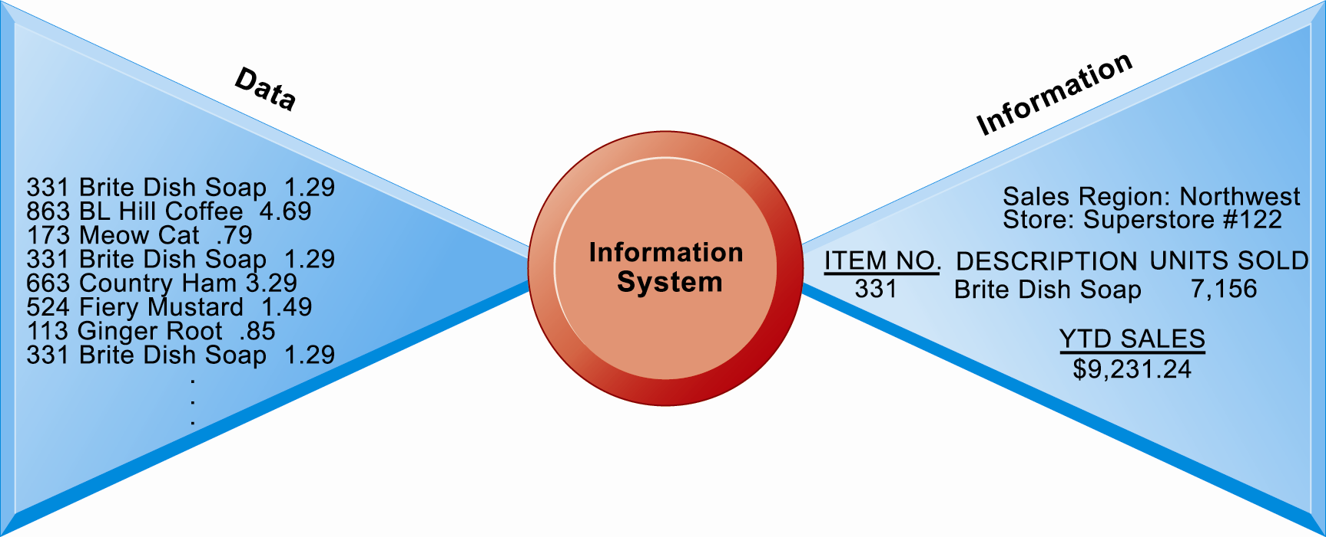
CHAPTER 1: INFORMATION IN BUSINESS SYSTEMS TODAY
Perspectives on Information Systems
Data and Information
Figure 1.3
Raw data from a supermarket checkout counter can be processed and organized to produce meaningful information, such as the total unit sales of dish detergent or the total sales revenue from dish detergent for a specific store or sales territory.
© Prentice Hall 2011
Notes:
Emphasize the distinction between information and data. You could, for example, ask several students to list their ages and write the numbers on one side of the board – then you could calculate the average age of those students on the other side, oldest student, youngest student, and so forth, to illustrate the difference between raw data and meaningful information.

Slide 27
CHAPTER 1: INFORMATION IN BUSINESS SYSTEMS TODAY
Perspectives on Information Systems
Three activities of information systems produce information organizations need
  Input: Captures raw data from organization or external environment
  Processing: Converts raw data into meaningful form
  Output: Transfers processed information to people or activities that use it
© Prentice Hall 2011
Notes:
Use an example similar to the one given in the previous slide to illustrate the three activities involved in the function of an information system. Continuing with that example, the process of asking students their age would represent input, calculating the average age and determining the oldest and youngest age would represent processing, and writing that information on the board would represent output.

Slide 28
CHAPTER 1: INFORMATION IN BUSINESS SYSTEMS TODAY
Perspectives on Information Systems
Feedback:
  Output returned to appropriate members of organization to help evaluate or correct input stage
Computer/Computer program vs. information system
  Computers and software are technical foundation and tools, similar to the material and tools used to build a house
© Prentice Hall 2011
Notes:
Explain to students how the ‘house’ analogy works: assuming that a successful information system is like a completed ‘house’, computers and software only represent the tools and materials used to build the house. Tools and materials don’t just suddenly become a completed house – outside (human) input is required. Systems need to be designed to fit the firms and the humans who work with the systems.

Slide 29
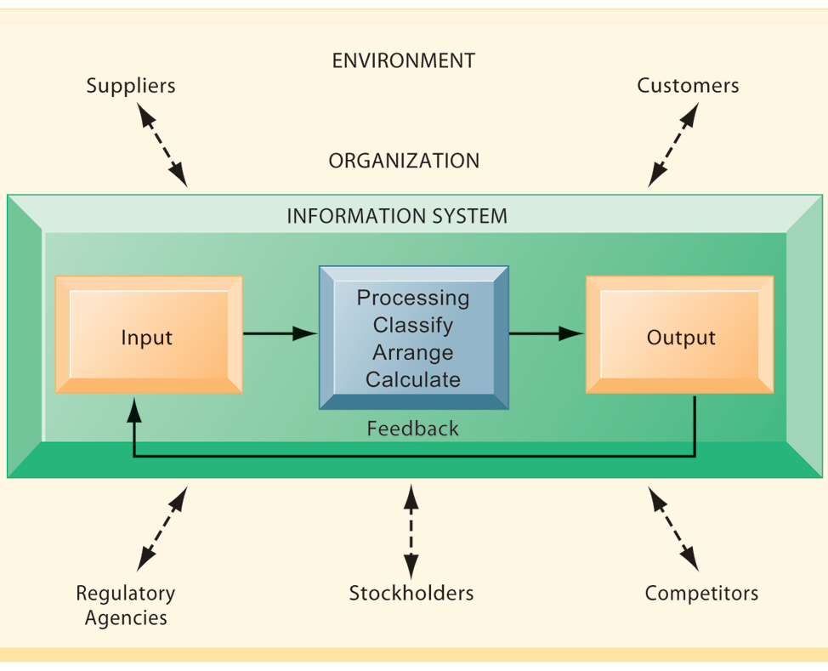
CHAPTER 1: INFORMATION IN BUSINESS SYSTEMS TODAY
Perspectives on Information Systems
Functions of an Information System
An information system contains information about an organization and its surrounding environment. Three basic activities—input, processing, and output—produce the information organizations need. Feedback is output returned to appropriate people or activities in the organization to evaluate and refine the input. Environmental actors, such as customers, suppliers, competitors, stockholders, and regulatory agencies, interact with the organization and its information systems.
Figure 1.4
© Prentice Hall 2011
Notes:
The point of this diagram is first of all to highlight the three basic activities of information systems, so that students can understand what an information system is doing at its most fundamental level. But the diagram also puts information systems into the context of organizations (firms), and then puts the firm into its respective environment composed of shareholders, higher level authorities (government), competitors, suppliers and customers. Suddenly students should see that information systems play a central role mediating and interacting with all these players. Hence, systems play a key role in the operations and survival of the firm.
You could also explain this diagram by relating it back to the opening case, as the book does. The two types of input into the Synergy system are manually entered data as well as video. The system processes that data and creates the output, video and statistics about specific types of players and plays.

Slide 30
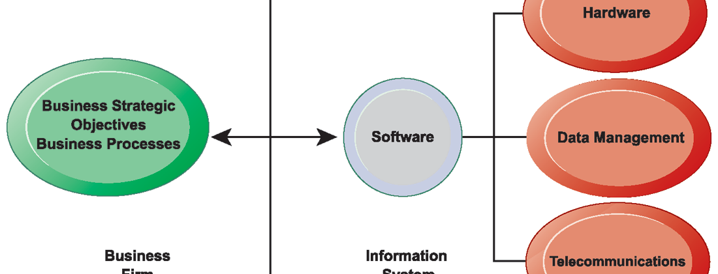
CHAPTER 1: INFORMATION IN BUSINESS SYSTEMS TODAY
The Role of Information Systems in Business Today
The Interdependence Between Organizations and Information Technology
Figure 1.2
In contemporary systems there is a growing interdependence between a firm’s information systems and its business capabilities. Changes in strategy, rules, and business processes increasingly require changes in hardware, software, databases, and telecommunications. Often, what the organization would like to do depends on what its systems will permit it to do.
© Prentice Hall 2011
Notes:
The basic point of this graphic is that in order to achieve its business objectives, a firm will need a significant investment in IT. Going the other direction (from right to left), having a significant IT platform can lead to changes in business objectives and strategies.
Emphasize the two-way nature of this relationship. Businesses rely on information systems to help them achieve their goals; a business without adequate information systems will inevitably fall short. But information systems are also products of the businesses that use them. Businesses shape their information systems and information systems shape businesses.

Slide 31
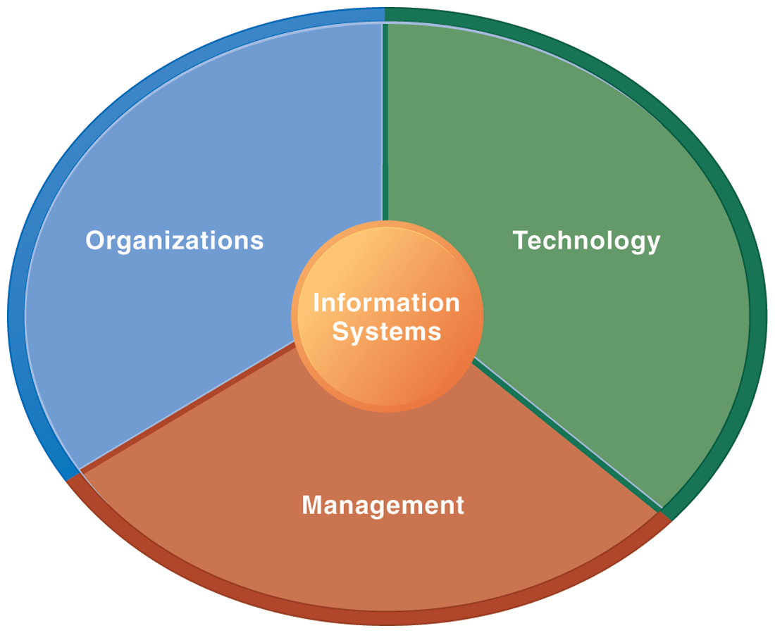
CHAPTER 1: INFORMATION IN BUSINESS SYSTEMS TODAY
Perspectives on Information Systems
Information Systems Are More Than Computers
Using information systems effectively requires an understanding of the organization, management, and information technology shaping the systems. An information system creates value for the firm as an organizational and management solution to challenges posed by the environment.
Figure 1.5
© Prentice Hall 2011
Notes:
These three themes (management, organizations, and technology) will reappear throughout the book. Understanding the interaction between these factors and information systems is known as information system literacy. Knowing how to optimize the relationship between technology, organizations, and management is the purpose of this book and course.

Slide 32
CHAPTER 1: INFORMATION IN BUSINESS SYSTEMS TODAY
Perspectives on Information Systems
Organizational dimension of information systems
  Hierarchy of authority, responsibility
    Senior management
    Middle management
    Operational management
    Knowledge workers
    Data workers
    Production or service workers
© Prentice Hall 2011
Notes:
Pages 18 and 19 in the text provides more specific details on each level of this hierarchy. You can ask students to talk about an organization where they currently work, or have worked in the past. What was their contact with senior management, middle management, and operational (supervisory) management? Many younger students will have had little or no contact with senior and middle management. Older students most likely will have experience. You might need to provide more description about exactly what senior managers do for the firm (and middle managers).

Slide 33
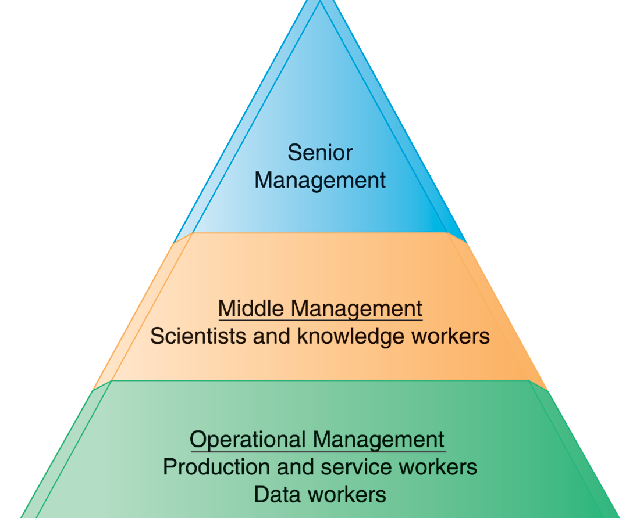
CHAPTER 1: INFORMATION IN BUSINESS SYSTEMS TODAY
Perspectives on Information Systems
Levels in a Firm
Business organizations are hierarchies consisting of three principal levels: senior management, middle management, and operational management. Information systems serve each of these levels. Scientists and knowledge workers often work with middle management.
Figure 1.6
© Prentice Hall 2011
Notes:
Ask students to think about how information systems would factor into the day-to-day jobs of each of the three types of workers in the pyramid.

Slide 34
CHAPTER 1: INFORMATION IN BUSINESS SYSTEMS TODAY
Perspectives on Information Systems
Organizational dimension of information systems (cont.)
  Separation of business functions
    Sales and marketing
    Human resources
    Finance and accounting
    Manufacturing and production
  Unique business processes
  Unique business culture
  Organizational politics
© Prentice Hall 2011
Notes:
The point of this slide is to let students know there are many organizational factors that will shape information systems. A common observation is that “Every business is different.” Does this mean every business will have different information systems? Every business has its unique culture, and politics. Systems reflect these business cultures.
For an example of how information systems shed light on a firm’s unique business processes and culture, you might describe the UPS Interactive Session later in the chapter. The company’s package tracking systems exemplify their commitment to customer service and putting the customer first.

Slide 35
CHAPTER 1: INFORMATION IN BUSINESS SYSTEMS TODAY
Perspectives on Information Systems
Management dimension of information systems
  Managers set organizational strategy for responding to business challenges
  In addition, managers must act creatively:
    Creation of new products and services
    Occasionally re-creating the organization
© Prentice Hall 2011
Notes:
How might information systems assist managers in the development of new products and services? What is meant by re-creating the organization? Why do organizations need to be continually re-created? The answer is that they quickly become obsolete unless they continue to change. Ask students to help you list some organizations that have recently failed, or are about to fail.

Slide 36
CHAPTER 1: INFORMATION IN BUSINESS SYSTEMS TODAY
Perspectives on Information Systems
Technology dimension of information systems
  Computer hardware and software
  Data management technology
  Networking and telecommunications technology
    Networks, the Internet, intranets and extranets, World Wide Web
  IT infrastructure: provides platform that system is built on
© Prentice Hall 2011
Notes:
Information technology is at the heart of information systems. While organization and management are important too, it’s the technology that enables the systems and the organizations and managers who use the technology.
The distinction between the Internet and intranets & extranets has to do with their scope. Intranets are private networks used by corporations and extranets are similar except that they are directed at external users (like customers and suppliers). In contrast, the Internet connects millions of different networks across the globe. Students may not immediately understand this distinction.

Slide 37
CHAPTER 1: INFORMATION IN BUSINESS SYSTEMS TODAY
Perspectives on Information Systems
Business perspective on information systems:
  Information system is instrument for creating value
  Investments in information technology will result in superior returns:
    Productivity increases
    Revenue increases
    Superior long-term strategic positioning
© Prentice Hall 2011
Notes:
You could ask students to consider how this view of information systems might contrast with the sociotechnical view or other views. You could also ask them to consider the circumstances under which information systems might not result in increased productivity and revenue.

Slide 38
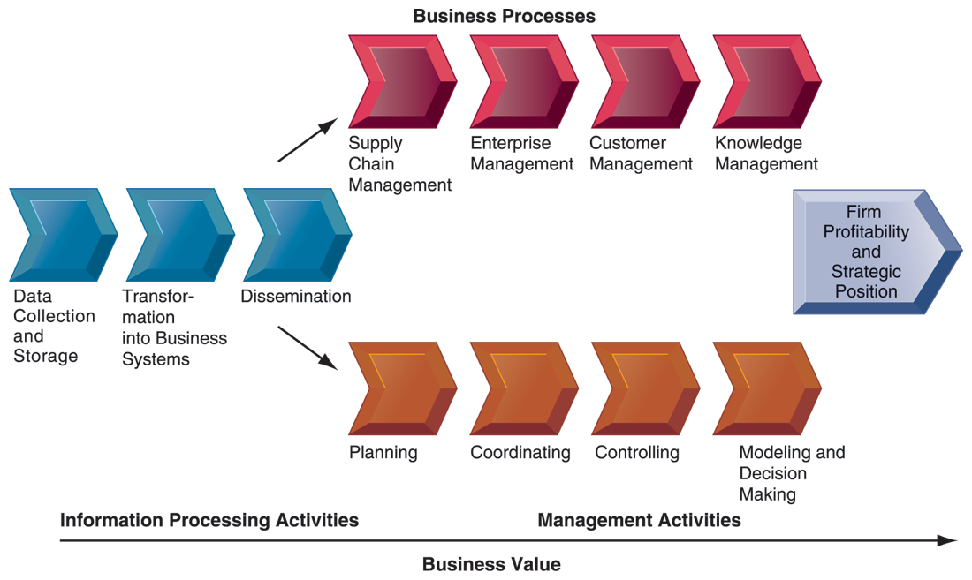
CHAPTER 1: INFORMATION IN BUSINESS SYSTEMS TODAY
Perspectives on Information Systems
The Business Information Value Chain
Figure 1-7
From a business perspective, information systems are part of a series of value-adding activities for acquiring, transforming, and distributing information that managers can use to improve decision making, enhance organizational performance, and, ultimately, increase firm profitability.
© Prentice Hall 2011
Notes:
The information value chain is one way to visualize the relationship between information activities, business processes, and management activities. You could also ask students if they could imagine any reason to create an information system besides profitability or strategic positioning (it’s not likely that they will think of one, which will prove the point). One reason to create a system that is not primarily profit oriented is to meet the information reporting requirements of government and other authorities.

Slide 39
CHAPTER 1: INFORMATION IN BUSINESS SYSTEMS TODAY
Perspectives on Information Systems
Complementary assets:
  Assets required to derive value from a primary investment
  Firms supporting technology investments with investment in complementary assets receive superior returns
  E.g.: invest in technology and the people to make it work properly
© Prentice Hall 2011
Notes:
The example used in the book for complementary assets is for automobile companies: these companies rely on investments in highways, other roads, gas stations, repair facilities, and so on to maximize the value of their primary investment. Ask students to provide a different example of another company’s or industries complementary assets.

Slide 40
CHAPTER 1: INFORMATION IN BUSINESS SYSTEMS TODAY
Perspectives on Information Systems
Investing in information technology does not guarantee good returns
Considerable variation in the returns firms receive from systems investments
Factors:
  Adopting the right business model
  Investing in complementary assets (organizational and management capital)
© Prentice Hall 2011
Notes:
Connect this slide to the previous slide. Many firms make significant investments in IT for very little benefit to the bottom line. Discuss why companies experience a wide variety of outcomes in their efforts to invest in IT. Consider the factors we use in this book: organizational and management factors.

Slide 41
CHAPTER 1: INFORMATION IN BUSINESS SYSTEMS TODAY
Perspectives on Information Systems
Complementary assets include:
  Organizational assets, e.g.
    Appropriate business model
    Efficient business processes
  Managerial assets, e.g.
    Incentives for management innovation
    Teamwork and collaborative work environments
  Social assets, e.g.
    The Internet and telecommunications infrastructure
    Technology standards
© Prentice Hall 2011
Notes:
Emphasize that firms that make significant investment in complementary assets tend to derive greater benefit from information technology investment than those that do not. Consideration of complementary assets should be a part of any firm’s broader view of how to create and implement their information systems. Stress to students that managers must consider dimensions like complementary assets in order to derive benefit from information systems and be successful.

Slide 42
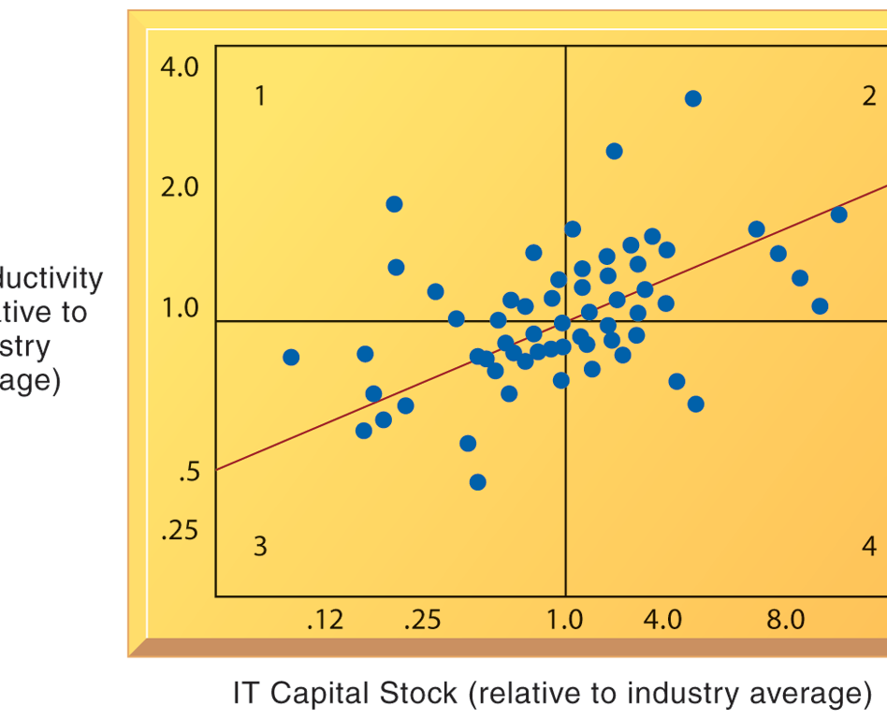
CHAPTER 1: INFORMATION IN BUSINESS SYSTEMS TODAY
Perspectives on Information Systems
Variation in Returns On Information Technology Investment
Although, on average, investments in information technology produce returns far above those returned by other investments, there is considerable variation across firms.
Figure 1.8
© Prentice Hall 2011
Notes:
Emphasize that each quadrant of the graph represents a different type of firm.
Quadrant 1 represents firms that invest much less in IT but still receive strong returns.
Quadrant 2 represents firms that invest a great deal in IT and receive a great deal in returns.
Quadrant 3 represents firms that invest much less in IT and receive poor returns.
Quadrant 4 represents firms that invest a great deal in IT but receive poor returns.
Ask students where they want their firms to show up? The purpose of the course and book is to show students how to end up in top quadrant (2).

Slide 43
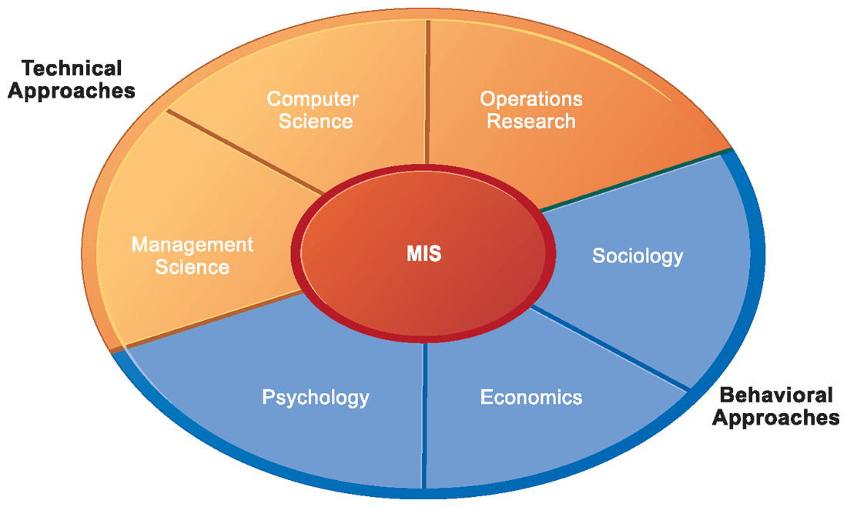
CHAPTER 1: INFORMATION IN BUSINESS SYSTEMS TODAY
Contemporary Approaches to Information Systems
Contemporary Approaches to Information Systems
The study of information systems deals with issues and insights contributed from technical and behavioral disciplines.
Figure 1.9
© Prentice Hall 2011
Notes:
Ask students which of the two major types of approaches, behavioral and technical, they find to be most appropriate or accurate. Why do they feel this way? Emphasize that the technical approach does not ignore behavior and the behavioral approach does not ignore technology, but that they are indeed two distinct approaches.

Slide 44
CHAPTER 1: INFORMATION IN BUSINESS SYSTEMS TODAY
Contemporary Approaches to Information Systems
Technical approach
  Emphasizes mathematically based models
  Computer science, management science, operations research
Behavioral approach
  Behavioral issues (strategic business integration, implementation, etc.)
  Psychology, economics, sociology
© Prentice Hall 2011
Notes:
You might ask the students whether they think it’s possible to adopt only one of the two approaches to information systems and be successful. Then emphasize that the most accurate position is that there is no single approach that can truly capture the full scope and importance of information systems by itself.

Slide 45
CHAPTER 1: INFORMATION IN BUSINESS SYSTEMS TODAY
Contemporary Approaches to Information Systems
Management Information Systems
  Combines computer science, management science, operations research and practical orientation with behavioral issues
Four main actors
  Suppliers of hardware and software
  Business firms
  Managers and employees
  Firm’s environment (legal, social, cultural context)
© Prentice Hall 2011
Notes:
Ask students to describe some of the relationships between the four main actors. For example, business firms look to acquire the components of their information systems from suppliers of hardware and software. The firm’s environment may dictate the type of software a company uses as well as the kind of employees that work there.

Slide 46
CHAPTER 1: INFORMATION IN BUSINESS SYSTEMS TODAY
Contemporary Approaches to Information Systems
Approach of this book: Sociotechnical view
  Optimal organizational performance achieved by jointly optimizing both social and technical systems used in production
  Helps avoid purely technological approach
© Prentice Hall 2011
Notes:
The sociotechnical systems perspective was also discussed briefly in slide 3, which you could revisit to give students a refresher. The critical aspect of this view is the balance between technological and social/behavioral concerns. Sometimes a lesser form of technology may be the best option because it is more suited to the personal needs of the individual, for example.

Slide 47
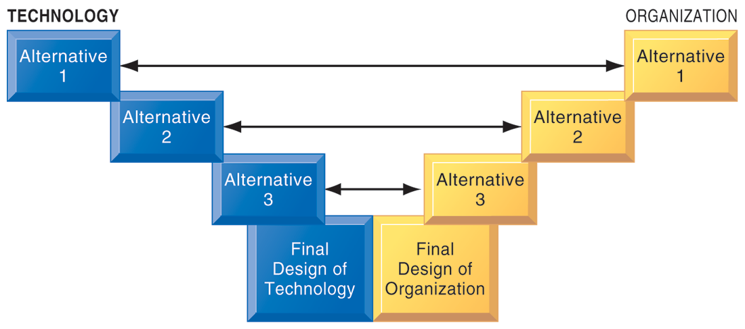
CHAPTER 1: INFORMATION IN BUSINESS SYSTEMS TODAY
Contemporary Approaches to Information Systems
A Sociotechnical Perspective on Information Systems
Figure 1-10
In a sociotechnical perspective, the performance of a system is optimized when both the technology and the organization mutually adjust to one another until a satisfactory fit is obtained.
© Prentice Hall 2011
Notes:
This graphic illustrates the interplay between technology and the organization. The two continue to grow closer together until an approach satisfying both perspectives is reached. Ensure that students understand that the two sides do not always need to form an equal compromise. Sometimes highly advanced technology may be more acceptable than at other times. As they will see with packaged software solutions, and enterprise systems, firms are often required to change greatly in order to make the software applications work.

Slide 48
© Prentice Hall 2011

