Slide 1


Slide 2


Slide 3


Slide 4


Slide 5


Slide 6


Slide 7
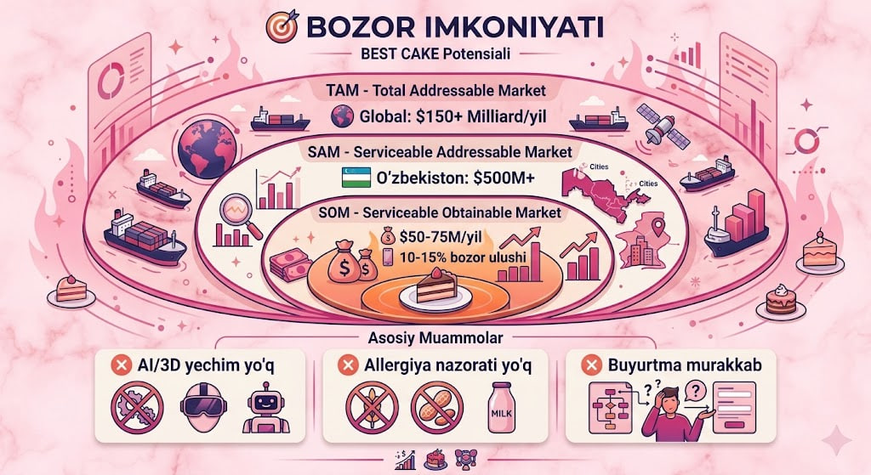

Slide 8


Slide 9


Slide 10

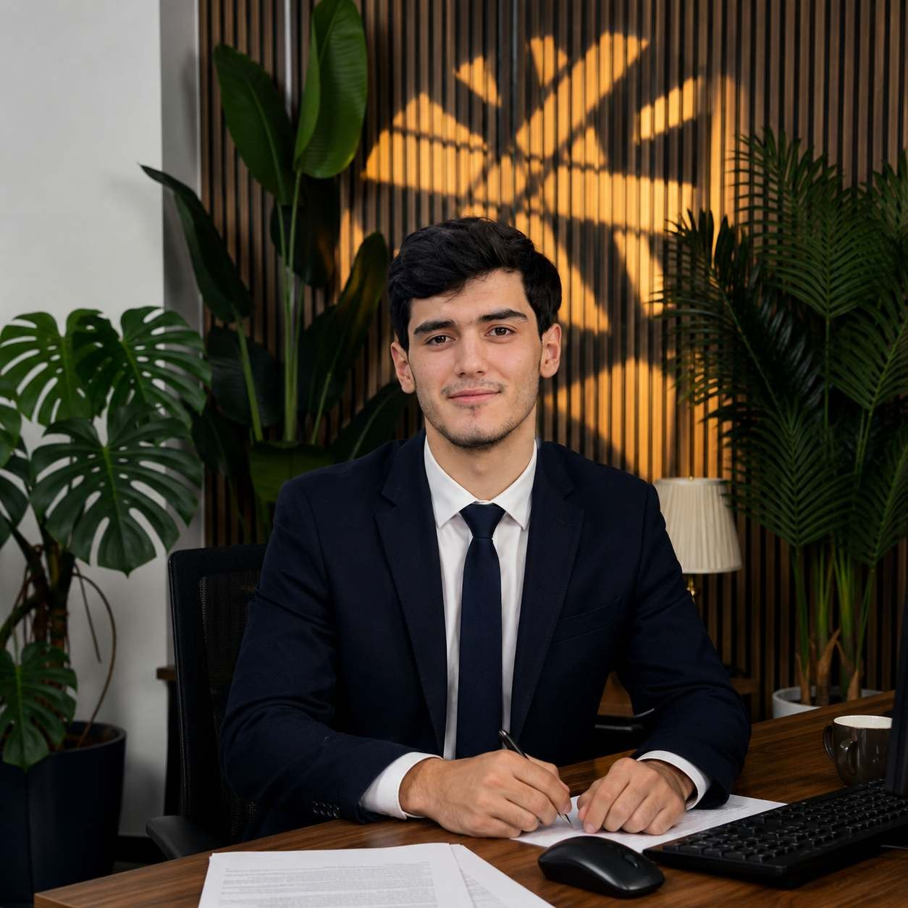
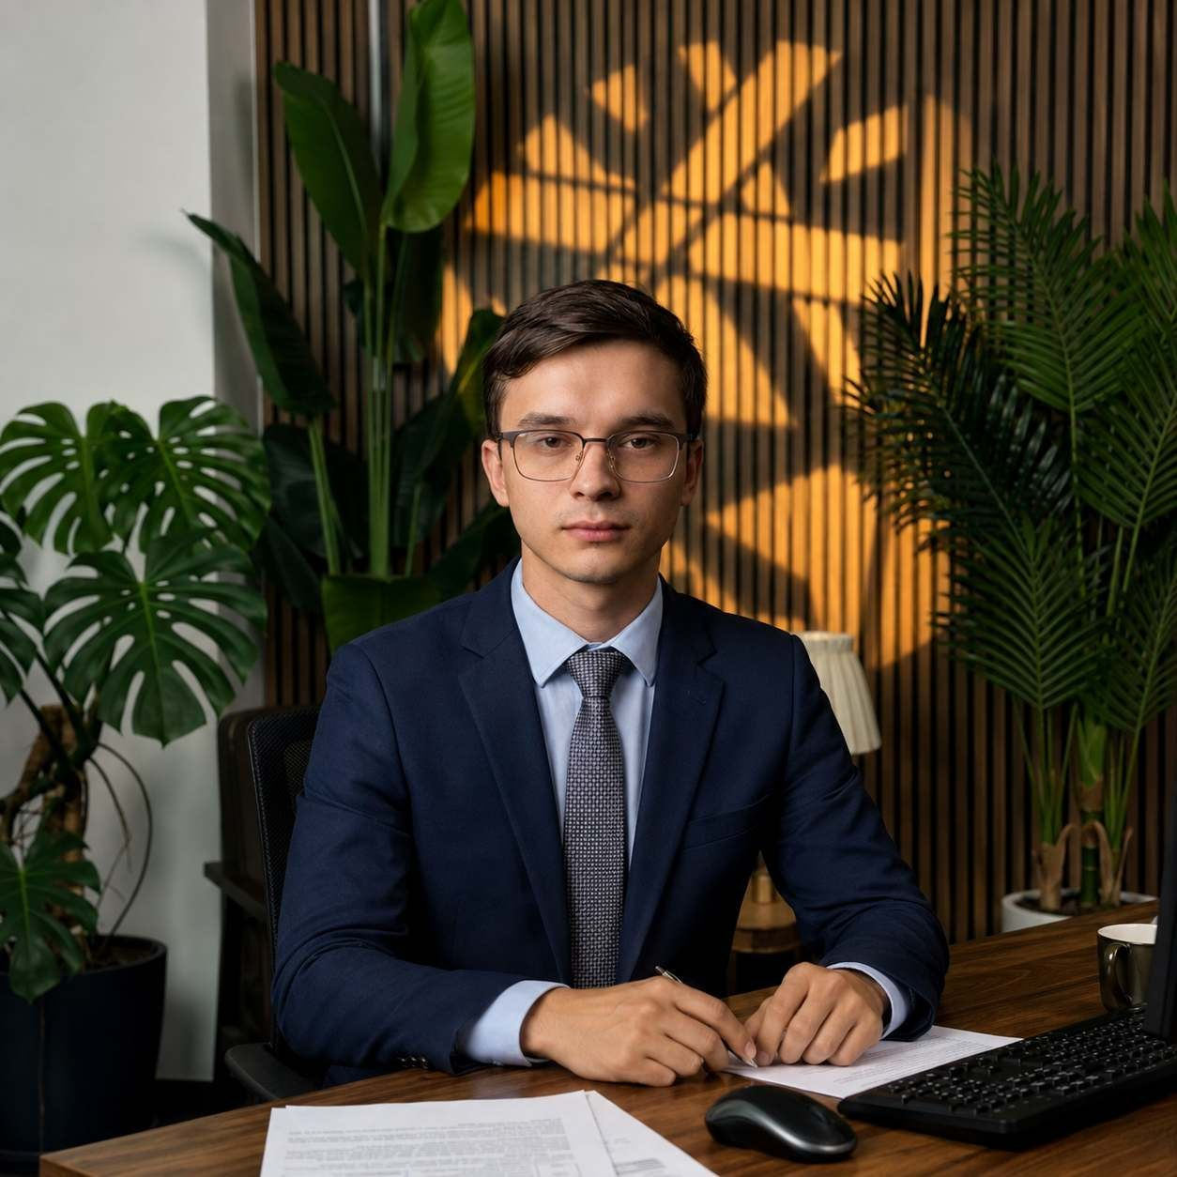
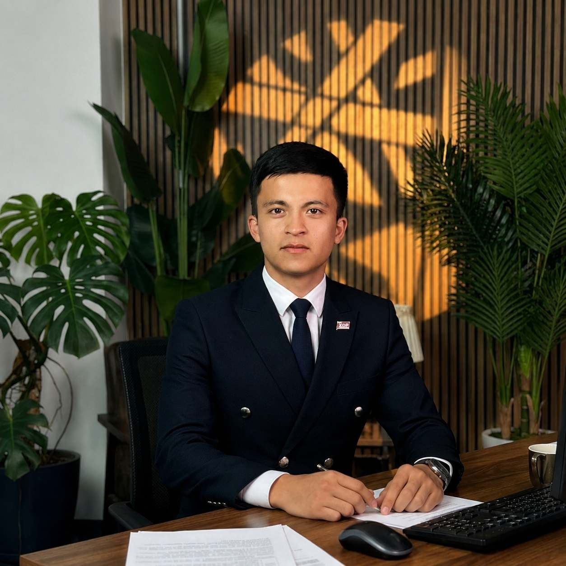
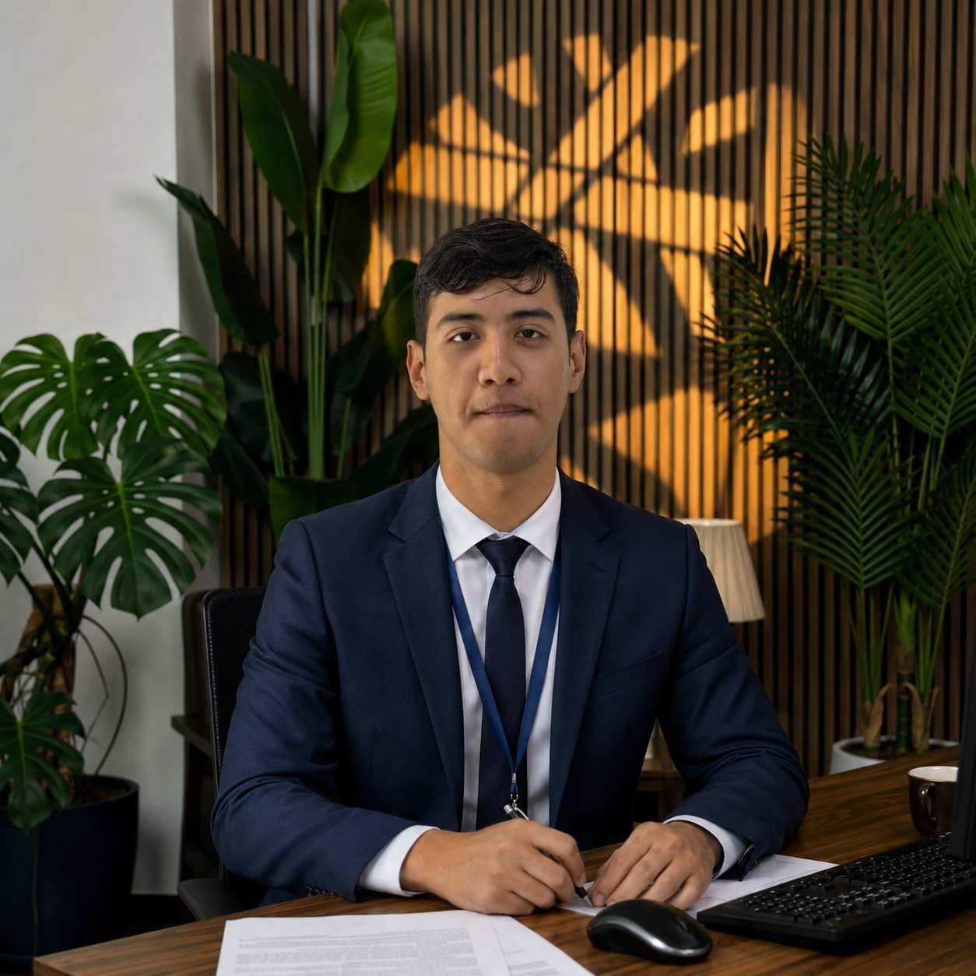
SWIPIES TEAM
Sardorbek Albakiev
Bogdan Stadnyuk
Umidjon Odiljonov
Abdulloh Ma`murov
CEO /Loyiha rahbari
CTO/Dasturchi
Biznes analitik
Co-founder

