Slide 1
Prototype for Feature-Based Classification of Euro Coin Images
Martin Limberger, Monika Moser

Slide 2
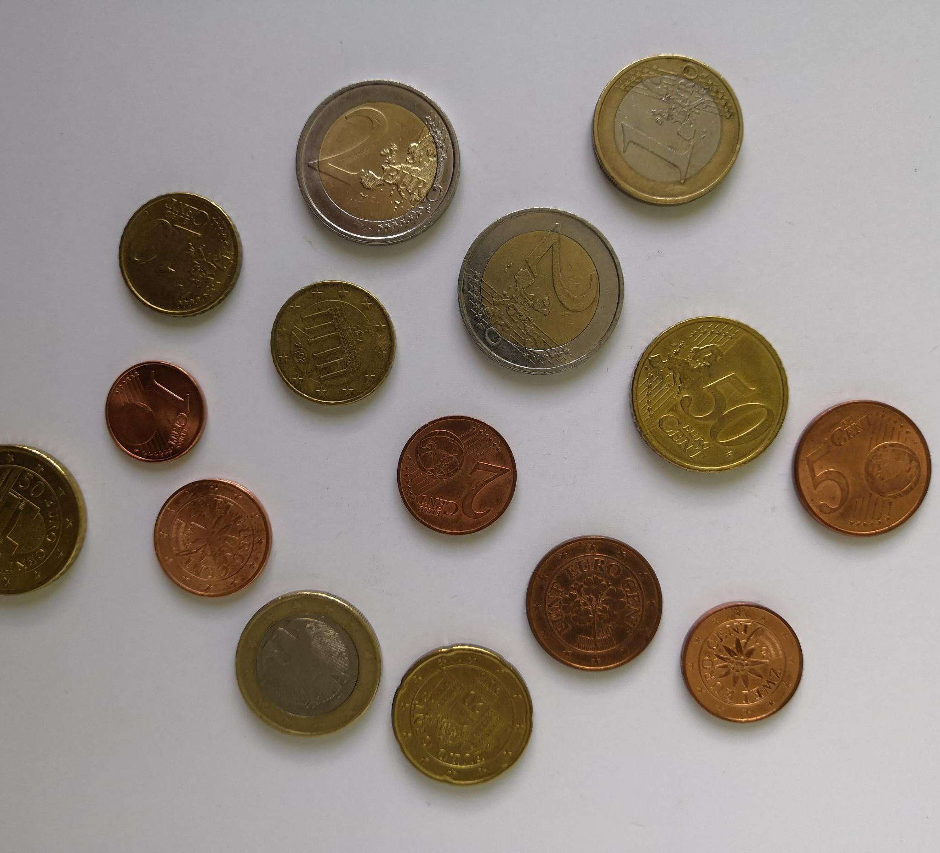
Overview
Material
Basics
Methodology
Live Demo

Slide 3
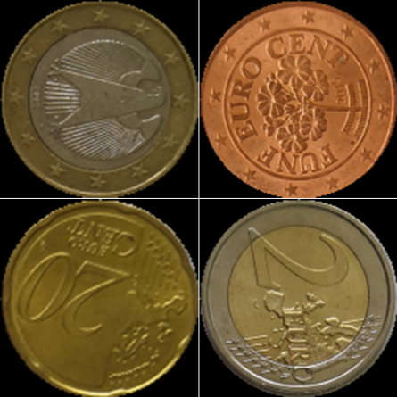
Material
Python
OpenCV
scikit-learn/Keras
Trainingdata
Testdata

Slide 4
Basics
Watershed Transformation
Circle Hough-Transform
Mean shift filter
K-means clustering
Gaussian blurring

Slide 5
Methodology
Preprocessing
1
Prefragmentation
2
Training
3
Classification
4

Slide 6
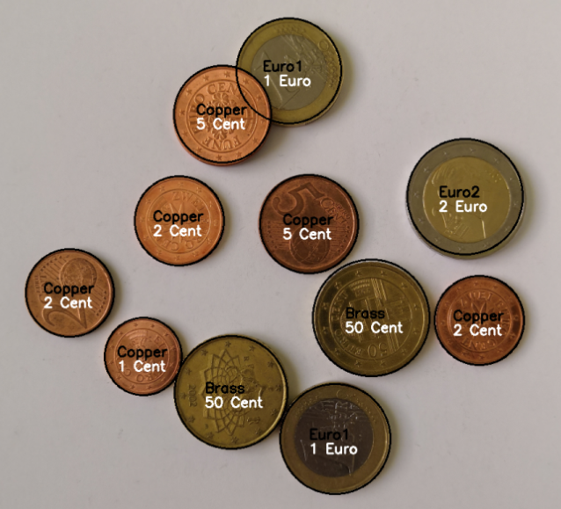
Live Demo

