Slide 1
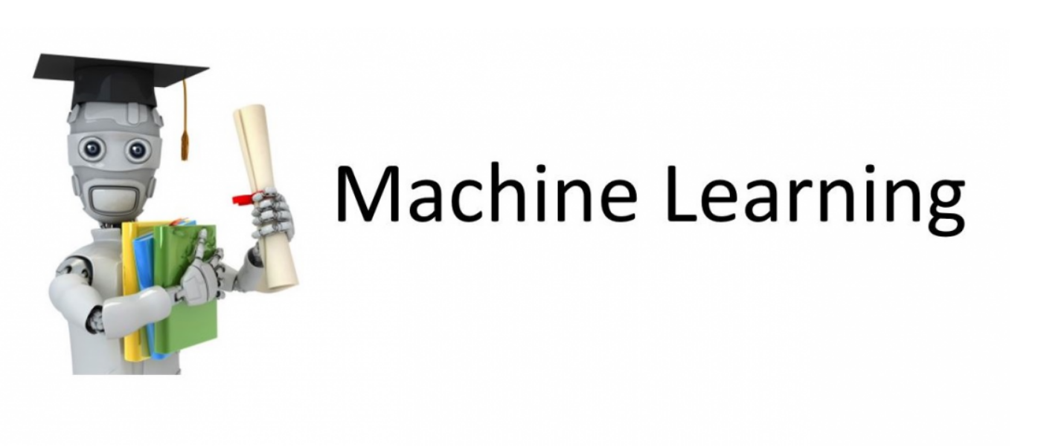
Introduction to

Slide 2
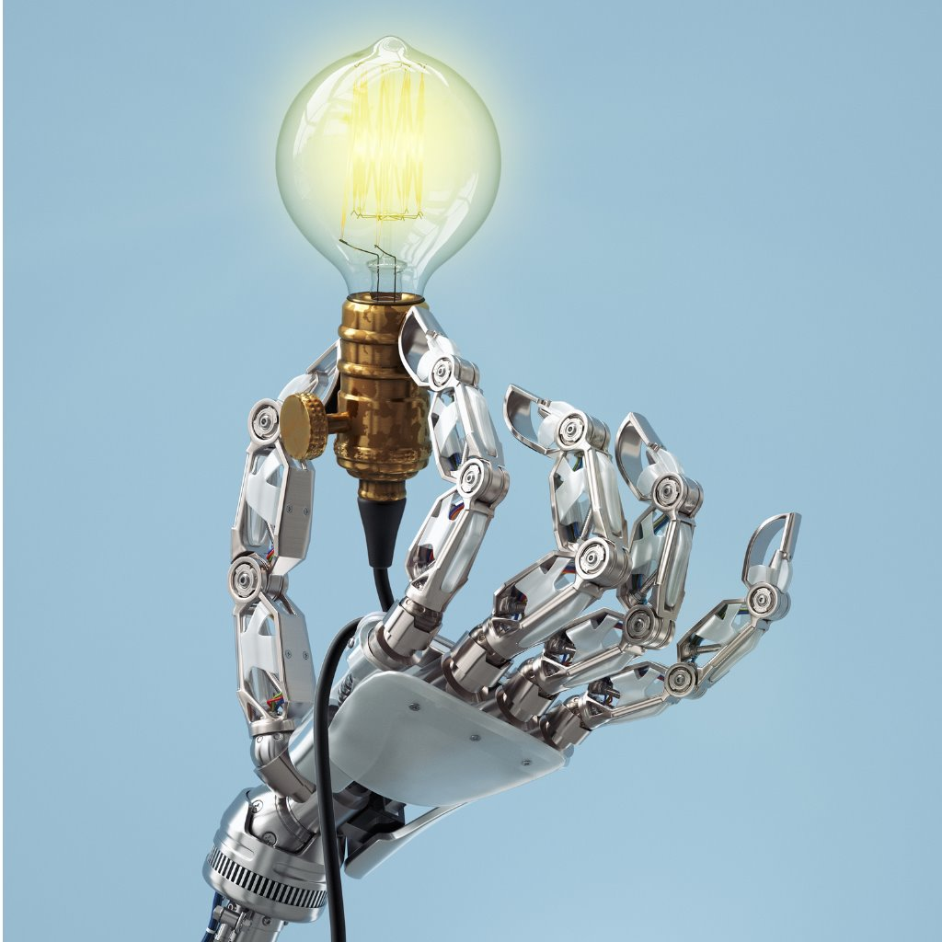
“AI is the new electricity”
(Andrew Ng)

Slide 3
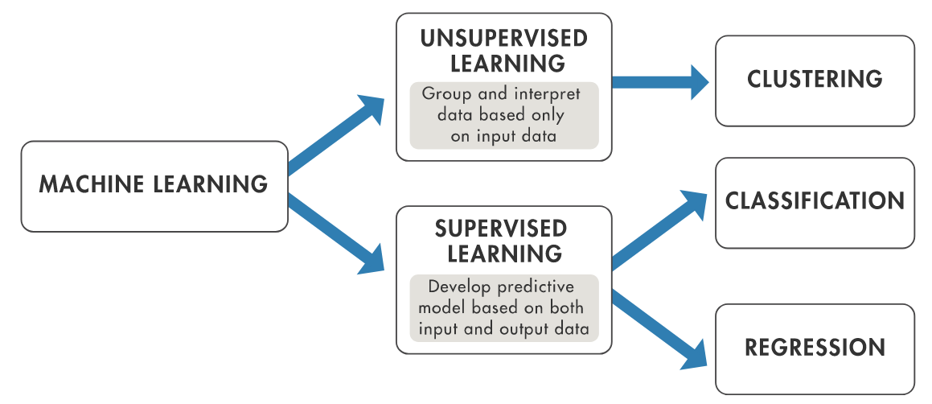
Machine Learning
Supervised Learning: Data with Labels
Unsupervised Learning: Data without Labels
Reinforced Learning: Interaction with Environment

Slide 4
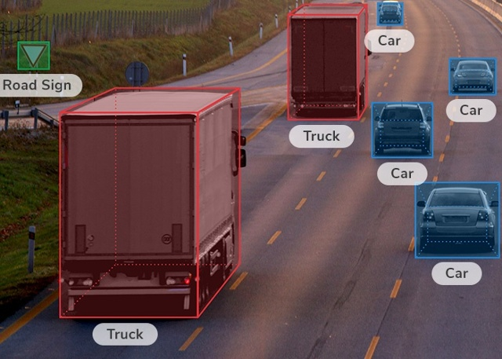
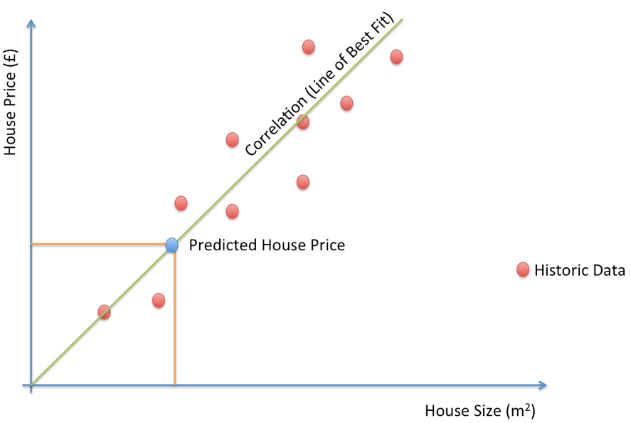
Supervised Learning: Data with Labels
Regression: Continuous Data
Classification: Classifying into categories
Example: Predicting Housing Prices

Slide 5
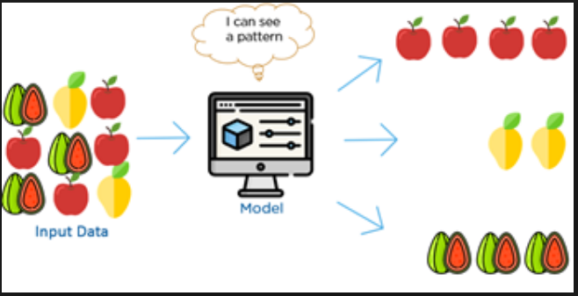
Unsupervised Learning: Data without Labels
Clustering: finding Patterns in the Data
Example: Clustering DNA sequences

Slide 6
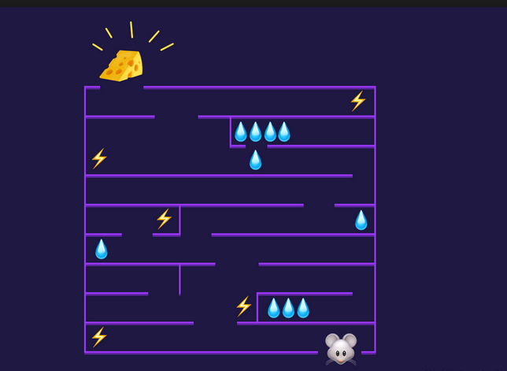

Reinforced Learning
Q-Learning: teaching an agent to play games

Slide 7
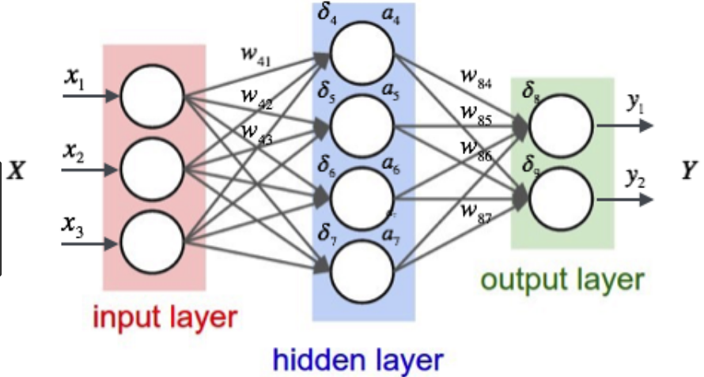
Deep Learning
Supervised Deep Learning: Fully Connected Neural Networks

Slide 8
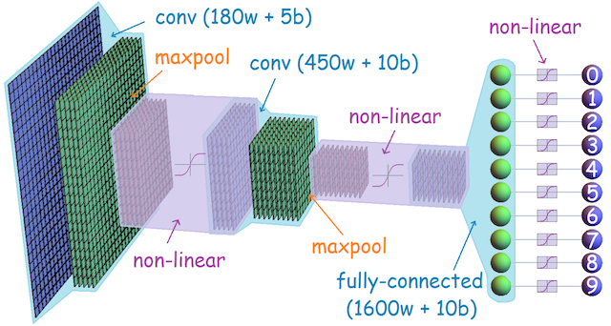
Convolutional Neural Network
Supervised Deep Learning: Image Processing

Slide 9
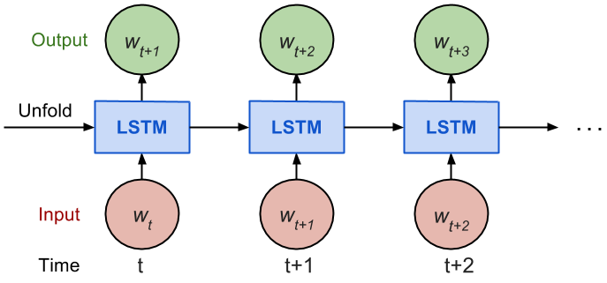
Recurrent Neural Network
Supervised Deep Learning: Image Processing

Slide 10
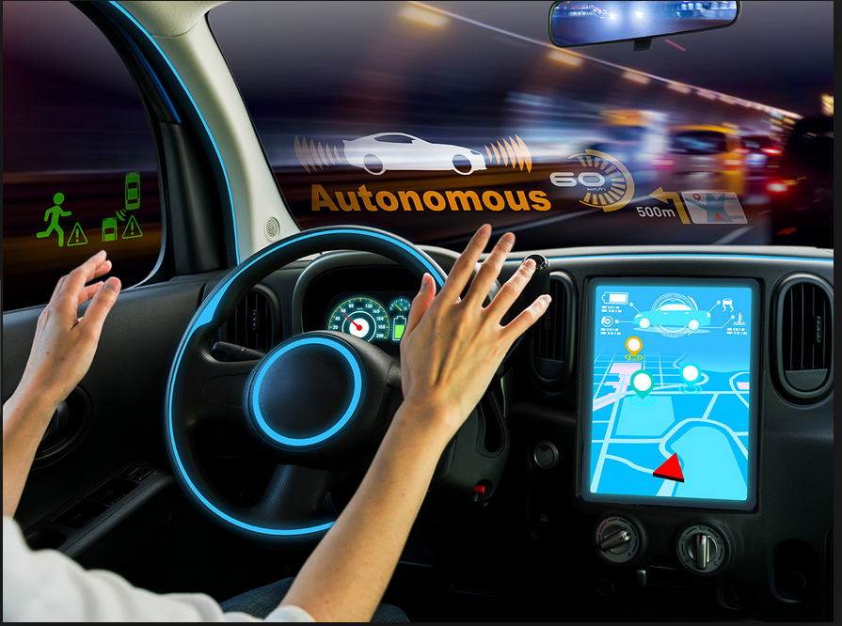
Autonomous cars

Slide 11
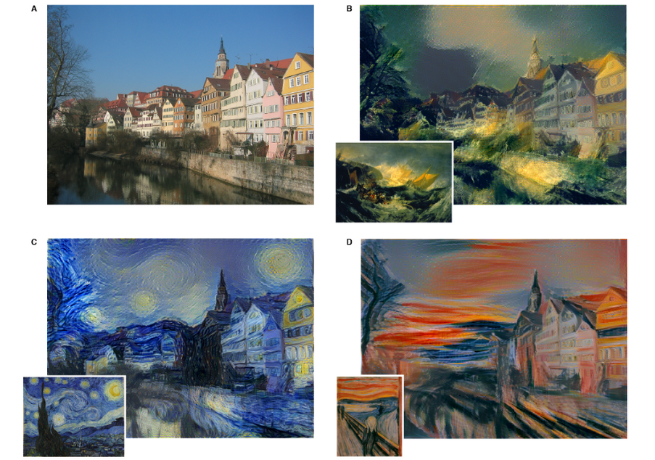
Generic Adversarial Networks: Style Transfer

Slide 12

Deep Q Learning: DQN

Slide 13
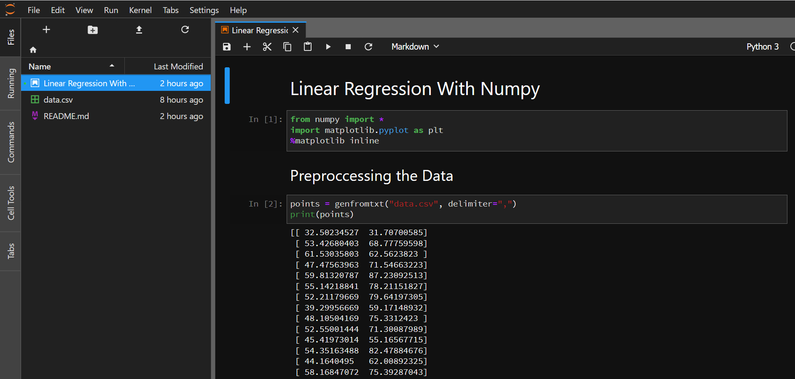
The Process of training an ML model
Preprocessing Data
Visualizing Data
Implementing the algorithm
Training
Prediction

