Slide 1

Integrating MRI and genetic Data For Flexible Alzheimer’s Disease Diagnosis
by
S.SARFARAZ
Roll No. 224G1A0595
D.MAHABOOB BASHA
Roll No. 224G1A0544
P.GOWTAMI
Roll No. 224G1A0522
Under the guidance of
Mrs.M.Soumya, M.Tech,
Associate Professor
Department of Computer Science and Engineering (AI&ML)
Srinivasa Ramanujan Institute of Technology
Autonomous
Rotarypuram Village, B K Samudram Mandal, Ananthapuramu – 515701.
2024-2025

Slide 2
Contents
Integrating MRI and Genetic Data for Flexible Alzheimer’s Disease
Title Justification
Abstract
Problem statement
Objectives of Project
Literature survey for objectives
Proposed Work -(Methods to be followed for proposed system)
References
GitHub Link
Queries
Srinivasa Ramanujan Institute of Technology

Slide 3
Title Justification
Integrating MRI and Genetic Data for Flexible Alzheimer’s Disease
"Integrating MRI and Genetic Data" (Multimodality): Standard diagnostic tools often rely on a single source of data. By integrating MRI scans (providing spatial and structural information about brain atrophy) with Genetic Data (providing biological markers), the framework creates a more comprehensive and accurate diagnostic picture than unimodal systems.
"Flexible... Diagnosis" (Operational Versatility): The term "flexible" refers to the system’s ability to operate in diverse clinical environments. Through a unified fusion module, the framework can provide a diagnosis even when data is incomplete—such as in rural clinics that may have access to clinical biomarkers but lack expensive MRI machinery.
"Alzheimer’s Disease Diagnosis" (Clinical Impact): The title highlights the specific medical goal: solving the problem of high-cost, high-barrier diagnostic approaches. The integration of multiple data streams aims to balance accuracy, cost-efficiency, and healthcare accessibility.
Srinivasa Ramanujan Institute of Technology

Slide 4
Abstract
Integrating MRI and Genetic Data for Flexible Alzheimer’s Disease
Alzheimer’s Disease (AD) is a progressive neurodegenerative disorder where early and accurate diagnosis is crucial for effective treatment and patient management.
Traditional diagnostic systems rely on unimodal approaches, using either MRI-based deep learning models or structured clinical/genetic data, which limits accuracy and accessibility.
This project proposes a Multimodal Diagnostic Framework that integrates MRI imaging data with genetic and clinical biomarkers to achieve a more comprehensive Alzheimer’s diagnosis.
A unified fusion module combines imaging and non-imaging features, enabling the system to provide predictions even when partial data (only MRI or only clinical data) is available.
The proposed framework improves diagnostic accuracy, cost-efficiency, and healthcare accessibility, especially in resource-limited clinical environments.
Srinivasa Ramanujan Institute of Technology

Slide 5
Problem Statement
Integrating MRI and Genetic Data for Flexible Alzheimer’s Disease
Alzheimer’s Disease (AD) is a progressive neurodegenerative disorder where early diagnosis is essential for effective patient intervention.
Proposed Innovation: This project introduces a Multimodal Diagnostic Framework that synergizes high-resolution features from MRI scans with the predictive power of genetic and clinical biomarkers.
Insufficiency of Unimodal Clinical Models: Machine learning models trained exclusively on structured data often fail to capture the complex structural changes in the brain, leading to lower predictive precision.
Srinivasa Ramanujan Institute of Technology

Slide 6
Objectives of Project
Integrating MRI and Genetic Data for Flexible Alzheimer’s Disease
Implement a Multimodal Diagnostic Framework: To develop a system that synergizes high-resolution MRI features with genetic and clinical biomarkers for a more comprehensive Alzheimer's diagnosis.
Optimize Classification for Structured Clinical Data: To apply traditional Machine Learning classifiers—including Random Forest, SVM, and Logistic Regression—to effectively analyze genetic risk factors.
Bridge the Gap in Healthcare Accessibility: To optimize the trade-off between diagnostic accuracy and cost-efficiency, making early Alzheimer’s detection more accessible in diverse clinical settings.
Srinivasa Ramanujan Institute of Technology

Slide 7
Integrating MRI and Genetic Data for Flexible Alzheimer’s Disease
Literature survey for objectives
Author(s) / Source | Year | Objective Linked | Main Contribution | Research Gap
Kumar et al. / NIH Din, F. Nagarhalli et al. Nghiem et al. | 2025 2025 2024 2022 | Objective 1 Objective2 Objective3 Objective4 | Developed FusionNet, achieving 94% accuracy by synthesizing MRI, PET, and CT scans using GANs. Comparative analysis of ML algorithms for classification. Multimodal framework using CNN (MRI) + LSTM (Cognitive). Prediction using ML + socio-admin data | Lacks AD-specific risk modeling and image integration. Imbalanced datasets; minimal validation on medical imagery. High reliance on sequential data; lacks genetic biomarker fusion. Not generalized for complex neuroimaging tasks.
Srinivasa Ramanujan Institute of Technology

Slide 8
Proposed System
Integrating MRI and Genetic Data for Flexible Alzheimer’s Disease
Multimodal : Unlike standard unimodal systems, your framework integrates high-resolution structural data (MRI) with molecular-level biological markers (Genetics) to capture a complete disease profile.
Deep Learning (Imaging) Pipeline: Utilizes a suite of pre-trained Convolutional Neural Networks (CNNs)—InceptionV3, VGG16, and ResNet50—to automatically identify hierarchical patterns of brain atrophy without manual feature engineering.
Advanced Image Processing: The system employs data augmentation (horizontal/vertical flips, rotations) to resolve dataset imbalances and improve the model's ability to generalize across different scanner types.
Data Augmentation for Robustness: To prevent overfitting on limited medical datasets, the system applies random rotations and horizontal/vertical flips to MRI slices, artificially expanding the training data.
Srinivasa Ramanujan Institute of Technology

Slide 9
References
Integrating MRI and Genetic Data for Flexible Alzheimer’s Disease
[1]. Givian, H. & Calbimonte, J. P. "A Review on Machine Learning Approaches for Diagnosis of Alzheimer’s Disease and Mild Cognitive Impairment Based on Brain MRI," IEEE Access, vol. 12, pp. 1543–1560 (2024). DOI: 10.1109/ACCESS.2024.3438081.
[2AlSaeed, D. & Omar, S. F. "Brain MRI Analysis for Alzheimer’s Disease Diagnosis Using CNN Based Feature Extraction and Machine Learning," Sensors, vol. 22, no. 8, p. 2911 (2022).
[3] Liu, M., Zhang, J., Adeli, E. & Shen, D. "A Multi-Modality Deep Learning Approach for Alzheimer’s Disease Diagnosis," Neuroinformatics, vol. 18, no. 3, pp. 325–342 (2020).
[4] Lu, D., Popuri, K., Ding, G. W., Balachandar, R. & Beg, M. F. "Multimodal Deep Learning for Alzheimer’s Disease Detection Using MRI and Genetic Data," in Proceedings of the IEEE International Conference on Bioinformatics and Biomedicine (BIBM), pp. 1024–1031 (2022).
[5] Venugopalan, J., Tong, L., Hassanzadeh, H. R. & Wang, M. D. "Multimodal Deep Learning Models for Early Detection of Alzheimer’s Disease," Frontiers in Aging Neuroscience, vol. 13, Art. no. 636843 (2021).
[6] Ebrahimi, A., Luo, S. & Chiong, R. "Convolutional Neural Networks for Alzheimer’s Disease Detection on MRI Images," Journal of Biomedical Science and Engineering, vol. 14, no. 2, pp. 15–28 (2021).
Srinivasa Ramanujan Institute of Technology

Slide 10
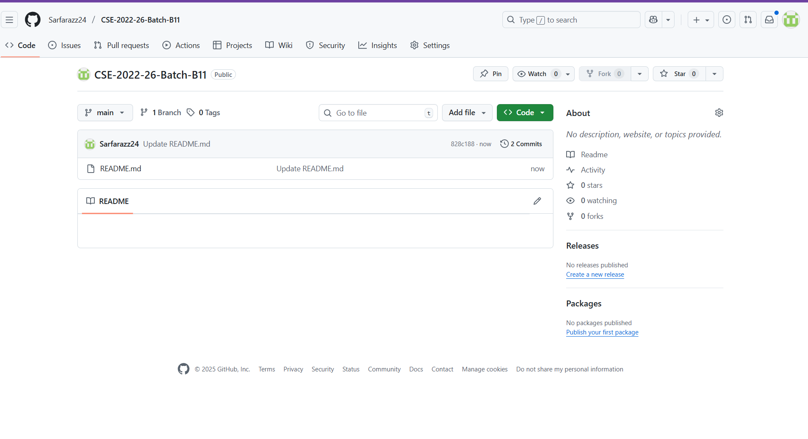
Git Hub Dashboards of each student
Integrating MRI and Genetic Data for Flexible Alzheimer’s Disease
l Github Link : https://github.com/Sarfarazz24/CSE-2022-26-Batch-B11
Srinivasa Ramanujan Institute of Technology

Slide 11
Any Queries?
Integrating MRI and Genetic Data for Flexible Alzheimer’s Disease
Srinivasa Ramanujan Institute of Technology

