Slide 1
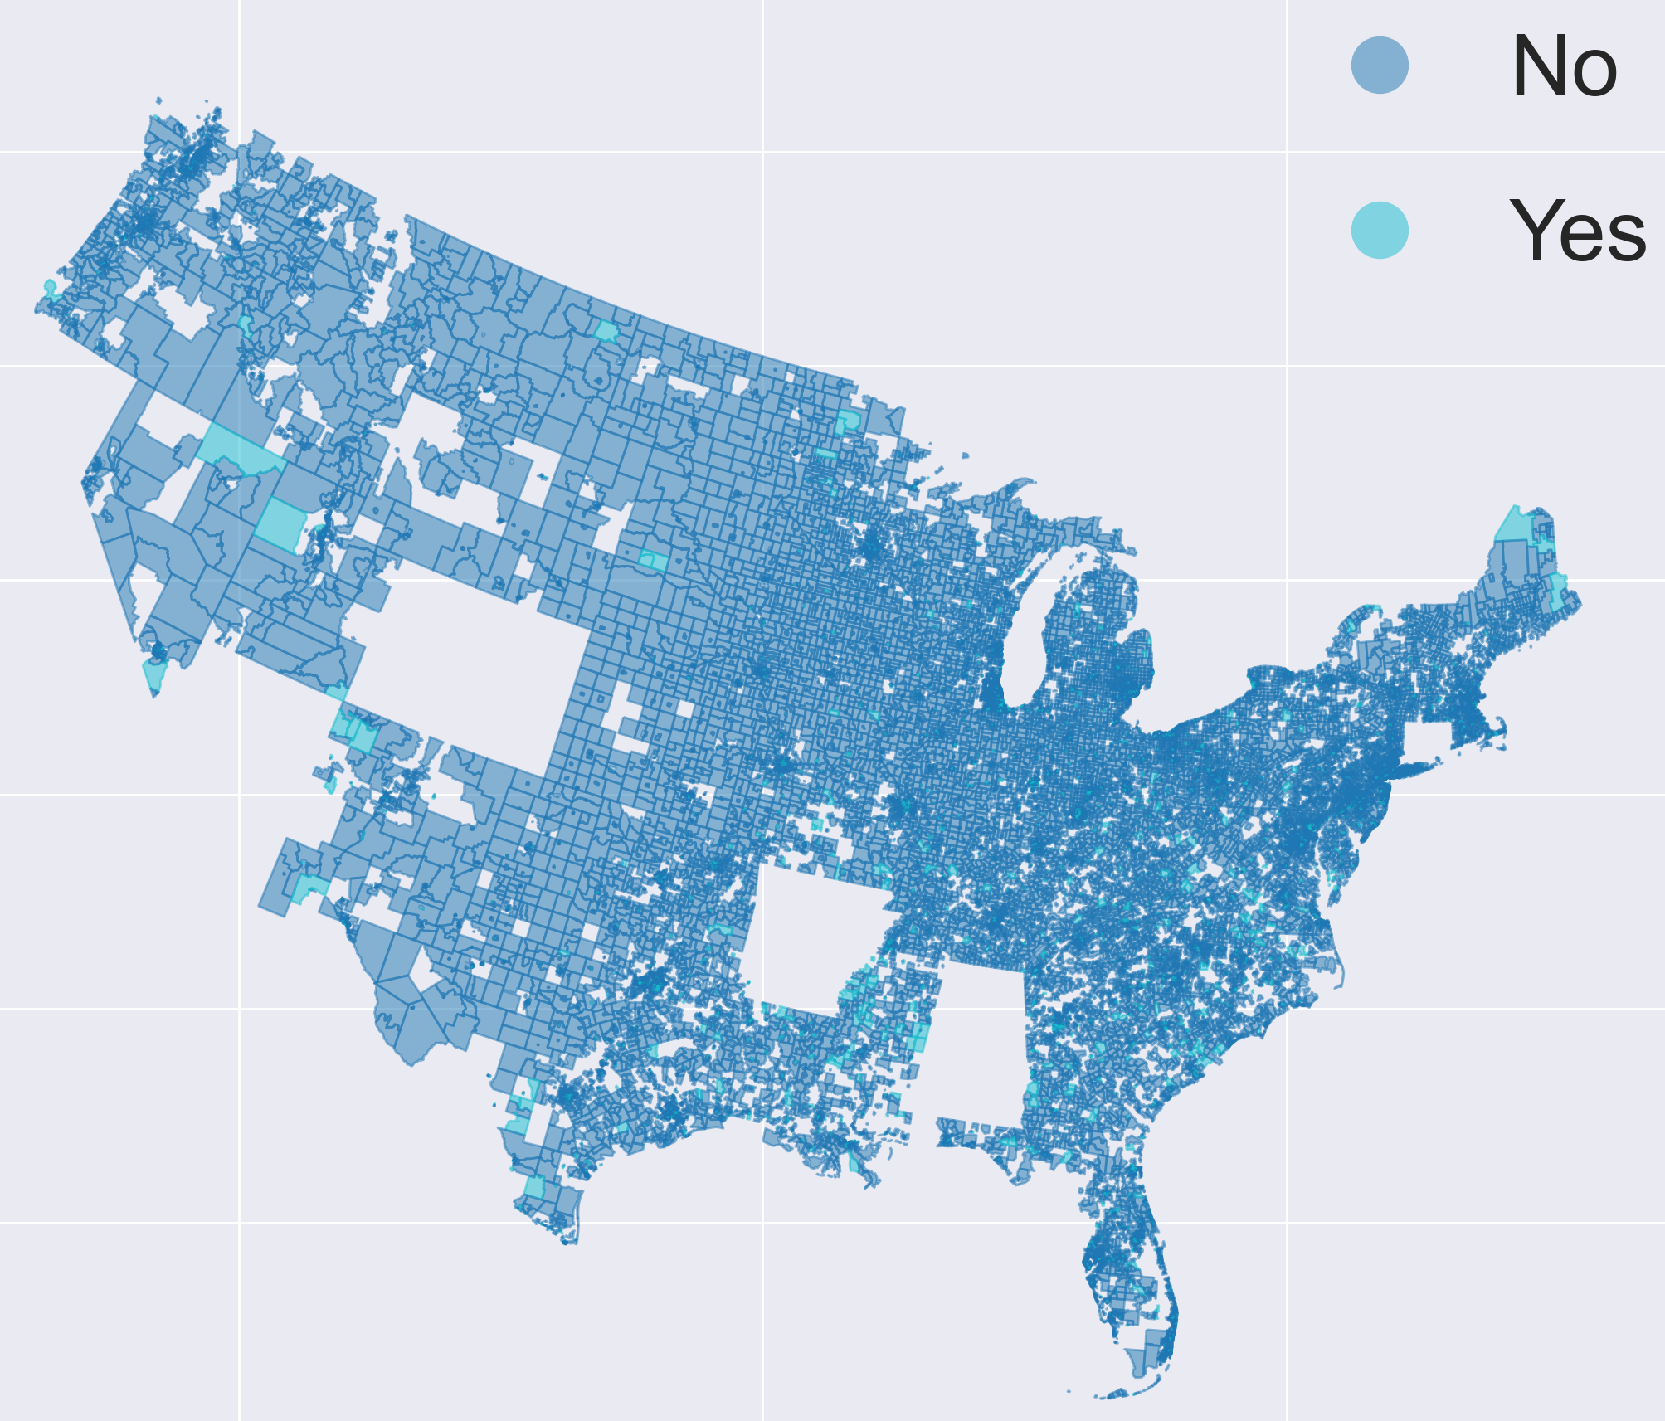
From Tracts to Tables: A Data Journey Through America’s Food Access
DSA Datathon 2025
Team Extrapolates 2.0 – Tejas Nisar, Akshay Nayak, Mohammed Ismail Sarfaraz Shaik

Slide 2
Food Desert Definitions
USDA: a region of higher concentrations of low income households that have poor access to healthy and affordable food options (2009).
Food Empowerment Project: affordable access to healthy foods is very limited or nonexistent due to few to no options within a reasonable travel distance (2016).
Problem Overview
Millions of Americans live in food deserts—communities where income, geography, and transportation limit access to healthy food. This analysis uncovers the key drivers of food inaccessibility to support targeted, equitable policy solutions.

Slide 3
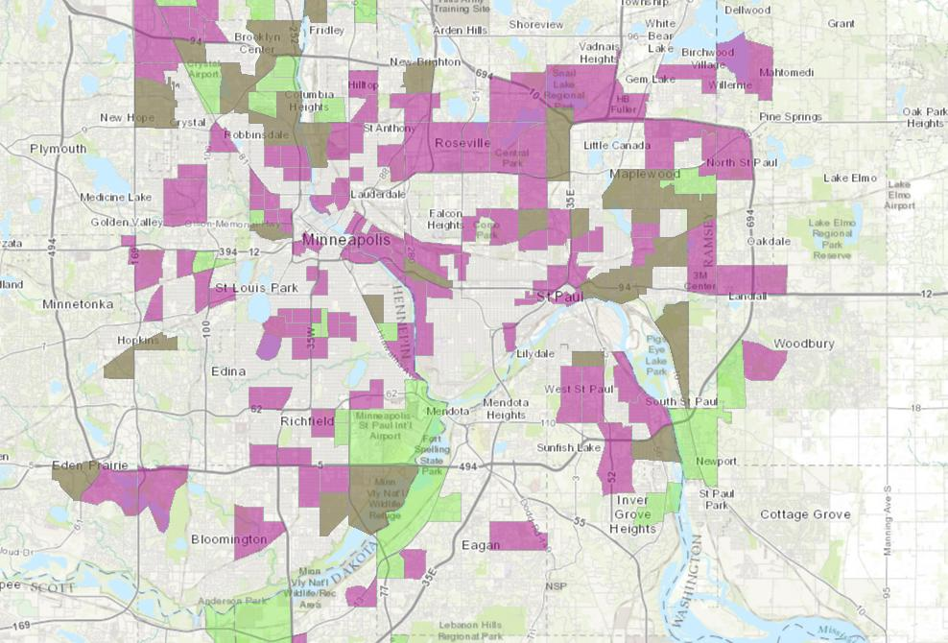
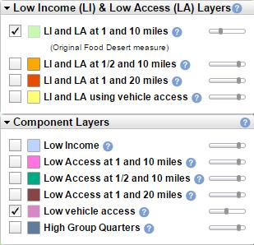
Food Desert Definition – USDA
Low Income
Low Access (10 miles)
USDA, 2016a

Slide 4
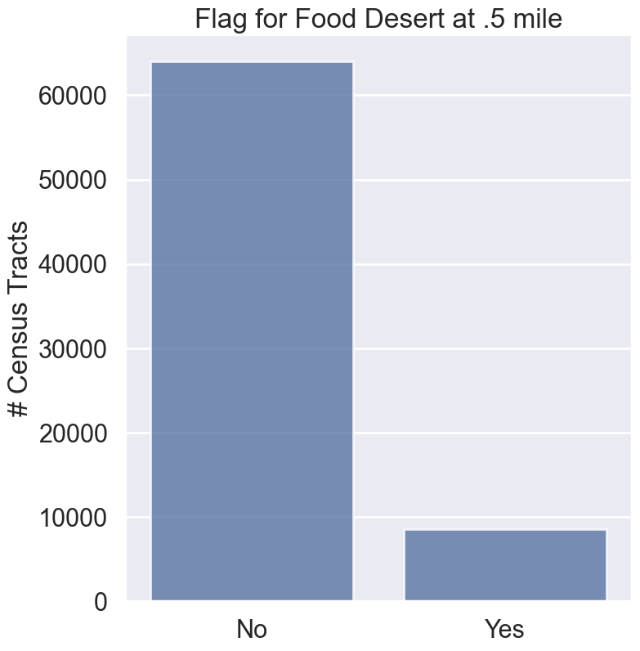
Objective
Analyze USDA datasets to identify key indicators of food inaccessibility and suggest policy solution.
Data Used:
Tract-level food access research atlas.
County-level food environment atlas.
63977
8554

Slide 5
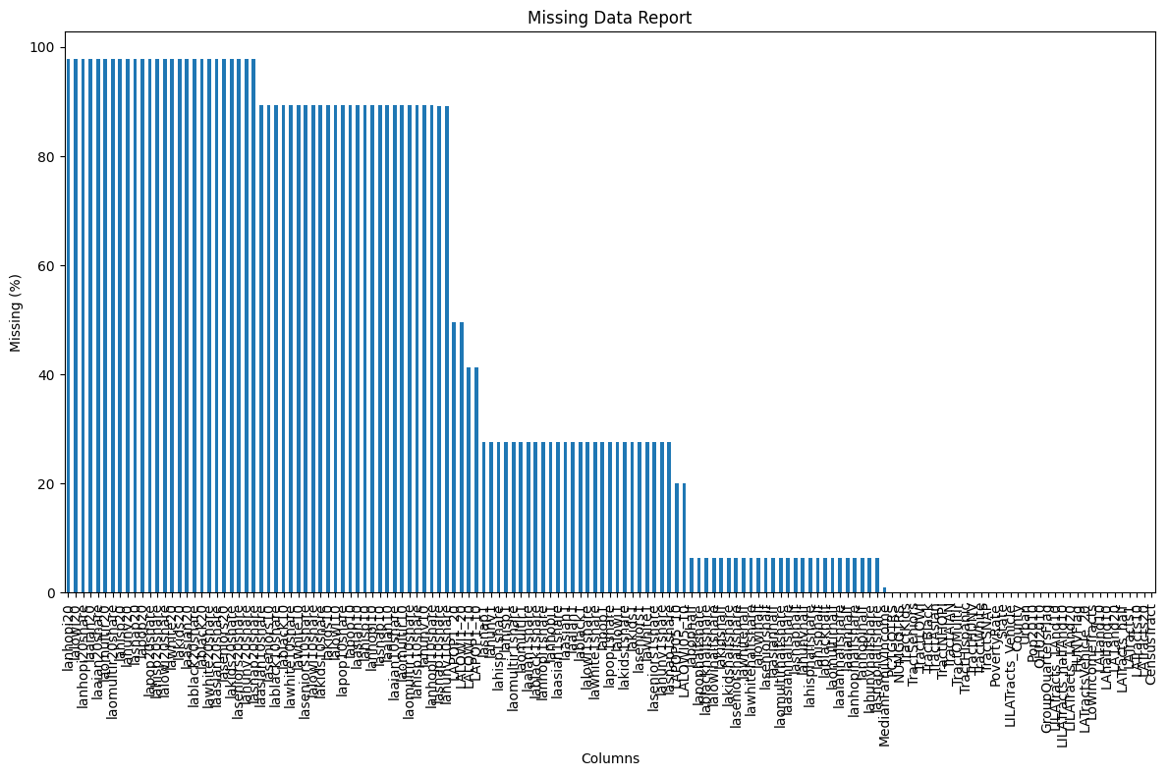
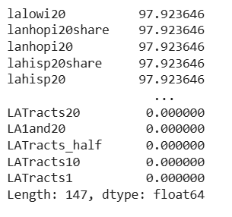
Data Preprocessing

Slide 6
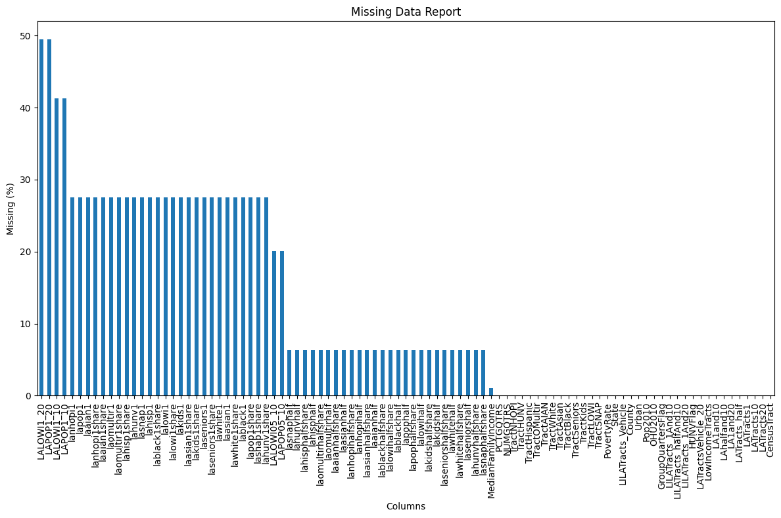
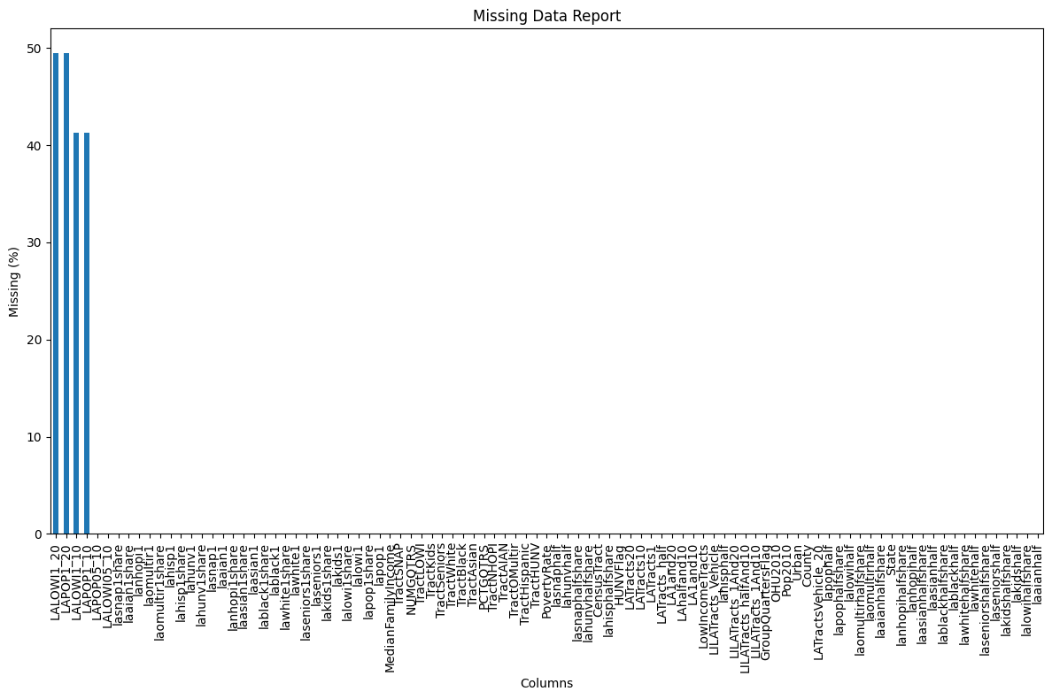
Implemented smart imputation technique on columns with missing values < 30%.
Implemented KNN imputation technique on columns with missing values between 50% and 30%.

Slide 7
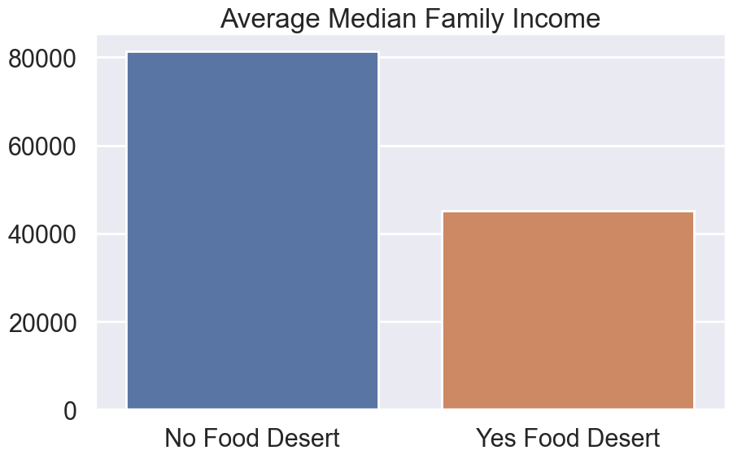
Data Insights
Food desert tracts are more diverse and economically disadvantaged:
Median family income is ~45% lower in deserts.
SNAP participation: 21% (deserts) vs 7% (non-deserts).
14% of desert households lack a vehicle (vs 3%).

Slide 8
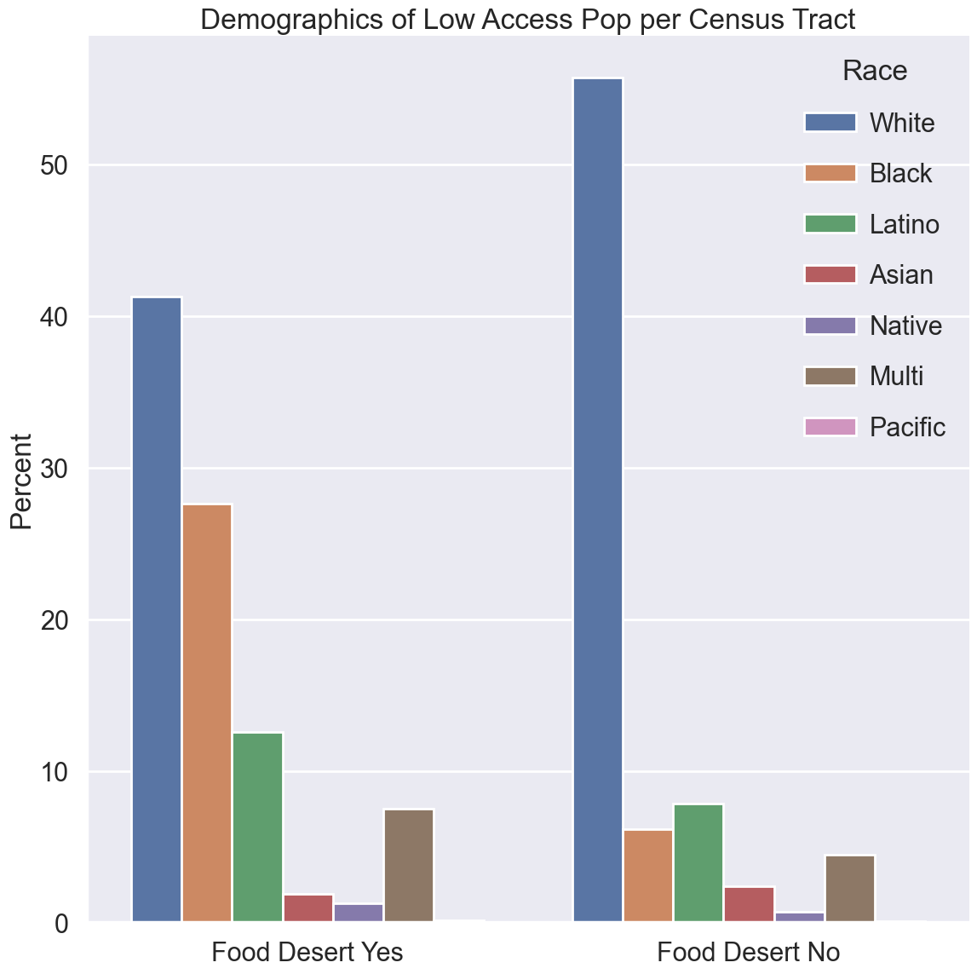
Racial Inequalities in Food Access
Significant disparities between racial groups:
In some counties , food access for Black residents is 30% worse than for White residents.
Deserts have higher proportions of Black and Hispanic residents.

Slide 9
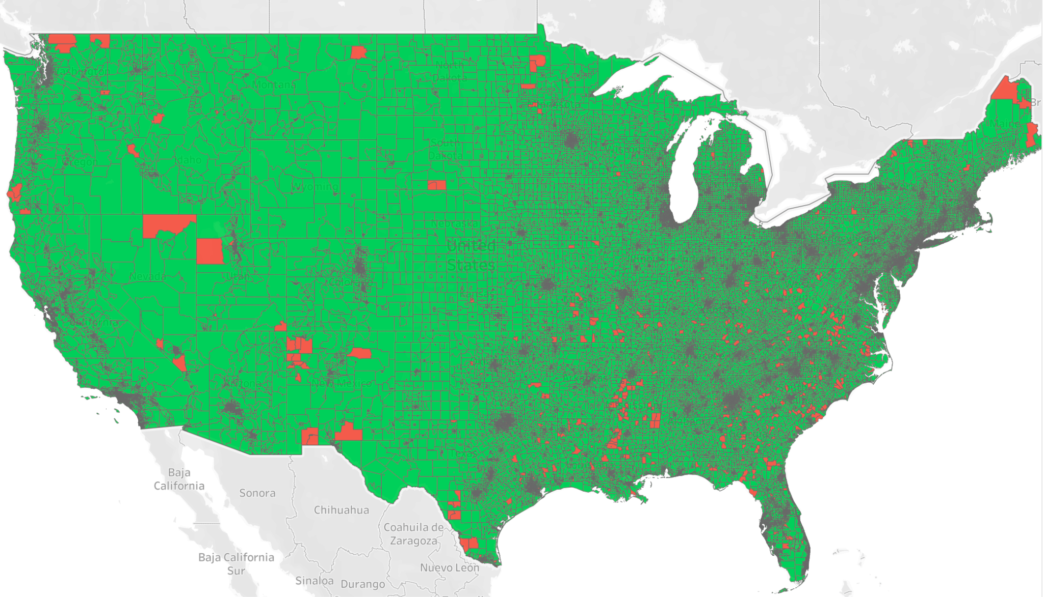
Visualization of Deserted Places

Slide 10
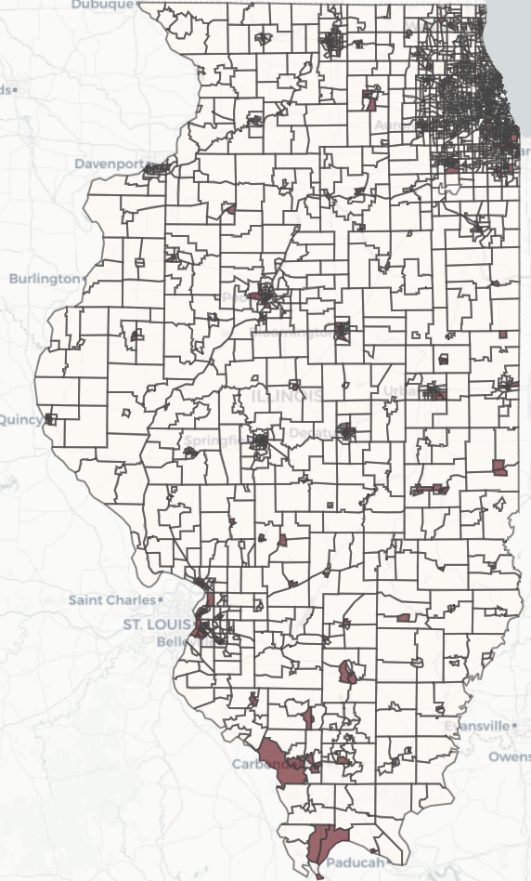
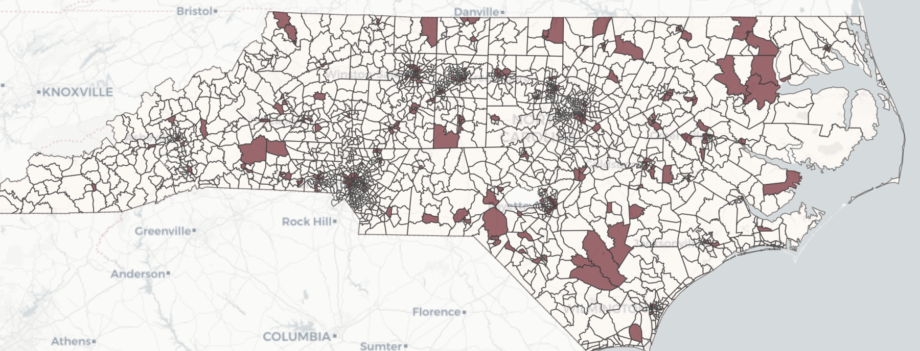
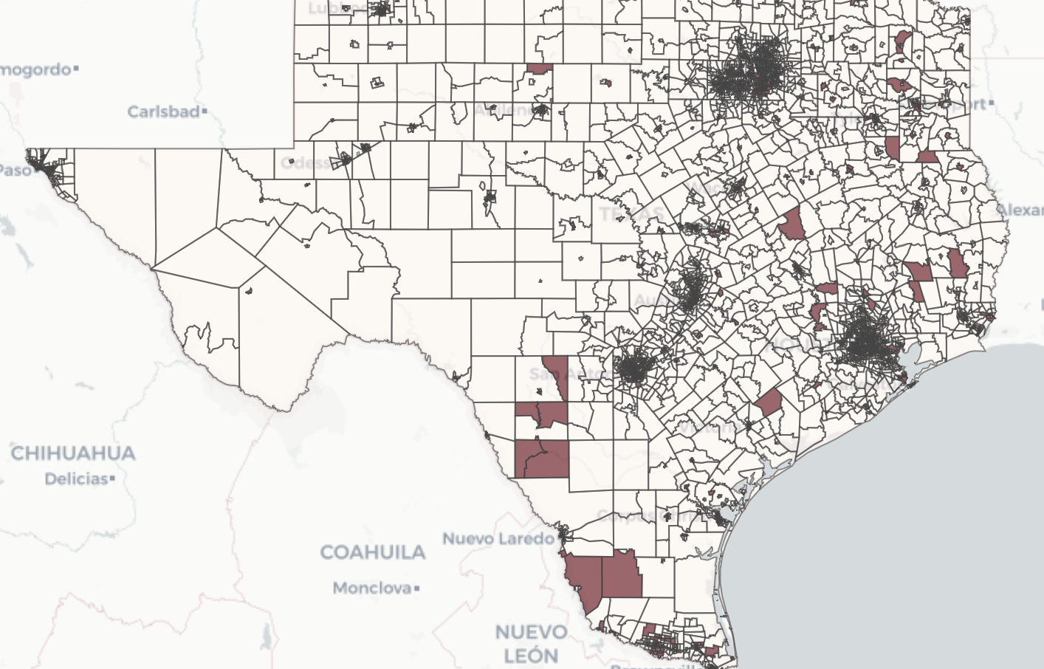
North Carolina
Illinois
Texas

Slide 11
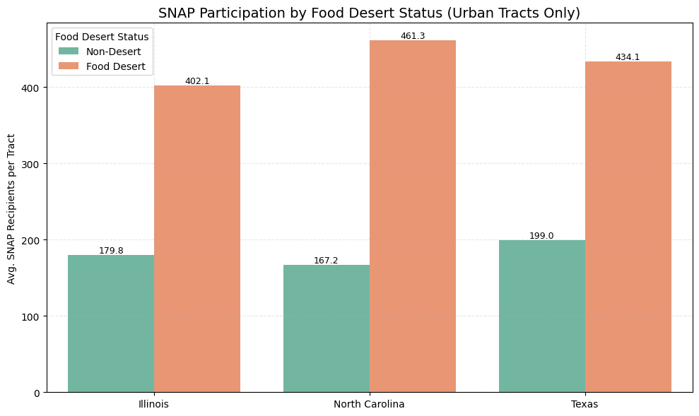
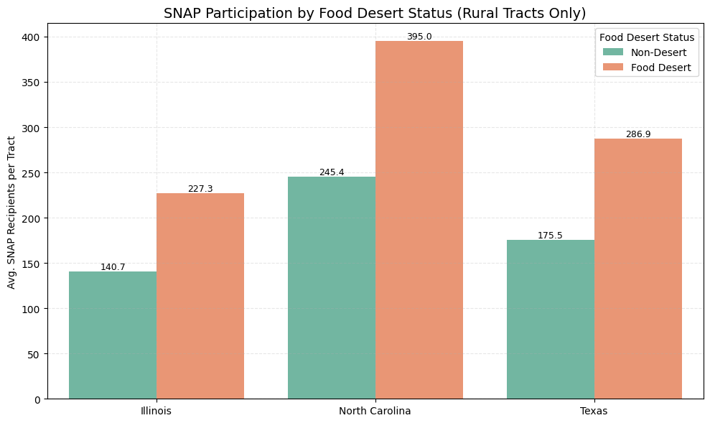
Food Deserts Rely More Heavily on SNAP

Slide 12
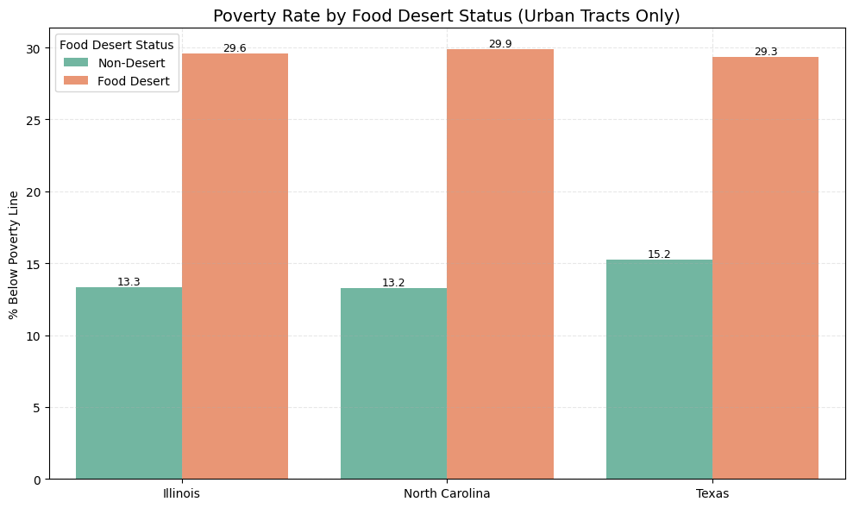
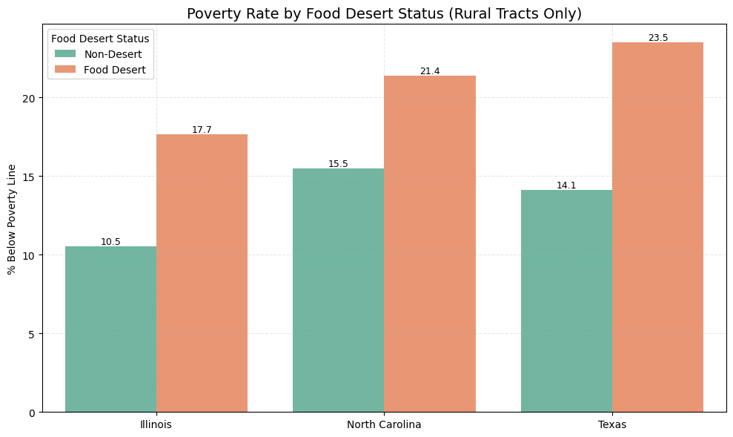
Poverty in Food Deserts Is Twice as High

Slide 13
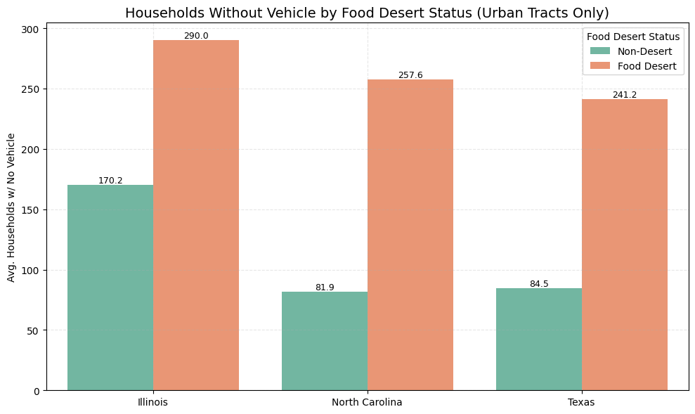
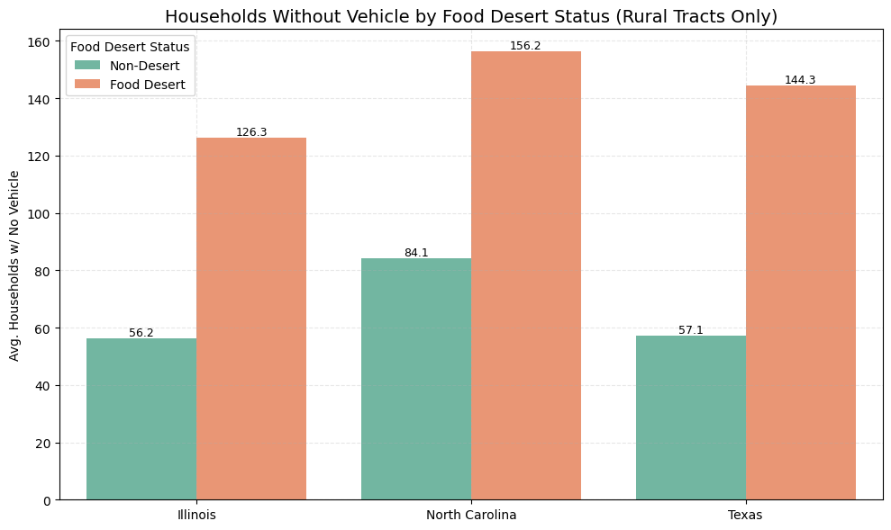
Lack of Transportation Worsens Food Inaccessibility

Slide 14
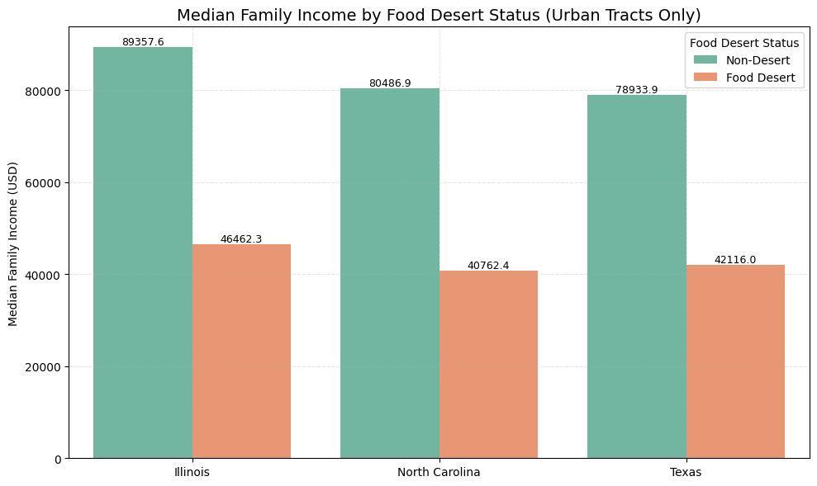
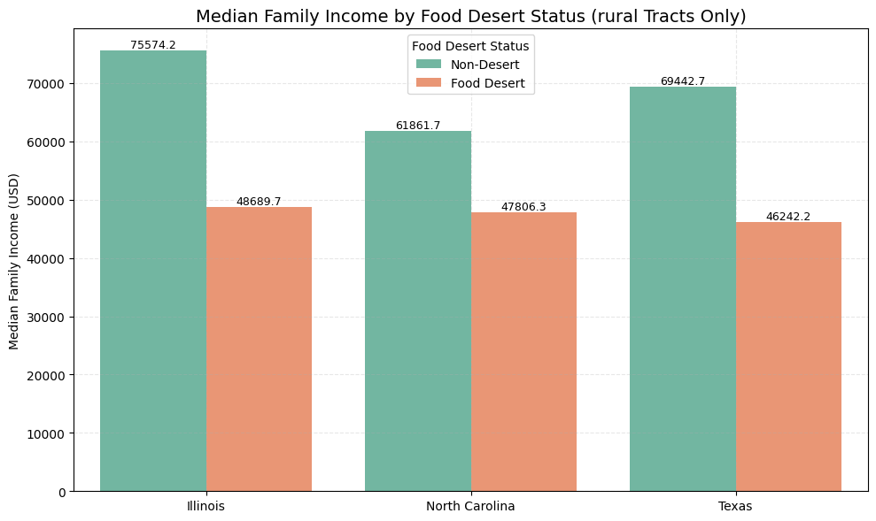
Income Gaps Are Stark Between Desert and Non-Desert Tracts

Slide 15
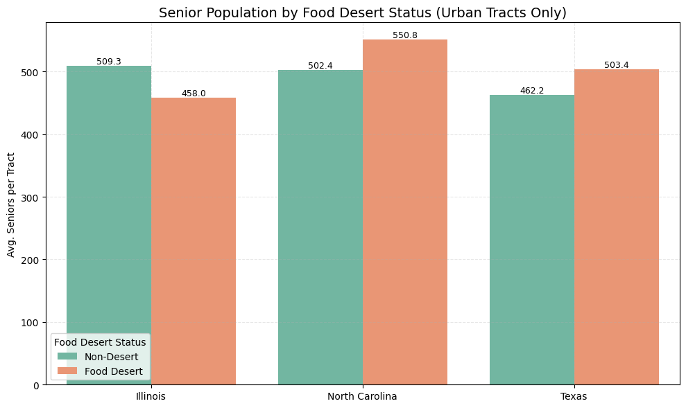
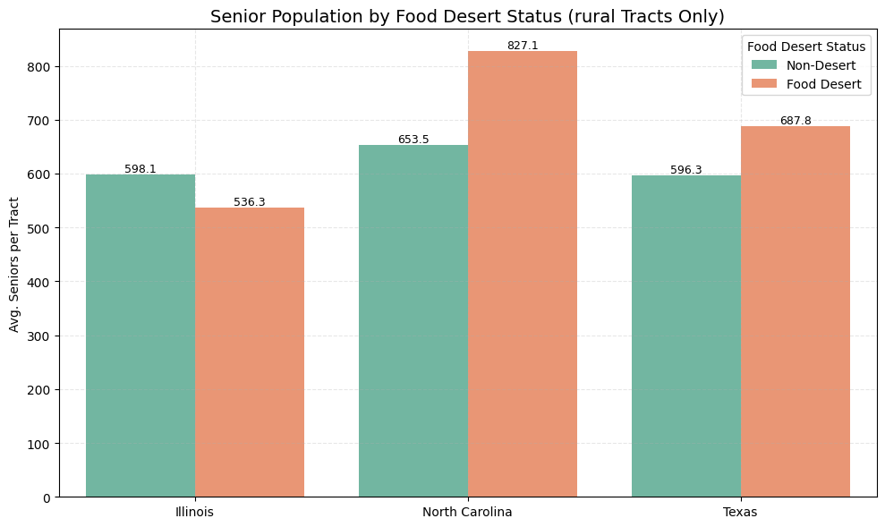
% of Senior Population

Slide 16
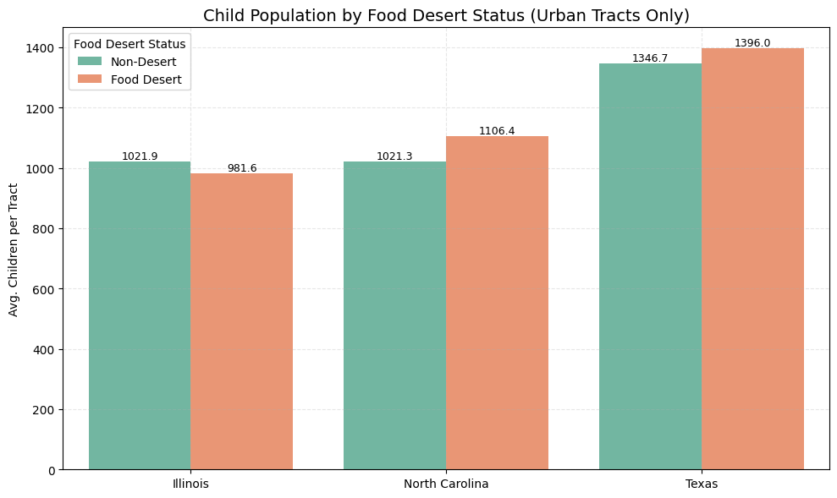
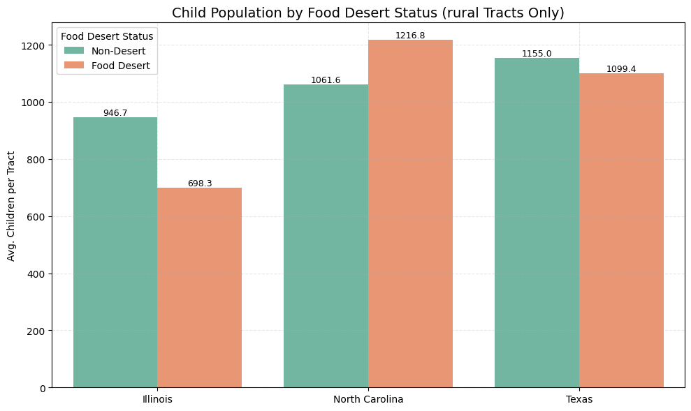
% of Child Population

Slide 17
Model Development
WHY?

Slide 18
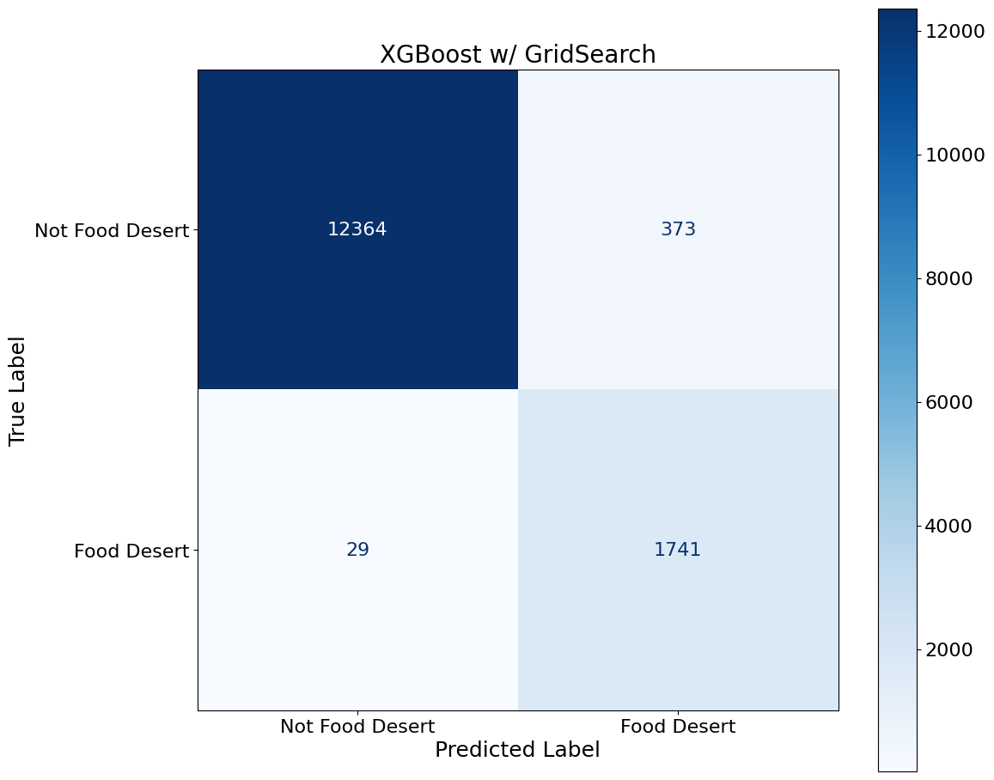
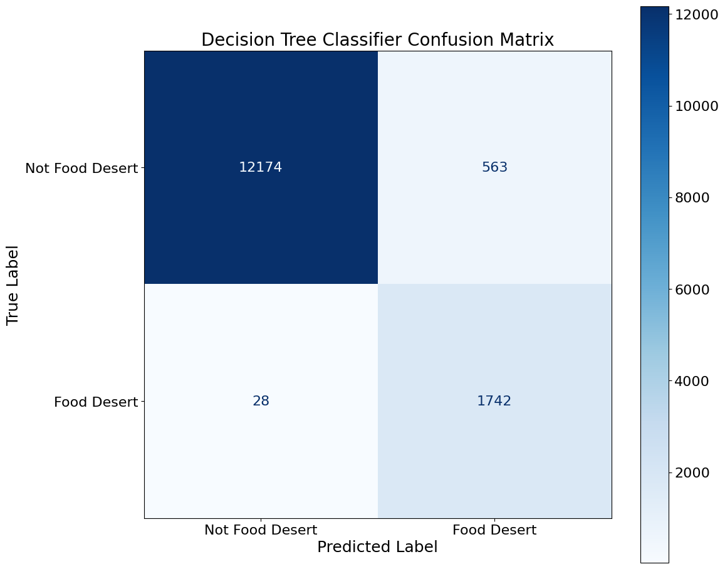
98%
96%

Slide 19
Model Findings: What Predicts Food Deserts
What predicts food access issues?
Our model achieved 96–98% accuracy in distinguishing food desert tracts. Top predictors include -
Population loss (+0.24)
% Native American population (+0.19)
% age 65+ (+0.14)

Slide 20
Food Retail Trends
Health Impacts
Store type changes (2011-2016)
Poor food environments ~ higher health risks
Supercentres (increase by 7%)
Convenience stores (increase by 2%)
Grocery stores (decrease slightly)
Obesity and diabetes are strongly correlated.
Most affected counties overlap with low access areas.
Lack of supermarkets and high rate of diabetes are correlated and concentrated in minority and poor neighborhood.

Slide 21
Policy Recommendations
Support Local Infrastructure: Fund farmers’ markets, mobile markets.
Improve Transportation: Launch grocery shuttles, rideshare programs.
Equity Funding: Target tracts with high racial gaps & senior populations.
Retail Incentives: Tax breaks for stores in SNAP-heavy areas.
Update Data regularly at the tract level.

Slide 22
Conclusion: Bridging the Gap from Data to Action
Food deserts are not just about geography — they’re about inequity.
Our analysis confirms that poverty, vehicle access, race, and age are strong drivers of inaccessibility.
But the data also shows us where we can act: through transportation, infrastructure, and equitable investment.
“Tackling food deserts means targeting both place and people — and doing so with precision, not assumption.”

