Slide 1





BIOSOLVE 2026
BinGo
One photo → 5 waste categories
Recyclable
Smart Waste Sorting · SDG 15 — Life on Land
Organic
Hackathon: BioSolve 2026
Problem Statement: Smart Waste Classifier App (SDG 15: Life on Land)
Team Name: Fantastic Four
E-Waste
Hazardous
Snap a photo of any waste item — BinGo tells you how to dispose of it, on-device, with no data leaving your phone.
General / Non-recyclable

Slide 2
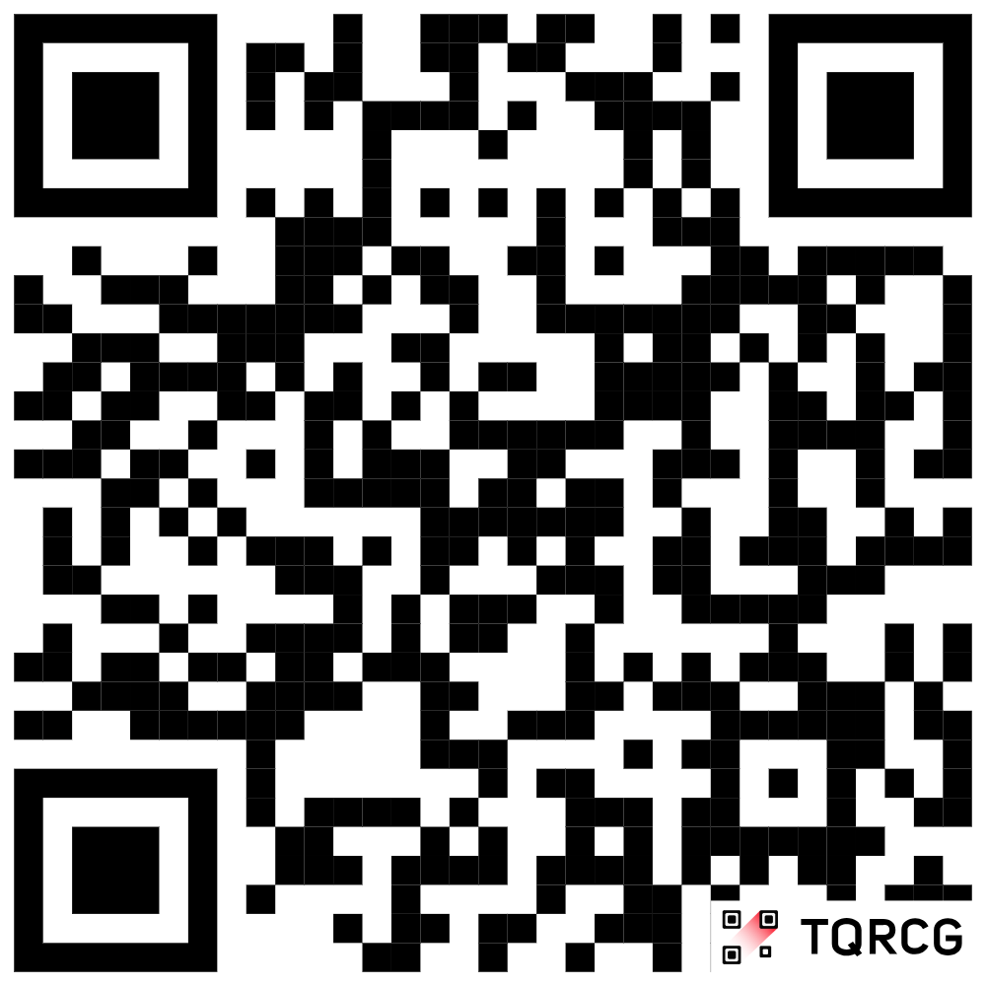
PROBLEM & SOLUTION
Understanding the Problem
Our Solution: BinGo
Improper segregation at household level in India sends recyclable and hazardous waste to open landfills.
Environmental damage: heavy-metal leaching, soil degradation, groundwater poisoning, habitat destruction.
Ambiguity at the bin: multi-material packaging, e-waste and household hazardous items are hard to place.
Result: contamination and improper dumping, even when people want to sort correctly.
Mobile-first web app: capture or upload one photo of an item.
In-browser AI classifies it into 5 standard waste categories.
Clear India-friendly steps (dry/wet bins, kabadiwalas, e-waste centres).
SDG 15 fact on every result links disposal to soil and biodiversity.
Honest "Not sure" fallback instead of misleading advice.
Project Live Link
BinGo
Instant clarity
Zero barrier
Transparent ML
Environmental literacy
Result in under 2 s (target)
No login, no install, no server round-trip
Confidence %, "Not sure" gate, feedback
Disposal tied to SDG 15: Life on Land

Slide 3
HOW BINGO WORKS
YES → Confident
1 · Open app
2 · Capture
3 · Analyze
Category, "{n}% sure", disposal steps, SDG 15 fact, thumbs
Top class
≥ 60% and not Background?
Loads rules.json and the TF.js model; scan buttons disabled until ready
Camera (native capture) or gallery upload; one item per scan
Image scaled to ≤512 px; scan-line view shown for at least 500 ms
NO → Not sure
"Not sure, try another angle" + 2 tips; not saved
On every confident scan
Navigation & next scan
100 px thumbnail saved to local history (last 50 scans)
Items-sorted counter increments (keeps counting past 50)
Daily streak updated by local calendar date
Thumbs up / down feedback stored on-device only
"Scan another item" button on both result screens
Browser/system Back returns to Home or History; never leaves the app
Close X on the analyzing screen returns Home

Slide 4
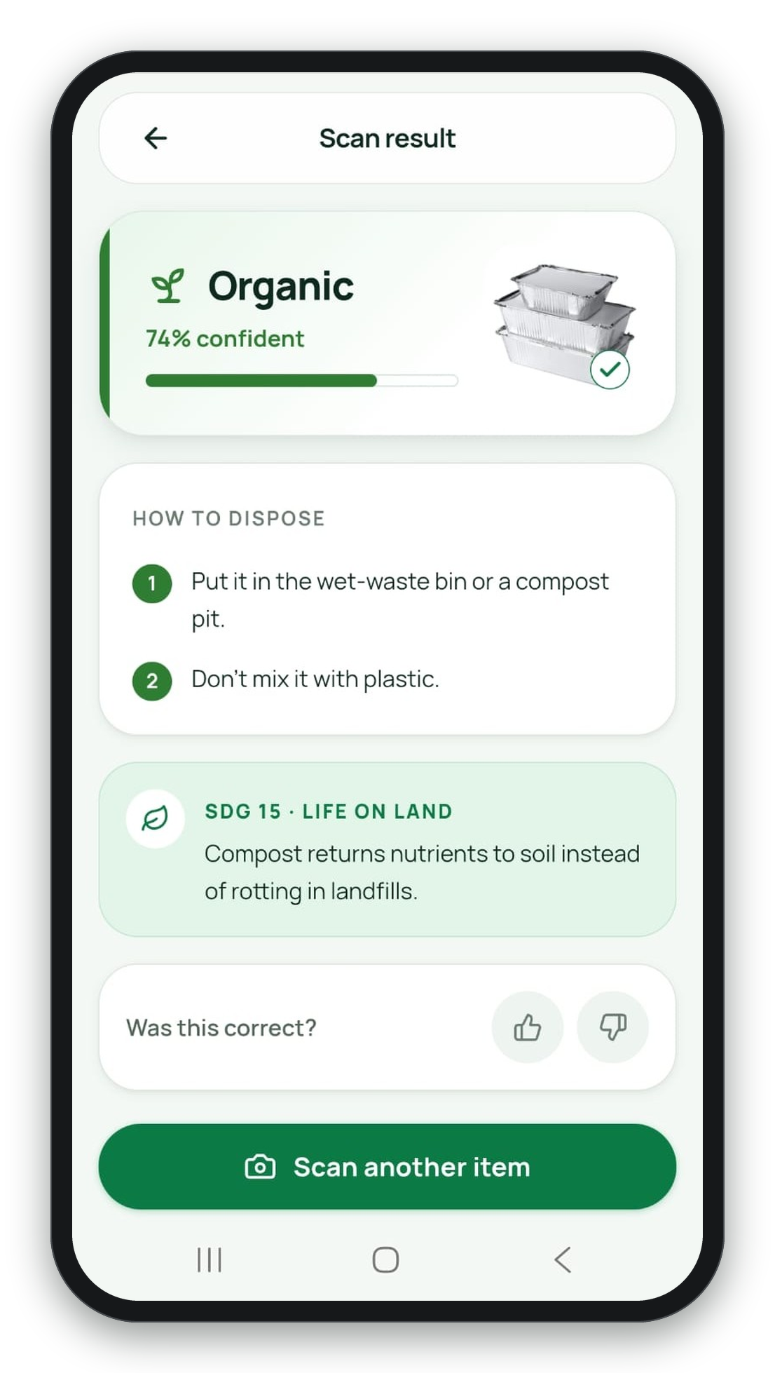
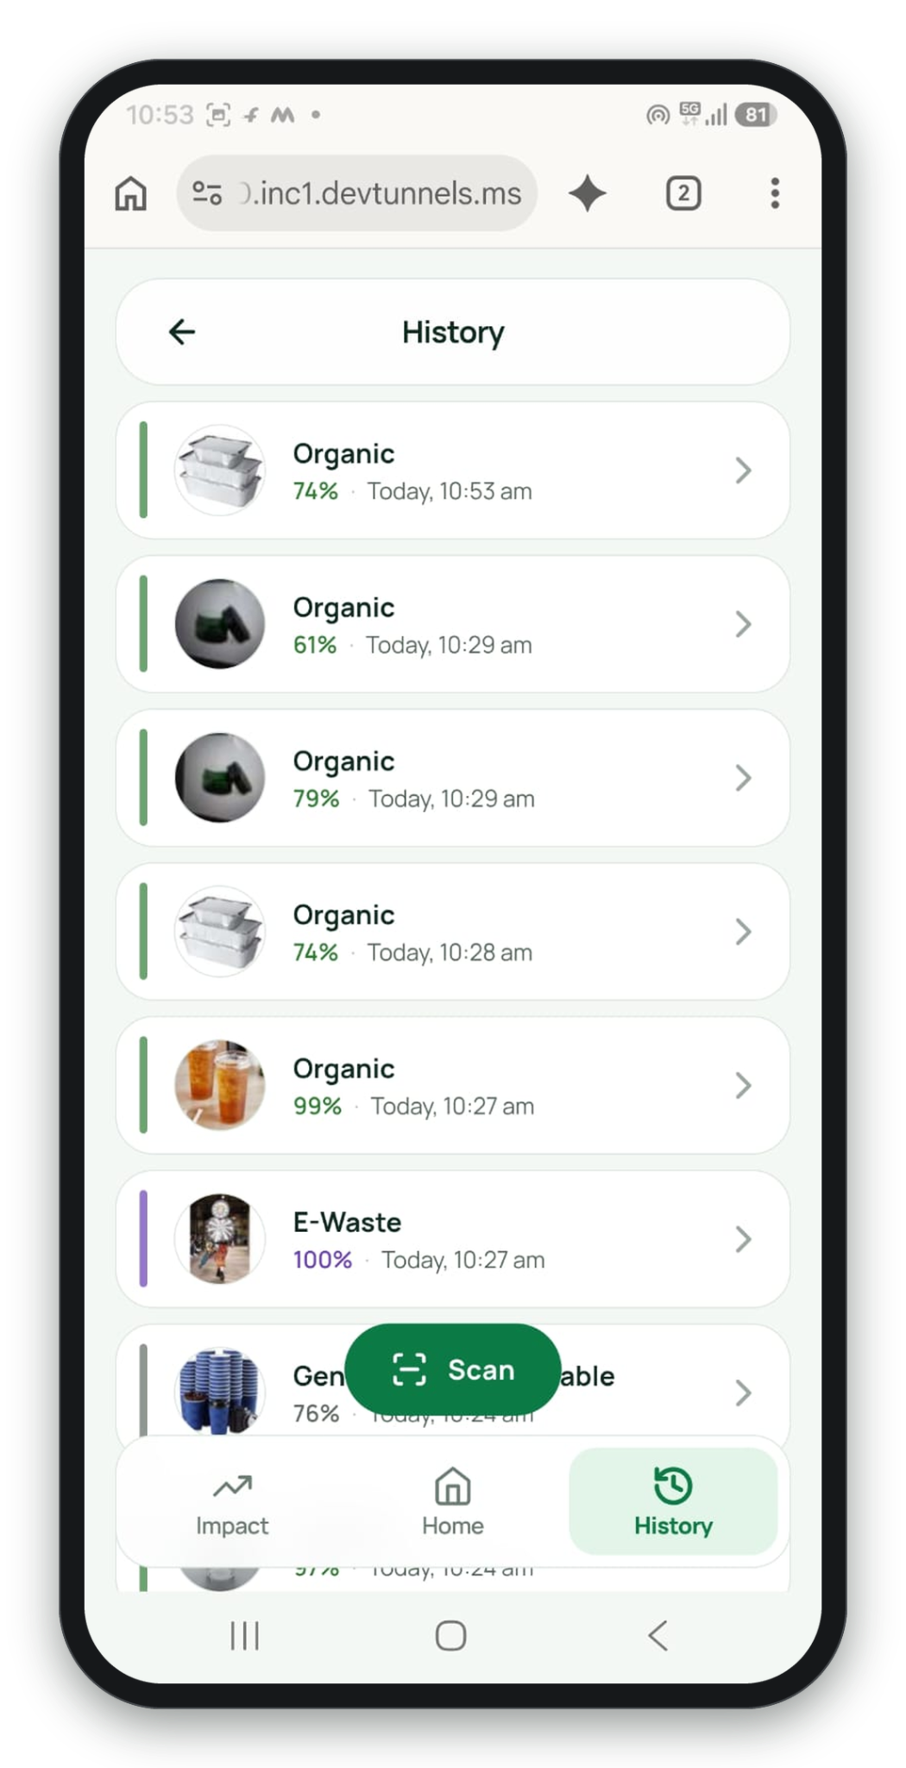
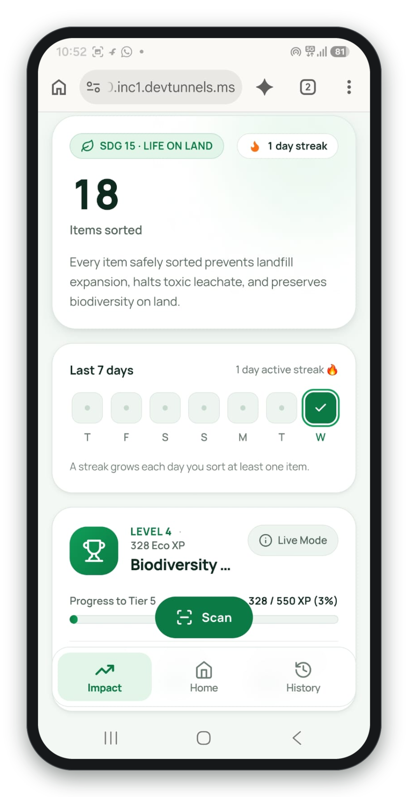
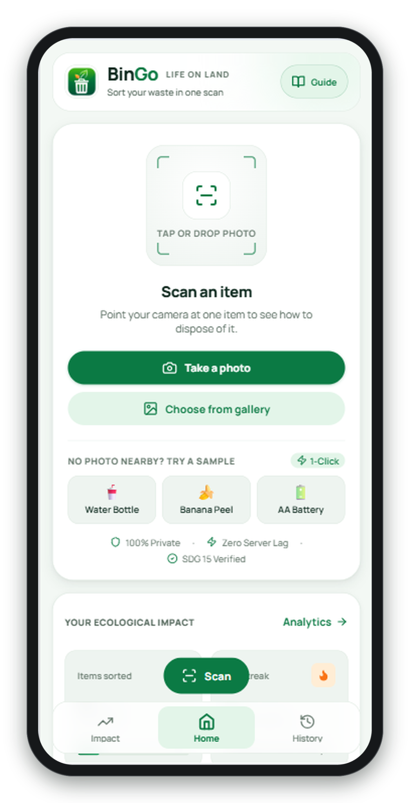
APP SCREENS
Home — impact card & scan
Result — steps, SDG 15 fact, feedback
Impact Counter
History — last 50 scans

Slide 5
WASTE CATEGORIES & DISPOSAL
Recyclable
Organic
E-Waste
Hazardous
General / Non-recycle
Includes
Includes
Includes
Includes
Includes
Bottles, clean paper, cans, glass jars, tetra packs
Peels, food leftovers, tea leaves, eggshells, garden leaves
Old phones, chargers, cables, earphones, power banks
Loose batteries, CFLs / tubes, expired medicines, aerosol cans
Chip wrappers, soiled paper, tissues, thermocol, broken ceramics
How to dispose
How to dispose
How to dispose
How to dispose
How to dispose
Empty and rinse it.
Keep it dry.
Dry-waste bin, or give to a kabadiwala / recycler.
Wet-waste bin or compost pit.
Don't mix it with plastic.
Not in household waste.
Hand to an authorised e-waste collector or take-back counter.
Keep separate and sealed.
Don't burn, flush or mix it.
Hazardous-waste collection point.
Wrap it, general dry non-recyclable bin.
Don't litter.
Hidden 6th class — Background (empty frames, walls, hands, clutter): never shown to users; if it wins, the app answers "Not sure".

Slide 6
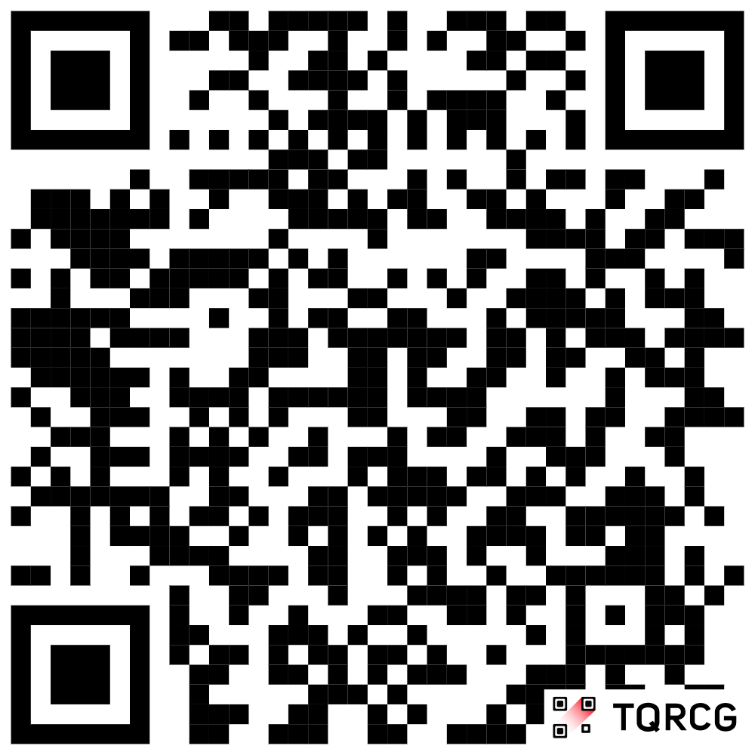
TECHNICAL APPROACH
Technology Stack
Client-side Architecture
Frontend: React 18, Vite 5, Tailwind CSS 3.4, Lucide icons
On-device AI: TensorFlow.js + MobileNetV2 graph model (transfer learning, 224×224 RGB input)
Storage: localStorage with in-memory fallback — streak, total sorted, history[50]
Content: editable rules.json (steps, labels, SDG facts) — no rebuild needed
Hosting: static files on Vercel — no backend, no database, no analytics
React 18 + Vite UI
Home · Scan · History screens
View state machine
home → analyzing → result → history
Decision engine
60% confidence gate + Background filter
91.49%
60%
~10 MB
58 kB
TensorFlow.js model
test accuracy (target ≥ 80%)
confidence gate for "Not sure"
model weights, served separately
gzipped JS bundle (limit 350 kB)
MobileNetV2 · EXIF-aware 224 px input
Github Repo
Runs fully on the phone: no photo or personal data leaves the browser. HTTPS required for camera.
(Source Code)

Slide 7
FEASIBILITY & IMPACT
Challenge → Fix
Impact & Benefits
Unknown or unclear items
60% gate + hidden Background class return "Not sure" instead of wrong advice
Citizens: one-scan clarity with numbered, India-friendly steps
Habit loop: items-sorted counter, day streak, history, thumbs feedback
Privacy by design: no backend, uploads, accounts or analytics
Land & biodiversity: every result carries an SDG 15 fact
Real phone photos
EXIF-aware decoding; run-ID guard cancels stale async scans
Storage limits
100 px JPEG thumbnails, 50-scan cap, oldest dropped on quota error
Mid-range phones
All on-device; ≤ 2 s target; Android Chrome 111+, iOS Safari 16.4+
Out-of-scope waste
Sanitary, bio-medical, textiles, debris, furniture may give "Not sure" or nearest class (accepted v1 limit)
SDG 15 · LIFE ON LAND — "Every scan that lands waste in the right bin is a vote for the planet."

