Slide 1


SMART INDIA HACKATHON 2026
SMART INDIA
HACKATHON
2026
SINISTER
6
From Farm to Buyer, Direct &
Transparent
Problem Statement
ID-
SIH26033
Problem Statement
Title-
Direct Farmer-to-Consumer Digital Agri-
Marketplace
Theme-
Agriculture, FoodTech & Rural Development
PS Category-
Software
Team ID-
[ADD REGISTERED TEAM ID]
Team Name-
SINISTER6
Direct Marketplace • AI Fair Pricing • Trust • Logistics

Slide 2
SINISTERSIX
SMART INDIA
HACKATHON
2026
DIRECT FARMER-TO-CONSUMER DIGITAL AGRI-
MARKETPLACE
Understanding The Problem
Fragmented Intermediaries: Produce passes through 4–6 middleman layers (aggregators, arhatiyas, wholesalers), draining value without contributing proportional utility.
Low Farmer Realization: Farmers capture only 30–35% of final consumer price for perishables (supported by NABARD/ICAR studies).
Consumer Price Inflation: Consumers pay 2–3x farm-gate price driven by cumulative intermediary margins and logistics inefficiencies.
Opaque Price Discovery: Short shelf-life crops leave farmers vulnerable to distress selling and market manipulation.
Trust & Logistics Bottleneck: Absence of verified buyer networks and last-mile cold chain logistics prevents direct stranger-to-stranger trade.
Our Solution
Direct Digital Marketplace: Connects farmers directly to buyers via transparent e-commerce discovery, eliminating intermediary markups.
AI-Driven Fair Pricing: Real-time market intelligence engine prevents distress sales and guarantees fair value.
Verified Buyer Network: Builds digital trust and verification rails for secure high-value perishable transactions.
Integrated Last-Mile Logistics: Solves key agri-tech challenges through end-to-end route optimization and order tracking.
Existing Rail Integration: Leverages India's 750M+ smartphones and rural UPI payments for rapid disintermediation.
Hybrid Mandi Coexistence: Modernizes trade disintermediation without restricting traditional mandi access if desired.
FARMER / FPO
AI PRICING
VERIFIED
BUYER
PAYMENT
LOGISTICS
List crop
Fair-price range
UPI / Razorpay
Batch + route
Discover + order
KEY INNOVATION
AI Pricing
Trust Score
Route Optimization
Transparent
Comparison
2
@SIH Idea submission- Template
2

Slide 3
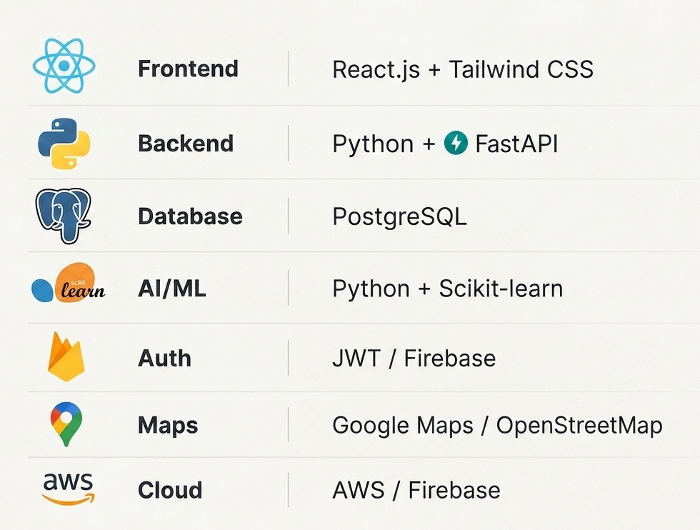
SINISTERSIX
TECHNICAL APPROACH
SMART INDIA
HACKATHON
2026
SYSTEM ARCHITECTURE
Farmer / Buyer Web
REST API
Data
Intelligence
Services
React.js + Tailwind CSS
Python + FastAPI
PostgreSQL
Scikit-learn
Fair Price + Demand
Trust + Orders + Logistics
Maps / OSM
UPI / Razorpay
AWS / Firebase
INTEGRATIONS
MAPS/OSM
UPI/ Razorpay
JWT / Firebase
TECH STACK
UML — CORE USE CASES
AGRI MARKETPLACE
👨‍🌾
Farmer/FPO
🛒
Buyer
List Crop
Get Fair
Price
Place Order
Track
Delivery
3

Slide 4
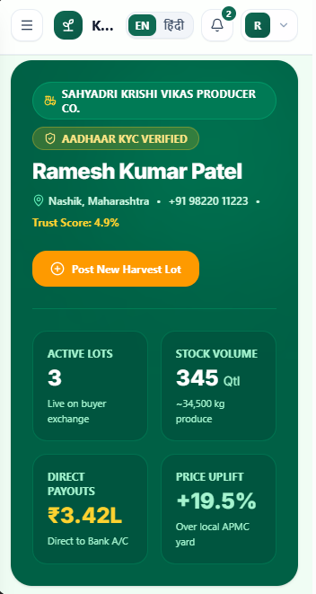
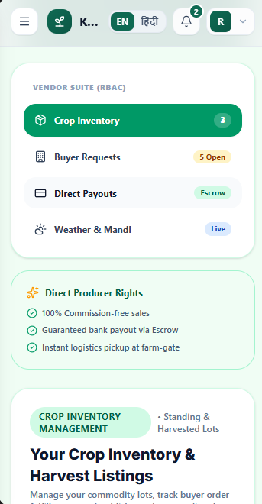
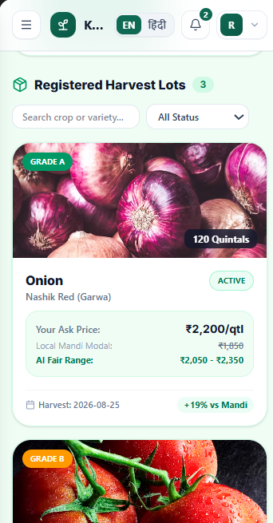
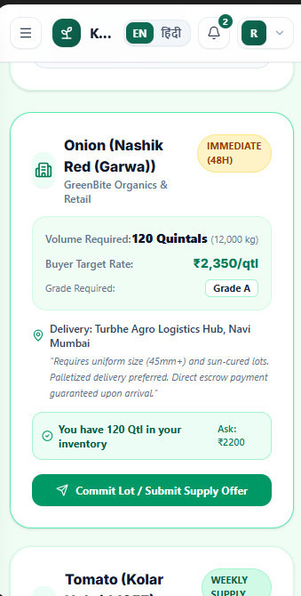
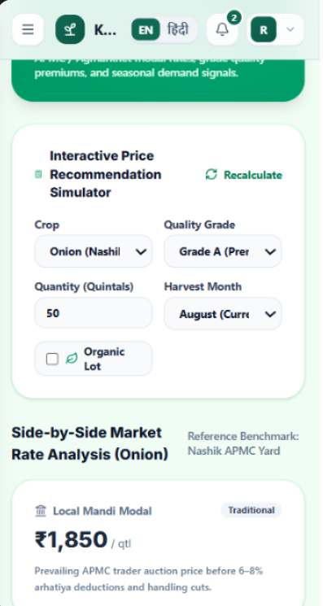
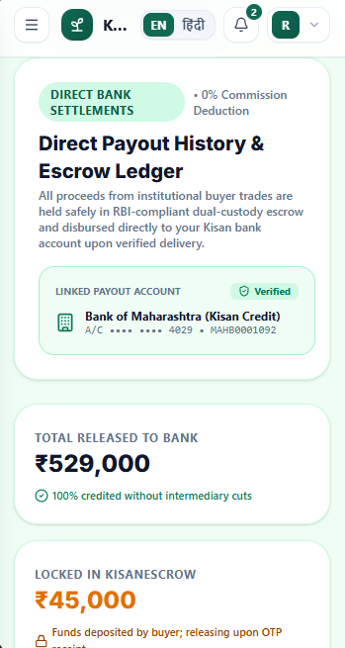
SINISTERSIX
SMART INDIA
HACKATHON
2026
FEASIBILITY AND VIABILITY
TECHNICAL FEASIBILITY
CHALLENGE → MITIGATION
FUTURE FEATURES
Government/Agri official monitoring dashboard
Advanced demand forecasting (time-series model)
Full KYC/Aadhaar-based buyer verification
Multi-language/voice interface for farmers
Escrow-based payment holding
SMS/WhatsApp-based listing for low-smartphone-literacy farmers
React + FastAPI → rapid prototype
Scikit-learn → lightweight price model
PostgreSQL → transactional integrity
Maps / OSM → routing + geolocation
UPI / Razorpay → practical payment layer
Digital literacy → simple mobile-first UX
Buyer trust → verification + ratings
Small-lot logistics → nearby-order batching
Limited data → baseline sample/synthetic
dataset
4

Slide 5
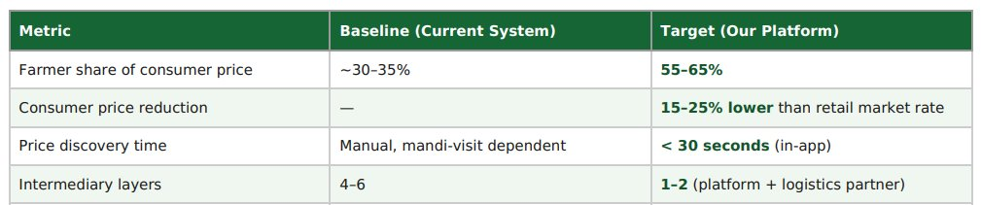
SINISTERSIX
SMART INDIA
HACKATHON
2026
IMPACT AND BENEFITS
🌾 FARMERS
🛒 BUYERS
🚚 LOGISTICS
Direct buyer access
AI fair-price guidance
Better price discovery
Organized logistics
Direct-from-farm sourcing
Transparent price comparison
Origin / quality visibility
Verified suppliers
Batch nearby pickups
Optimized routes
Lower empty travel
Less delay / spoilage
PROTOTYPE-STAGE TARGETS
Targets are prototype-stage simulation targets, not guaranteed real-world outcomes.
@SIH Idea submission- Template
5

Slide 6
SINISTERSIX
SMART INDIA
HACKATHON
2026
RESEARCH AND REFERENCES
RESEARCH BASIS
TECHNOLOGY REFERENCES
NABARD — e-NAM participation study
React
Scikit-learn
www.nabard.org/Publication.aspx?cid=50&csrt=17113928875636088101&id=24
react.dev/
scikit-learn.org/stable/user_guide.html
ICAR — Value chain development in Indian Agriculture
epubs.icar.org.in/index.php/IndFarm/article/view/118471
FastAPI
Razorpay Payments
fastapi.tiangolo.com/
razorpay.com/docs/payments/
ICAR — Impact of e-NAM on farmers
epubs.icar.org.in/index.php/IJAgS/article/view/127701
PostgreSQL
OpenStreetMap
www.postgresql.org/docs/
www.openstreetmap.org/
eNAM — National Agriculture Market
enam.gov.in/
RESEARCH GAP /
DIFFERENTIATOR
Existing: digital trading + price information
→
Our approach: direct marketplace + AI pricing + trust score +
logistics optimization
6

