Slide 1
Healthy Habits App
Help KP patients to improve on healthy habits
Product Owner: Sargam Shah
© 2019 Udacity. All rights reserved.

Slide 2
Background
Why Are We Here?
Preventive Care based mobile application to help patients increase their physical activity, and improve healthy habits
Fitter, Healthier, Happier
© 2019 Udacity. All rights reserved.

Slide 3
Business Case
© 2019 Udacity. All rights reserved.
Notes:
[ALL PARTICIPATION]

Slide 4
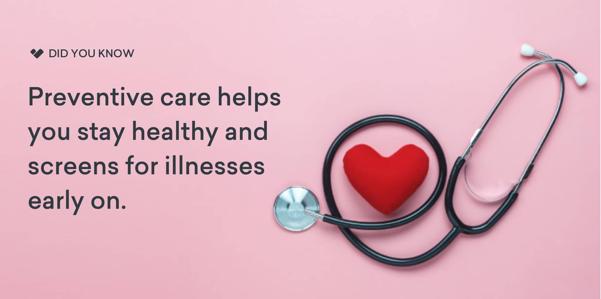
Initial Focus
KP is aiming to enter into the tech and mobile app world, this year, by creating a customer centric app. Creating a preventive care centric app to improve the healthy habits by providing correct information, exercise plans, monitoring health etc. could be a great fit.
Where are we starting?
© 2019 Udacity. All rights reserved.

Slide 5

Opportunity
What’s the problem?
The financial goal is to reduce cost by emphasizing
improved health prior to any adverse conditions developing.
KP wants to decrease spending on conditions such as
type 2 diabetes. We never had such a mobile app
in the market and hence this is a great development effort.
In 2018, an estimated 0.7 million new cases of diabetes were treated at KP. adults aged 18 years or older. Between 2012 and 2017, excess medical costs per person associated with diabetes increased from $8,417 to $9,601 (2017 dollars)
Kaiser Permanente is one of the nation's largest not-for-profit health plans, serving 12.4 million members who could be benefitted by the mobile app.
TAM = Average revenue per user X total number of potential users in the market = 5 X 12 Million = 60 Million USD for the first 3 years of app usage.
© 2019 Udacity. All rights reserved.

Slide 6
Proposal
What’s Our Solution?
Overall goal is to improvie patient well being by emphasizing on improved health and preventive care.
The app would address these by
monitoring the patient health statistics such as weight, blood pressure,
providing information on improving health by the benefits of exercising, consuming a nutrient rich diet,
providing means to avoid addiction,
improve sleeping habits etc.
This app will be a go-to solution to the patients and act as a guide for them to improve their health.
© 2019 Udacity. All rights reserved.

Slide 7
Return On Investment
What can we do?
It is predicted that a huge portion of our customer base will be downloading and using our app. The cost of building the app will be huge as we are starting from scratch and entering the tech world. However, this will bring a cultural change in the company which will give it a technological advantage and edge as compared to our non-tech savy competitors. After building the framework for the app, we can use it to implement our existing solutions and products through app. Hence, the scope of the project is huge and we expect a huge ROI.
Budget for the first year: $500,000 * 3 = $15,00,000
Database:$5,000 Hosting Costs: $15,000 Development Costs: $200,000 Marketing: $100,000 Security: $5,000 Legal: $10,000 Testing Costs: $100,000 Business Analysis: $50,000 Others: $10,000 per feature, There are 3 feature team.
Developers 3, Team lead 2, Testers 3, Business Analyst 1 per team. There will be 3 feature teams. Total: 27, 1 program manager. (Salaried employees)
Expected user base in first year will be 1 Million.
Revenue per user is 5 USD. However, 50 percent user will have free access without subscription
ROI = Net Profit / Total Investment * 100, here -> 500000 * 5 / 1500000 percent = 166.66% (in mobile world)
© 2019 Udacity. All rights reserved.

Slide 8
Measurement
How will we know if we’re successful?
We will measure the success of the application by the number of downloads and the increase in the customer base who are benefitting by using the app. The goal of the first year is to deliver a user-friendly app and get positive feedback from the patients about the app.
i.e.
App Store Ratings
Number of new Users
Reduction in number of patient cases and correlation to app usage
Positive Feedback for the app
© 2019 Udacity. All rights reserved.

Slide 9
Competitors
© 2019 Udacity. All rights reserved.
Notes:
[ALL PARTICIPATION]

Slide 10
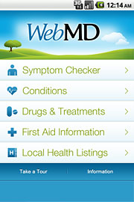
WebMD
WebMD is an American corporation known primarily as an online publisher of news and information pertaining to human health and well-being. The site includes information pertaining to drugs. It is one of the top healthcare websites by unique visitors.
Conditions – Find medically-reviewed information about conditions relevant to you and learn more about causes, treatments, and related symptoms.
Medication Reminders – Never miss a dose. You’ll receive reminders when it’s time to take your medications. View daily prescription schedules and instructions, plus pill images with dosage and timing information for each drug.
Customization and Saving Functionality – Save your conditions, drugs, doctors, hospitals, pharmacies, and healthy living articles for secure, easy access and reference.
Symptom Checker – Choose your symptoms, learn about potential conditions or issues, and lookup treatment and care options.
App Review 4.5, Installs 10,000,000+
© 2019 Udacity. All rights reserved.

Slide 11
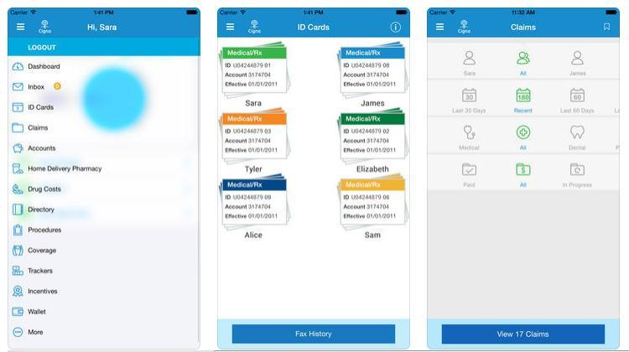
Cigna Wellbeing
Cigna is an American worldwide health services organization based in Bloomfield, Connecticut. Its insurance subsidiaries are major providers of medical, dental, disability, life and accident insurance and related products and services, the majority of which are offered through employers and other groups
Assessments -Kick off your experience with the health and well-being assessment Choose targeted assessments such as stress, sleep and activity to find out how you stack up. Use your results to create healthy changes
HEALTH & LIFESTYLE PROGRAMS- Recommended programs guide you in simple daily activities Get guidance and tips from health coaches and work healthy improvements into your daily routine
TRACKERS- Your health numbers all in one place Monitor your progress with trackers for BMI, cholesterol, blood pressure, blood sugar, sleep info, and more. Integration with your assessment activities
Rating is 2.3, installs 10,000+
© 2019 Udacity. All rights reserved.

Slide 12
Our Advantages
Why are we better?
Kaiser Permanente, the provider with the second-largest market share within the health insurance industry
This organizational structure also gives them the ability to create a “one-stop shop” for their members to receive all levels of care.
Our content for health and medicine is unique and will help beat the competitors
Our in-house network of doctors and nurses will help bring the app alive and cater to the patient needs and this provides an edge to our competitors
© 2019 Udacity. All rights reserved.

Slide 13
Roadmap and Vision
© 2019 Udacity. All rights reserved.
Notes:
[ALL PARTICIPATION]

Slide 14
Roadmap Pillars
Where do we go from here?
User Friendly app with FAQ Section to help users navigate and understand the app
Launch the initial version of app for users in Texas and analyze their feedback on the application, followed by launch in other prioritized states in phases
Themes : 1. Healthy Habits
2. Health Monitoring
3. Predictive Analysis of Health
© 2019 Udacity. All rights reserved.

Slide 15
Healthy habits
Healthy Videos: Patients will be benefitted with videos on healthy habits, nutrition and diet, early symptoms of the disease, exercise videos, meditation videos
Check symptoms, find doctors, research treatments: Options to check early symptoms, schedule of screenings, immunization, lab tests, x-rays, physical exams. Chat with your personal physician through the app!
© 2019 Udacity. All rights reserved.

Slide 16
Health Monitoring
Monitoring of vital health of you and your family: Weight, Cholesterol, Blood pressure, Blood test results, (find all reports on the app), depression, diabetes, STDs
medication reminder & counselling: Schedule reminders for your medicines, avail counselling on alcohol abuse, improper diet, obesity, STDs,
© 2019 Udacity. All rights reserved.

Slide 17
Predictive Analysis of health
Exercising plan, weight loss: Weight loss monitoring/logging, goal setting feature, daily exercise plan(duration, core, aerobic, hobbies, logging), gamification
Health Assessment for preventive care: Notifications based on the predictive analysis of possible symptoms of the disease, risk of contracting heart related disease or other complications, obesity, breast cancer.
© 2019 Udacity. All rights reserved.

Slide 18
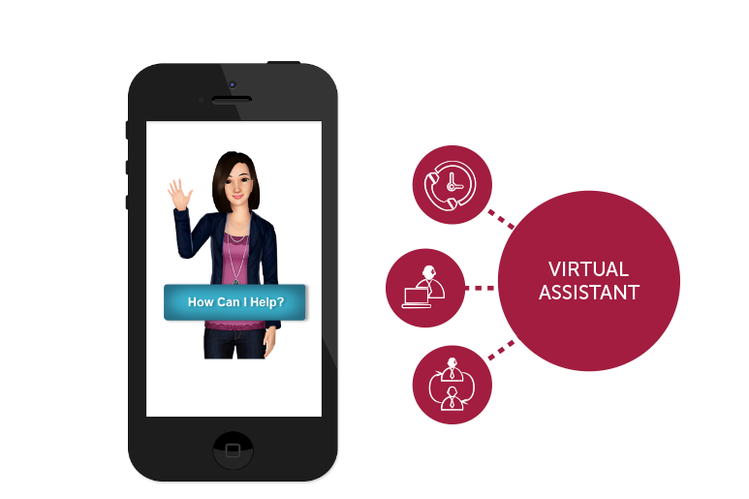
Where do we go from here?
We could provide a virtual healthcare assistant who would understand and interact with the patients via text, tap or speech and answer basic questions such as “Talk to my doctor”, “ My weight last month”, “My medication due today.”
Widening the scope
© 2019 Udacity. All rights reserved.

Slide 19
Research links
https://about.kaiserpermanente.org/who-we-are/fast-facts
https://bestcompany.com/health-insurance/blog/review-aetna-vs-cigna-vs-kaiser-permanente
https://healthy.kaiserpermanente.org/static/health/annual_reports/kp_annualreport_2018/?kp_shortcut_referrer=kp.org/annualreport
https://my.kp.org/apria/wp-content/uploads/sites/47/2013/11/82650_2012_HCR_PrevntiveServices_Flyr_Ntl_v4a_ap_ATC_HR_ADA.pdf

